Slide 1
A New Model for Run Coordination
Gregory Marr
RHIC Operations Specialist

Slide 2
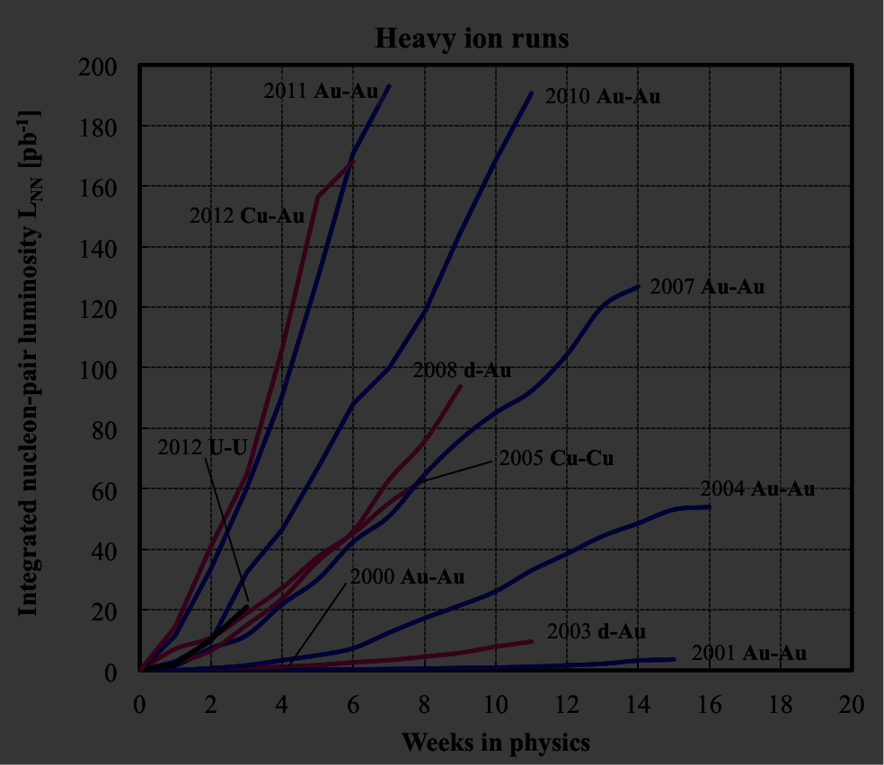
Recent experience
Recent runs have exhibited quick startup and excellent performance, with smooth transitions between runs. Why? (unsubstantiated list)
Quick startup begets high initial performance?
Experienced Operations staff?
Stochastic cooling?
Lull of equipment lifetime issues, failures?
Genius Run Coordinators?

Slide 3
Looking forward
How can we continue this trend of efficient transitions between runs (and shutdowns)?
Forcing a new Run Coordinator to pick it all up from scratch is probably not the best avenue.
Start-up has become a sequence of tasks largely in the domain of experts.
Is this the best model? If not, how should it be treated? (open question)

Slide 4
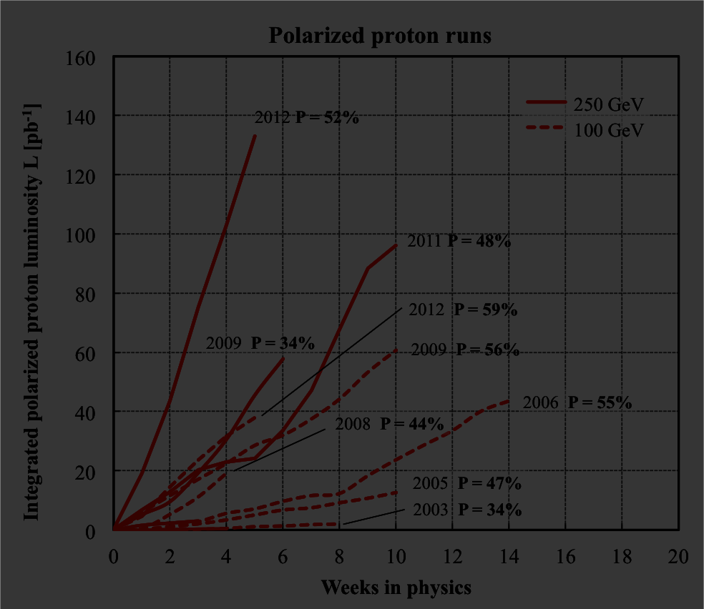
New Model: Start-up via Operations
Treat all start-up events as an expert driven task, some of which are assigned to Operations.
Operations directly oversees start up, coordinated by machine specialists.
Run Coordinator still monitors, reports on progress.
Tasks accomplished sequentially, with support of system experts as required.

Slide 5
Major start-up tasks, issues
Maintenance
Wrapping up shutdown periods neatly, without surprises is key.
Cryo (experts)
Can’t run any PS ‘til it’s cold. Can’t ramp ‘til it’s really cold.
Are there tasks that hold up these milestones, or conflict with PS work?
Ramp preparation (experts)
Better ramp design, improve tools to allow more designers, more understanding.
Power Supply (experts)
Requiring swept ring for ramping: delays PS group and everyone else waiting to work.
Much progress in automation, streamlining ramp testing. More?
More predictive quench tuning?
Less ramps?

Slide 6
Major start-up tasks, issues
Injector preparation (Operations)
Should be done well before first day of RHIC beam. Hasn’t always gone well.
PP development, NSRL scheduling, EBIS ion source conflicts: we told you so.
RF ATR synchro (experts/Operations)
Often cannot be done in advance.
Requires LLRF personnel.
Upgrade this year – potential to eliminate personnel and hardware issues.
Injection, circulating beam (Operations)
We’re too fast at it.
We never return to optimize it.
RF capture (experts)
It’s usually not tough. But the RF group still does it.

Slide 7
Major start-up tasks, issues
Bunched beam/instrumentation setup (experts)
Shouldn’t be hard, but we seem to make it so.
Remote scopes for IP4 WCM?
Ramp (Operations/experts)
We’re too fast at it.
Too few feedback experts.
RF rebucket (experts)
At this point we’ve usually outstripped the RF group’s ability to condition cavities as well as their ability to provide personnel.
Store Setup (Operations/experts)
Polarimetry (experts)
Initially, a resource conflict.

Slide 8
Other Run Coordination issues
Scheduling physicist role?
Cons:
Overlaps Run Coordinator role
e.g. many scheduling issues determined at 9AM meeting
OC can independently make interruption/access determination.
Others tend to mediate between experiments in any case
Pros:
Has jurisdiction (IF exercised) over injector conflicts.
More impartial than Run Coordinator
Learning experience for newer personnel
Who else would get stuck running time meeting?

Slide 9
Other Run Coordination issues
AP shift role?
Senior staff is most capable
Combine broad collider knowledge with deep knowledge of specific systems to accomplish myriad of start-up, ramp-up tasks quickly and efficiently
However, over many runs, most have tired of the shift work
System experts typically only fill the “deep knowledge” situations; Operations (especially Machine Specialists) must lead when broader experience is called for.
AP shift then falls to… less senior staff
Similar to Scheduling Physicist, role provides learning experience for newer personnel.
Results have been mixed.
Without senior AP staff present, it falls upon Operators, Coordinators, Specialists to provide instruction.
Like most Operations training opportunities, highly dependent on trainee’s initiative to get involved.
With new start-up role for Operations, more holes appear in AP shift rotation.

Slide 10
Summary
We wish to preserve the efficient start-up and transitions between runs of recent experience by accumulating institutional knowledge instead of forcing a steep learning curve on the Run Coordinator.
Start-up has become a sequence of tasks largely in the domain of experts. With a little additional effort, it could be placed largely in the domain of Operations.

