Slide 1
AGS Low Level RF Upgrade
T. Hayes / F. Severino
RHIC Retreat July 2012

Slide 2
Motivation
Current system is 20 years old – many parts no longer supported
Limited number of spare parts available
Improved functionality
Improved reliability
Uniformity of hardware – same hardware used in RHIC, EBIS and ERL
Allows for development of new operating modes (e.g. extraction on the fly)
RHIC Retreat July 2012

Slide 3
System Benefits
PPM control of all parameters
Beam control and AtR synchro loop gains can now be optimized for different beams
Cavity and feedback transformer tuning can be optimized for different frequency sweeps – tuning is a major cause of HLRF downtime in the AGS
Remote monitoring and control of the system
All system parameters accessible via the control system
Improved data logging
High bandwidth data logging provides information to monitor system performance
High data rate post-mortem data is invaluable tool for troubleshooting
RHIC Retreat July 2012

Slide 4
System Benefits - continued
Individual rf drive signal for each cavity
Feedback done directly on F_{rev} – no longer use 10.7 MHz intermediate frequency and a mixing scheme
Separate harmonic control for each cavity – along with feedback on F_{rev} greatly simplifies setup of bunch merging schemes
I/Q feedback on cavities instead of just AGC
AtR Synchro Improvements (currently a weak link)
PPM control over loop parameters
Digital phase measurements between the AGS and RHIC
Open loop frequency lock to the RHIC reference frequency
AC coupled phase loop
RHIC Retreat July 2012

Slide 5
System Benefits - continued
Simplified generation of rev ticks
No longer need complicated beam locked loop to generate rev ticks
Improved reliability
Same hardware as used in RHIC – very low downtime this run
Common spares readily available and easy to replace
Full development system in the lab for testing and debugging
RHIC Retreat July 2012

Slide 6
Implementation Plan
The AGS LLRF consists of two main parts
1. Beam Control
a. Phase and Radial Loops
b. AtR Synchro Loop
2. Cavity Controller
a. Tuning control (cavity and feedback transformer)
b. AGC (or I/Q) loops
The upgrade will be performed in stages. Due to manpower limitations, schedule is very aggressive.
RHIC Retreat July 2012

Slide 7
Stage I
Beam Control
Implement new digital control loops for phase, radius and AtR synchro.
Average bunch to bucket (b2b) phase measurement only
Keep existing input mixers and limiters for b2b phase measurement
All beam sync’d signals generated from new hardware
Cavity Controllers – development to be on-going this summer – requires temporary cooling water to allow running an AGS cavity
Individual frequency controlled drive for each cavity
AGC via existing analog system
Individual F to V reference for the feedback transformer of each cavity
RHIC Retreat July 2012

Slide 8
Stage II
Beam Control
No additional changes
Cavity Controllers
Individual grid modulation for each cavity
Separate F to V signals for tuning bank for each cavity
Additional hardware is required to add this functionality to the Cavity Controllers.
RHIC Retreat July 2012

Slide 9
Stage III
Beam Control
Bunch by bunch phase measurements (developed during the run)
Quad mode damping (developed during the run)
Cavity Controllers
Closed loop cavity tuning
Closed loop feedback transformer tuning
I/Q feedback loops
Stage I will be implemented for start up. Stage II is expected to be ready for startup as well (depending on speed of getting hardware built) .
Cavity Controller portion of Stage III may have to be rolled in
during the run. This depends on resources and time.
RHIC Retreat July 2012

Slide 10
Initial Testing
The first pieces of hardware were installed just prior to the beginning of the run. Using this hardware, the RHIC blue and yellow synchro reference signals were generated locally in the AGS rf control center.
These signals were used operationally for the entire run, demonstrating the stability of the clock and data links between RHIC and the AGS.
RHIC Retreat July 2012

Slide 11
Testing
Initial beam tests were completed behind RHIC stores during the last week of the run.
We used new hardware to generate an I.F. at 10.7 MHz to replace the VCO in the existing analog beam control system.
Successfully accelerated beam to top energy in the AGS with minimal losses.
System components verified with these tests
Bunch to bucket phase detector
Gauss clock receiver and distribution
Digital beam control feedback implementation
Data logging at high repetition rate
RHIC Retreat July 2012

Slide 12
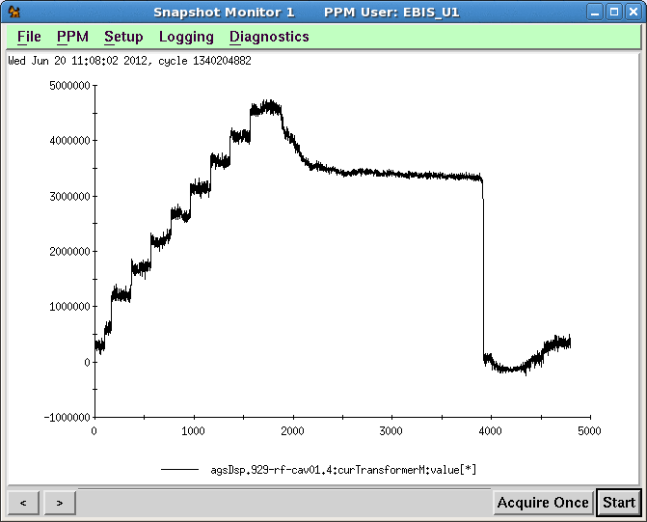
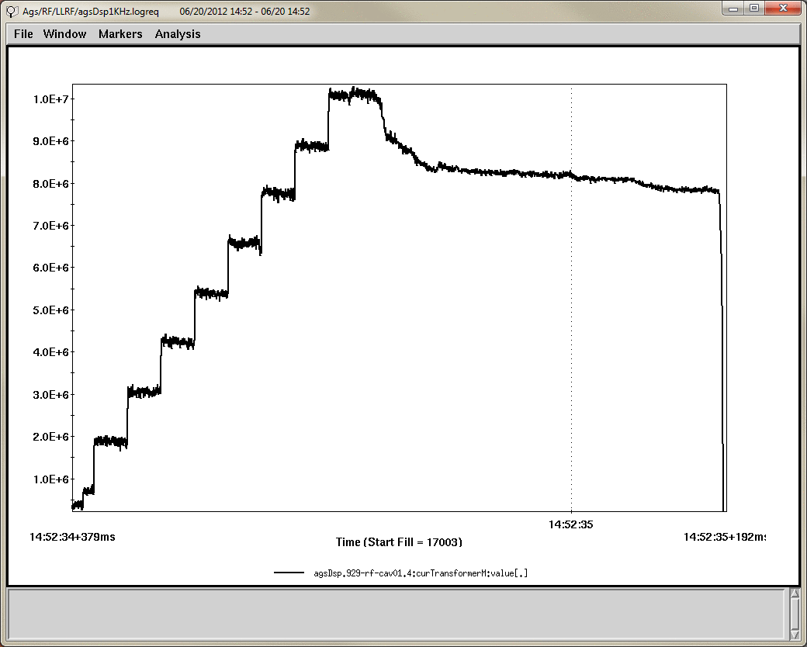
Results
Acceleration efficiency at least as good as on the old system
AGS current transformer running on old system
AGS current transformer running on new system
RHIC Retreat July 2012

Slide 13
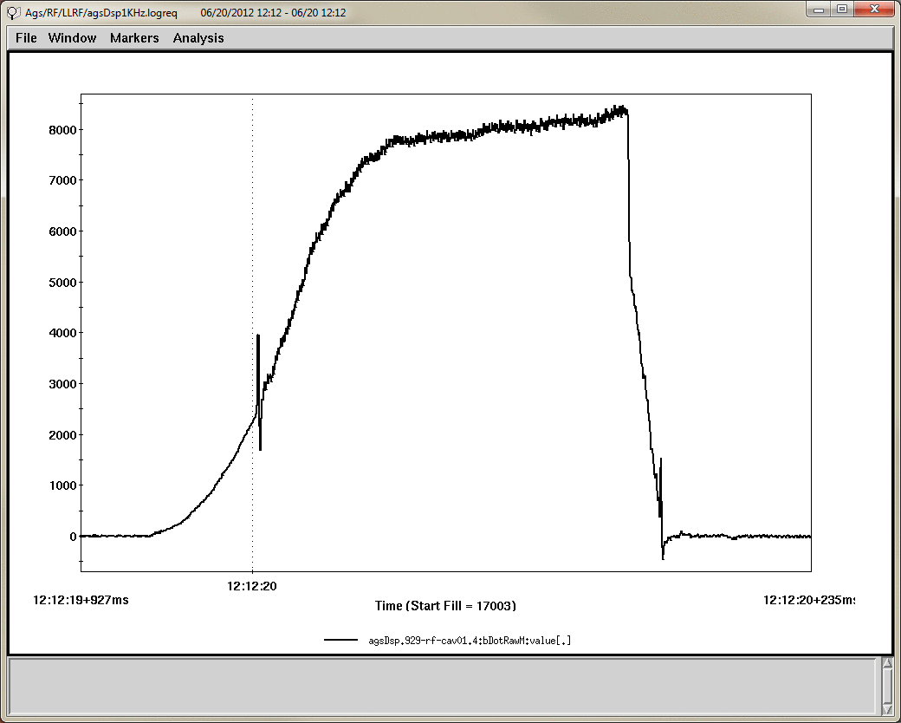
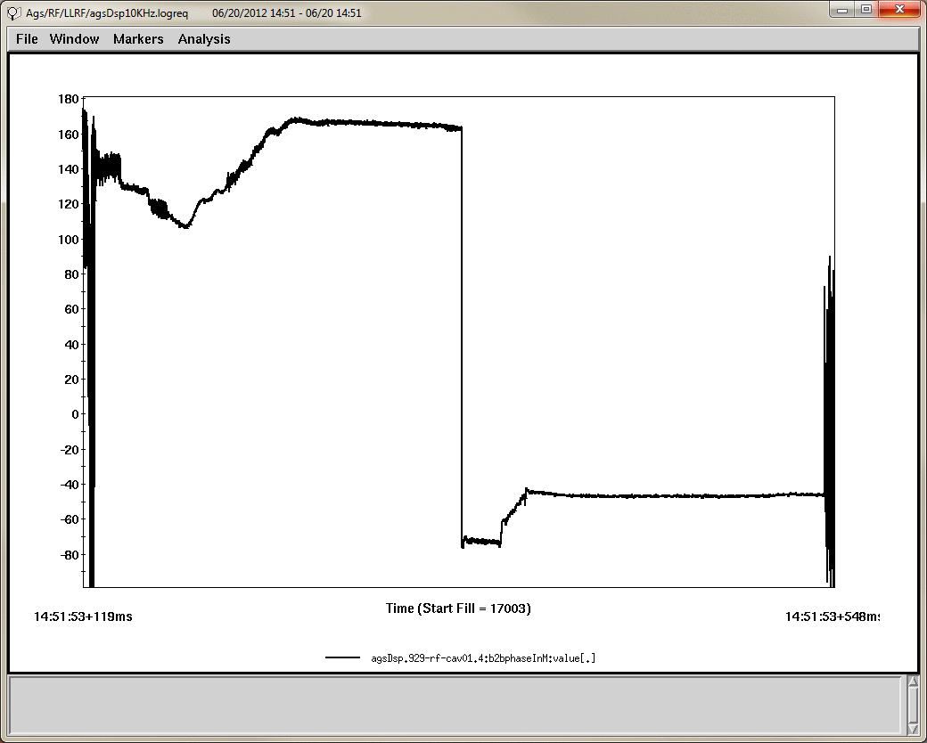
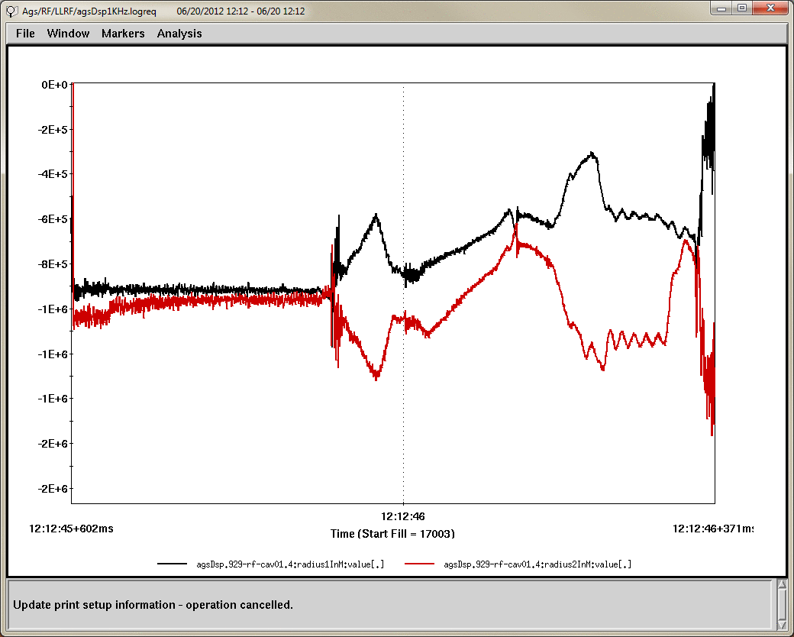
Results
Transition
B dot from gauss clock
Bunch to bucket phase thru entire acceleration cycle
Logged RF BPM signals were useful in troubleshooting a recurring problem in the AGS that required MCR to make drastic radial steering changes to restore acceleration. Logged signals showed that RF bpms were not the cause, which was eventually traced to a bad corrector .
Logged RF BPM signals
RHIC Retreat July 2012

Slide 14
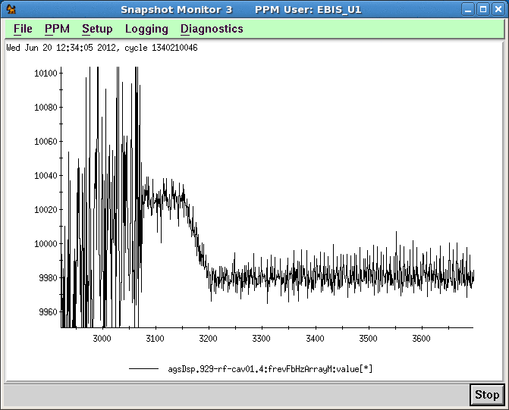
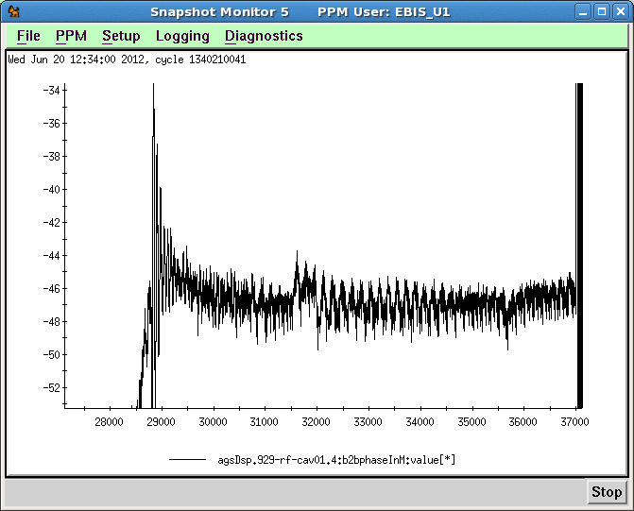
AtR Synchro Results
Open loop frequency ramp to a target frequency
Bunch to bucket phase during frequency ramp (running ac coupled phase loop)
RHIC Retreat July 2012

Slide 15
Summary
System is old and in need of an upgrade
Key benefits of the upgrade
PPM control of all parameters – particularly loop gains and tuning control
Improved AtR synchro
Improved reliability
Greater flexibility – easier to setup bunch merges, etc.
Data logging and remote access / control of the system
Staged implementation plan allows best use of available resources
Beam control and AtR synchro loops will be ready for startup
Cavity controller functionality will be completed as time permits – can even be done on a cavity by cavity basis during the run
RHIC Retreat July 2012

