Slide 1
RHIC Retreat 2012
Charge from the Retreat Coordinator
Hi Kevin,
Please give an overview of existence proofs for Keith. If time permits, perhaps also a talk on his favorite subject – longitudinal emittance.
Thanks,
Vincent

Slide 2
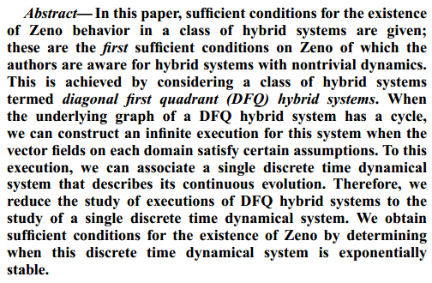
http://chess.eecs.berkeley.edu/pubs/131/AmesCDC2005.pdf
RHIC Retreat 2012

Slide 3
Charge from the Retreat Coordinator
Hi Kevin,
Please give an overview of existence proofs for Zeno. If time permits, perhaps also a talk on his favorite subject – longitudinal emittance.
The talk is primarily, I would suggest, tutorial in nature.
It would be good to get an overview of the life of the longitudinal phase space.
What sets the longitudinal emittance early in the chain (Source? Linac? Booster injection/Capture?).
Where does it get diluted?
What are the longitudinal acceptance bottlenecks?
What are reasonable points of attack?
Vague, huge topic. Little guidance, except to say maybe make in the form of a game or something. I understand now why retreat coordinators do this to people. Let me know if you have questions.
Thanks,
Vincent
No Vincent – Thank You!

Slide 4
RHIC Retreat 2012 Longitudinal Emittance Source to Store Edition

Slide 5
Booster Ion
Long. Emittance
Before the Merge
Booster Ion Long. Emittance Through the Merge
AGS Ion Longitudinal Emittance
RHIC Ion Longitudinal Emittance
What About Polarized Protons?
100
100
100
100
100
200
200
200
200
200
300
300
300
300
300
400
400
400
400
400
500
500
500
500
500

Slide 6
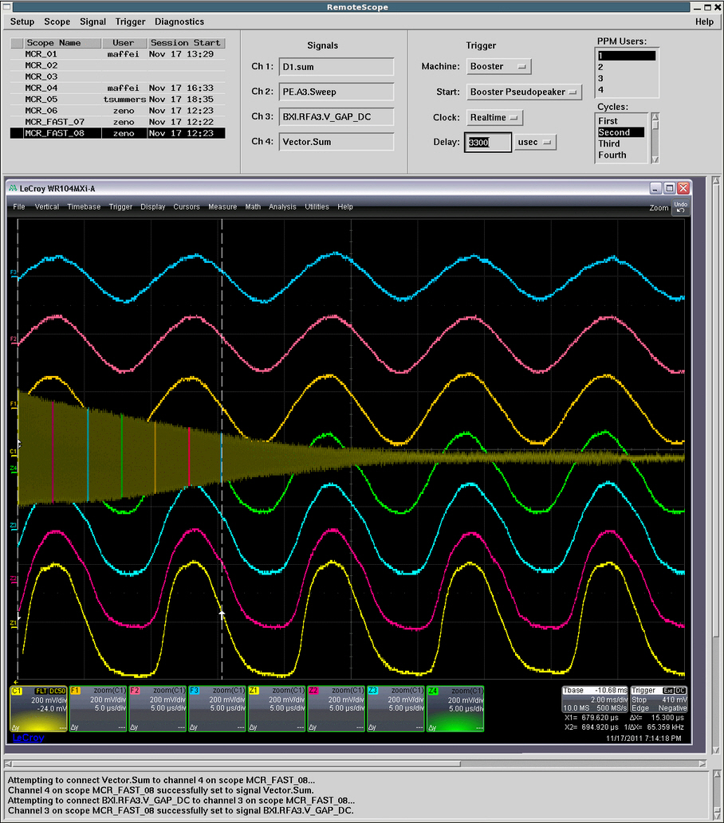
Booster Ion Longitudinal Emittance Before the Merge – 100
A: 0.025 eV*s/u
Q: What is the total longitudinal emittance resulting from multi-turn EBIS injection?
Measured via debunching time ...
This is much closer to the TVdG generated total emittance (0.022 eV*s/u) than it was thought was going to be the case prior to Run12.
Due to tuning and optimization of the EBIS debuncher cavities?
http://www.cadops.bnl.gov/cgi-bin/elog/viewMain.pl?elog=Booster-AGS-EBIS_2012&shiftlog=Thu_Nov_3_2011_12:23:20_PM#2191421

Slide 7
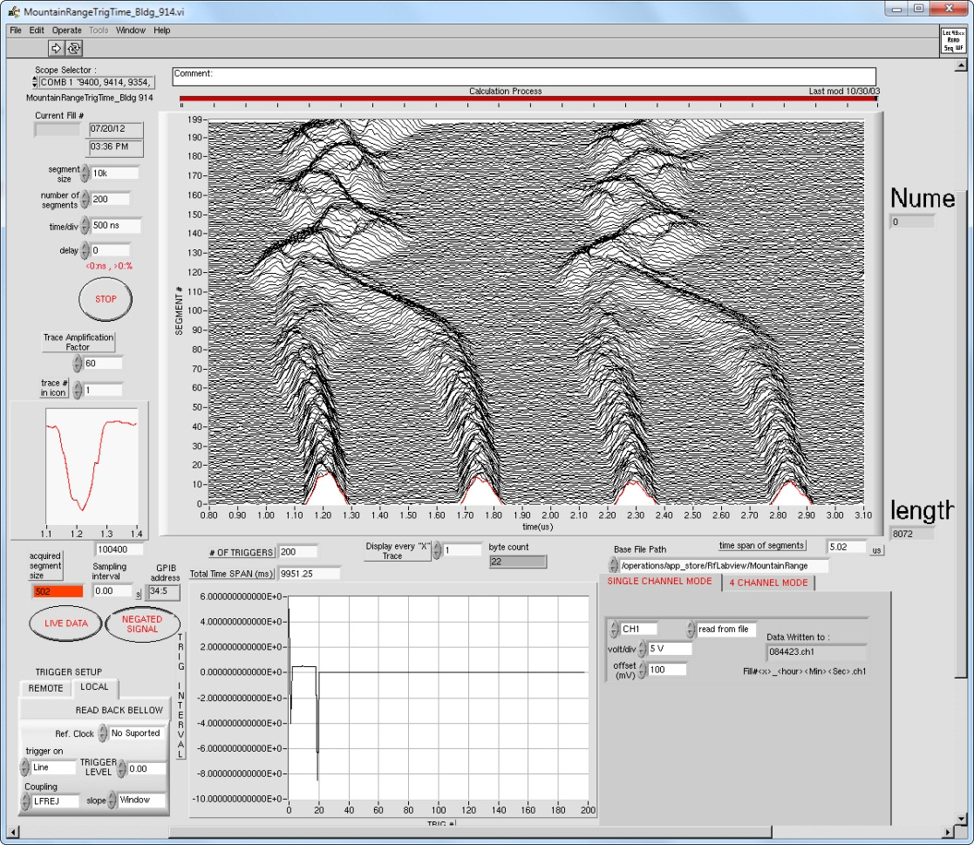
Booster Ion Longitudinal Emittance Before the Merge – 200
A: 0.026 eV*s/u
Q: What is the total longitudinal emittance resulting from multi-turn EBIS injection?
Incorrect. The correct question is …
Q: What is the per bunch emittance of the captured ion beam?
Measured just prior to the 4:2:1 merge porch, so includes effects of capture and acceleration.
Factor of 4 growth over injected emittance. ☹
An area requiring more detailed study.
http://www.cadops.bnl.gov/cgi-bin/elog/viewMain.pl?elog=Booster-RF_stay&shiftlog=Tue_May_15_2012_8:48:41_AM#20120521084444

Slide 8
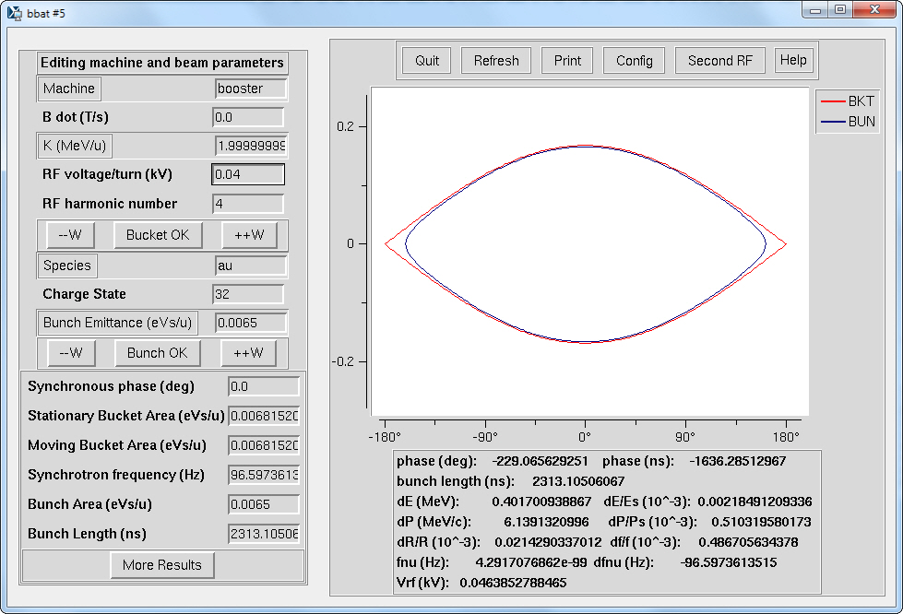
Booster Ion Longitudinal Emittance Before the Merge – 300
A: 40 Volts
Q: What is the RF voltage required to adiabatically capture this beam into h=4 buckets?
Extremely difficult to achieve.
Short capture time available, but simulations says not so bad.
Total voltage is 60dB below the maximum total voltage available. Very difficult (impossible) for the analog AGC loop.
Efficacy of Counter-Phasing to reduce net voltage depends on:
- Control of relative cavity voltages at low amplitude.
- Performance of cavity tuning servo.
- Performance of direct RF feedback in ring.
Very difficult with analog control loops, compounded by the low capture frequency.

Slide 9
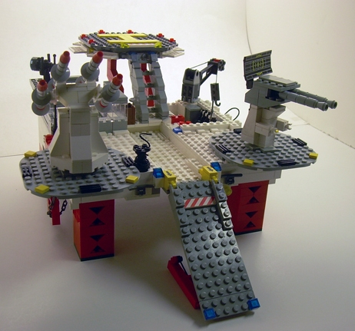
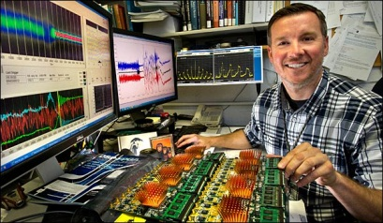
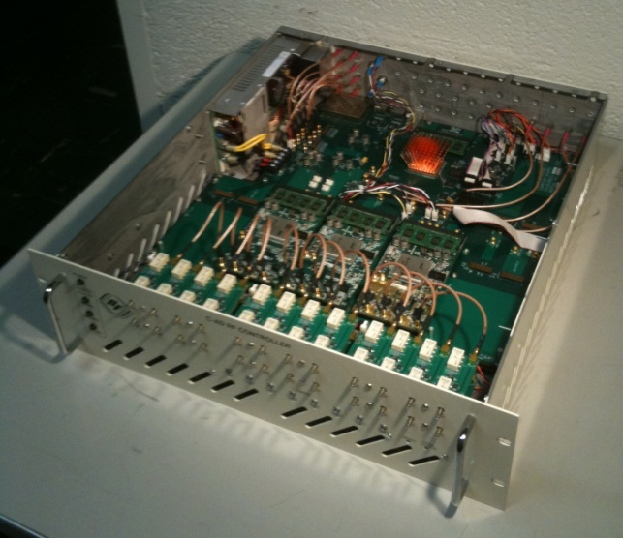
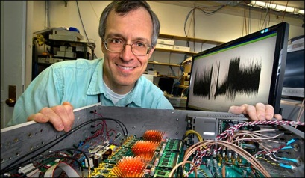
Booster Ion Longitudinal Emittance Before the Merge – 400
A: This miracle device will one day be employed to address RF control issues in the Booster, improving emittance and possibly preventing earthquakes.
Q: What is the “LLRF Platform”?
Amongst myriad potential benefits, an upgraded Booster LLRF system based on the Platform will provide vastly improved stability and control of cavity voltage and phasing, which will in turn help improve tuning of capture and merge gymnastics, leading to improved and more robust machine performance.
LEGO G.I. Joe Transportable Tactical Battle Platform
RHIC LLRF Platform
Pictured with simulated satisfied customers.
Evaluation of commercially available platforms revealed significant cost benefit shortfalls and COTS obsolescence issues.

Slide 10
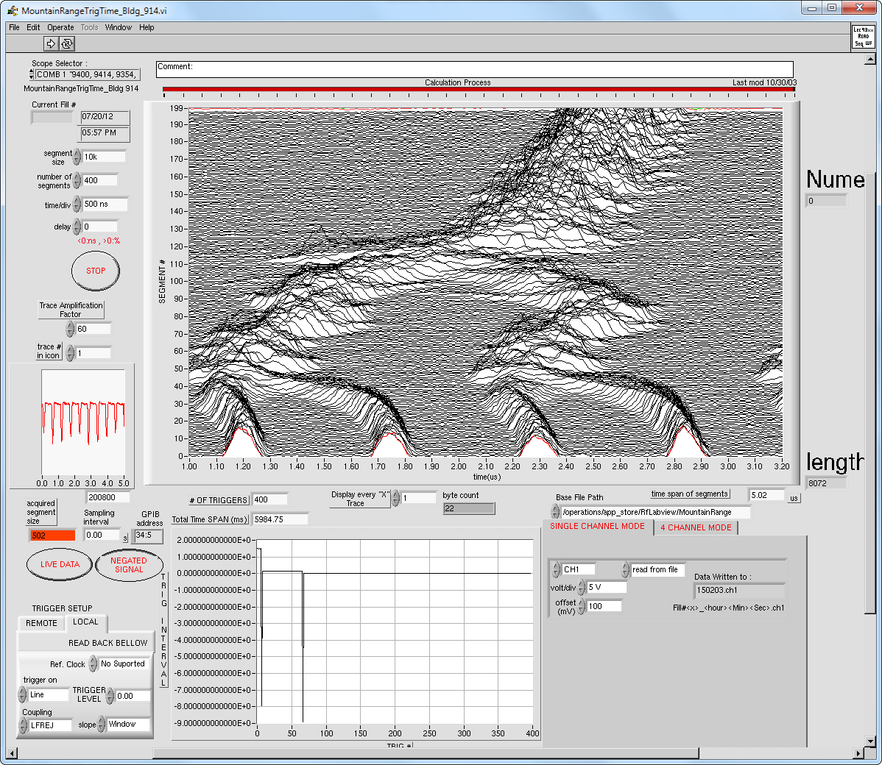
Booster Ion Longitudinal Emittance Through the Merge – 100
A:
VIDEO
DAILY
DOUBLE
“When I was born I was so ugly the doctor slapped my mother.”
Rodney Dangerfield
Q: How awesome does the Booster 4:2:1 merge look?

Slide 11
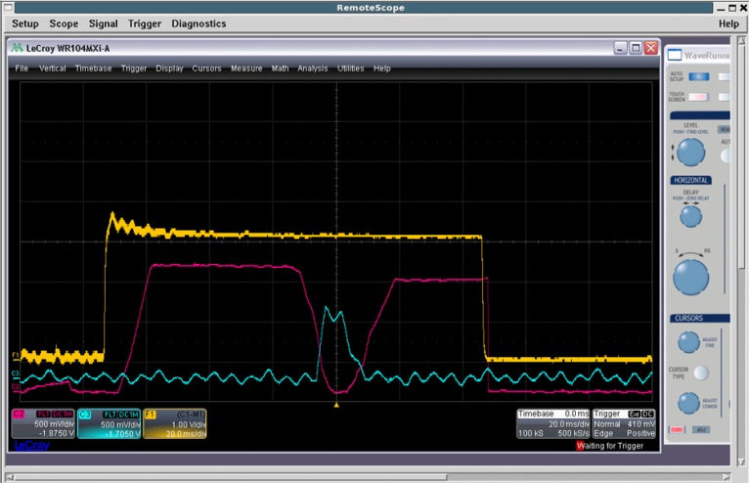
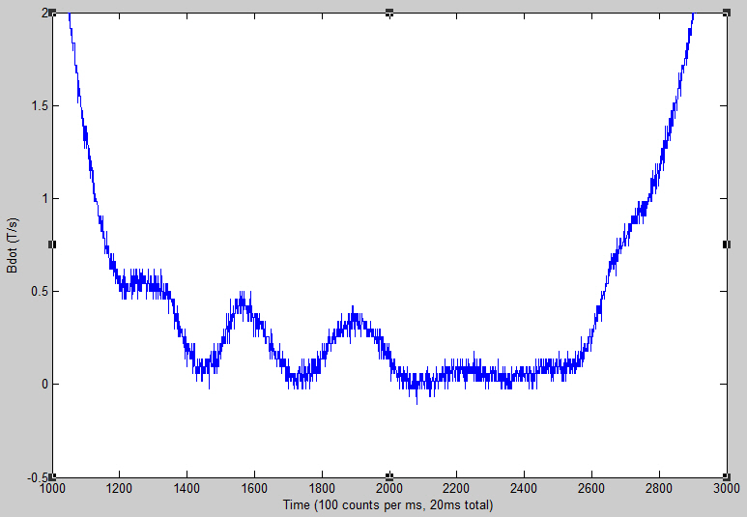
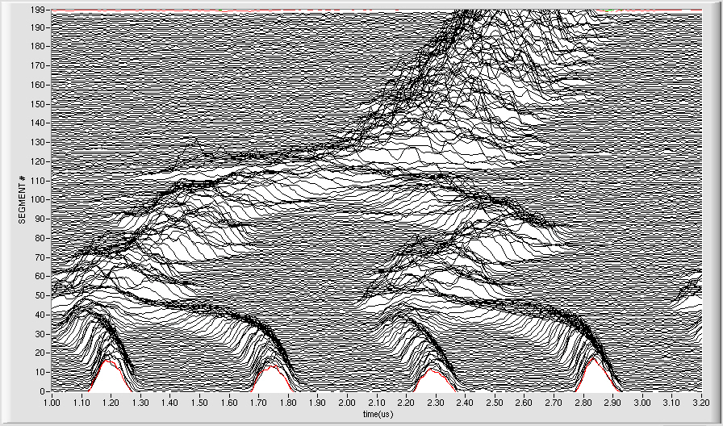
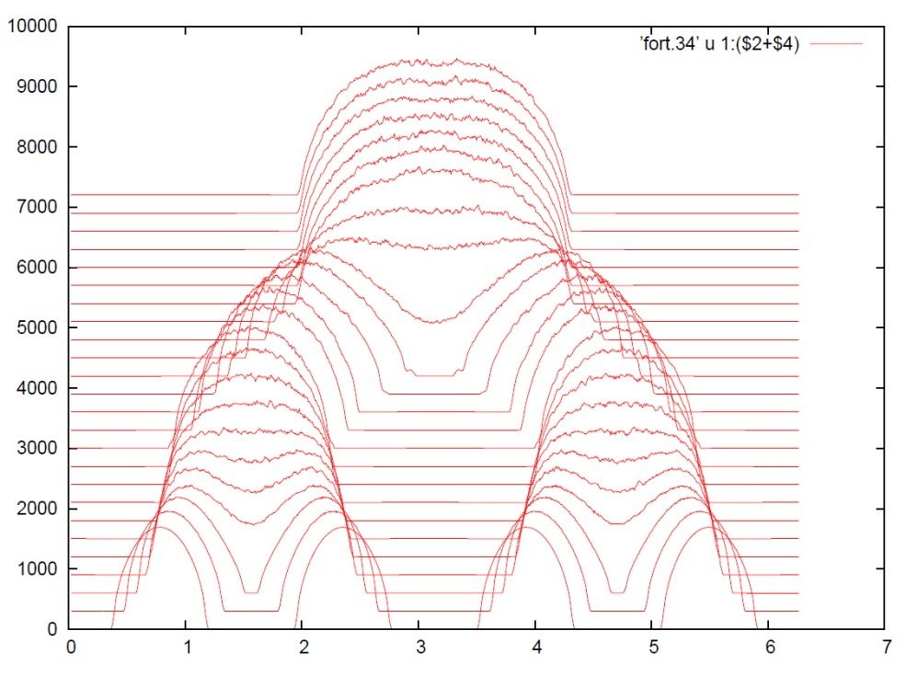
Booster Ion Longitudinal Emittance Through the Merge – 200
A: The first question uttered by Kip when shown a mountain range plot of the 4:2:1 Booster merge..
Q: Why so ugly?
Booster Main Magnet Bdot across merge porch.
Mike Blaskiewicz and Kip’s simulations shows that we have sufficient time on the 15ms merge porch for a smooth adiabatic merge.
1) Booster Main Magnet porch not ideal.
2) RF beam control loops in hold across the merge porch.
3) Cavity voltage and phase control issues?

Slide 12
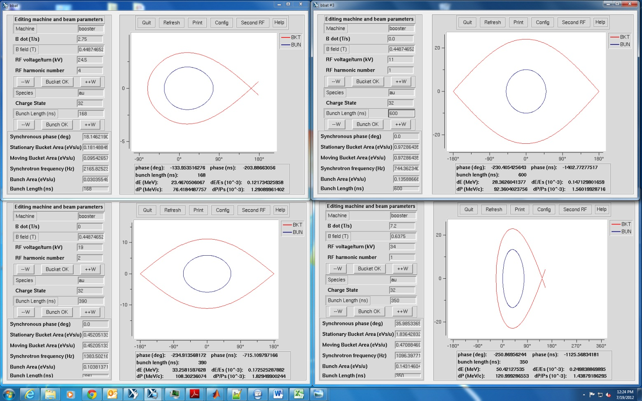
Booster Ion Longitudinal Emittance Through the Merge – 300
A: You’d think it would be about 100% - from the looks of it.
Q: What is longitudinal emittance growth resulting from the entire merge?
Measurements of total emittance pre-merge through to extraction show surprisingly little growth.
A
C
C / 4*A
= 0.136 / (4*0.03)
= 13%
B
D
D / 4*A
= 0.143 / (4*0.03)
= 19%

Slide 13
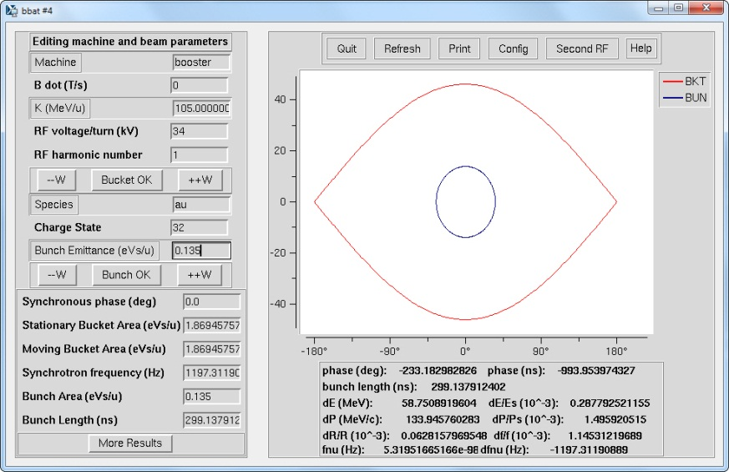
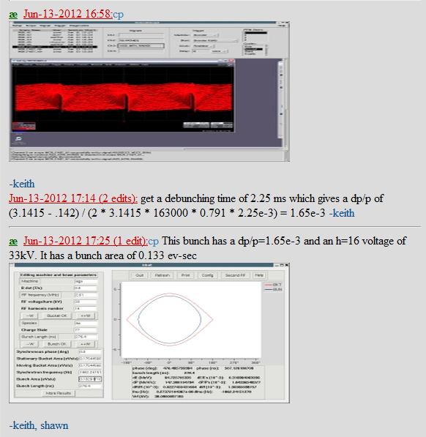
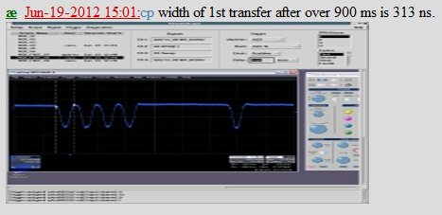
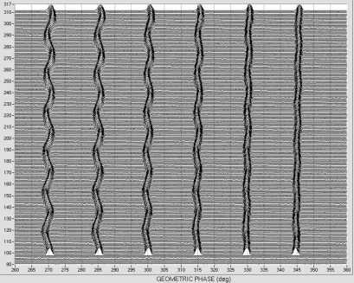
Booster Ion Longitudinal Emittance Through the Merge – 400
A: This obstacle’s impact on longitudinal emittance is very limited, particularly when you factor in the side benefit of single bunch transfer to AGS.
Q: What is the BTA stripping foil?
Booster Extraction
AGS Injection
Single bunch extraction increase momentum spread vs multi-bunch extraction of same total emittance.
10% growth
Bunch dp/p helps swamp the foil imparted dp/p.
Single bunch transfer ameliorates residual emittance growth induced by the frequency mismatch that necessarily exists with multi-bunch transfers using a stripping foil.
Bunches are frequency matched to AGS RF, but their incoming spacing (phase) remembers the Booster frequency.
2007 6 bunch transfer from Booster to AGS

Slide 14
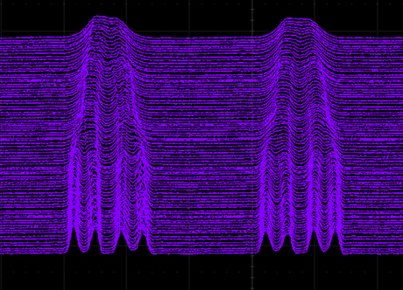
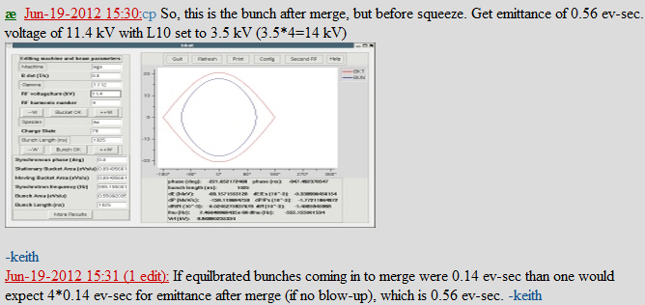
AGS Ion Longitudinal Emittance - 100
A: This parameter, identified in the title of this slide, handily debunks the so-called “Theory of Evolution”, as it is not prone to evolve.
Q: What is the AGS longitudinal emittance?
Zero growth. It does not evolve. Pretty sweet …
Per bunch emittance
eV*s/u

Slide 15
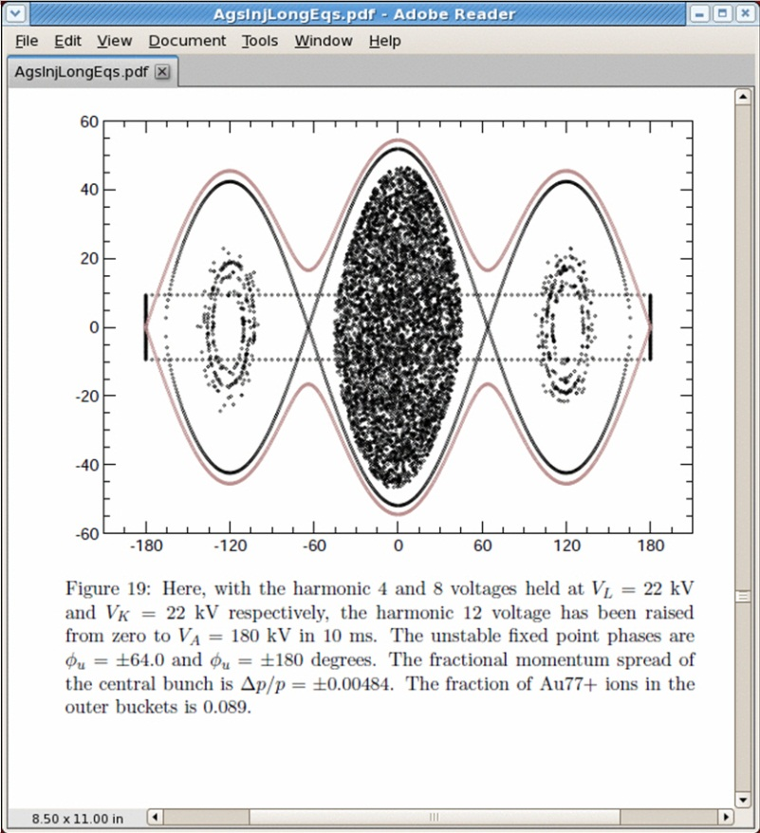
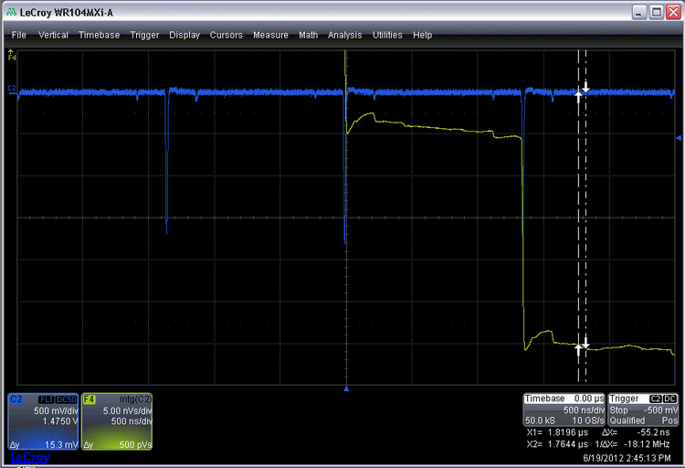
AGS Ion Longitudinal Emittance - 200
A: Based on its miraculous emittance preserving characteristic, the AGS 16:8:4 merge might be prematurely described using this cheery colloquialism ...
Q: What is a big box of chocolatey awesomeness?
0.55 eV*s/u is about the limit that we can cleanly transfer (squeeze) from h=4 => h=8 => h=12 for acceleration.
A lot of time and effort must be put into keeping the setup optimized.
Per bunch emittance

Slide 16
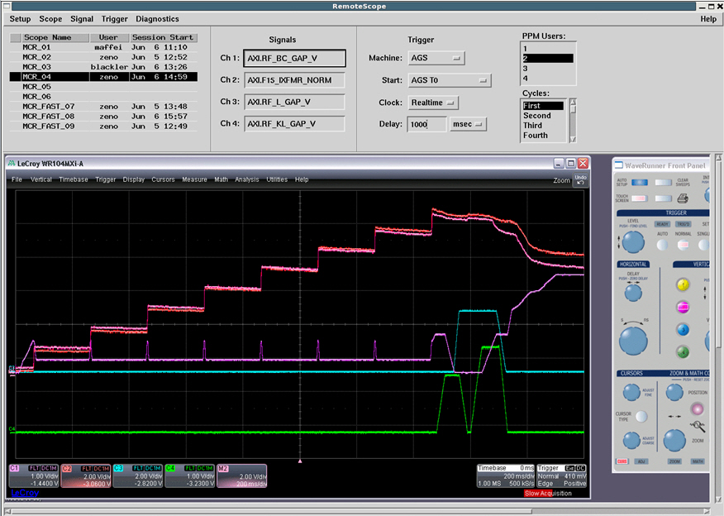
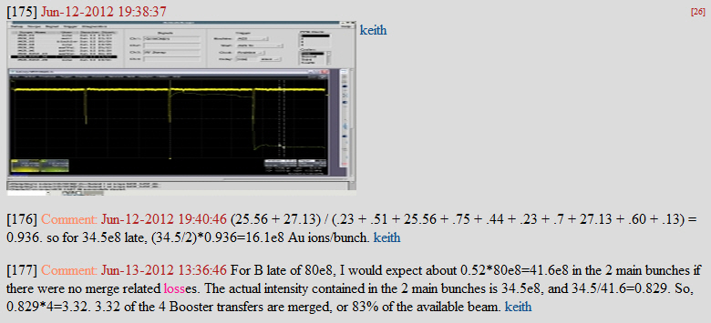
AGS Ion Longitudinal Emittance - 300
A: 83% - stupendous, given the hoop jumping it entails.
Q: What is the overall AGS cycle efficiency?
“Capture / early acceleration” losses.
Lots of tuning effort …

Slide 17
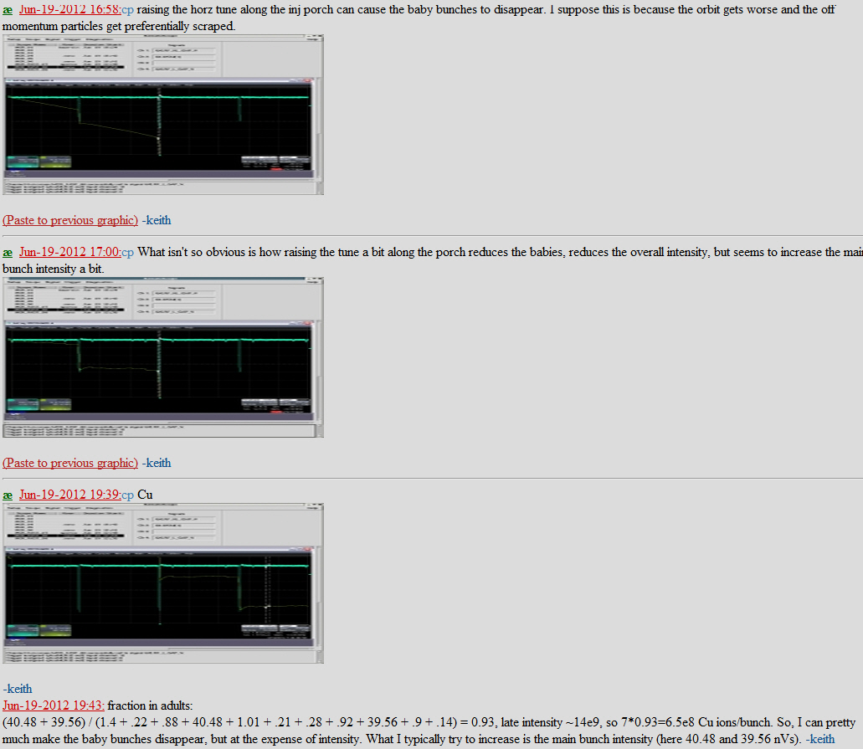
AGS Ion Longitudinal Emittance - 400
A: Science and common sense teach us that beam loss is fundamentally transverse in nature. Nonetheless, beam losses during acceleration are often blamed on this longitudinal parameter.
Q: What is bucket area?
Regardless of loss mechanism, it would seem that a pre-requisite for improved AGS performance is a reduction in longitudinal emittance at injection.
dp/p = +/- 5E-3
Fraternizing between the longitudinal and transverse.

Slide 18
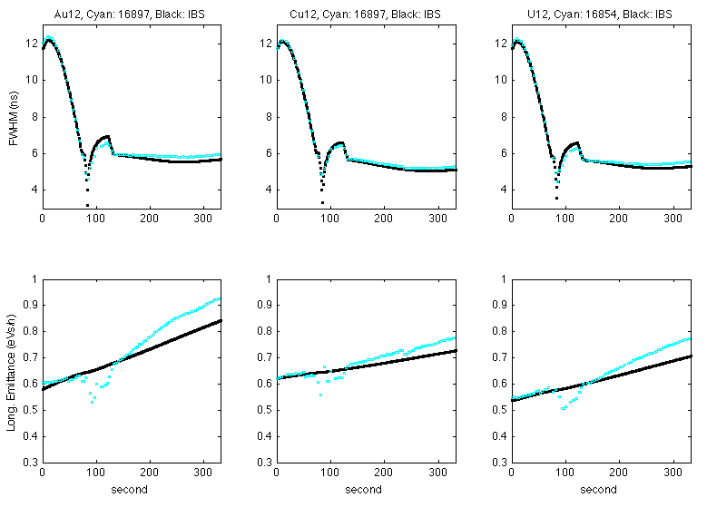
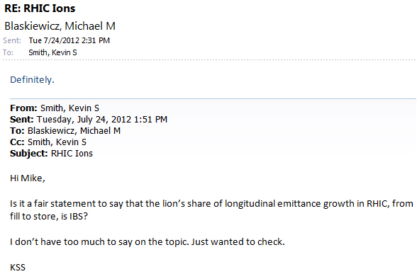
RHIC Ion Longitudinal Emittance - 100
A: Intra-Beam Scattering
Q: What is the dominant contributor to longitudinal emittance growth in RHIC?

Slide 19
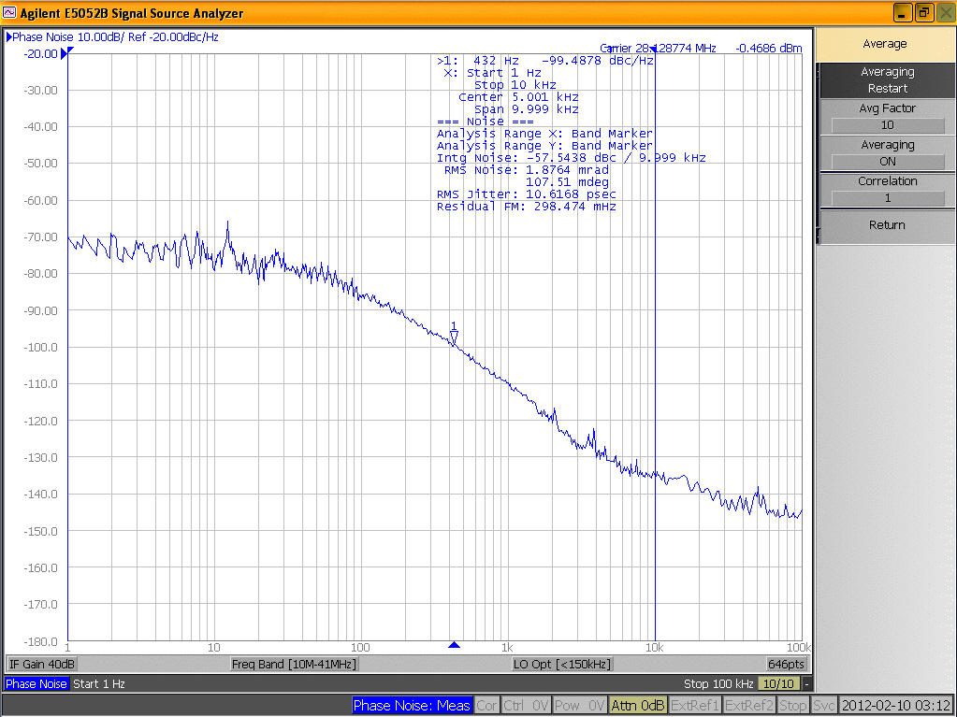
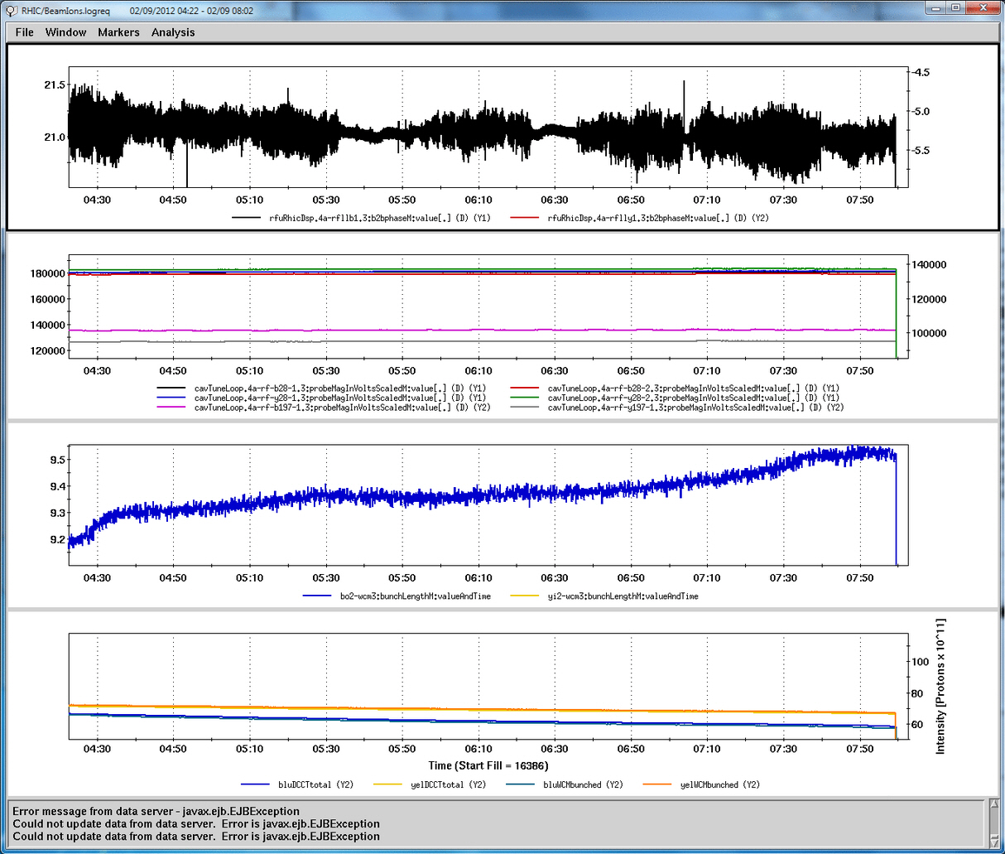
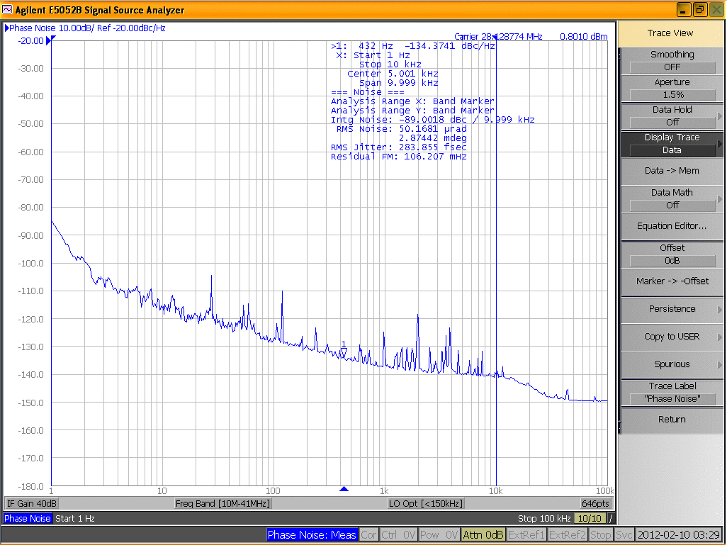
RHIC Ion Longitudinal Emittance - 200
A: Bad connectors, RMMPS, operator malfeasance, ennui ...
Q: What are convenient excuses for anomalous emittance growth that the RF Group might hide behind at meetings?
Before connector fixed.
After connector fixed.

Slide 20
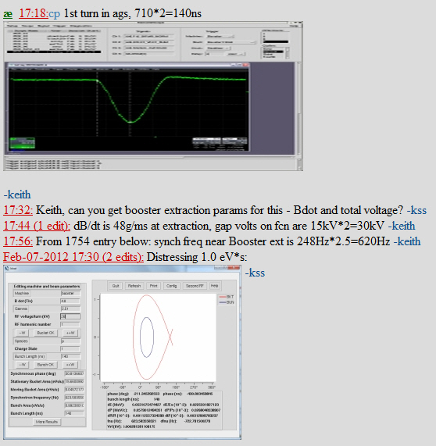
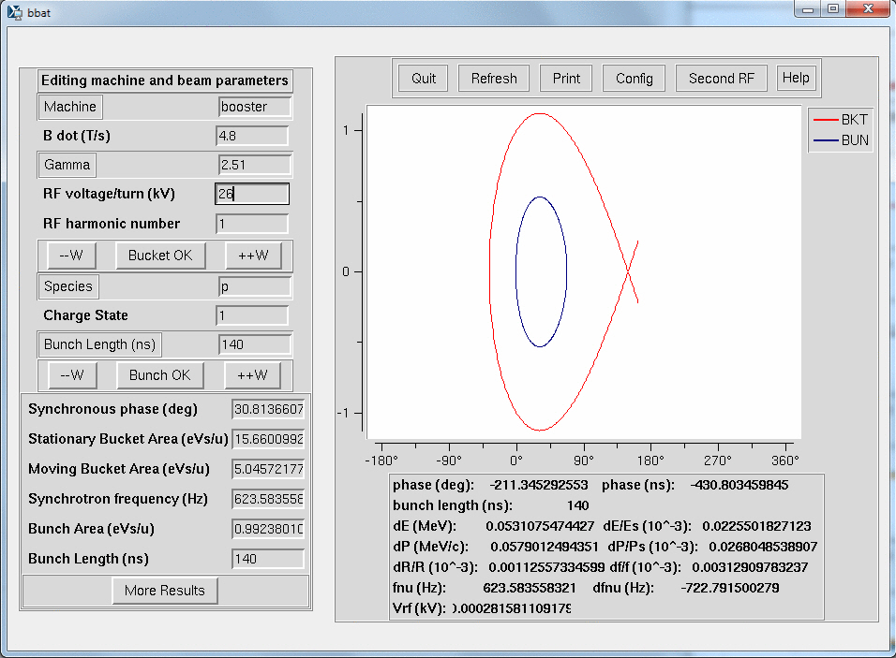
What About polarized Protons? - 100
A: The epic 2012 TriBeCa Film Festival Best Documentary, “930 UEB”, delves deeply into this disturbing subject.
Q: What is the origin of Polarized Proton longitudinal emittance?
Linac dp/p = +/- 1.2E-3
dE/E = +/- 0.386E-3
dE = +/- 435 keV
Emittance before Booster capture = 1.04 eV*s

Slide 21
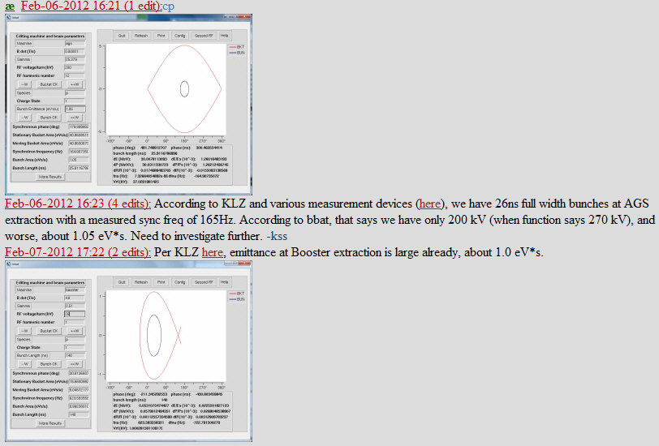
What About polarized Protons? - 200
A: This particle accelerator is not only useful for the study of rare kaon decays, but was employed several slides back to prove that evolution is scientific mumbo jumbo.
Q: What is the AGS or Alternating Gradient Synchrotron?
Once again, no change.
Longitudinal emittance of PP bunches extracted to RHIC is determined by Linac.

Slide 22
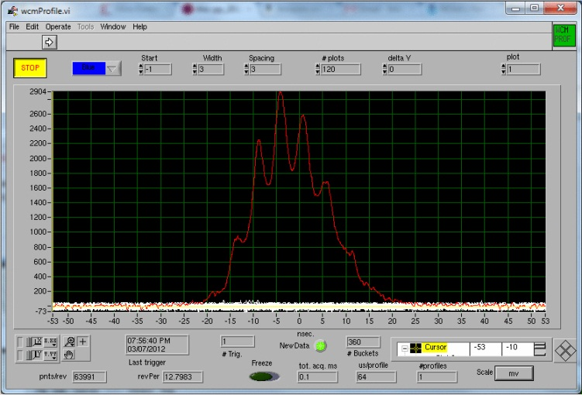
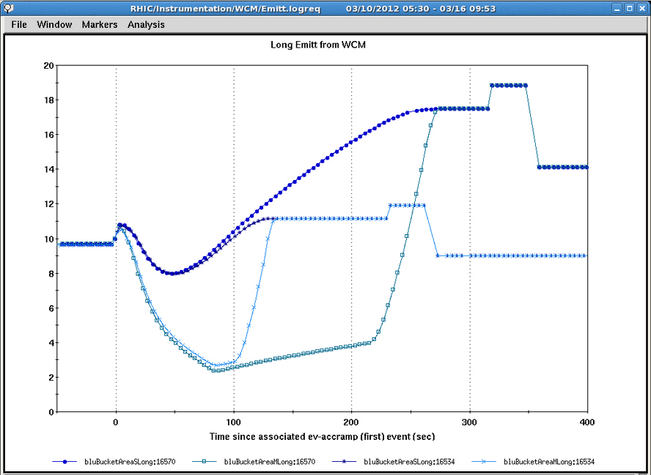
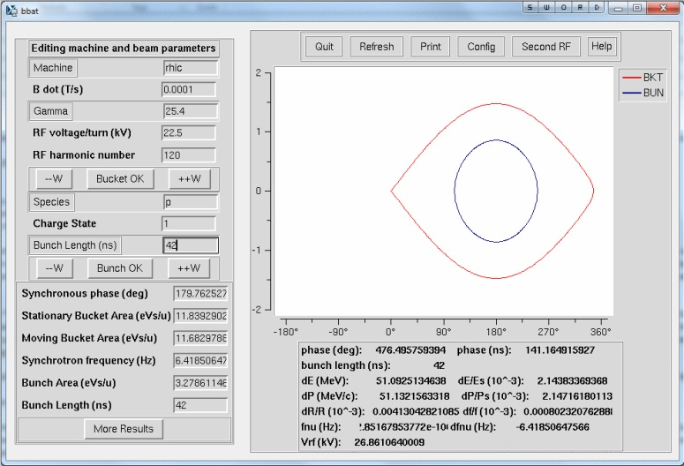
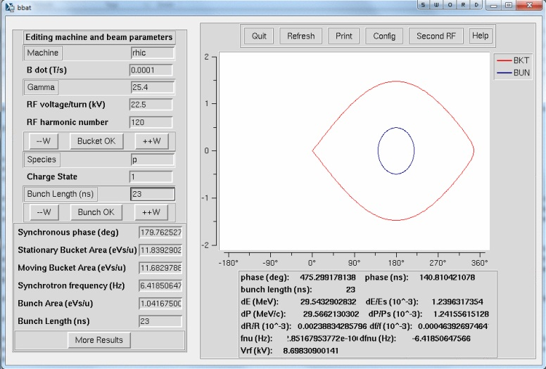
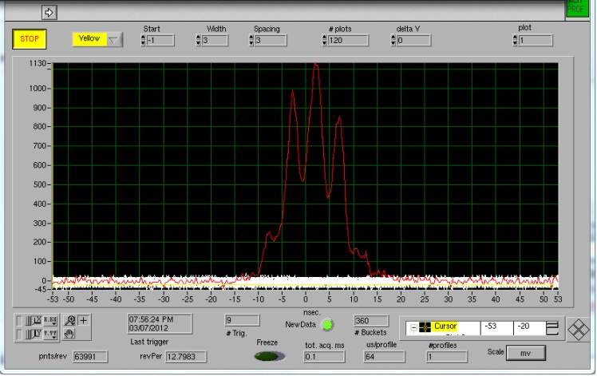
What About Polarized Protons? - 300
A: This little particle accelerator, ¼ the circumference of the AGS with ½ as many superperiods, has an outsized impact on longitudinal emittance growth during RHIC PP fills.
Q: What is the Booster?

Slide 23
What About Polarized Protons? - 400
A: Let’s see what Mike thinks.
Q: What is a good answer to most questions?
More specific please.
Q: What is the answer when (Thomas, Wolfram, Vincent) asks “What are you going to do about this troublesomely large emittance and the resulting luminosity limit?”

Slide 24
FINAL JEOPARDY
Summary &
Suggestions

Slide 25
FINAL JEOPARDY – Summary & Suggestions
The longitudinal emittance story is similar across species …
Longitudinal emittance delivered to RHIC is determined very early.
Booster Capture for Ions.
Surprisingly little growth in Booster 4:2:1 merge (the ugly one).
Linac dP/P for Polarized Protons.
The resulting bottlenecks differ …
Ions – AGS post-merge squeeze and early acceleration limit us to ~ 0.55 eV*s/u.
4 Booster loads per bunch vs 1 Booster load per bunch in ye olden days.
PP – RHIC 9 MHz bucket area limits us to a 3eV*s or so at max Bdot – and that’s a problem?
We inject 1 eV*s into RHIC which then gets beaten up during the fill.
Attack scenarios …
Ions
LLRF upgrades to improve robustness (and ease of tuning) of setups.
AGS LLRF Upgrade in progress.
Booster LLRF Upgrade planned for 2013 Shutdown.
Improvements to capture, feedback loops through merge?
If ions for Run13, we’ll figure something out …
PP
Mike Brennan’s talk will detail proposals.
Continue investigation of Linac output dP/P.

