Slide 1
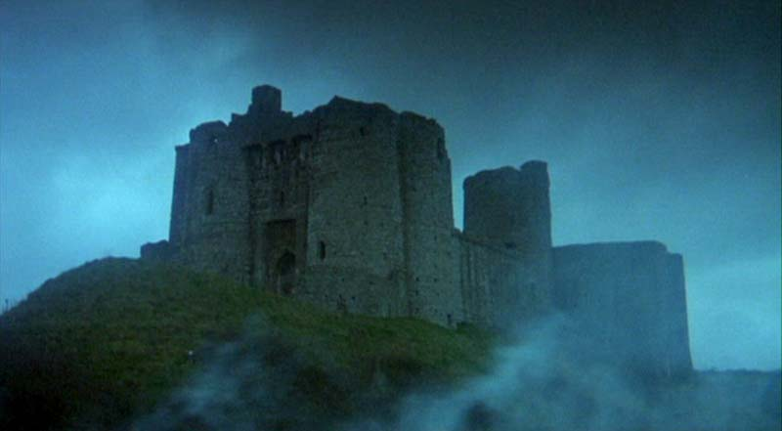
2012 MCR Commissioning
Trials and Tribulations

Slide 2
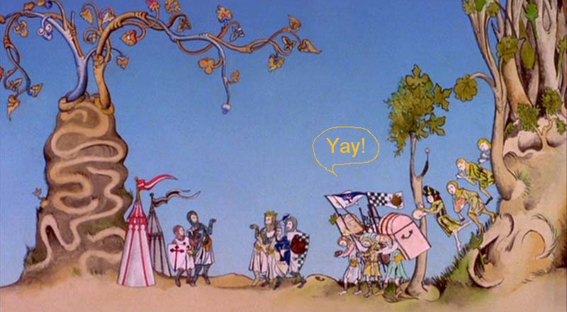
First NSRL beam
Sept 20, 2011 1 GeV iron beam established in NSRL target room
Sept 26, 2011 NSRL science begins as scheduled
There was much rejoicing

Slide 3
Things We Can Live With (for now)
Portable UPS have not been installed yet
Verizon cell phone repeater not installed
Conference room lighting has just one zone
Large screen TV’s suffer from screen burn

Slide 4
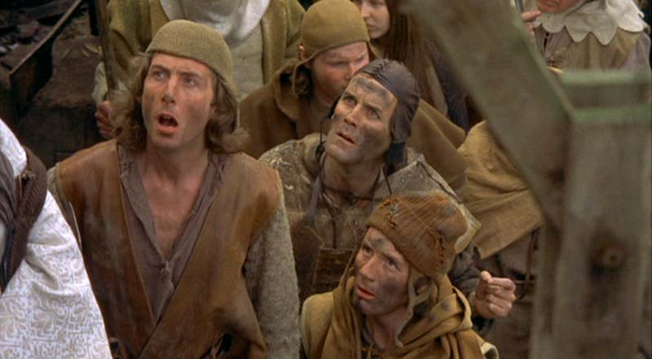
Things That We Didn’t Think About
HVAC zones are totally wrong
Ceiling speakers create radio feedback
Not enough phone locations
Need more screen real estate now that scopes are on workspace
Heat from monitors

Slide 5
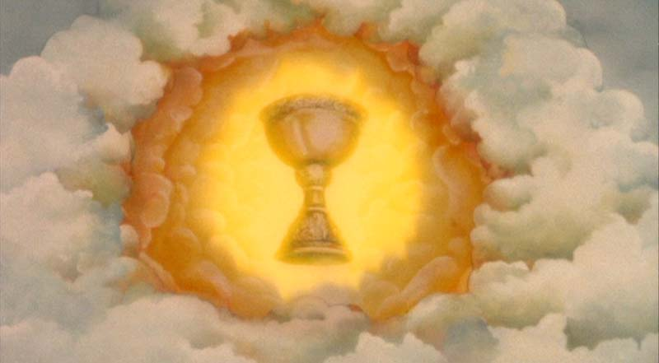
Things That Need to Change
CAS/Cryo integration is not working
Shiny new control room, same slovenly behavior
More scopes
Scope layout saving
More copies of scope signals

