Slide 1
Plan for Run 13: Polarized Protons
V. Ranjbar

Slide 2
Out line
What are our Goals for this Run?
What are the major changes to the Machine?
What can be done for RHIC?
Polarization On the Ramp
Lifetime
What can be done for AGS?

Slide 3
We have an extremely Ambitious Goal for 250 GeV : 750 pb⁻¹ for PHENIX
One might say too Ambitious?
Our best estimates for 12 week run (W. Fischer) ~ 550 pb⁻¹
So what could save us?
Turn around time? Right now we are at 4 hours. If we can drop that to 1 hour we might be able to get above 700 pb⁻¹. But we should also trim our store time down to ~ 5 hours.

Slide 4
Turn around time is Very Important!
With a turn around time of 1½ hour
and a reachable (77%) increase in peak L, we can
achieve integrated luminosity equivalent to
135% increase in peak luminosity. 77% could be
achievable with 2.05e11 per bunch and 0.5 m bunch
rms. (Wolfram’s maximum is 2e11 per bunch).
Going to shorter stores becomes even
more important if we consider LP²
Luminosity value.

Slide 5
Lots of changes to the Machine
If the this ambitious goal wasn’t enough we are going to be commission several major items during this run:
Source Upgrade:
New RF bunch structure for Booster and AGS
Change in bunch spin pattern
E-lens :
New Lattice at new integer tune values
Change in abort gap location
Other RF Upgrades:
Vector Sum (real bunch-to-bucket phase measurement)
Next run we should calibrate the voltage readbacks with beam measurements (synchrotron frequency via Schottky)
I/Q feedback on bouncers for amplitude and phase accuracy
New landau cavities this year
harmonic this year (FY13) = 21 ½ x 9 MHz (not storage cavity)
Improve beam loading, enabling lower voltage at injection
New dipole mode longitudinal damper (already tested past run. Still needs work)
Courtesy M. Bennan

Slide 6
Source Upgrade
OPPIS Improvements:
Increase from 0.5 mA to 4 mA at the Linac
from the source: More than a factor of 10 higher
The outstanding question is if high polarization
can be maintained with this new source.
What to do with this higher Intensity?
This motivates our RF changes in the AGS to
exploit this.
→ This permits us to follow M. Brennan’s plan:
Capture two bunches at Booster injection, h=2
Accelerate and transfer two bunches to ¼ of the AGS circumference (h = 8 )
Each one will have ½ the longitudinal emittance as in FY12 (scraped away)
3. Fill RHIC in ½ the time (hopefully experiments won’t mind double polarization pattern).
Courtesy A. Zelenski

Slide 7
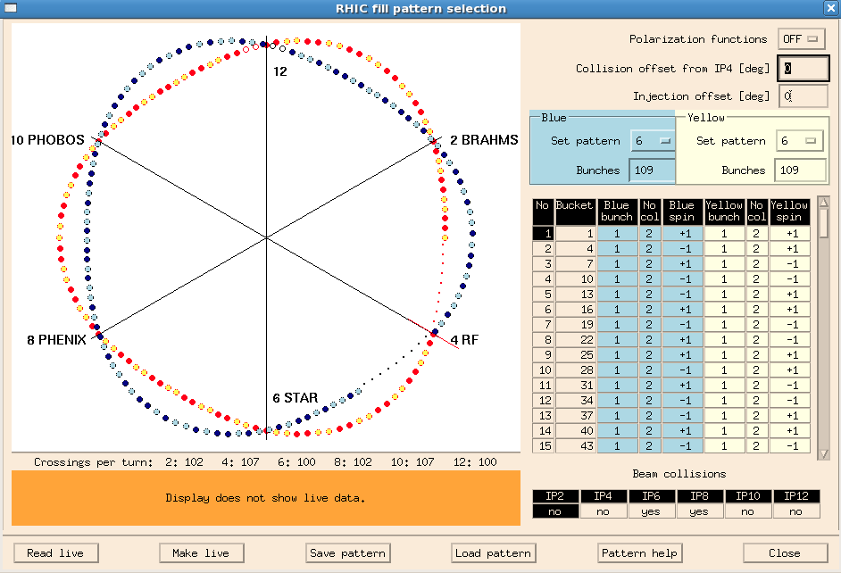
E-lens Upgrade
Courtesy X. Gu
Requires new Lattice Commissioning:
Yellow → 29.685 30.675
Blue → 27.685 29.675
Change in abort gap timing:
Move from IP2/8 → IP4/10
This to permit the instrumentation for the E-lens to “see” the beam signal without being swamped by the proton beam.
This reduces number of collisions from 107 → 102

Slide 8
RHIC Polarization Ramp Efficiency
If we believe the CNI Polarimetry then we have several examples of basically 100 % transmission efficiency . So the question is why we don’t get this all the time?
Factors we think are causing loss on the Ramp
Snake incorrectly Tuned
Orbit driven Imperfection Resonances > 0.12
Tunes are under Control and Chromaticity below 4 is not a factor
Emittance only enhances underlying orbit or Snake issues

Slide 9
Backing Out Imperfection Strength
We picked a baseline orbit from one of the highest polarization transmission efficiency ramps and calculated differential orbits for each fill which we had polarization data. We then backed out the associated differential imperfection resonance strength by first calculating the corrector settings to recreate this orbit using SVD and then ran DEPOL on the final lattice.

Slide 10
Can we understand Polarization loss by considering a simple model
Tracking results indicate our threshold for losses across the last
Two strong intrinsic resonances are at 0.12. We see variability in the orbit at these
Resonances crossings which indicate a maximum of 0.05 imperfection resonance swing this is consistent with an underlying Imperfection resonance strength of ~ 0.1
So can we fit a simple model?
In this model we assume an underlying Imperfection resonance ₀₁ and ₀₂
an Imperfection from the snakes _{s} and differential Imperfection resonance caused by ramp to ramp orbit fluctuations. So we should capture both the
Orbit and some of the snake effects.

Slide 11
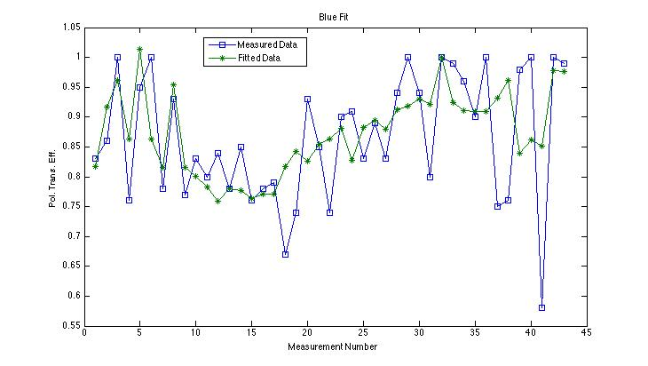
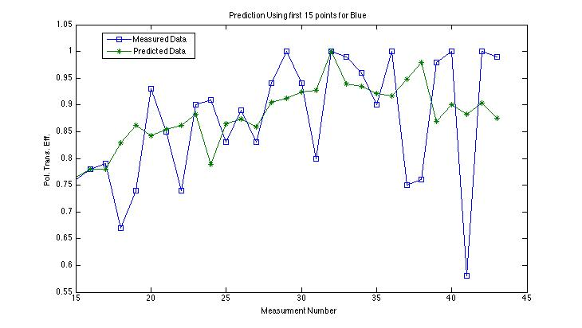
Blue Model Fit
Fitted ₀₁ for 381 and 423 Imperfection Resonance = 0.08 and 0.07
Chi2 = 0.4
Prediction based on 15 points yields
Chi2 = 0.4

Slide 12
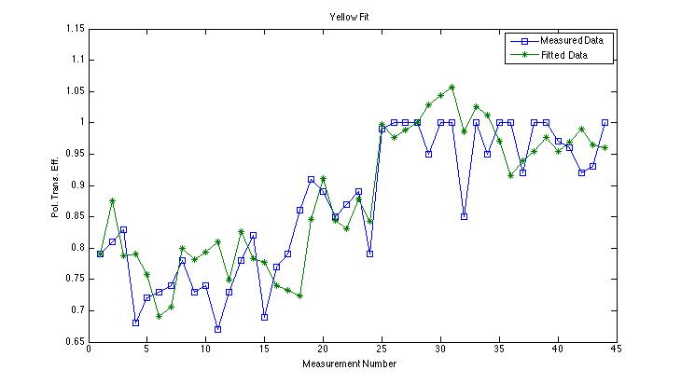
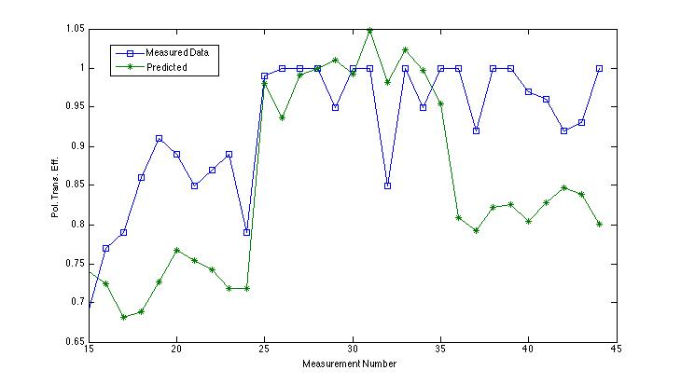
Yellow Model fit
For underlying 381 and 423 Imperfection Resonance fit gives 0.1 and 0.08 respectively
Chi2 = 0.17
Chi2 fit for Predicted points is 0.5

Slide 13
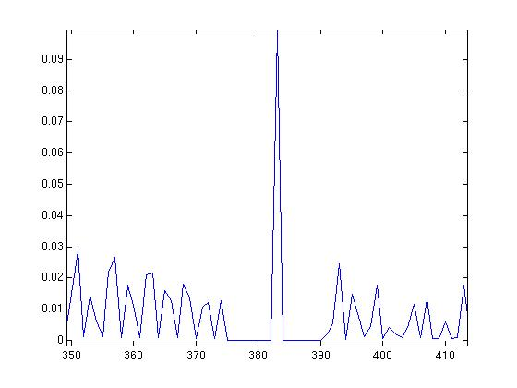
Controlled RHIC Polarization Calibration
Model of course is not quite perfect but it tells us that our system responses to
the strength of these imperfection resonances which is consistent with our
theoretical understanding. A more deliberate calibration of the model using
defined orbit distortions and snake de-tuning we believe will improve its predictive
capacity so that we can better tune on polarization transmission efficiency.
too reduce Imperfection resonance fluctuation
IMPERFECTION BUMPS
Similar to ORM approach: apply controlled Imperfection resonance bumps during
the first several stores these should effect Polarization < 20% level.
Demonstrated during APEX 12
We also should bump snake currents in a controlled manner.

Slide 14
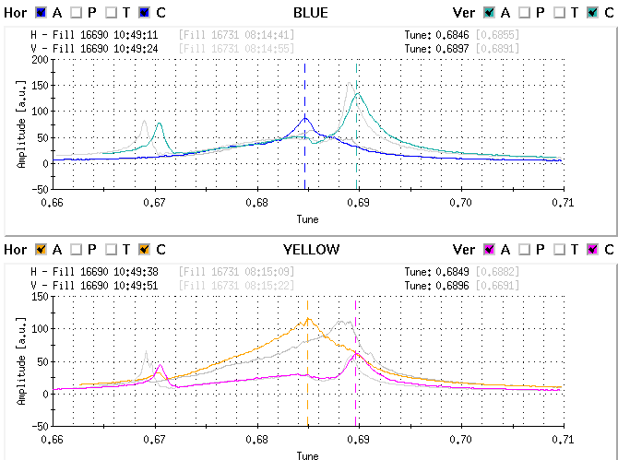
RHIC Polarization Lifetime
Based on analysis done by Mei and others the driver of our lifetime is due to
collision induced betatron tune spread. Higher intensity will no-doubt make this
worse. There appears to be fluctuation driven by emittance size and Snake detuning.
We have yet to analyze the orbit data at store for any correlations but we do not expect
to see anything significant.
Mei Bai: Courtesy
Mei Bai: Courtesy

Slide 15
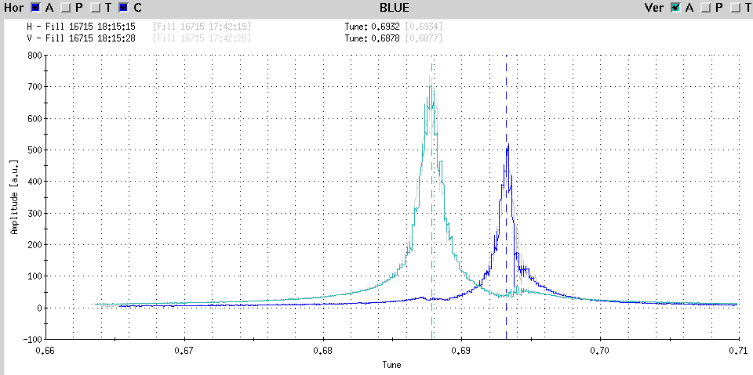
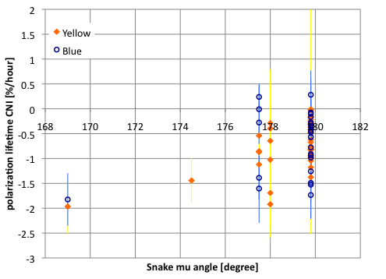
Possible Lifetime knobs
Coupling:
We are sitting awfully close to the 7/10 Snake resonance for the nominal horizontal tune.
Snake Current (too hard):
There seems to be lifetime response in Yellow, blue undetermined
Probably too expensive unless Polarimetry statistics improve significantly.
Qx=0.6932,Qy=0.6878
Mei Bai: Courtesy
Mei Bai: Courtesy

Slide 16
AGS Planned Changes for Run 13
Move to h=2 acceleration cycle. To fill yellow with two bunches (same sign) and blue, if experiments agree. (lower emittance per bunch, lower Polarization loss and faster RHIC fills)
Add RHIC type IPM into AGS
AGS jump quads shorter cycle: 4s. -> 3s. This is to reduce RHIC filling time .
New C5 corrector for horizontal beta function measurement.
Courtesy H. Huang

Slide 17
AGS Development
The bulk of our polarization losses occur in the AGS ramp. So targeting this machine for particular attention will be a priority. I would like to make sure we are exploiting the “free” time with AGS cycles for optimization as much as possible. Ideally have a physicists
working on testing some new idea or optimizing an existing system.
Projects to develop during AGS free time:
Tune jump Quads optimization
Test of extraction-on-the-fly. But first need expert to check the feasibility with 9MHz cavity.
AGS ZGOUBI model as (semi-) online model, behind optical control, IPM.
Automatic IPM beta function measurement.
Automatic emittance correction (from space charge, dispersion-> requires longitudinal dimension measurement).
Automatic chromaticity measurement.
Snake and Harmonic correction configuration optimization
- Best Snake strength vs. harmonic bump scheme to max. polarization
bunching structure
- Accelerating four bunches at half bunch length and merging two at AGS flattop?
lower space charge tune spread
lower transverse emittance induced losses
Courtesy H. Huang

Slide 18
Summary
We have a very ambitious goal
We have several significant things which are changing (e-lens, optics, RF)
Too meet our goals we will need to really work on turnaround time.
(although it has been done before many times I am sure) I should sit down with Ops and parse each step of the steps leading to store to see where things can be optimized also for my education.
RHIC polarization stability store to store
AGS optimization

