Slide 1
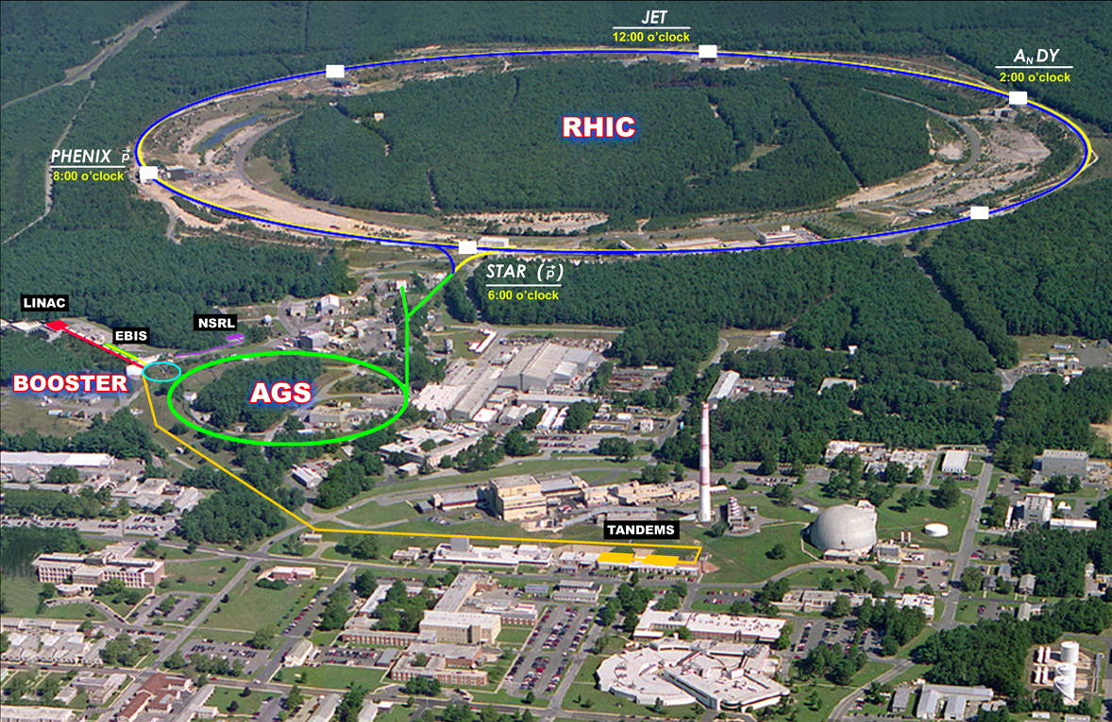
Projections for Run-13 Wolfram Fischer
27 July 2012
RHIC Retreat, Bellport
Notes:
27 July 2012, 09:05, 20 min (incl. questions)

Slide 2
Content – Run-13 and Run-14
Species and energies
Recent performance
Upgrades
Projections for Run-13

Slide 3
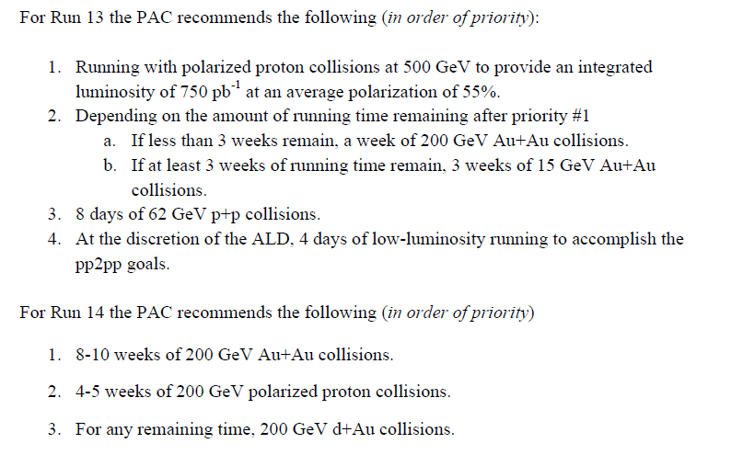
PAC Recommendations for Runs 13 & 14
Asked PAC for advice, priorities for 20-cryoweek Runs 13 & 14, in light of anticipated upgrade schedules and NP performance milestones:
5. Also: discussion in STAR of 2 weeks Pb-Pb instead of Au-Au

Slide 4
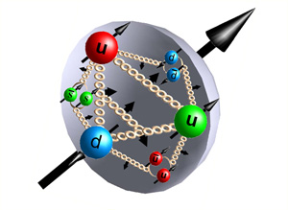
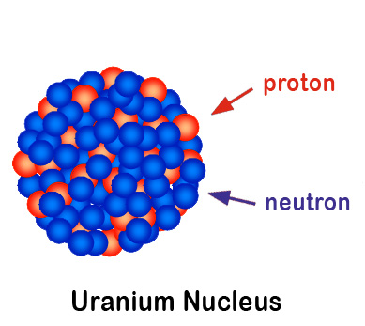
2012 RHIC Run (23.6 weeks of cryo ops) – most varied to date
100 GeV polarized protons
new records for L_{peak} (1), L_{avg} (2), P (3)
255 GeV polarized protons
highest energy polarized proton beam (4)
new records for L_{peak} (5), L_{avg} (6), P (7)
96.4 GeV/nucleon uranium-uranium
heaviest element in collider (8), shape stochastic cooling: L_{max} > L₀ 1st time in hadron collider! (9)
all ions lost through burn-off 1st time in hadron collider! (10)
100 GeV/nucleon copper-gold
new species combination in collider (11) highest ion charge/bunch (+8.5% rel. to Run-11) (12)
2.5 GeV/nucleon gold-gold collision test
lowest energy to date, 20% of nominal injection (Bρ) (13)
He-3 acceleration (unpolarized) in Booster and AGS
highest energy He-3 beam (14)
Notes:
Polarized proton picture: http://www.physastro.iastate.edu/research/highlights/view.php?id=15
Uranium nucleus picture: http://paomura.wordpress.com/2012/04/19/nuclear-physics-nuclear-weapons/

Slide 5
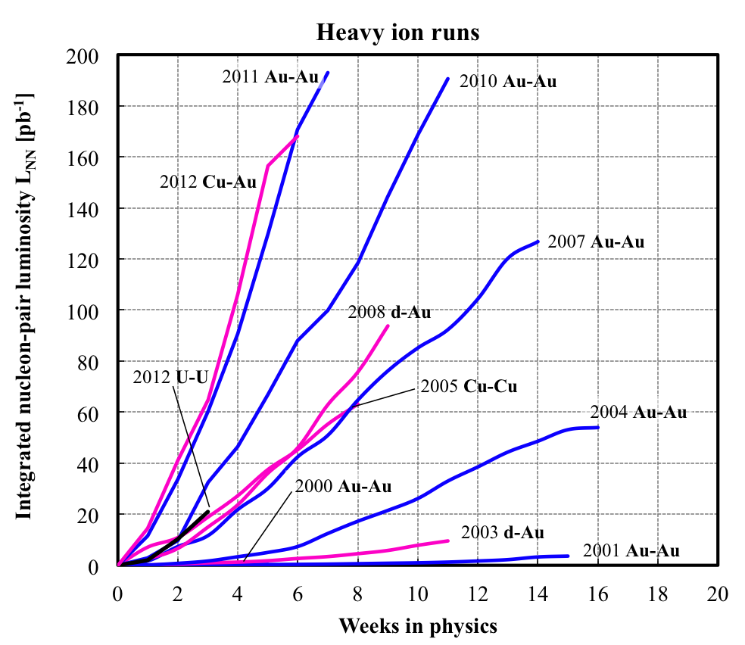
RHIC heavy ions – luminosity evolution to date
<L> = 15x design in 2011
About 2x increase in L_{int}/week each
Run-4 to Run-7
Run-7 to Run10
Run-10 to Run-11
Rate of progress will slow down – burn off 50% of
Au beam in collisions already
L_{NN} = L N₁N₂ (= luminosity for beam of nucleons, not ions)
Notes:
Needs update

Slide 6
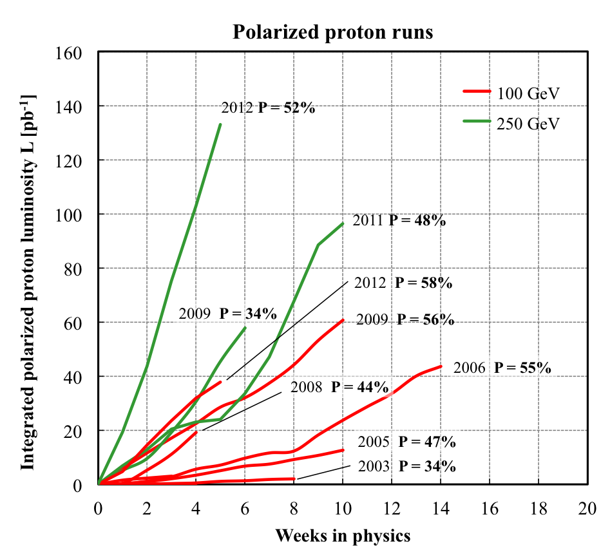
RHIC polarized protons – luminosity and polarization
At 255 GeV in 2012
L_{avg} = 105x10³⁰cm⁻²s⁻¹
P_{avg} = 52%
L_{avg} +15% relative to 2011
P_{avg} +8% relative to 2011
FOM = LP² (single spin experiments)
FOM = LP⁴ (double spin experiments)

Slide 7
Time-in-store as fraction of calendar time = r
85%
60%
Run-12 with low failure rates in all systems
Highest time-in-store ratios to date even with increased APEX time during 255 GeV protons, and few weeks per species
Could Run-12 performance be due to chance?

Slide 8
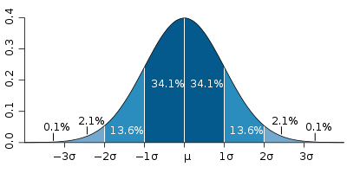
Run-12 time in store – could it be due to chance? (not entirely serious)
A: not likely i.e. system performance was really improved!
Assume Gaussian distributions for r:
Measured distributions (Run-4 to Run-11 at full energy):
A-A: μ = 54.0% σ = 4.0% (6 data points) p-p: μ = 52.4% σ = 4.6% (4 data points, exclude low-R Run-11)
Likelihood that observed r in Run-12 is due to chance:
100 GeV p-p: P(r ≥ 58.9%) = 7.6%
255 GeV p-p: P(r ≥ 54.2%) = 34.1% (increased E, more APEX)
96.4 GeV U-U: P(r ≥ 71.6%) = 0.001% (not a typo: 4.4 σ out, low intensity)
100 GeV Cu-Au: P(r ≥ 65.4%) = 0.24% (but high intensity here)

Slide 9
Upgrades for Run-13 and 14
Polarized protons
OPPIS upgrade
Electron lens installation, also new lattice
abort gaps meet in IP4/IP10
Polarimeter upgrades
RF: 9 MHz modifications, ferrite tuners, longitudinal injection damping, Landau phase compensation, …
Booster: inject with h=2 new spin patterns that always have 2 bunches with same orientation?
AGS: IPM like RHIC (hor), hor and ver survey, faster cycle (2.7s), test for extraction on fly
…
Heavy ions
EBIS: vacuum system, transmission through RFQ and Linac
Long. stochastic cooling pickup
IPM replacements
56 MHz SRF (Run-14)
Small vertical dump kicker (Run-14)
…

Slide 10
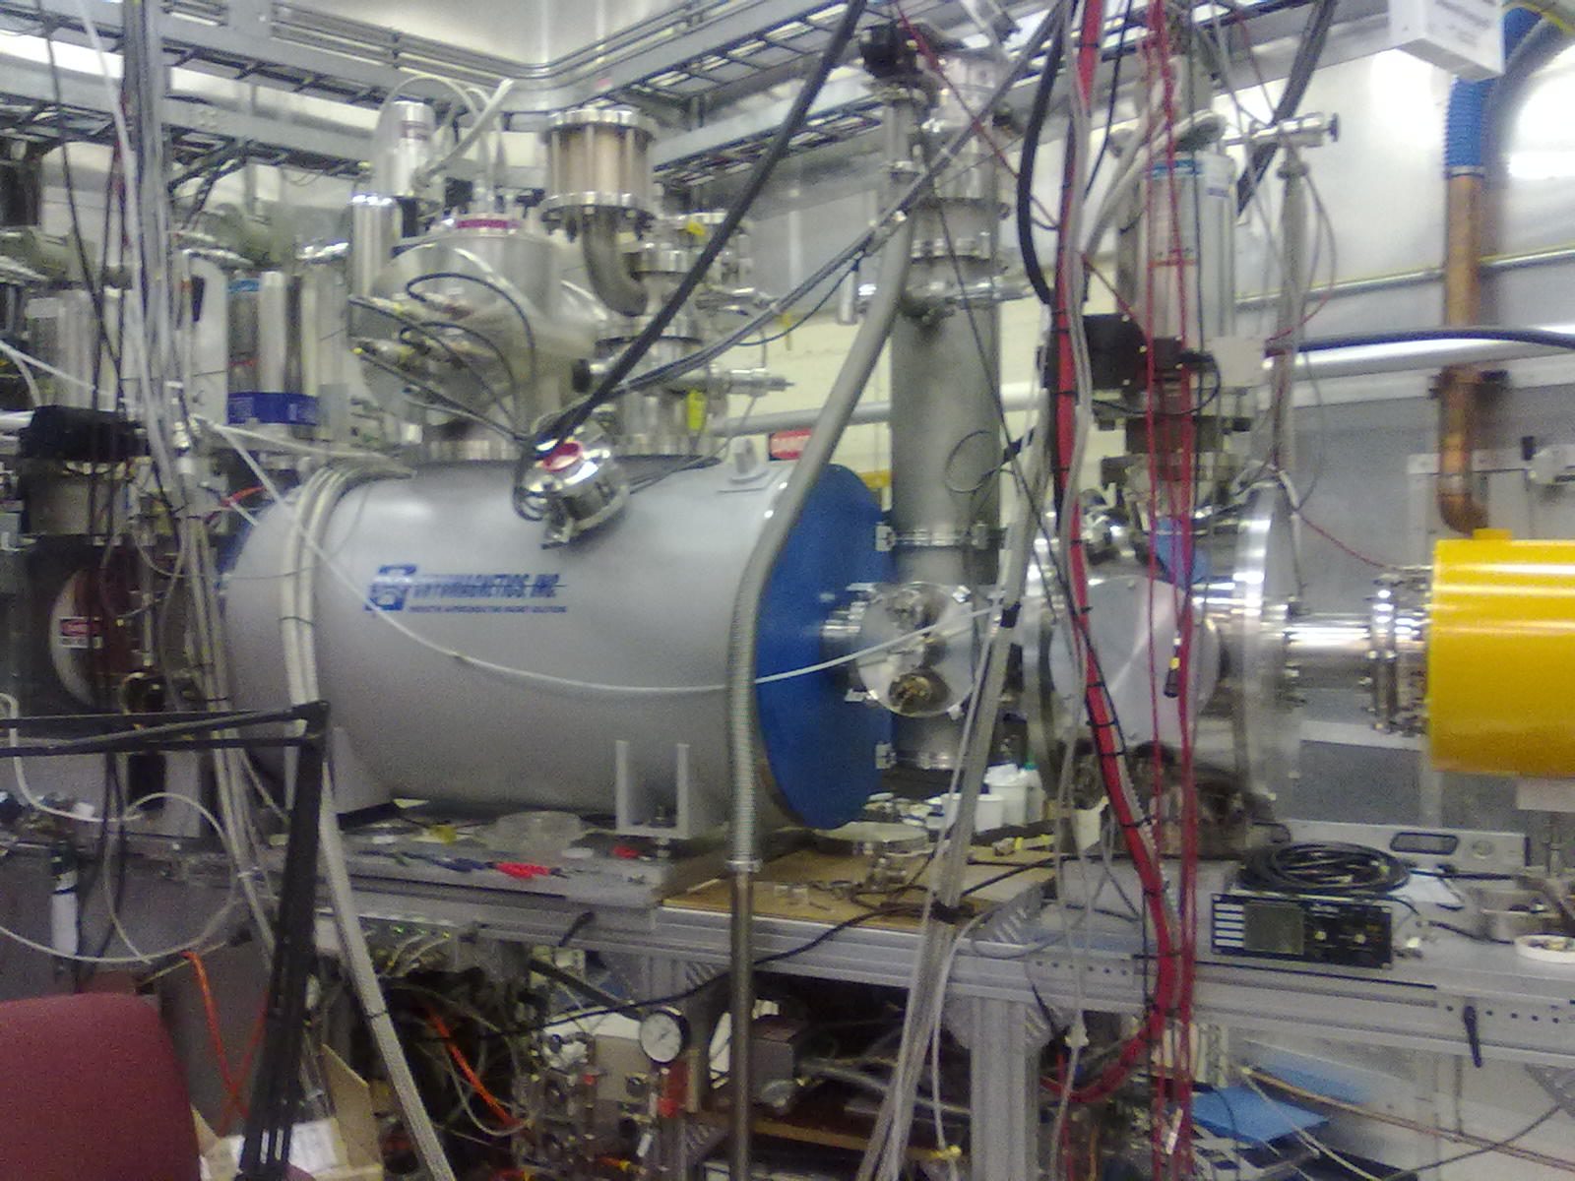
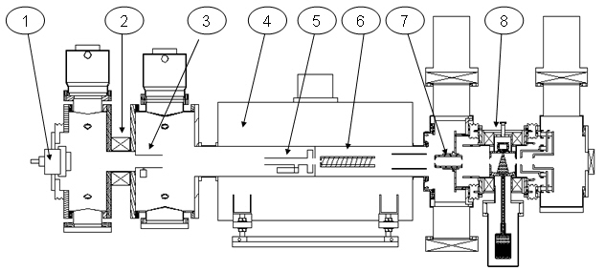
Optically Pumped Polarized H– source (OPPIS) – A. Zelenski
Upgraded OPPIS (2013)
Goals: 1. H⁻ beam current increase to 10mA (order of magnitude) 2. Polarization to 85-90% (~5% increase)
Upgrade components:
1. Atomic hydrogen injector (collaboration with BINP Novosibirsk)
2. Superconducting solenoid (3 T)
3. Beam diagnostics and polarimetry
23 May 2012
23 July 2012
Source Neutralizer Ionizer Rb-cell Sona Na-jet (H⁺) (H⁰) (H⁺) (H⁰) (H⁻)
New Atomic Beam Source
(ABS)
New superconducting solenoid
sc solenoid
=> 10x intensity from ABS was accelerated through Linac

Slide 11
RHIC electron lenses Motivation
Bunch intensity in 2012 polarized proton physics store
Goal:
Compensate for 1 of 2 beam-beam interactions with electron lenses
Then increase bunch intensity
up to 2× luminosity
Need new polarized proton source − under construction, A. Zelenski
bunches with 1 collision
bunches with 2 collisions

Slide 12
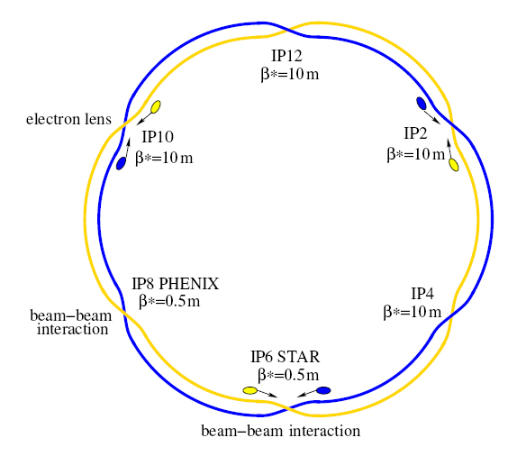
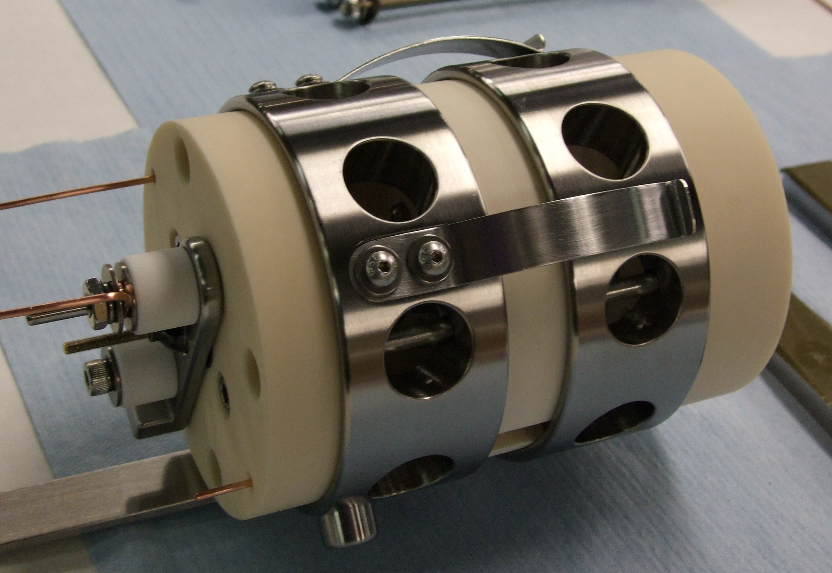
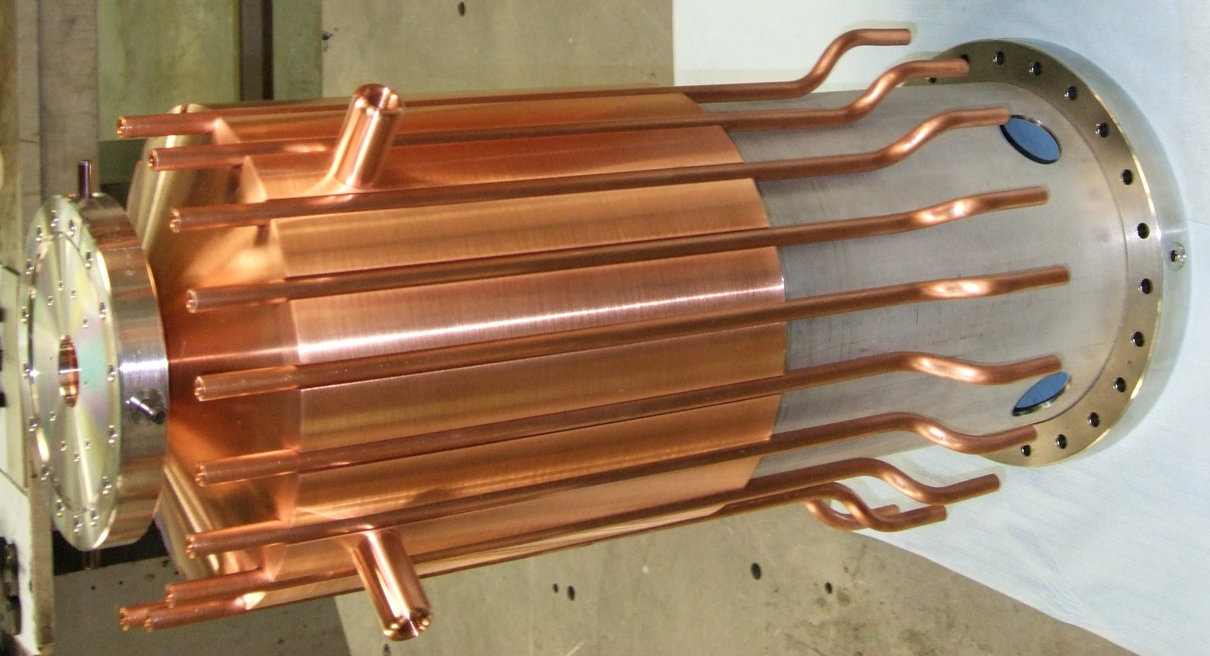
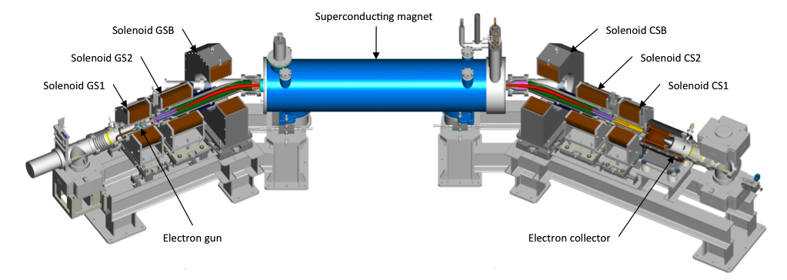
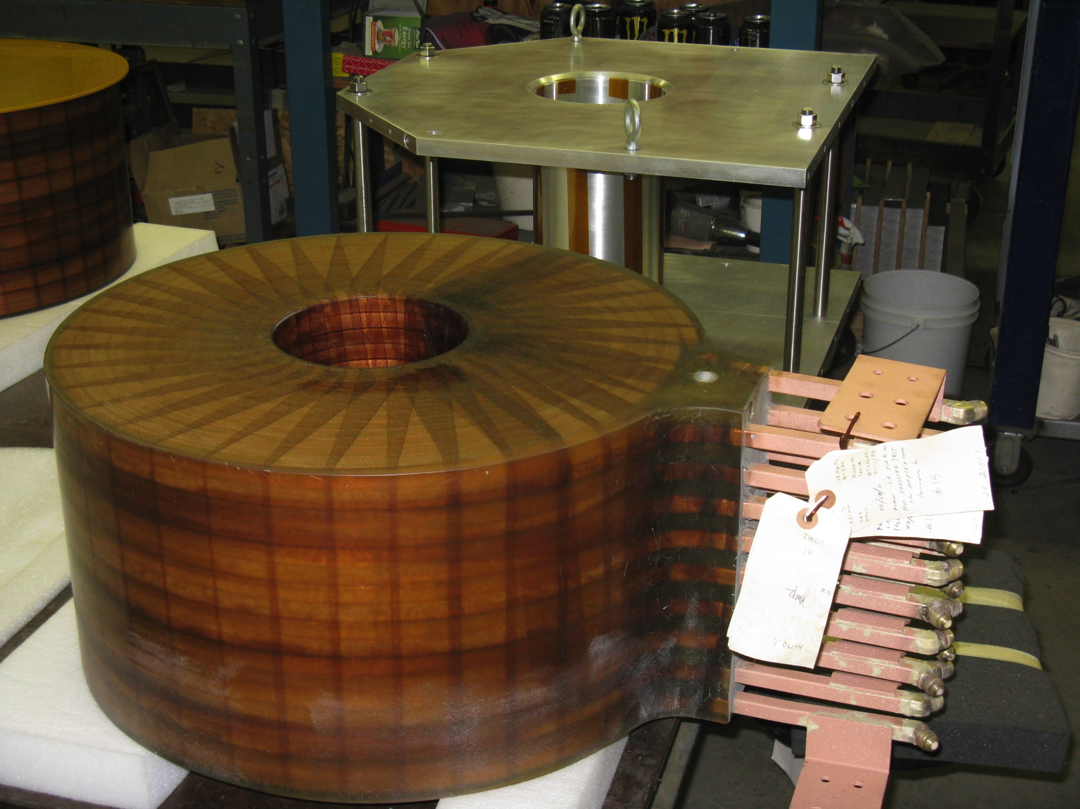
Electron lenses – partial head-on beam-beam compensation
Basic idea:
2 beam-beam collisions with positively charged beam
Add collision with a negatively charged beam – with matched intensity and same amplitude dependence
Compensation of nonlinear effects:
e-beam current and shape
=> reduces tune spread
Δψ_{x,y} = kπ between p-p and p-e collision
=> reduces resonance driving terms
Installation in 2012
Expect up to 2x more luminosity
e-gun
e-collector
main solenoid manufacturing in SMD
GS1 manufacturing in industry

Slide 13
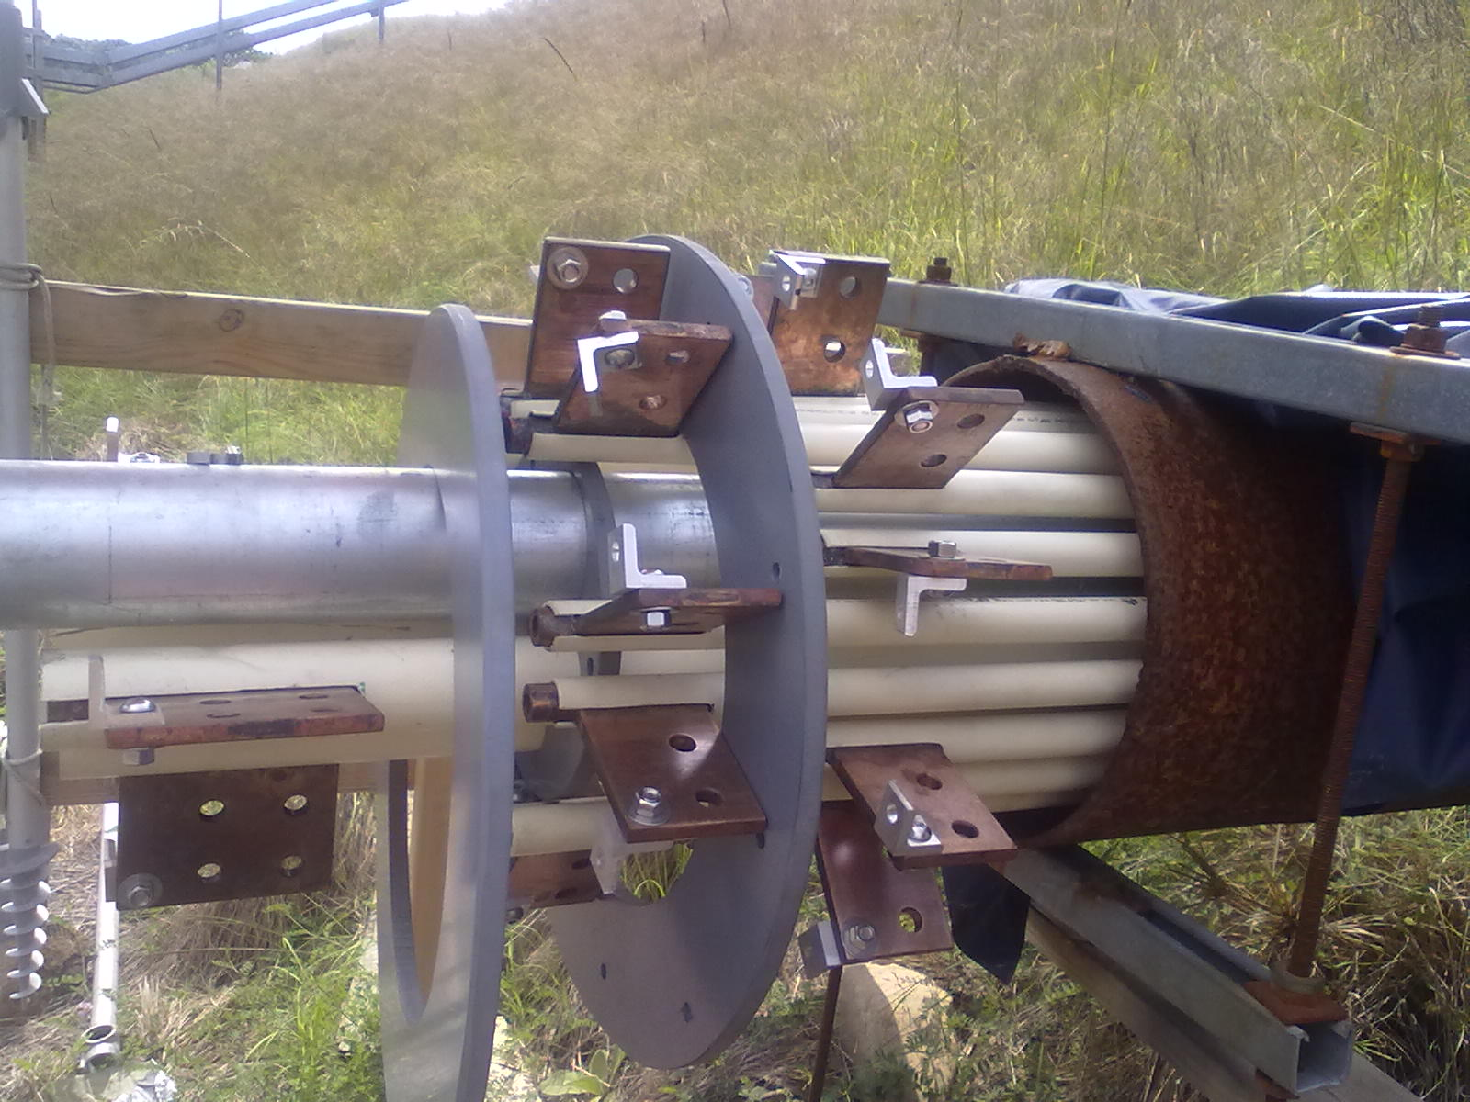
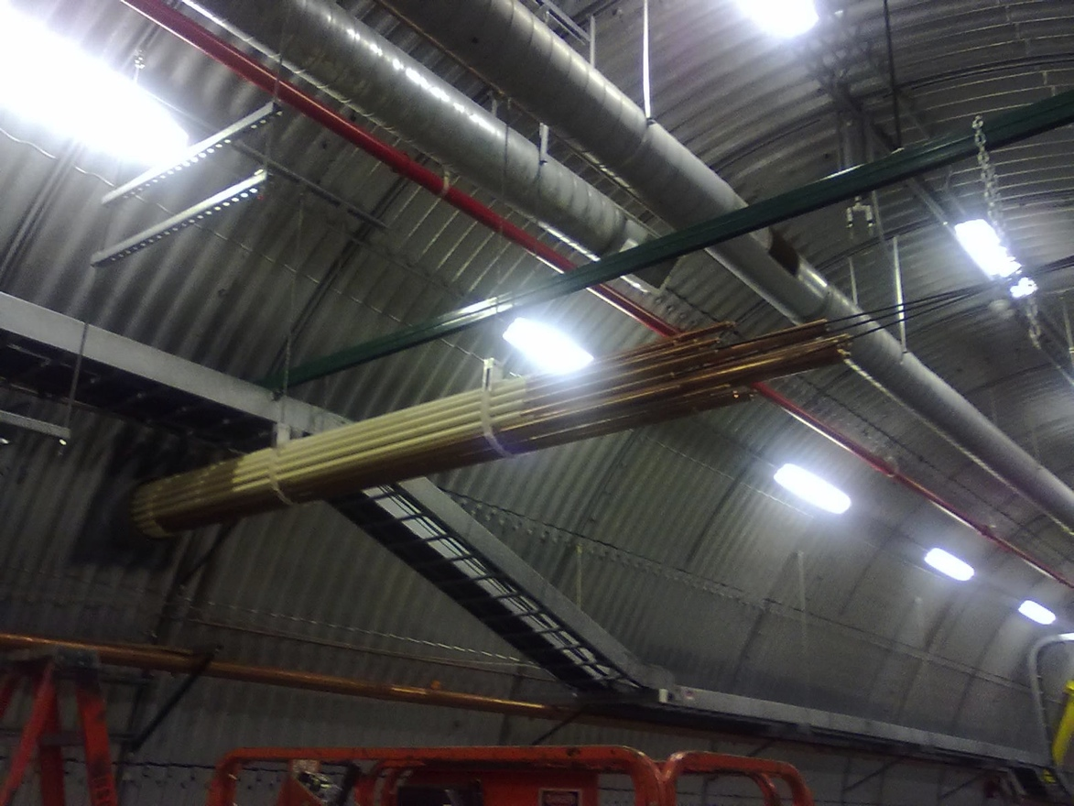
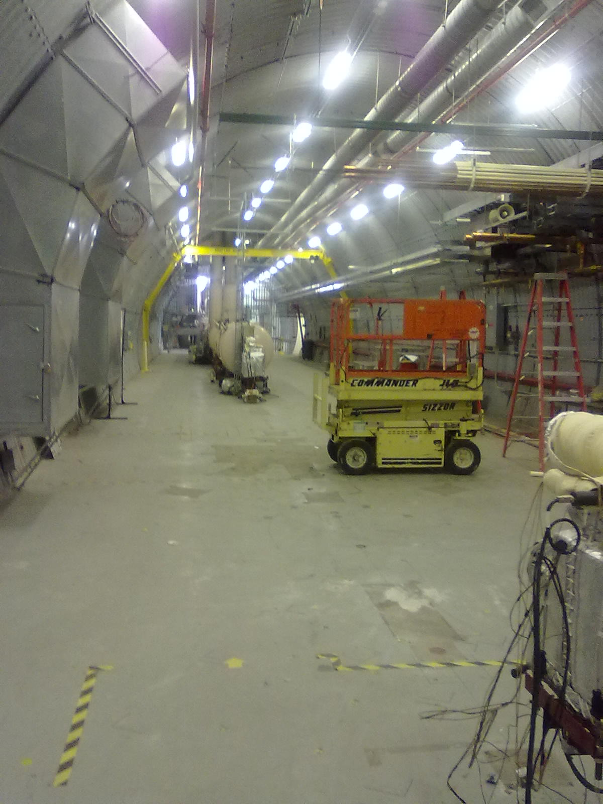
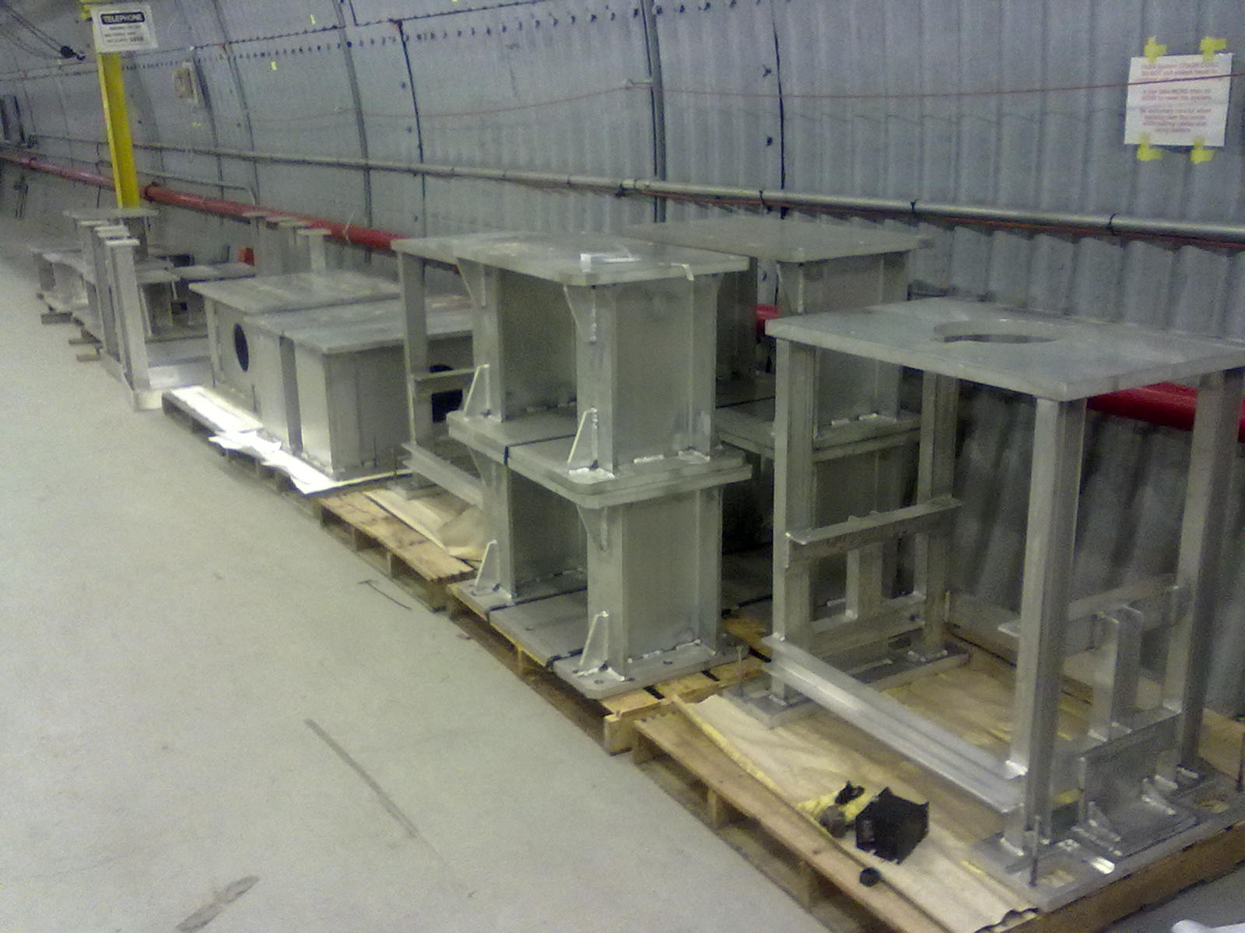
E-lens installation 2012

Slide 14
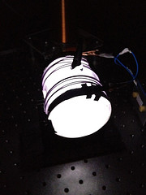
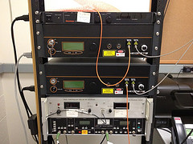
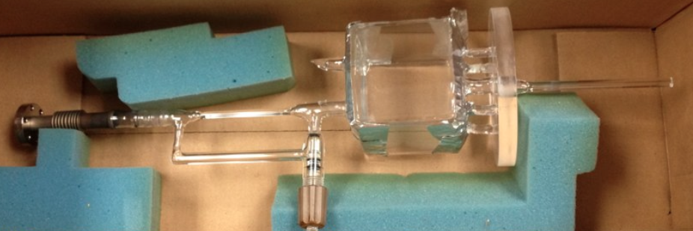
Development of Polarized ³He Ion Source for RHIC BNL-MIT Collaboration http://he3.xvm.mit.edu/
R. Milner, C. Epstein, MIT
Spec.: deliver ³He⁺⁺ at ≈ 3 x 10¹² atoms/sec with 70% polarization
Concept: polarize ³He gas in glass cell using MEOP in fringe
field of ≈ 5 Tesla EBIS solenoid and feed into EBIS
MEOP technology under development at MIT
- two Keopsys 10 Watt lasers operational
- data acquisition system operational
- 20 liters of ³He gas ordered
- glass systems under construction
Goal: to test principle of source using
spare EBIS solenoid within the next year
Funded by DOE Office of Nuclear Physics
R&D Program for Next Generation Nuclear
Physics Accelerator Facilities
Notes:
The three photos from the top are:
- sealed cell with 0.5 Torr pressure with RF discharge on
- rack with two laser systems and other electronics
- glass system for flowing polarized He3 we used in HERMES which shows cubic pumping cell with attached capillaries and stainless steel attachment to vacuum pump and He3 gas. The EBIS system will have many similarities.

Slide 15
Cu-Au store – new mode in 2012
10%/h
Cu and Au have different - intrabeam scattering growth rates (~Z⁴N_{b}/A²) r_{IBS,Au} ≈ 2x r_{IBS,Cu}
- cooling rates (~1/N_{b}) r_{SC,Au} ≈ 3x r_{SC,Cu}
beam loss rates
25 mm.mrad
Stores start with large ε, beams undergo instability at transition
Can tolerate with stochastic cooling
Increase bunch intensity until loss at transition (previously: until ε increase)
Larger ε before transition?
transverse emittances
120x10²⁶cm⁻²s⁻¹
luminosities
Notes:
Fillno 16992 06/15/12, last night

Slide 16
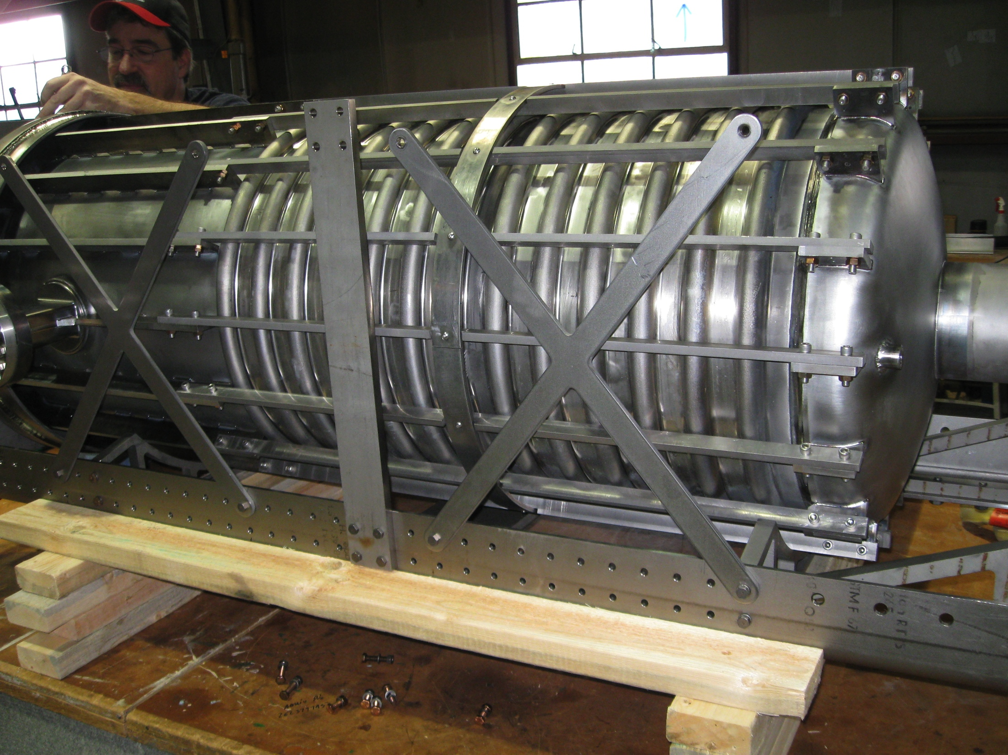
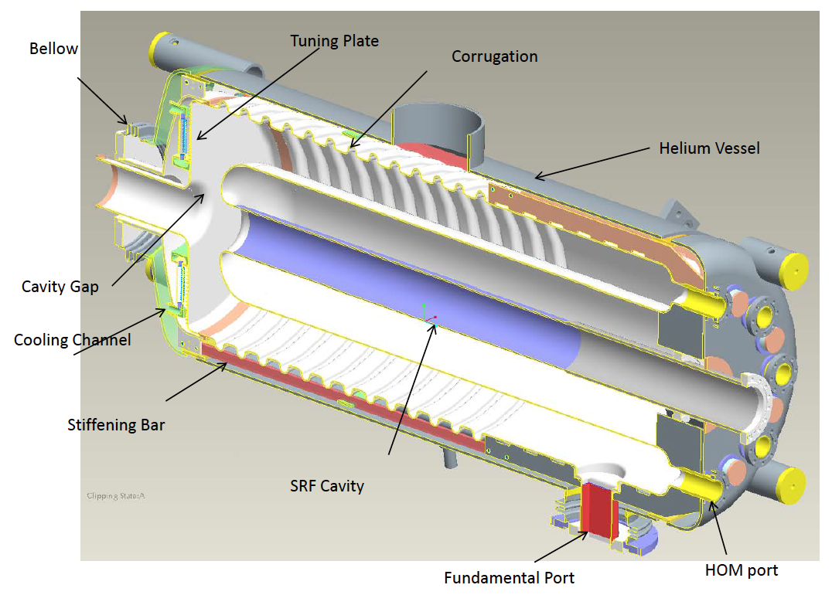
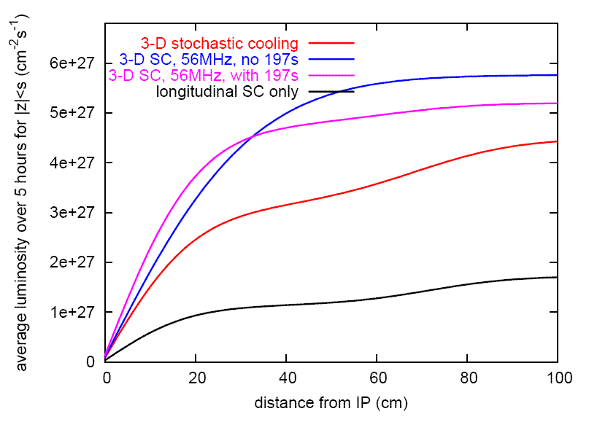
56 MHz SRF for heavy ions – under construction (I. Ben-Zvi et al.)
Longitudinal profile at end of store
even with cooling ions migrate into neighboring buckets
can be reduced with increased longitudinal focusing
Commissioning planned for 2014
40ns
40 ns
Average luminosity vs. vertex size
+ 56 MHz SRF
L +30-50%
full 3D cooling
λ/4 Ni resonator
common to both beams
beam driven
56 MHz, 2 MV
demonstrated 2011 long. + ver. cooling
30 cm
Calculations Calculation by M. Blaskiewicz
Notes:
Longitudinal profile: 11676 Blue

Slide 17
RHIC luminosity and polarization goals
parameter |  | unit | achieved |  | goals
Au-Au operation |  |  | 2011 |  | ≥ 2014 3D stochastic cooling + 56 MHz SRF
energy | GeV/nucleon |  | 100 |  | 100
no colliding bunches | … |  | 111 |  | 111
bunch intensity | 10⁹ |  | 1.3 |  | ≥ 1.1
avg. luminosity | 10²⁶ cm⁻²s⁻¹ |  | 30 |  | 40
p↑-p↑ operation |  |  | 2012 |  | ≥ 2013 source |  | ≥ 2014 source + e-lenses
energy | GeV |  | 100 | 255 | 100 | 250 | 100 | 250
no colliding bunches | … |  | – 107 – |  | – 107 – |  | – 107 –
bunch intensity | 10¹¹ |  | 1.6 | 1.7 | 1.6 | 2.0 | 1.8 | 2.5
avg. luminosity | 10³⁰ cm⁻²s⁻¹ |  | 33 | 105 | 30 | 150 | 60 | 300
avg. polarization* | % |  | 59 | 52 | – 60 – |  | – 65 –
*Intensity and time-averaged polarization as measured by the H-jet. Luminosity-averaged polarizations, relevant in single-spin colliding beam experiments, are higher. For example, for intensity-averaged P = 48% and R_{x} = R_{y} = 0.2 (250 GeV, 2011), the luminosity-averaged polarization is P = 52%.

Slide 18
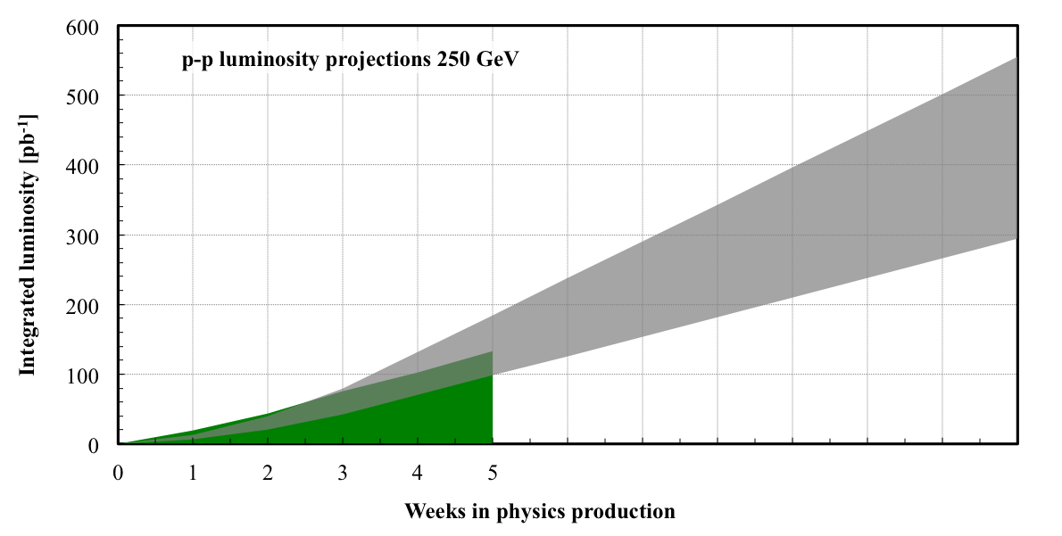
255 GeV polarized proton projection for Run-13
PHENIX goal: 750 pb⁻¹
N_{b} = 2×10¹¹
Run-12
6
7
8
9
10
11
12
Polarization (as measured by H-jet): 50-60%
New: lattice for e-lens (new qtrim & phase shifter ps), partial or full source upgrade, e-lens (commissioning in Run-13), abort gaps aligned in IP4/IP10, spin patterns always have 2 bunches with same orientation (?)

Slide 19
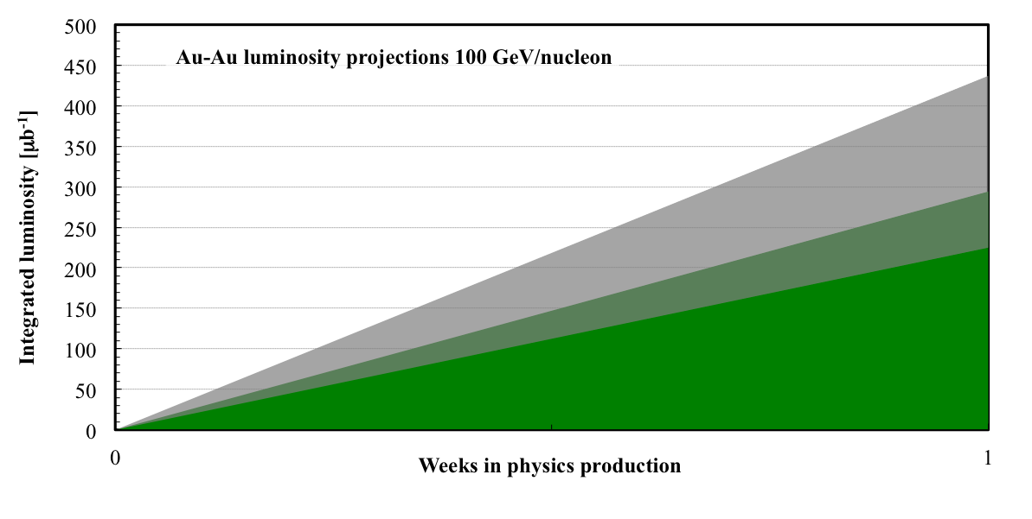
100 GeV/nucleon Au-Au projection for Run-13
Run-10
35% of max L/week = 450 μb⁻¹

Slide 20
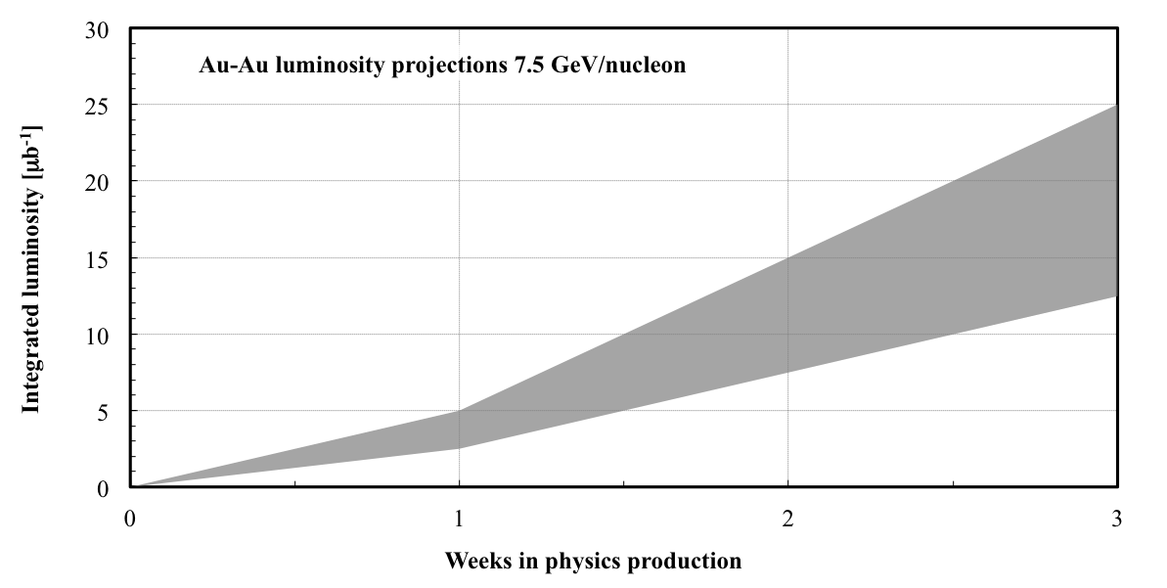
7.5 GeV/nucleon Au-Au projection for Run-13
Scaled from operation at 5.75 GeV/nucleon (Run-10) and 9.8 GeV/nucleon (Run-11)

Slide 21
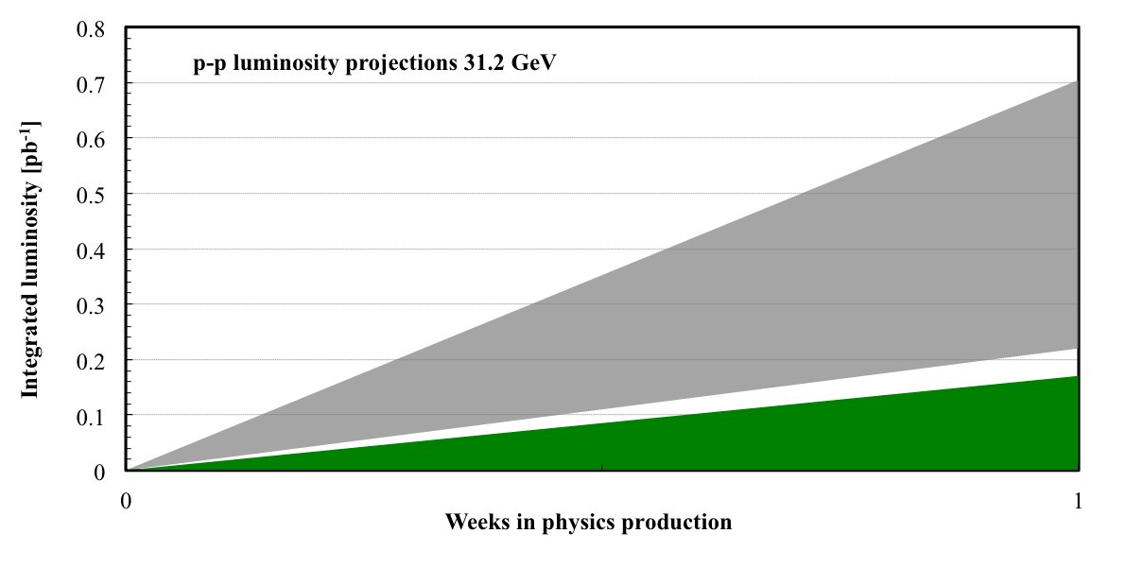
31.2 GeV p-p projection for Run-13
Scaled from operation in Run-6: N_{b} = 0.9 to 1.8×10¹¹

Slide 22
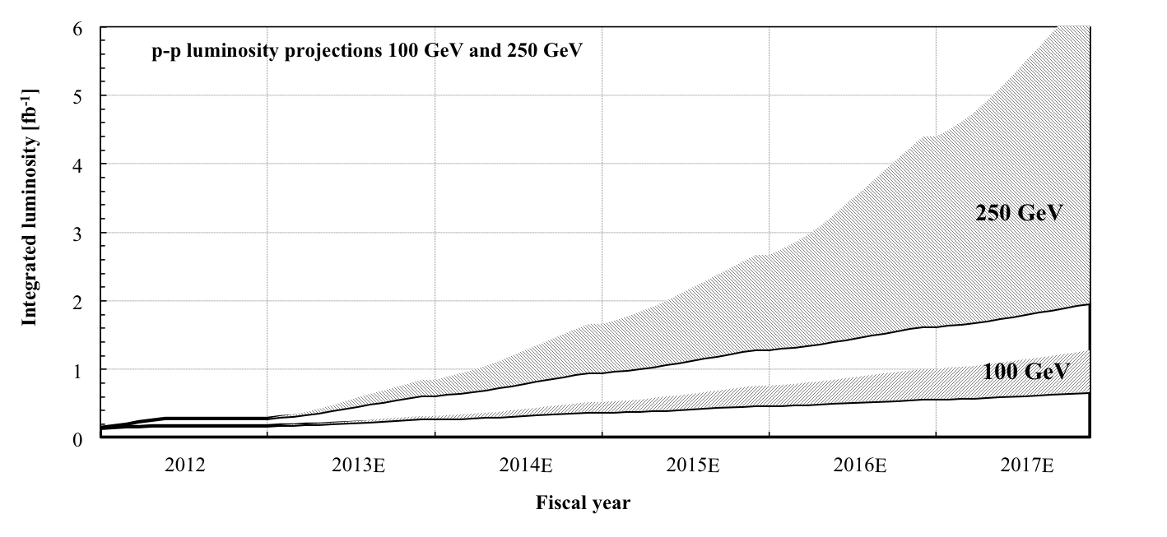
5-year projections for polarized protons
incremental changes (ε_{x,y}, ε_{s}, δβ/β, …)
56 MHz SRF
polarized source upgrade electron lenses (+ new lattice)
[Note1:assume 12 weeks of physics, 6 weeks of ramp-up, start at ½ of max]

Slide 23
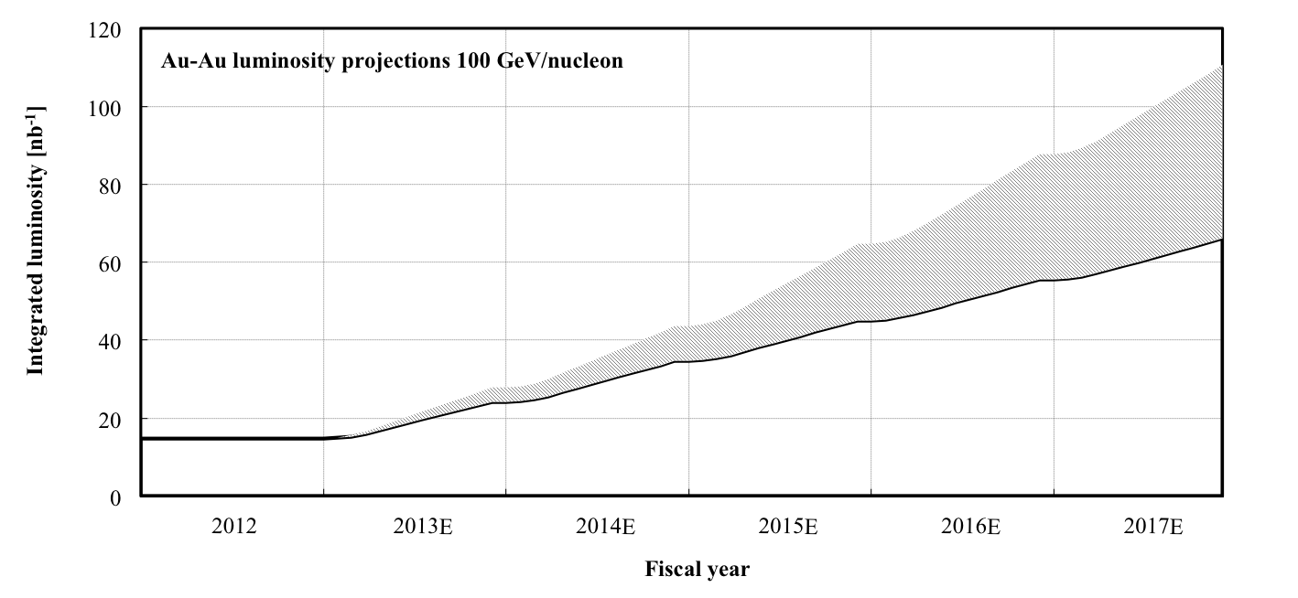
5-year projections projection for Au-Au
incremental changes (bunch intensity, lattice)
56 MHz SRF (longitudinal sc kicker)
incremental changes (EBIS, long. sc pickup)
[Note: assume 12 weeks of physics, 3 weeks of ramp-up, start at ½ of max]

Slide 24
Summary
Spectacular Run-12 new modes, record luminosity, polarization, setup time, time-in-store, EBIS, 3D stochastic cooling
Run-13 long 255 GeV pp run with ambitious PHENIX goals other possible modes: 100 or 7.5 GeV/nucleon AuAu, 31.2 GeV pp, pp2pp
Main upgrades for Run-13:
OPPIS (main improvement for pp) Electron lenses (commissioning)
Run-14:
long 100 GeV/nucleon Au-Au run (and other modes) 56 MHz SRF commissioning

Slide 25
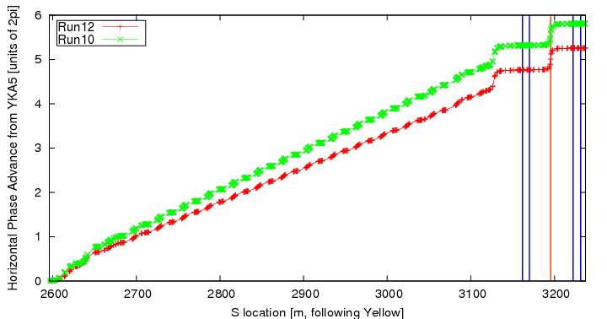
Yellow Abort Kicker Prefires in Au runs
run | date | fill | pattern | I_{beam} | _{H} mm | _{V} mm | comment
Run 7 | 05/06/07 | 8706 | 103x103 | 93e9 | 14 p | 20 p | Standard lattice, no MPC
Run 10 | 02/10/10 | 11679 | 111x111 | 72e9 | 15 p | 10 p | IBS supp. Lattice, MPC, minor damage (5 readouts)
Run 12 | 05/08/12 | 16890 | 111x111 | 90e9 | 10 p | 18 p | Standard lattice, MPC damaged (~300 readouts)
Only 1 arc between yellow abort and PHENIX
1 module fires anywhere in the bunch train when a prefire occurs, other modules fire within a msec
Total of 5 yellow prefires in run 12, damage happened in 1st prefire, variety of beam parameters
Same lattice was used in run 7 and run 12 but no comparison possible (no MPC in PHENIX), run 10 used IBS suppression lattice with significant difference in phase advance (~200º)
No conclusive difference between the May 8th 2012 prefire and others before and after in terms of beam parameters
Prefire loss patterns very similar in run 7 and 12
Distribution of damage indicates 'spray' from an upstream impact point (triplet?)
We are currently investigating chance for a 'mask' type collimator installation:
Has to be downstream of abort, upstream of sec 8 triplet (Q3)
Only warm spaces can be considered
Very sensitive to lattice choice/phase advance
IP
triplets

