Slide 1
RHIC Science Outlook for Coming Years
Steve Vigdor
RHIC Retreat
July 25, 2012
Launching the RHIC-II Era
Short- and Long-Term RHIC Science Goals
Preparation of RHIC White Papers

Slide 2
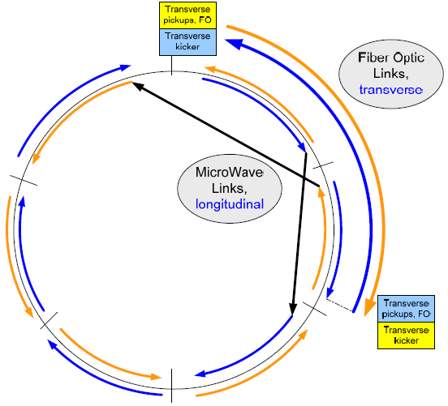
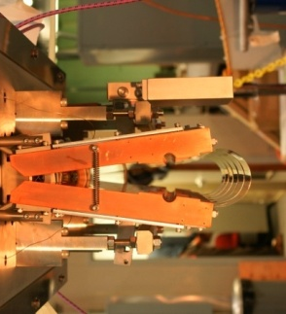
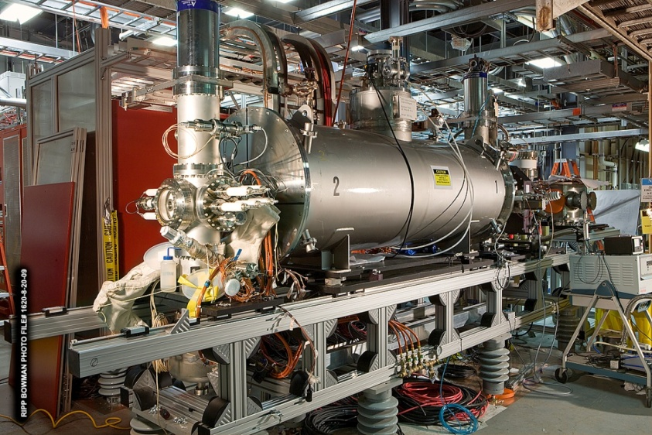
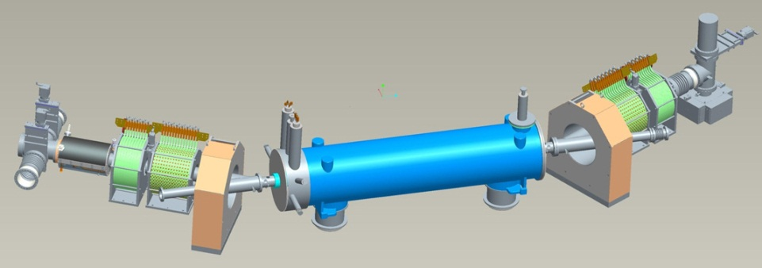
RHIC-II Era is Here, Done Very Cost-Effectively !
Y h+v pickups
RHIC breakthrough in bunched-beam stochastic cooling facilitates ~x10 improvement in heavy-ion collision rates, 5 years earlier and at ~1/7 the cost envisioned in 2007 NP Long Range Plan, saving ~$80M
All (6 planes of pickups & kickers) of the new system commissioned during 2010-12, new 56 MHz SRF cavity anticipated for 2014 run.
B h+v kickers
Horiz. Kicker (open)
Measure deviations from central moment-um in pickups, correct with kickers
Y h+v kickers
B h+v pickups
Electron lenses to be installed for 2013 run to improve polarized pp luminosity by factor ~2
EBIS
Electron lens
New Electron Beam Ion Source (EBIS, 2012) expands range of ions available (e.g., U) and enhances cost-effectiveness of operations
Notes:
2

Slide 3
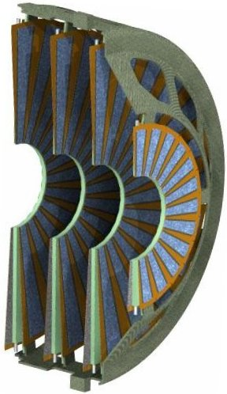
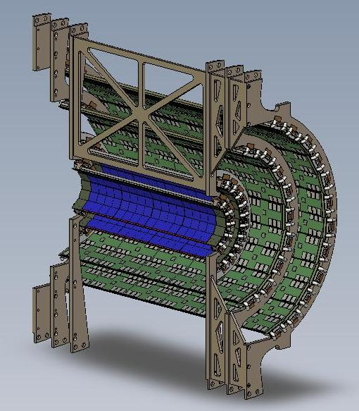
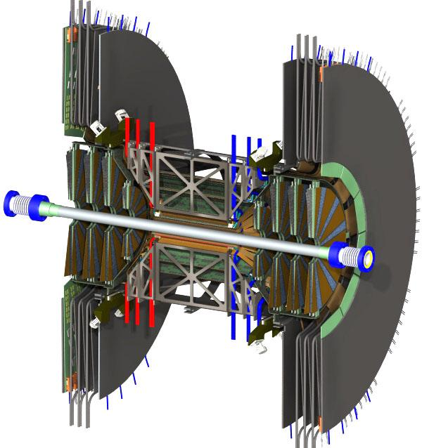
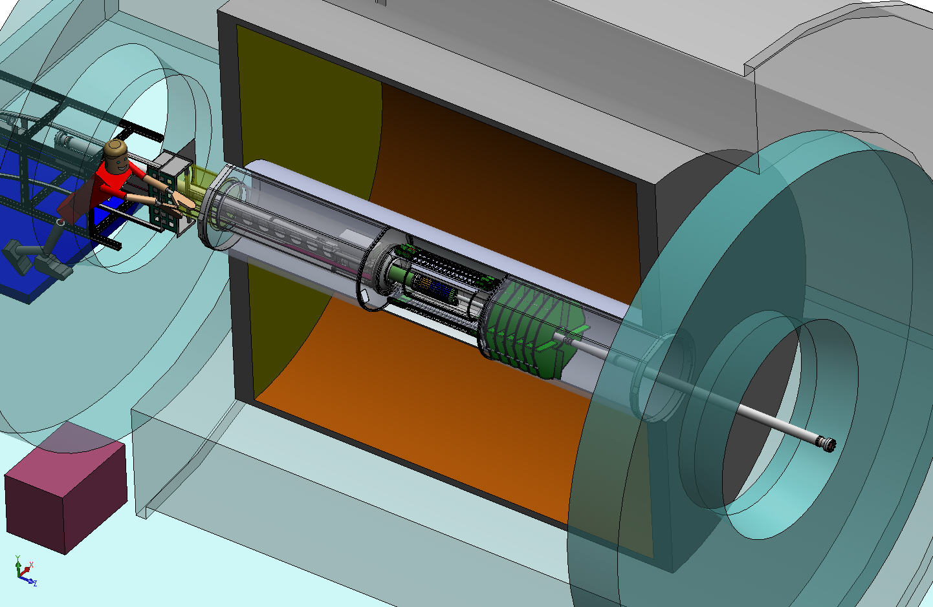
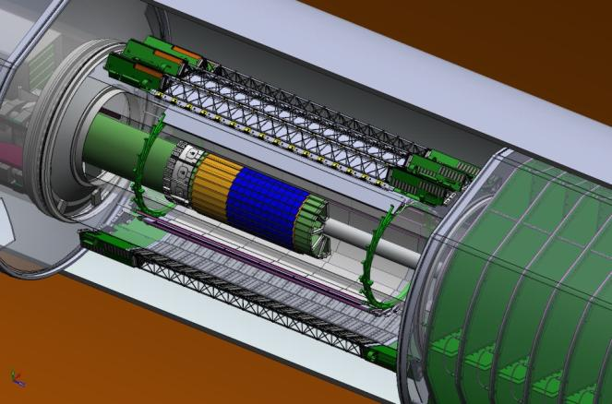
A Suite of Ongoing RHIC Detector Upgrades
PHENIX VTX & FVTX upgrades greatly improve vertex resolution, heavy flavor ID
μ trigger upgrade installed in FY10-11 enhances W prod’n triggering for spin program.
FVTX
VTX
Install for Run 12
Install for Run 11
A_{L} for W±
Ready for Run 13
STAR Heavy Flavor Tracker receives CD-2/3 review in 2011. Will permit topological recon-struction of charmed hadrons.
STAR Forward GEM Tracker to be installed for Runs 12 and 13, will enhance forward tracking, W charge sign discrimination.
STAR Muon Telescope Detector (Run 14) to improve quarkonium
SSD
IST
PXL
FGT
HFT
Identify heavy flavor hadron directly
Precision measurement HF hadron energy loss and collectivity
Partially ready for Run 14
Notes:
3

Slide 4
Run 12 PART Metric Performance
1) Cumulatively for Run 12 we have delivered 129% of the “expected delivered hours.” The main reasons for this overachievement are that the lower than expected power costs allowed us to extend the run from the originally planned 20 to 23 cryo-weeks, and the machine reliability reached an all-time high of 85.4% (86.1% for Q3 alone).
2) Reported pp performance metrics are calculated by dividing the total sampled luminosity for each experiment, summed over the 200 and 500 GeV portions of the run, by the similarly summed integrated luminosity goals. STAR achieved 189% of its goal and PHENIX 117% of its goal. These amounts were achieved actually in less running time than we had originally planned, because luminosity performance (especially for 500 GeV) strongly exceeded even maximum projections. PHENIX did not quite as well as STAR because PHENIX requires tighter vertex cuts in its triggers, and because STAR made very substantial improvements in detector up-time. An additional factor is that the pp runs came first, and PHENIX spent a part of its time commissioning the FVTX.
3) Because Cu+Au and U+U luminosities are substantially different, the reported heavy-ion run performance simply averages the ratios of sampled-to-projected luminosities achieved separately for the two colliding beam species. With this metric, STAR achieved 163% of its goal and PHENIX 137% of its goal. Each experiment also exceeded its goal for the U+U and Cu+Au runs independently.

Slide 5
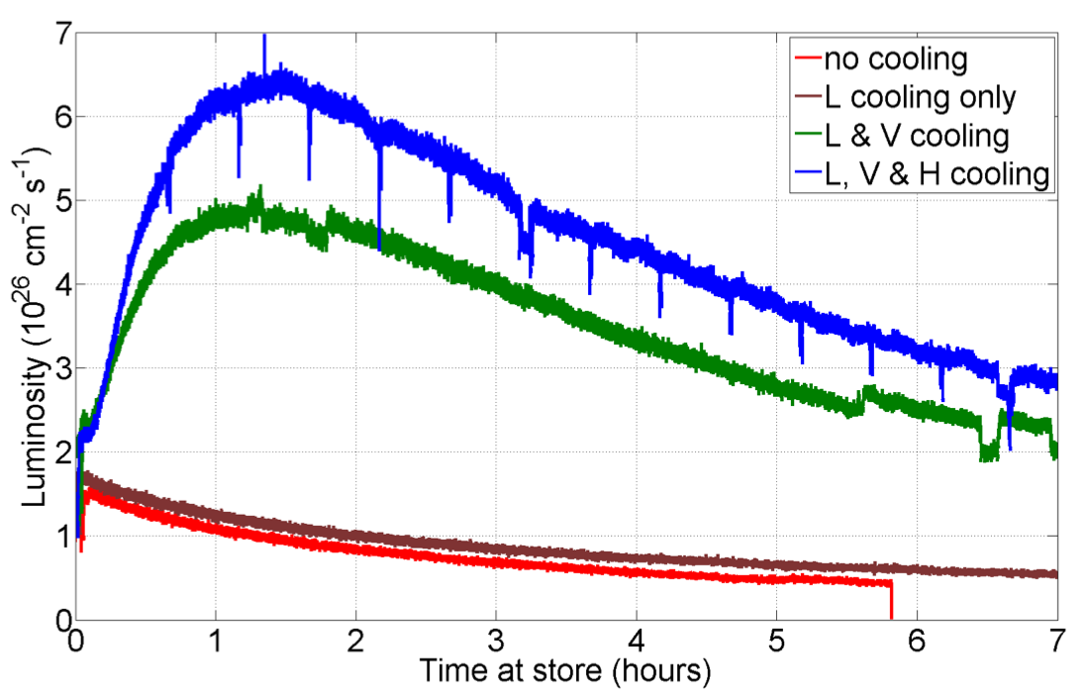
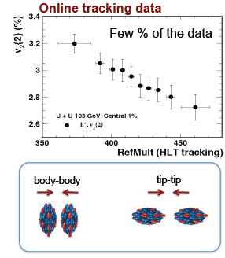
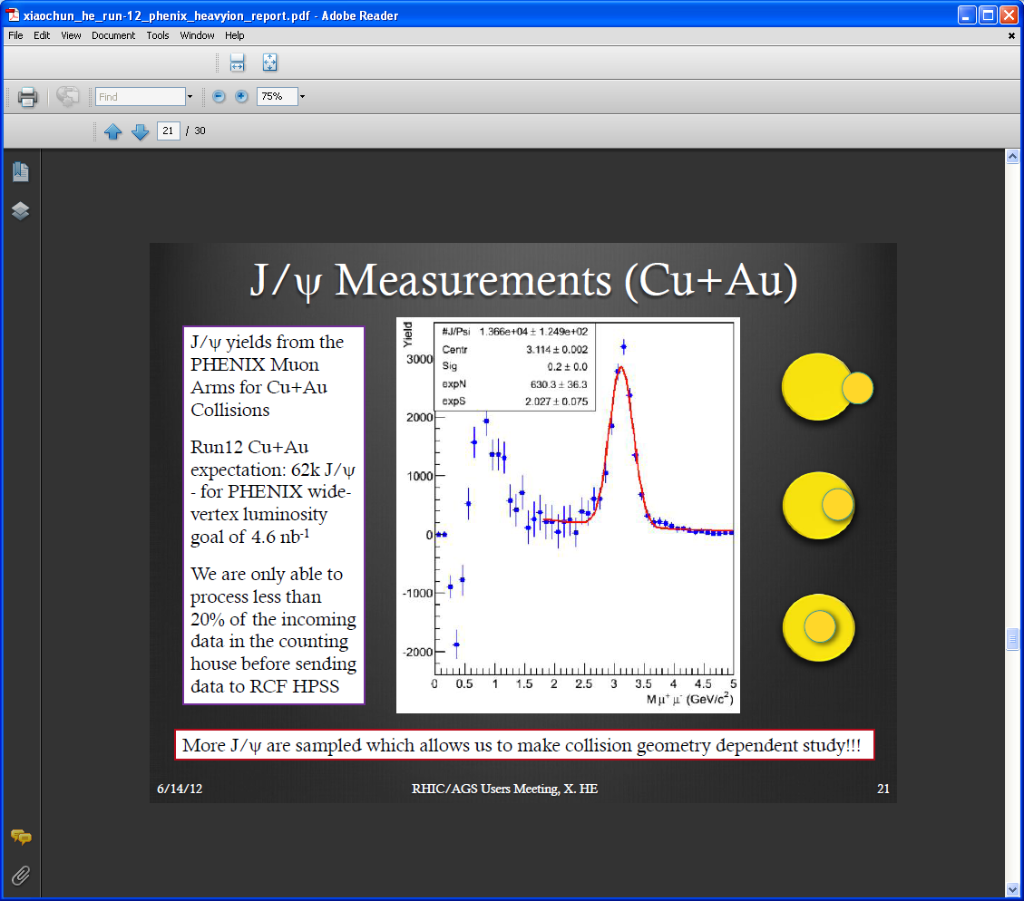

Just Completed Facility Upgrades Enable “Next Steps”
Stochastic cooling dramatically increases rates for rare events
2012 RHIC U-U run
STAR online U+U results, Run 12
Yield
Au
Cu
Fast online PHENIX J/ψ for Cu+Au ⇒ enough yield to study vs. collision geometry
Dimuon Mass (GeV/c²)
EBIS provides U beams to exploit deformation for initial geom. selection, e.g., to test signal/background for event EDM (sphaleron) correlations
EBIS simplifies asymmetric (e.g., Cu+Au) HI collisions for extra geom. control, e.g., to unravel dependences on energy density & path length

Slide 6
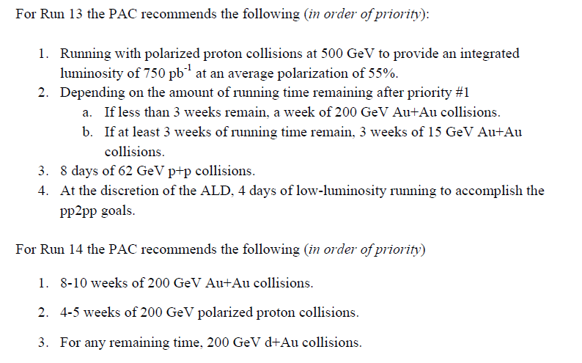
PAC Recommendations for Runs 13 & 14
Asked PAC for advice, priorities for 20-cryoweek Runs 13 & 14, in light of anticipated upgrade schedules and NP performance milestones:
With full FGT, aims at W production milestone
Au+Au to commission HFT prototype, ~15 GeV to fill in missing point on beam energy scan – is there √s nearby where both PHENIX and STAR can run?
With 56 MHz SRF + full HFT
Baseline data with new systems
For commissioning MPC-EX, if available

Slide 7
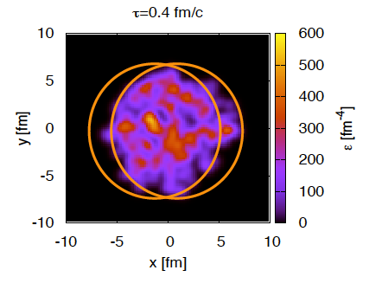
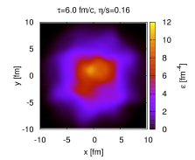
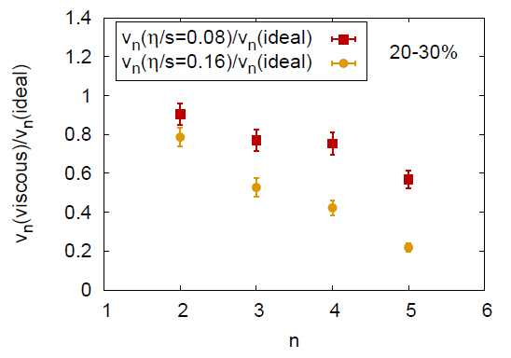
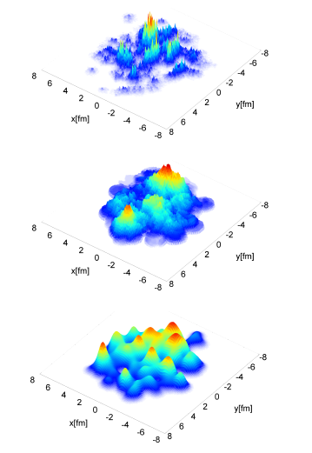
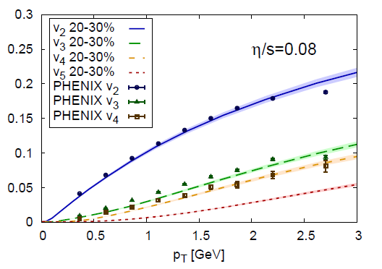
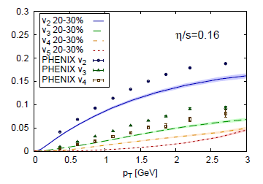
New Science Results from RHIC: How Perfect is the Liquid QGP?
B. Schenke et al., 2011
Higher multipoles more rapidly damped
Schenke et al. 3+1-D viscous E-by-E hydro ⇒ shape of flow power spectrum very sensitive to value of η/s
Impact parameter dependent gluon saturation
MC KLN – N pos’ns only
B. Schenke et al., arXiv:1202.6646
MC Glauber – N pos’ns only
Comparison to PHENIX data ⇒ η/s very near quantum limit
New BNL theory calcs. evaluate impact of different initial geometry fluctuations on flow power spectrum

Slide 8
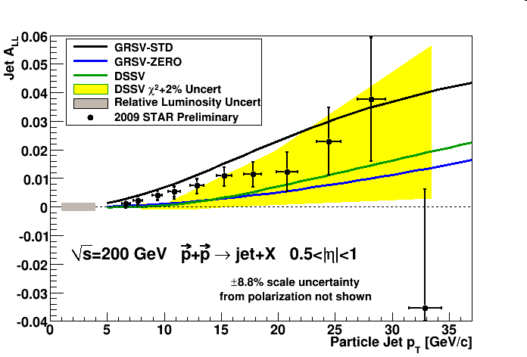
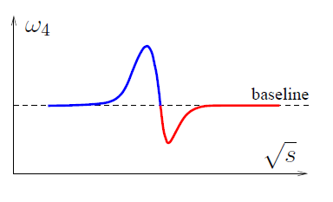
New Science Results from RHIC: Searching for the QCD Critical Point and Missing Proton Spin
STAR search for critical point fluctuations ⇒ deviations from smooth behavior in higher moments of E-by-E distributions of conserved quantities, near √ s_{NN} ~ 20 GeV.
Theory ⇒ expect bipolar excursions near critical point: is it missed near 15 GeV or broad at lower energies?
Latest RHIC spin results reveal clearly non-zero gluon polarization. Extending to lower x via 500 GeV and di-jet asyms.
Net-proton moments
Forward rapidity
M. Stephanov, 1104.1627

Slide 9
10 Basic Questions Going Into the RHIC Era
RHIC answers to date:
Do we reach the QGP phase?
Is it weakly coupled, with ~ideal gas behavior?
Can we demonstrate the transition from hadronic degrees of freedom?
Do partons lose energy rapidly in traversing QGP?
Does QGP color screening suppress quarkonium formation?
Can we find evidence of high-temp. excited QCD vacuum fluctuations (sphalerons), analogous to EW sphalerons as source of universe’s baryon asymmetry?
Is there a locus of 1st-order phase transitions and a Critical Point in the QCD phase diagram?
Do we see evidence of gluon density saturation in cold nuclear matter at very low Bjorken x?
Do gluon spin preferences account for a significant part of the missing proton spin?
Is there a significant flavor-dependence in sea quark polarizations?
Yes
No
Hints
Yes
Hints
Hints
Hints
Hints
Hints
Too little data to date
It is the responsibility of RHIC and LHC to design measurements to address the more quantitative 2nd-generation questions emerging from the definitive answers above, and to resolve the hints surrounding the others.

Slide 10
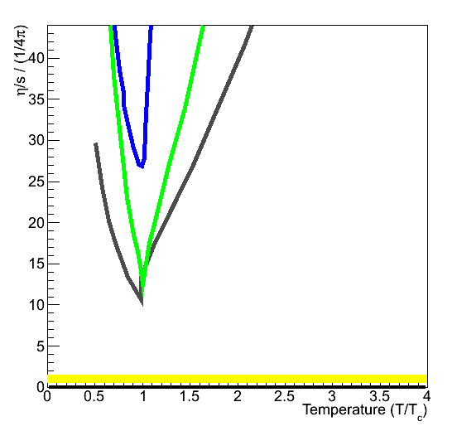
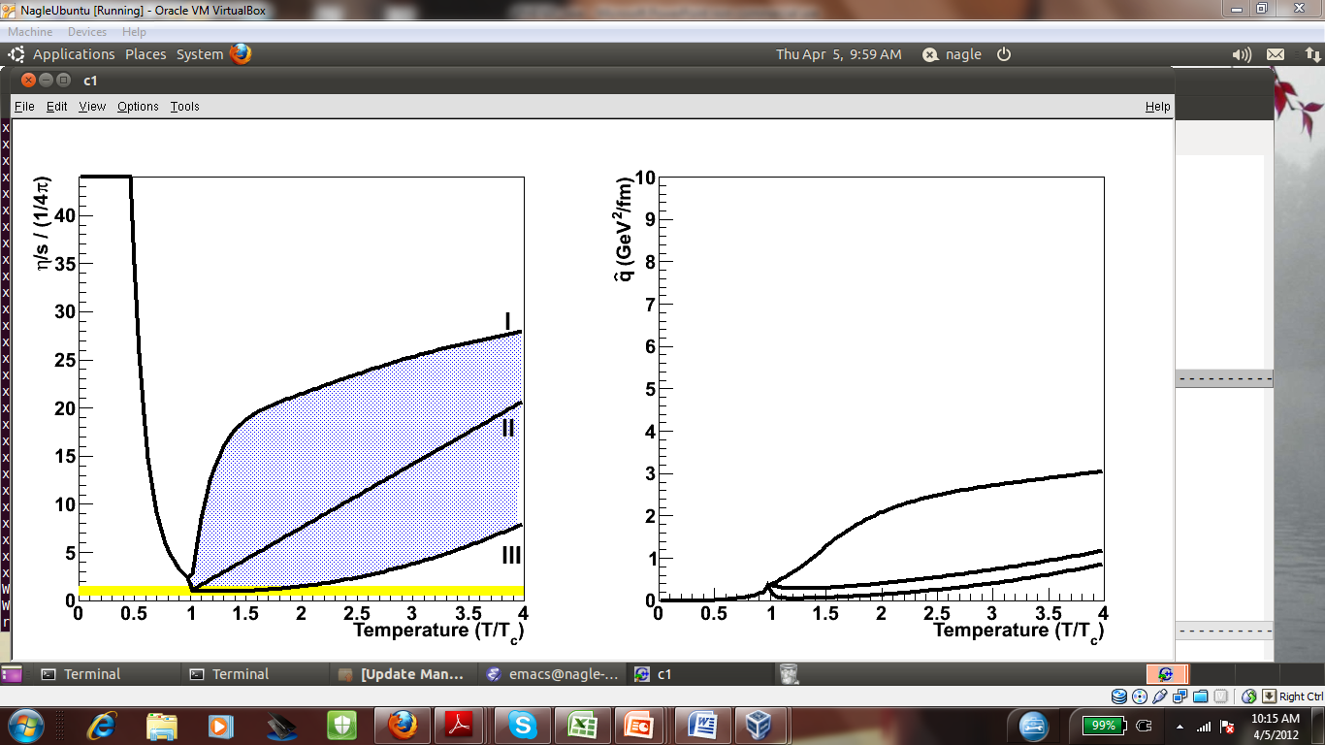
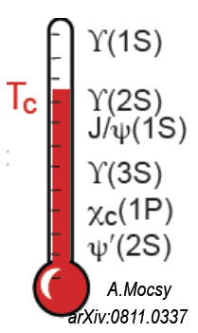
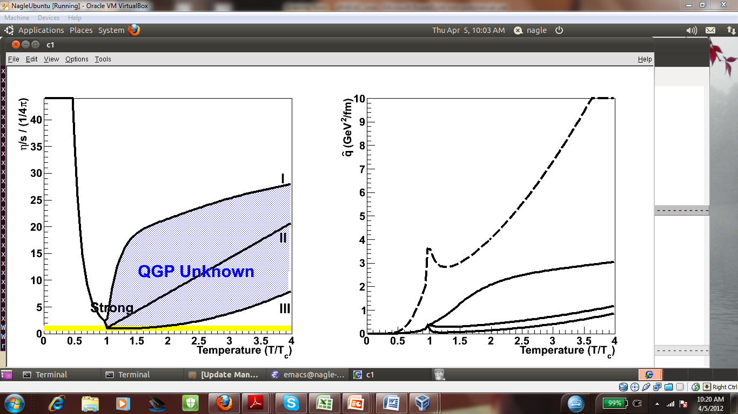
Mapping the Temperature-Dependence of QGP Properties Requires RHIC AND LHC
Is shear viscosity minimized near transition temp., as for other liquids?
Are T-dependences of parton E loss and viscosity parameters correlated as in weak coupling limit? How does perfect liquid emerge from asymptotic freedom?
How does color screening of quarkonium formation evolve with temperature?
QGP evolution spans range of T at given √ s. Need RHIC-to-LHC range of initial conditions to answer questions re T-dependence.
40
30
η/s / (1/4π)
20
Water (100 MPa)
Nitrogen (3.4 MPa)
Helium (0.1 MPa)
10
String Theory Bound
0
1
0
2
3
4
Temperature (T/T_{c})
“Small Shear Viscosity Implies Strong Jet Quenching”
A. Majumder, B. Muller, X.N. Wang, PRL (2007).

Slide 11
Which Facilities Are Needed To Address Open Questions?
Question | Facilities | Comments | Relevant Table 1 Q #’s
How perfect is “near-perfect” liquid? | RHIC & LHC | Flow power spectra, next 5 years | 1 + 2
How does strong coupling emerge from asymptotic freedom? | RHIC & LHC | Following 5 years @ RHIC; jets need sPHENIX upgrade | 2 + 4
Evidence for onset of deconfinement and/or critical point? | RHIC alone | Following 5 years, needs low-E electron cooling | 3 + 7
Sequential melting of quarkonia? | RHIC & LHC | LHC mass resolution a plus; RHIC det. upgrades help; √s-dependence important | 5
Are sphaleron hints in RHIC data real? | Mostly RHIC | Exploits U+U and μ_{B} ≠ 0 reach at RHIC | 6
Nature of initial density fluctuations? | RHIC, LHC & EIC | Benefits from asymmetric ion collisions at RHIC | 2 + 8
Saturated gluon densities? | RHIC, LHC & EIC | Want to see onset at RHIC; need EIC to quantify | 8
Where is missing proton spin? | RHIC & EIC | EIC will have dramatic impact | 9 + 10
RHIC and LHC are complementary. Both are needed to explore temperature- dependence of QGP properties. RHIC has unique reach to QGP onset, unique ion species versatility and unique polarized capability, until EIC is realized.
Addressing these questions requires an ~10-year program of A+A (various ion species), p+p and p/d + A runs at various RHIC energies.

Slide 12
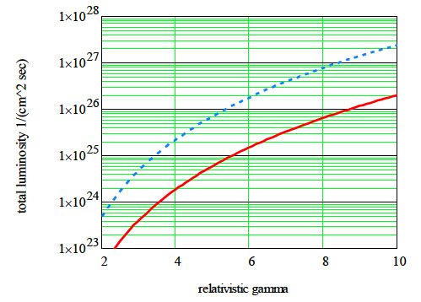
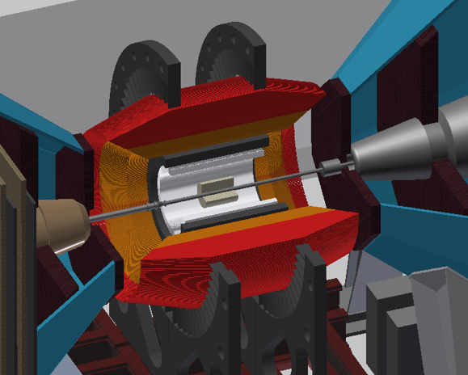
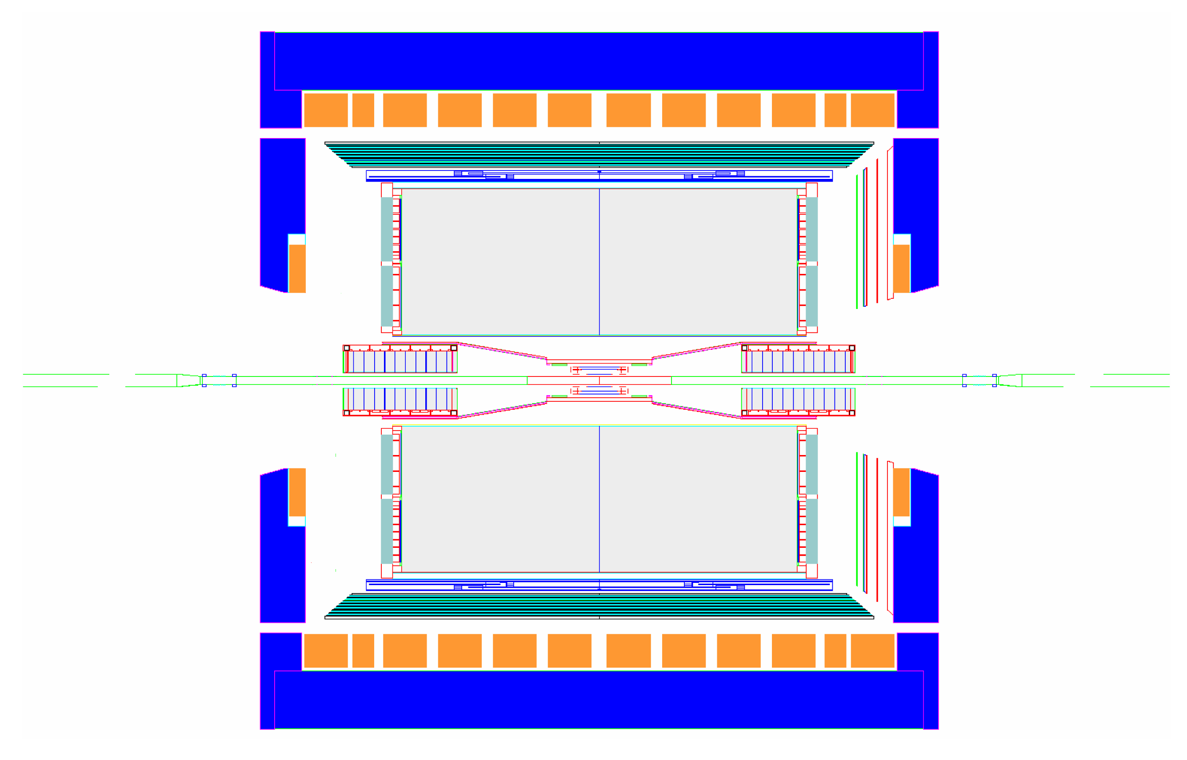
Contemplated Future Upgrades
RHIC with cooling and long bunches (ΔQsc = 0.05, σs = 3m)
Low-E electron cooling for further pursuit of onset of deconfinement/CP – e.g., via use of high-brightness SRF electron gun (test with CeC setup)
sPHENIX solenoid, EMCAL + HCAL for jet physics @ RHIC + enhanced acceptance for quarkonium, etc. studies
STAR forward upgrade for p/d+A and transverse spin (e.g., Drell-Yan) physics
Nearer-term upgrades: PHENIX MPC-EX for forward γ, STAR TPC inner pad rows for improved tracking
RHIC w/o cooling
Other machine possibilities: pol’d ³He, coherent e-cooling for L_{pp} – to be evaluated based on science case and timeliness
BNL review Sept.-Oct. 2012
proton
nucleus
~ 6 GEM disks
Tracking: 2.5 < η < 4
FMS
HCal
SPACAL
Threshold Cerenkov π^{+/-} ID
Preshower 1/2” Pb radiator Shower “max”

Slide 13
Drafting a White Paper for Tribble-II Subpanel
The Case for Continuing RHIC Operations
Reader comments coming in from RHIC user and support community – paper will be available before Sept. 7-9 Tribble Panel meetings

Slide 14
Other White Papers
Longer community-driven RHI white paper should be available for DNP Town Meetings in late October. Writing committee chaired by Steffen Bass includes two reps. from each RHIC and LHC exp’t + several theorists.
EIC Science White Paper now in 2nd draft form, being edited by Steering Committee for August release to wider community. Outline of ~120-page report given on next page. ~10-page Executive Summary draft under current discussion – to be available for Tribble Panel September meetings.

Slide 15
Summary & Upcoming Events
Outstanding Run 12 launched RHIC-II era! Stochastic cooling and EBIS performed outstandingly.
Anticipate primary focus on 500 GeV pp for Run 13, full-energy Au+Au (and baseline p+p) for Run 14
High-impact science continues to emerge from RHIC, and to motivate 2nd decade measurement program exploiting RHIC’s versatility and new capabilities.
Upgrade plans for the latter half of the coming decade are crystallizing now. sPHENIX to be reviewed @BNL in Sept.-Oct.
RHIC and LHC HI are complementary facilities, both needed to resolve many of the outstanding open questions. Long-term health is probably strongly correlated for the two.
Critical events for RHIC’s future: (N. B. BNL safety performance must improve for entire lab to survive!!)
June 29: LHC HI Town Meeting (to inform Europe’s HEP strategy)
July-August: White Paper(s) on RHIC and overall RHI next-decade goals
July-August: Community feedback on EIC Science White Paper
Aug. 12-18: Quark Matter 2012, incl. Town Meeting on White Papers
Sept. 7-9: Initial Tribble-II Panel hearings/presentations
Oct. 24-27: DNP meeting with Town Meetings for input to Tribble-II
December: Likely report of preliminary Tribble recommendations to NSAC

Slide 16
Backup Slides

Slide 17
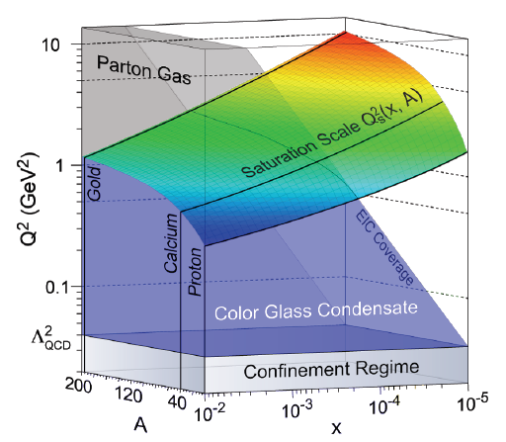
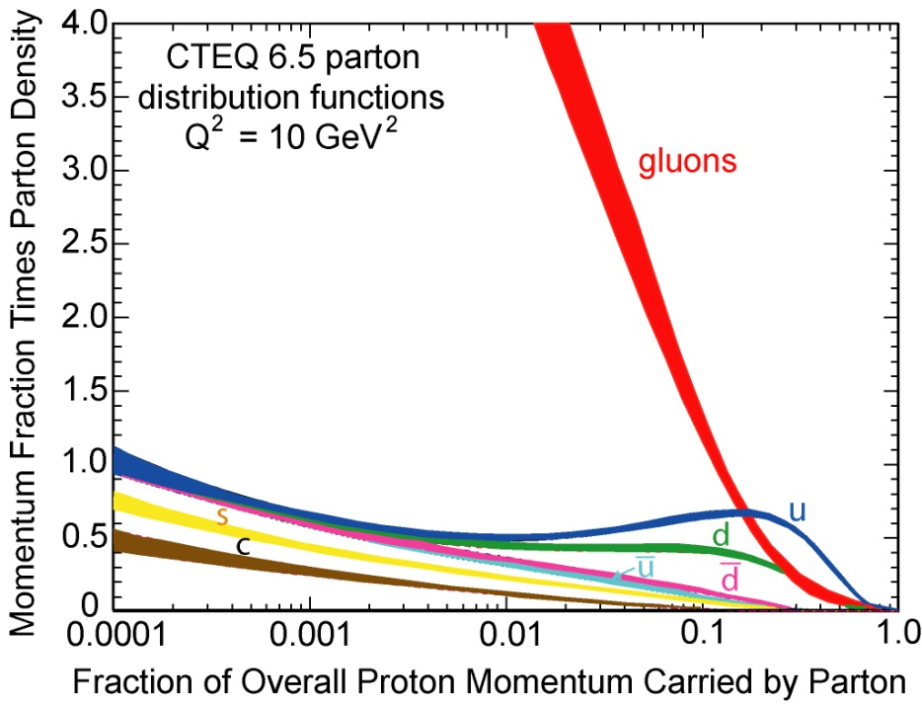
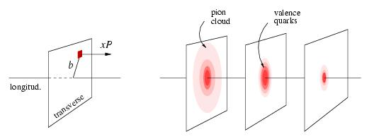
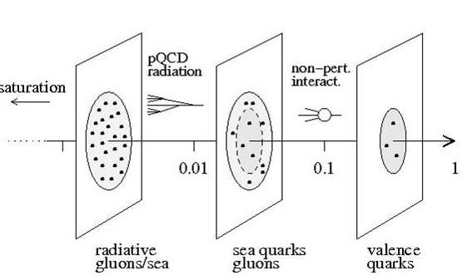
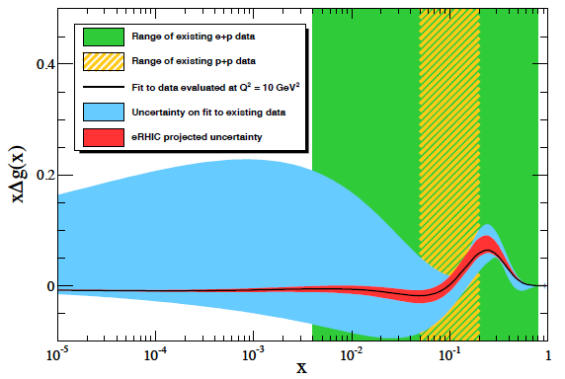
Electron-Ion Collider (EIC) Extends JLab and RHIC Science
EIC = high-resolution femtoscope for cold gluon-dominated matter:
Probe the momentum-dependence of onset of saturation in nuclei (initial state @ RHIC & LHC)
nuclear “oomph”
Gluon occupancy >> 1
Map the gluon densities and multidimensional spatial & spin distributions of partons in the gluon-dominated regime, explore parton orbital angular momentum
Test effective theory approaches to highly non-linear, high-density & strong-field limit of QCD
Proton tomography via exclusive reactions
x ~
x < 0.1
x ~ 0.3
x ~ 0.8
0.4
Existing e+p range
Existing p+p range
Current best fit
Current fit uncertainty
Uncertainty w/ EIC
Gluon momentum fraction × helicity distribution
0.2
Machine requirements: high √s (~100 GeV); high luminosity (~10³⁴ cm⁻²s⁻¹); polarized electron and nucleon beams; heavy-ion beams (to A~200); large variable energy range for F_{L}.
Search for missing spin among soft gluons
0
10⁻⁵
10⁻⁴
10⁻³
10⁻²
10⁻¹
1
Inferred momentum fraction of sampled gluons

Slide 18
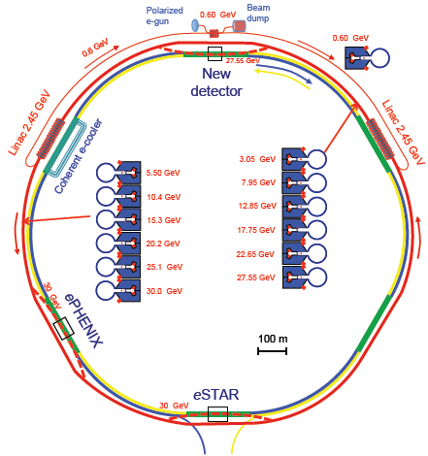
RHIC’s 3rd Decade: Reinvention as eRHIC ⇒ Path Forward for Cold QCD Matter
Why eRHIC is a cost-effective approach:
Reuses RHIC tunnel & detector halls ⇒ minimal civil construction
Reuses significant fractions of existing STAR & PHENIX detectors
  Exploits existing HI beams for precocious access to very high gluon density regime
  Polarized p beam and HI beam capabilities already exist – less costly to add e⁻ than hadron accelerator
  Provides straightforward upgrade path by adding SRF linac cavities
eRHIC @ BNL: add e⁻ Energy Recovery Linac in RHIC tunnel ⇒ L_{ep} ~ 10³⁴ cm⁻²s⁻¹
  Takes advantage of RHIC needs and other accelerator R&D @ BNL:
    E.g., coherent electron cooling can also enhance RHIC pp lumi.
    E.g., FFAG developments for muon collider considered for significant cost reductions
Design allows easy staging (start w/ 5-10 GeV, upgrade to ~20 GeV e⁻). Underwent successful technical design review in 2011. Bottom-up cost eval. + value engineering in progress.

Slide 19
What Would be Lost if RHIC Were Terminated?
Opportunity to map QCD matter properties vs. temp., especially across QGP transition, and discover the possible Critical Point.
Unique polarized pp access to nucleon spin structure.
U.S. leadership in a vibrant NP subfield it pioneered.
A major fraction of the productivity for U.S. NP over the better part of a decade – is this survivable?
The last operating U.S. collider, hence a critical attractor for talented accelerator scientists and cutting-edge R&D.
Quite possibly the only cost-realizable path to a future EIC.
Home research base for >1000 domestic + foreign users.
Strong foreign (esp. RIKEN) investment in U.S. facility.
~750 (direct + indirect) FTE’s @ BNL.
Many associated efforts will suffer collateral damage:
  Lattice QCD thermodynamics leadership
  Medical radioisotope production @ BNL
  NASA Space Radiation studies @ BNL
  Application offshoots in accelerator physics, esp. in next-generation hadron radiotherapy machine design
  Probably a sizable chunk of DOE ONP funding will be siphoned off to other agencies or program offices.

Slide 20
PAC Input on Future Upgrades
Low-energy electron cooling: The PAC recognizes that preliminary BES-I results point to the potential importance of this project on a several-year timescale. We look forward to the finalization of these results over the
coming year, and to considering the question again once these results have been discussed fully in the community.
sPHENIX: The PAC recognizes the necessity of pursuing large aperture and high rate for PHENIX to remain competitive on a world scale in the coming years. Simulation work…demonstrates sufficient tracking, good EMC performance (only excellent with the addition of a pre-shower detector), and robust jet triggering and identification for lower momentum jets than currently analyzed at LHC…only by the combination of precision measurements of jets at the widely different √sNN of LHC and RHIC could the temperature dependence of ˆ q be explored in the region where strongly-coupled behavior may cause a non-trivial dependence of ˆ q on temperature.
STAR upgrades: The idea of replacing the TPC inner sectors with a more fully instrumented device…would essentially double the path length of gas available for dE/dx measurements…While significant progress has been made on [the forward coverage] front, the PAC recognizes that STAR’s upgrade plans are not as fully developed as those of PHENIX, and recommends further effort towards bringing these ideas into a form suitable for a proposal.

