Slide 1
Run 12 Heavy Ions: Lessons Learned
Y. Luo, C-AD
( July 25-27, 2012)

Slide 2
Content
Overview of 2012 Ion Runs
Lessons Learned:
- Physics
- Operations
- Scheduling
Summary

Slide 3
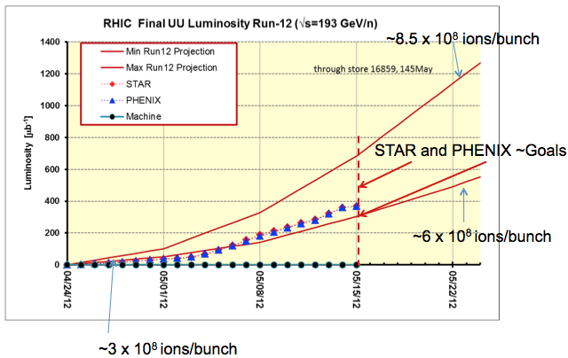
Overview of 2012 U-U Run
U-U run is a miracle. With
powerful EBIS,
amazing 3-D Stochastic cooling,
improved off-momentum aperture,
and mostly important high machine availability ( 72% store time ),
we were able to reach luminosity goal JUST 30 mins. before end of the run.

Slide 4
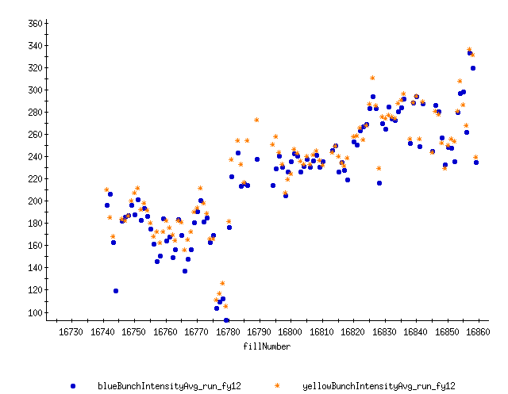
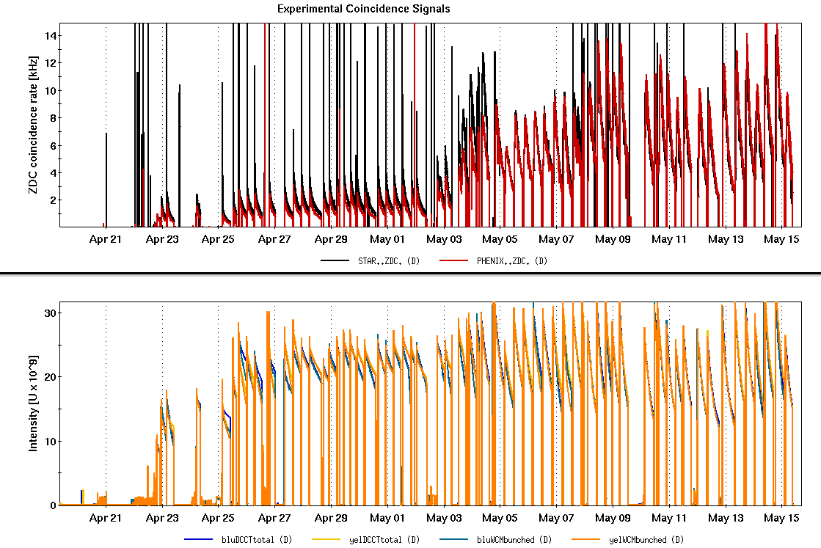
Bunch Intensity & Luminosity
Bunch Intensity at injection
Bunch Merge
APEX
Long. Cool
Vert. Cool
Hori. Cool

Slide 5
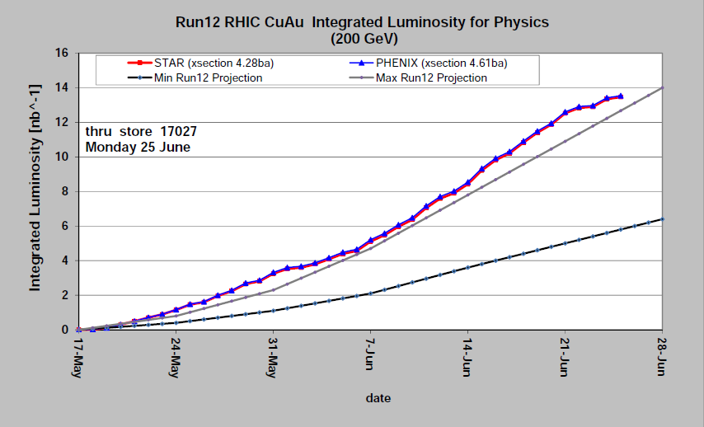
Cu-Au Run: Bunch Intensity & Luminosity
Cu-Au run is another miracle. With
powerful Stochastic cooling,
continuously improvements in RHIC injection bunch intensity from EBIS, double merging, injector tuning, ATR tuning,
continuously ramp efficiency improvement with chromaticity, tunes, octupoles,
Continuously maximizing integrated luminosity with cooling gains and store tuning,
We were able to reach Lumi. goals JUST on last day despite of high temp. & power-dips.

Slide 6
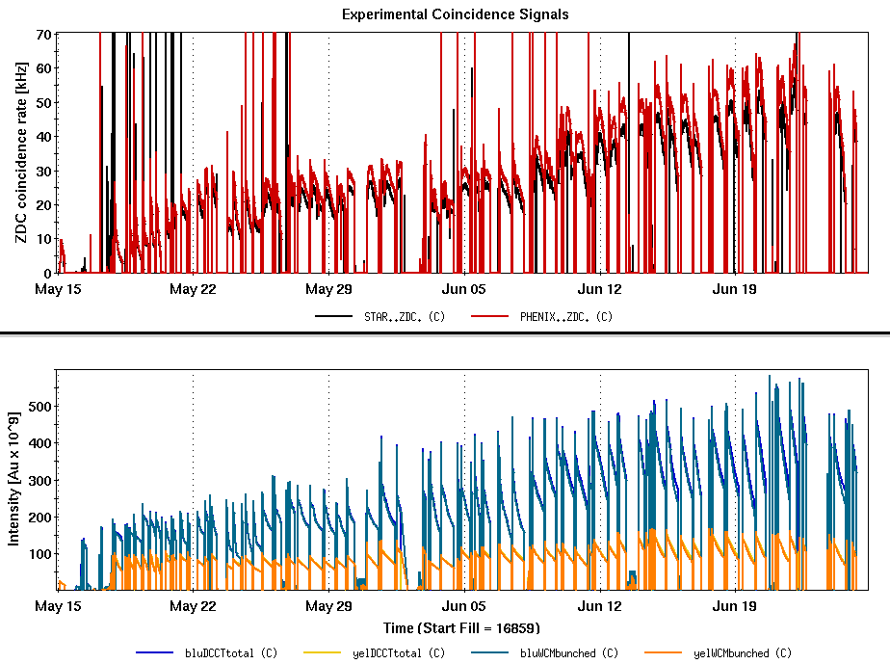
Bunch Intensity & Luminosity
Power-dip
Power-dip
APEX
APEX
3D Cool

Slide 7
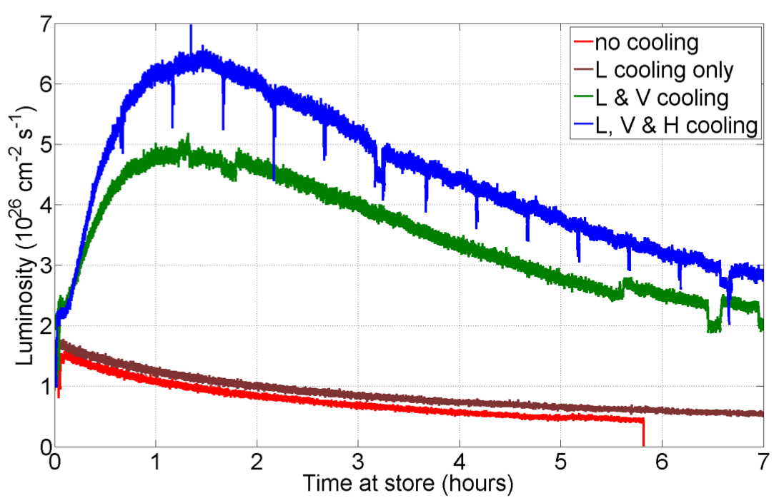
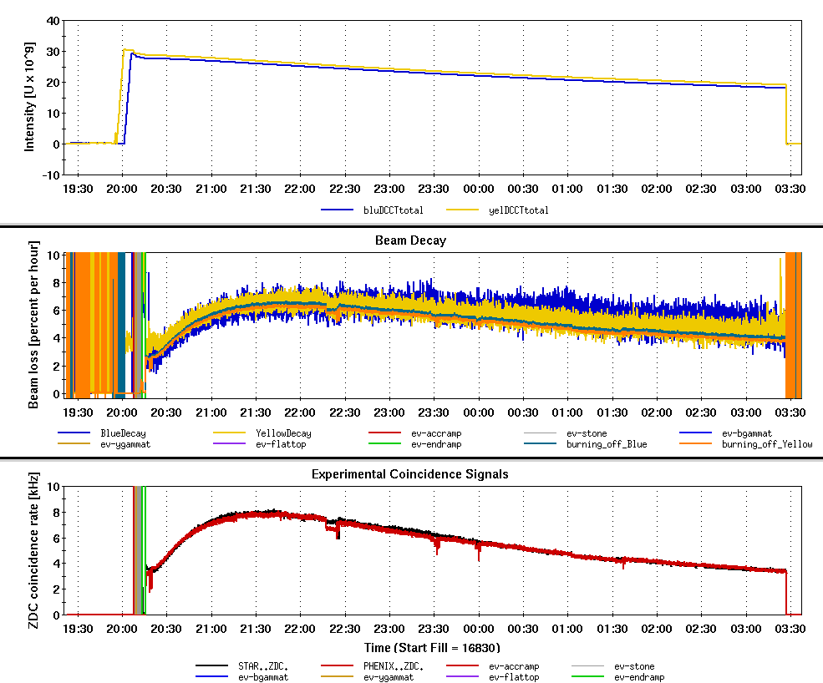
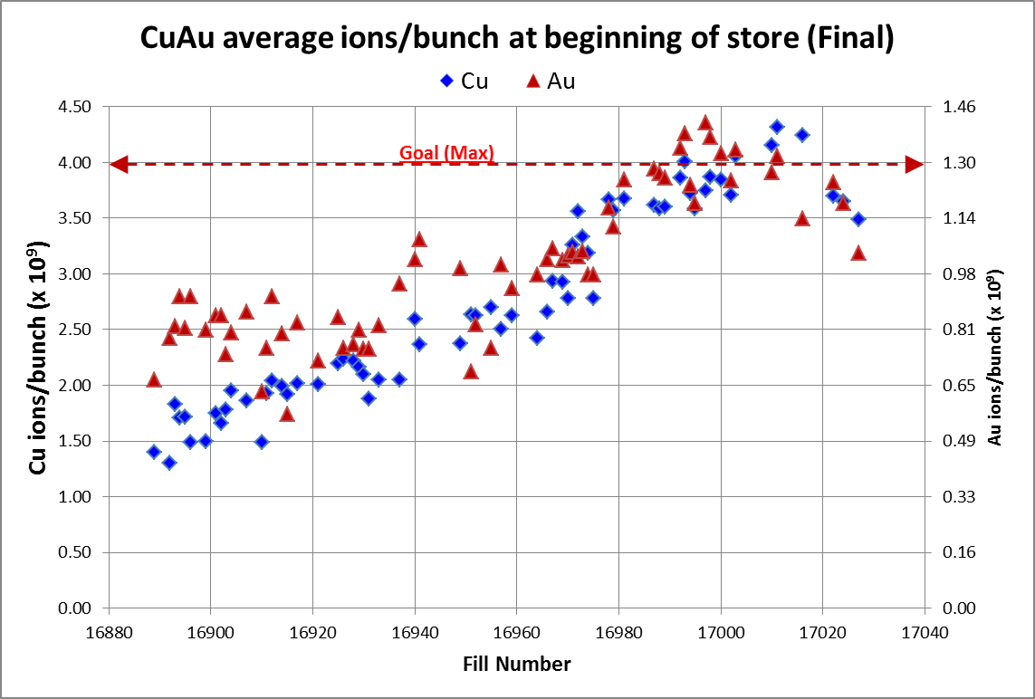
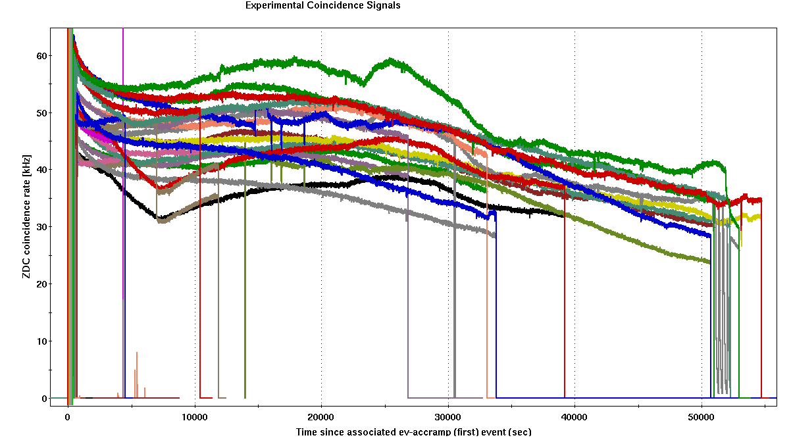
Personal Favorite Plots
Beam loss
3-D Cooling
Bunch Intensities
Best week: New record everyday

Slide 8
Lessons Learned: Physics
Physics right is important for success of RHIC run.
It includes ( AP Group ):
Choosing proper beta* and beam parameters
Designing good lattice
Performing non-linear correction
Giving a decent dynamic aperture & beam lifetime
Understanding operation observations
Pushing critical beam parameters to improve luminosity
……
In the following I focus on:
- Pre-run simulation study
- Lattice & ramp preparation

Slide 9
Pre-run Simulation Study
In the preparation of 2012 ion runs, based on dynamic aperture calculation and previous run observations, we decided to use the non-IBS suppression lattice, which was proved right.
Other examples to show importance of pre-run simulation:
- Difficulty of 2008 100 GeV run with beta*=0.7m
- Low momentum aperture in 2010 100 GeV Au-Au run
- beta* choosing in 2012 100 GeV p-p run
- DA studies with new working points :
near-integer, near-2/3, (0.18,0.19), and tune scan
Pre-run simulation study is critical to the future low beta* and e-lens lattices. It helps choose beam parameters and evaluate lattices.

Slide 10
Lattice and Ramp Preparation
There were continuous complaints about lattice and ramp preparation in past runs. In the 2012 ion runs, we paid particular attentions to them but still can’t completely avoid this problem. We had to change our ramp files in the start-ups of U-U and Cu-Au runs, which cost at least 1.5 shift loss.
Main Issues between ramp design & ramp implementation
- initial installation of magnet strengths ( separation bump correct?)
- ramping speed of magnet PS ( sextupole PS ?)
- smooth optics through transition ( beta*, tunes, chroms ? )
- different transition jump time in both rings ( do we really need it ?)
……
Can we do better ? ( My answer is YES )
Better organization and better communication before the run

Slide 11
Lessons Learned: Operations
OUR OPERATION CREW ARE THE BEST. After Physics declared, they took control. They really did a fantastic job!
OP crew are not only capable of routine operating, they also participated in operation improvement and maximizing luminosity.
Good examples:
- exploring how to increase beam lifetime and maximize integrated luminosity.
- providing good advices to run coordinators to improve operation and to avoid beam time loss.
- some of them participated critical machine development and beam experiment.
……

Slide 12
Quick Run Switching
In 2012 run, with powerful feedback systems ( thanks to Al M.), we spent less beam time on ramp development and store setup. We were able to deliver the first overnight stores for experiments on time.
Strategies in the start-ups of 2012 ion runs
- made a detailed shift-by-shift job plan
- free Machine Specialists from AP shifts and focus on machine setup
- put each AP shift leader on the right spot
- set priorities of jobs, focus on final goals, drop some details
Minimum switch days & Bottleneck:
- What’s the minimum switch days? 3 days ?
- Bottleneck: RF (HL) work in U-U run, EBIS Au beam in Cu-Au run

Slide 13
Role of Machine Specialists
Machine specialists play very important roles in machine setup in the beginning of run, considering most of AP shifters don’t have experiences in tuning ATR and AGS.
In this run, to let Greg and Vincent focus on machine setup, I didn’t give them AP shifts which proved to be a right arrangement, considering changing schedule.
In the Cu-Au run, Keith did a great job in injector tuning with double merging scheme to boost RHIC bunch intensities. Do we need another injector Machine Specialist ? We have two RHIC Machine Specialists.

Slide 14
After Physics Declaration
Physics declaration only means that we are ready to deliver Physics stores for experiment. It does not mean that we can run as it is to the end of run. There are still a lot of machine and operation improvements to meet the luminosity goals.
Therefore, after Physics declaration, as a run coordinator,
- I really wish that people continuously pay attention to operation to assist run coordinator and operation crew to continuously improve operation and push luminosity.
- I extremely needs your discussion, advice on how to interpret the operation observation, and how to push luminosity next.

Slide 15
Lessons Learned: Scheduling
Set a floating AP shift schedule so that each AP shift leader can better use their expertise to fasten machine setup.
During the U-U run, we have several LIPA jobs in Booster. By careful scheduling, we really minimized the store time loss in RHIC.
Paul did a good job on scheduling. He always lets run coordinator know what’s going on on maintenance days and consults run coordinator how to avoid RHIC beam time loss due to EBIS, injector repairing.
Thanks to Phil and Youself for going between experiments and RHIC to let us know what experiments think and their requests for IR access.

Slide 16
Thunder Storms & Power-dips
High temperature weather, thunder storm in the last week of Cu-Au run almost made us fail to reach the luminosity goal. We probably should avoid RHIC running in the end of June.
We suffered two major power-dips in Cu-Au run which caused at less 3 days loss. Otherwise store time would be higher than 65%.
We need to re-visit the procedure of machine recovery from major power dip. I suggest that system experts instead of MCR crew be the first ones to make sure their systems come back or not.

Slide 17
Summary
2012 RHIC ion runs are successful. With powerful EBIS, 3-D stochastic cooling, double bunch merging, machine fine tuning, and high machine availability, both experiments reached their integrated luminosity goals.
Lessons are learned for future runs to continuously improve RHIC operation and to continuously push RHIC luminosity.
RHIC run is a team work. Thanks to everyone.

