Slide 1
RHIC Run 12 Polarized Protons Lessons Learned
V. Schoefer
RHIC Retreat 7/25/12
Bellport Country Club

Slide 2
Outline
Overview
100 GeV performance
255 GeV performance
Startup and mode change
Longitudinal emittance
Machine Development
Communication and expectations

Slide 3
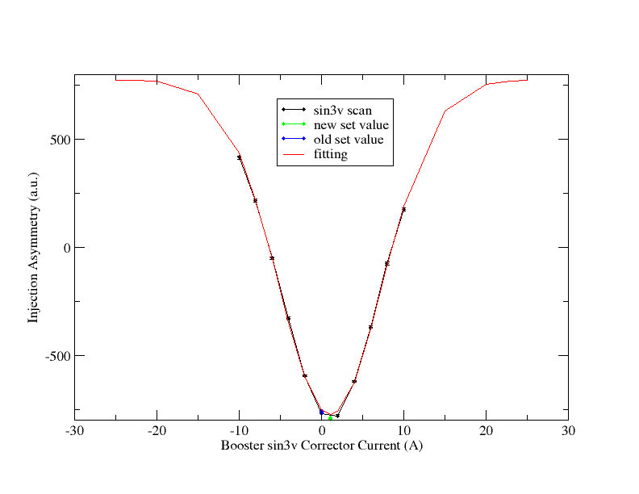
Injector Improvements
Polarization at AGS extraction higher at higher intensities than in Run 11
Increases from:
AGS pC polarimeter modification allows routine measurement of spin asymmetry at AGS injection enabled optimization of Booster resonance compensation (+4% abs)
Benefit eroded over time due to an orbit control software problem, corrected for future runs.
Higher source intensity
More scraping->10-15% smaller emittance

Slide 4
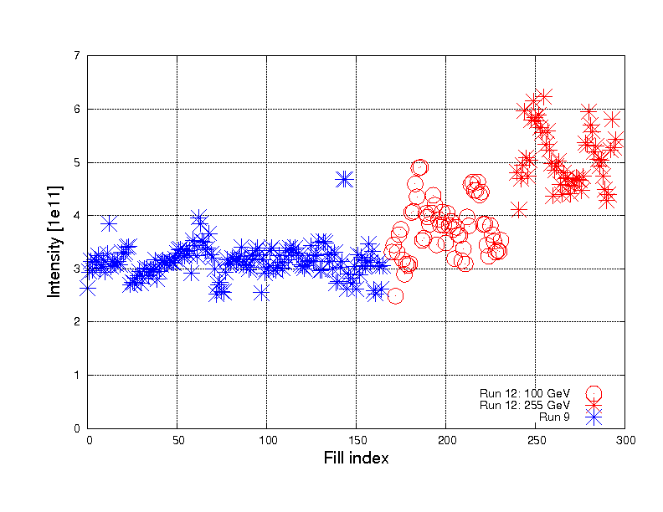
Injector Improvements: Source intensity
Intensity at Booster injection for physics fills
Source improvements yielded intensity at Booster injection as high as 6x10¹¹, nearly double Run 11 intensities
Allows additional scraping in the Booster
--- Longitudinal+vertical for
100 GeV
--- Vertical only for 255 GeV
Run 12: 255 GeV
Run 12: 100 GeV
Run 11: 250 GeV

Slide 5
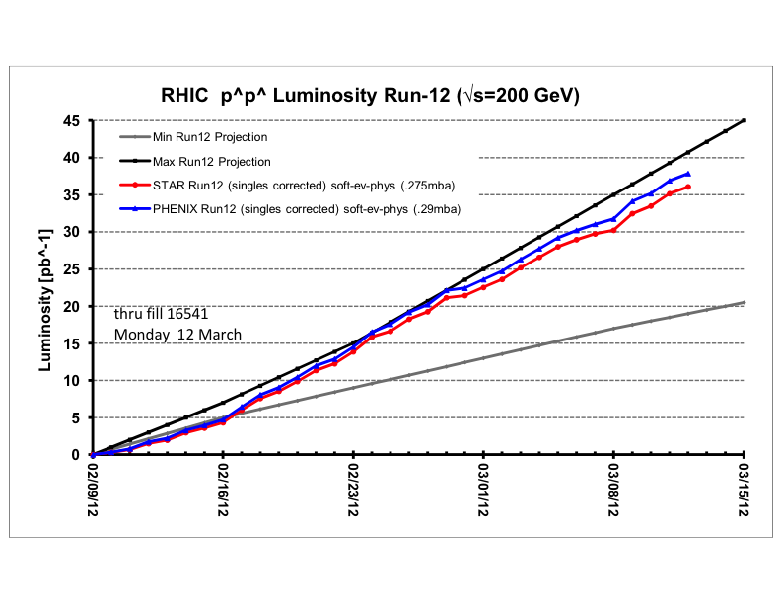
RHIC Performance: 100 GeV
Luminosity
Relative to Run 9
Increased β* 0.7 -> 0.85 m
Increased intensity 1.4->1.6x10¹¹/bunch
Above two approximately cancel to get slightly higher peak lumi of
~52x10³⁰ cm⁻²s⁻¹ (+5% relative to Run 11)
Lumi lifetime
Average ~16 hours, compared to 7 hours in Run 9 and 12 in Run 8 (even at 1 m β*)
Run 12: First 100 GeV p^ run to use tune/orbit feedback for all physics stores
10 Hz feedback
‘Blue noise’ problem solved in Run 11
Improved integrated lumi mostly due to a combination of good uptime (>60% calendar time at store) and improved lumi lifetime
Run | β* [m] | Lumi Lifetime [h]
Run 8 | 1.0 | 12
Run 9 | 0.7 | 7
Run 12 | 0.85 | 16

Slide 6
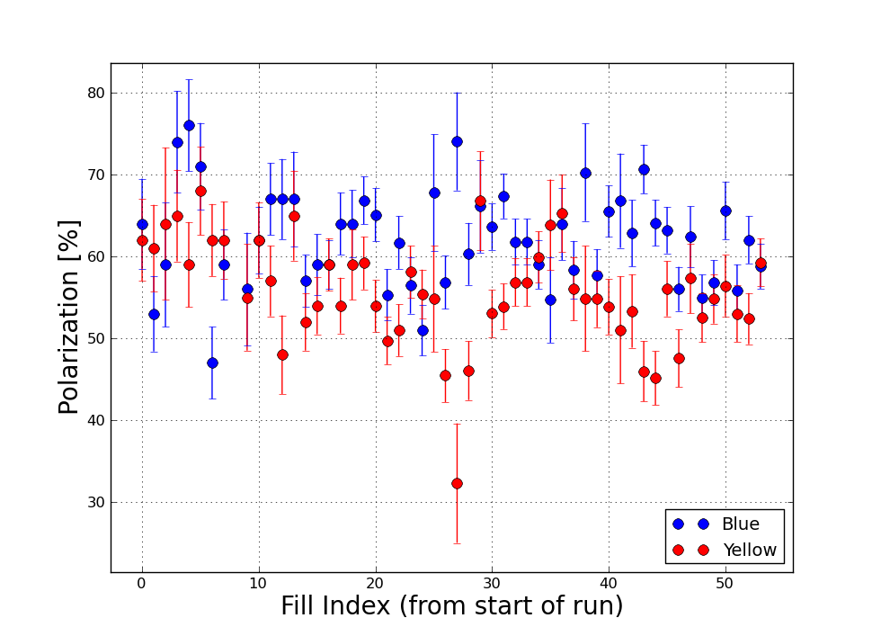
Polarization: 100 GeV
Polarization (from H-jet)
Polarization averages
(B,Y) ~ (61%, 55%)
Yellow slightly higher (57%) when omitting ‘split tune’ fills and the emittance blowup period
Polarization decay at store varies over the run, but is typically 0.5%/hr in blue and 1%/hr in yellow (absolute)
Standard store length is 8 hours
Emit. blowup
Split tune
experiment

Slide 7
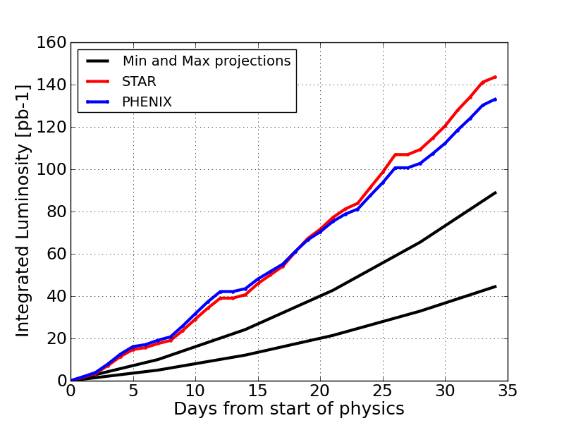
RHIC Performance: 255 GeV
Integrated Luminosity: 255 GeV
Luminosity
Peak
~25% higher than Run 11
Smaller emittance
Source intensity + scraping
Less growth in AGS
Integrated
Same in first week of Run 12 as best weeks (8,9) of Run 11
9 MHz RF commissioned in Run 11, operational day 1 in Run 12
No ‘big’ (multi-day) failures
Changeover from 100 GeV, 3.5 days, (with maintenance)
Enabled largely by tune/orbit feedback
tape/config control
Integrated Luminosity by Week

Slide 8
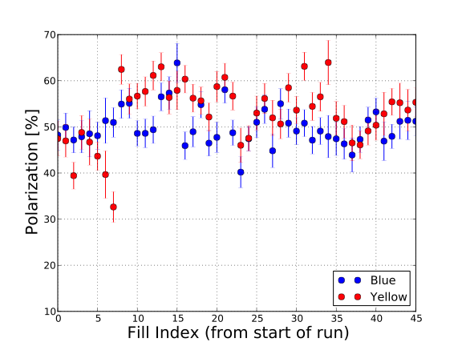
RHIC Polarization: 255 GeV
Run 11 48% +/- 0.5 (Jet, both rings)
Run 12 Blue 50%, Yellow 55% (each +/- 0.5)
Adjusted snake current during ramp between 100 and 255 GeV
Yellow +5% (abs)
Blue: Ramp efficiency may have improved (not clear from jet alone)
Further (large) scans of snake currents show polarization is largely insensitive to changes around this configuration
No obvious improvement in polarization decay from increasing energy to 255 GeV
0.7%/hr, consistent with Run 11
Polarization (from H-jet)
Snake current change
(both rings)

Slide 9
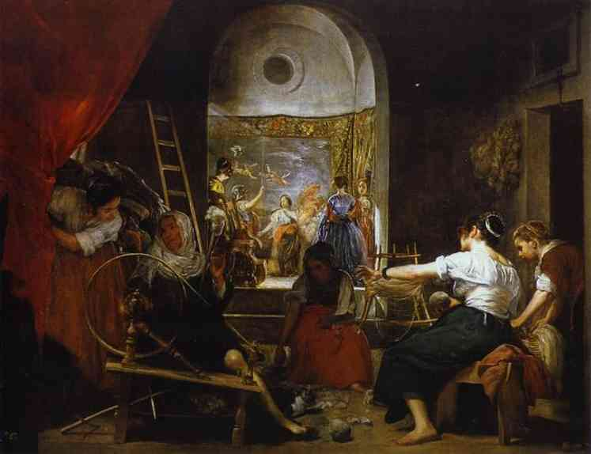
The Run Coordinator Delegates.
Detailed polarization analysis:
Mei and Haixin this afternoon
Polarimeter status (and noise remediation):
Bill Schmidke, also this afternoon

Slide 10
Startups and Mode Changes
Peak performance was essentially the same as the projections
Primary discrepancy was how fast we got to peak performance
There is no need for a one week ‘ramp-up’ (two shifts for experiments, one for development). Get to previous peak, go to three shifts physics, incrementally improve from there. Retain day shift for contingency.
If necessary, maybe have short stores for the first week.
6 bunches = 56 bunches
56 bunches + chrom adjustment + ramp collimation = 109 bunches
Written startup plans are key (especially for commissioning)
Don is 150 pages worth of lucky
RF spelled out LL commissioning plan really nicely.
Beam work goes really quickly (faster than p.s., RF setup)
During initial startup, plan ahead for MD/APEX style activities at injection.
‘Day trips’ like large working point changes, beta* changes should be treated like mode changes.

Slide 11
Problems with Startups and Mode Changes
They are too fast!
Groups that previously had multiple shifts between call-ins now do not
Capture, first ramp and rebucketing come together within one shift of each other
Instrum setup for injection and ready for ramp are essentially the same thing.
Scheduling difficulties:
RF->Instrumentation/FB take alternating shifts
But then everyone needs to be around together for first ramp
No group can split into shifts
Results the same even in the frequency domain
Planetary upgrade outside DOE long-range planning scope

Slide 12
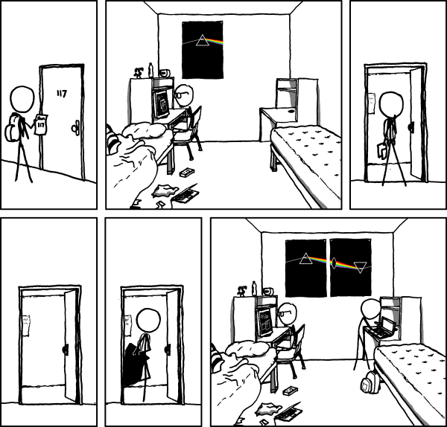
Problems with Startups and Mode Changes
Requires reliable chrom measurements:
Some indication that the ‘wiggles’ method was not accurate
Should fix that and develop the ‘offset’ ramp method

Slide 13
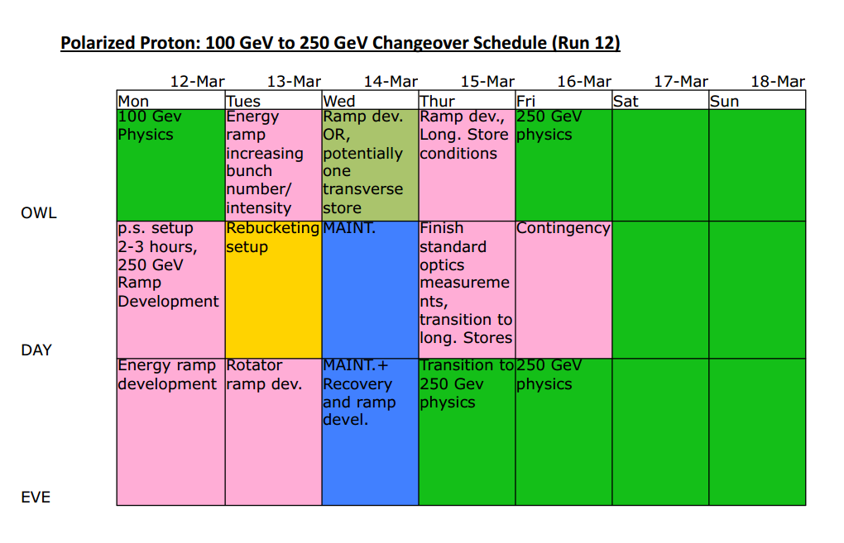

Slide 15
Deviations from expectation:
Power supply setup +1 shift
Wfg problem with 255 GeV, +2 shifts
No ramp collimation, +1 shift
Rebucketing, -1 shift [Yeah!]
Rotator ramp, -1 shift [Yeah!]
I think 2 days is about the theoretical minimum.
3.5-4.5 days is at reasonable estimate, with contingency.
Let’s try to avoid maintenance during setup.
By Friday night, we had 109, 1.6x10¹¹

Slide 16
Are these fast mode changes reproducible?

Slide 17
Yes.

Slide 18
The Run Coordinator Delegates Some More.
Keeping Startups Awesome: Greg’s talk tomorrow.

Slide 19
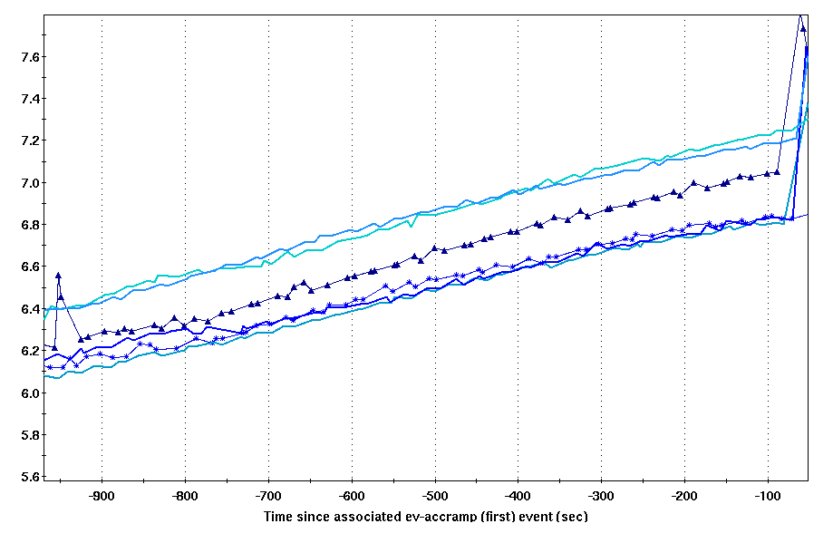
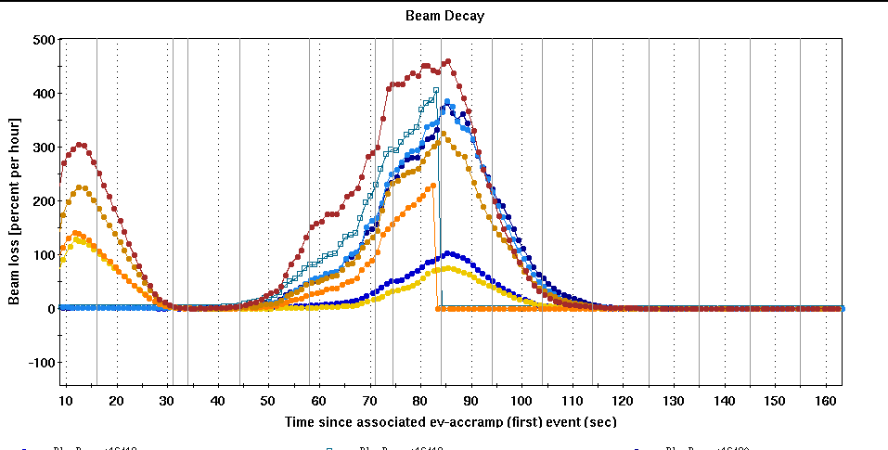
Longitudinal Emittance
Longitudinal emittance limits the luminosity for 100 and 255 GeV:
100 GeV
Rebucketing
Vertex cut ~16%, want 20%
255 GeV
Vertex OK
Limited to 1.8e11 by ramp, would like 2e11 (+20% LUMI)
Nearly ALL the MD during the polarized proton run and TWO TALKS (tomorrow afternoon) dedicated to this effort
[I will defer to those talks for full analysis]
Bunch length at injection
Beam decay at max Bdot

Slide 20
Machine Development
‘Fallout’ is downtime attributable to the development or unexplained
‘Failure’ is downtime independent of the MD effort, but which delayed return to physics
‘Machine Setup’ is time after MD ends that is reasonably used to get back to physics
Almost all MD took place during 255 GeV
Almost entirely to improve longitudinal emittance (2-3 hrs optics/coupling)
Mode | Total [h]
MD (Sched) | 25
MD (Actual) | 21 | ~2 stores
Fallout | 10.5 | ~ 1 store
There were ~60 255 GeV stores total.

Slide 21
Machine Development
In all three instances, the Fallout is yellow injection:
3/22: Booster scraping scheme changed, fast injection loss
3/29: Yellow injection lifetime
4/5: Devices not returned to nominal + injection instability
Injection instability/lifetime problems happened throughout the run
Chrom control really important at this intensity
Most efficient remediation is to measure the chroms and set appropriately
One minute measurement saves many lost fills (instability at end of fill)
Mode | Total [h]
MD (Sched) | 25
MD (Actual) | 21 | ~2 stores
Fallout | 10.5 | ~ 1 store
There were ~60 255 GeV stores total.

Slide 22
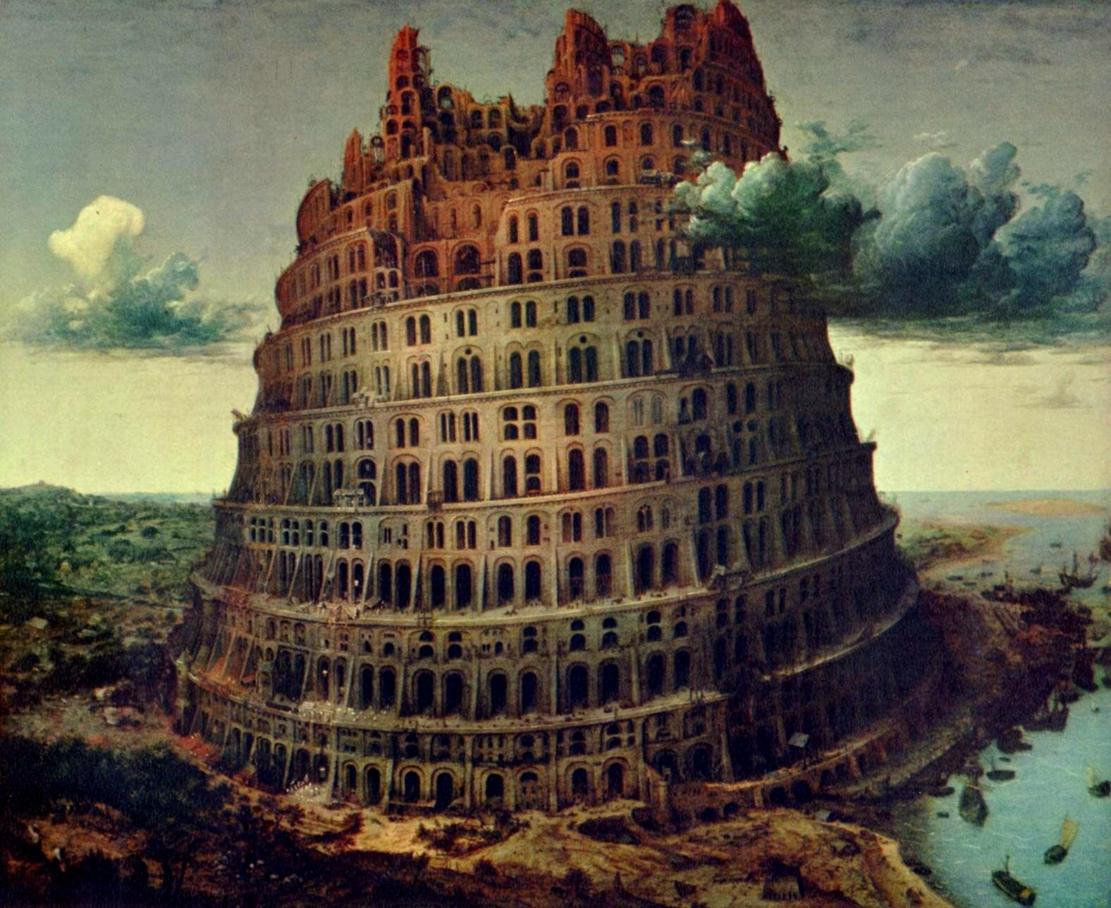
Communication
Several concrete examples of successful communication:
Rotator setup at 255 GeV [Thanks to Vahid, Bill, Xiaochun and John Koster]
Maintaining of polarization direction through run [ditto]
PHENIX crossing angle experiment
Stellar maintenance planning [Thanks Paul]
Several instances of maintenance days moved on short notice (but which went well anyway)
Maintenance mid-255 GeV setup caused no additional delay
Where can we do better?
Experimenter goals (and the connection with machine performance)

Slide 23
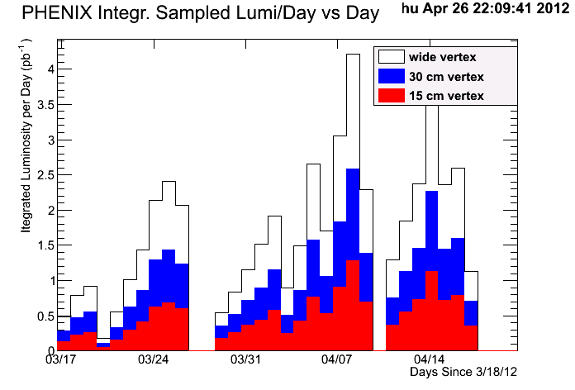
Patterns in the Luminosity
What is the ‘sawtooth’ in the sampled lumi?
Does not show in delivered.
Where does the lumi go?
It’s NOT the vertex
Connects Wed’s
PHENIX Sampled Lumi
Two caveats:
Delivered lumi not consistently handled for stores that span midnight (~1 pb-1 could slip a day in either direction)
Either the dates in the PHENIX plot are shifted early one day, or Tuesdays are worse than Wednesdays.
(courtesy X. He)

Slide 24
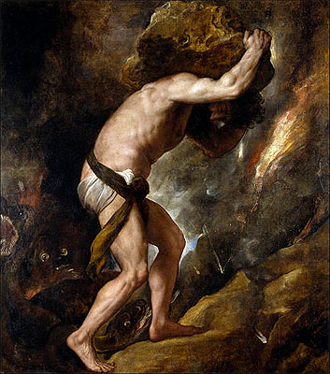
Why is this important?
Experimenter goals drive the schedule
In a run where delivered lumi was almost twice the projected (and the vertex projection was accurate), still discussions to the end about every ten minutes.
This year’s performance is next year’s expectation, we have to capitalize on good runs to spend time to make improvements.

Slide 25
Summary
Run 12 was a great success!
Records in lumi, polarization (and energy!)
Product of many years of work in many areas:
Spin physics
Instrumentation and feedback
RF
Power supplies
Operations and maintenance
Very well positioned to integrate planned upgrades
E-lens
OPPIS Source upgrade
Integrated Luminosity: 255 GeV

Slide 26
THANK YOU!
Dance in a Madhouse – George Bellows

