Slide 1
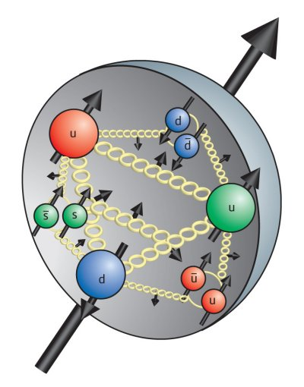
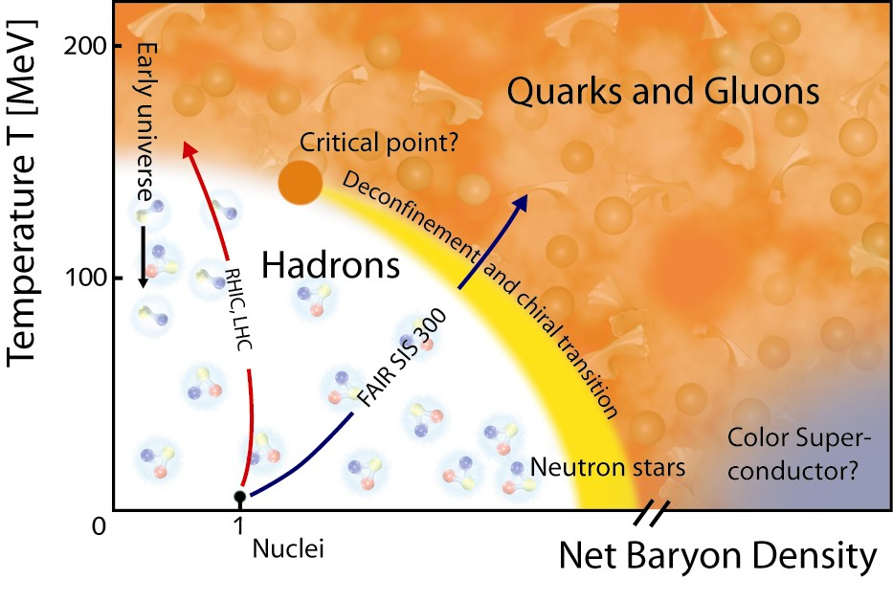
The View from PHENIX
Xiaochun He @ RHIC Run-12 Retreat
Georgia State University
Outline
PHENIX Run-12 goals
How did PHENIX do?
    Detector commissioning and performance
    Data taking and fast analysis
General comments
Study QCD Matter in Difference Phases
Notes:
This talk will be an executive summary of a series of presentations that I had given at the Time Meeting and Phil Pile Meeting during Run-12:

Slide 2
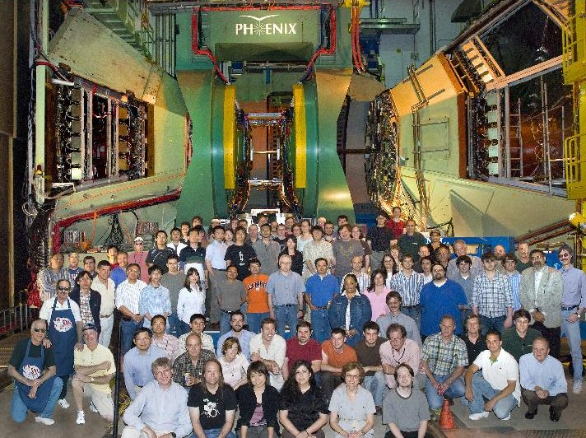
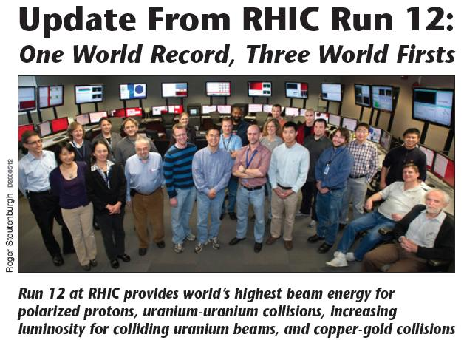
Cast and Crew
There were 246 participants who sat at least one data-taking shift.
One run coordinator and one spin coordinator.
Thirteen period coordinators.
There were twenty-one weeks of fully staffed shifts (4- or 5-person), and three weeks of 2-person watch-shift started on Jan 11th at the beginning of the run and three days of 2-person watch-shift ended at midnight on June 28.
Notes:
Story line and the cast crew

Slide 3
Recent and Future RHIC Run Summary
Run | Species | √s | Wks | ±30 cm | ±10 cm | Pol | Comments
11 | p+p | 500 | 10 | 27 pb⁻¹ |  | 50%(L) | W program + ΔG
 | Au+Au | 19.6 | 1.5 | 13.7M MB evts |  |  | energy scan
 | Au+Au | 200 | 7 | 915 μb⁻¹ | 790 μb⁻¹ |  | heavy flavor (VTX)
 | Au+Au | 27 | 1 | 5.2 μb⁻¹ |  |  | energy scan
12 | p+p | 200 | 4.4 | 9.2 pb⁻¹ | 2.9 pb⁻¹ | ~60%(T) | HI ref. + transv. spin
 | p+p | 510 | 4.9 | 30.0 pb⁻¹ | 10 pb⁻¹ | 50%(L) | W program + ΔG
 | U+U | 193 | 2.9 | 171.2 μb⁻¹ | 89.9 μb⁻¹ |  | explore geometry
 | Cu+Au | 200 | 5.5 | 4.96 nb⁻¹ | 2.47 nb⁻¹ |  | control geometry
13 | p+p | 510 | 15 | 250 pb⁻¹ |  | 60%(L) | W program
 | p+p | 200 | ~5 | 20 pb⁻¹ | 5.5 pb⁻¹ | 60%(T) | HI ref. + transv. spin
14 | Au+Au | 200 | 6-8 | 1.7 nb⁻¹ | 1.0 nb⁻¹ |  | high bandwidth
 | d+Au | 200 | rest | 260 nb⁻¹ | 150 nb⁻¹ |  | CNM
PHENIX Beam Use Proposal for Run-13 & Run-14 was recently submitted.
Notes:
Run-12 heavy ion measurements fit strategically well within the long-term running program at RHIC.

Slide 4

Run-12 Physics Goals
Study QCD Matter Properties at Extreme High Temperature and Density, and Resolve the Puzzle of Proton Spin
Notes:
We take the advantage of the versatile capability (its strength) of RHIC to explore and map out the phase space of the QCD matter created from heavy ion collisions at RHIC.

Slide 5
PHENIX Run12 Spin Goals
200 GeV with Transverse Polarization
  What is transverse structure of proton?
510 GeV
  What is the sea quark and gluon spin contribution to the proton?
Transversity distributions from A. Prokudin
DSSV: Phys.Rev.Lett.101:072001,2008

Slide 6
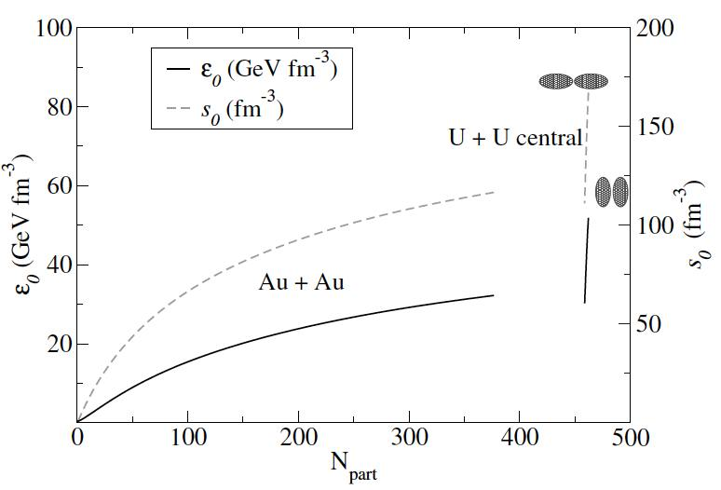
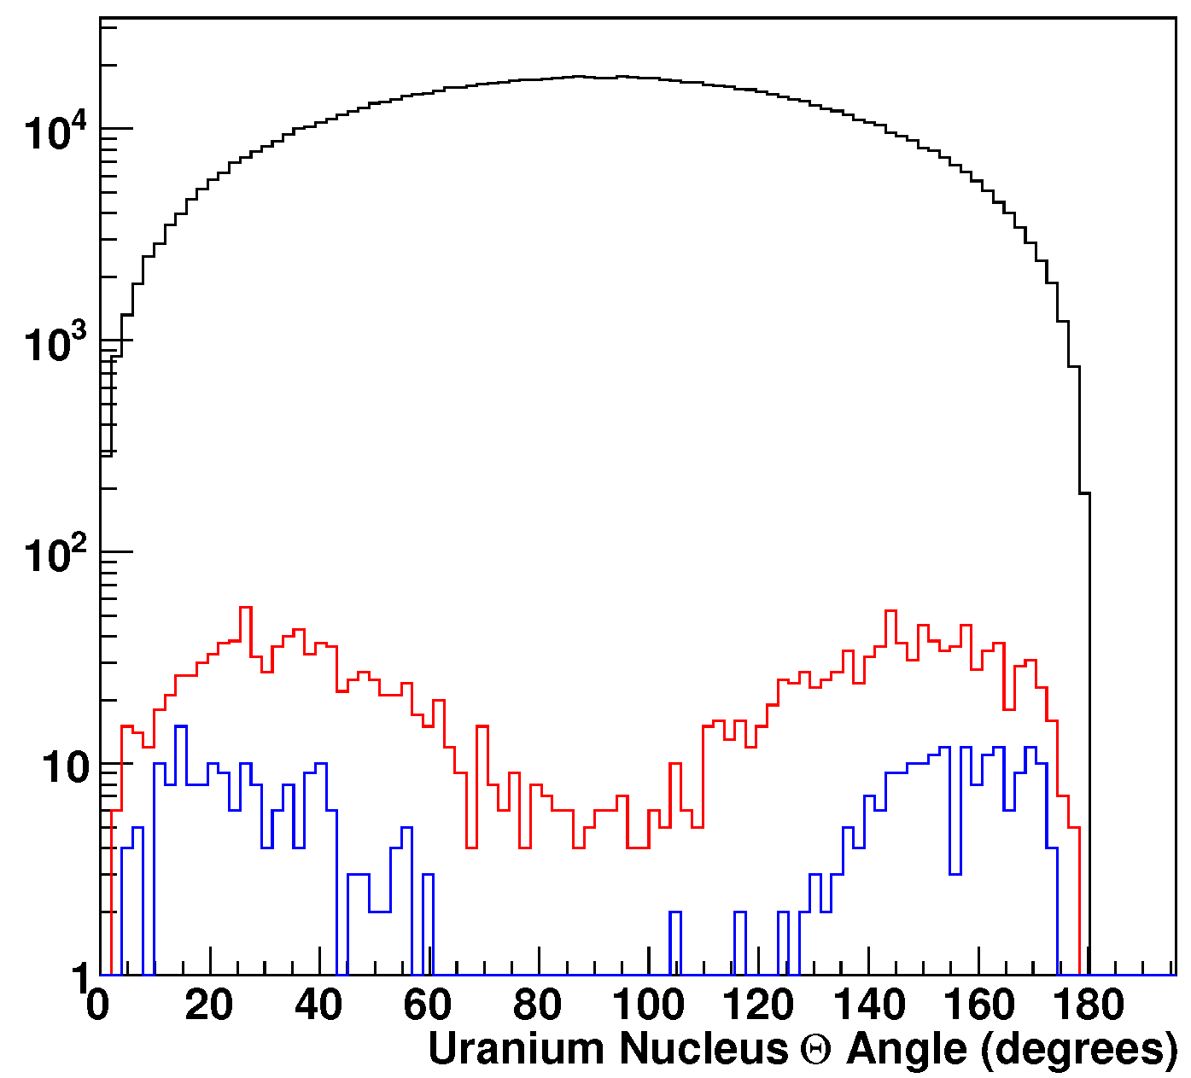
U+U Collisions
Allow us to explore early time dynamics and thermalization: a) varying the eccentricity for flow studies; b) varying path length for parton suppression studies.
Tip-tip
Body-body
U. Heinz
U+U energy density (65% larger than Au+Au for tip-tip)
U+U simulation
0.2%
0.04%
The key to utilizing UU collisions for these purposes is the ability to disentangle the various geometries of the individual interaction !!!
Uranium θ Angle (deg)
Notes:
The selectivity within the two-component model alone and a cut on charged particle multiplicity for the top 0.2% and 0.04% is shown in the figure above. The black curve is all collisions (i.e., random geometries), and the red curve selects the highest 0.2% based on charged particle multiplicity, and the blue curve selects the highest 0.04%.

Slide 7
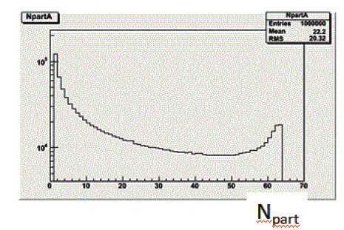
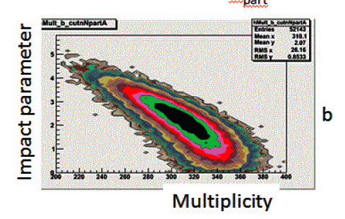
Cu+Au Collisions
Cu buried inside Au for most central collisions
  Minimize effects of the surface on hard probes
  Select top 3% centrality class for this study
Eccentricity w/o left/right symmetry for non-central collisions
  Non-fluctuation source of odd harmonics.

Slide 8
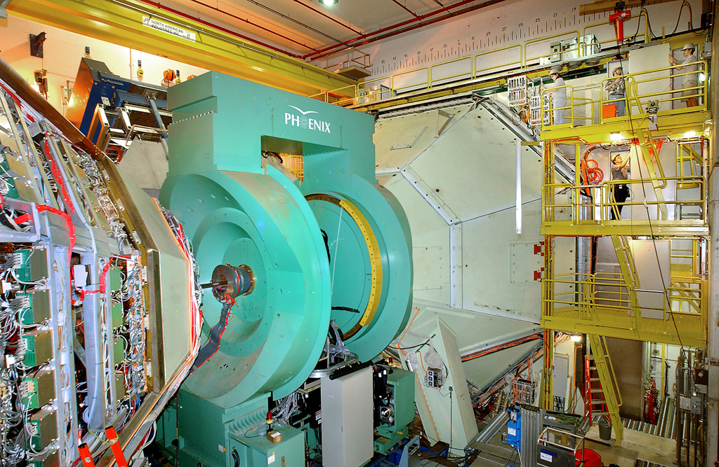
PHENIX Detectors
Emphasize newly commissioned detectors

Slide 9
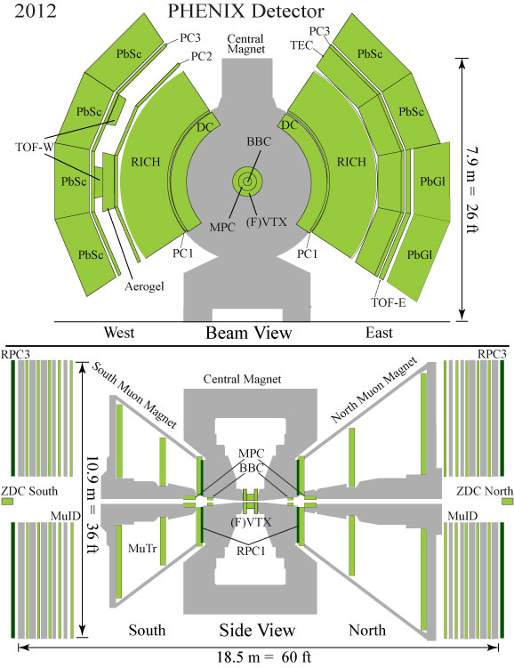
Central Arms:
hadrons, photons, electrons
|η| < 0.35
Δφ = π (2 arms x π/2)
Global Detectors:
Beam-Beam Counter (BBC)
Zero Degree Calorimeter (ZDC)
Muon Arms:
muons
1.2 < |η| < 2.2
Δφ = 2π
MPC:
3.1 < |η| < 3.9
Δφ = 2π
VTX/FVTX

Slide 10
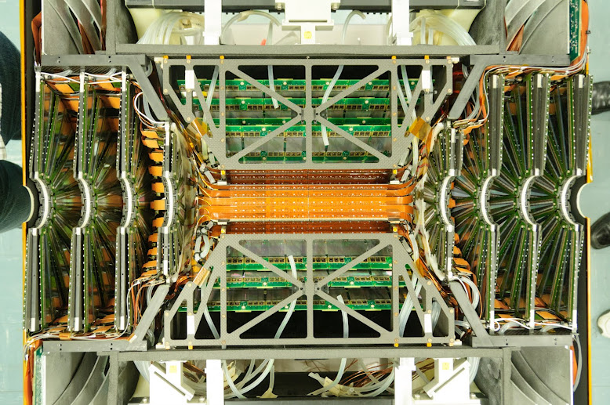
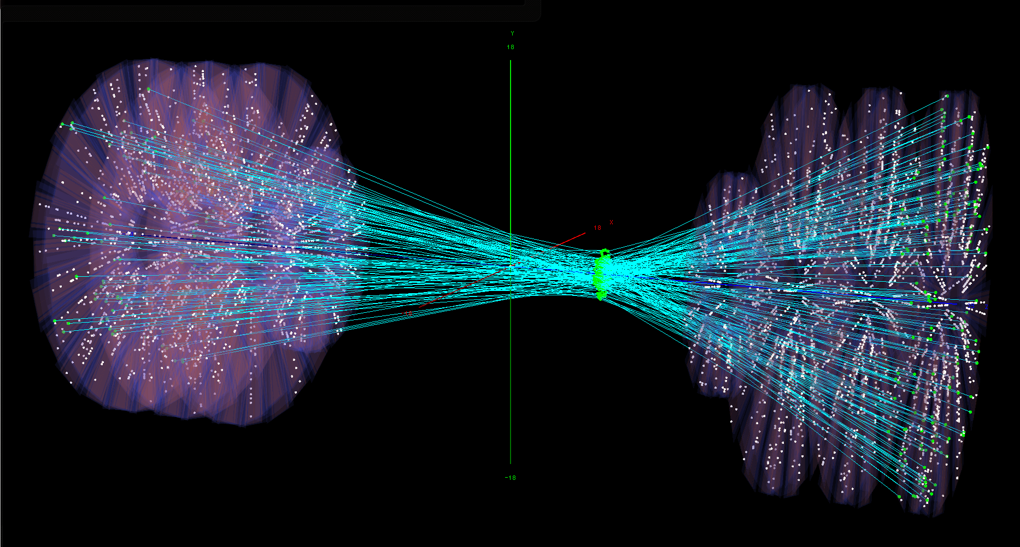
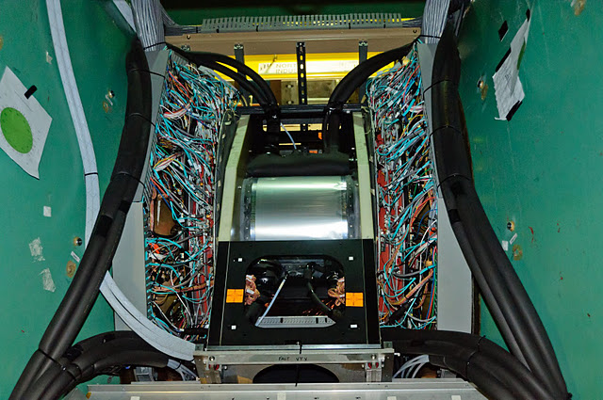
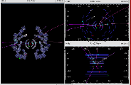
New detector, better precision physics measurement, with new challenges too.

Slide 11
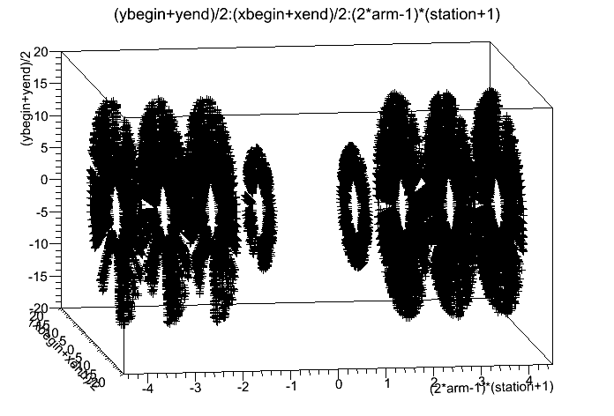
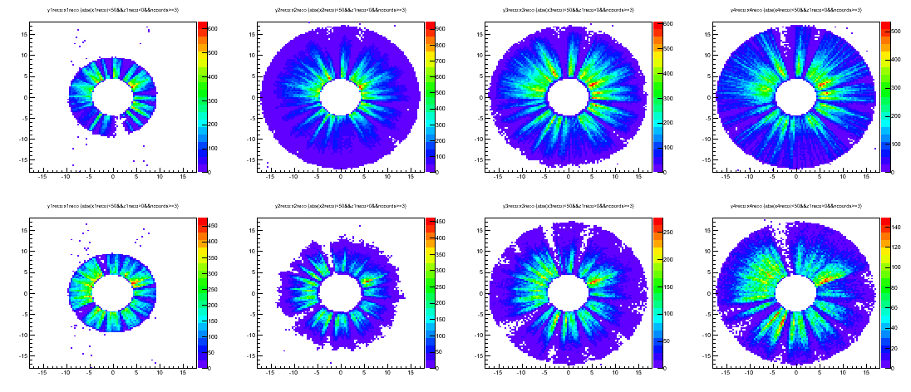
FVTX
Detector Commissioning + Software Development
Close to IR
Away from IR
Hits distribution from matched tracks from existing muon spectrometer

Slide 12
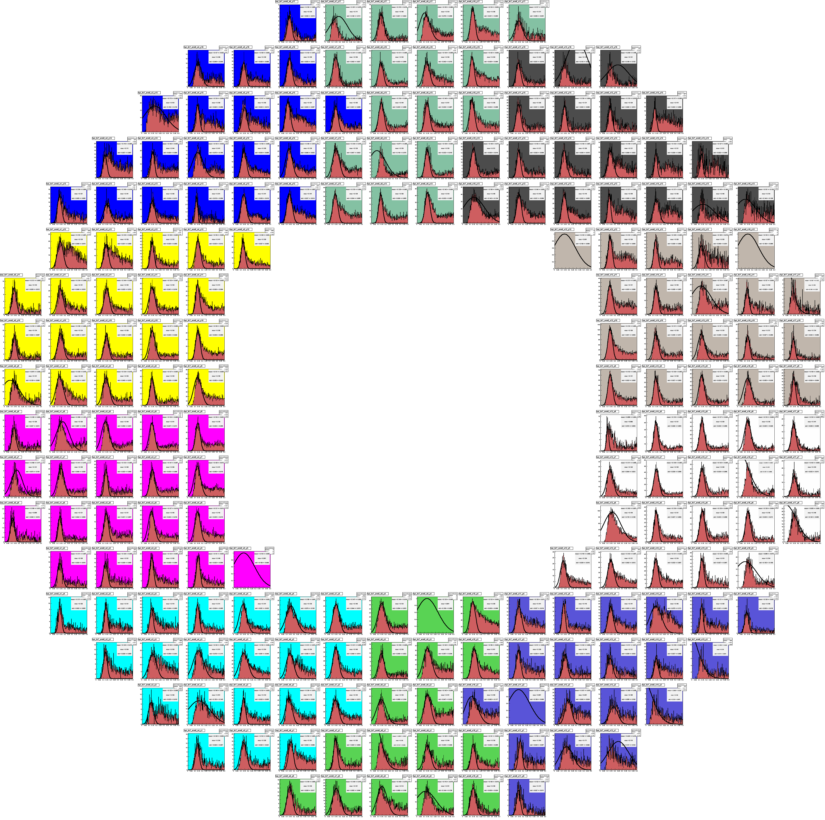
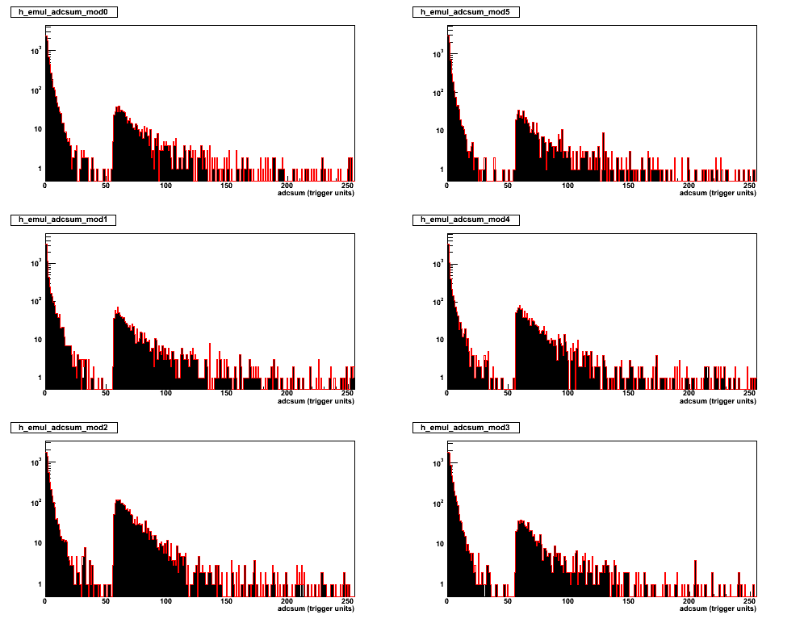
MPC Electronics Upgrade
Run 361772, 03-Mar-2012
π⁰ tower-by-tower calibration
Sharp (Digital) Trigger Threshold
Results from M. Chiu, S. Wolin, C. McKinney, E. Zarndt
Notes:
The new fully digital trigger for MPC; The south side was working since ~2nd week of Run12pp200; North side was added in at the beginning of 510 pp run; The trigger calculates tower sum within each module 6 times per beam clock.
2006 South MPC installed
2007 North MPC installed (both arms now fully in)...
2010 During Au+Au running, lost about 5 crystals in two separate dump events (for a total of ~10)
2012 During Cu+Au running, lost almost all of south and half of north.

Slide 13
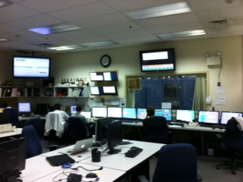
PHENIX Data Taking
Sampled total luminosity, data taking efficiencies

Slide 14
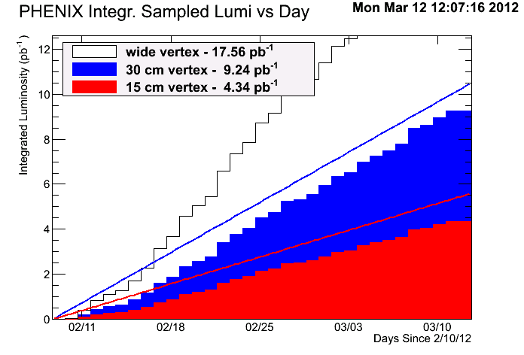
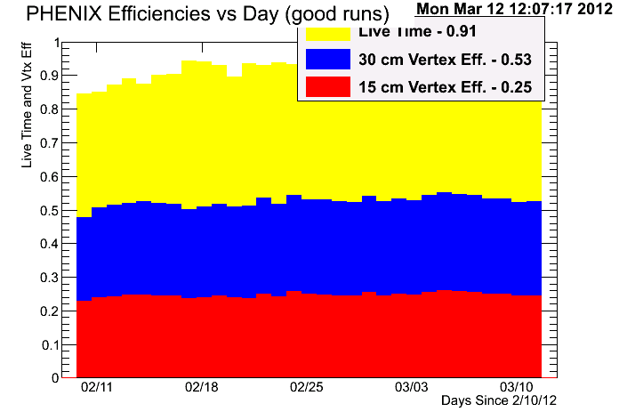
Comparison Measurement
200 GeV p+p (polarized protons)
Integrated Sampled Luminosity
Collision Vertex Distributions
P=61.8%
P=56.6%
88% achieved
76% achieved
Goal: 10.5 pb⁻¹ for |z|<30 cm & 3.8 pb⁻¹ for |z|<10 cm
We collected over 4.5 billion physics events !!!

Slide 15
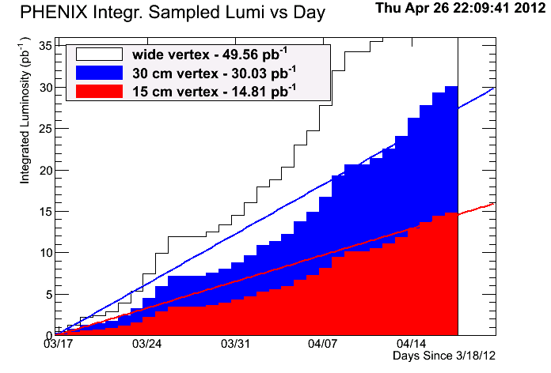
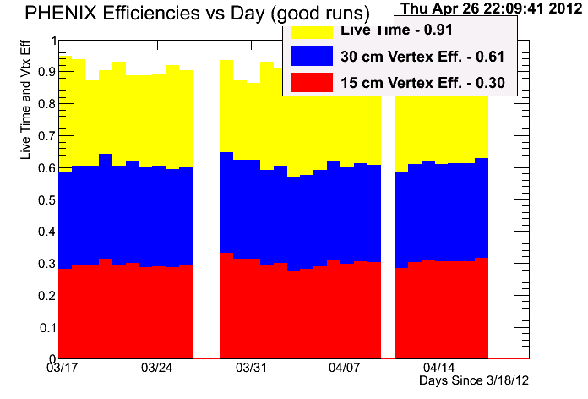
W Physics Program
510 GeV p+p (polarized protons)
Integrated Sampled Luminosity
Collision Vertex Distributions
P=50.3%
P=53.5%
100% achieved
100% achieved
Goal: 30 pb⁻¹ for |z|<30 cm & 10 pb⁻¹ for |z|<10 cm
We collected over 4.2 billion physics events !!!

Slide 16
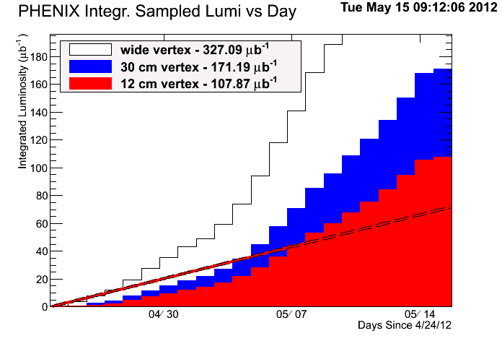
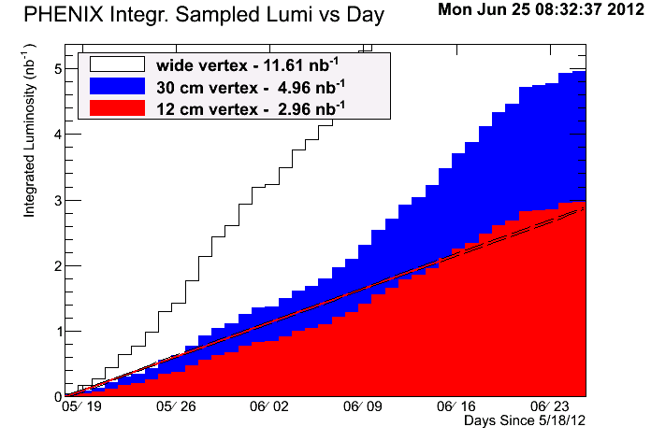
Sampled Luminosity (U+U & Cu+Au)
150%
~103%
Cu+Au
U+U
Goal: 60 μb⁻¹ for |z|<10 cm
Goal: 2.4 nb⁻¹ for |z|<10 cm
Collected over 3 billion events (4/25 – 5/15). Far exceeded the requested goal !!!
Collected over 9.8 billion events already, data taking was ended at 8am, June 25.

Slide 17
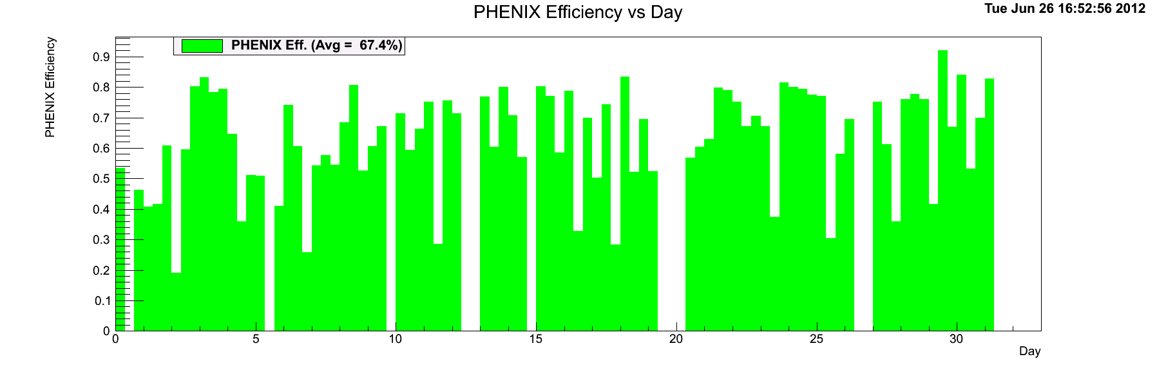
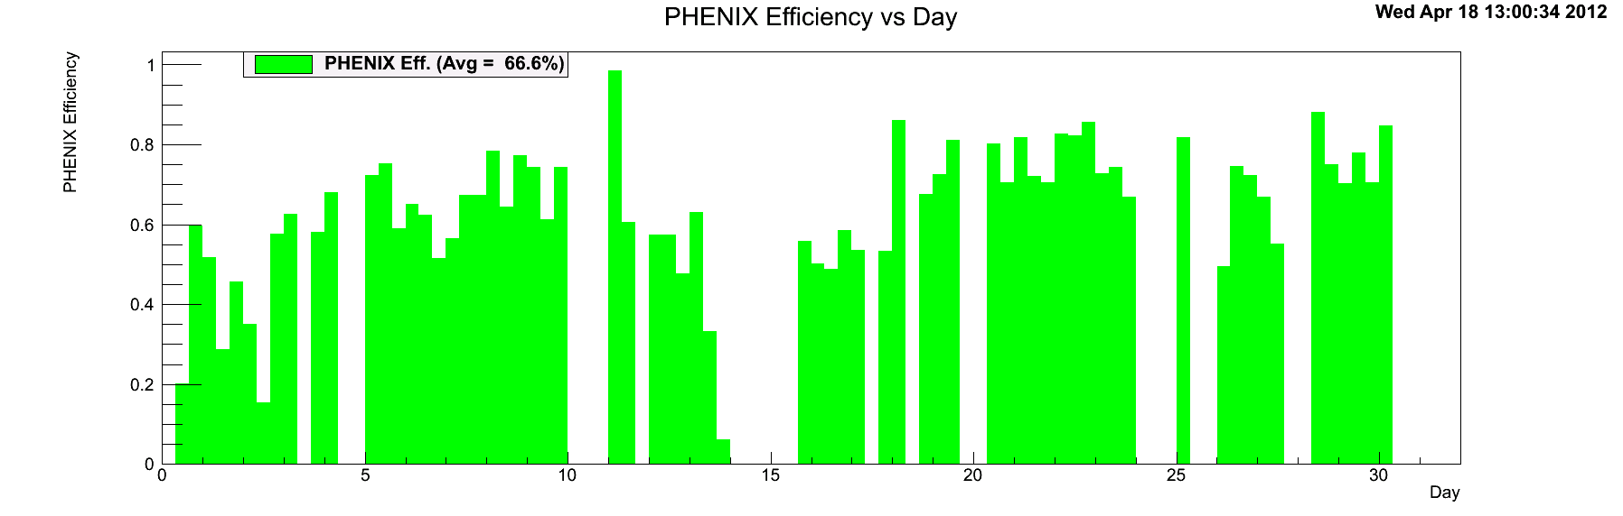
Data Taking Efficiency (200 & 510 GeV p+p)
Ave = 67.4%
PHENIX Efficiency
Ave = 66.6%
PHENIX Efficiency
Day

Slide 18
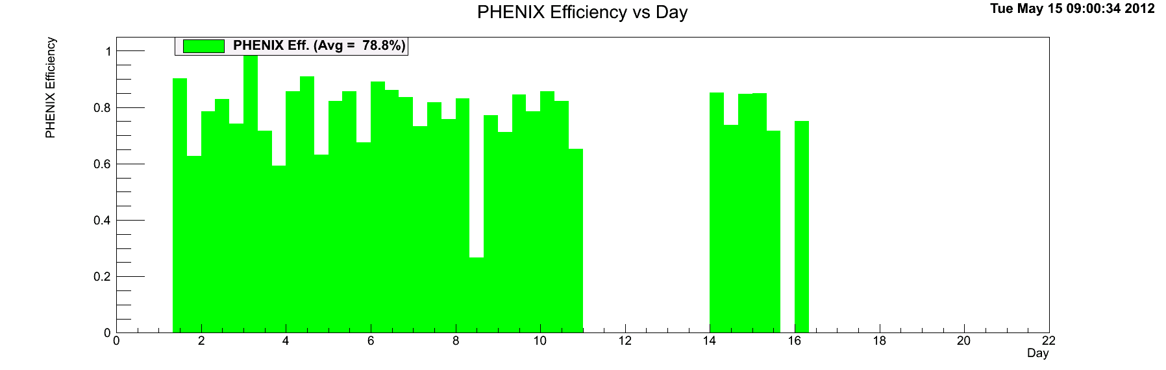
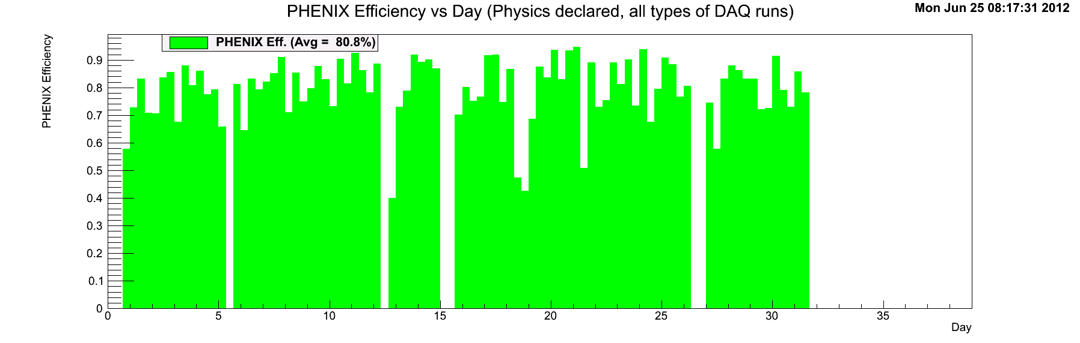
Data Taking Efficiency (U+U, Cu+Au)
Ave = 78.8%
PHENIX Efficiency
Day
Ave = 80.8%
PHENIX Efficiency
Day

Slide 19
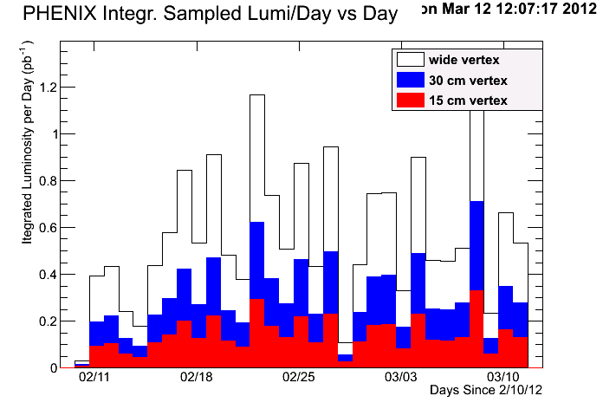
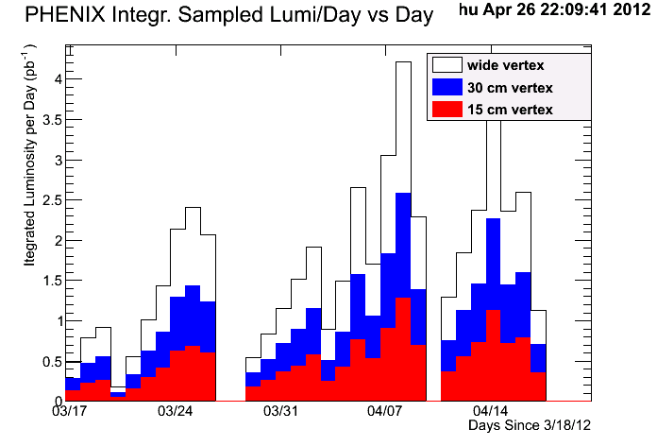
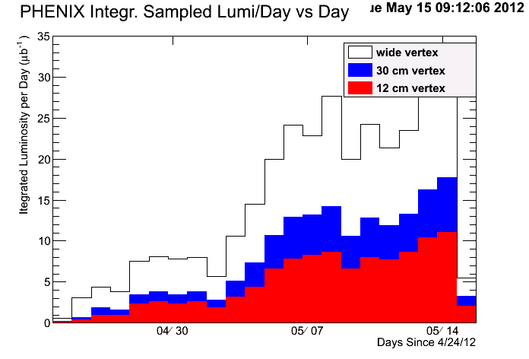
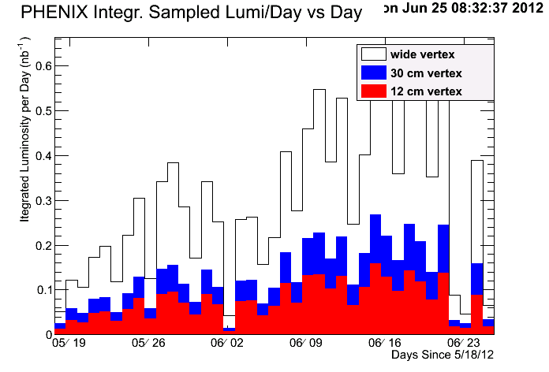
Daily Sampled Luminosities
pp 200
pp 510
UU 193
CuAu 200

Slide 20
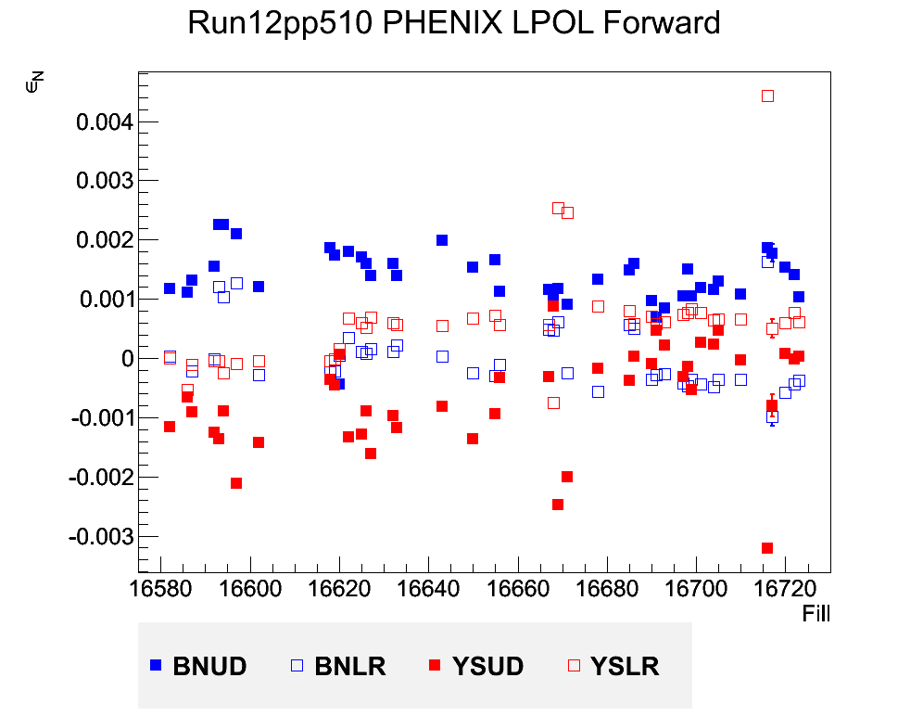
Online Local Polarimetry
The large residual component will degrade our precision measurements of A_LL !!!
Goal zone for residual polarization
P_{T}=2.5%
Some large outliers
Blue and Yellow beam residual
Notes:
Hi Xiaochun,
Could you add a slide on the residual transverse spin component that was present during transverse running? This is an issue Vincent and Mei know about very well from our discussions during the run but it doesn't hurt to remind them. I am attaching a slide from my talk at the User's meeting. The vertical axis is proportional to the polarization transverse to the beam momentum. During longitudinal running, these values would ideally all be zero. The large residual component will degrade our precision measurements of A_LL. I think the main culprit for the large outliers is that CAD would change beam parameters as part of their APEX during Physics running effort.

Slide 21
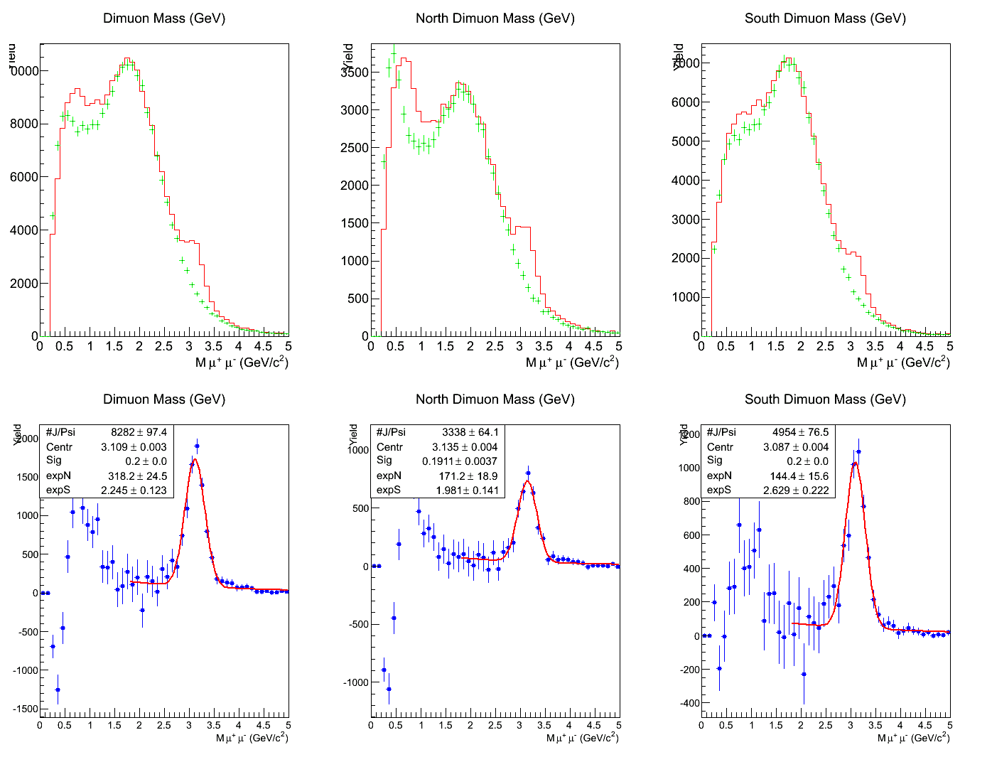
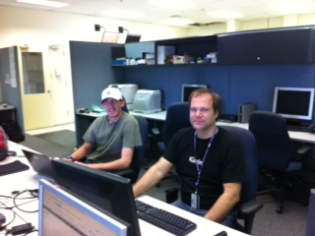
Fast Data Analysis
Provide near real-time feedback of detector performance
and data quality

Slide 22
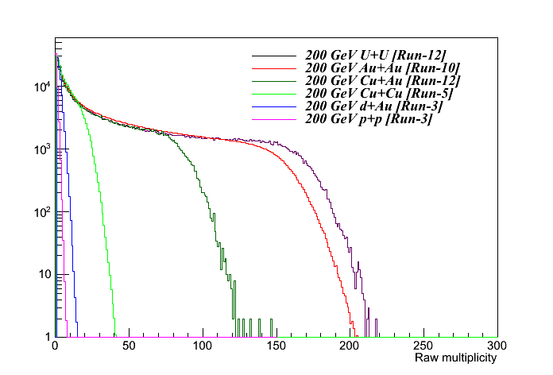
Multiplicity Distributions
U+U
Cu+Au
These are all raw values. No corrections for acceptance, efficiency, etc. have been applied.

Slide 23
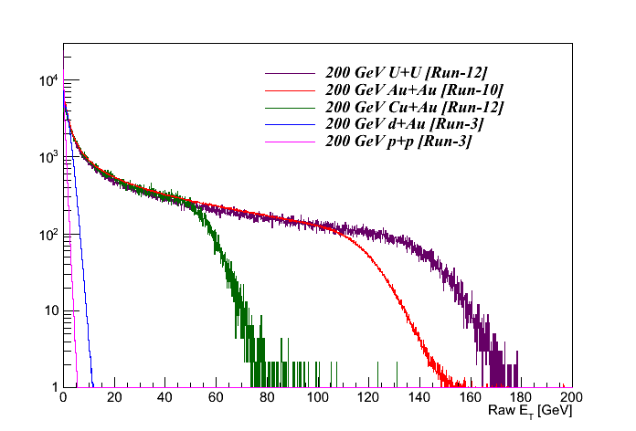
E_{T} Distributions
U+U
Cu+Au
These are all raw values. No corrections for acceptance, efficiency, etc. have been applied.

Slide 24
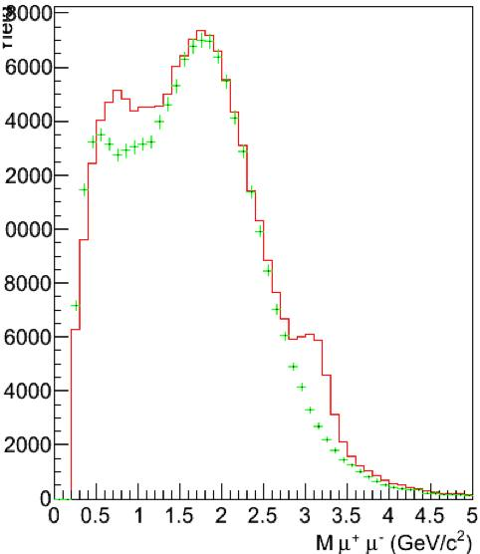
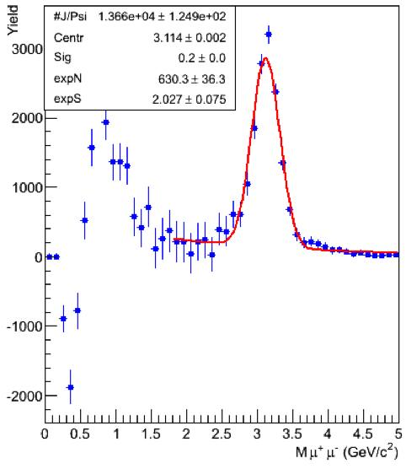
J/ψ Measurements (Cu+Au)
J/ψ yields from the PHENIX Muon Arms for Cu+Au Collisions
Run12 Cu+Au expectation: 62k J/ψ - for PHENIX wide-vertex luminosity goal of 4.6 nb⁻¹
We are only able to process less than 20% of the incoming data in the counting house before sending data to RCF HPSS
μ±μ± like-sign bkgd
μ⁺μ⁻ signal
More J/ψ are sampled which allows us to make collision geometry dependent study!!!

Slide 25

Operational Lessons

Slide 26
We had great support from CA-D for periodic detector repairs.
Having a pre-planned/fixed CA-D run schedule made running the experiment much smoother.
In the future, we need to plan ahead and agree on the balance between the machine studies and physics measurements.

Slide 27
Frequent APEX and MD Effect on Luminosity Sampling
p+p 510 GeV
For future runs, we request less frequent interventions to increase the number of days when we can record “steady state” luminosity.

Slide 28
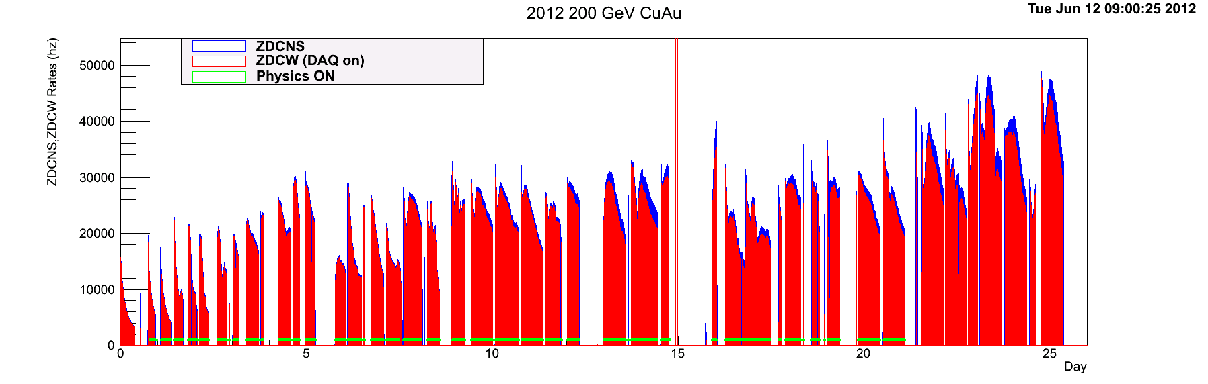
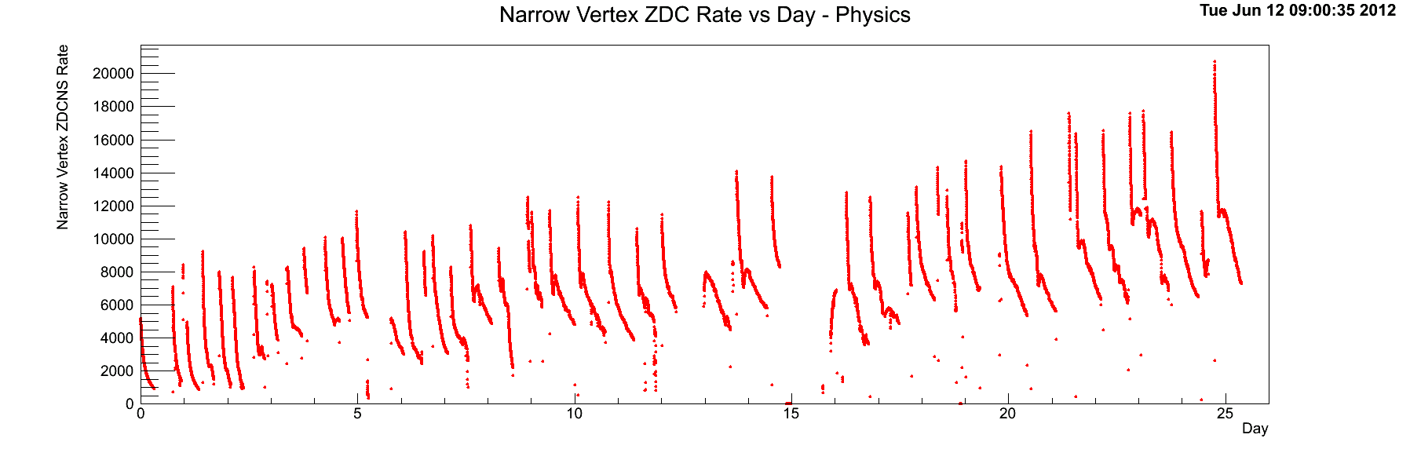
Everyday was a Record Breaking Day
We were able to record 25% of the goal of integrated luminosity in one-week alone. Superb RHIC performance!
ZDCNS Rates (Hz)
ZDCNS Rates (Hz) Narrow

Slide 29

Force of Nature Impacted Data Taking
Cu+Au 200 GeV
On 5/18, lost 3/4 of MPC detector modules from pre-fire event
~36 hours of downtime caused by a lightning

Slide 30
About MPC
Lost APD/preamp was not new to us but NOT in such a large scale.
The last significant losses occurred during Run-10 period. We lost 5 readouts in each of unexpected beam dumps.

Slide 31
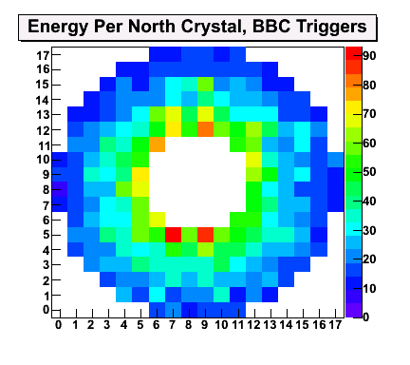
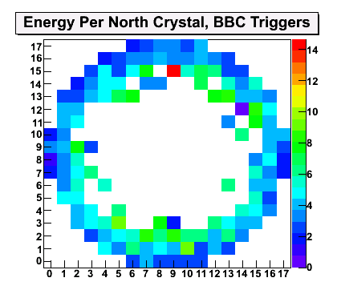
North MPC, Before and After
Cu beam going direction

Slide 32
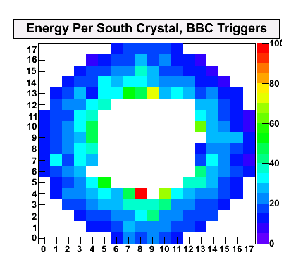
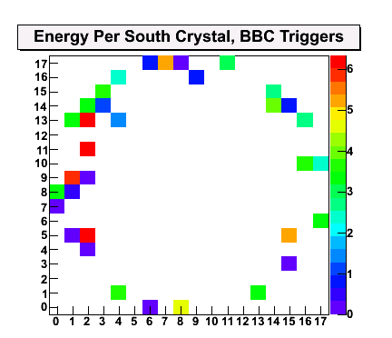
South MPC, Before and After
Au beam going direction
We lost about 300 crystal readout out of 416 in total.
The only way to fix the problem is to wait for summer shutdown.
Add about 2-week extra work to the planned shutdown activities.
Proper collimation between 10:00 and 08:00 clock should be helpful before Run-13

Slide 33
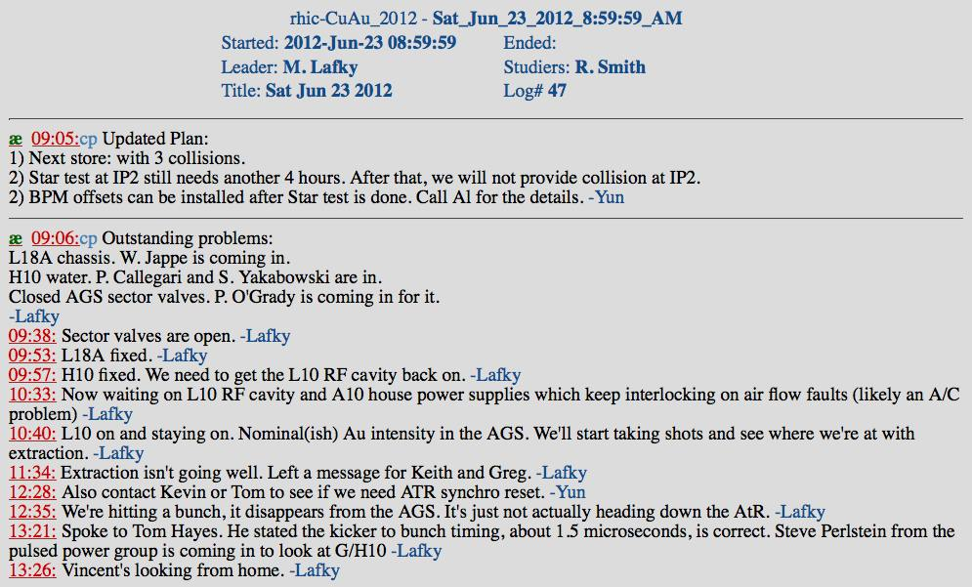
Extended Downtime near the End of
Cu+Au Run (from CA-D eLog)
It seemed taking too much time to recover!!!

Slide 34
Summary
PHENIX/RHIC Run-12 run is a huge success.
RHIC has demonstrated beautifully its versatile colliding capability of different species and energies in a single run-year: 200 and 510 GeV polarized p+p; U+U and Cu+Au collisions with increasing luminosity.
RHIC computing facility is also a bright spot in Run-12, which supported a record-breaking data storage rates and provides efficient computing power for a fast physics data analysis.
Great communication and feedback between CA-D and PHENIX.

Slide 35
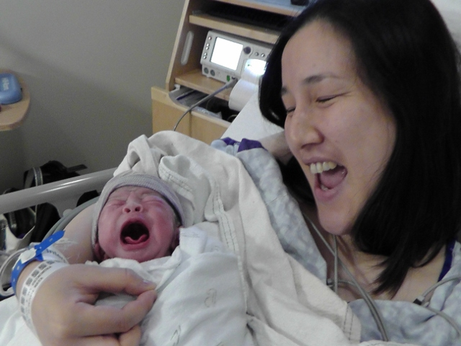
Newest Phenixians
In Run-12, as far as I was informed, there were four new Phenixians born during this period. This magically matches the number of four types of collisions we had in Run-12.
Lisa (Maya and Takashi are the proud parent) came on June 26, 2012, one day after the end of Run-12 physics run.

Slide 36

Acknowledgement
PHENIX would like to thank CA-D for the record-breaking performance in Run-12, especially to three run coordinators: Vincent, Yun and Christoph.

Slide 37

Run-12 Physics Programs
p+p collisions at 200 GeV: Heavy ion reference measurements for separating charm and beauty; Measurement of the transverse structure of proton.
p+p collisions at 510 GeV: Studying the sea quark and gluon spin contribution for resolving the proton spin puzzle.
U+U at 193 GeV: Exploring colliding geometry.
Cu+Au at 200 GeV: Use the unique geometry (core vs corona and asymmetric peripheral) of the colliding system
Projected Data Taking Goals
Species | sqrt(s_NN) | Weeks | Int L dt (|z| <10 cm)
p+p | 200 GeV | 4 | 3.8 pb⁻¹
p+p | 510 GeV | 5 | 9.9 pb⁻¹
U+U | 193 GeV | 3 | 60 μb⁻¹
Cu+Au | 200 GeV | 5 | 2.4 nb⁻¹

Slide 38
Efficiency for Good Physics Runs
2012 200 pp
  Efficiency for Good Physics Runs vs All Runs = 0.829
2012 510 pp
  Efficiency for Good Physics Runs vs All Runs = 0.881
2012 193 UU
  Efficiency for Good Physics Runs vs All Runs = 0.971
2012 200 CuAu
  Efficiency for Good Physics Runs vs All Runs = 0.970
Notes:
From Mike Leitch: For Run12 here are calculations of the fraction of good physics runs (counted in my luminosity totals) wrt all runs (when physics is decalared). So this is an additional efficiency factor that goes on top of the ones I've calculated already in real time during the run (those were just the faction of luminosity in declared physics (from CAD) that our DAQ was running for).
DAQ phys
------- --------
200 pp 0.674 0.829
510 pp 0.666 0.881
193 UU 0.788 0.971
200 CuAu 0.804 0.970

