Slide 1
AGS Polarized Protons: What Now?
Haixin Huang
RHIC Retreat 2012
July 25, 2012

Slide 2
Improvement in Run12
Surveyed AGS ring (moved 70+ magnets).
Booster radius wobble at 98ms was found and corrected, which improves intensity efficiency in the Booster.
CNI injection measurement (reproducible, fast) for the first time.
The measurement allows to improve the Booster Gγ=3 correction.
New analysis was in use for CNI polarimeter: fast; same A_{N} as in RHIC, but added rate correction factor.
Sweep mode (similar to RHIC) works to give precise polarization profiles.
9th harmonic feed-forward (Sev, Leif) greatly reduced the tuning time.
JQ timing real time measurement (Peter Thieberger). Found accumulated error in JQ timing (control software bugs) and consistent wrong up (30μs) and down (30μs) timing. But improvement in polarization is not easily visible.
Vertical Beta function measurement with new dipole at vertical IPM (Leif).

Slide 3
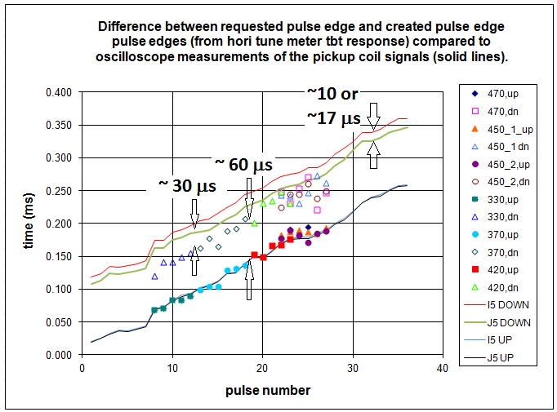
Note: the ~30 μs are due to pulse mid-point vs. edge timing
(Leif, John Morris)

Slide 4
AGS Injection Polarization Measurements
Date Time Asymmetry Err Pol(200MeV) Normalized Asym.
(10^-3) (10^-3)
2/15/2008 61.4 0.20 76.0 64.63
2/5/2011 63.8 1.10 79.1 64.52
1/23-27/2012 68.0 0.46 79.6 68.34
Injection polarization (by e880 polarimeter) is higher this year by a few percent. The gain vs. last year could be due to different Booster harmonic correction.
200MeV polarimeter had background issue before run9, but I ignored them here and assume the values are correct.

Slide 5
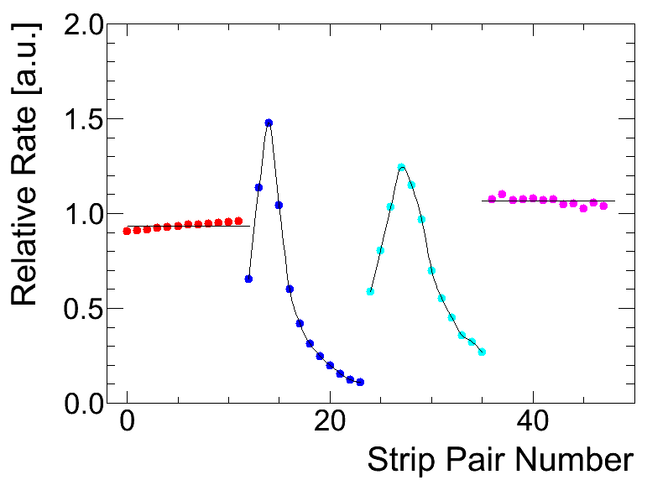
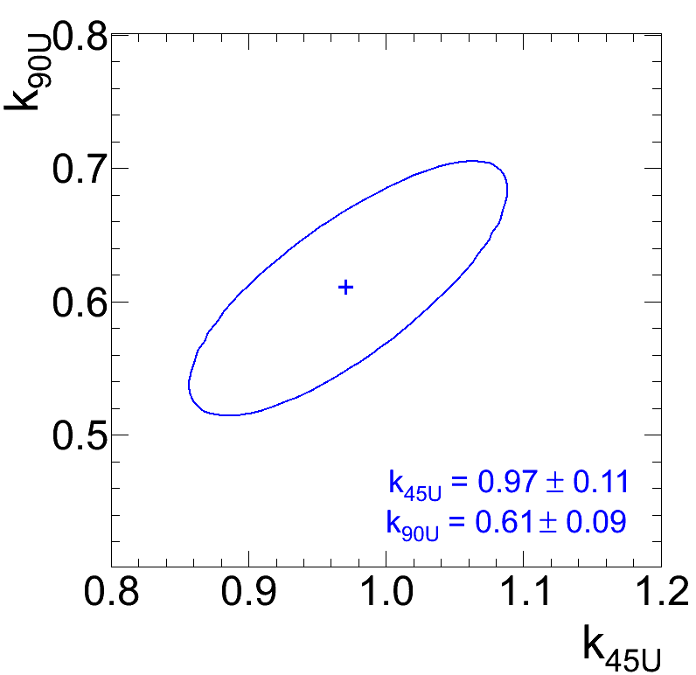
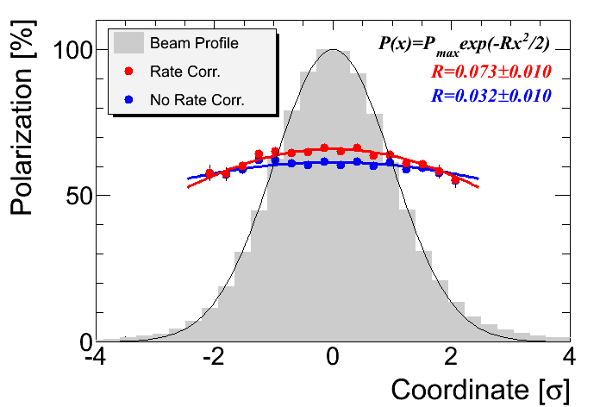
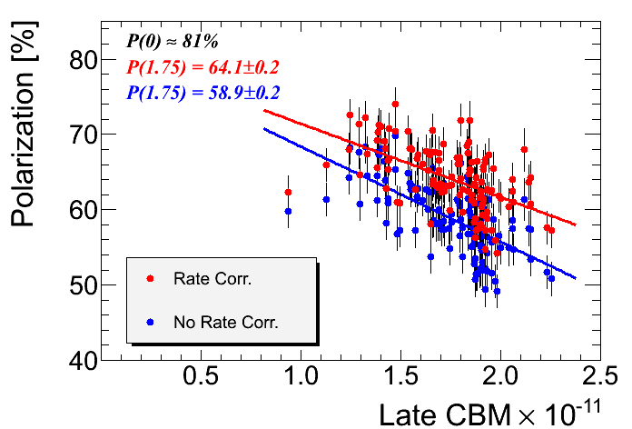
Rate Corrections for the CNI polarimeter
（Andrei）
In the 90 degree detectors the rate is strip dependent. It may be employed for experimental determination of the parameter k
Rate dependence of signal detection efficiency (due to pileup)
ε(r) = e^{-kr} ≈ 1-kr
results in systematic error of polarization measurements
P_{meas.} ≈ P_{true} × (1-kr)
In AGS r ≈ 0.1-0.15 (Run12)
Naive estimate: k ≈ 0.75
45U
90U
90D
45D
Horizontal Polarization Profile
Polarization in RHIC reference runs

Slide 6
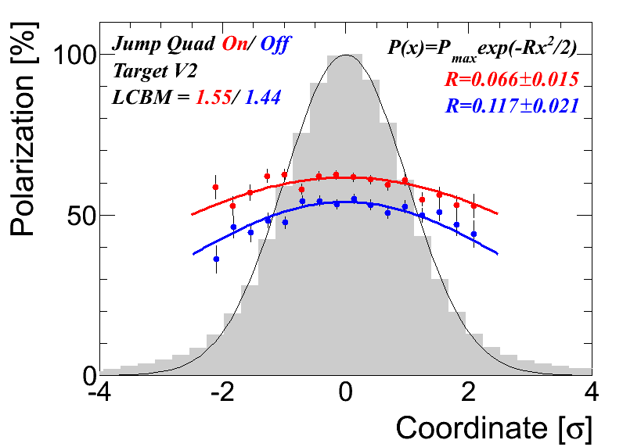
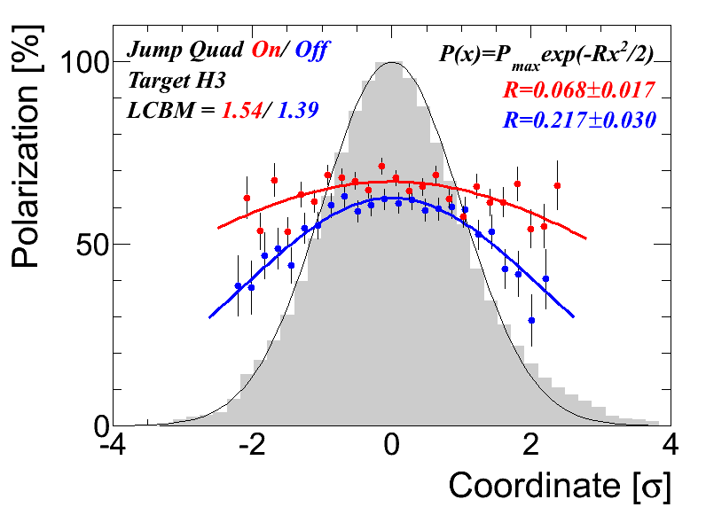
Run 2012 Polarization Profiles
（Andrei）
Horizontal
Vertical
P₀ = <P> (1+<R_{H}>) (1+<R_{V}>)
P₀, the polarization of the core particle, should be equal to the maximum achievable polarization.
Horizontal profile: JQ on/off: P₀ is 70.2/73.4, consistent.
Vertical profiles: JQ on/off: P₀ is 76.4/85.1, not consistent.
But note the large error bars of all R values.
Not a perfect experiment: there was beam loss around 230ms, as the orbit was not corrected without beam loss for both jump quads on and off states.

Slide 7
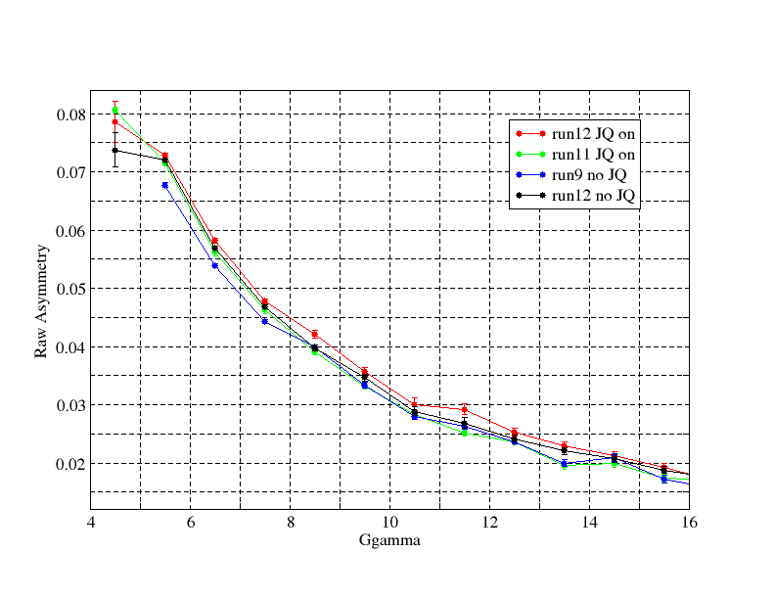
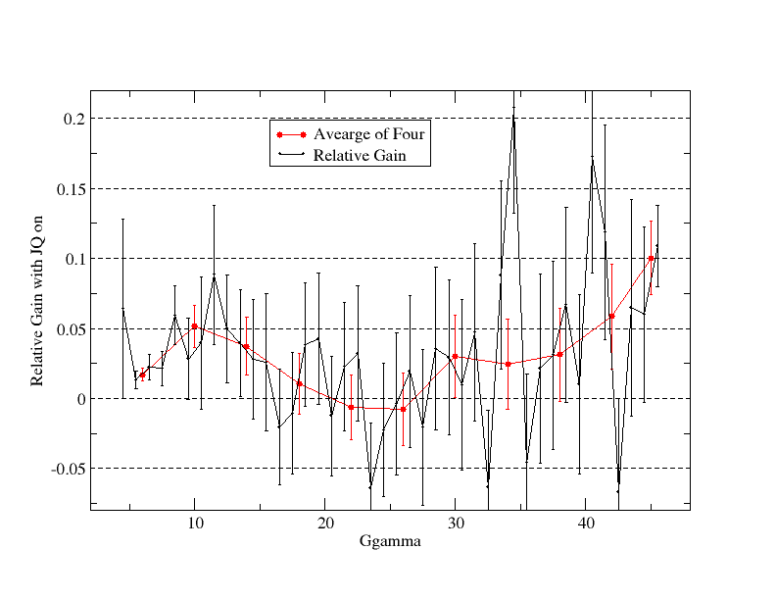
The Polarization Gain at Last One is Large
(ramp measurements from Kin)
The relative gain from JQ shows in last a few jumps: overall 10.0+-2.6%.
Gγ 12 off 12 on 11on 9off
5.5 .0720 .0729 .0715 .0677
6.5 .0569 .0582 .0563 .0539
7.5 .0468 .0478 .0463 .0443
8.5 .0398 .0422 .0392 .0400
Smaller difference between run12 and run11 than the injection measurements showed. The Booster sin3v correction may not be the only reason for higher polarization at extraction.

Slide 8
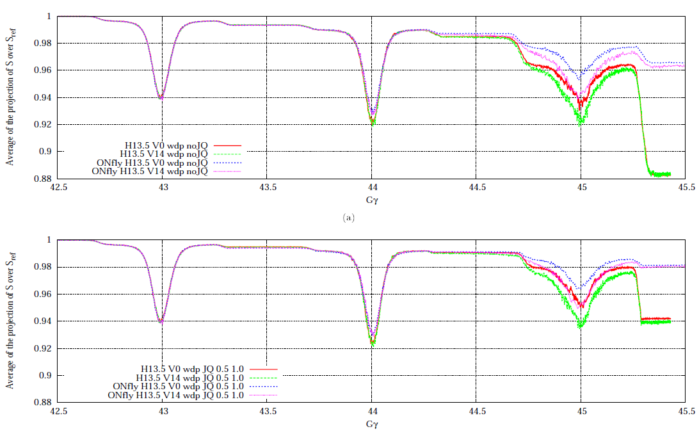
Polarization Gain @ last 3 Jump
Extraction on the fly only helps last 2 hori. res., but it is a 4% effect
The average of JQ timing scan:
Normal one : 69.04+-0.90
New last 3 : 67.90+-0.97
Normal last 3: 68.55+-0.97
JQ off : 63.81+-0.97
JQ on/off gain:
New last 3: 6.4+-2.2%
Normal last 3: 7.4+-2.2%
Normal all: 8.2+-2.2%
Simulation last 3: 6.4%

Slide 9
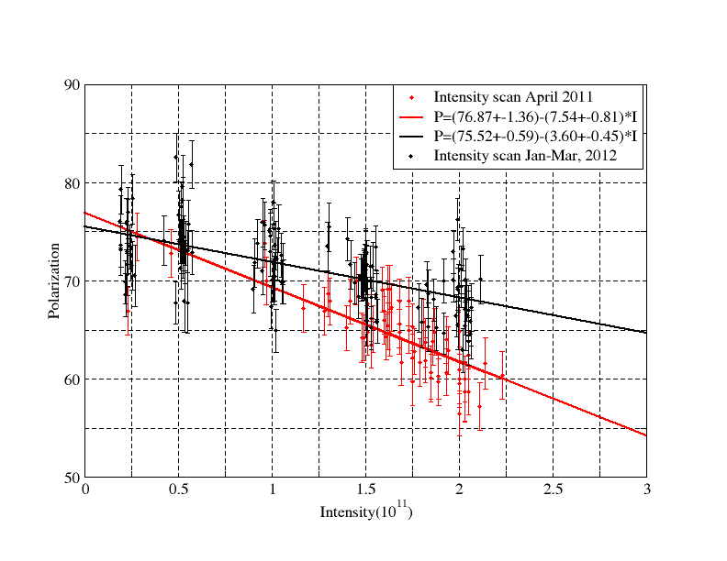
Better Polarization This Year
Fit @1.5*10^11:
65.5+-0.8% (run11)
70.1+-0.4% (run12)
Relative gain of 7.1+-1.4%
Smaller slope due to emittance improvement.
Same Analysis process for both runs (with rate correction)

Slide 10
Polarization RHIC Jet @ Injection
Yellow Injection measurement with jet: 63+-4.4% (whole beam)
No. V2 target H1 target
1st 63.84+-0.95 68.41+-1.66
2nd 63.92+-1.08 70.98+-1.36
3rd 65.69+-1.09 65.08+-1.38
Average 64.42+-0.60 68.23+-0.70
V2 target is the one we used most for RHIC fill during run12.
the spin match factor for yellow is 0.991 (meaning yellow should be lower than AGS by less than 1%).
AGS measurements were fixed target measurement. With polarization profile, the corresponding polarization with whole beam should be lower. Given the R value of 0.067 in both planes (in the AGS), the numbers for V2 and H1 targets are 62.33 and 66.01,respectively for the whole beam. Taking into account the 0.991 factor, the numbers are 61.77+-0.60 and 65.42+-0.70, respectively.

Slide 11
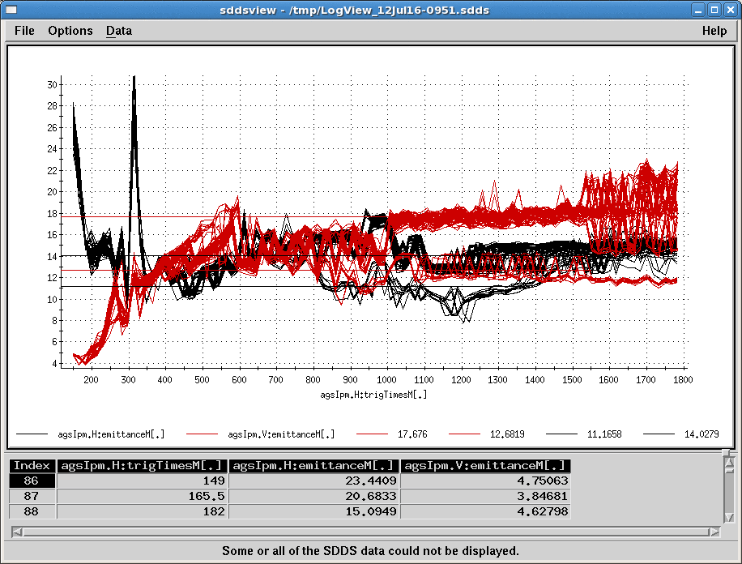
AGS IPM Emittance
Variation of +-2pi due to fitting.
RF off (@800ms) data showed the effect from space charge.
Beta function: 22m used everywhere. In reality (from model and some from measurement): β_{x}=55m, β_{y}=12m @ injection; β_{x}=β_{y}=23m @ flattop (600ms).
Vert. emittance: 8.7pi(inj.)->12.7pi(ext.)
Hori. emittance: 10.2pi(inj.)->11.2pi(ext.)
For 10^11. The modest growth shown here will be larger for higher intensity.

Slide 12
Emittances from run9 to run12
There is not much difference of emittances reported from the BtA multi-wire this year vs past. The reduction of emittance seen this year is believed to be in the AGS.
The parameter c was fitted from the RF on/off measurements (assuming RF off gives the true beam emittance). c=1.546 for vertical and c=1.141 for horizontal from fitting the intensity scan emittance data. For 1.5*10^11 intensity, here is the list of emittances from past a few years:
inj. E_{y} inj. E_{x} ext. E_{y} ext. E_{x} Booster Input
Run9 10.20 7.90 14.82 11.37 4.2*10^11
Run11 9.10 10.53 17.21 12.59 3.3*10^11
Run12 8.41 9.65 13.89 11.09 3.7*10^11
The difference between run11 and 12: more Booster input, higher vertical chromaticity around 200-300ms.
Using beta functions derived from run12 machine is a fat assumption.
Injection emittance is not corrected by space charge.
The data were taken throughout the run, but not in RHIC fill mode (less Booster input intensity).

Slide 13
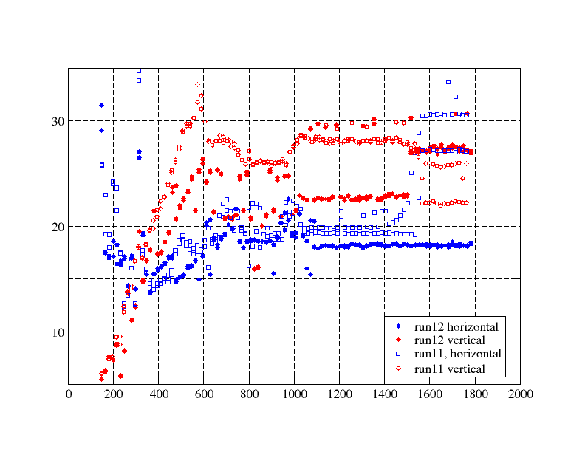
Emittance Seen by IPM
4/12/2011 vs. 1/24/2012 with same intensity 1.8*10^11. Both planes are smaller this year.
The reduction of emittance is likely due to more Booster acraping and the AGS injection and ramp setup (subtle difference in vertical chrom settings between 200-300ms, better matching between the two jump quads). Further study is needed.
Red: vertical
Blue: horizontal
Deviation starts here.

Slide 14
Some Running Issues
Vertical dipole corrector lurch disappeared in the end of Feb. It came back in the end of March. It disappeared by itself after one switch to uranium user. It reappeared in the last three days and we did not find the source of it. Offline analysis showed that it could be due to correctors in phase with D12. P/S test is going on.
CNI horizontal target drive jump several mm suddenly. It happened less when the speed was reduced. This drive needs to be checked and probably replaced during summer shutdown. This requires repair or replacement.
We don’t have a model for the jump quad P/S so that we can “predict” what voltage is needed for a given jump pulse. This makes changing jump quads pulse function very difficult, if not impossible.

Slide 15
Polarization Front
ZGOUBI has been setup to do spin tracking for the AGS. It can provide parameter scans for jump quads setup ( JQ timing, 3-D emittance, ramp rate, jump quad pulse shape). With several sets of designed JQ comparison measurements (JQ on/off, JQ timing scan), we can compare the simulation with experimental data.
The new JQ timing function derived from the horizontal tune measured this year gave lower polarization. The polarization with last three pulses only showed comparable results from both new and old JQ timing functions. They are better than the JQ off and close to JQ on old JQ timing function. However, the measurements with old JQ timing gave higher polarization when all pulses on. It is a puzzle. To make sense, some JQ pulses in the middle of the energy ramp have to hurt polarization. We don’t have explanation for that yet.
It seems that we did not get all the benefit of jump quads in the early part of the ramp. Further simulation and experiment are needed. In addition, there is no visible emittance growth when left the jump quads on across transition. We should try to jump throw more resonances next run.

Slide 16
What Now?
Add RHIC type IPM into AGS (horizontal first), which can provide turn-by-turn emittance (critical for injection match) and does not have space charge problem.
With higher input intensity from source next year, it is possible to capture at Booster with two or even three buckets. The direct benefit is smaller longitudinal emittance, which should allow higher intensity at RHIC rebucketing. We can fill yellow with two bunches (same sign) or even blue, if experiments agrees.
AGS cycle shorter cycle: 4s. -> 3s. This is to reduce RHIC filling time to reduce emittance growth at RHIC injection. The jump quads LV PS needs modification.
New C5 corrector for horizontal beta function measurement.
Test of extraction-on-the-fly. But first need expert to check the feasibility with 9MHz cavity.
AGS ZGOUBI model as (semi-) online model, behind optical control, IPM.
Automatic IPM beta function measurement.
Automatic emittance correction (from space charge, dispersion-> requires longitudinal dimension measurement).
Automatic chromaticity measurement.

Slide 17
Summary
We have seen higher polarization and smaller transverse emittance this year. Polarization is higher as we push bunch intensity the same time.
The gain of polarization is due to higher injection polarization, smaller emittances.
In the coming run, polarization gain has to come from further reduction of emittance and optimization of tune jump quads operation.

