Slide 1
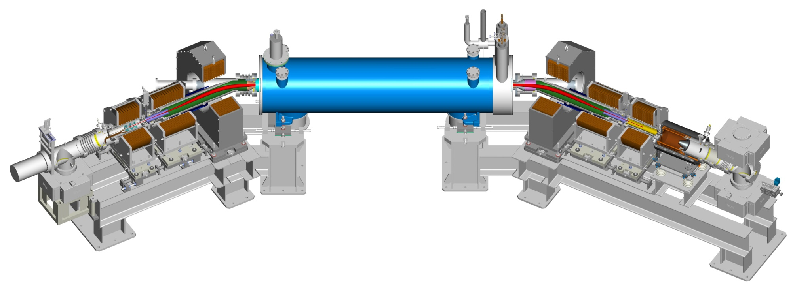
RHIC Elens Status and Its Commissioning Plan
for Run 13
W. Fischer† , Z. Altinbas, M. Anerella, E. Beebe, M. Blaskiewicz, D. Bruno, W.C. Dawson, D.M. Gassner, X. Gu, R.C. Gupta, K. Hamdi, J. Hock, L.T. Hoff, A.K. Jain, R. Lambiase, Y. Luo, M. Mapes, A. Marone, T.A. Miller, M. Minty, C. Montag, M. Okamura, A.I. Pikin, S.R. Plate, D. Raparia, Y. Tan, C. Theisen, P. Thieberger, J. Tuozzolo, P. Wanderer, S.M. White and W. Zhang
25 July 2012, Brookhaven National Lab.
Xiaofeng Gu

Slide 2
A Introduction and Status of The Elens Project
B Elens Commissioning and Its Effects on Operation
Xiaofeng Gu

Slide 3
A Introduction and Status of The Elens Project
Xiaofeng Gu

Slide 4
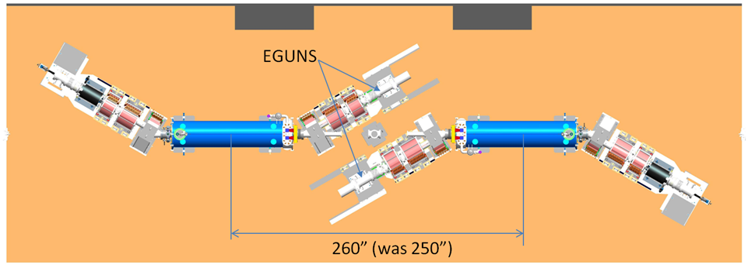
Introduction: The Layout of E-lens System
Blue elens
Yellow elens
Blue elens has 5 mm offset mechanically, and yellow has -5 mm;
At IR10, blue elens is on south side, and yellow is on north side.
Xiaofeng Gu

Slide 5
Introduction: The Layout of E-lens System
E-Gun: Electron source, e-beam current & energy control with DC mode or Pulse Mode
GS1 & Main Magnet: E-beam size control by changing field strength ratio between them
GSB
Superconducting Magnet
CSB
GS2
CS2
GS1
CS1
GSX&GSY
CSX&CSY
E-Gun
Collector
GSX & GSY: E-beam position control
GS2, GSB, CSB, CS2,CS1, CSX and CSY: Beam trajectory control
Xiaofeng Gu

Slide 6
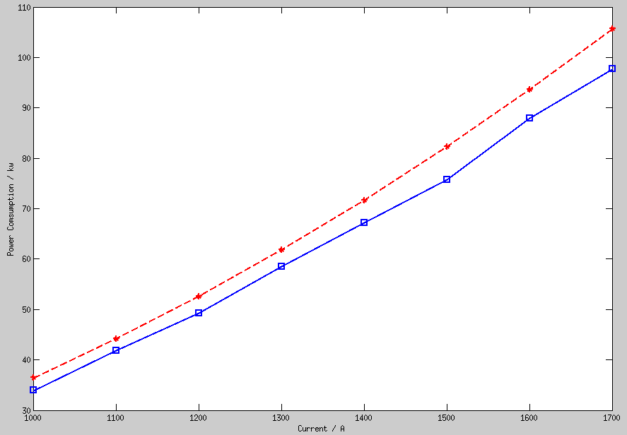
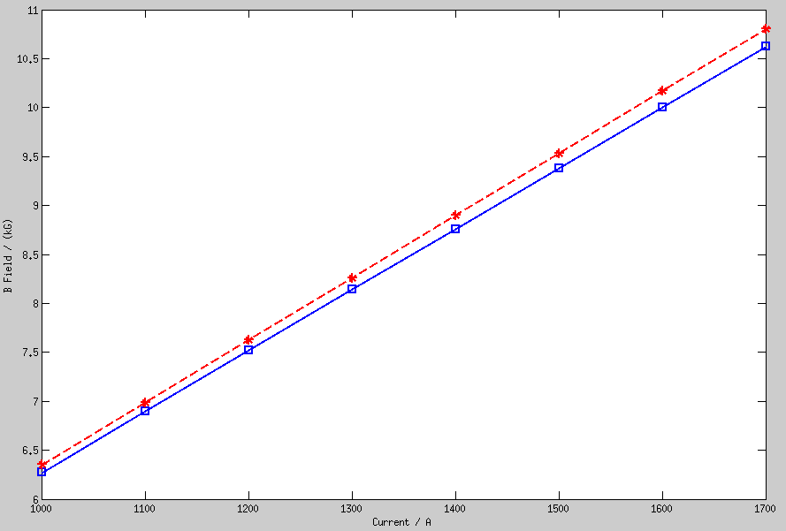
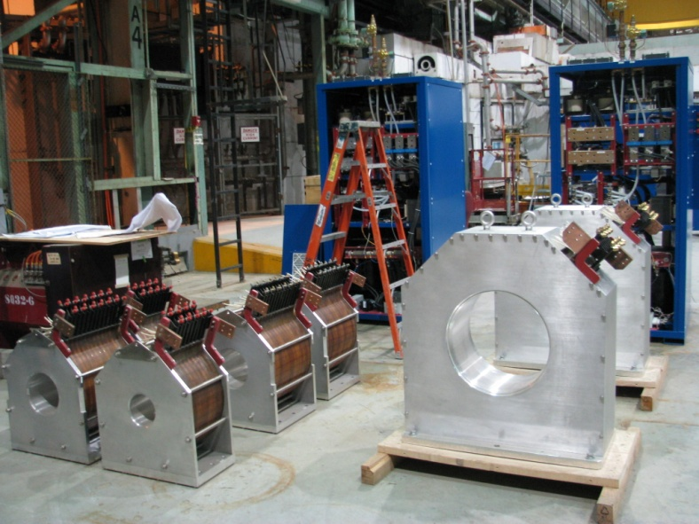
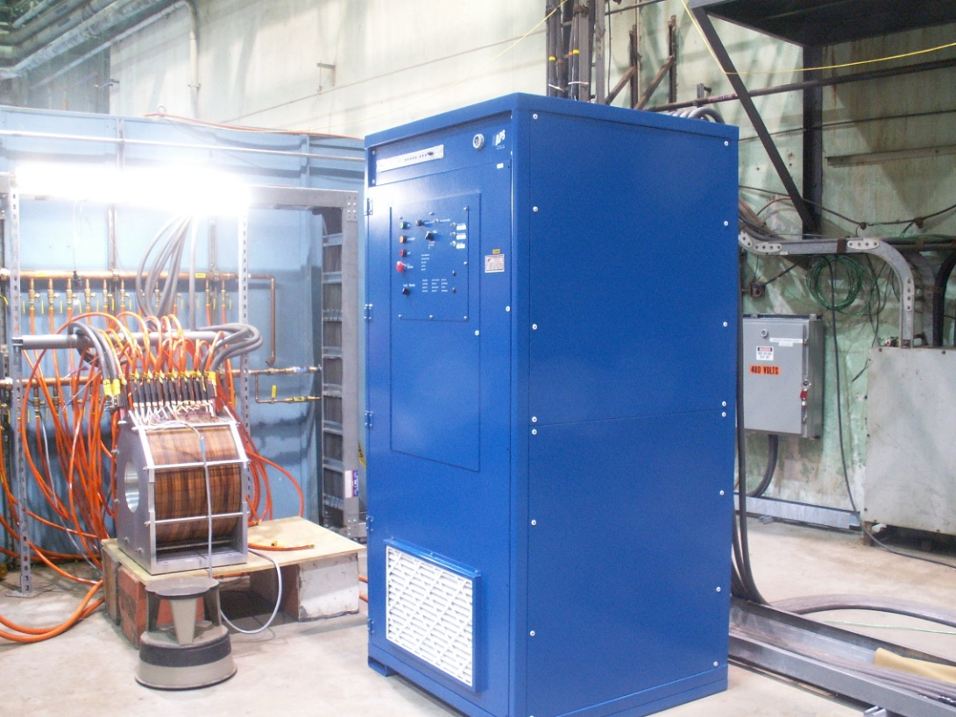
Status: Warm Solenoid and Test
Power
B Field
Xiaofeng Gu

Slide 7
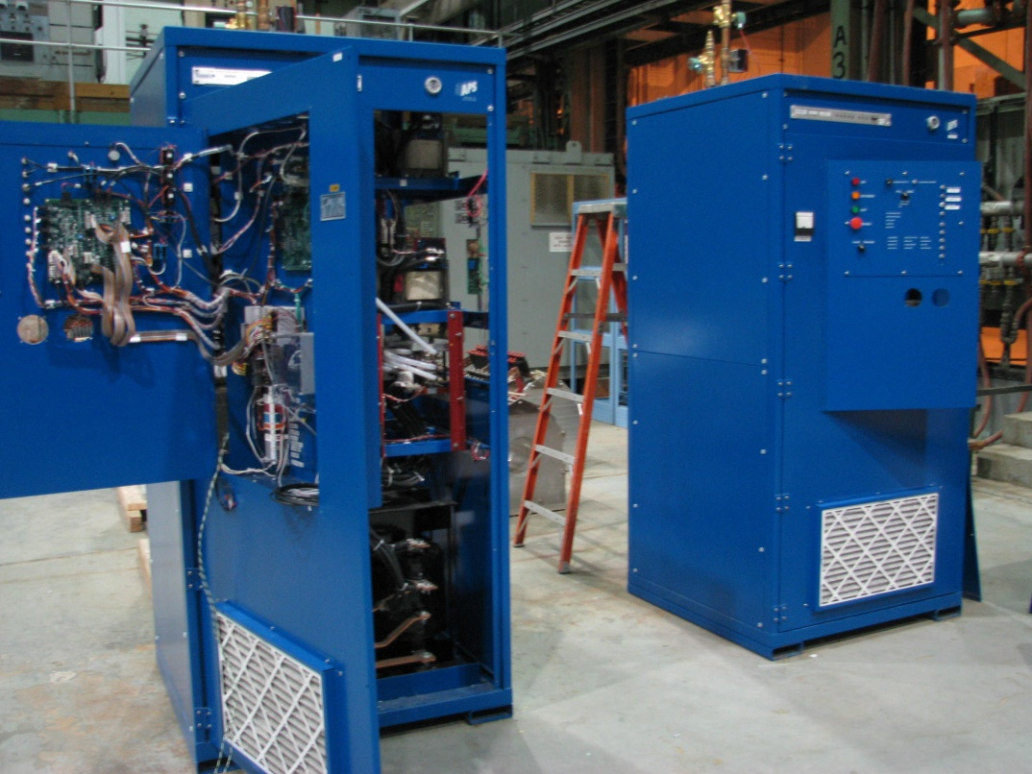
Status: Power Supplies and Test
Xiaofeng Gu

Slide 8
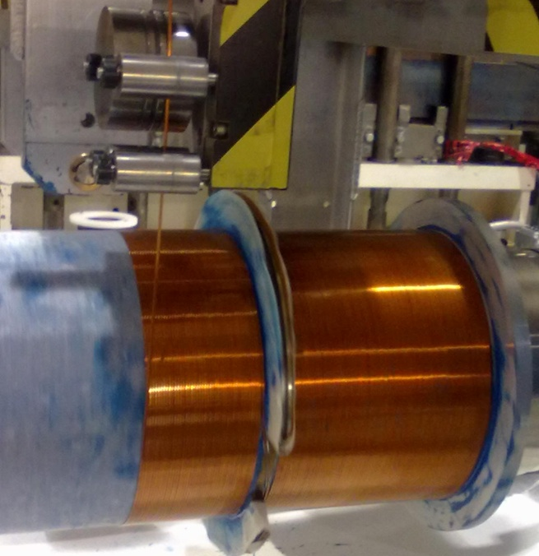
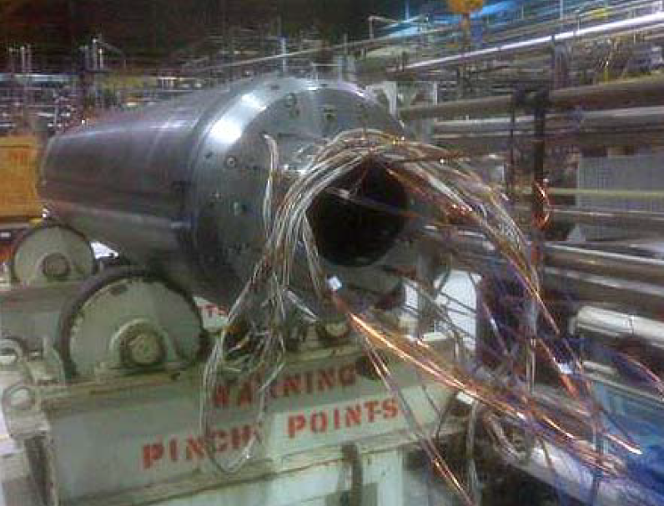
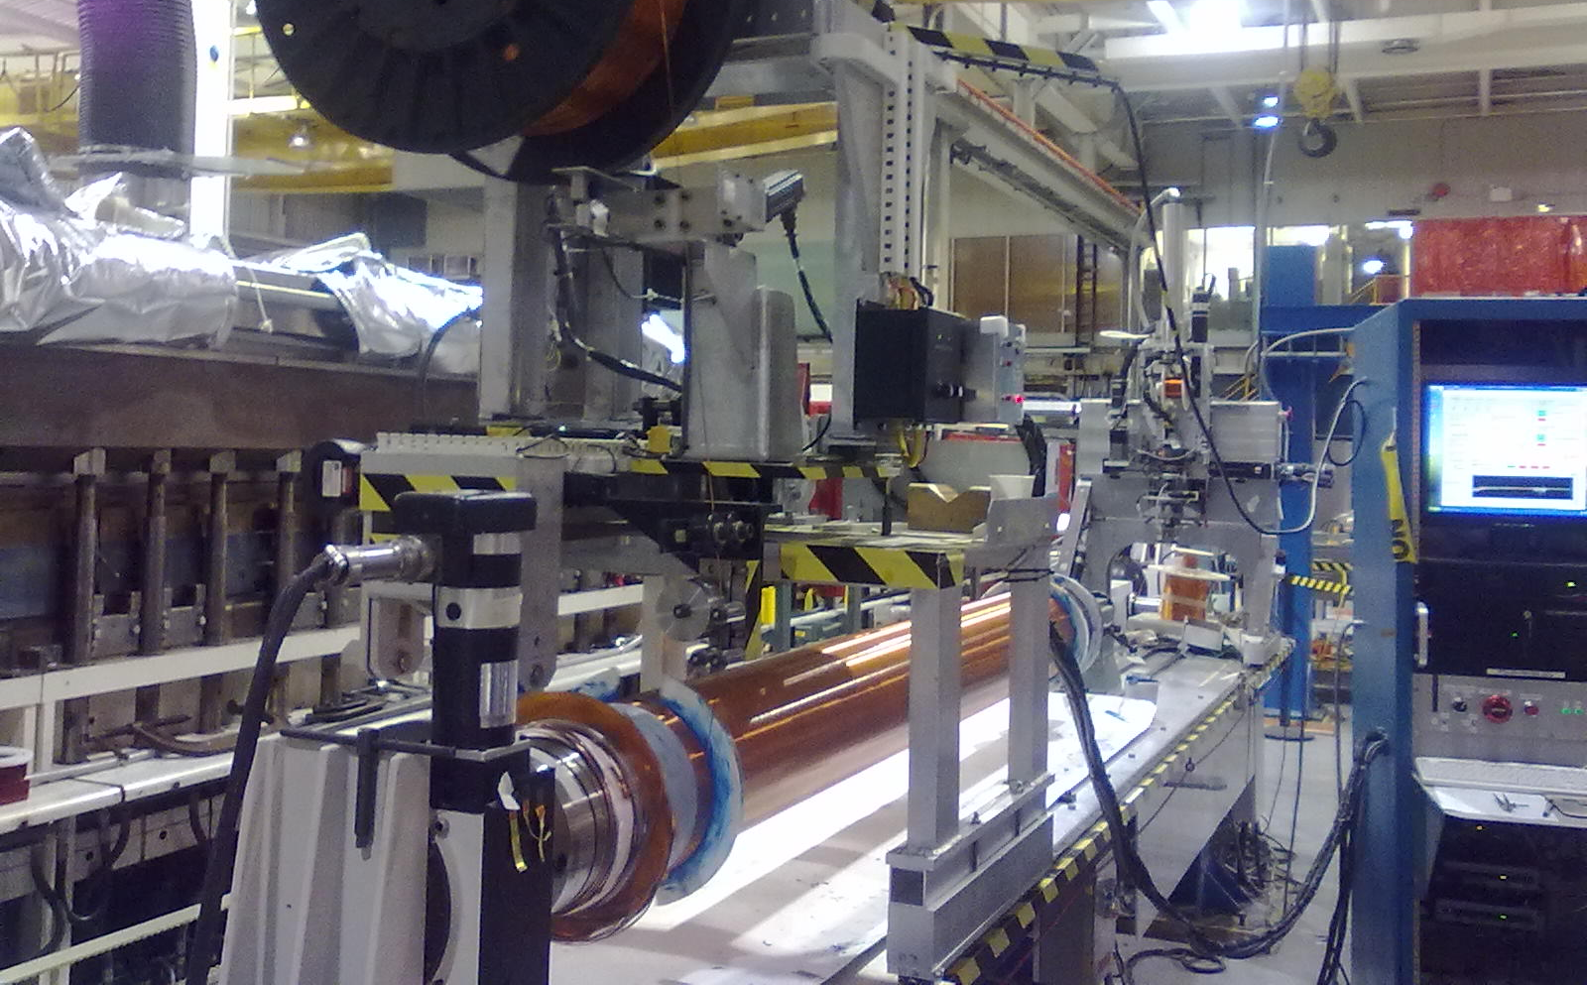
Status: Main Solenoid
Two superconducting coils fabrication is under the way.
#1 reached full field (6T).
#1nd completion in October, #2 in November.
Blue elens will be available for 2013 proton run.
Courtesy of SMD
Xiaofeng Gu

Slide 9
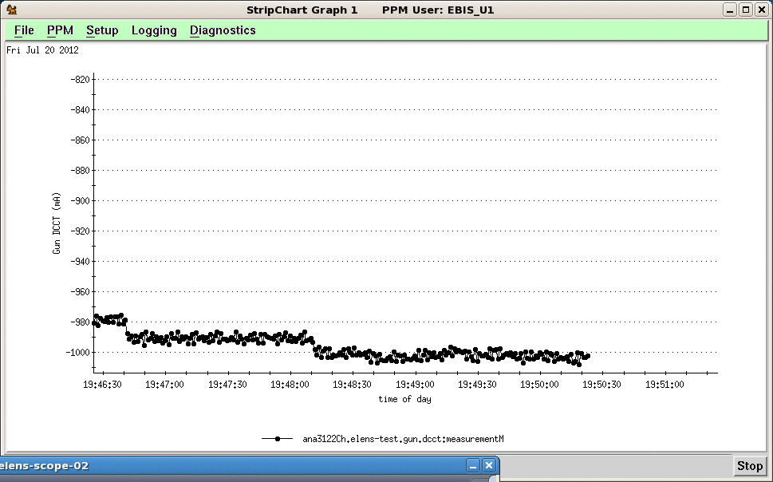
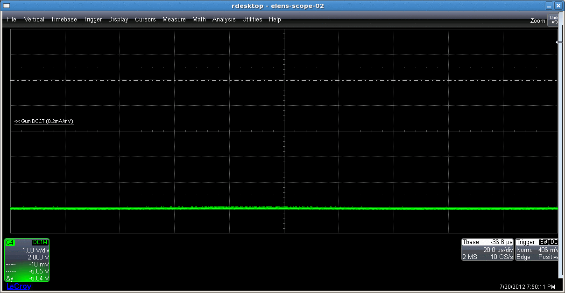
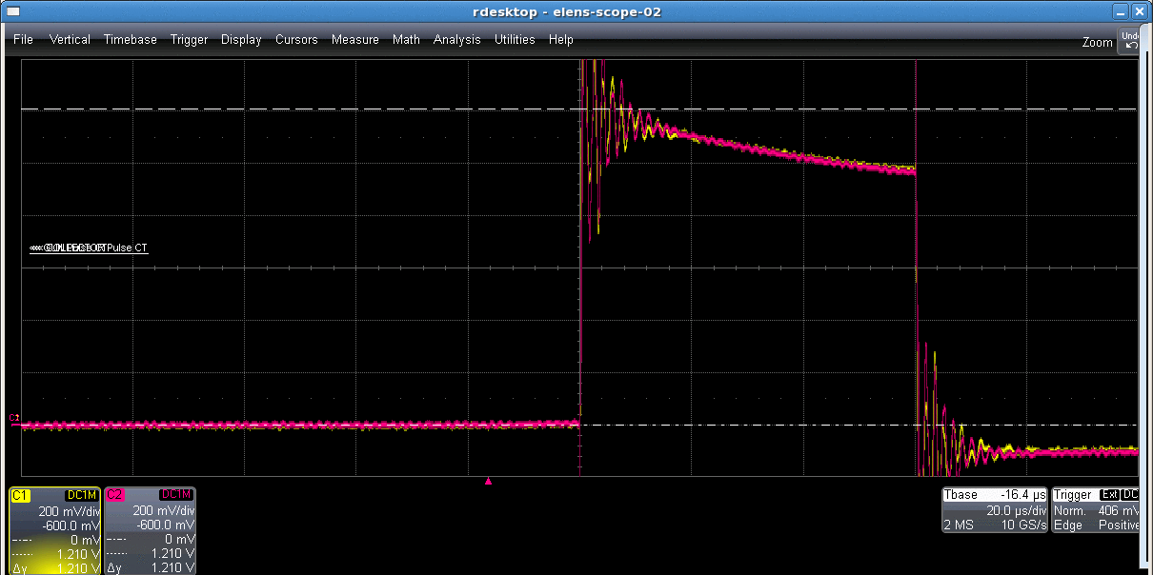
Status: Electron Gun Current (Test Bench)
DC beam 1040 mA
Pulsed beam 1210 mA
Xiaofeng Gu

Slide 10
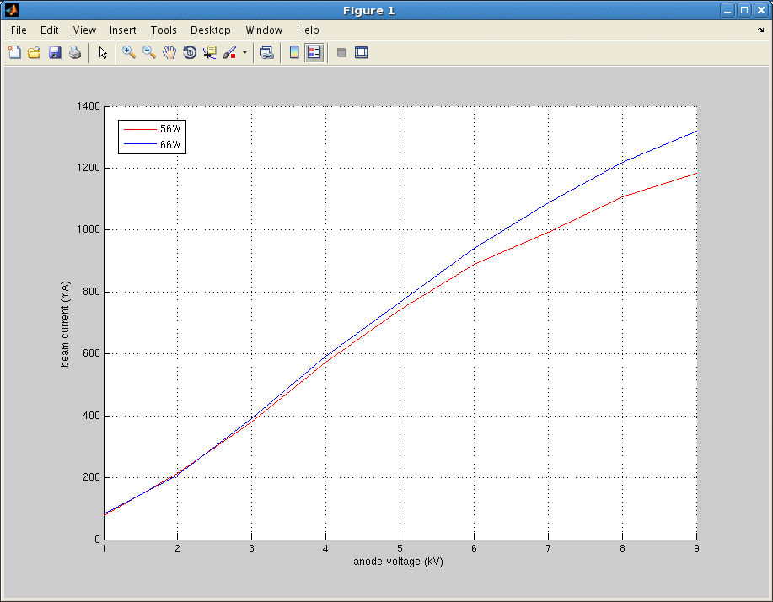
Status: Electron Gun Current (Test Bench)
Pulse Mode
Xiaofeng Gu

Slide 11
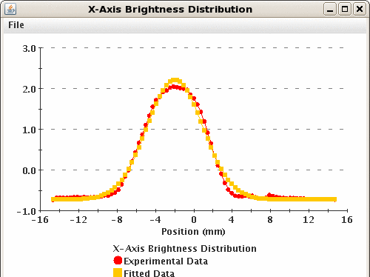
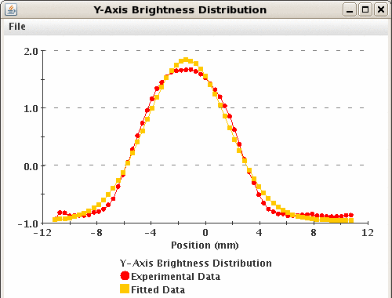
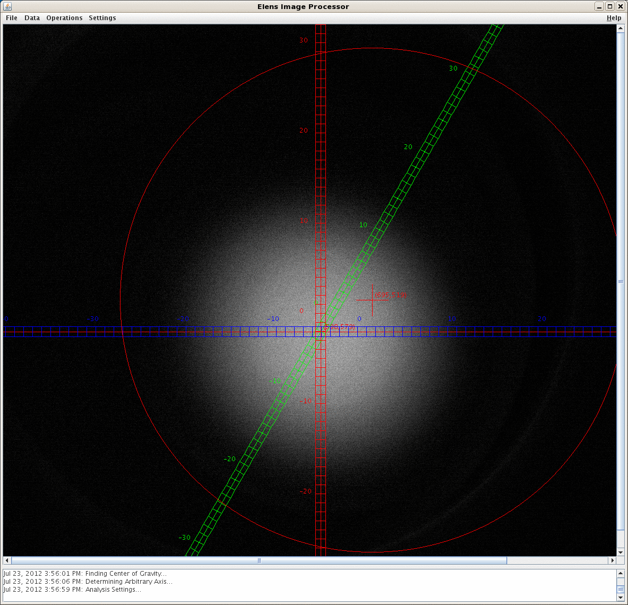
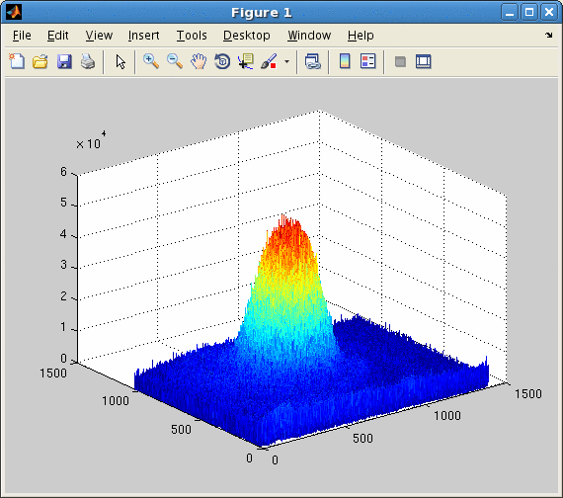
Status: Electron Gun Profile YAG (Test Bench)
Xiaofeng Gu

Slide 12
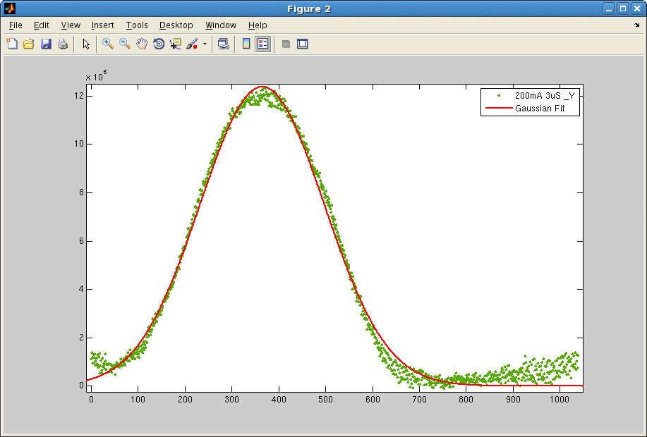
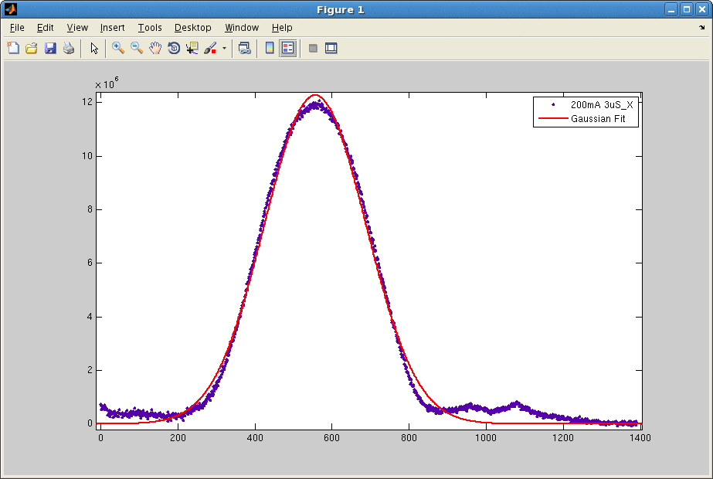
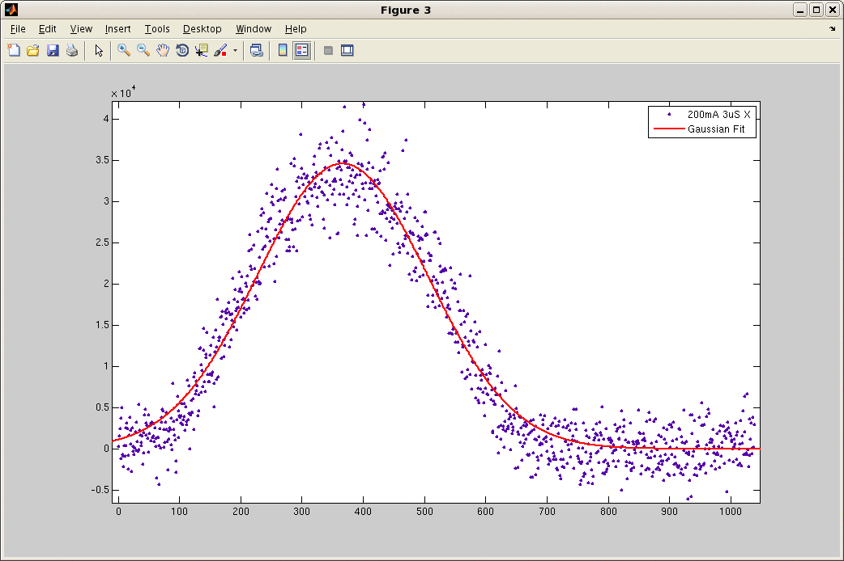
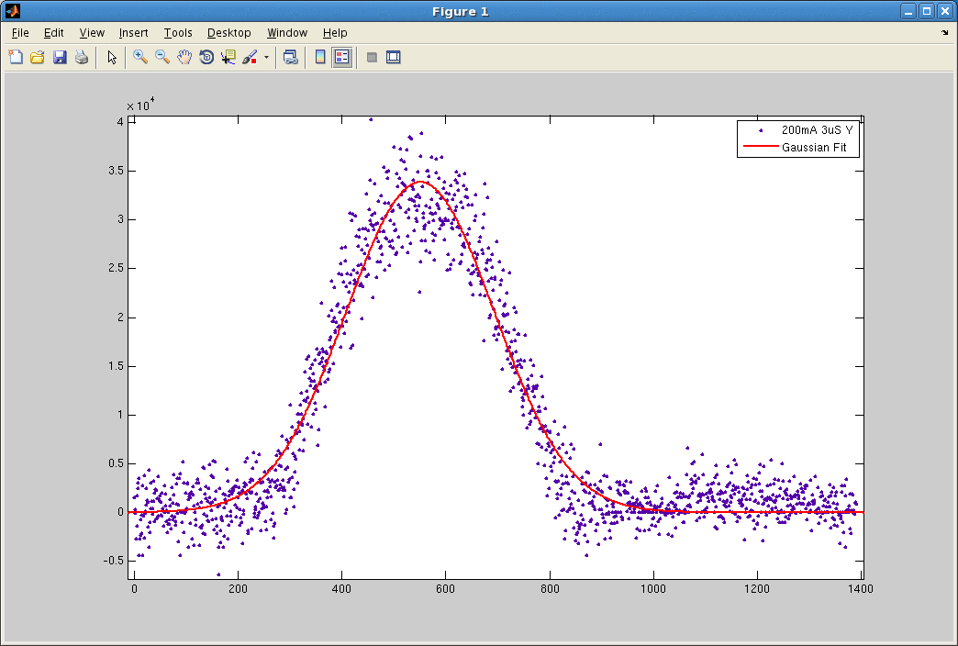
Status: Electron Gun Profile YAG (Test Bench)
Xiaofeng Gu

Slide 13
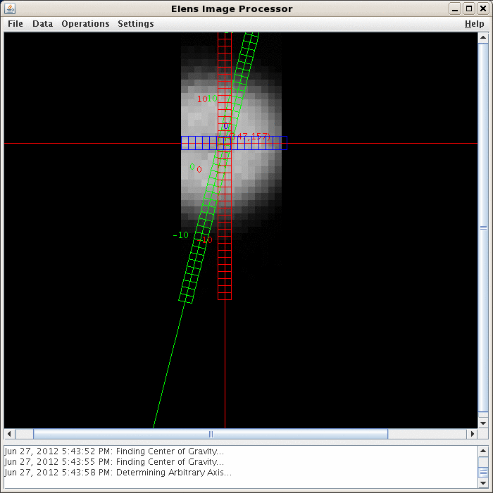
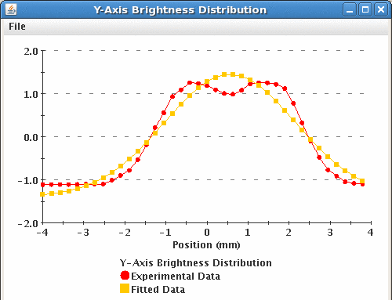
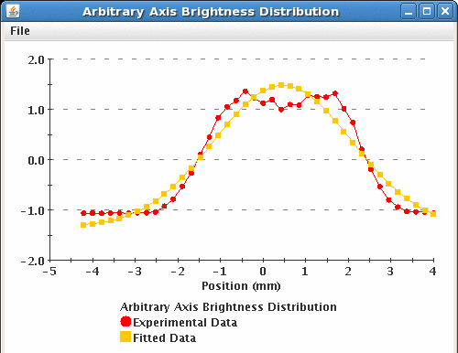
Status: Electron Gun Profile Pin-Hole Scan (Test Bench)
Xiaofeng Gu

Slide 14
Instrumentation
E-Beam Diagnostics Quantities
Beam Alignment : BPM (2) (also for p-beam), Backscattered electron monitor(1)
E-beam Current : BCT (3), e-beam Loss (drift tubes)
E-beam Profile : YAG Screen (1), Pin-hole detector (1)
Ion Current : Ion collector (1)
Collector Temperature: RTD (8)
Xiaofeng Gu

Slide 15
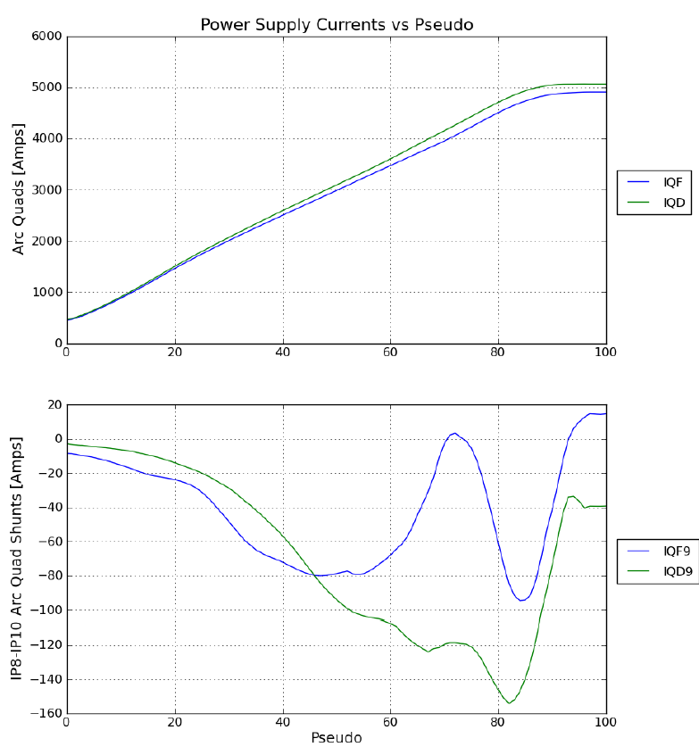
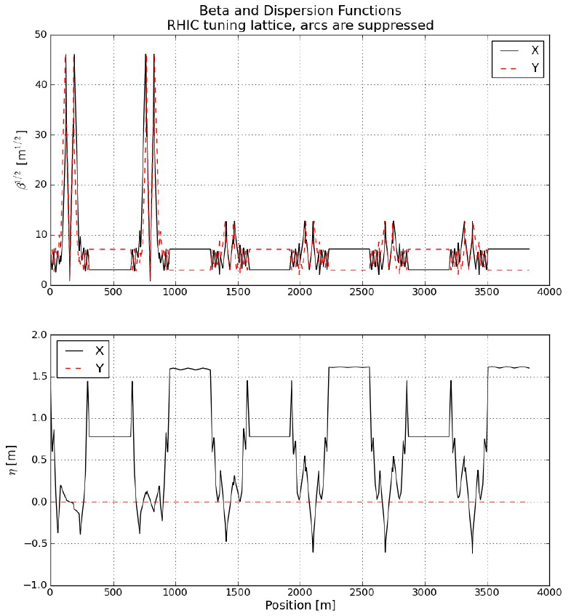
Lattice Design
Courtesy of Steve
Xiaofeng Gu

Slide 16
Others
Now, we are also working on:
Control software and applications
78.8 k Hz modulator
Backscattered electron detector
Tunnel installation
Superconducting solenoids
Xiaofeng Gu

Slide 17
B Elens Commissioning and Its Effects on Operation
Xiaofeng Gu

Slide 18
Strategy
Elens Hardware Commissioning (Before Cooling Down)
Electron Beam Commissioning (Before Cooling Down)
Commissioning with Proton Beam
Ramp development with all elens solenoids on (orbit control)
100 Hz and 78.8k Hz modulator test with pulse electron beam in abort gap
Transverse position pre-alignment with BPM (local orbit control)
Longitudinal alignment electron beam to the last proton bunch
Change to DC beam if single bunch proton beam life time is good.
Tune proton beam or electron beam according to the collision detector.
Xiaofeng Gu

Slide 19
Single Bunch Compensation
The abort gaps are aligned in IP4 and IP10.
Xiaofeng Gu

Slide 20
Instrumentation in RHIC
RHIC Orbit:
Global Orbit Feedback, Local Orbit Control (Chuyu, Al)
Beam Loss & Intensity Monitors (Bunch-by-Bunch)
pin diode BLM’s, WCM (bunched), fill pattern
Tune (Bunch-by-Bunch)
Schottky Cavity, BBQ? ARTUS?
Emittance (Bunch-by-Bunch )
CNI polarimeter
Longitudinal Profile (Bunch-by-Bunch)
WCM (bunched beam)
Xiaofeng Gu

Slide 21
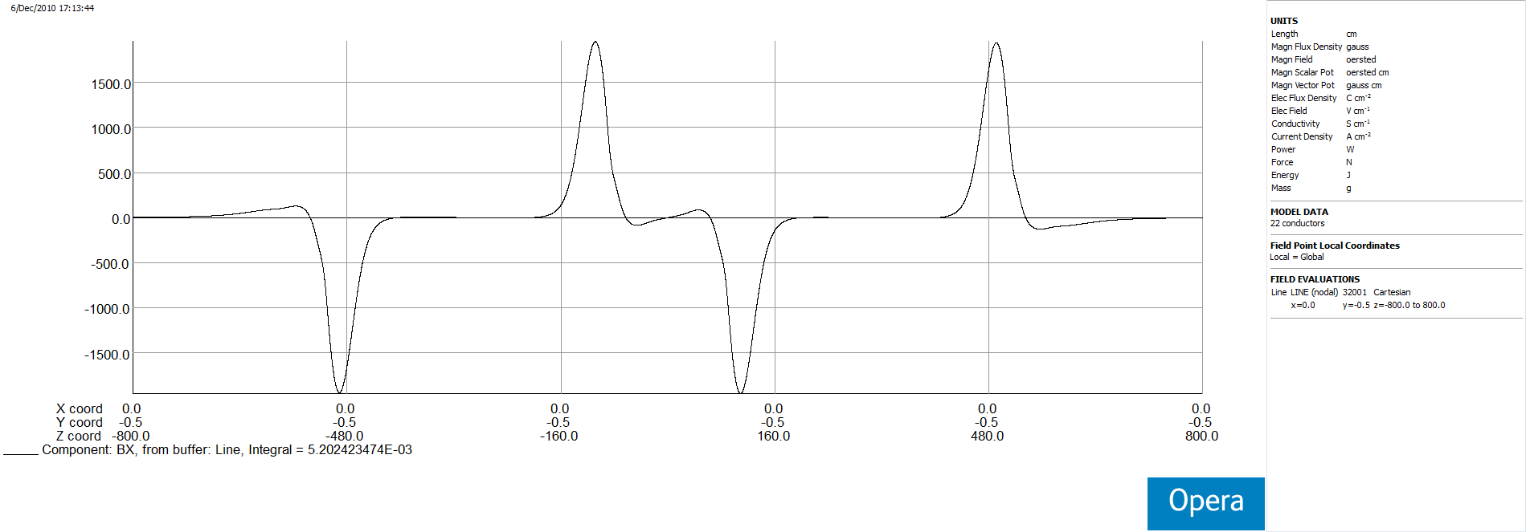
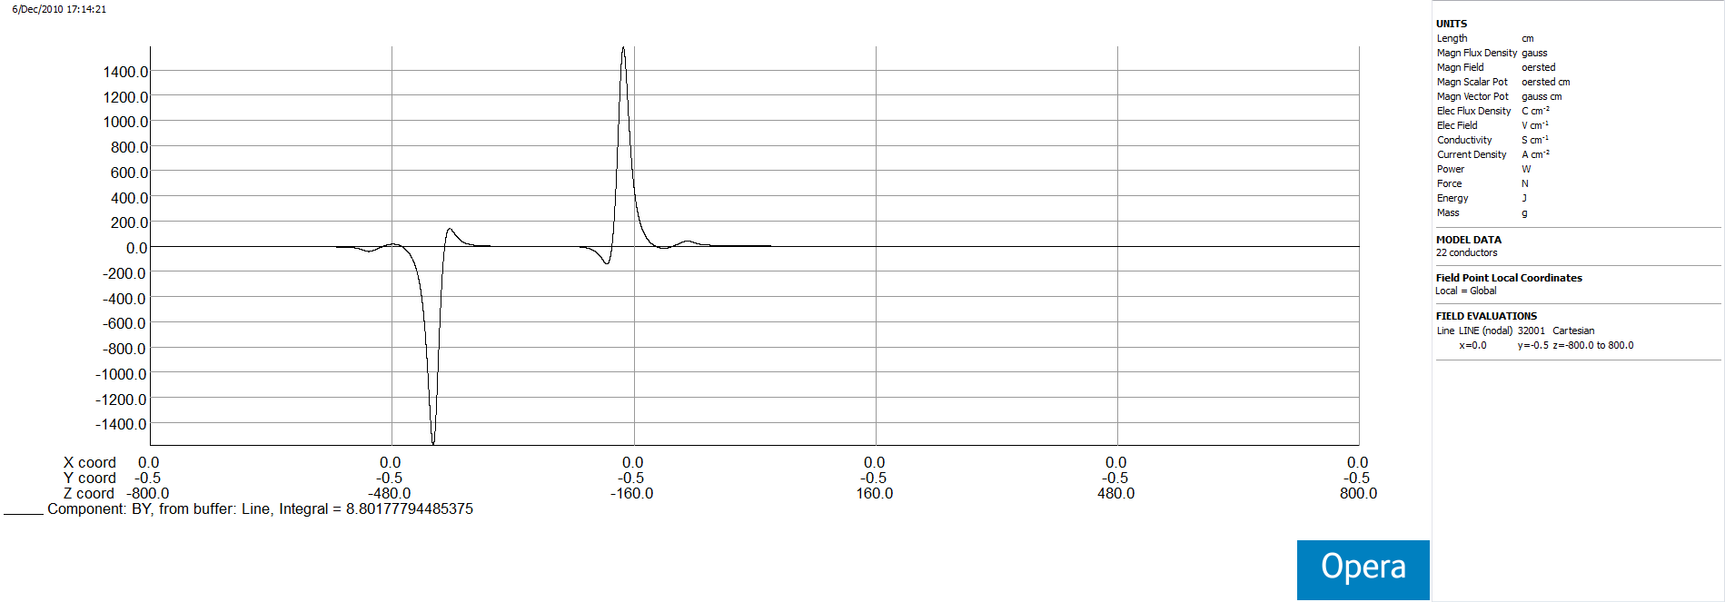
Transverse Magnetic Field on Proton Beam
Xiaofeng Gu

Slide 22
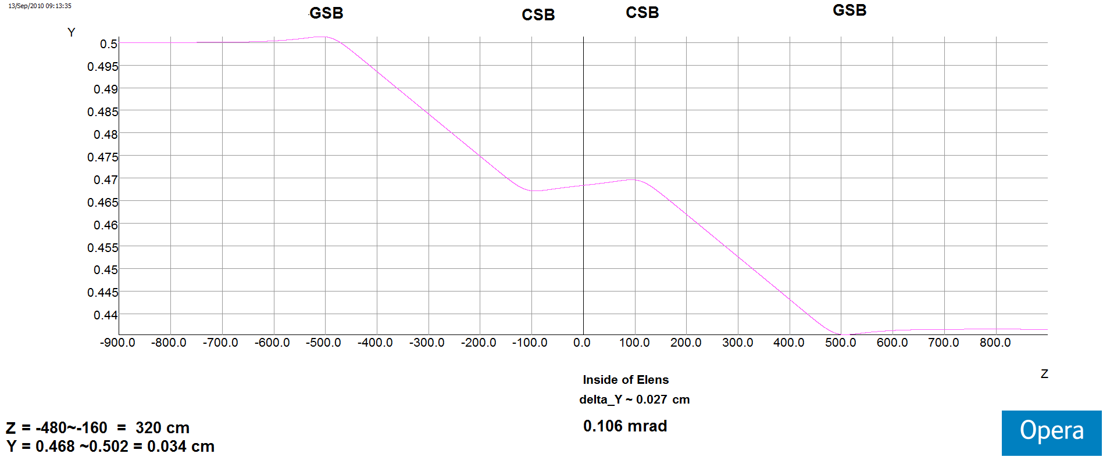
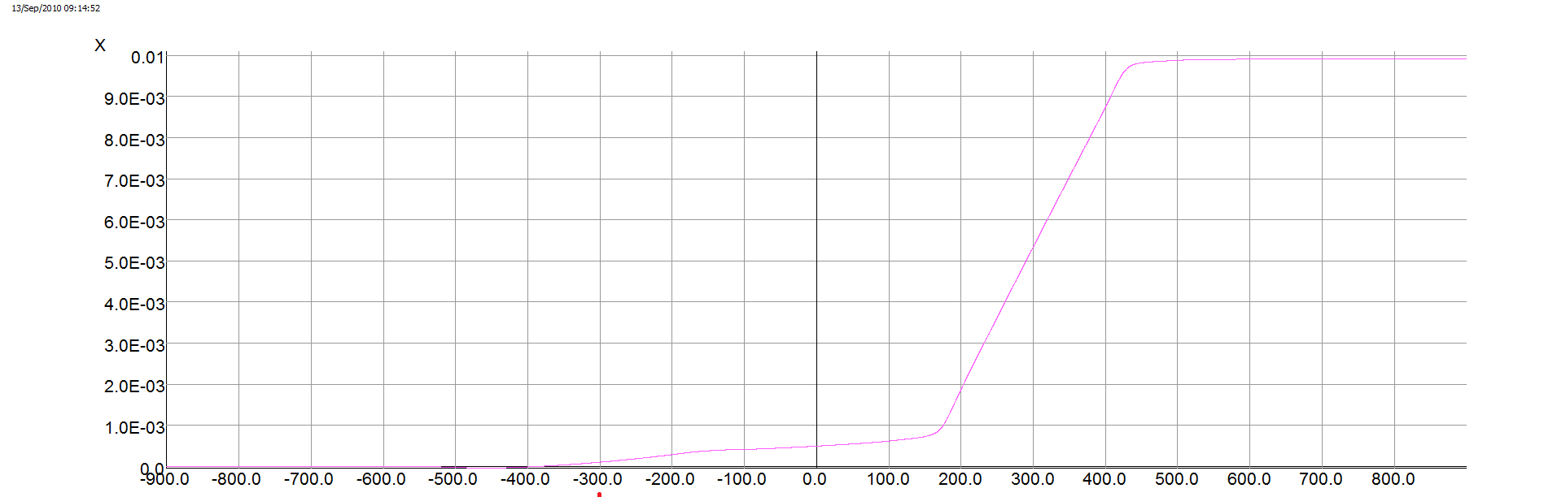
Trajectories with Opera Simulation
0.1 mrad
250 GeV proton
Xiaofeng Gu

Slide 23
The Effects of Elens
The proton beam’s closed orbit.
The horizontal and vertical tune (quadrupole field components from elens).
One elens, coupling.
Abort gaps, luminosity.
Others
Xiaofeng Gu

Slide 24
Thanks !
Xiaofeng Gu

