Slide 1
Recap of the first EBIS run for RHIC
Jim Alessi

Slide 2
Fell short on intensity at Booster input
  “bailed out” by bunch merges (Kip’s talk)
Exceeded expectations (mine, at least) on reliability and stability
Had previously run a lot of Au, but never U, Cu, or He-3 until this run (also Xe for NSRL)
Had run some 4-pulse, but never 8-pulse
By far, this was our longest continuous run
We’re essentially now at the point where we’re comfortable going home while it’s running.

Slide 3
Intensity at Booster input (xf108)
These values were after Keith’s tune through Booster (he would tune all EBIS rf and quads).
Generally, if we tune to 108, we can get more there, but Booster late may drop. Proper upstream vs. downstream tuning needs to be explored more in the future.
Au 32+: 1.5e9/pulse; 7.7 nC (2.7e9)
Cu 11+: 6.1e9/pulse; 10.7 nC (11e9)
U 39+: 1.1e9; 6.8 nC (Kip/Keith - 1.25e9) (2.0e9)
He-3 2+: 3.75e10; 12 nC (> 10e10)
Why the shortfall?
EBIS output (total charge) is > design.
Unfortunately, we still don’t have a good handle on relative contributions of things like the following:
  % in desired Q, impurities, matching into RFQ, RFQ / Linac transmission, MEBT misalignment, rf tuning, …
We’ll continue to try and sort this out during the shutdown

Slide 4
Early on, because of the lower than required intensity, we tried to extract EBIS ions in ½ turn (5 μs) to keep longitudinal emittance small with bunch merging
One scheme tried – empty half the trap at a time, in 5μs, separated by 5 μs
1
2
1
2
Best was only ~77% in 1/2 turn * 75% of the normal charge getting to the Booster (increased energy spread of ions out of EBIS as you push them out reduces transmission). So this was abandoned for this run.

Slide 5
Uranium (all charge states) at EBIS output and RFQ input (both 2 mA/div)

Slide 6
Watching over the EBIS
Start - nuisance trips due to electrical noise. Had to stay around.
  But controls hardware people (Charlie Theisen, Mike Costanzo, Pete Zimmerman, etc.) helped early on. Took some things off remote reset, moved controls off the HV platform, etc.
  Also, Ioannis, Edward Bajon, et.al. fixed nuisance trips of collector ps(passtube, which was a new addition and was a big success).
After that, our lives got much easier.
  Went from sitting there holding our breath with our finger on the reset button during fills, to eventually not even knowing when there was a fill.
Au-Cu switching – eventually became painless. (We kept both beams pulsing all the time).
As run went on – we were still on site, but often not by EBIS.
(with a few minor improvements before next run, we think we can leave it without too much worry)
(Recovery from the power dip was only a couple hours for EBIS)

Slide 7
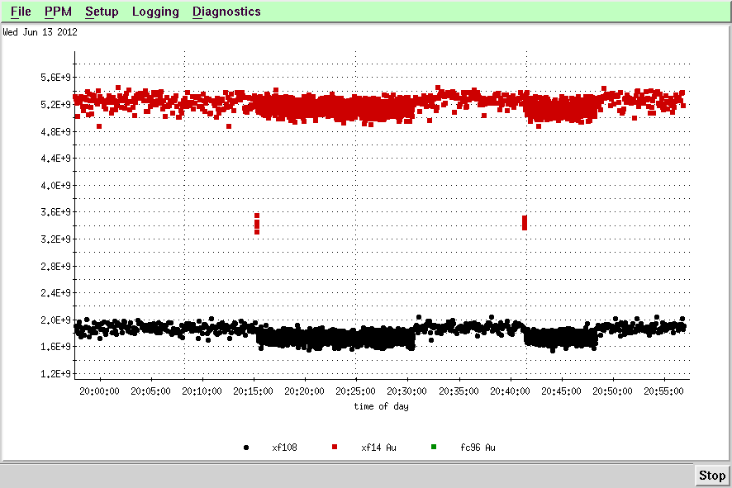
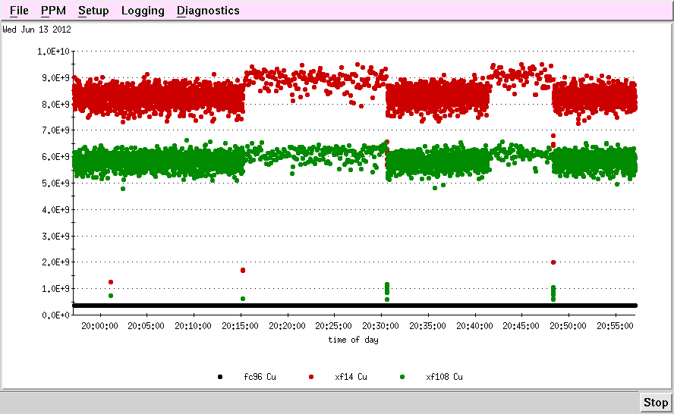
Always had both Au and Cu running
8 Au & 1 Cu or
8 Cu & 1 Au or
1 Au & 1 Cu (during stores)
Au
Cu

Slide 8
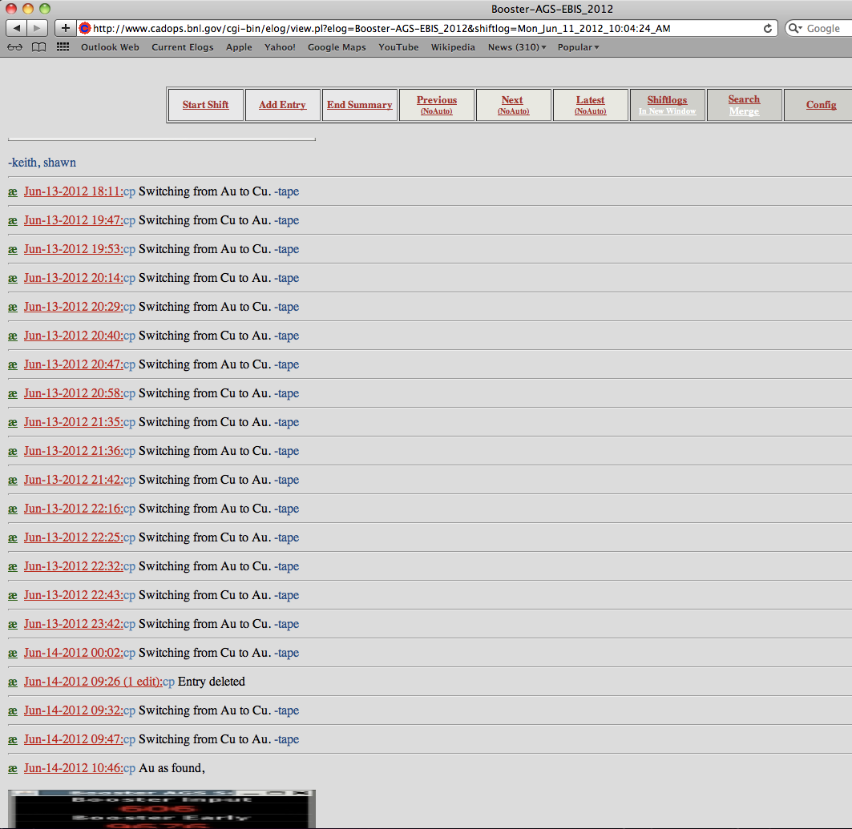
Sometimes frequent switching between Au and Cu.
Switching became routine.

Slide 9
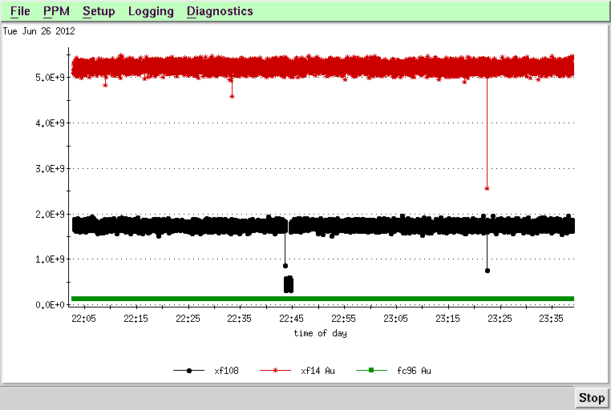
Example of beam stability – 8 pulses of Au continuous
For low energy Au run, we ran 8 pulses continuously for ~48 hours
Estimate ~0.05% missed pulses

Slide 10
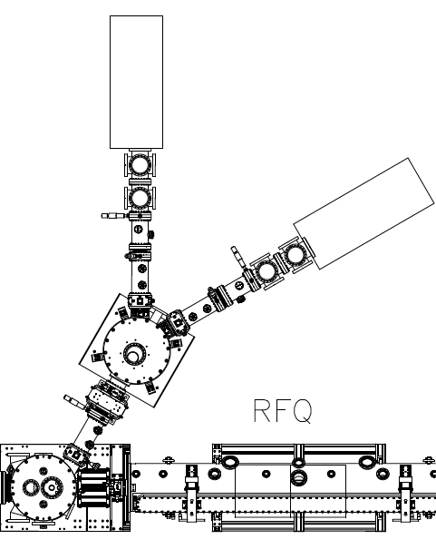
External 1+ ion production to feed the EBIS trap
Cu source
U source, then Au
1+ Ions
into EBIS

Slide 11
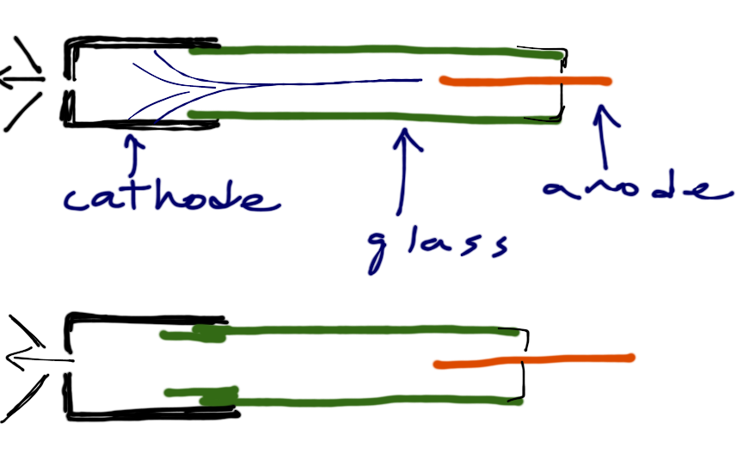
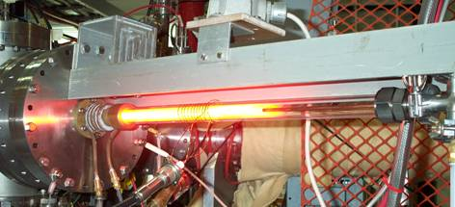
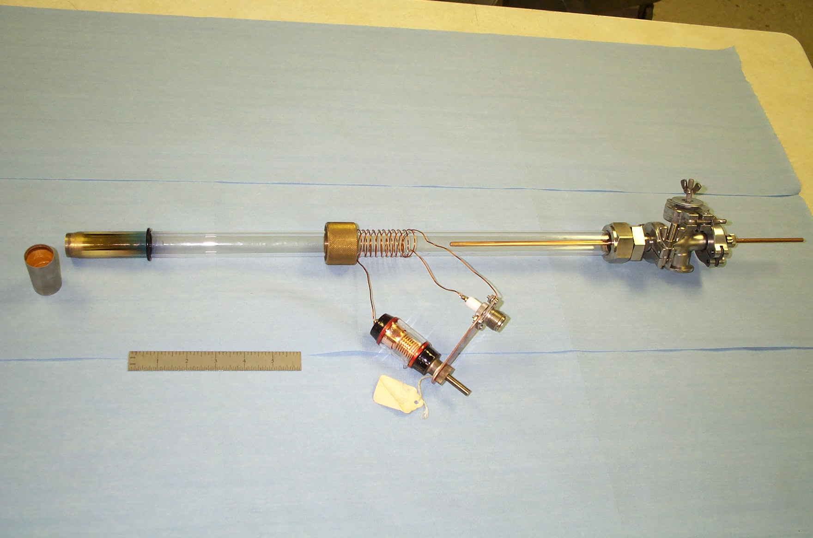
Hollow cathode ion sources used to produce 1+ ions
Coating of glass → breakdowns; hard to recover without cleaning glass (why we were hesitant to push uranium, due to contamination issues).
  “Step” in glass - seemed to improve. Last month was ~ troublefree
Neon vs. argon working gas

Slide 12
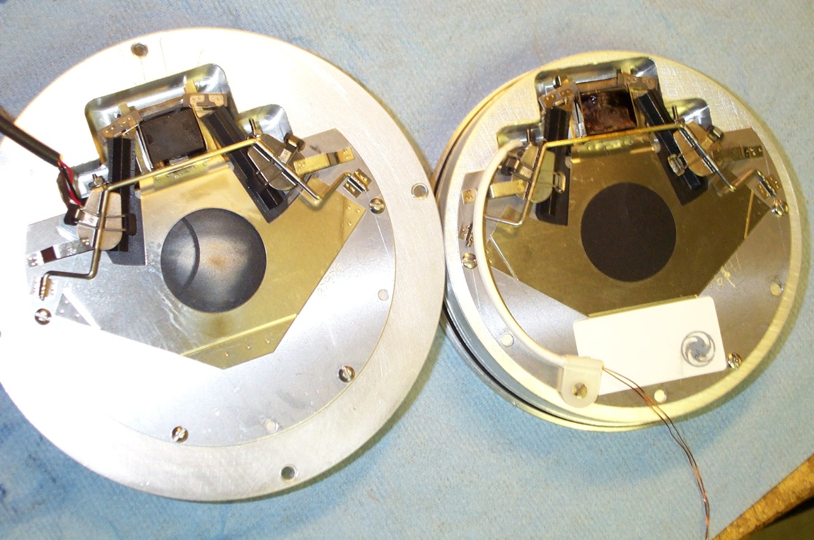
Electronically Controlled Shutters
  Electronically controlled shutters are used to help provide differential pumping in the ion injection beam line. (25mm aperture, 6ms minimum open time).
  Shutter failures (8 pulses) → during the run, we improved reliability, plus added “hot spare”

Slide 13
Cu source
Shutter
U source, then Au
Shutter added
Second turbopump added on this chamber
Shutter, changed to double shutter
1+ Ions
into EBIS

Slide 14
Activities (improvements) behind stores
Helium fills of SC solenoid ~ every 10 days
Replacing shutters, adding shutters
HCIS tube cleaning, then modification
Added turbo on switching chamber
Added pump on insulating vacuum (on HV platform) to reduce helium consumption
Swapped out scroll pumps backing several turbos
New pulsers for both HCIS’s (built at Tandem).
Setup of Cu (first time tried) during U.
(Also set up Kr and Xe for NSRL during U running).

Slide 15
Helium-3
Gas was fed directly into the trap
Had never tried He-3 until after the Au-Cu run ended. Then took ~12 hours to get to Booster input (highest q/m we’d ever run)
Following the run, we looked at the He spectrum with the TOF; estimate ~70% in He-2+
2+
2+
1+
1+
At reduced gas pressure, He 2+ is >90%

Slide 16
During run:
3.75e10 He3 2+/pulse at Booster input.
18% increase in intensity out of linac following the run, by increasing the RFQ power.
(→ est. 4.4e10 ions/pulse)
More gain from further tuning seems likely.
Red: Helium 3 at Booster input
1.2 mA peak current
Green = EBIS output, ~ 7 mA

Slide 17
EBIS work during this shutdown
(before and after NSRL run)
Vacuum
  Fix shorted NEG in EBIS trap bore
  Fix leaky cryo valves so cryopumps can be regenerated properly (and add elbows so leaks from charcoal dust don’t redevelop)
  Replace leaking feedthrough
  Electron collector electrode modification to reduce gas load
  Re-bake the source
Intensity?
  Add temporary diagnostics to try and quantify losses, emittances, etc.
  Some realignment
Work on beams for NSRL
  C, Si, O, Cl, ….

Slide 18
Present plan for upcoming NSRL run -
  Species changes will need to be set up by us. But then EBIS will be left on, and MCR can turn on their request when beam is needed
  We will implement a remote reset and an auto reset of electron beam (trips have become very infrequent)
  Train CAS on reset of rf (tripped ~ a couple times a week). Also finish the PLC controls for rf systems.

Slide 19
Summary
Uranium, gold, copper, and helium-3 !
We’ll continue to work on intensity (eliminate at least one merge next time?)
Stable and reliable – (hopefully not beginner’s luck)
Special thanks to:
EBIS “watchers” – Ed Beebe, Dan McCafferty, Sasha Pikin, Dannie Steski
EBIS “fixer” – Bob Schoepfer
Optics – Deepak Raparia
John Morris & Sev Binello for lots of help on controls software
(plus lots of others who helped before & during the run on rf, vacuum, controls, power supplies, diagnostics, …..)

