Slide 1

Stochastic Cooling
K. Mernick
RHIC Retreat
July 25, 2012

Slide 2
Outline
This year was the first with all six planes of stochastic cooling
Longitudinal and vertical in both rings had run successfully in the past, horizontal was new this year
Stochastic cooling was a major success, with no significant failures or downtime
I’ll start with a quick review of the work last shutdown and then briefly discuss results from the run, then I’ll describe plans for upgrades and enhancements over the near future

Slide 3
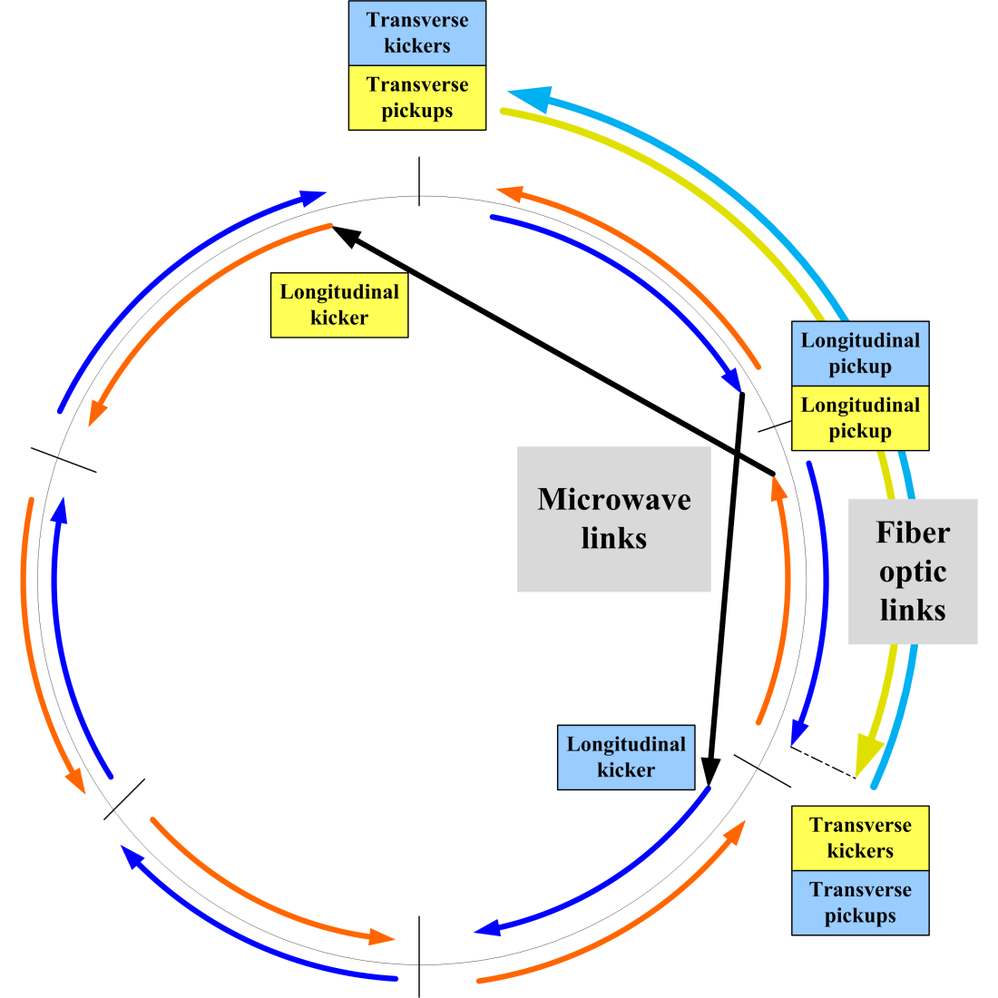
Geography of stochastic cooling
Locations of beam-line components:
Sector 11: YLK (Yellow Longitudinal Kicker)
Sector 12: BVK, BHK, YVPU, YHPU
Sector 1: BLPU
Sector 2: YLPU
Sector 3: YVK, YHK, BVPU, BHPU
Sector 4: BLK
All kickers are located near the Q4 end of the straight sections (warm bore)
H pickups are located near the Q3 end and L & V pickups are located near the Q4 end

Slide 4
Shutdown 2011 Major Installations
Major beam-line installations from last shutdown:
Repair YLK & BVK
Complete rebuild of BLK
Replace YVPU & BVPU
Install YHPU
Install YHK & BHK
This required opening and baking 6 sectors (bo3, bi4, bi12, yi3, yi11, yo12). This summer we only have 2 sectors planned (bi1, yi2) for new longitudinal pickup installations.
In addition to the beam-line components, there was a lot of supporting electronics, cabling, and infrastructure installed.

Slide 5
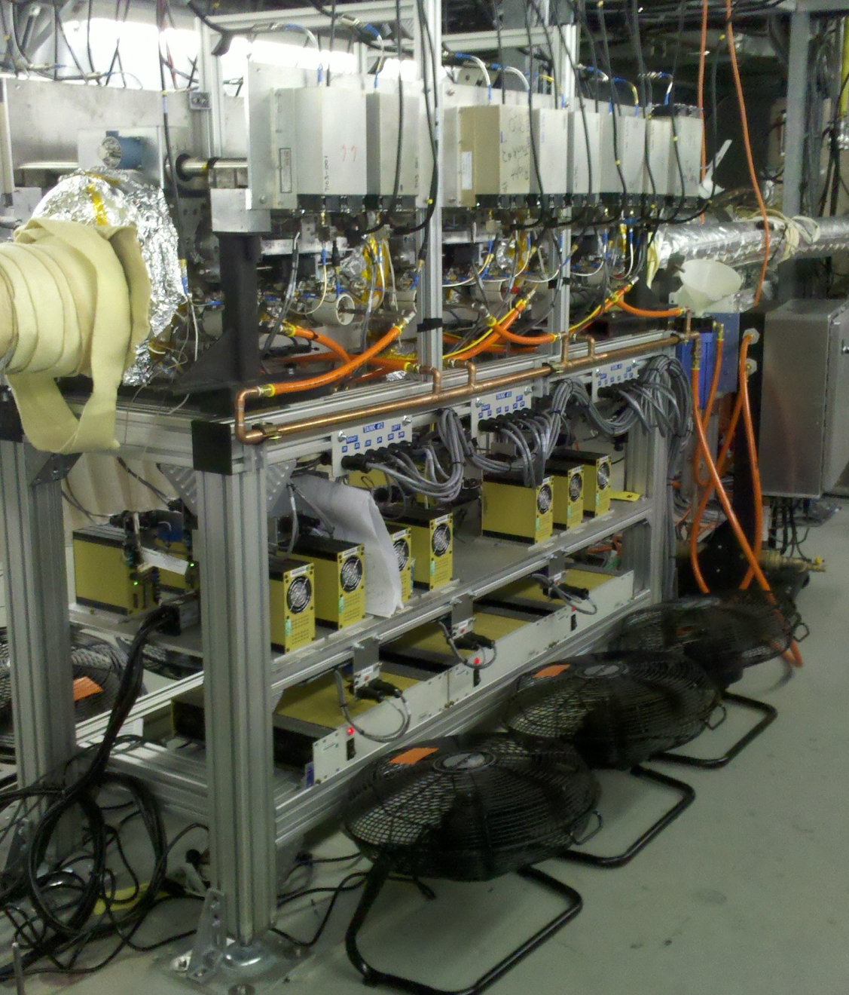
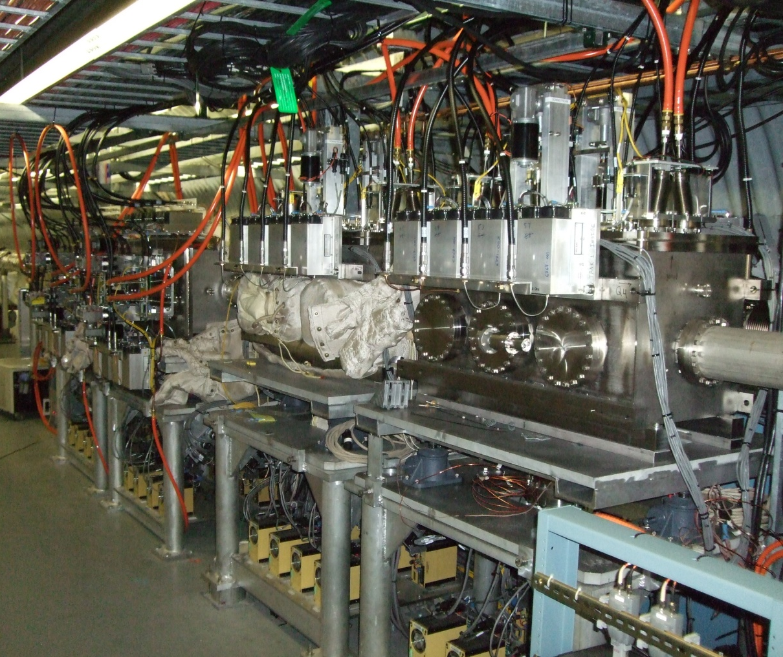
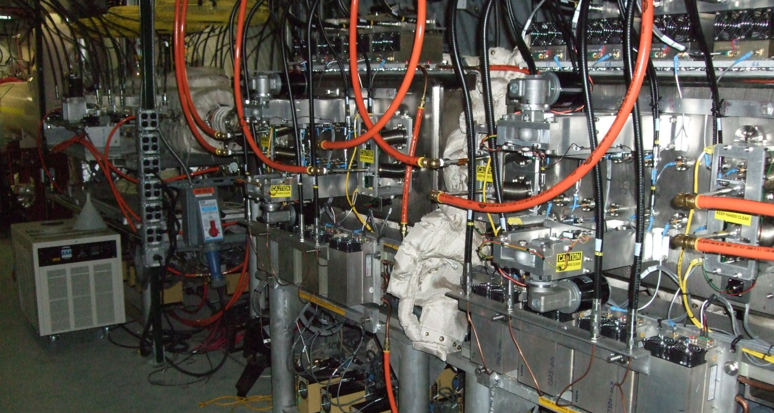
Kickers
Blue Longitudinal
Blue Horizontal and Vertical
Yellow Vertical and Horizontal

Slide 6
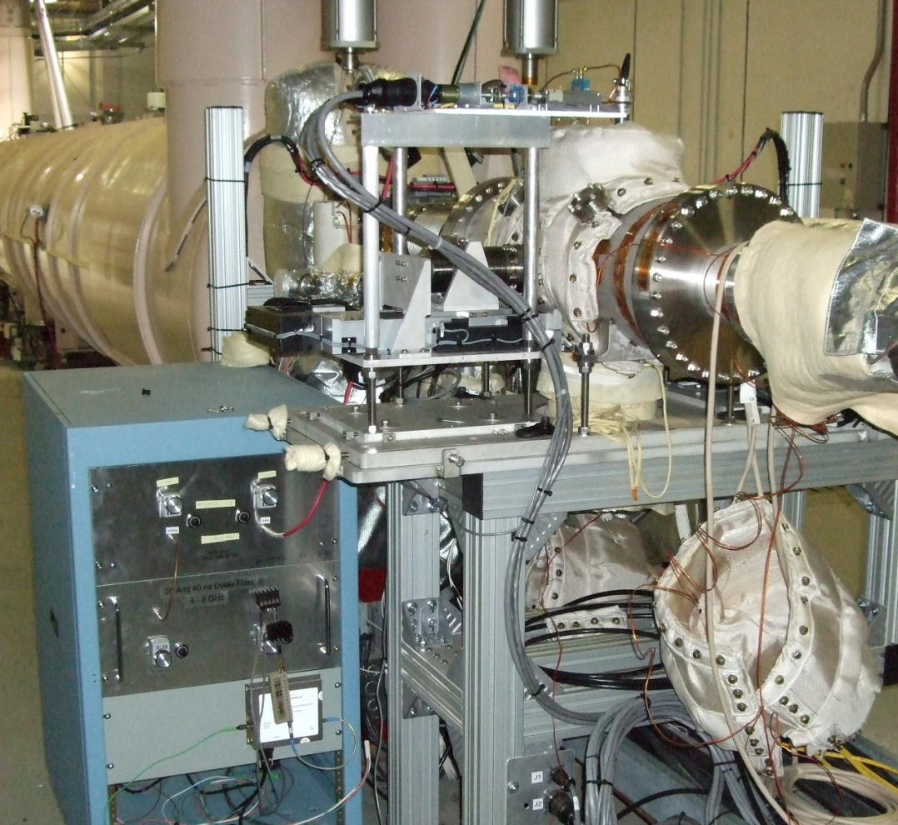
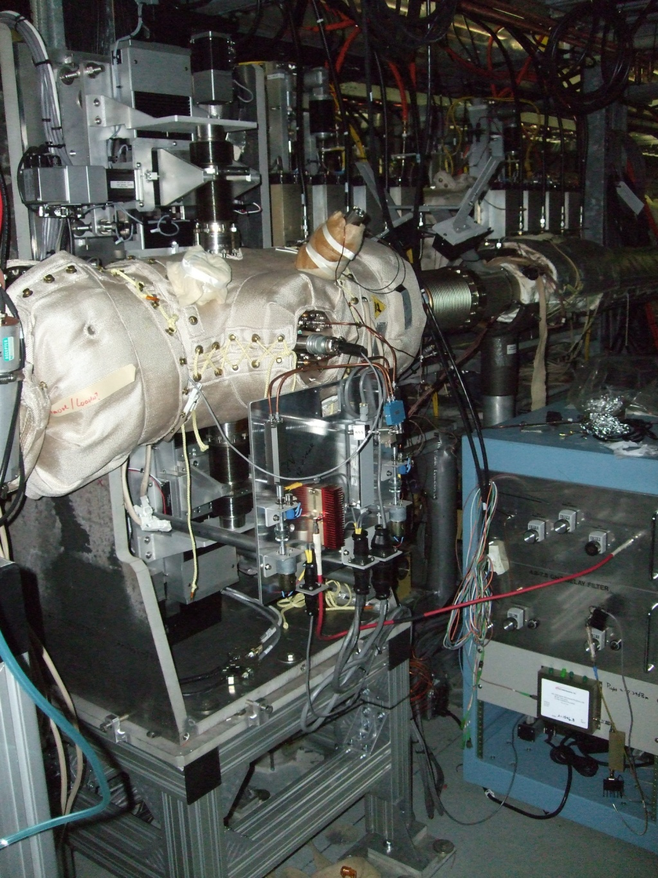
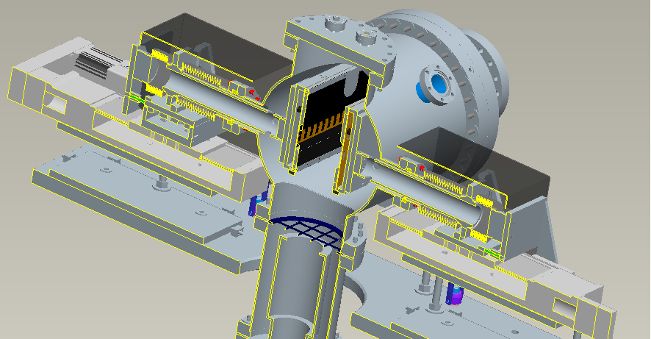
Pickups
Blue Horizontal
Yellow Vertical

Slide 7
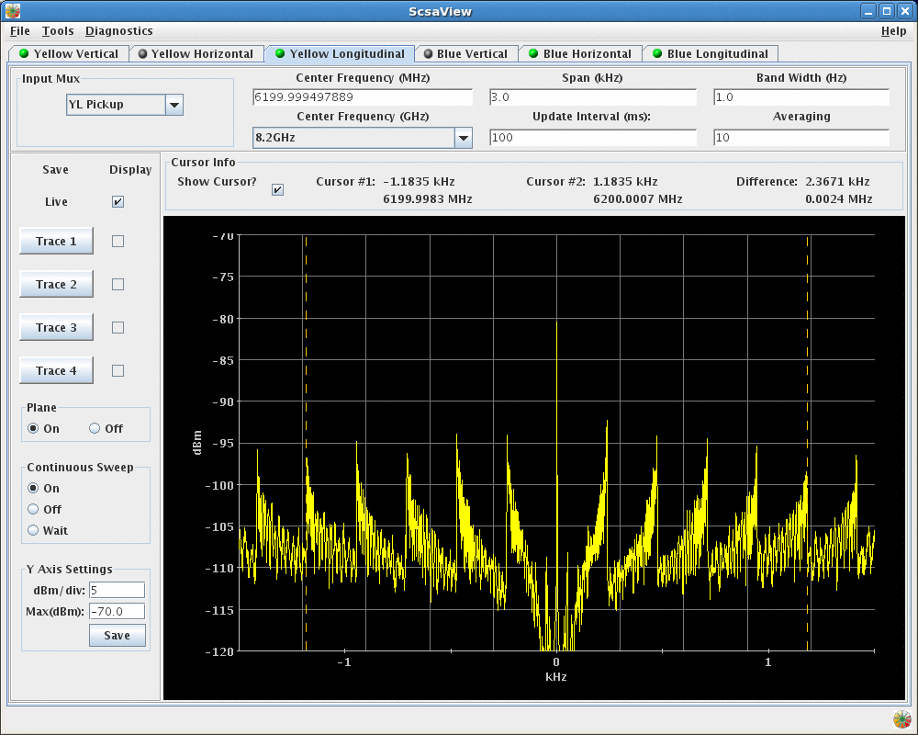
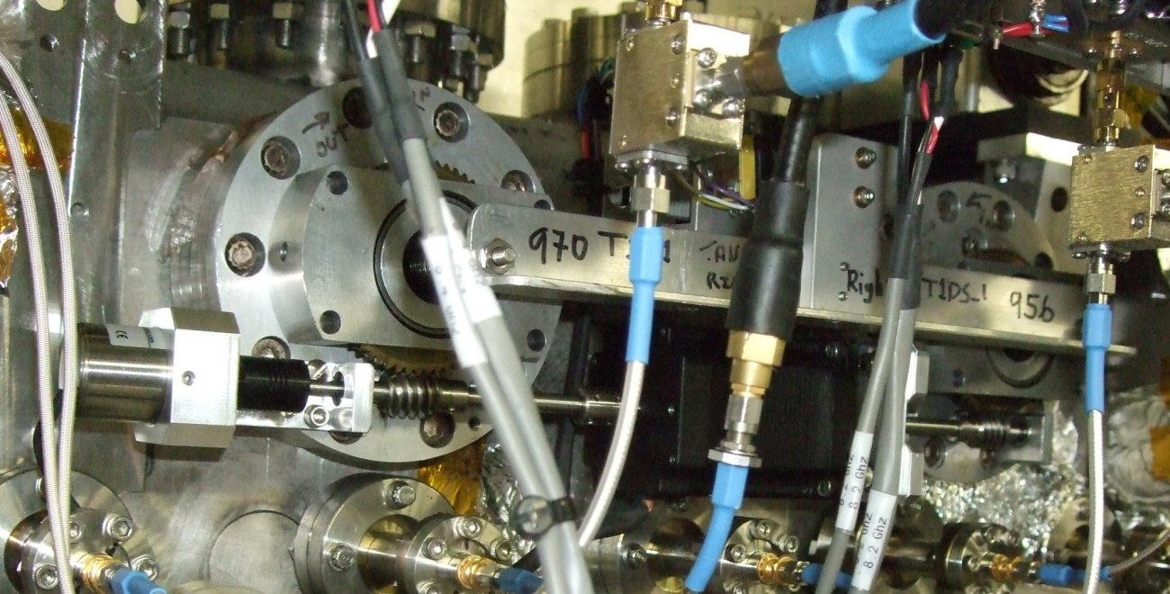
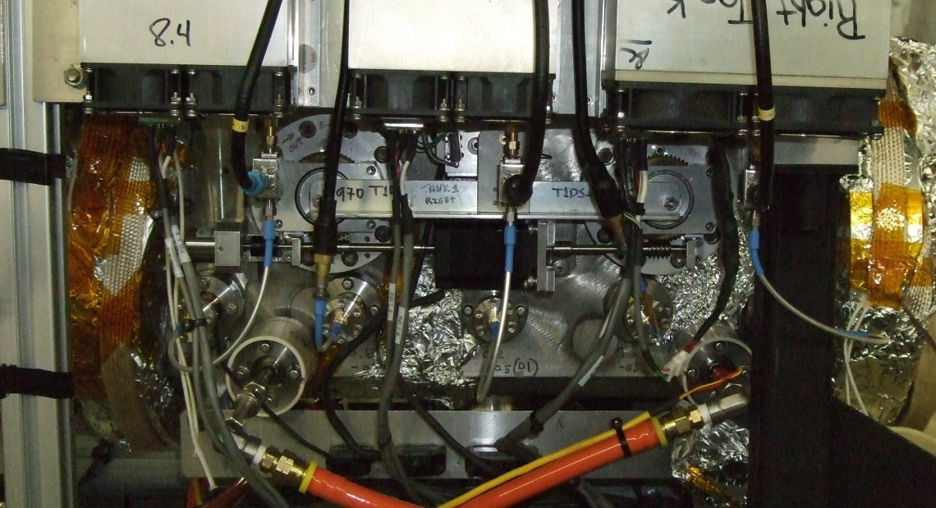
Other Improvements for Run12
Nothing leaked, nothing got stuck
A major issue in the past was failure of PAs at the longitudinal kickers – this run we didn’t have any PA failures, and only a couple DC power supply failures
We replaced the optical encoders on the longitudinal kickers (a source of several problems last year) with resolvers – there were no problems with these, and the new design makes repair/replacement easier in case of a problem
The motion control software worked reliably – probably a combination of better communications with Controls, more testing, and that many issues were found and fixed in previous runs
Spectrum Analyzer viewing application was vastly improved over last run and a huge help
Insertion of the pickups and kickers was “cleaner” (i.e. beam losses were lower) – this was probably partially due to lower intensity with U-U, but there was also some improvement in Cu-Au

Slide 8
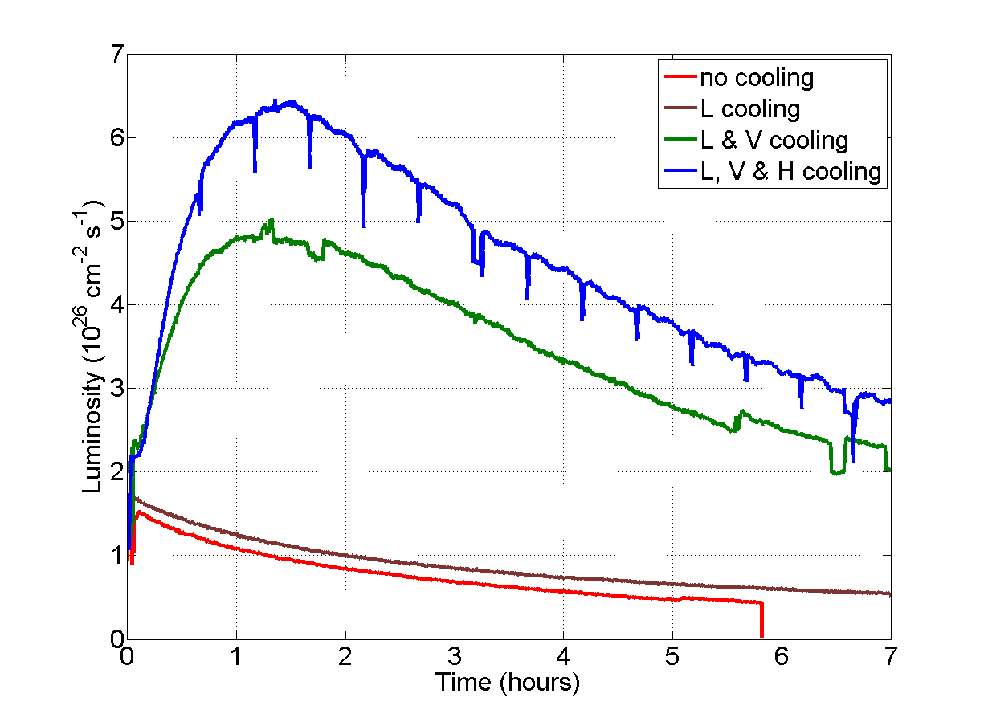
U-U Results

Slide 9
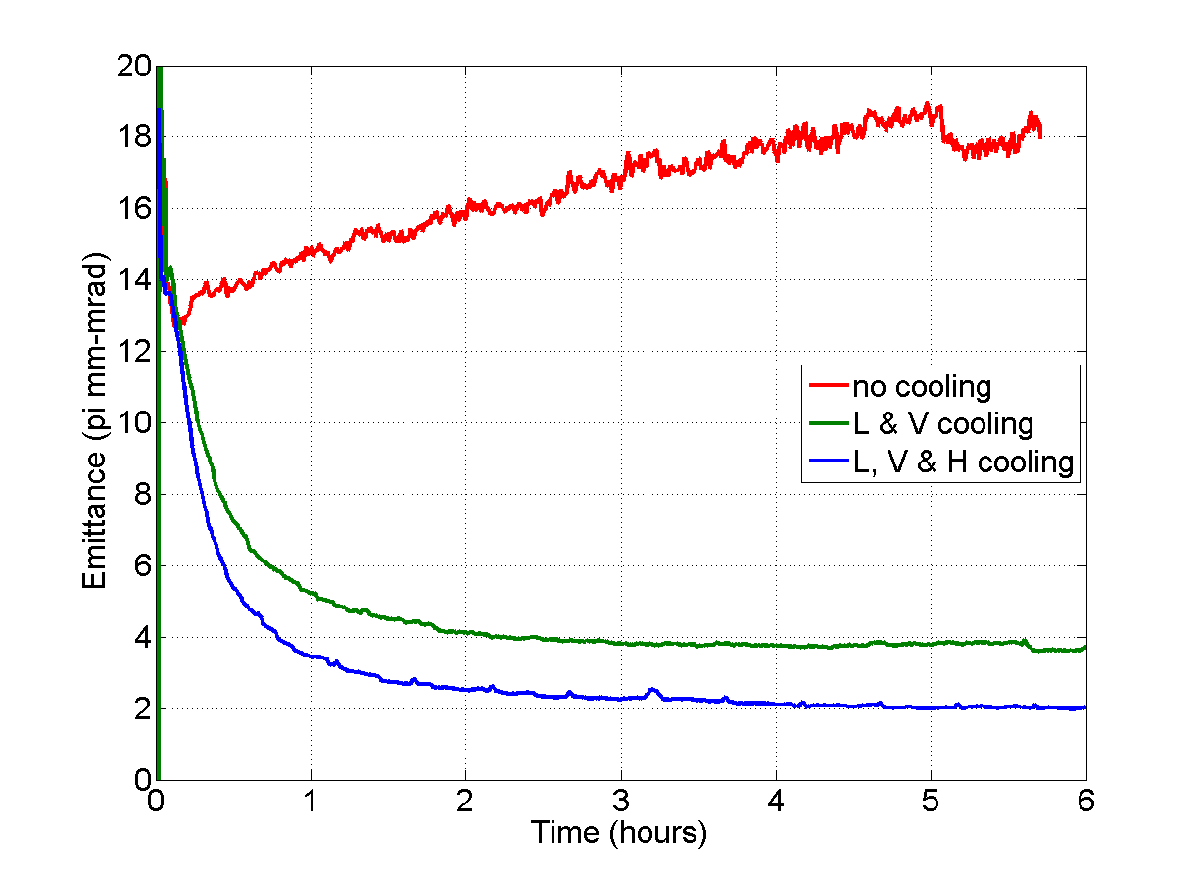
U-U Results
Emittance (ZDC Calculated)

Slide 10
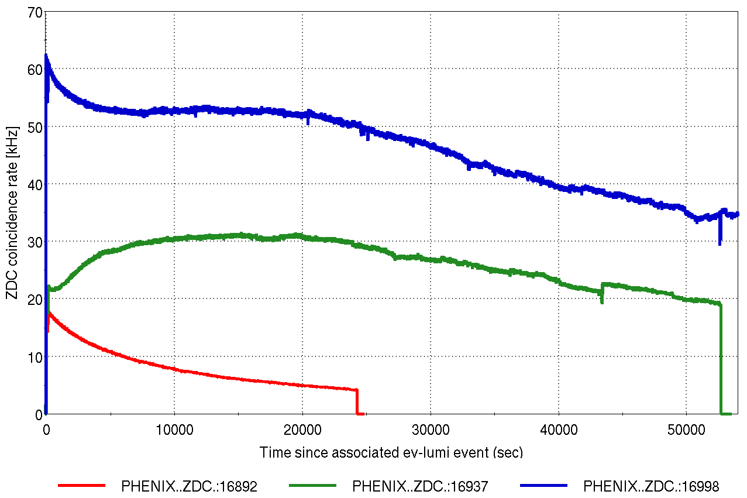
Cu-Au Results
Cooling worked as expected for the Cu-Au run
The cooling rate for Copper was slower due to the larger number of particles per bunch
The beam-beam effect of the asymmetric colliding bunches was a major factor in operations – we had to intentionally slow down the cooling of the Gold beam to prevent Copper losses
Various tweaks to the cooling were attempted, but they had minimal effect on integrated luminosity (total or in the PHENIX narrow vertex)

Slide 11
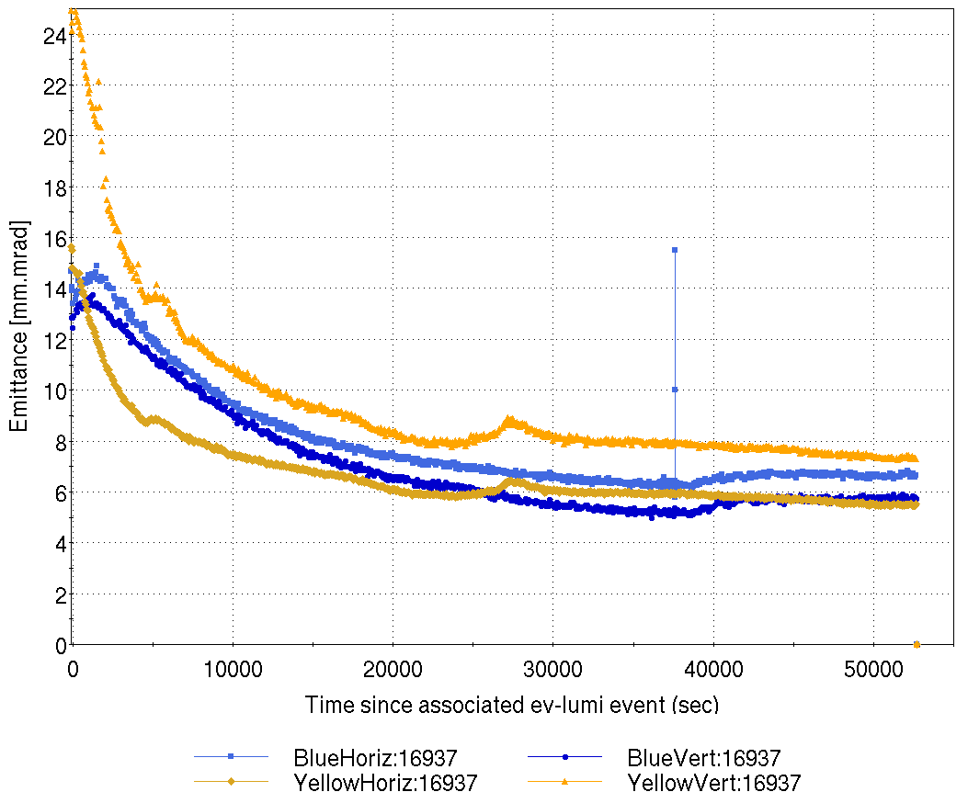
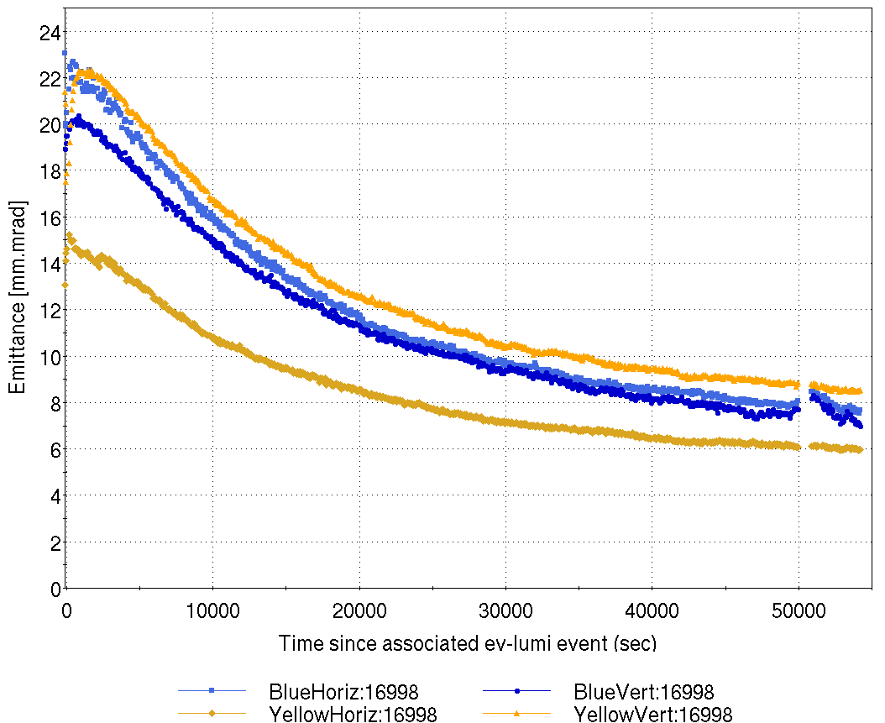
Cu-Au Results
Emittance (IPM)
Luminosity (ZDC)

Slide 12
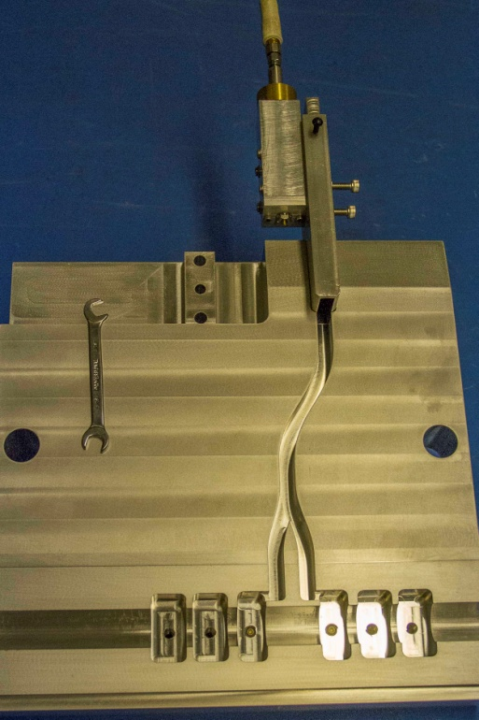
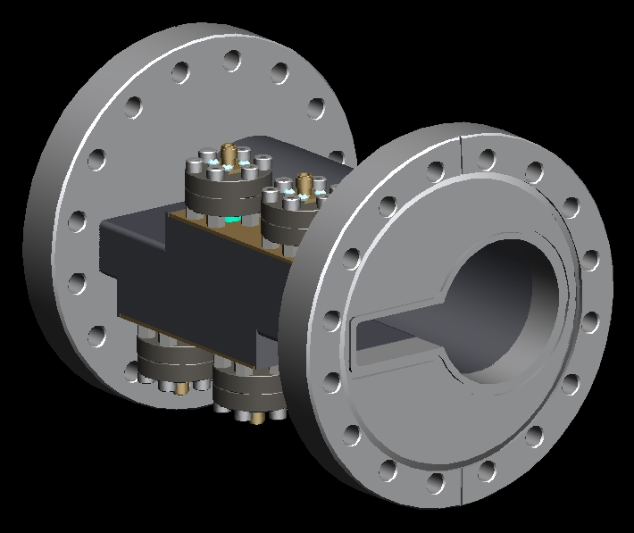
R&D Efforts
We hope to install new longitudinal pickups during this shutdown
The main goal of the new pickup is to cutoff propagating waveguide modes that are present in the current pickup with a 3” aperture
The key component is the “keyhole” shaped beam pipe (see next slide)
There is also an effort underway to replace the longitudinal kickers – the Fermilab vacuum tanks will be replaced with tanks similar to the existing rectangular tanks used for the horizontal and blue vertical kickers
The existing 4 cell longitudinal cavities will be replaced with 6 cell cavities, providing a larger kicker for the same amplifier power
The plan is to have no coaxial cables in the vacuum, and fewer vacuum feedthrus (no water, no thermocouples, fewer RF feedthrus)

Slide 13
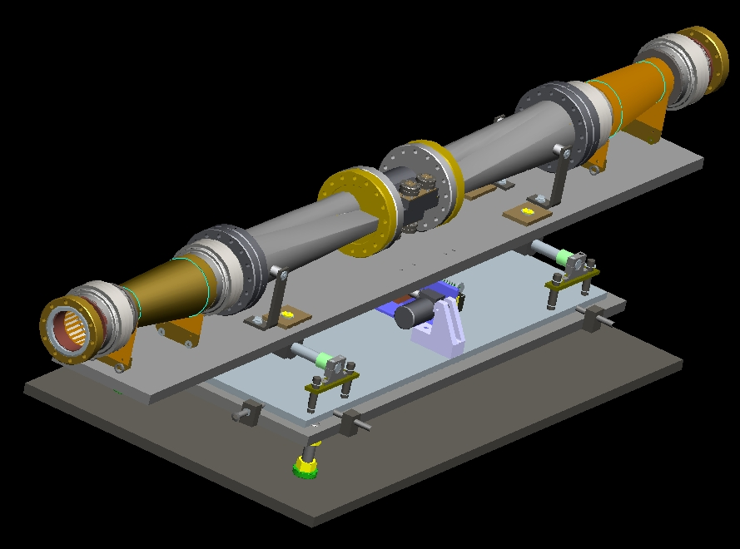
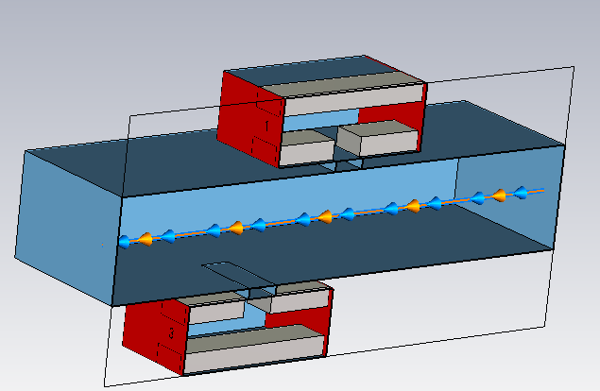
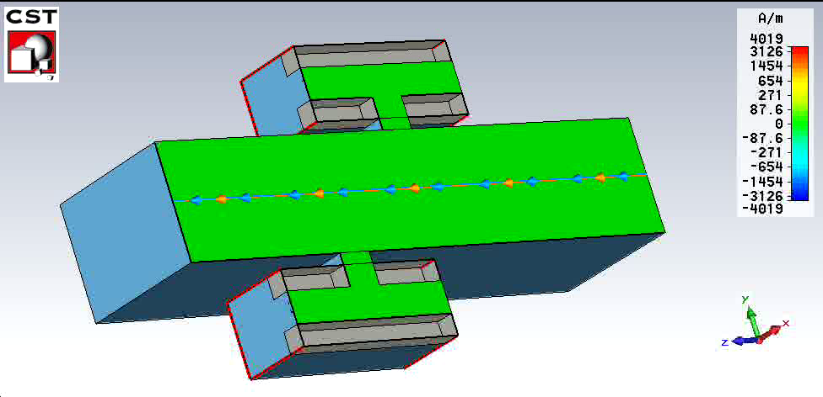
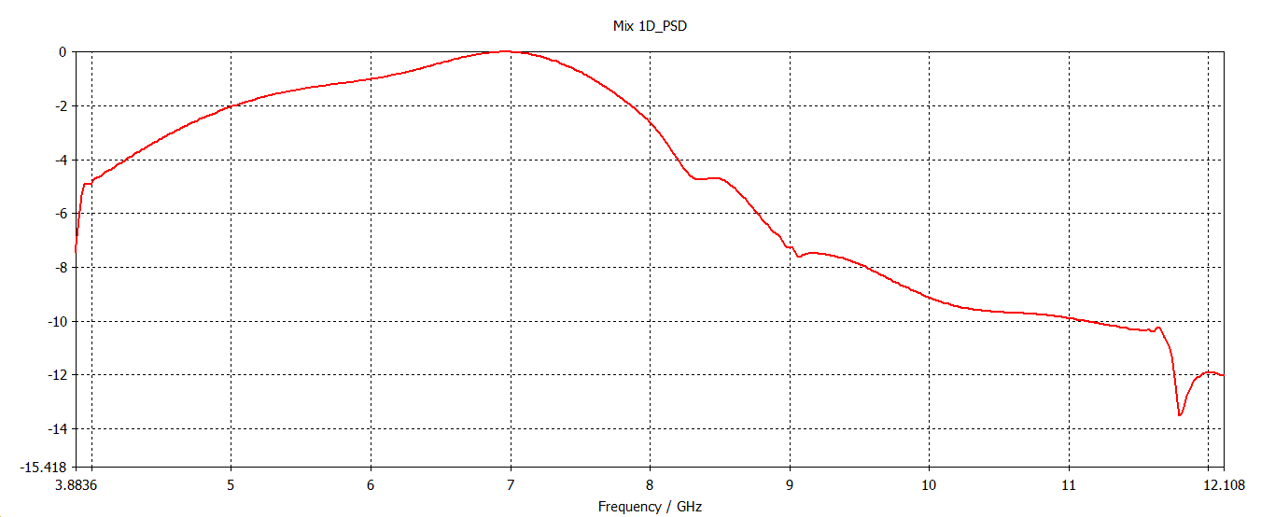
Longitudinal Pickups

Slide 14
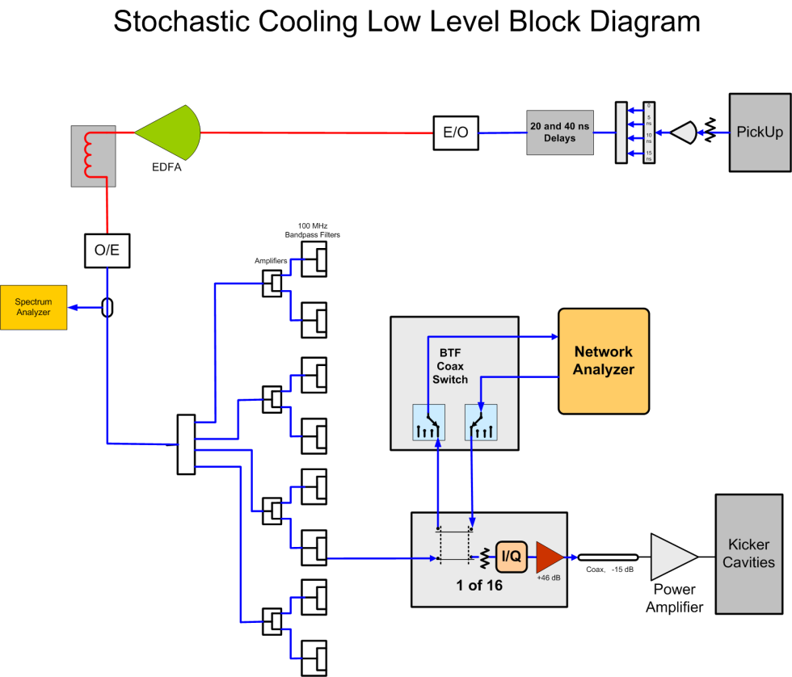
Software
Main software goal once again is to replace the LabView/ADO combination running on the network analyzer and FEC with an ADO manager to co-ordinate and run the periodic system transfer function measurements
This was a goal last year, but was not finished in time for the run – some last minute changes to the old software got us through this run
Another high priority item is software for viewing the measured system transfer functions, both in real-time and logged data
Along with the spectrum analyzer viewing program, this will be one of the main tools for setting up and tuning the system
BEAM

Slide 15
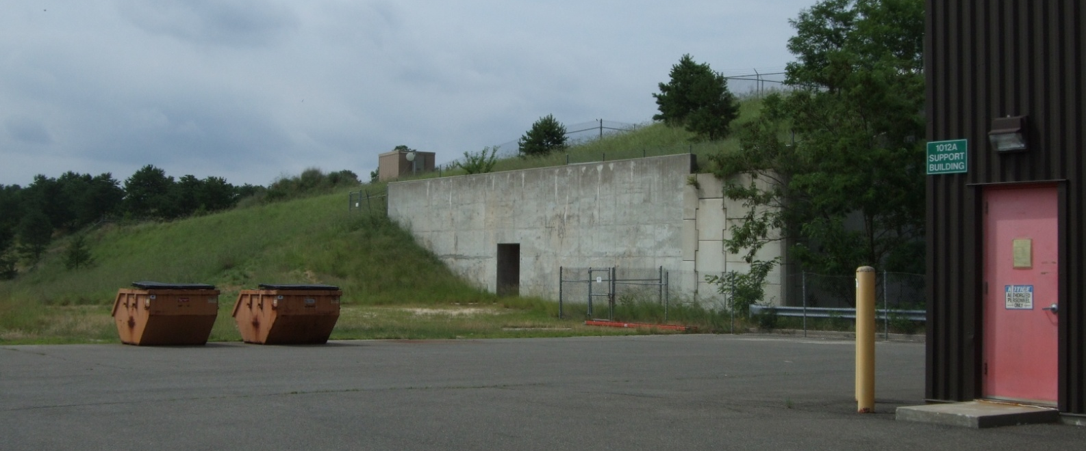
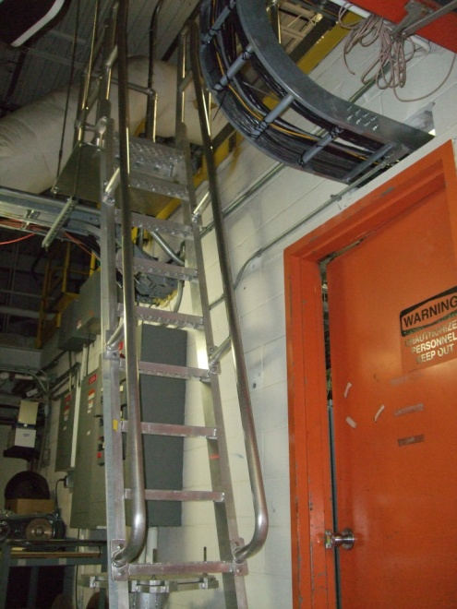
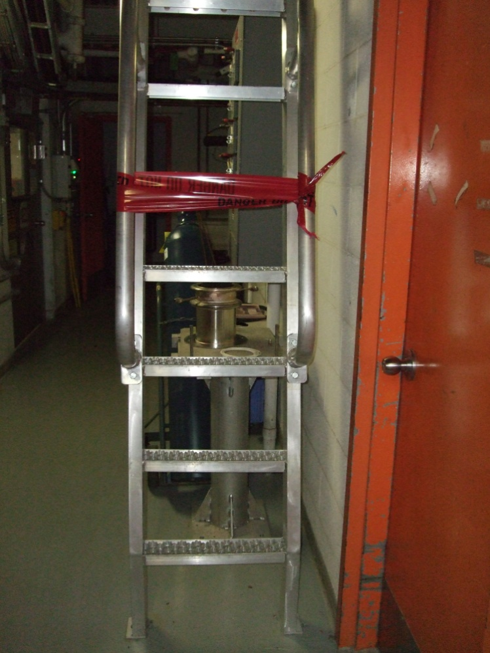
Summary
Last year’s summary slide included these two pictures:
Stairs?
Lift for
equipment?
…or at least cut the grass more often
There has been no visible sign of progress on the stairs (an action item from the BORE review in 2009), but at least they have acquired a nickname (“the stairway to heaven”).
The grass on the berm was cut once during the run. This has been typical over the last several years, despite repeated statements from F&O that it would be cut regularly. Ticks (and other bugs) are common up there.
A new lift to hoist equipment to the crow’s nest in 1004A was installed before the run and used successfully. Thank you to Al Pendzick for leading the effort.
But…
Now we can’t use the hoist (or access any of the equipment, including equipment necessary for development efforts this summer) because the ladder has been tagged out as a result of the recent ladder inspections.

Slide 16
Summary
Stochastic cooling was a major success this year, running successfully in all three planes in both rings with no significant failures or downtime
We are continuing development efforts to improve system performance, increase reliability, and enhance operational efficiency
Thank you to the many, many people who contributed to the success of stochastic cooling

