Slide 1
Reliability of RF Systems FY12 Retreat
Alex Zaltsman
July 2012

Slide 2
Topics
RF Systems performance
What was new in the last run
What went “wrong”
Commissioning of the new systems
Ways of improving the “UP” time

Slide 3
RF systems Total Hours
2012 2011 2010 2009 2008 2007
Species pp/U/Au-CU pp/Au Au pp d-Au/pp Au
Severe
Booster 9 10 4 10 4 1
AGS 10 13 19 13 6 17
RHIC 20 75 61 73 41 35
Total 39 98 84 96 51 52
SC 14
HL 29 47 35 46 43 21
LL 10 51 35 50 8 31

Slide 4
Severe Faults Trend

Slide 5
Systems commissioned and improved in 2012 Run
9 MHz common cavity system upgraded
Replaced copper beam pipe with stainless steel beam pipe to decrease the cavity Q.
Increased water flow to accommodate the increase in calculated power dissipation
Installed protection to allow FFB power limiter knee to be pushed out by about 16dB. This greatly increased available PA power during high beam loading conditions.
9 MHz bouncer cavities
Added a tuner to track beam loading and temperature fluctuations of the cavities.
Worked with E&I to resolve issues with the A1000 amplifiers
Redesigned combiner output transformer
Moved DC power supplies to 1004C
Replaced preamp 24 V switching power supply with the linear one

Slide 6
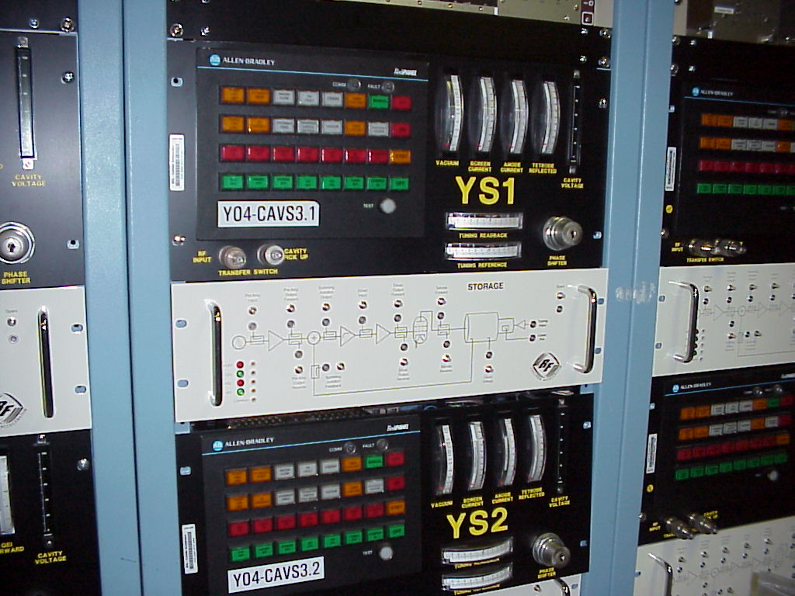
Systems commissioned and improved in 2012 Run cont.
Added additional metrology
including a new RF measurements box that has helped to quickly identify and solve issues
BS1 failed at the end of the run and the new diagnostic metrology allowed us to figure out exactly what the issue was and how long the repair would take without making an access. This decision lead us to lockout the system quickly make adjustments to the other systems for the next ramp
Comprehensive system performance testing was conducted on all storage systems before the run started. The performance data recorded during this effort was compared to the previous year’s baseline data to ensure all systems were operating normally.

Slide 7
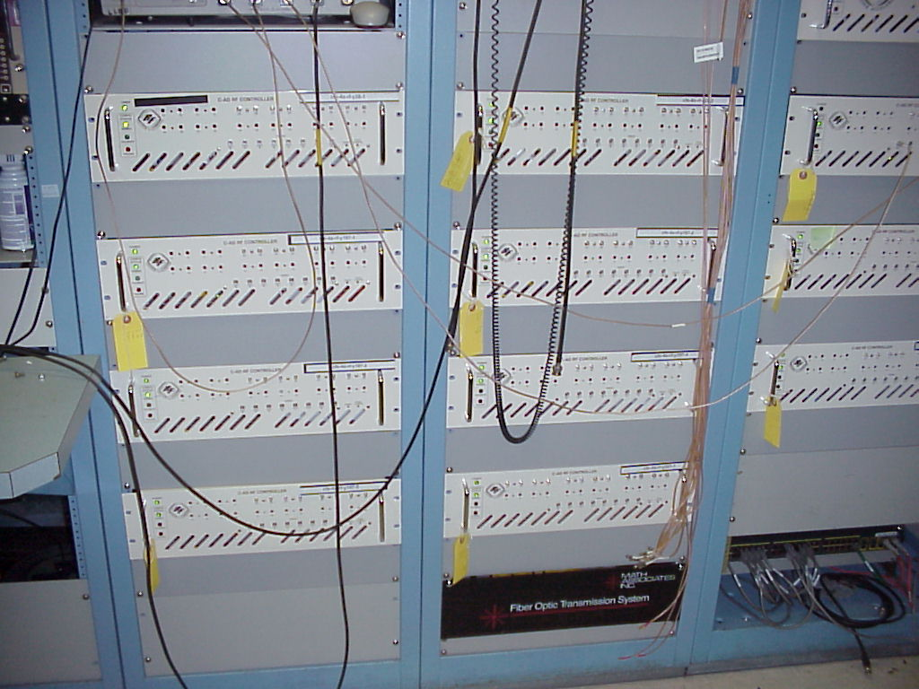
Systems commissioned and improved in 2012 Run cont.
LLRF
Independent “Cavity Controllers” for every RHIC cavity
Cavity tuning (resonance) control integrated into controllers
IQ feedback loops for amplitude and phase stabilization
Fast cavity protection
Flexible rebucketing schemes and setups made possible
100 kHz Post-mortem data available for first time on all systems. Very helpful in diagnosing problems
improved diagnostic data available in general
9 MHz systems
New and improved “regular” narrowband damping scheme for bouncers
Proof of principle demonstrated for bunch by bunch damping capability

Slide 8
Systems commissioned and improved in 2012 Run cont.
LLRF (continued)
ATR synchro (FSS talk)
New synchro reference chassis in Bldg 929 (AGS LLRF)
First operation of a remote LLRF system integrated and synchronized with the RHIC LLRF
Only connection to RHIC system is 2 fibers. Remote system maintains stable deterministic relationship with RHIC LLRF
Vast improvement in quality of atr synchro reference signals to the analog synchro loop controller => less jitter
Booster 4:2:1 merge
Relied on another upgrade platform chassis deployed at Booster to provide “ideal sample and hold” capability integrated into old analog feedback loops

Slide 9
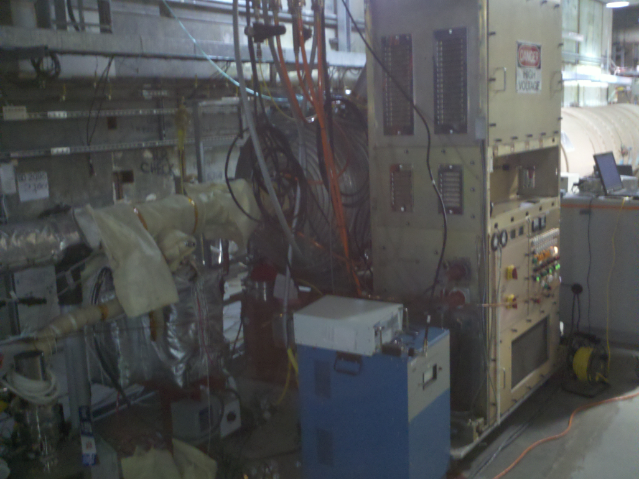
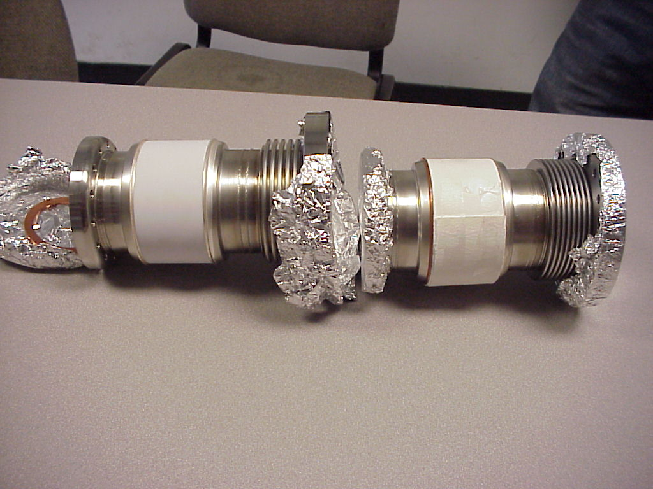
9 MHz Common System
Corona ring on the tuning capacitor
missing causing sparking and eventually burning through the beam pipe

Slide 10
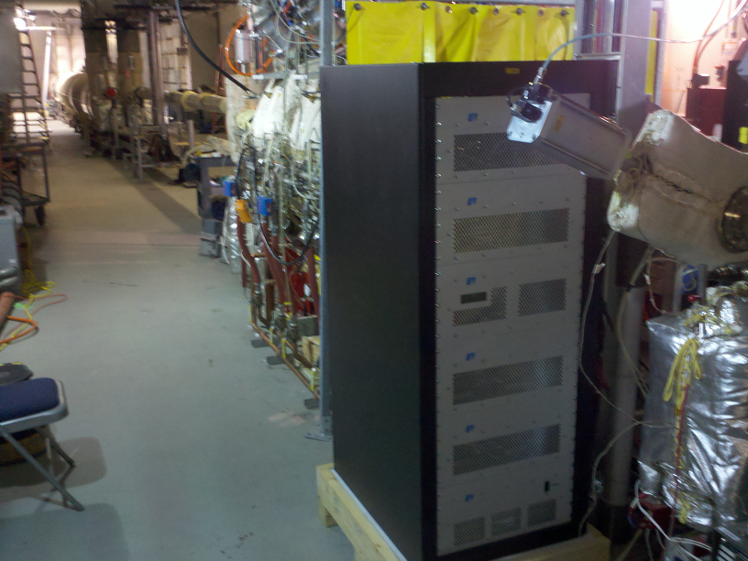
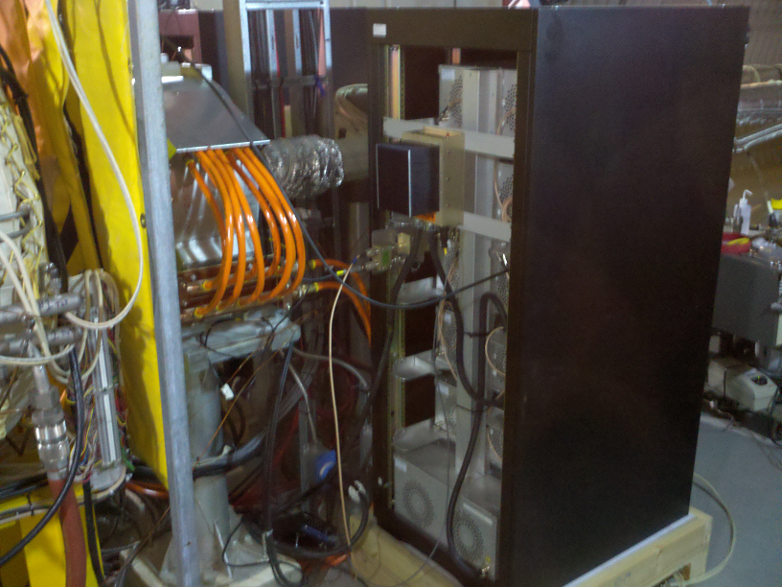
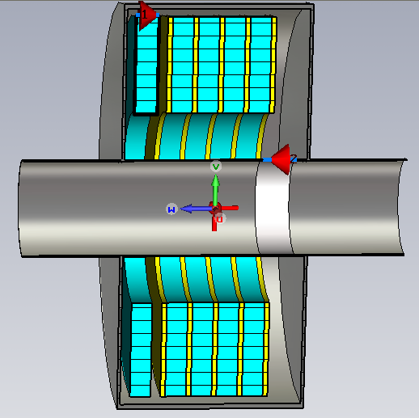
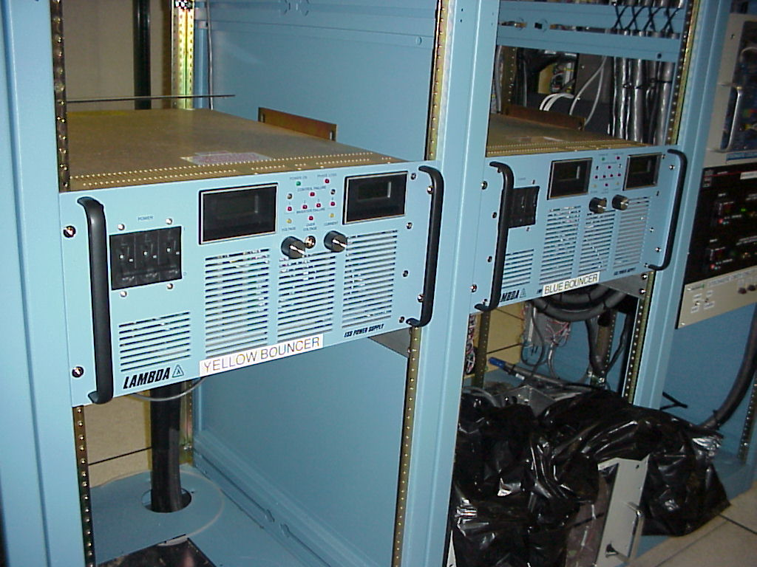
3KV Bouncer System
Bouncer amplifier
PS failure (radiation?)

Slide 11
What do/did we do about all the down time (LLRF)
LAST YEAR
Develop procedural or list assisted setup processes
Setup for LLRF is always under time pressure
Aggravated by the fact that we’re always commissioning something new
Inconsistent setup process can result in downtime
e.g. Overlooked LLRF injection kicker timing scan (1/4 frev vs. 360 frev)
Develop more automation and scripting of tasks
Eliminate the troublesome human problem
We need to continue identifying candidate processes for this
e.g. Simple pushbutton script to switch between 9MHz and 28MHz modes
Minimized downtime directly through speed of switchover, and indirectly through removing an entry point for human error
THIS YEAR
Procedures/Documentation still need to be done. Always get pushed to the bottom of the to-do list
Kicker timing scans were on everyone's mind so no problems this year
Beam sync timing scan became instrumentation’s domain – one problem during U setup (the wrong parameter was accidentally change and the timing setup had to pretty much be redone). RF or Instrumentation – who should be responsible for this?
Automation - not too much new for this run. We were able to speed up the programCavities step drastically by integrating the RF into the rampManager. ~1.25 hrs of downtime attributed to this.

Slide 12
What do/did we do about all the down time (LLRF) cont.
LAST YEAR
Develop friendlier user interfaces (more GUI, less PET) Need for Controls Group help.
Make system configuration and status easier to discern for the non-expert.
Too many PET pages and lots of PET level drilling required now.
Slows down setup, troubleshooting, etc.
THIS YEAR
GUI stills needs development. CSS (Controls System Studio) be investigated or Java based GUI’s will start be developed.
Lots of new, simplified, non-expert pet pages
We have done a good job of generating new alarms this run – this is operations go-to tool to find/fix problems
The largest source of downtime for LL was self-inflicted:
1.5hrs due to a lose cable at 929 (this was associated with the setup going on for next years upgrade).
1.5hrs due to a lose cabling for 9MHz associated with getting the storage cavities ready for ions.
Progress always comes at a price!
ULR fix was 100% SUCCESS!

Slide 13
What can we improve on (last year’s slide) with comments
Commissioning of new systems
Need to resist time pressures to allow for more thorough testing of changes *
Start-up time *
Commissioning with beam *
Operations
Develop procedural or list assisted setup processes where possible. ongoing
Develop more automation and scripting of tasks. ongoing
Develop friendlier user interfaces (more GUI, less PET) Need for Controls Group help ongoing
Maintenance
Overall the schedule is good, but Booster is problematic
Can NSRL to be synchronized with the rest of C-AD *

Slide 14
Lessons learned
Commissioning of new systems are painful but necessary!
Engineering run
(9MHz problems revealed prior to the run)
Learning operational intricacies
Learning how to use all the available tools in the new systems(window comparators, etc…)
Commissioning time with the beam is essential
Hot spares for unique systems (bouncer amps, etc)
Planning/preparing for the future run (knowing species helps)

Slide 15
New and ongoing projects
Operational changes, such as Booster bunch merge and squeeze for Au
Ferrite tuners for acceleration systems
New Landau cavities (to allow turn on below transition)
Coherent electron cooling
ERL
iRCMS
Ongoing LLRF upgrade for RHIC, AGS and Booster
56 MHz system
EBIS

