Slide 1
AGS/Booster He3 Test and Plans
July 26, 2012
RHIC Retreat
Haixin Huang

Slide 2
Why Polarized Helion?
There are experiment interests to study spin of neutrons. Since we can’t accelerate neutrons, the two candidates are deuteron (p+n) and helion(p⬆+p⬇+n). Acceleration of polarized deuteron will have other technical difficulties, so polarized helion is the next choice.
We will have polarized helion source in about one year. As a preparation, we would like to know if we can measure polarization (or asymmetry, before we calibrate it with a helium jet) and have the needed optics working.
A lot to be done, but we only have less than three days.

Slide 3
Booster Setup Details
G=-4.18 for He3. The range of |Gγ| range is 4.19-7.5 in the Booster and 7.5-49.5 in the AGS.
The Booster injection energy is low from the EBIS (all ion species with same velocity). The extraction energy is chosen to gives best spin match at AGS injection.
To avoid the two intrinsic resonances in the Booster (0+ν and 12-ν), the vertical tune needs to be 4.1 at injection and below 4.43 at extraction. To start at this low energy, we have to start with h=4, which fits well with needed bunch merge. The merge happened at Gγ=5.5 (near Au case), less change from RF system.

Slide 4
AGS Setup Details
The AGS Gγ range is 7.5 to 49.5. We first got beam to flattop with cold snake off as this is a new specie for AGS.
Gγ=7.5 corresponds to Bρ=6.9Tm, which is slightly smaller than proton case (7.2Tm).
Since the intrinsic resonance strength only goes up with square root of G but snake strength goes up with G, we can reduce the cold snake strength by a factor √|G_{H}/G_{p}|≈ 1.5, namely 1.5T. It also reduces the horizontal resonance strength.
Preliminary spin tracking with ZGOUBI shows that two 15% partial snakes are enough for the strongest intrinsic resonance at 36+ν (Francois).
We keep the warm snake at the same current (it only works at this current). ZGOUBI simulation shows that the orbit excursion is only slightly larger than the case of proton at injection.

Slide 5
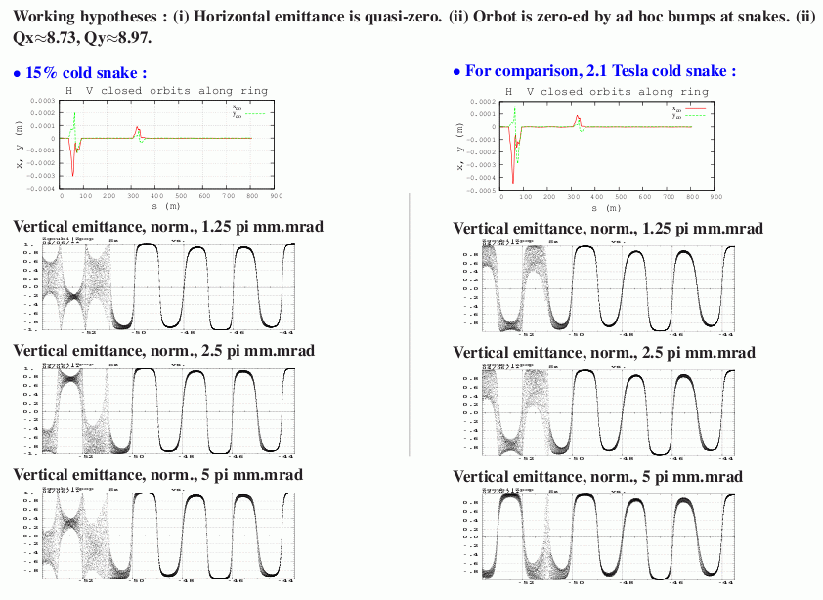
Preliminary ZGOUBI Simulation
(courtesy Francois)
⬆
43.5
⬆
43.5

Slide 6
Intrinsic Resonance Strength (DEPOL)
NU= 8.9900 G= -4.1841(helion)
INVARIANT EMITTANCE 10.000 MRAD-MM
RESONANCE KP GAMMA EPSR EPSI WIDTH
-8.99 = NU + 0 2.149 -0.022987 0.000799 0.02300075
-15.01 = 24 - NU 3.587 -0.000761 0.002767 0.00286993
-20.99 = 12 + NU 5.017 -0.001559 0.010587 0.01070117
-27.01 = 36 - NU 6.455 0.002289 0.022077 0.02219568
-32.99 = 24 + NU 7.885 0.001666 0.002750 0.00321525
-39.01 = 48 - NU 9.323 0.000303 -0.004343 0.00435338
-44.99 = 36 + NU 10.753 0.011845 0.043754 0.04532866
NU= 8.9900 G= 1.7928(proton)
INVARIANT EMITTANCE 10.000 MRAD-MM
RESONANCE KP GAMMA EPSR EPSI WIDTH
8.99 = NU + 0 5.014 0.015992 0.000567 0.01600184
15.01 = 24 - NU 8.372 0.000440 0.001862 0.00191275
20.99 = 12 + NU 11.708 0.001035 0.006900 0.00697731
27.01 = 36 - NU 15.065 -0.001511 0.014457 0.01453594
32.99 = 24 + NU 18.401 -0.001048 0.001816 0.00209671
39.01 = 48 - NU 21.759 -0.000252 -0.002843 0.00285385
44.99 = 36 + NU 25.094 -0.007768 0.028629 0.02966440

Slide 7
He-3 Beam Energies
Helion
 | Energy | Momentum | γ
AGS Injection | 5.05GeV | 4.19GeV/c | 1.79
AGS Extraction | 33.30GeV | 33.18GeV/c | 11.83
RHIC Store | 501GeV | 501.14GeV/c | 178.04
Proton
 | Energy | Momentum | γ
AGS Injection | 2.36GeV | 2.16GeV/c | 2.51
AGS Extraction | 23.81GeV | 23.79GeV/c | 25.38
RHIC Store | 250GeV | 250.00GeV/c | 266.45

Slide 8
Goals and Setup Plan (6/28)
Test the CNI polarimeter in the AGS. We need to confirm that the polarimeter Si detectors can detect recoil carbons from C-He3 scattering.
Second goal is to test the optics we will run for He3 in Booster and AGS, specifically, any problem with cold snake on.
The expected running time is three days (starting on June 28th):
First day: get beam through Booster and possible in the AGS without snakes (new specie, first try). Polarimeter setup overnight.
Second day: get beam through AGS with cold snake on but low tune; polarimeter setup follows overnight.
Third day: get beam in the AGS with high vertical tune and cold-snake-on.

Slide 9
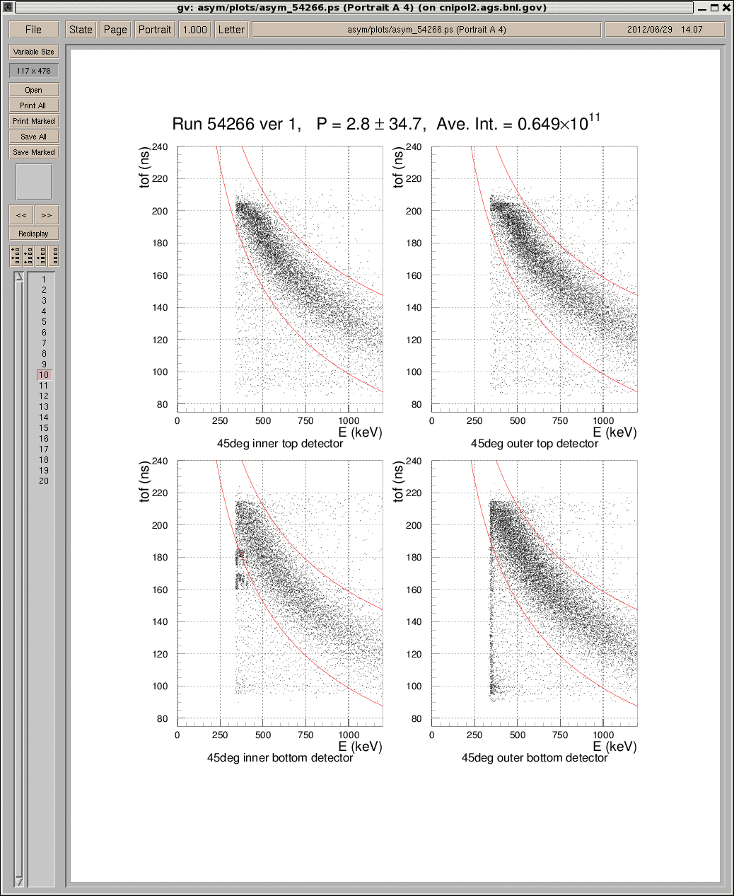
Carbon Bananas Seen!
Rate estimate: gain due to elastic cross section: A^2/3=3^3/2=2.08.
Actual observed: ~2.
A_{N}: estimated as 78% of the p-carbon one (from Nigel Buttimore, Trinity College)
The kinematics only tells us these are slow carbons. But are they coming from elastic scattering?

Slide 10
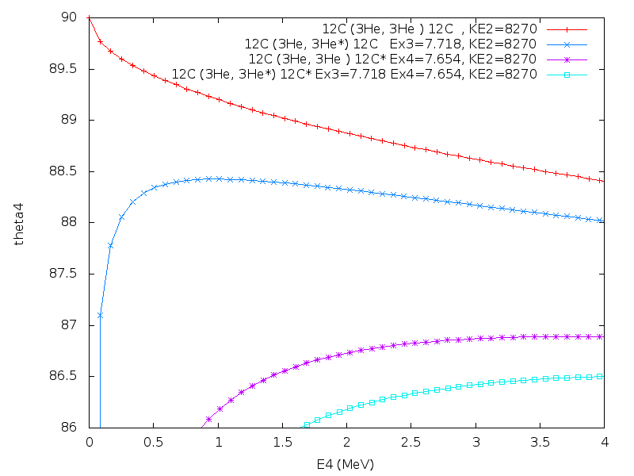
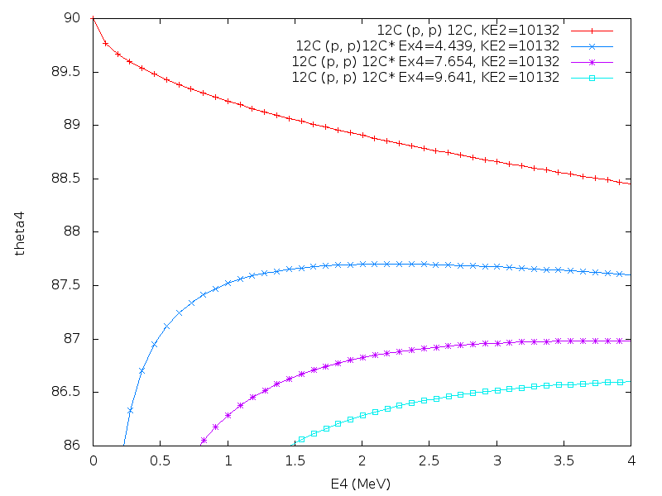
Carbons inside the Detector Acceptance
1mm detector
acceptance
He3 breakup
(courtesy Buttimore)
2mm detector
acceptance
Carbon excited
helion
proton
Carbon excited

Slide 11
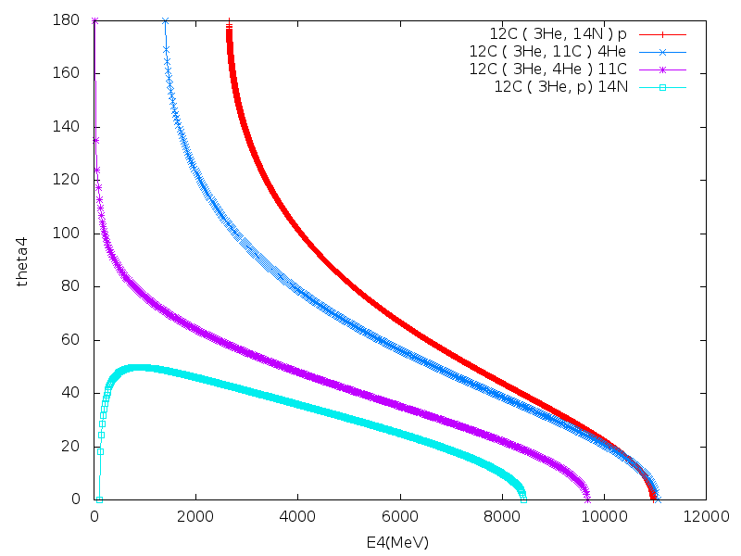
More Inelastic Channels
(courtesy Buttimore)
These are fast carbons and can be easily ruled out and there are really nothing around the 90 deg.

Slide 12
Helion Setup Results
Helion beam was accelerated to the flattop with both partial snakes on. The intensity out of EBIS is 3.5*10^10 and is 3*10^9 at AGS flattop. transverse emittance is about 5-10pi as reported by IPM. Only about 1.2*10^10 at Booster early and half of that is gone at Booster late. Beam can be lost with Booster injection field drifted by a few Gauss.
Bunch merge was done at Ggamma=-5.5 and A3 RF cavity occasionally dropped and wiped out all the beam. This was later tuned out by HLRF change and extending the length of the porch.
We did see carbon bananas and the polarization is consistent with zero as expected: 0.89+-1.84% with chi^2=1.16. The normalized rate is about twice as high as the case for proton. Excellent preparation by Kin and RF group made this setup quick and smooth.
Tunemeter worked on the first day thanks to Leif and Michelle. The vertical tune was as high as 8.97 along the ramp. Both tune and chromaticity have been measured on the ramp and will be compared with model (Francois and Yann).
ORM data has been taken for the snake on machine at 400ms with Vincent's instruction.

Slide 13
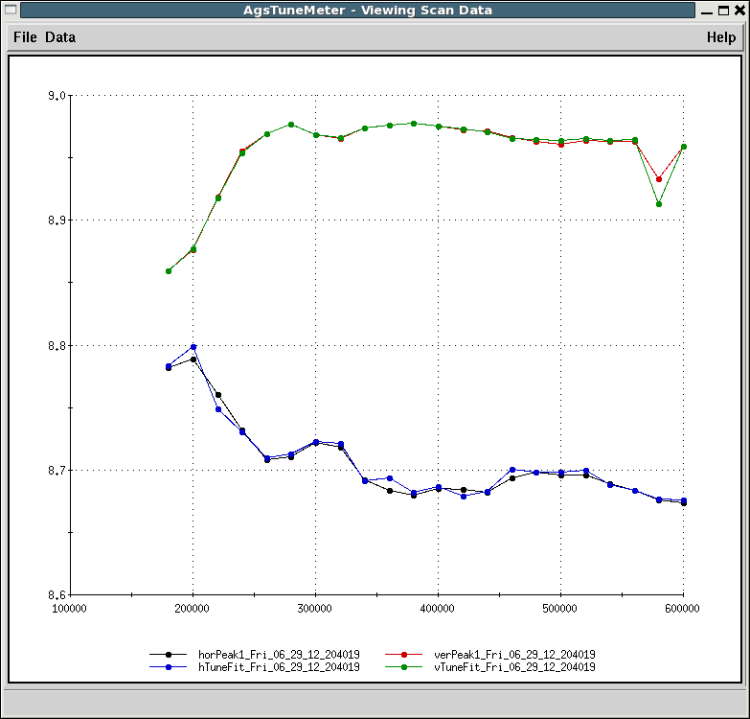
Betatron Tunes
Top energy reached at 485ms. ν_{y} at injection is inside spin tune gap already. But need to push even higher, as the tune has to be close to 8.97 at 0+ν_{y.}

Slide 14
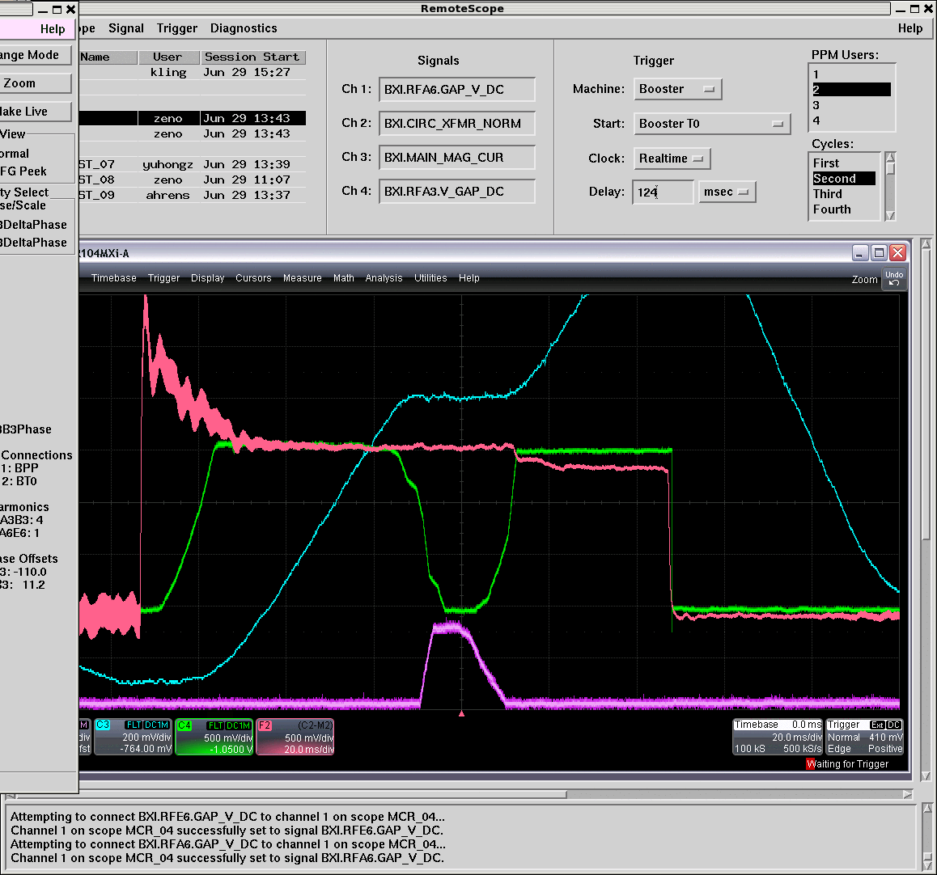
Helion Beam in the Booster

Slide 15
Transfer Efficiency
The EBIS input was about 3.5*10^10, according to Jim. The high value at AGS extraction was only 3*10^9. It usually takes Keith a lot time to optimize a new setup, much more time than was allotted here. So the poor efficiency should not necessarily be attributed to real problems. With that in mind, In the meantime, we can list the the sources of the losses.
EtB injection efficiency is about 52%. Normal injection efficiency is 80%, or higher. The beam at the end of EtB (29mw141) may have been larger than other beams. The He3 beam had FWHMs of 17.25 mm (h) and 18 mm (v), whereas the Au beam had FWHMs of 8.05 mm (h) and 9.16 mm (v).
Early Booster acceleration efficiency was about 50%, whereas in an optimized setup it's over 80%. The flatness of the field during capture may be important in reducing early acceleration losses, and it was not optimal. And, adjusting the tunes during early acceleration was difficult. May need PS group to monitor the PS when we run helion again.
Losses after the merge. It can be resolved either by extend the porch or lower the merge energy to Ggamma=4.5.
With snake on, the BtA transfer efficiency was probably about 70%. This is expected to be tuned out with enough time.

Slide 16
Preliminary Plan for Next Year
Bunch merge can also be done at Ggamma=4.5, which probably is easier for RF cavity. We will test this in next run.
It is not clear if we can set Qy=4.1 due to space charge (did not try this run). Tried to set Qy=3.9, one vertical tune trim P/S tripped. A tune below 4 near extraction rigidity, required about 1100 A, which is the limit of the supply.
Booster transmission efficiency needs to be improved, need to give Keith enough time.
Measure betatron tune with PIP (couldn’t do in this run as a gain switch stuck, needs to be fixed).
Spin tune gap at injection is about 0.85. The 0+ν_{y} is closer to injection for helion: injection is Gγ=7.5 and 0+ν_{y} is at Gγ=9. We need to either inject at higher vertical tune or to ramp faster after injection. In any case, injection with vertical tune above 8.86 is needed.
Time wise, the spacing of resonances is smaller. 43 jumps in 335ms compared to 42 jumps in 450ms for protons. Need to develop the requirement for tune jump quads.
Prefer to spread about one week helion beam time behind proton run.

