Slide 1
Accelerator Physics EXperiment
Highlight of RUN 12
M. Bai, C-A Dept., BNL

Slide 2
Outline
Statistics
Highlights
Summary for RUN12 APEX
Suggestions/plans for future

Slide 3
APEX Statistics
RUN | Scheduled/Planned[%] | Beam Availability [%]
RUN-3 | 80 | 65
RUN-4 | 90 | 84
RUN-5 | 84 | 83
RUN-6 | 89 | 86
RUN-7 | 92 | 72 (physics: 49%)
RUN-8 | 97 | 83.4 (physics: 59%)
RUN-9 | 98 | 82.9 (physics: 54%)
RUN-10 | 79 | 82.5 (physics: 83%)
RUN-11:pp | 42 | 92 (physics: 37%)
RUN-11:Au | 63 | 78.5 (physics: 59%)
RUN-12:pp | 134 | 86.8
RUN-12:ion | 61 | 93.7

Slide 4
Detailed Statistics
Run12 | scheduled | scheduled | APEX | APEX | actual | APEX | Failure | APEX/scheduled
date | interval | duration (h) | START | END | duration (hh:mm:ss) | hours(OpLog) | hours | %
22-Feb | 0800-2400 | 16 | 2/22/12 8:00 | 2/22/12 23:35 | 15:35:00 | 11.67 | 3.45 | 72.9%
7-Mar | 0800-2400 | 16 | 3/7/12 7:55 | 3/7/12 22:45 | 14:50:00 | 10.53 | 4.27 | 65.8%
21-Mar | 0800-2000 | 12 | 3/21/12 8:00 | 3/21/12 19:10 | 11:10:00 | 9.87 | 1.30 | 82.3%
27-Mar | 2000-0800 | 12 | 3/27/12 20:00 | 3/28/12 7:40 | 11:40:00 | 11.05 | 0.62 | 92.1%
4-Apr | 0800-2000 | 12 | 4/4/12 8:25 | 4/4/12 19:50 | 11:25:00 | 9.7 | 0.00 | 80.8%
12-Apr | 0800-2000 | 12 | 4/12/12 8:00 | 4/12/12 22:00 | 14:00:00 | 11.27 | 2.67 | 93.9%
18-Apr | 1330-0900 | 19.5 | 4/18/12 13:20 | 4/19/12 8:15 | 18:55:00 | 17.33 | 0.82 | 88.9%
2-May | 0800-1900 | 11 | 5/2/12 8:20 | 5/2/12 18:20 | 10:00:00 | 8.7 | 1.13 | 79.1%
30-May | 0800-2300 | 15 | 5/30/12 8:00 | 5/30/12 22:15 | 14:15:00 | 14.22 | 0 | 94.8%
13-Jun | 0800-2400 | 16 | 6/13/12 8:00 | 6/13/12 23:30 | 15:30:00 | 14 | 1.5 | 87.5%
Courtesy of P. Ingrassia

Slide 5
Studies during RUN12
Study # | title | Studiers | priority | Total time [h]
12-05,06,02 | Beam-beam | White, Luo | 0A | 15
12-07 | V dispersion | Liu | 0A | 5.5
12-12,13 | High intensity proton | Montag | 0A | 19
12-09 | BBA | Beebe, Zieger |  | 10
11-30 | Beam-beam and space charge | Fedetov | 0A | 3
10-15 | Phase shifter | Montag | 1A | 4.5
 | Local coupling | Marusic |  | 4
11-33 | IP transfer matrix | Tepikian, Ptitsyn | 0A | 4.5
11-21 | Off-momentum beta beat | Luo | 0A | 2
 | Polarization lifetime | Bai |  | 8

Slide 6
Studies during RUN12
Study # | title | studiers | priority | Total time [h]
12-17 | Long. Matching w.o. gammaT | Montag | 0A | 4
12-07 | V dispersion | Liu | 0A | 10
11-17 | Spin flipper | Bai, Oddo, Roser, Dawson | 0A | 5.5
11-16 | Optics correction | Bai, White, GRD | 0A | 5.5
11-18 | PoP of CeC | Igor, Wang | 1A | 2
12-10 | 9MHz cavity bunch intensity limit | Bai,Hao,Blaskiewicz, Brennan | 0A | 1

Slide 7
RUN 12
A total of 19 proposals submitted before the start of run 13. 4 proposals received during the run with one proposal received closed to the end of run
19 beam studies were carried out
11 from 2012 proposal and 8 on-going from previous proposals
Still a mixture of APEX and MD
which compensated the reduction of MD during this pp run

Slide 8
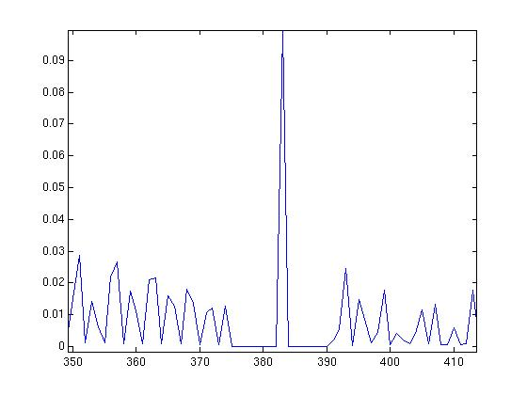
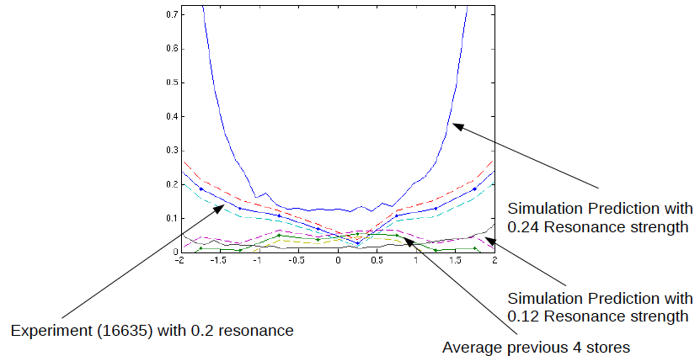
Highlights from APEX-12
Effect of spin harmonic: Vahid
Developed a technique to use a set of correctors to change the imperfection resonance strength at a certain location, spin harmonics
This was implemented during the ramp in both rings, one at Ggamma=411-nu and another at Ggamma=393+nu

Slide 9
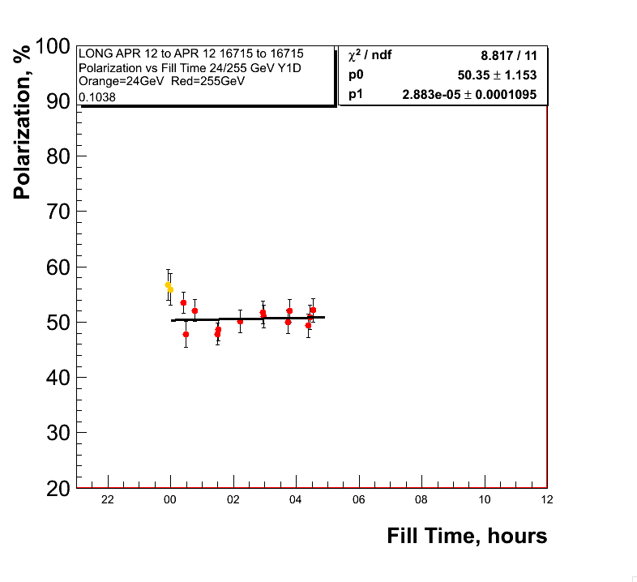
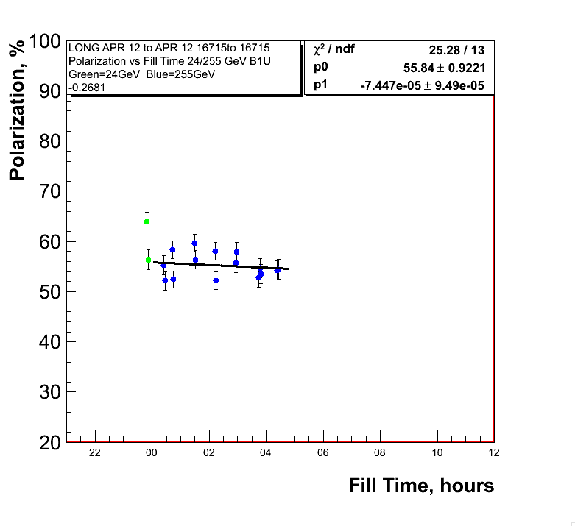
Highlights from APEX-12
Polarization lifetime without collisions
Evaluate the effect of snake resonance at 11/16
Evaluate beam-beam contribution to polarization lifetime
Qx=0.69
Qy=0.68
Qx=0.695
Qy=0.6875

Slide 10
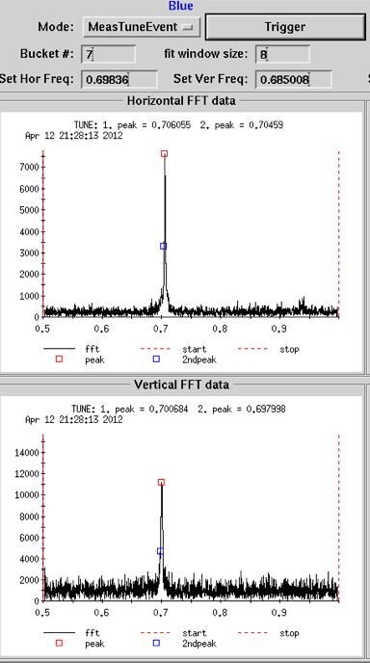
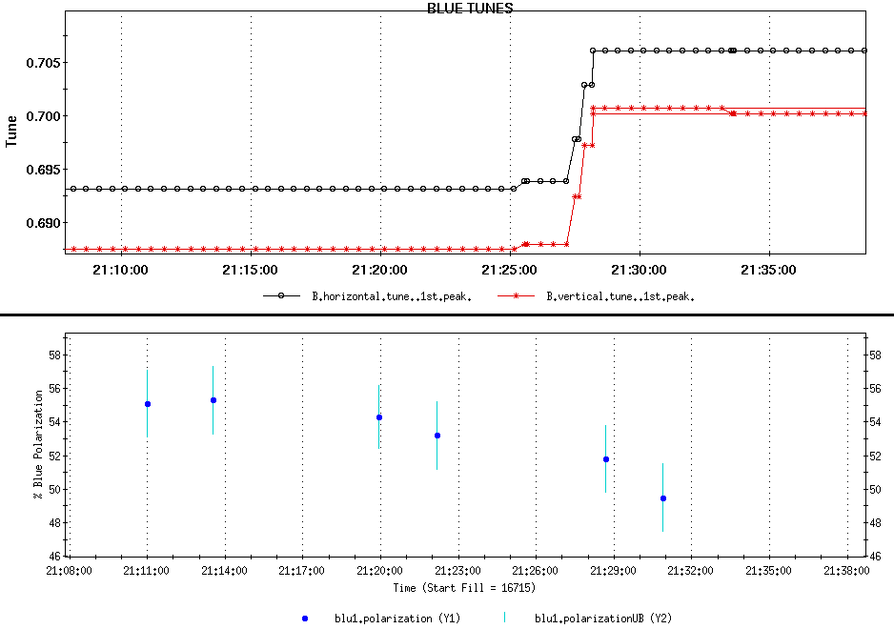
Highlights from APEX-12
Polarization lifetime without collisions
11/16 snake resonance is not the dominant source of
polarization lifetime for physics store
Data indicates the polarization lifetime is affected by
beam-beam.

Slide 11
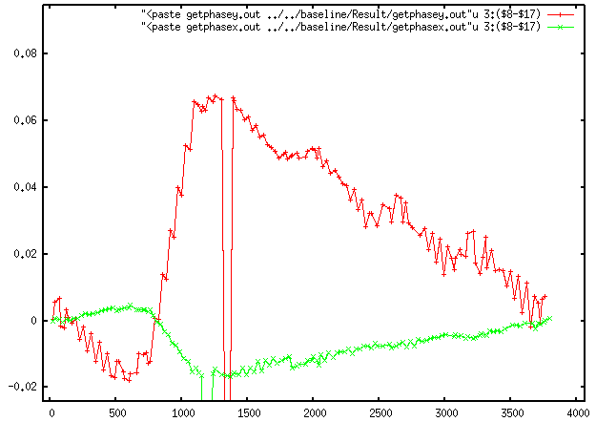
Highlights from APEX-12
Phase shifter: Montag, Bai, Simon, Minty, etc.
Motivation: to see whether one can measure phase advance change induced by phase shifter
Phase shifter:
To provide integer multiple of pi phase advance between IP8 and IP10 to compensate the beam-beam at IP8 with e-lens at IP10
two shunt power supplies to main quads in arc IP8 – IP10
Blue at injection
A vertical betatron
phase different of
~32 degrees with
phase shifter at 10A
was measured

Slide 12
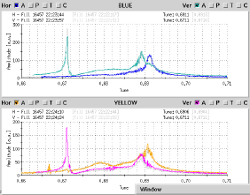
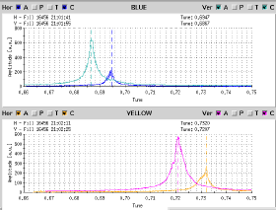
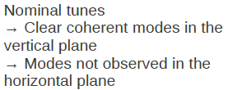
Highlights from APEX-12
Beam-beam: Simon, Yun
Tune scan for pi-mode suppression
BTF measurements of store with split tune shows significant suppression of pi mode

Slide 13
Highlights from APEX-12
Beam-beam: Simon, Yun
Tune scan for pi-mode suppression
BTF measurements of store with split tune shows significant suppression of pi mode
However, it is proven to be non-operational due to emittance blowup. Poor polarization lifetime also confirmed the observation in RUN2004
Understand why coherent bb mode missing in the horizontal plane
Impact of coupling
Impact of 10 Hz feedback
Impact of white noise
Understand the effect of coherent modes on beam lifetime
Excite coherent mode with BBQ kicker. Emittance blowup and deterioration of beam lifetime were observed when BBQ kicker was excited as high as 35dB. No instability was observed

Slide 14
Highlights from APEX-12
Commissioning of spin flipper/tunemeter
A group of 5 AC dipoles interwined with DC dipoles to provide rotating field oscillating at a frequency
Goal this year is to demonstrate whether we can excite rotating field
y
z
x
Only one resonance is excited

Slide 15
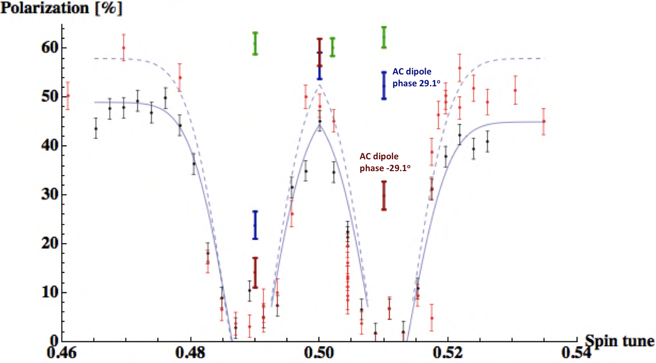
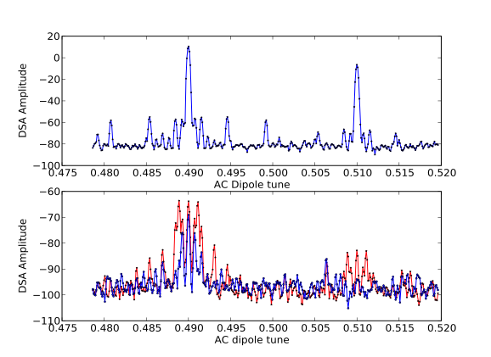
Highlights from APEX-11
Commissioning of spin flipper/tunemeter

Slide 16
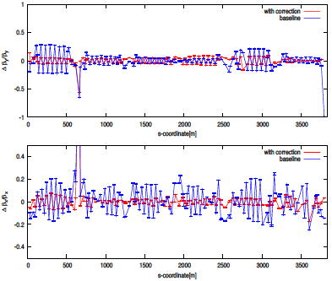
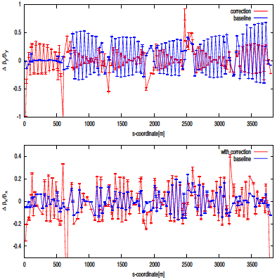
Highlights from APEX-12
Optics Correction: Bai, GRD, Joe, Simon
SBST was successfully implemented during APEX
Blue pp @ 255 GeV
Yellow Au @ 100 GeV

Slide 17
Highlights from APEX-12
Beam-based alignment: Joanne, Jordan
Motivation: Automated (or faster) BBA application for RHIC to determine difference between electrical center of BPM and mechanical center of nearby quadrupole in the IRs
Had a long history
Limited dipole correctors.
Very large ring. When all the BPMs in all arcs are used, some BPMs contribute to noise more than to signal.
Signal/Noise ratio is low
This new effort is to
Take advantage of improved bpm performance
Choose subgroup bpms
minimize the frequency of quadrupole changes
Automate the measurement

Slide 18
Highlights from APEX-12
Beam-based alignment: Joanne, Jordan
Q1 & Q3 Completed in both ring (48 BPMs in each ring).
tQ4 in IR 6, 8, 12 in both ring (24 BPMs in each ring).
3. Confirmed some of large offsets. Results are generally good.
Script ready and tested.
Was also implemented to operation
BPM at Q1 & Q3 completed in both rings(24 horizontal, 24 vertical in each ring).
Confirmed some of large offsets(8 in Blue, 10 in Yellow)

Slide 19
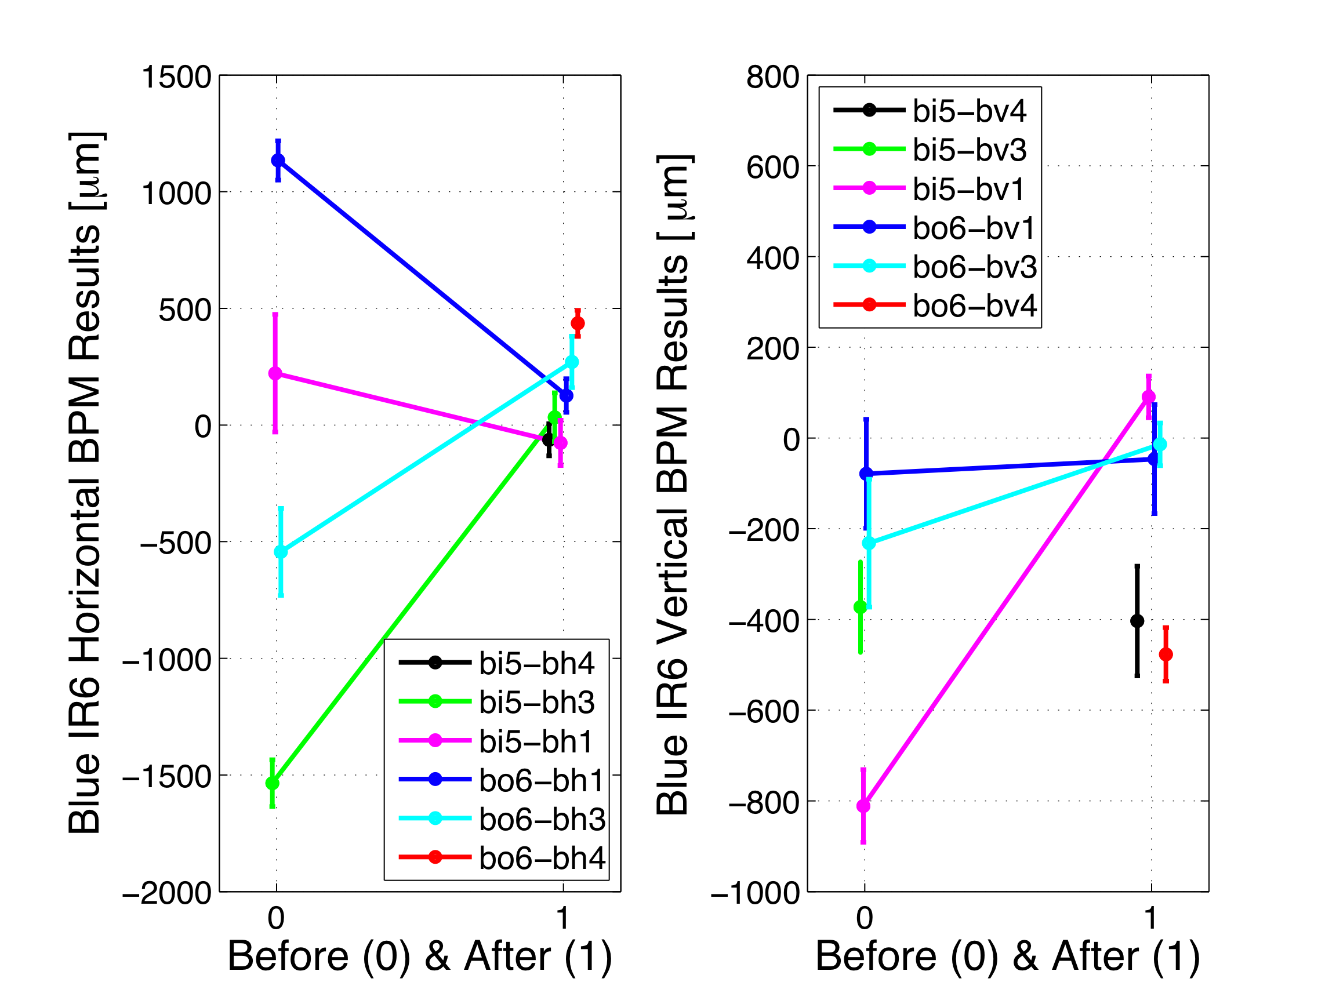
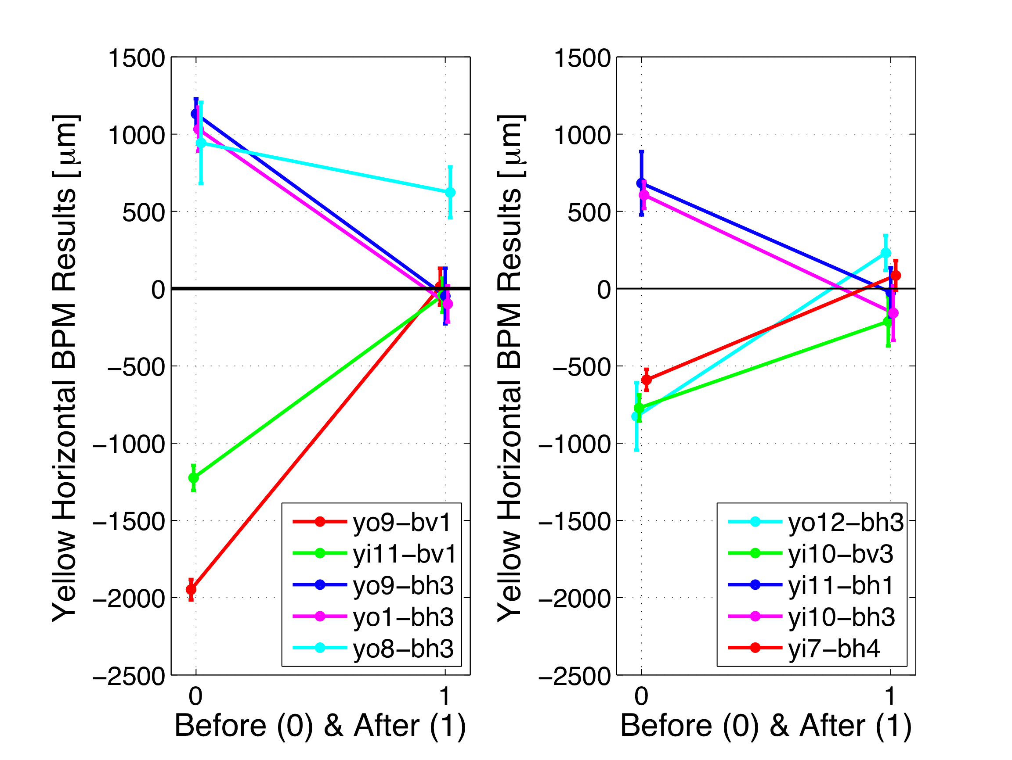
Beam-based alignment: Joanne, Jordan

Slide 20
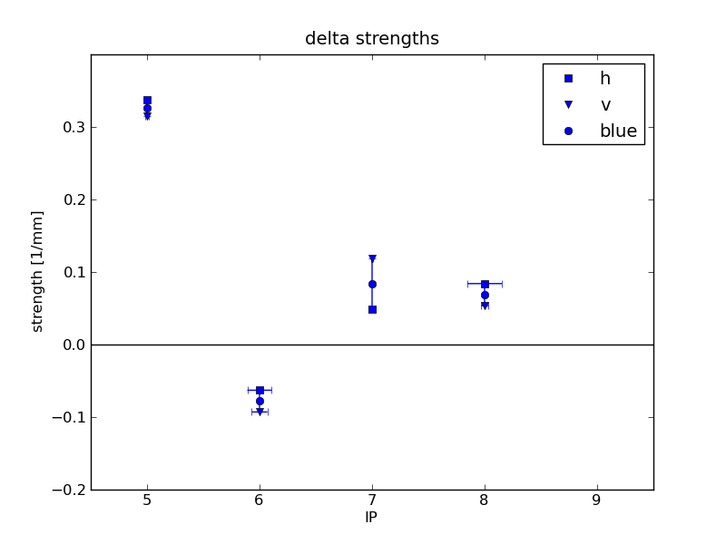
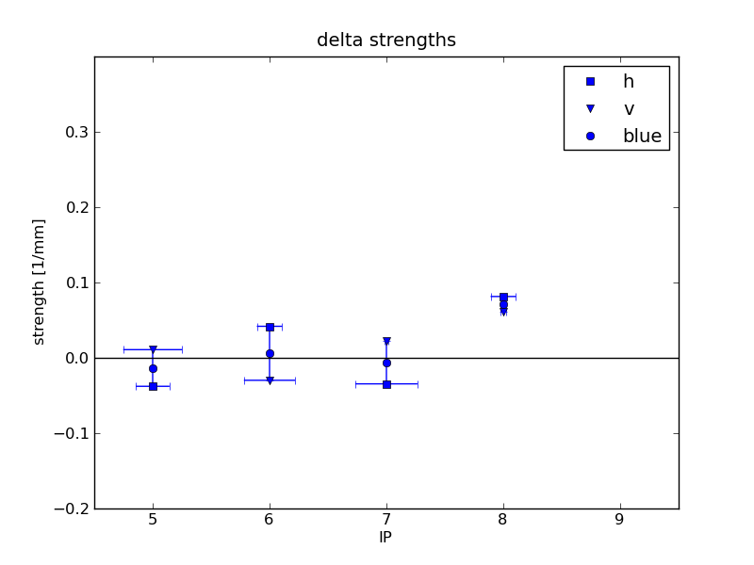
Highlights from APEX-12
Local coupling: Marusic
Automated technique developed by Vadim. Data-taking and analysis are now done in ~15 mins

Slide 21
Highlights from APEX-12
CeC PoP: Igor, Gang
Goal: Measure beam parameters critical for CEC POP (jitter, beam spectrum, orbit stability, bunch profiles)
Set-up
100 GeV/u gold ions in the yellow ring (left after the previous session with blue ring dumped)
No re-bucketing, Landau cavity ramped down, no stochastic cooling
10 Hz orbit feedback on
Utilized IP4 WCM (used for cogging observation)
Signal observed on LeCroy WaveRunner 640Zi

Slide 22
Highlights from APEX-12
CeC PoP: Igor, Gang
Goal: Measure beam parameters critical for CEC POP (jitter, beam spectrum, orbit stability, bunch profiles)
Conclusion
Beam orbit stability and bunch jitter were successfully measured
We do not expect that the observed beam motion will affect CEC POP experiment, but real data will be used for simulations
Oscilloscope noise level is above the beam spectrum power in the region of interest, measurement with spectrum analyzer can be done in background mode

Slide 23
Summary of Run 12 APEX
Beam studies biased towards polarized proton run
Switched to 12 hour-weekly mode from 16 hour-biweekly mode during pp-255GeV
Driven by more issues we need to find out
The limit on intensities
Look forward to significant intensity increase from e-Lens in the next couple of runs
Polarization performance
Bridge between APEX outcome and operation
The goal of APEX is to transfer the benefit to operations
BBA results were first time applied to operations later in the CuAu run
Look forward to seeing more benefits to coming run
Local decoupling
V dispersion and coupling correction
Optics correction

Slide 24
Prepare for RUN 13
Workshop
Mid-Nov as the primary candidate.
Challenges for the coming RUN
E-Len commissioning
Polarization improvement/understanding
Brighter beam
Smaller longitudinal emittance
Smaller transverse emittance
Instrumentation development
Novel way of measuring chromaticity
Polarimeter, polarimeter, …
High precision bpm development for pEDM

Slide 25
Process & Rules of APEX
Process
Submit proposal at http://www.c-ad.bnl.gov/BeamEx/scripts/beform.pl
Proposal followed by the approval by AEAC committee
Rating Criteria
a) relevance to RHIC performance and operation
b) scientific merit
c) level of preparedness
Rules
Prepare study beforehand, including notifying personal support
Revert changes at the end of study
Documentation. It is required that each study should be reported in at least one of the forms of
Informal technote
Conference proceedings
journals

