Slide 1
Summary of Performance Challenge Session
Haixin Huang
RHIC Retreat 2012
July 27, 2012

Slide 2
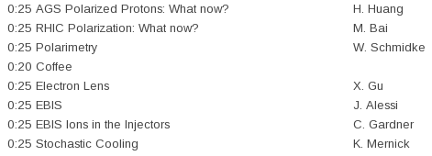
Performance Challenges Session
four talks about proton run and three about ion run

Slide 3
AGS Polarized Protons: What Now?
Haixin Huang
RHIC Retreat 2012
July 25, 2012

Slide 4
Improvement in Run12
Surveyed AGS ring (moved 70+ magnets).
Booster radius wobble at 98ms was found and corrected, which improves intensity efficiency in the Booster.
CNI injection measurement (reproducible, fast) for the first time.
The measurement allows to improve the Booster Gγ=3 correction.
New analysis was in use for CNI polarimeter: fast; same A_{N} as in RHIC, but added rate correction factor.
Sweep mode (similar to RHIC) works to give precise polarization profiles.
9th harmonic feed-forward (Sev, Leif) greatly reduced the tuning time.
JQ timing real time measurement (Peter Thieberger). Found accumulated error in JQ timing (control software bugs) and consistent wrong up (30μs) and down (30μs) timing. But improvement in polarization is not easily visible.
Vertical Beta function measurement with new dipole at vertical IPM (Leif).

Slide 5
What Now?
Add RHIC type IPM into AGS (horizontal first), which can provide turn-by-turn emittance (critical for injection match) and does not have space charge problem.
With higher input intensity from source next year, it is possible to capture at Booster with two or even three buckets. The direct benefit is smaller longitudinal emittance, which should allow higher intensity at RHIC rebucketing. We can fill yellow with two bunches (same sign) or even blue, if experiments agrees.
AGS cycle shorter cycle: 4s. -> 3s. This is to reduce RHIC filling time to reduce emittance growth at RHIC injection. The jump quads LV PS needs modification.
New C5 corrector for horizontal beta function measurement.
Test of extraction-on-the-fly. But first need expert to check the feasibility with 9MHz cavity.
AGS ZGOUBI model as (semi-) online model, behind optical control, IPM.
Automatic IPM beta function measurement.
Automatic emittance correction (from space charge, dispersion-> requires longitudinal dimension measurement).
Automatic chromaticity measurement.

Slide 6
Summary
We have seen higher polarization and smaller transverse emittance this year. Polarization is higher as we push bunch intensity the same time.
The gain of polarization is due to higher injection polarization, smaller emittances.
In the coming run, polarization gain has to come from further reduction of emittance and optimization of tune jump quads operation.

Slide 7
RHIC Polarization, what now?
M. Bai, C-A Department, BNL

Slide 8
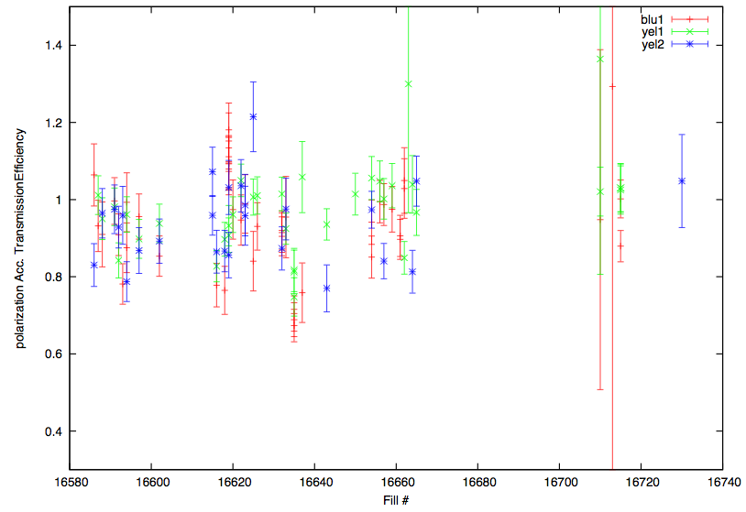
Polarization Acceleration Transmission Efficiency
Negligible loss during acceleration to 100 GeV
On average, losses along the ramp is ~5% based on current CNI polarimeter analyzing power at injection
Yellow Injection measurement with jet: 63+-4.4%.
Same period, yellow2 pCarbon: 58.34+-0.83% and chi^2=1.38.
This will give scaling factor for pCarbon: 1.08+-0.08
Note that the estimated polarization loss on the ramp was 10-15% (relatively) from the down ramp in run11.
Ratio of polarization@store before rotator
ramp vs. polarization at injecjtion

Slide 9
What contributes to Polarization Lifetime?
Shadow of strong resonance, which deviates the stable spin direction away from vertical direction
Moved the store energy to 255 GeV, i.e. Ggamma=487 to be further away. Simulation shows 2~3% difference at large betatron amplitude(~30\pi)
Imperfection of spin rotators
Causes non-vertical stable spin direction outside IP if not perfectly closed
Spin tune deviation from vertical orbital angle between spin rotators
Beam-beam Effect
The direct effect on spin motion due to beam-beam force
The beam-beam tune spread makes it difficult to avoid snake resonance
Shadow of nearby snake resonance
Did not see effect
Did not see effect

Slide 10
Polarization Improvements
At current working point
Tight control of betatron tune spread
Chromaticity feedback during ramp
Tight monitor the local orbit at snakes as well as spin rotators
Reduce local coupling
Reduce beam transverse size
2/3 resonance correction to gain more tune space below 0.7
Explore ways to reduce spin tune spread
D’ zero lattice

Slide 11
Summary
Polarization lifetime studies during 2012 run indicate the polarization lifetime is dominated by either weak resonances nearby or the shadow of snake resonance at 7/10
At the current working point, the polarization performance is currently limited by available tune space. Better control of chromatic betatron tune spread as well as local coupling should help to improve of polarization performance
Further polarization improvement may require
Reduction of spin tune spread (D’ zero lattice)
A near-integer working point, which provides large tune space free of snake resonance and to accommodate more beam-beam tune spread
Most importantly, accurate and robust polarimetry can allow systematic snake/spin rotator optimization

Slide 12
Noise not gone after the termination. We still have to ramp down 200MHz cavity voltage for pol. Measurement. Probably next year, too.

Slide 14
Why targets are so fragile this year remains puzzle and it is my biggest concern about polarimeters.

Slide 16
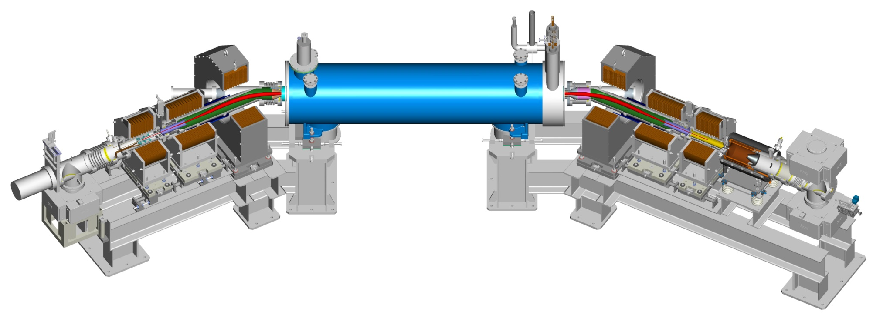
RHIC Elens Status and Its Commissioning Plan
for Run 13
W. Fischer† , Z. Altinbas, M. Anerella, E. Beebe, M. Blaskiewicz, D. Bruno, W.C. Dawson, D.M. Gassner, X. Gu, R.C. Gupta, K. Hamdi, J. Hock, L.T. Hoff, A.K. Jain, R. Lambiase, Y. Luo, M. Mapes, A. Marone, T.A. Miller, M. Minty, C. Montag, M. Okamura, A.I. Pikin, S.R. Plate, D. Raparia, Y. Tan, C. Theisen, P. Thieberger, J. Tuozzolo, P. Wanderer, S.M. White and W. Zhang
25 July 2012, Brookhaven National Lab.
Xiaofeng Gu

Slide 17
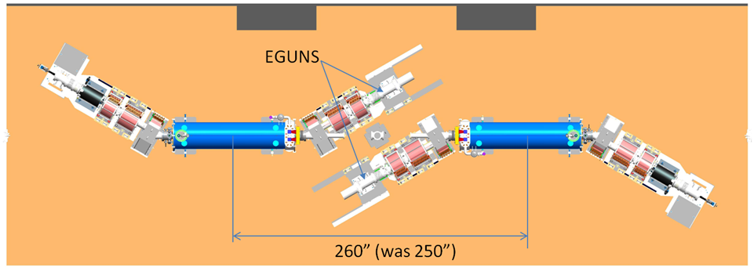
Introduction: The Layout of E-lens System
Blue elens
Yellow elens
Blue elens has 5 mm offset mechanically, and yellow has -5 mm;
At IR10, blue elens is on south side, and yellow is on north side.
Xiaofeng Gu

Slide 18
Strategy
Elens Hardware Commissioning (Before Cooling Down)
Electron Beam Commissioning (Before Cooling Down)
Commissioning with Proton Beam
Ramp development with all elens solenoids on (orbit control)
100 Hz and 78.8k Hz modulator test with pulse electron beam in abort gap
Transverse position pre-alignment with BPM (local orbit control)
Longitudinal alignment electron beam to the last proton bunch
Change to DC beam if single bunch proton beam life time is good.
Tune proton beam or electron beam according to the collision detector.
Xiaofeng Gu

Slide 19
Recap of the first EBIS run for RHIC
Jim Alessi

Slide 20
Fell short on intensity at Booster input
“bailed out” by bunch merges (Kip’s talk)
Exceeded expectations (mine, at least) on reliability and stability
Had previously run a lot of Au, but never U, Cu, or He-3 until this run (also Xe for NSRL)
Had run some 4-pulse, but never 8-pulse
By far, this was our longest continuous run
We’re essentially now at the point where we’re comfortable going home while it’s running.

Slide 21
Intensity at Booster input (xf108)
These values were after Keith’s tune through Booster (he would tune all EBIS rf and quads).
Generally, if we tune to 108, we can get more there, but Booster late may drop. Proper upstream vs. downstream tuning needs to be explored more in the future.
Au 32+: 1.5e9/pulse; 7.7 nC (2.7e9)
Cu 11+: 6.1e9/pulse; 10.7 nC (11e9)
U 39+: 1.1e9; 6.8 nC (Kip/Keith - 1.25e9) (2.0e9)
He-3 2+: 3.75e10; 12 nC (> 10e10)
Why the shortfall?
EBIS output (total charge) is > design.
Unfortunately, we still don’t have a good handle on relative contributions of things like the following:
% in desired Q, impurities, matching into RFQ, RFQ / Linac transmission, MEBT misalignment, rf tuning, …
We’ll continue to try and sort this out during the shutdown

Slide 22
Summary
Uranium, gold, copper, and helium-3 !
We’ll continue to work on intensity (eliminate at least one merge next time?)
Stable and reliable – (hopefully not beginner’s luck)
He-3 setup in 12 hours was quite impressive.
Special thanks to:
EBIS “watchers” – Ed Beebe, Dan McCafferty, Sasha Pikin, Dannie Steski
EBIS “fixer” – Bob Schoepfer
Optics – Deepak Raparia
John Morris & Sev Binello for lots of help on controls software
(plus lots of others who helped before & during the run on rf, vacuum, controls, power supplies, diagnostics, …..)

Slide 23
EBIS Ions for RHIC Run 12
Setup of Booster and AGS for delivery of EBIS U, Au, and Cu to RHIC for physics

Slide 24
This was a difficult and challenging exercise which
reached a successful conclusion only because of
the extraordinary effort and talents of many…
The EBIS folks
The RF group
The Controls group
The Operations Coordinators
and operators
The Tandem folks
and…

Slide 25
Keith Zeno Keith
Zeno Keith Zeno
Keith Zeno Keith
Zeno Keith Zeno

Slide 26
Standard setup…
Transfer 4 Booster loads of 4 bunches to AGS per AGS cycle.
Merge 16 to 8 to 4 bunches in AGS.
Gives 1 Booster load per RHIC bunch.

Slide 27
EBIS beam in Booster
1.3 to 1.6e9 Au32+ ions per EBIS pulse
(5.0e9 Au31+ ions per Tandem pulse)
Booster injection efficiency initially 60-70%
(efficiency up to 80% for Tandem beam)
Bstr capture and acceleration efficiency for EBIS beams somewhat better
So per bunch intensity for RHIC down by factor of 1.6/5.0…

Slide 28
The challenge…
Increase RHIC bunch intensity by a factor of 3 to 4
And keep longitudinal emittance low enough for successful RHIC operation
This was quite worrisome and stressful…

Slide 29
Even the Queen was concerned…

Slide 30
Things done or considered:
Booster inflector aperture increased
Booster “merge and squeeze” scheme used for deuterons during RHIC run 8
Capture half-turn of EBIS beam in Booster with barrier bucket
Debunch and rebunch beam in Booster
4 to 1 merge in Bstr; 16 to 8 to 4 in AGS

Slide 31
Booster debunch rebunch…
Inject EBIS beam and capture and accelerate to an intermediate porch
Debunch the 4 bunches and rebunch into one large bunch
Accelerate, and transfer 8 loads of 1 bunch to AGS
Merge 8 into 4 bunches on AGS porch

Slide 32
1 of 8 Booster loads to AGS

Slide 33
Merge 8 bunches into 4
2 Booster loads per bunch

Slide 34
Booster debunch rebunch setup used for part of U physics run
Then we switched to
something better…

Slide 35
Booster double merge:
Inject EBIS beam and capture and accelerate to porch as before
Merge 4 bunches into 2, then the 2 into 1
Accelerate, and transfer 8 loads of 1 bunch to AGS
Find that Booster bunches now fit into harmonic 16 buckets in AGS. This makes double merge in AGS possible.

Slide 36
1 of 8 Booster loads to AGS

Slide 37
Merge 8 to 4
2 Booster loads per bunch

Slide 38
Merge 4 to 2
4 Booster loads per bunch

Slide 39
But, can the AGS merges be done with missing bunches?
(Here the Queen enters
stage right…)

Slide 40
A 16 to 8 to 4 merge with missing bunches can’t be that difficult…

Slide 41
The difficulty was overcome and the scheme worked brilliantly
___________________________

Slide 42
Numbers achieved:
1.62e9 Au77+ ions per bunch at AGS ext
6.50e9 Cu29+ ions per bunch at AGS ext
3.8e8 U90+ ions per bunch at AGS ext
0.5 to 0.6 eV s per nucleon at AGS ext
(Careful measurements by K. Zeno)
These met the needs of the RHIC physics program…

Slide 43
And the Queen was delighted…

Slide 44
Issues…
“Baby” Bunches
AGS capture loss
Booster magnetic cycle
Booster merges (why so ugly?)

Slide 45
Stochastic Cooling
K. Mernick
RHIC Retreat
July 25, 2012

Slide 46
Outline
This year was the first with all six planes of stochastic cooling
Longitudinal and vertical in both rings had run successfully in the past, horizontal was new this year
Stochastic cooling was a major success, with no significant failures or downtime
I’ll start with a quick review of the work last shutdown and then briefly discuss results from the run, then I’ll describe plans for upgrades and enhancements over the near future

Slide 47
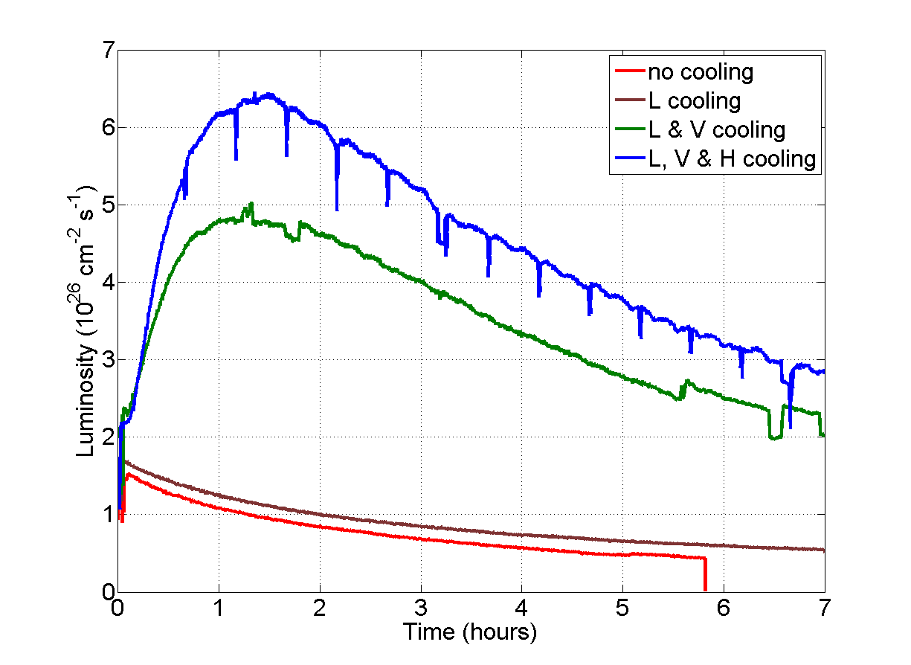
U-U Results

Slide 48
Summary
Stochastic cooling was a major success this year, running successfully in all three planes in both rings with no significant failures or downtime
We are continuing development efforts to improve system performance, increase reliability, and enhance operational efficiency
Thank you to the many, many people who contributed to the success of stochastic cooling

