Slide 1
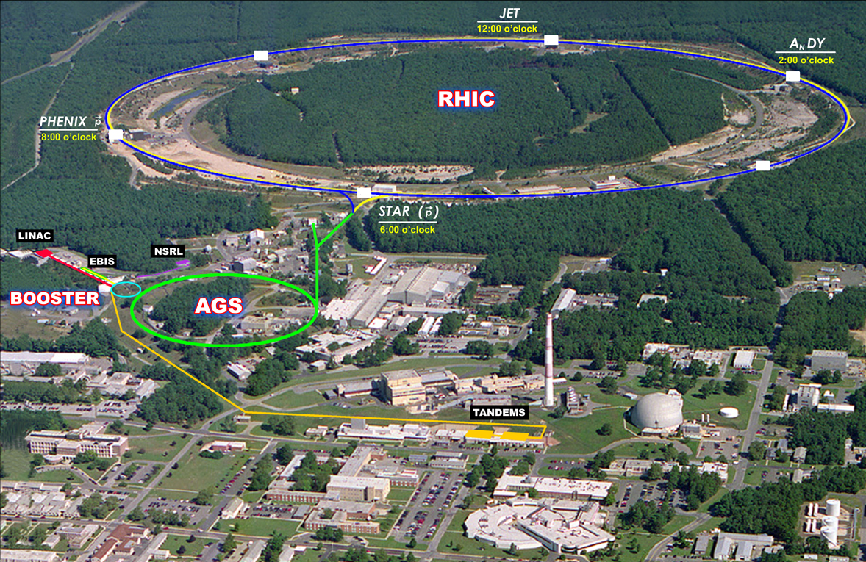

Summary of Session I
Lessons From Run-12
Wolfram Fischer
27 July 2012
RHIC Retreat, Bellport
Notes:
27 July 2012, 09:05, 20 min (incl. questions)

Slide 3
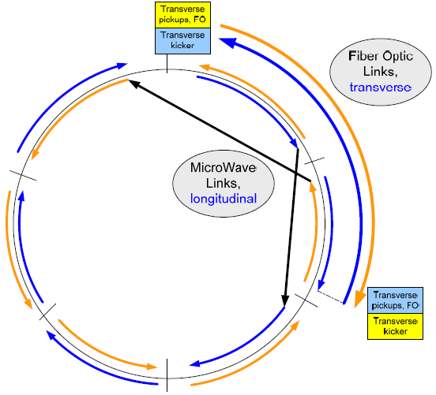
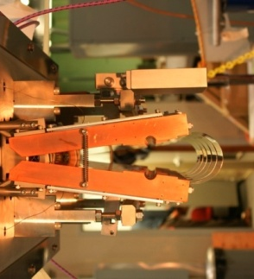
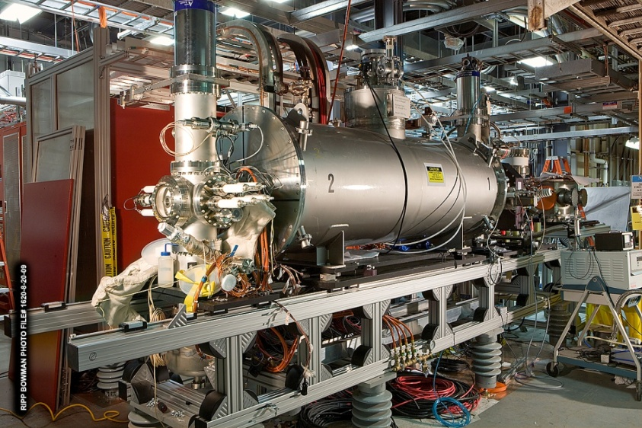
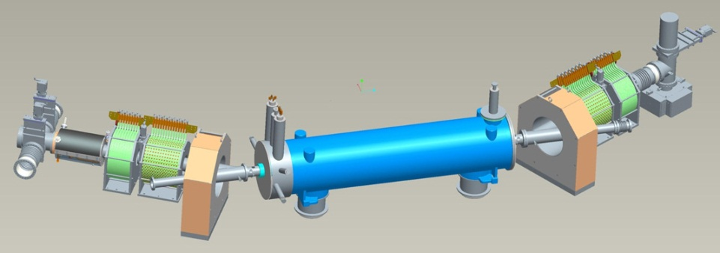
RHIC-II Era is Here, Done Very Cost-Effectively !
S. Vigdor, NP
Y h+v pickups
RHIC breakthrough in bunched-beam stochastic cooling facilitates ~x10 improvement in heavy-ion collision rates, 5 years earlier and at ~1/7 the cost envisioned in 2007 NP Long Range Plan, saving ~$80M
All (6 planes of pickups & kickers) of the new system commissioned during 2010-12, new 56 MHz SRF cavity anticipated for 2014 run.
B h+v kickers
Horiz. Kicker (open)
Measure deviations from central moment-um in pickups, correct with kickers
Y h+v kickers
B h+v pickups
Electron lenses to be installed for 2013 run to improve polarized pp luminosity by factor ~2
EBIS
Electron lens
New Electron Beam Ion Source (EBIS, 2012) expands range of ions available (e.g., U) and enhances cost-effectiveness of operations
Notes:
3

Slide 4
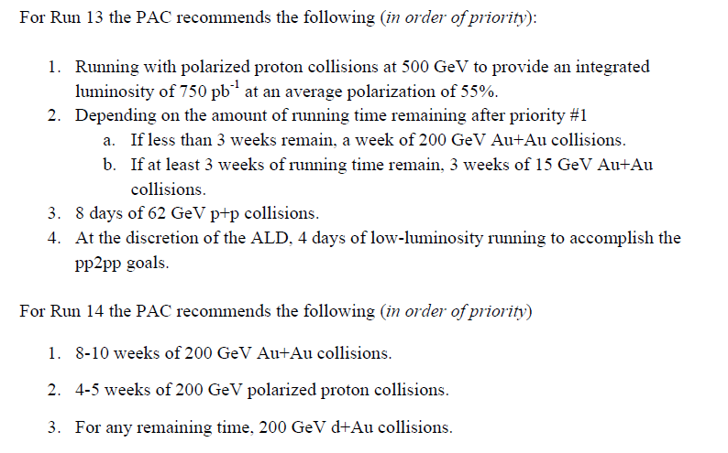
PAC Recommendations for Runs 13 & 14
Asked PAC for advice, priorities for 20-cryoweek Runs 13 & 14, in light of anticipated upgrade schedules and NP performance milestones:
With full FGT, aims at W production milestone
Au+Au to commission HFT prototype, ~15 GeV to fill in missing point on beam energy scan – is there √s nearby where both PHENIX and STAR can run?
With 56 MHz SRF + full HFT
Baseline data with new systems
For commissioning MPC-EX, if available

Slide 5
10 Basic Questions Going Into the RHIC Era
S. Vigdor, NP
RHIC answers to date:
Do we reach the QGP phase?
Is it weakly coupled, with ~ideal gas behavior?
Can we demonstrate the transition from hadronic degrees of freedom?
Do partons lose energy rapidly in traversing QGP?
Does QGP color screening suppress quarkonium formation?
Can we find evidence of high-temp. excited QCD vacuum fluctuations (sphalerons), analogous to EW sphalerons as source of universe’s baryon asymmetry?
Is there a locus of 1st-order phase transitions and a Critical Point in the QCD phase diagram?
Do we see evidence of gluon density saturation in cold nuclear matter at very low Bjorken x?
Do gluon spin preferences account for a significant part of the missing proton spin?
Is there a significant flavor-dependence in sea quark polarizations?
Yes
No
Hints
Yes
Hints
Hints
Hints
Hints
Hints
Too little data to date
It is the responsibility of RHIC and LHC to design measurements to address the more quantitative 2nd-generation questions emerging from the definitive answers above, and to resolve the hints surrounding the others.

Slide 6
Which Facilities Are Needed To Address Open Questions?
Question | Facilities | Comments | Relevant Table 1 Q #’s
How perfect is “near-perfect” liquid? | RHIC & LHC | Flow power spectra, next 5 years | 1 + 2
How does strong coupling emerge from asymptotic freedom? | RHIC & LHC | Following 5 years @ RHIC; jets need sPHENIX upgrade | 2 + 4
Evidence for onset of deconfinement and/or critical point? | RHIC alone | Following 5 years, needs low-E electron cooling | 3 + 7
Sequential melting of quarkonia? | RHIC & LHC | LHC mass resolution a plus; RHIC det. upgrades help; √s-dependence important | 5
Are sphaleron hints in RHIC data real? | Mostly RHIC | Exploits U+U and μ_{B} ≠ 0 reach at RHIC | 6
Nature of initial density fluctuations? | RHIC, LHC & EIC | Benefits from asymmetric ion collisions at RHIC | 2 + 8
Saturated gluon densities? | RHIC, LHC & EIC | Want to see onset at RHIC; need EIC to quantify | 8
Where is missing proton spin? | RHIC & EIC | EIC will have dramatic impact | 9 + 10
S. Vigdor, NP
RHIC and LHC are complementary. Both are needed to explore temperature- dependence of QGP properties. RHIC has unique reach to QGP onset, unique ion species versatility and unique polarized capability, until EIC is realized.
Addressing these questions requires an ~10-year program of A+A (various ion species), p+p and p/d + A runs at various RHIC energies.

Slide 7
Drafting a White Paper for Tribble-II Subpanel
The Case for Continuing RHIC Operations
S. Vigdor, NP
Reader comments coming in from RHIC user and support community – paper will be available before Sept. 7-9 Tribble Panel meetings

Slide 8
Other White Papers
S. Vigdor, NP
Longer community-driven RHI white paper should be available for DNP Town Meetings in late October. Writing committee chaired by Steffen Bass includes two reps. from each RHIC and LHC exp’t + several theorists.
EIC Science White Paper now in 2nd draft form, being edited by Steering Committee for August release to wider community. Outline of ~120-page report given on next page. ~10-page Executive Summary draft under current discussion – to be available for Tribble Panel September meetings.

Slide 9
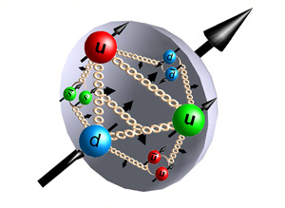
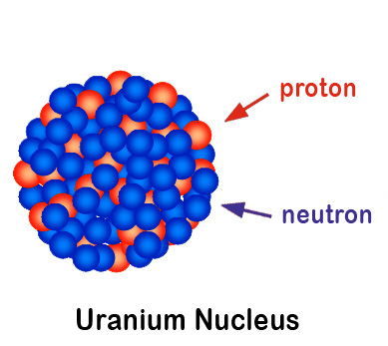
2012 RHIC Run (23.6 weeks of cryo ops) – most varied to date
100 GeV polarized protons
new records for L_{peak} (1), L_{avg} (2), P (3)
255 GeV polarized protons
highest energy polarized proton beam (4)
new records for L_{peak} (5), L_{avg} (6), P (7)
96.4 GeV/nucleon uranium-uranium
heaviest element in collider (8), shape
stochastic cooling: L_{max} > L₀ 1st time in hadron collider! (9)
all ions lost through burn-off 1st time in hadron collider! (10)
100 GeV/nucleon copper-gold
new species combination in collider (11)
highest ion charge/bunch (+8.5% rel. to Run-11) (12)
2.5 GeV/nucleon gold-gold collision test
lowest energy to date, 20% of nominal injection (Bρ) (13)
He-3 acceleration (unpolarized) in Booster and AGS
highest energy He-3 beam (14)
Notes:
Polarized proton picture: http://www.physastro.iastate.edu/research/highlights/view.php?id=15
Uranium nucleus picture: http://paomura.wordpress.com/2012/04/19/nuclear-physics-nuclear-weapons/

Slide 10
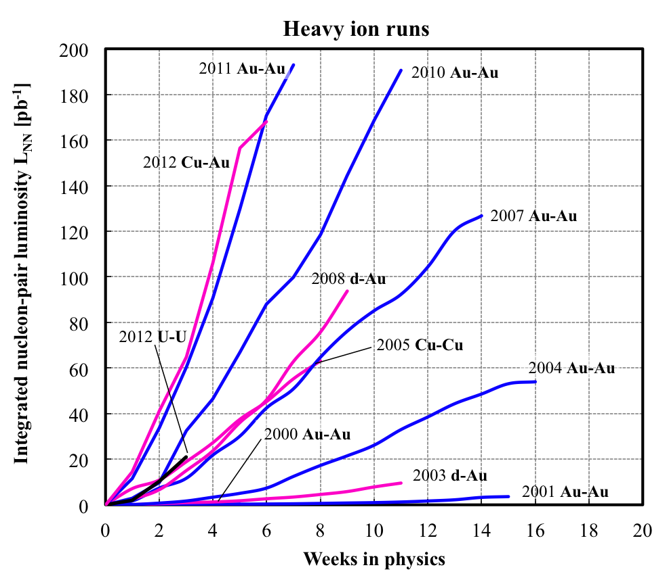
RHIC heavy ions – luminosity evolution to date
<L> = 15x design
in 2011
About 2x increase
in L_{int}/week each
Run-4 to Run-7
Run-7 to Run10
Run-10 to Run-11
Rate of progress will slow
down – burn off 50% of
Au beam in collisions already
L_{NN} = L N₁N₂ (= luminosity for beam of nucleons, not ions)
Notes:
Needs update

Slide 11
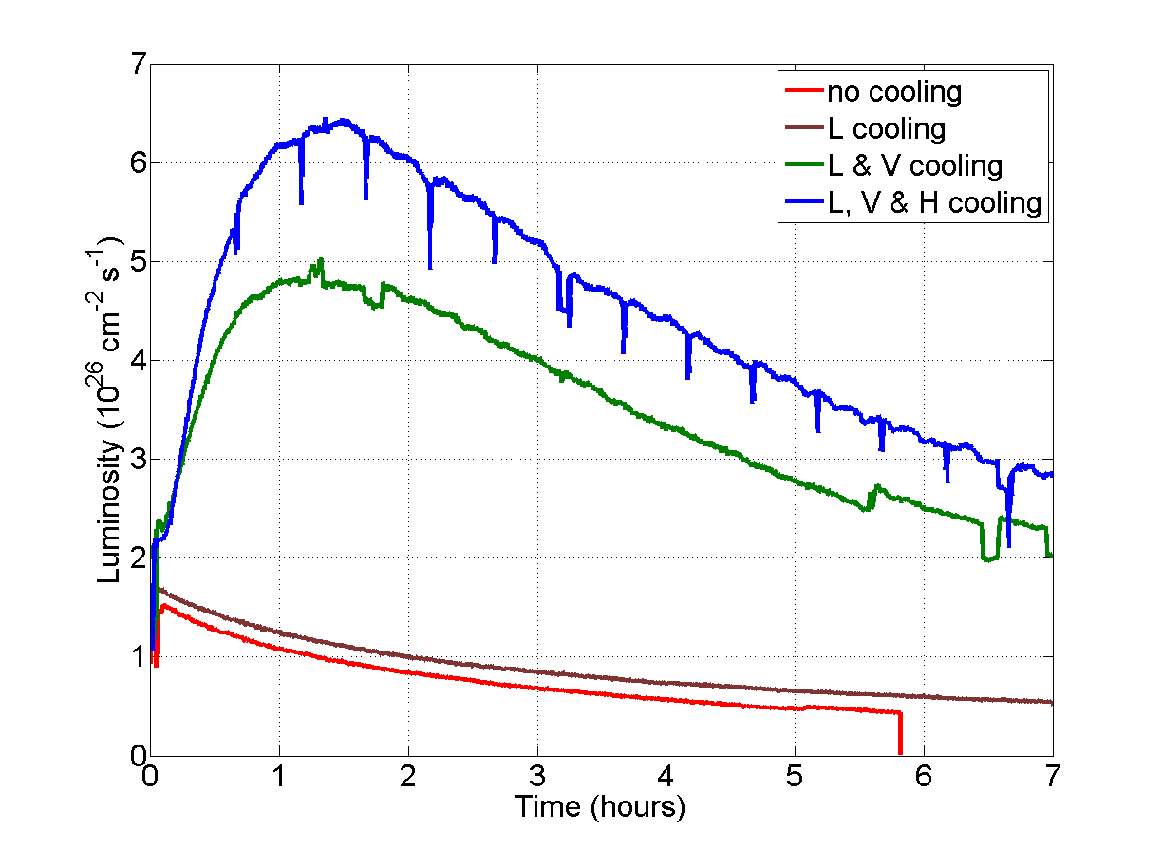
U-U Results
EBIS
Booster & AGS bunch merges
3D Stochastic cooling

Slide 12
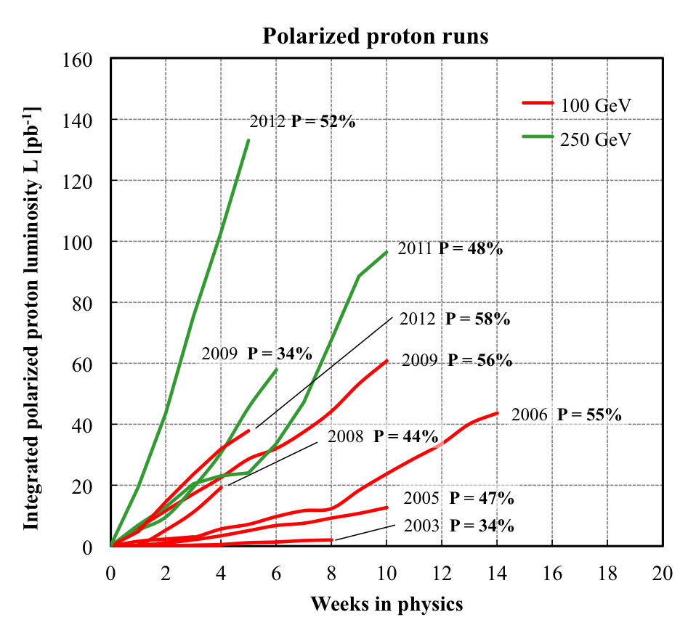
RHIC polarized protons – luminosity and polarization
At 255 GeV in 2012
L_{avg} = 105x10³⁰cm⁻²s⁻¹
P_{avg} = 52%
L_{avg} +15% relative to 2011
P_{avg} +8% relative to 2011
FOM = LP²
(single spin experiments)
FOM = LP⁴
(double spin experiments)

Slide 13
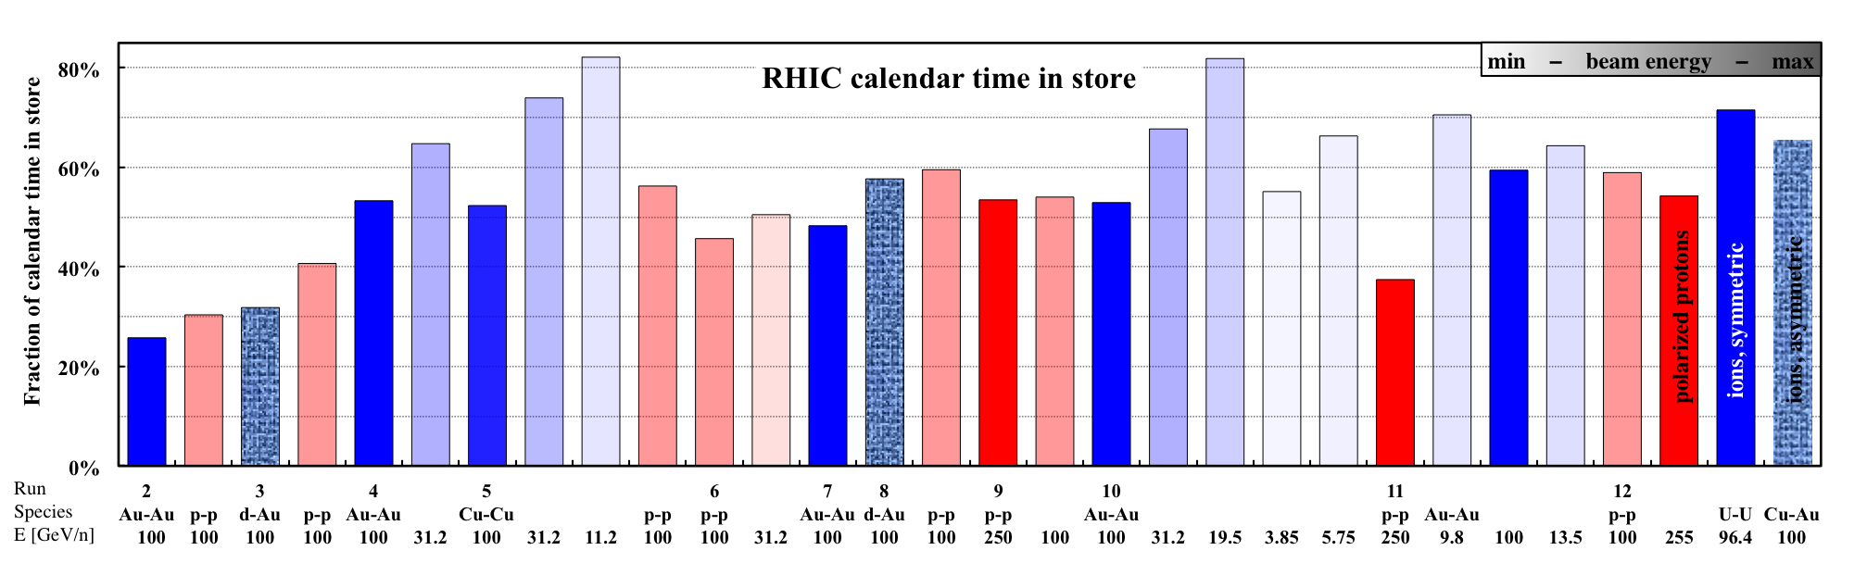
Time-in-store as fraction of calendar time = r
85%
60%
Run-12 with low failure rates in all systems
Highest time-in-store ratios to date
even with increased APEX time during 255 GeV protons, and few weeks per species
Could Run-12 performance be due to chance?

Slide 14

Run-12 time in store – could it be due to chance?
(not entirely serious)
A: not likely
i.e. system performance
was really improved!
Assume Gaussian distributions for r:
Measured distributions (Run-4 to Run-11 at full energy):
A-A: μ = 54.0% σ = 4.0% (6 data points)
p-p: μ = 52.4% σ = 4.6% (4 data points, exclude low-R Run-11)
Likelihood that observed r in Run-12 is due to chance:
100 GeV p-p: P(r ≥ 58.9%) = 7.6%
255 GeV p-p: P(r ≥ 54.2%) = 34.1% (increased E, more APEX)
96.4 GeV U-U: P(r ≥ 71.6%) = 0.001% (not a typo: 4.4 σ out, low intensity)
100 GeV Cu-Au: P(r ≥ 65.4%) = 0.24% (but high intensity here)

Slide 15
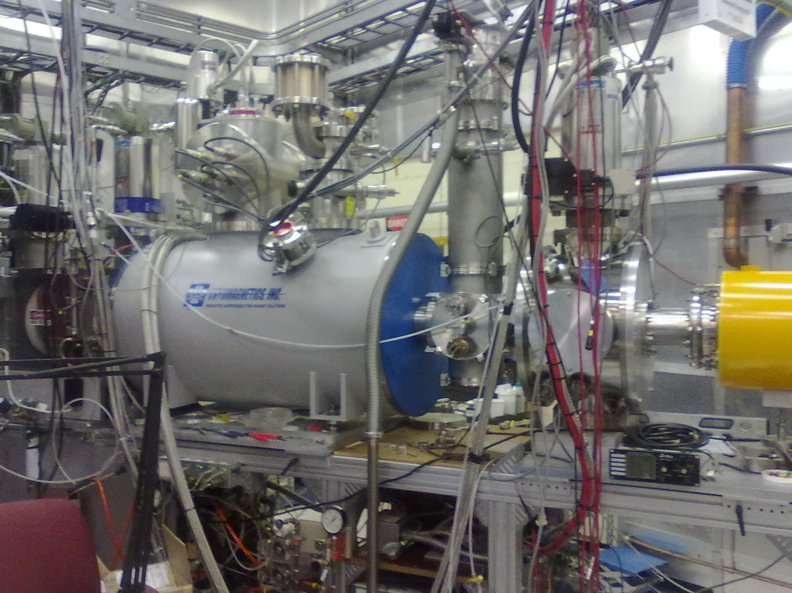
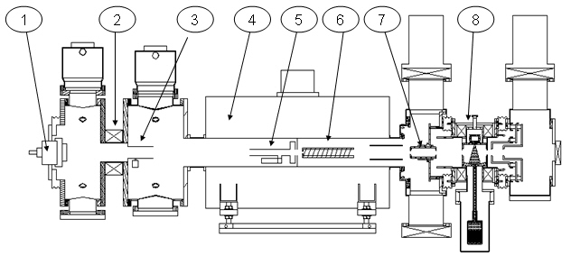
Optically Pumped Polarized H– source (OPPIS) – A. Zelenski
Upgraded OPPIS (2013)
Goals:
1. H⁻ beam current increase to 10mA (order of magnitude)
2. Polarization to 85-90% (~5% increase)
Upgrade components:
1. Atomic hydrogen injector (collaboration
with BINP Novosibirsk)
2. Superconducting solenoid (3 T)
3. Beam diagnostics
and polarimetry
23 May 2012
23 July 2012
Source Neutralizer Ionizer Rb-cell Sona Na-jet
(H⁺) (H⁰) (H⁺) (H⁰) (H⁻)
New Atomic
Beam Source
(ABS)
New superconducting
solenoid
sc solenoid
=> 10x intensity from ABS was accelerated through Linac

Slide 16
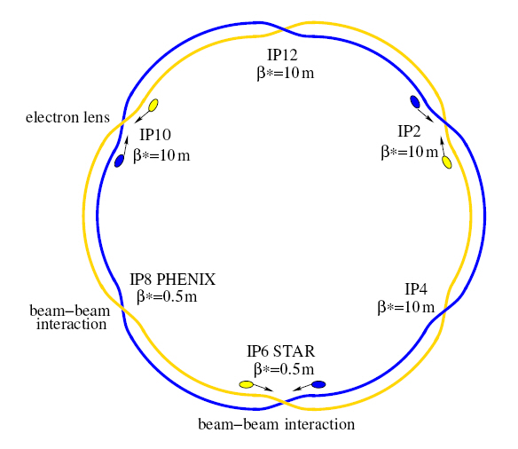
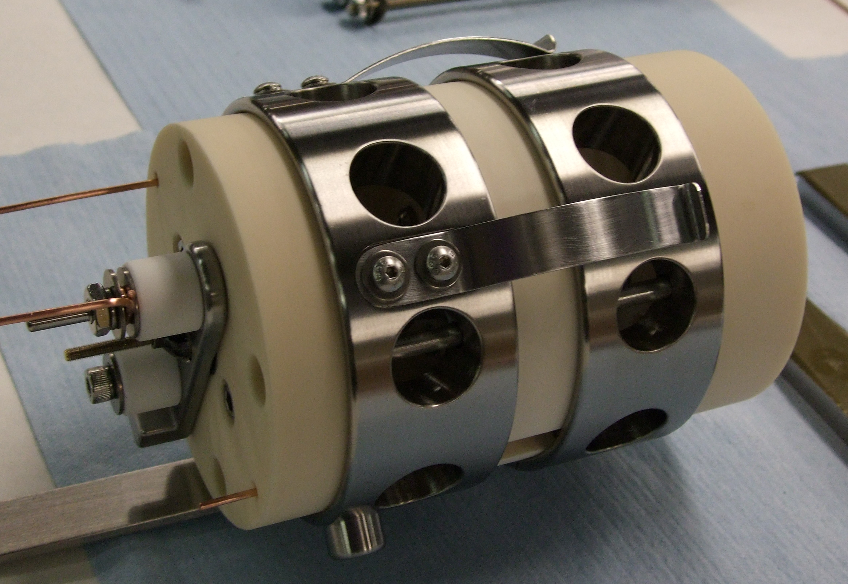
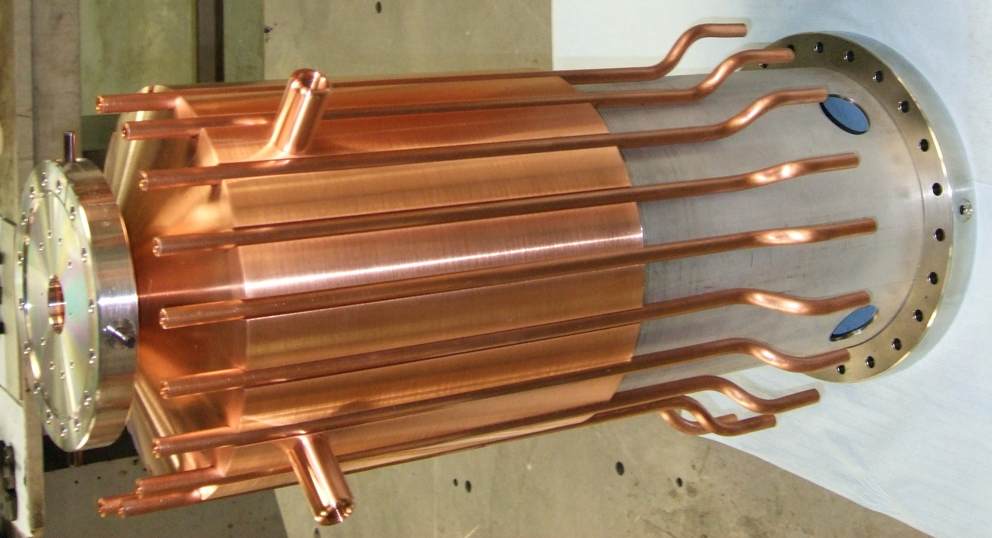
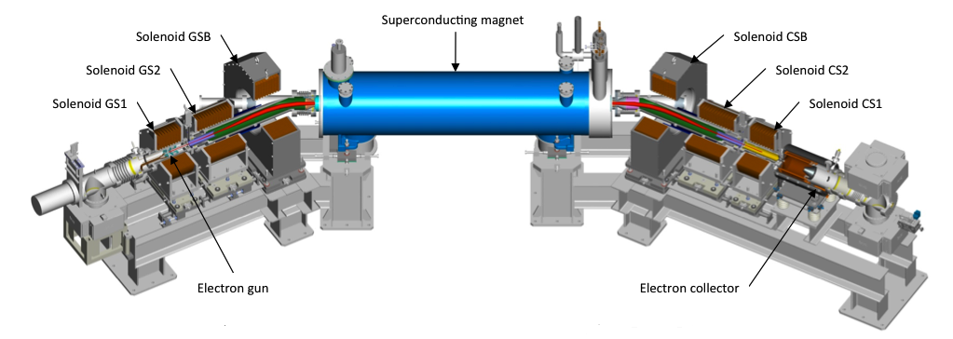
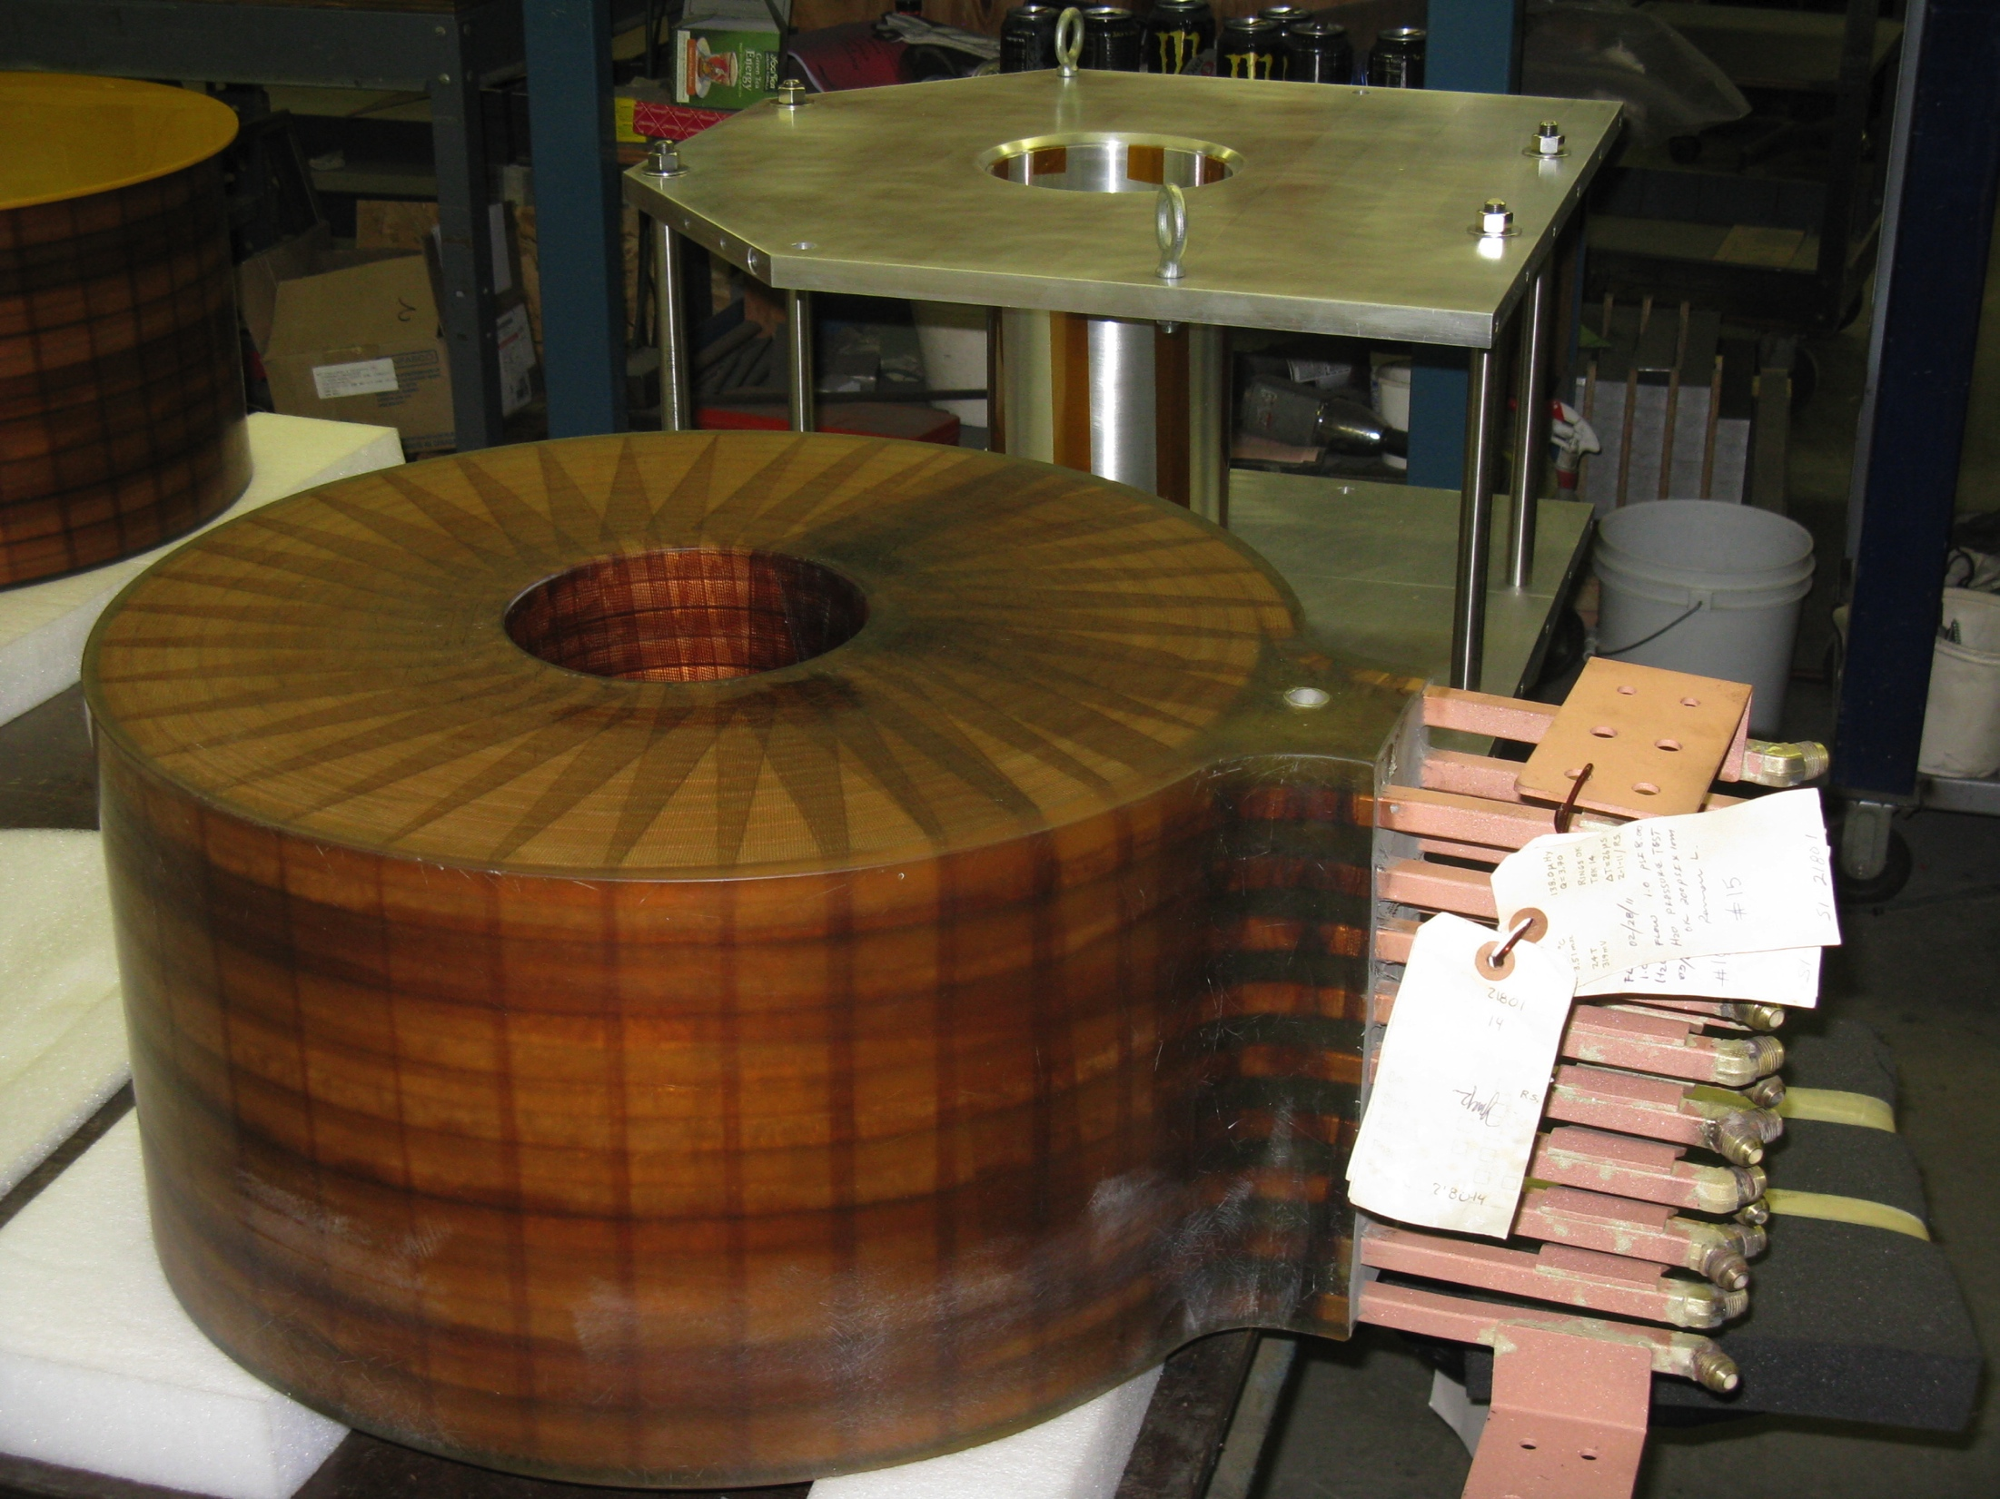
Electron lenses – partial head-on beam-beam compensation
Basic idea:
2 beam-beam collisions with positively charged beam
Add collision with a negatively charged beam – with matched intensity and same amplitude dependence
Compensation of nonlinear effects:
e-beam current and shape
=> reduces tune spread
Δψ_{x,y} = kπ between p-p and p-e collision
=> reduces resonance driving terms
Installation in 2012
Expect up to 2x more luminosity
e-gun
e-collector
main solenoid
manufacturing in SMD
GS1 manufacturing
in industry

Slide 17
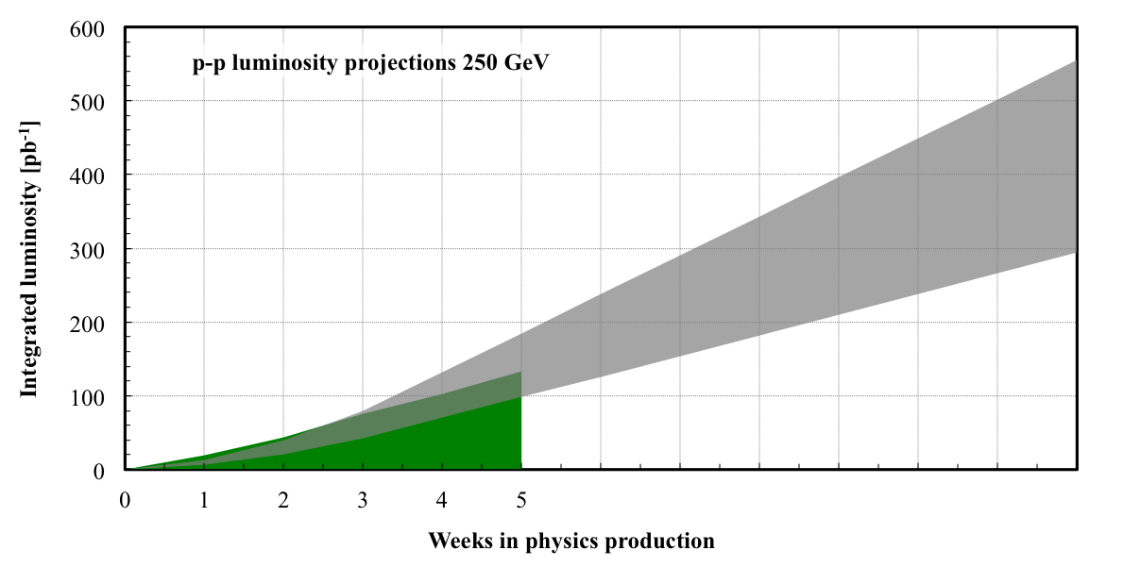
255 GeV polarized proton projection for Run-13
PHENIX goal: 750 pb⁻¹
-- not likely in 12 weeks physics --
N_{b} = 2×10¹¹
Run-12
6
7
8
9
10
11
12
Polarization (as measured by H-jet): 50-60%
New: lattice for e-lens (new qtrim & phase shifter ps), partial or full source upgrade,
e-lens (commissioning in Run-13), abort gaps aligned in IP4/IP10, spin patterns
always have 2 bunches with same orientation (?)

Slide 18
Startups and Mode Changes
V. Schoefer, Lessons from pp
Peak performance was essentially the same as the projections
  Primary discrepancy was how fast we got to peak performance
There is no need for a one week ‘ramp-up’ (two shifts for experiments, one for development). Get to previous peak, go to three shifts physics, incrementally improve from there. Retain day shift for contingency.
  If necessary, maybe have short stores for the first week.
  6 bunches = 56 bunches
  56 bunches + chrom adjustment + ramp collimation = 109 bunches
Written startup plans are key (especially for commissioning)
  Don is 150 pages worth of lucky
  RF spelled out LL commissioning plan really nicely.
Beam work goes really quickly (faster than p.s., RF setup)
  During initial startup, plan ahead for MD/APEX style activities at injection.
‘Day trips’ like large working point changes, beta* changes should be treated like mode changes.

Slide 19
V. Schoefer, Lessons from pp
Are these fast mode changes reproducible?

Slide 20
V. Schoefer, Lessons from pp
Yes.

Slide 21
Lessons Learned: Physics
Y. Luo, Lessons from AA
Physics right is important for success of RHIC run.
It includes ( AP Group ):
Choosing proper beta* and beam parameters
Designing good lattice
Performing non-linear correction
Giving a decent dynamic aperture & beam lifetime
Understanding operation observations
Pushing critical beam parameters to improve luminosity
……
In the following I focus on:
- Pre-run simulation study
- Lattice & ramp preparation

Slide 22
Lattice and Ramp Preparation
Y. Luo, Lessons from AA
There were continuous complaints about lattice and ramp preparation in past runs. In the 2012 ion runs, we paid particular attentions to them but still can’t completely avoid this problem. We had to change our ramp files in the start-ups of U-U and Cu-Au runs, which cost at least 1.5 shift loss.
Main Issues between ramp design & ramp implementation
- initial installation of magnet strengths ( separation bump correct?)
- ramping speed of magnet PS ( sextupole PS ?)
- smooth optics through transition ( beta*, tunes, chroms ? )
- different transition jump time in both rings ( do we really need it ?)
……
Can we do better ? ( My answer is YES )
Better organization and better communication before the run

Slide 23
General comments from RHIC Run12 (1)
B. Christie, STAR
First comment, and overall statement on Run 12:
Run 12 was an extremely successful run! All aspects of the collider performance and operations were exceptional.
In the following comments I primarily just list a few momentary relapses that occurred of some past sub optimal practices (from the archives):
1.) DX Magnet training on Feb. 29, 2012.
The length of the scheduled access on Feb. 29th was driven by the desire/plan to allow for up to three training cycles for the DX magnets. The first cycle occurred early in the period as planned. The second cycle was delayed from the morning (before noon) to the late afternoon due to some collider (Controls?) problem, with the quench of this second cycle occurring about 6 pm.
By all rights and expectations after this second cycle the Collider should have gone back to Physics operations. Instead, the STAR (and I presume PHENIX) Shift personnel got called by the Collider to ask if it was OK to do another Quench cycle. The impact, they were told, would be about a 1 hour delay in getting back to Physics.
A.) It costs about 1 M$/day to run the RHIC program. How is it that whom ever happens to be on Shift at the Experiments is assumed to have the authority to change the schedule for running the program?????
B.) This additional delay of the third cycle pushed the recovery of the Collider and Experiments further into the night, when more of the necessary expertise to resolve issues with either the Collider of the Experiments is unavailable/asleep.
C.) The end result of this decision was that the collider couldn't recover and get back to the Physics program until about 10:45 am on March 1st. I'd call this a 500 k$ mistake.
* I'd like to think that last minute changes to the planned schedule for the use of the RHIC Facility get input not from whoever happens to be on Shift but is decided upon by more Senior C-AD Management.

Slide 24
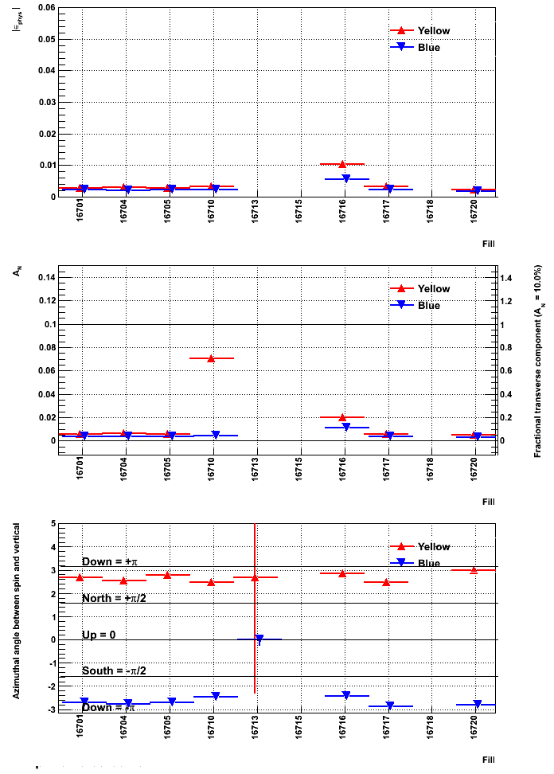
General comments from RHIC Run12 (2)
B. Christie, STAR
2.) Hi Vincent and Mei,
Attached please find a ppt file showing the transverse components at STAR for the Fill that went up around midnight this morning, as well as the current Fill (went up ~ noon). I assume you heard it this morning Vincent, but if you plan to make significant adjustments to parameters like snake currents for Physics Fills it's important to let us know.
Greetings, PHENIX also wasn’t informed before hand
Bill
Transverse Asymmetry for many Fills
3.) Dear All, (sent about midnight on Friday 5/11)
As we discussed at this morning's mtg., if we could have a good weekend with steady Fills I thought there was a fair chance for STAR to reach its U+U goals by Tuesday, and start the transition to Cu+Au a day early. I certainly didn't get any idea that you were going to go into Machine development tonight.
My understanding was that the plan work on commissioning Cu in the injectors today, and then continue, in the background, working on the AGS bunch merge. A priority for STAR is to get this
Fill early Friday morning, 4/13/12
U+U data set. You've got five weeks to work on this bunch merging in Cu+Au, a data set we're not so interested in.
If you get this increase to work sometime in the middle of the night I don't know how gracefully we'll handle it, as I didn't see this coming, and adapting to significant changes in the RHIC beam conditions is not something the majority of our Shift crews can deal with.
This doesn't seem to have been well thought out or communicated.
Greetings,
Bill

Slide 25
General comments from RHIC Run12 (3)
B. Christie, STAR
4.) APEX Process:
I think it’s fair to say that we’ve all come to realize the importance of the APEX program, and we’ve come to a good agreement with respect to scheduling this effort and allowing the appropriate amount of collider time for the program.
However, it seems that more often than one would like, it turns out that APEX efforts end up with inconclusive results (e.g. one is looking for a 1 to 2% change in some parameter but the APEX sensitivity, as run, is 5%, etc.)
The impression/suspicion is that the part of this process that needs more effort is the committee review and approval process for the APEX proposals.
Part of this process should be enough estimation of the statistical and systematic errors for whatever the proposal endeavors to measure so that the end result is conclusive.

Slide 26
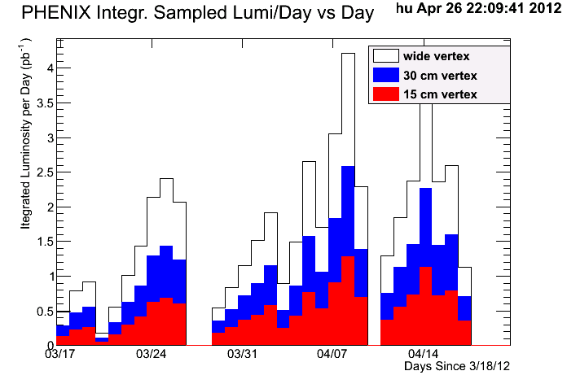
Frequent APEX and MD Effect on Luminosity Sampling
X. He, PHENIX
p+p 510 GeV
For future runs, we request less frequent interventions to increase the number of days when we can record “steady state” luminosity.

Slide 27
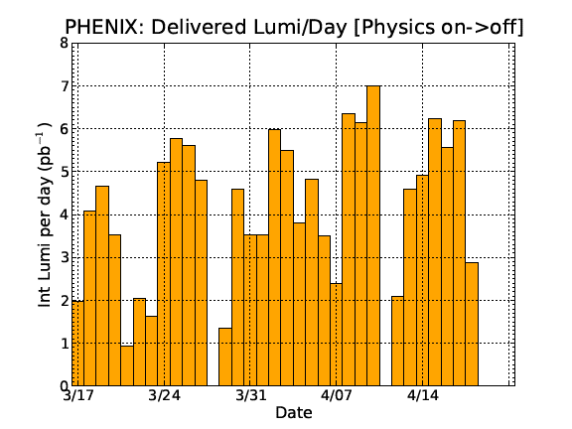
Patterns in the Luminosity
V. Schoefer, Lessons from pp
What is the ‘sawtooth’ in the sampled lumi?
Does not show in delivered.
Where does the lumi go?
It’s NOT the vertex
Connects Wed’s
PHENIX Sampled Lumi
Two caveats:
Delivered lumi not consistently handled for stores that span midnight (~1 pb-1 could slip a day in either direction)
Either the dates in the PHENIX plot are shifted early one day, or Tuesdays are worse than Wednesdays.
(courtesy X. He)

Slide 28
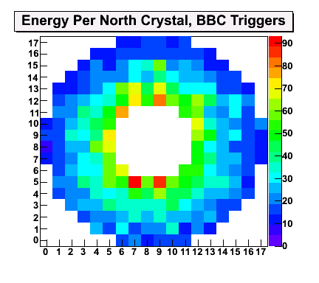
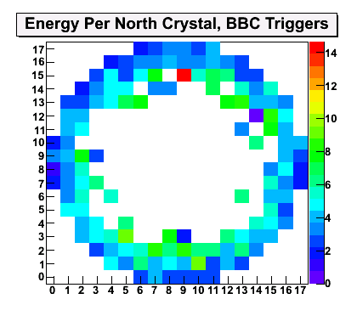
North MPC, Before and After
X. He, PHENIX
Cu beam going direction

Slide 29
F. Meot, Scheduling Physicist

Slide 30
F. Meot, Scheduling Physicist

Slide 31
General Information
A. Pendzick, AC in CAD
We have ~585 AC units & associated equipment
Repairs are initiated through a Maximo work order where parts & labor are charged to our accounts, referencing the asset #
Responsibilities & costs:
  Repairs/Replacements/Maintenance –-- F&O,
    ~750K/y labor (2.75my), ? Materials
  New Installations/Replacements --------- MPO/FES,
    ~400K/y (contracts)
The North Complex has 6 AC Techs with little or no exchanges between Complex’s
There are 2 AC Techs on shift, but only one is available for calls.

Slide 32
Summary
Very successful Run-12 – RHIC II performance is here
record luminosity and polarization, new ion species
EBIS + bunch merges, 3D stochastic cooling
Scientific case for another decade of RHIC, and eRHIC,
is being made to the Nuclear Science Advisory Committee
Run-13 with long 510 GeV pp run (plan for 15 cryo weeks)
very ambitious luminosity goal of 750 pb⁻¹, with P = 55%
possibly other modes
main upgrades: polarized source, electron lenses (commissioning)
PHENIX propsed for longer uninterrupted running
maintenance + APEX together, every other week
proposal not met with enthusiasm by CAD

