Slide 1
Overview of Laser System Development
Michiko Minty

Slide 2
Outline
Specifications and achieved performance
Development history
Priorities from the LEReC Retreat
Laser Safety
Laser Lab
Laser Systems Group: personnel and responsibilities
Supplemental Materials
Summary

Slide 3
Specifications and Achieved Performance
 | Original | Updated | Currently Achieved
Power on cathode, W | 10 | 6.5 | 2-3
Power on Gun table before iris, W | 15-20 | 10-13 | 4.5
Beam diameter on the cathode, mm | 4-6 | 4-6 | 4-6
Transverse profile | Uniform | Truncated Gaussian (3mm sigma) | Truncated Gaussian (4mm sigma)
Longitudinal profile | Uniform, “flat top” | Stacking with <40% peak-to-peak modulation | Stacking with <40% peak-to-peak modulation
Pulse length after stacking, ps | 80 | 40-80 | 40
Time jitter rms, ps | 1 | 1 | < 0.5
Intensity rms, shot-to-short. % | 2 | 2 | 0.4 (laser) 0.3 (20 mA beam)
Spatial stability C.O.M. on iris rms, um | 10 | 50 (<10μm on cathode) | (< 75 μm on cathode)
Extinction ratio (power leakage, pulsed mode) | 10^6:1 | 10^6:1 | 10^7:1
MPS extinction ratio (between MPS interlock and slow shutter closed, full current CW) | 100:1 (5 msec response) | 300:1 (15 msec) | > 200:1

Slide 4
Development History
Subsystem development vs time (parenthetic remarks in backup slide)
2016
2017
2018
Year highlights:
2016 major infrastructural work (optical table stabilization, laser transport construction, development of laser lab for fiber laser development)
2017 laser commissioning during LEReC DC gun test
2018 laser operation during LEReC commissioning

Slide 5
Development History
2016
2017
2018
Steady progress with no major setbacks

Slide 6
Development History
2016
2017
2018
Developments proceeded with difficulties encountered
+ three major operational challenges:
intensity stability – implemented slow and fast feedback
position stability
dynamic thermal lensing (CW vs pulsed)

Slide 7
Priorities from LEReC Retreat (9/27/18)
High power transport and thermal lensing
Beam position stabilization
MPS extinction ratio for 50 mA
76 kHZ CW mode
Pulse stretching without crystals (under discussion)
Temporal profile measurements (under discussion)
Presentations following
on these topics
Additional Tasks
Continue characterization and (local) mitigation of component sensitivities to environmental factors
Complete laser safety related installations
Develop laser lab for spares testing

Slide 8
Laser Safety
2017 added shutter with administrative controls in laser trailer
added locks to all (six) laser table enclosures in RHIC tunnel
added shutter credited control interface to PASS (personnel safety system)
redundancy provide by PASS A and B Divisions with status, readback and control
will add Laser Controlled Access (LCA) mode to PASS utilizing tokens
evaluating need for interlocked laser enclosure cover monitoring in RHIC tunnel
Access Mode | Shutter command | Audible visual alarms
Safe Access | Disabled (shutter in) | Disabled (off)
Restricted Access | Disabled | Disabled
Controlled Access | Disabled | Disabled
Laser Controlled Access | Enabled (shutter in) | Disabled
RF No Access | Enabled | Disabled
No Access | Enabled | Disabled
Incorrect Primary Critical device response | Disabled | Enabled (on)

Slide 9
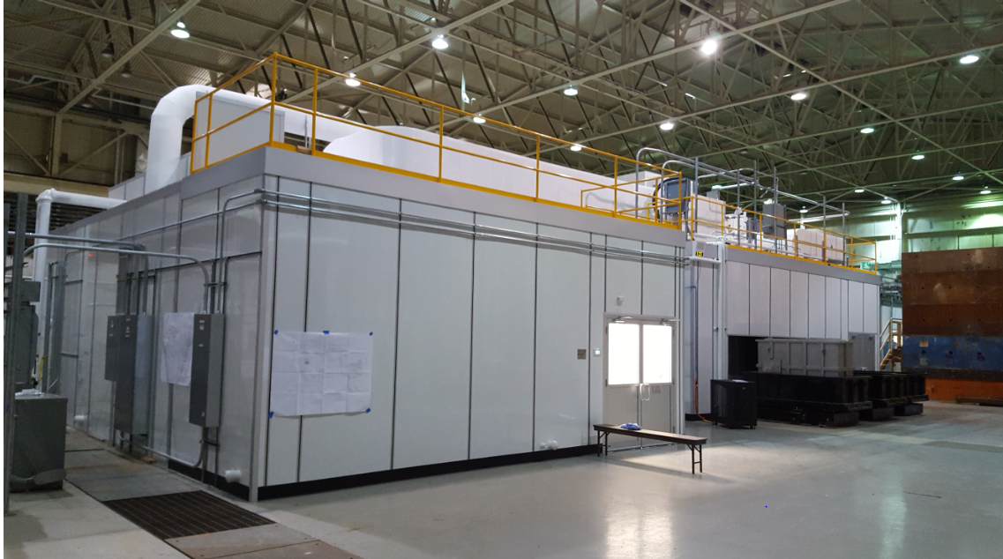
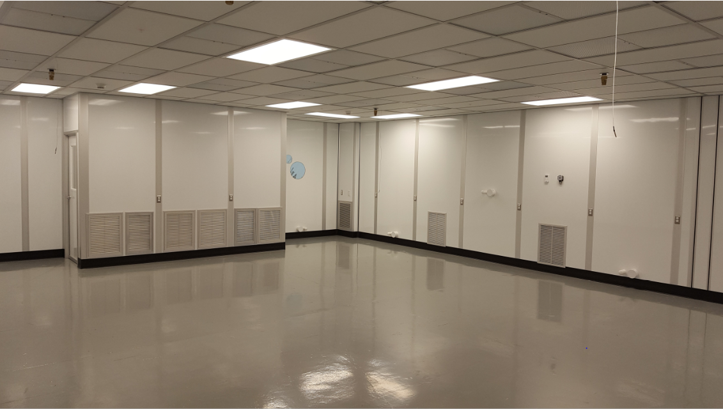
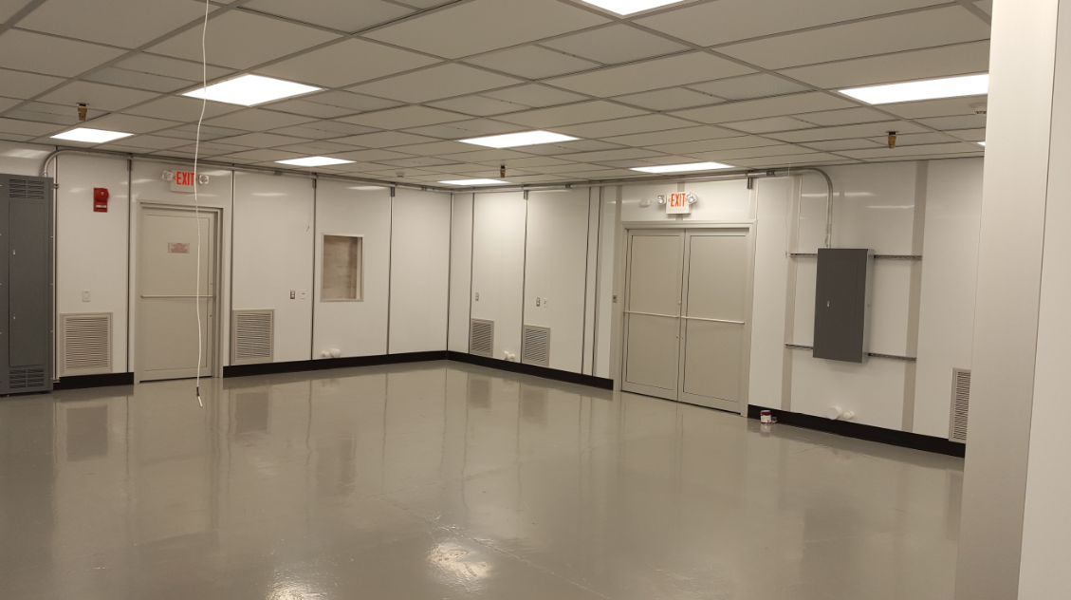
Laser Lab
Beneficial occupancy evaluation on 11/13/18
Total area: 1,807 sq. ft
main laser room 968 sq. ft
ISO 7 at 680 F, +/- 10F and 40% RH, +2%, - 10%
secondary laser room 648 sq. ft.
ISO 7 at 680 F, +/- 10F and 50% RH, +2%, -20
control room 135 sq. ft.
ISO 8 at 70F and nominal humidity control
gowning room 56 sq. ft.
ISO 8 at 680F and 45%-60% RH

Slide 10
Laser Systems Group
Personnel:
P. Inacker, M. Minty, L. Nguyen, Z. Zhao (staffing history in supplemental material)
Systems supported:
LEReC – development and operation (ongoing); call-in list initiated 7/30/18
CeC – development and operation (limited for now, was top priority from 3/13/17-6/21/17); developed regenerative amplifier (P. Inacker) for FY18
eRHIC
Gatling gun (<Jan, 2018) with additional support from NSLS-II (summer, 2017)
LDRD #17-002 (May 2017 – May 2020), “High-powered Er-doped fiber laser for 50 mA highly polarized electron beam”, PI: Z. Zhao
E-RHIC – future gun tests at SBU and BNL
Laser lab development
Bldg. 912 ‘ERL’ laser lab (since 2016 first for LEReC, then LDRD)
Bldg. 912 clean room - recently approved for LEReC spares tests, R&D for eRHIC) needs laser interlock system and cable tray installations then optical tables, racks, etc.

Slide 11
Supplementary Materials
Personnel development history
Monthly status updates (FY17 and FY18)
Operations Post Mortems
DC gun tests (May 5 – Aug 11, 2017)
Beamline commissioning (Mar 6 – Sep 16, 2018)
Presentations from past reviews
Response to past reviews and recommendations

Slide 12
Summary
Majority of planned installations completed (position feedback excepted) with many, many groups involved
During FY18 LEReC systems commissioning, laser MPS was installed followed by 24/7 laser operations
Operational difficulties encountered with intensity stability (now feedback controlled), laser position stability and dynamic thermal lensing
Priorities from LEReC Retreat + additional tasks are being addressed
To the review committee: Thank You in advance for your advice and suggestions!

Slide 13
Development History
2016
2017
2018
Developments proceeded with difficulties encountered
+ three major operational challenges:
intensity stability – implemented slow and fast feedback
position stability
dynamic thermal lensing (CW vs pulsed)

Slide 14
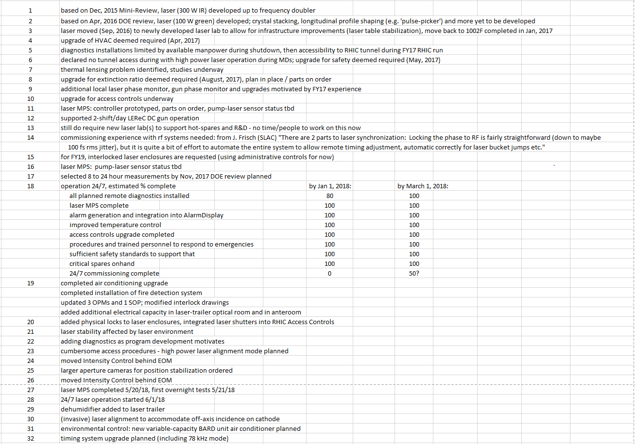
Comments to table with subsystem development vs time

Slide 15
LEReC Laser Diagnostics
Trailer | Relay Table | Gun Table | Exit Table
Temp./Hum. Temp./Flow.: Main Amp, 60W Amp, Rod/Dumps 60W Amp Intensity Photodiode Dumped IR PM (Total IR, or left over after conversion) 9MHz Signal Photodiode 704MHz Signal Photodiode 1Hz Signal Photodiode Alignment Laser Fire Detection Transport Vacuum detection | Temp./Hum. Profile Camera Intensity Photodiode | Temp./Hum. Profile Camera Low Power PM High Power PM Intensity Feedback Photodiode | High Power PM Cathode Camera
Profile Camera | Stabilisation Camera | Stabilisation Camera
Installed
Planned

Slide 16
LEReC Laser Controls
Trailer | Relay Table | Gun Table | Exit Table
Intensity control Piezo mirror HWP for pulsed/cw control Fast and slow shutters | Piezo mirror | Zoom lens Flip mirror x-y stage Laser aperture wheel Laser mask | Flip mirror
Installed

