Slide 1
Low Energy RHIC electron Cooling (LEReC)
High-power Fiber Laser System for LEReC
Zhi Zhao

Slide 2
Outline
Laser parameter review
Laser design and implementation
Conclusion

Slide 3
Laser Parameter Review

Slide 4
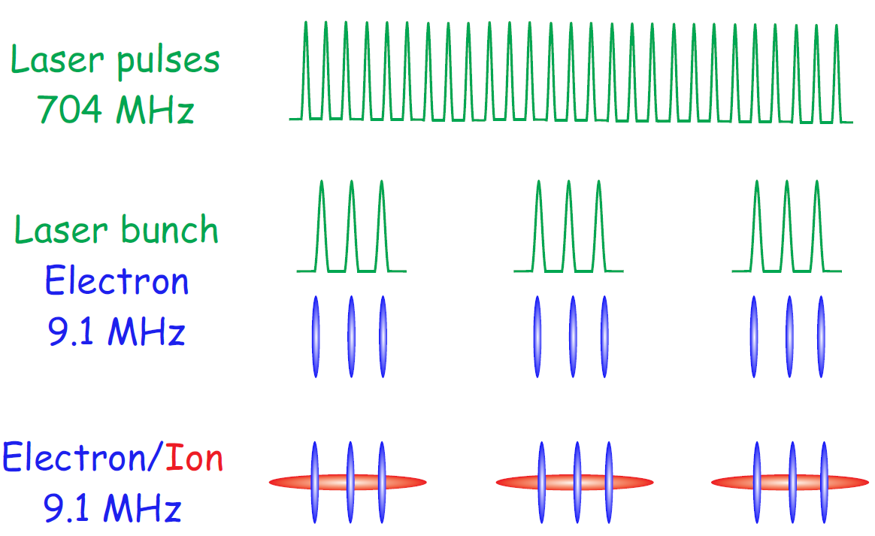
Laser Pulse Pattern for LEReC
Pulsed mode: 704 MHz, 9.1 MHz bunch rate, 10-30/bunch
CW mode: 704 MHz

Slide 5
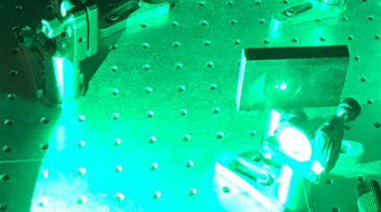
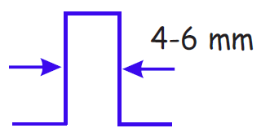
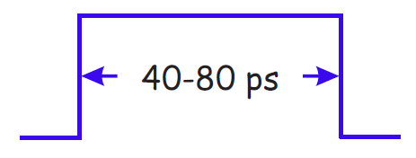
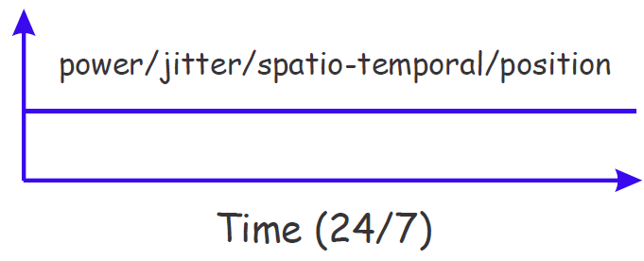
Laser Design Specifications
Green average power: 13*2.5 W
Timing jitter: 1 ps rms
Spatial profile: M^2<1.2
Pointing stability: 50 µm rms
“Flat-top” temporal profile
Stability & reliability

Slide 6
Laser Design & Implementation

Slide 7
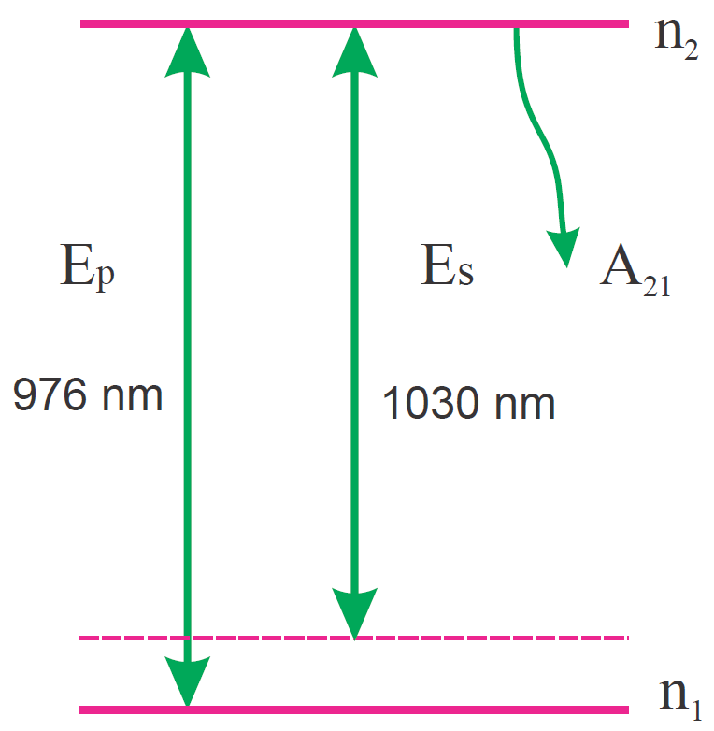
Yb-doped Fiber Amplifier
Master oscillator power amplifier
Advantages for fiber lasers
High repetition-rate & average power
Excellent spatial mode
Low point instability
Maintenance–free operation
Energy structure

Slide 8
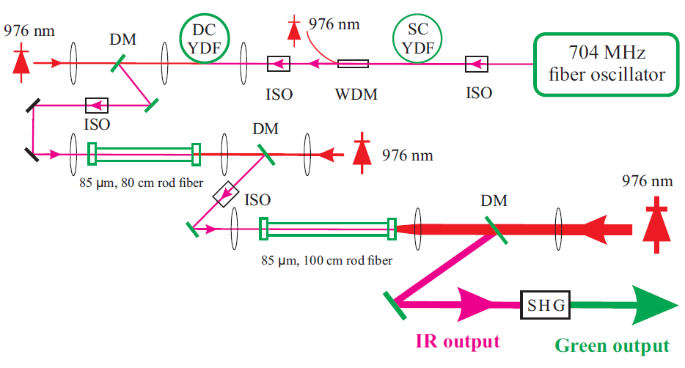
Yb-doped Fiber Laser System

Slide 9
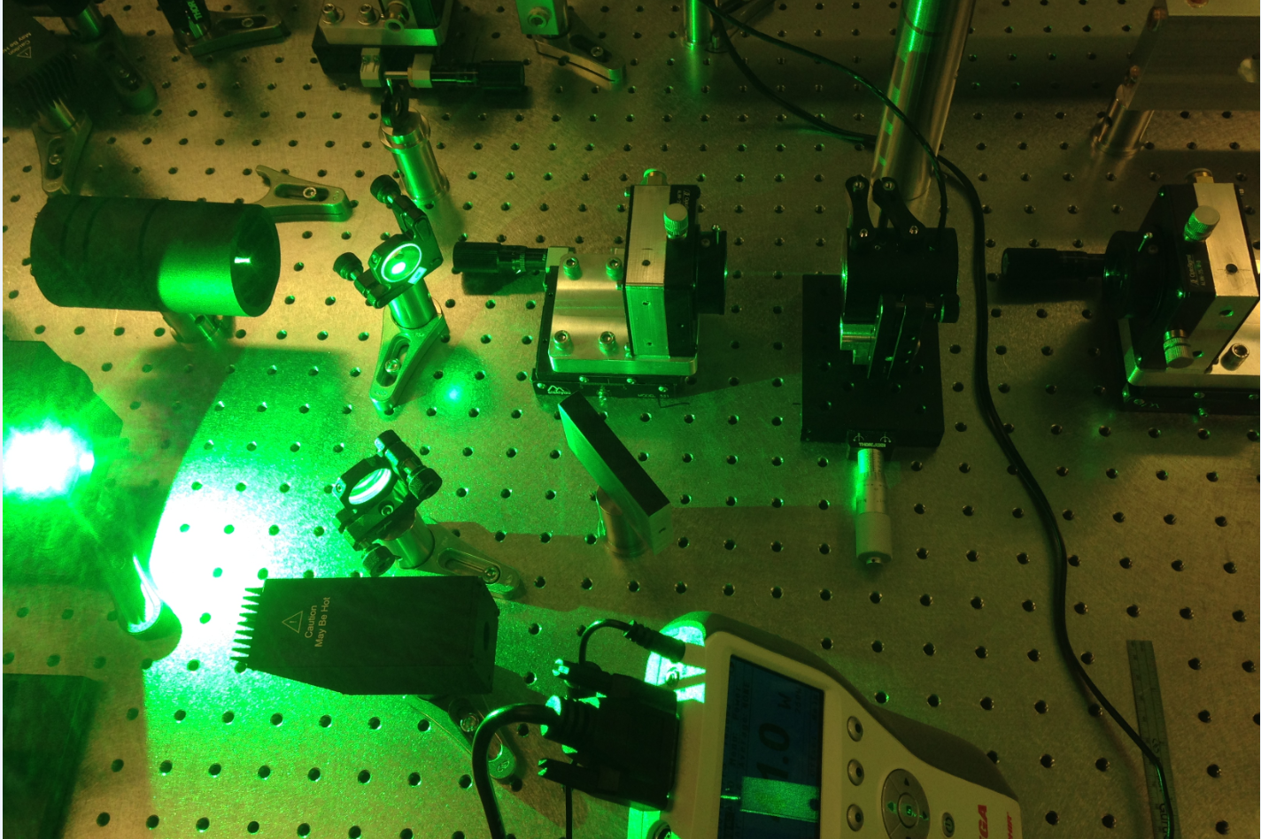
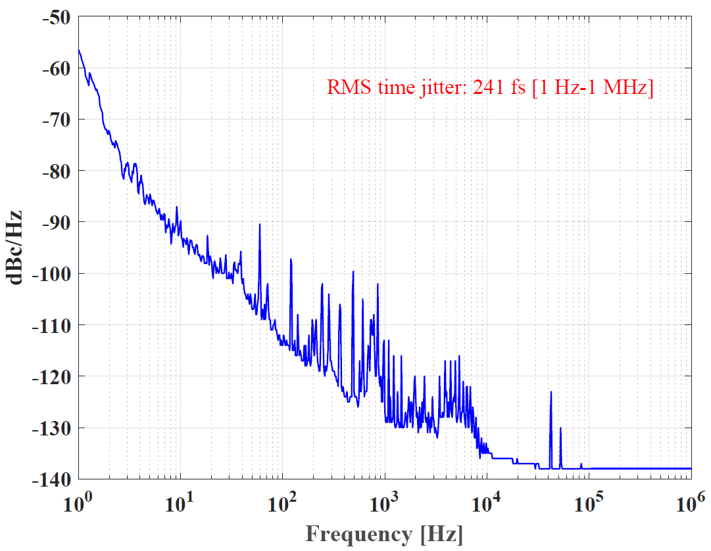
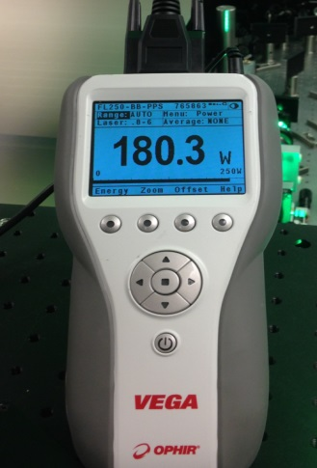
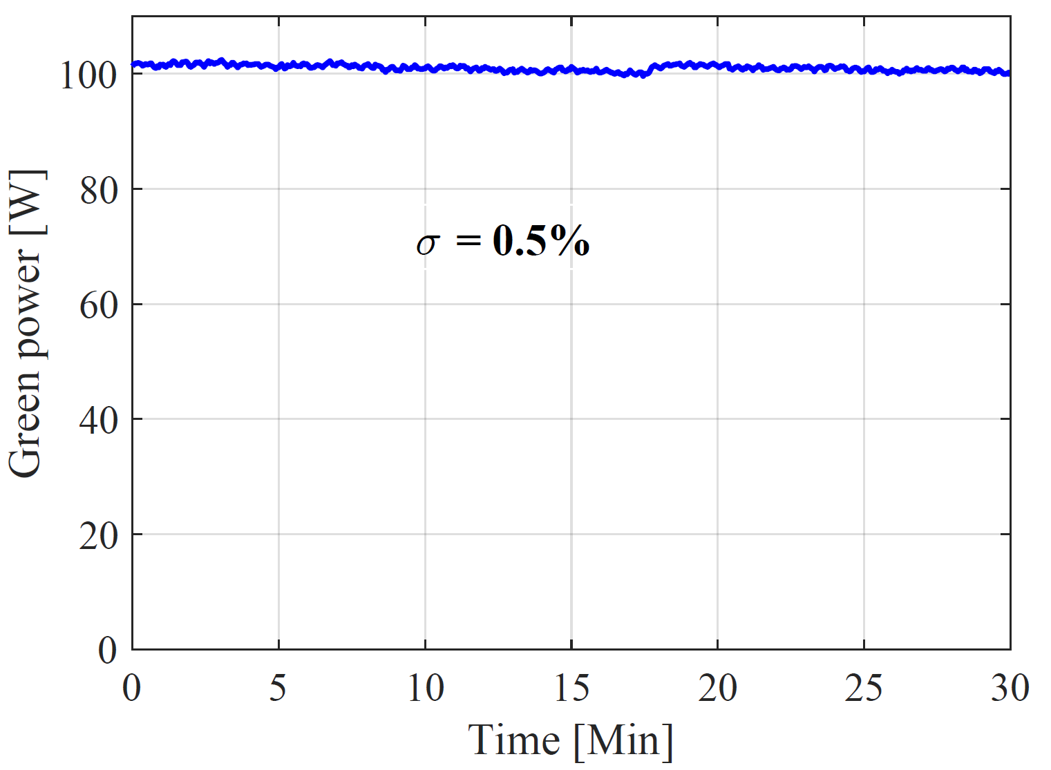
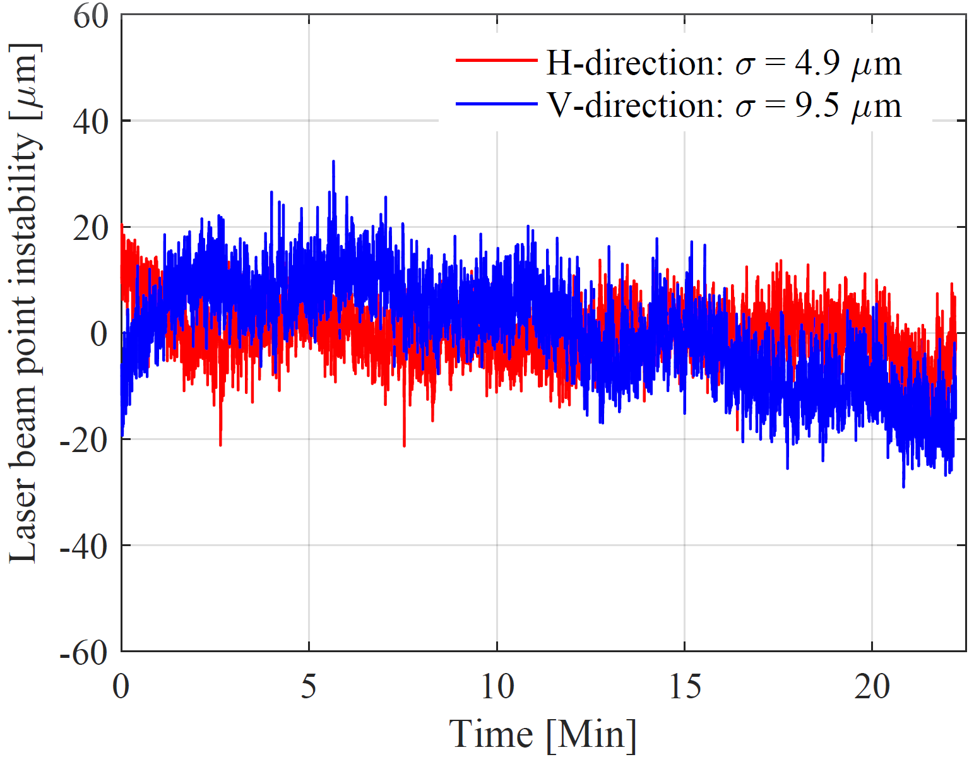
Laser Specifications: Demonstrated
Green average power: 180 W
Timing jitter: 240 fs rms
Power stability at 100 W
Point stability at 60 W
Spatial mode: M^2 < 1.1 at 100W

Slide 10
Layout of Laser Control for Beam Operation
Key control
Pulse pickers
Intensity control
Spatiotemporal shaping
Key diagnostics
Laser power and QE
Laser spatial profile
Point stability on cathode

Slide 11
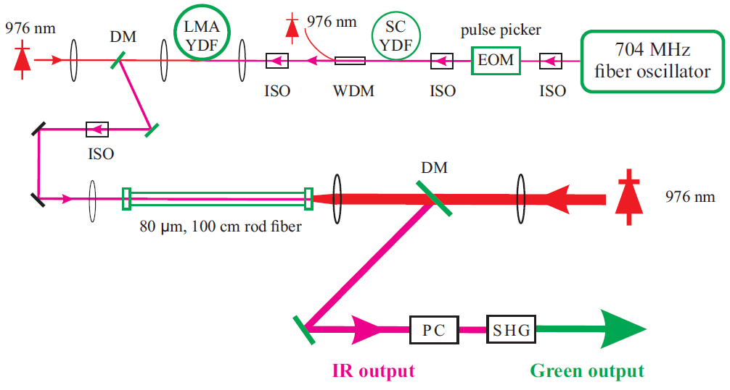
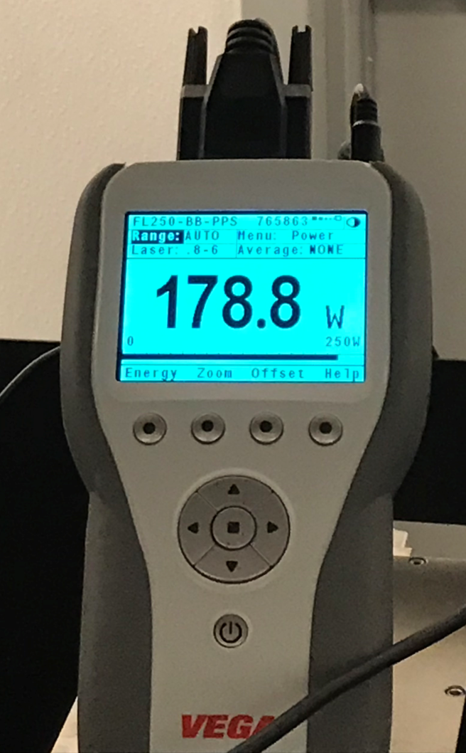
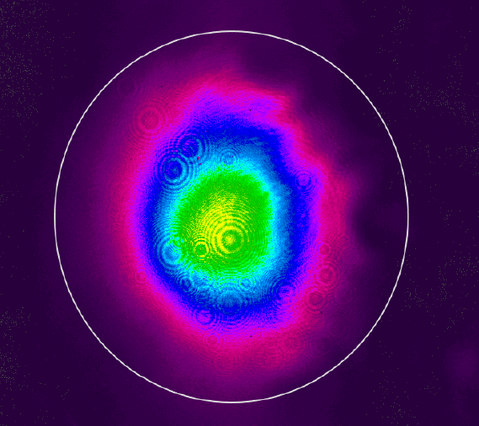
Final Laser System for Beam Operation
Laser MPS (done by Patrick):
temperature & pressure in chillers detected and linked to the room interlock.

Slide 12
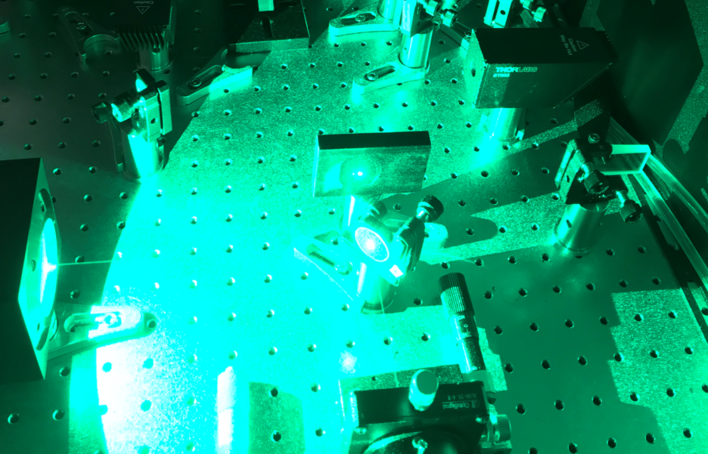
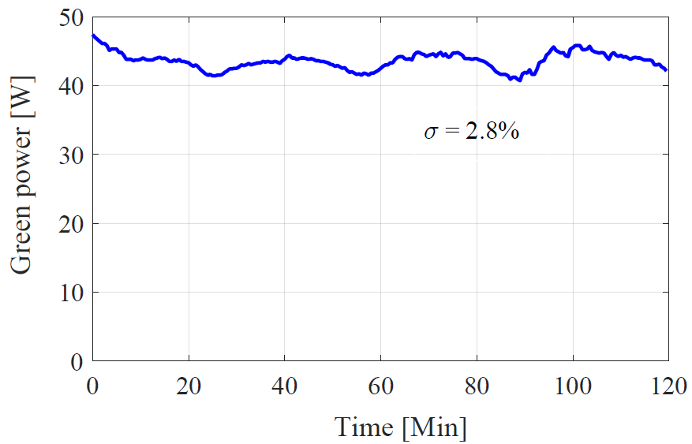
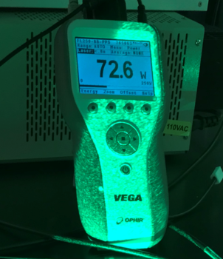
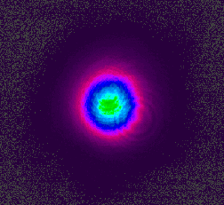
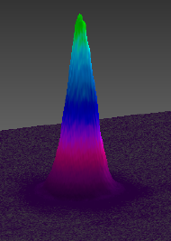
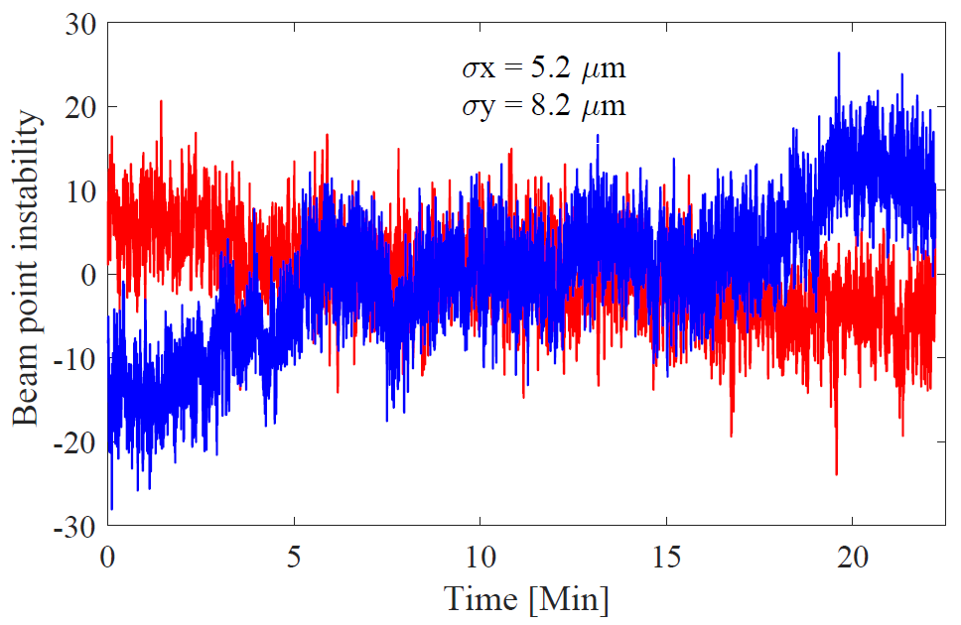
Laser Specifications for Beam Operation
Green average power: 72 W
Power stability at 45 W
Spatial mode: M^2 ~ 1 at 30 W
Point stability at 30 W

Slide 13
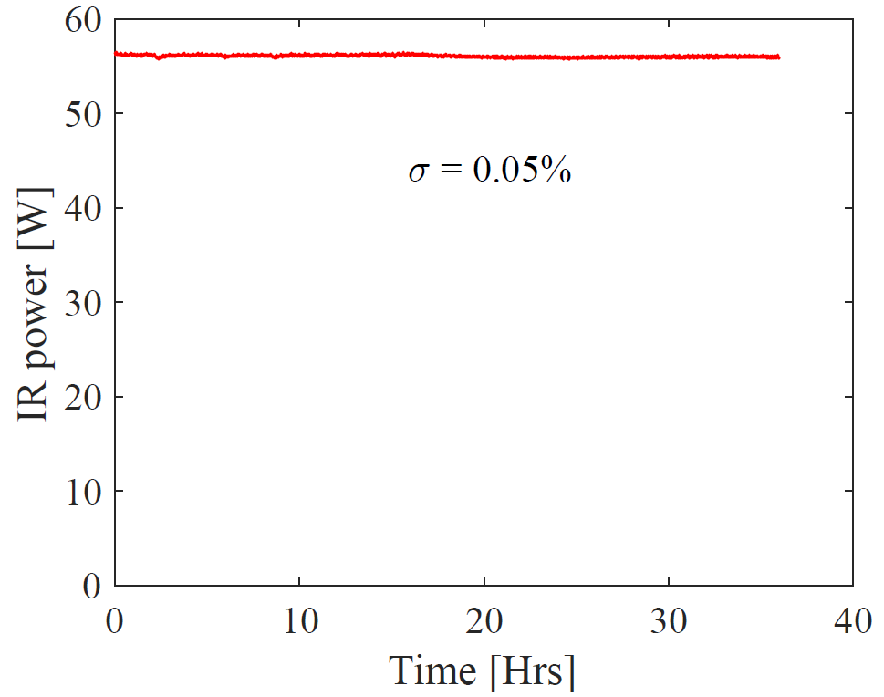
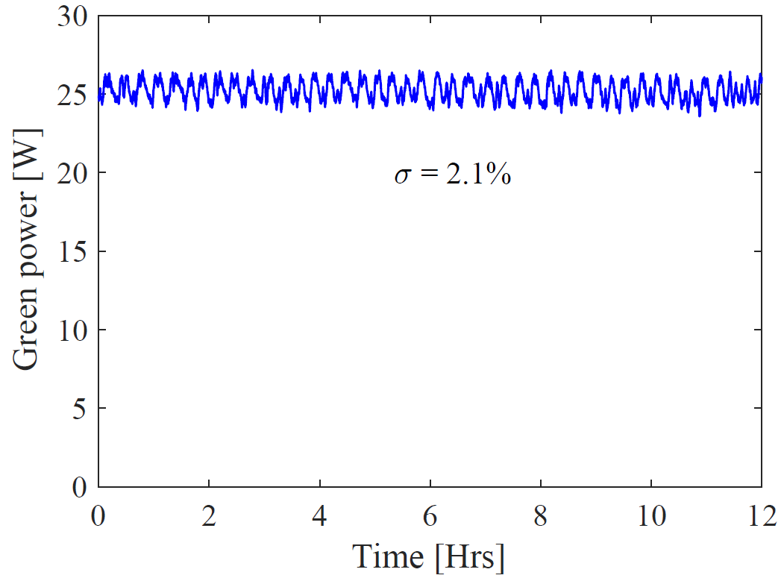
Laser Power: Recent Performance
IR power: 36 hours
Green power: 12 hours
Measurement done by Patrick

Slide 14
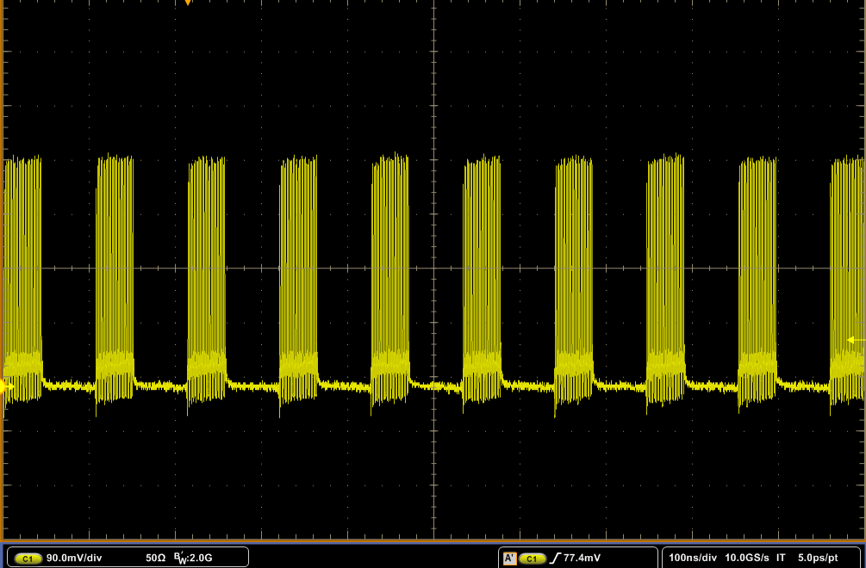
Ultrafast Pulse Picker
Macro-bunch generator
Major specifications
High extinction ratio: 42 dB
Variable bunch: 10-30 pulses
No change in few-months operation
9 MHz bunch rate

Slide 15
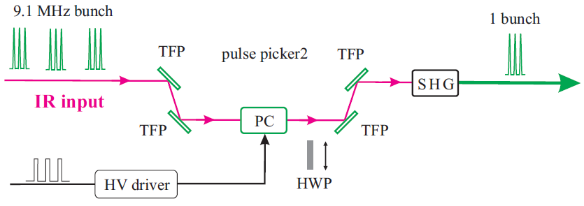
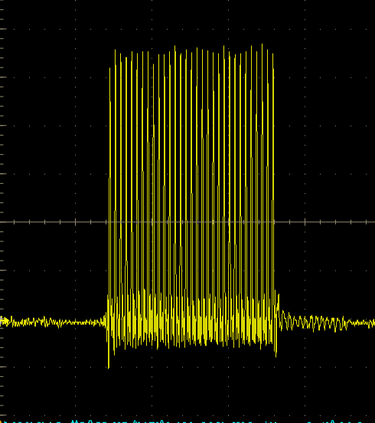
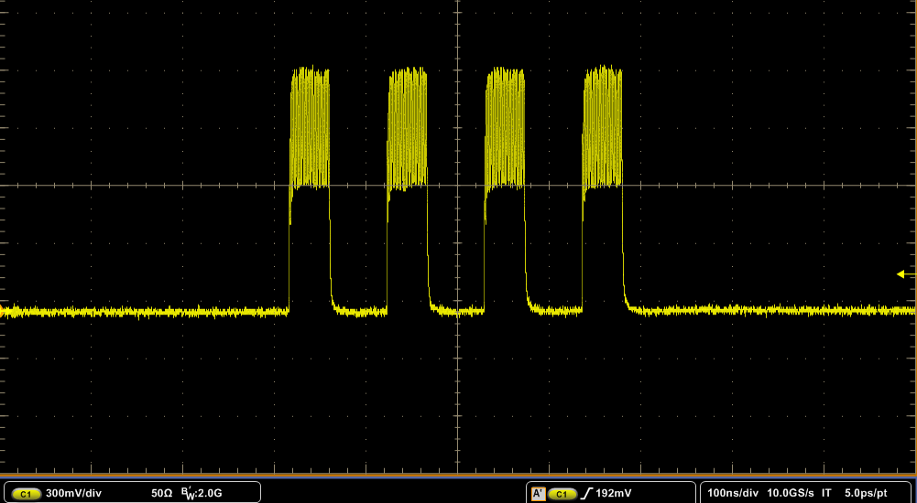
High-power Pockels Cell for Bunch Pickup
Bunch pickup for beam diagnostic
30 pulses/bunch
Major specifications
High extinction ratio:>5*10^5 @green
Fast switch time: ~ 5 ns
High average power: 100W IR
Switch between pulsed & cw mode
MPS in the pulsed mode
4 bunches

Slide 16
Conclusion
High-power fiber laser design specifications: demonstrated
Laser power (72W green), RMS time jitter (241 fs), excellent spatial mode (M^2<1.1), and laser point stability (σ<10 µm)
Ultrafast & high-power Pulse pickers
CW mode: 9 MHz bunch rate
Pulsed mode: single & multiple bunches for beam diagnostics
Laser used for 24/7 beam operation

Slide 17
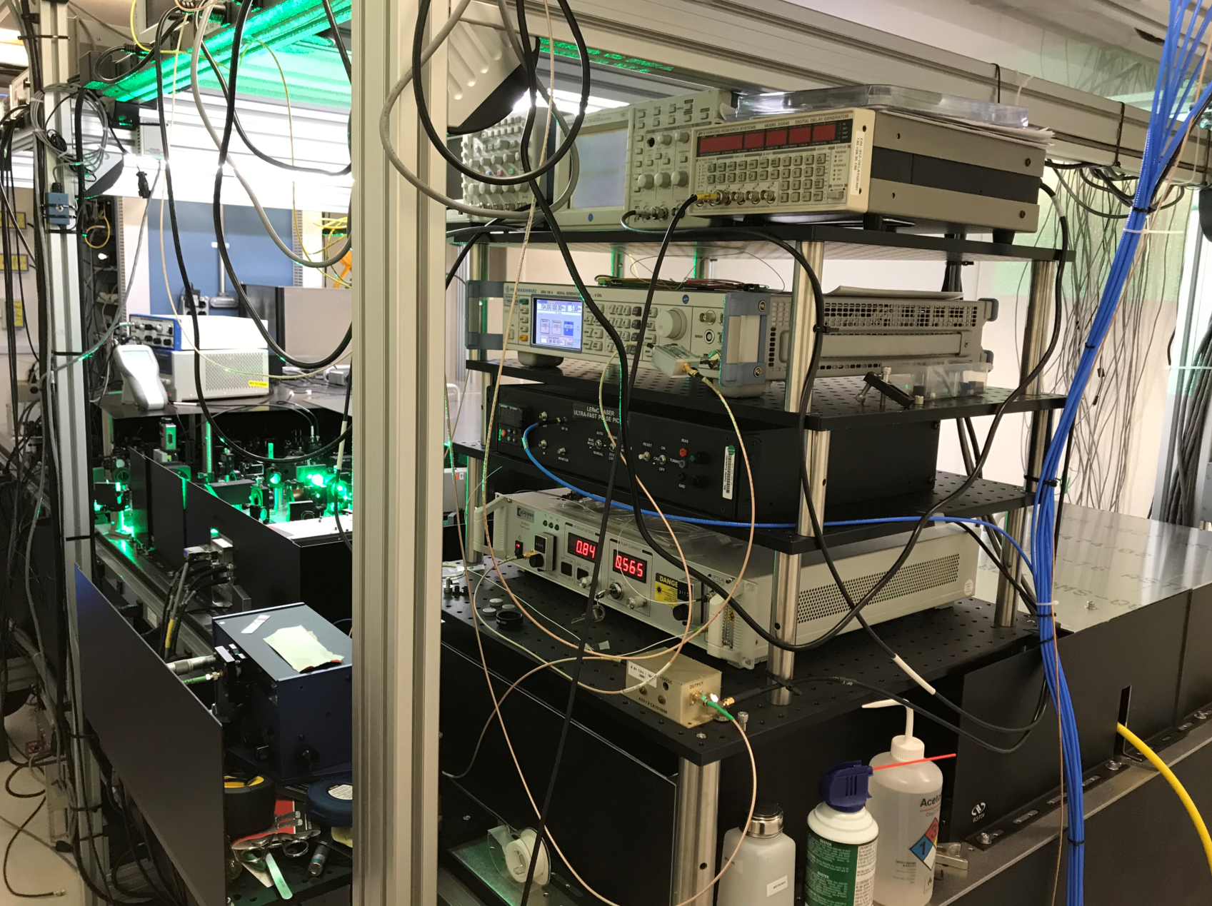
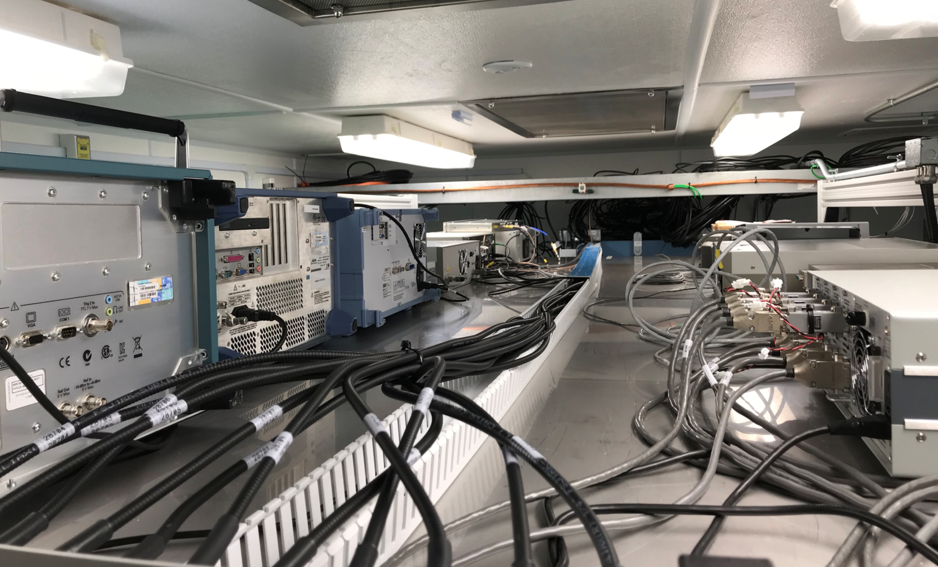
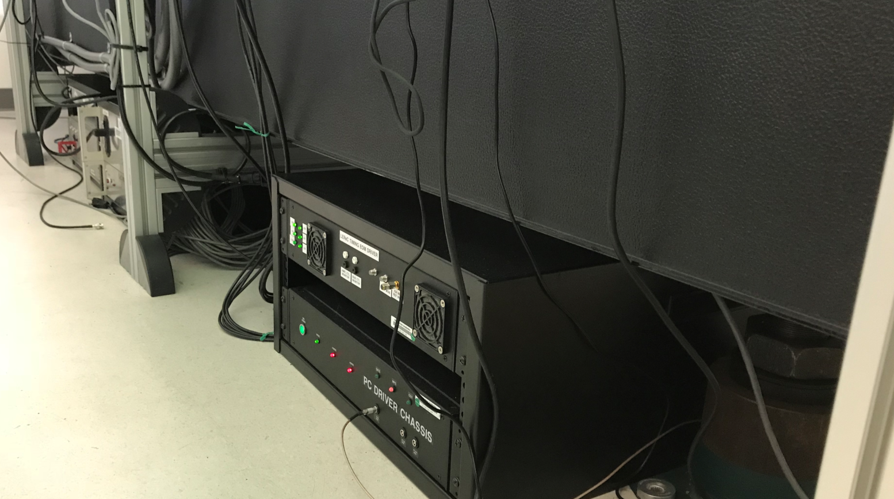
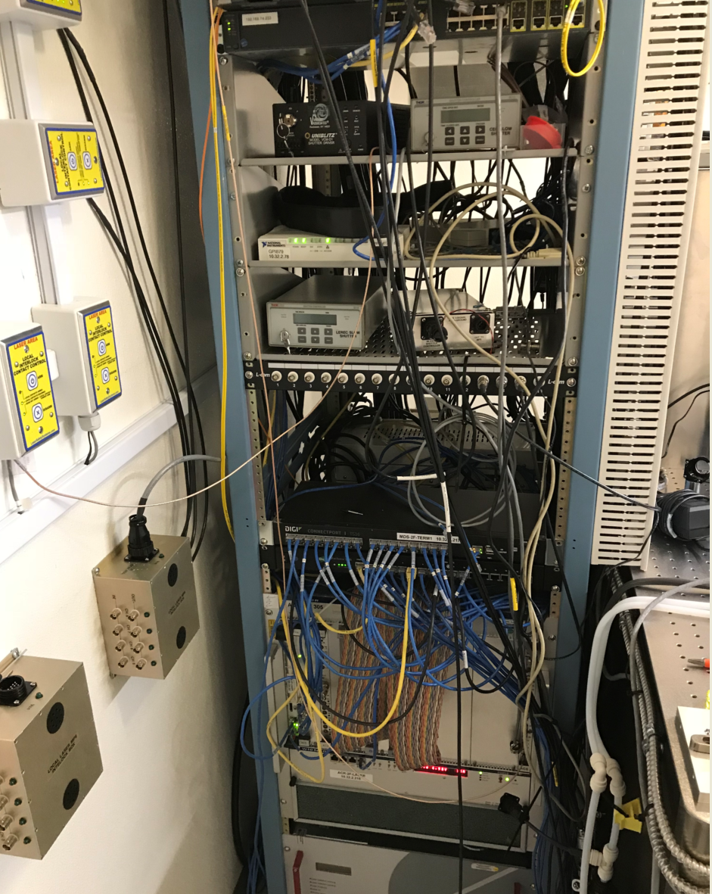
Laser System in the Lab

