Slide 1
LEReC Laser Review
Laser Shaping and Transport
Patrick Inacker-Mix

Slide 2
LEReC Laser Parameters
Parameter | Target Value | Currently Achieved Value
Power on Gun Table | 13 W | 4.5 W
Beam Profile | Gaussian | Distorted Gaussian
Temp. Profile | Modulated Flat Top | Modulated Flat Top

Slide 3
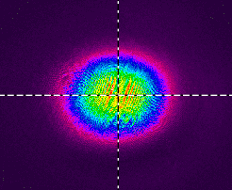
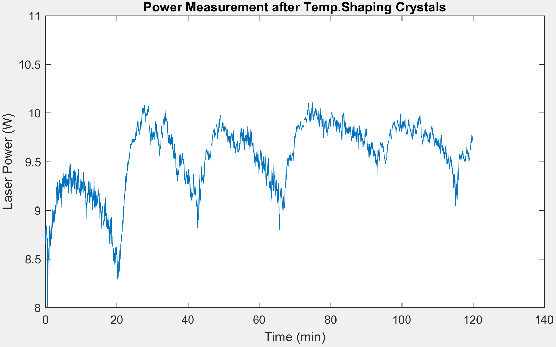
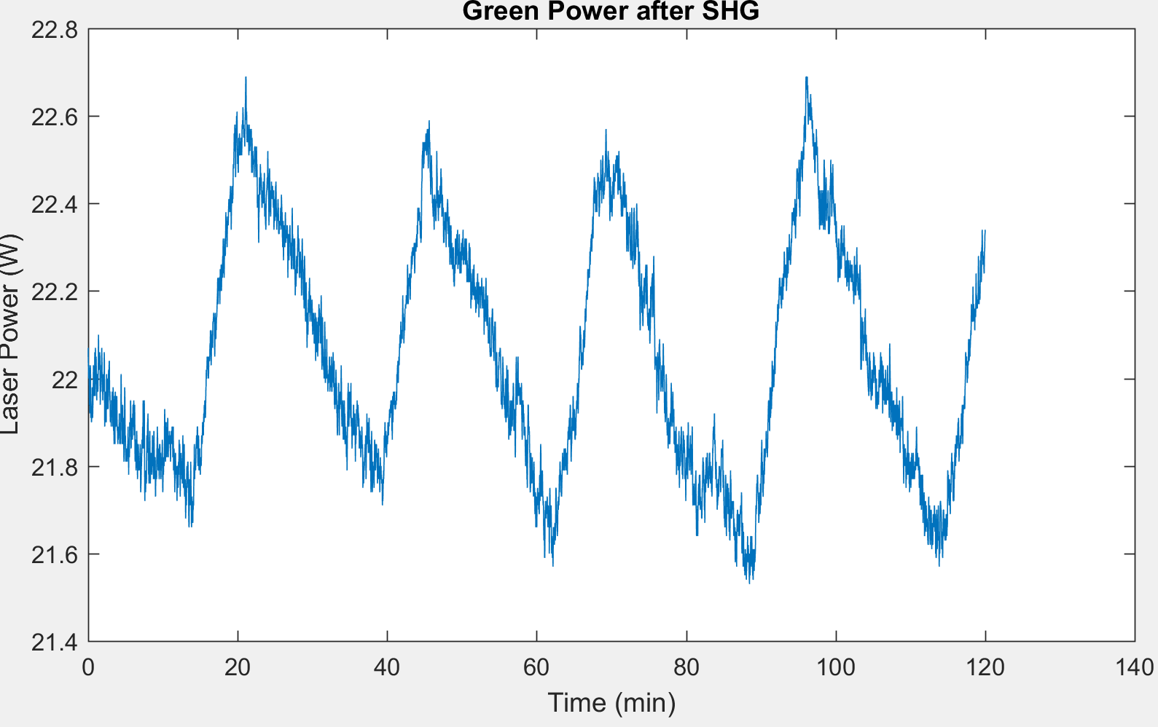
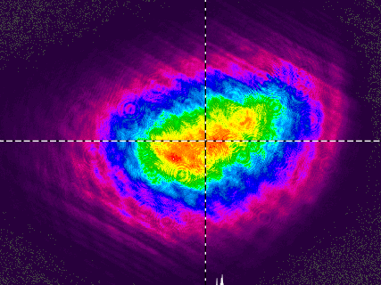
Power Loss before Transport
Current Transparancy of the Beam shaping stage is not sufficient to get 13W on the Gun table
Beam Loss due to clipping and absorption
Beam Loss ~60% before Transport

Slide 4
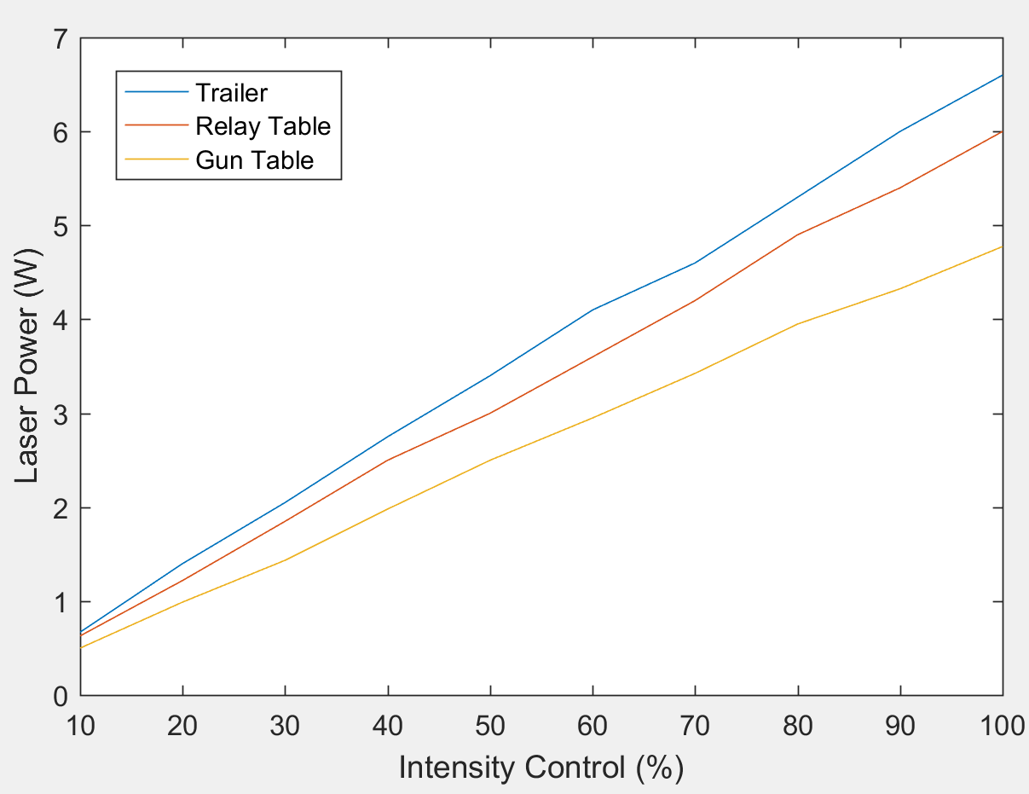
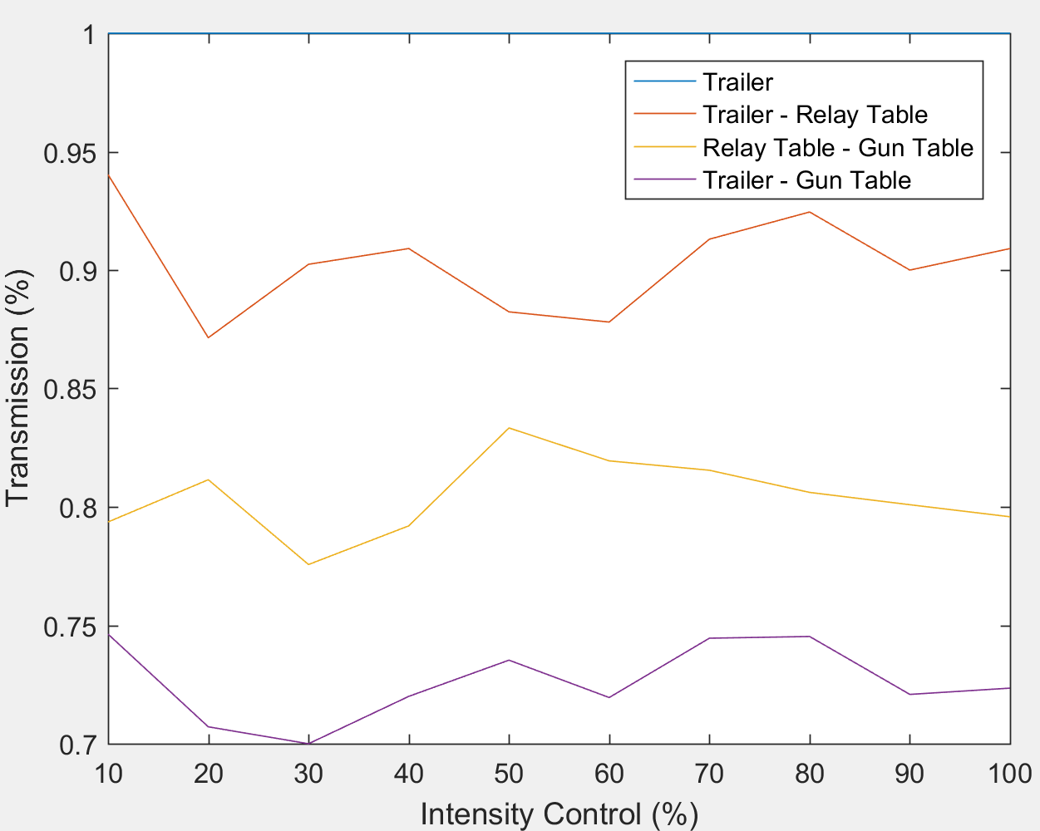
Transport Transmission
Transport had to be tweaked before measurement (Transmission is better than at the end of the run)
Trailer – Relay Table Loss = High Order Loss due to distortions in the Trailer
Relay Table – Gun Table Loss = Aperture Problems, further High Order Loss, Absorption

Slide 5
Laser Transport Overview
31‘
Gun Table
Shield Wall
Relay Table
DC Gun
+35“
RHIC Beamline
(Top View)
Laser Trailer
-52“
Imaging
43‘
f=7m
Diode
Camera
+12“
+6“
Laser
80“
115“
f=1.25m
68“
Not to scale

Slide 6
Power Loss to the Cathode
Achieved Run 18
Originals Power (W) | Intensity feedback + MPS | Temporal Shaping | Transport
22 | 17 | 10 | 7
Low conversion Efficiency (~45%) | Long EOM Crystal + Pockels Cell (75%) | Absorption in Interferometer + Crystals (60%) | Clipping, Absorption (70%)
Total transparency = 31%; Power needed to reach 15W on Gun Table 48W
Planned Run 19
Originals Power (W) | Intensity feedback + MPS | Temporal Shaping | Transport
25 (option for 30) | est. 20 (est. 24) | est.15 (est. 18) | est.12 (est.14.4)
Low conversion Efficiency (~48%) | AOM (80%) + Feedback (?) | New components + alignment (75%) | Smaller beam, better quality (80%, demonstrated 2017)
Total transparency = 51%; Power needed to reach 13W on Gun Table 30W

Slide 7
Temporal Shaping Evolution
Original Setup:
6 Crystals – 80ps
Very Strong Thermal lensing + Distortion
Second Setup:
4 Crystals + 1 Interferometer – 80ps
Strong Thermal lensing + Distortion
Third Setup:
3 Crystals + 1 Interferometer – 40ps
Strong Thermal lensing – No Distortion

Slide 8
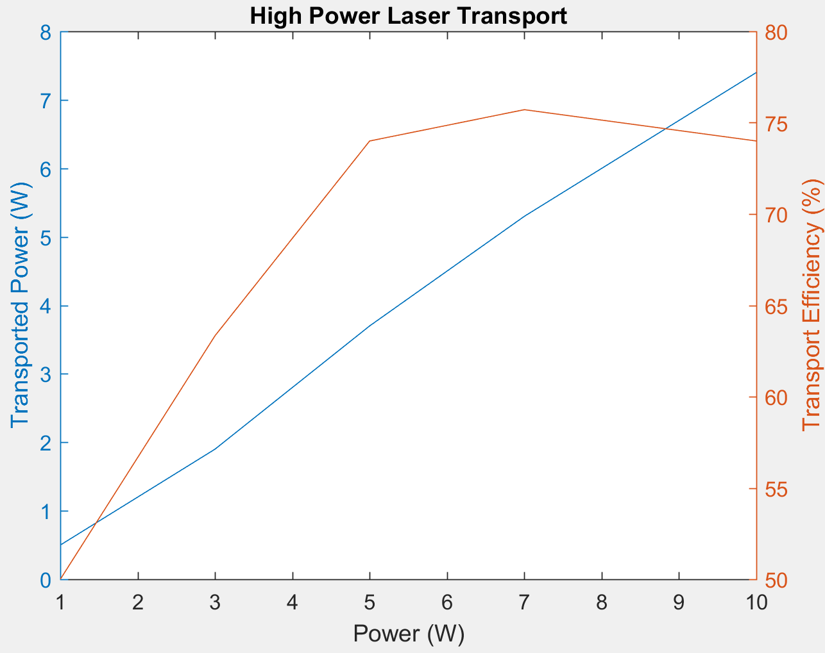
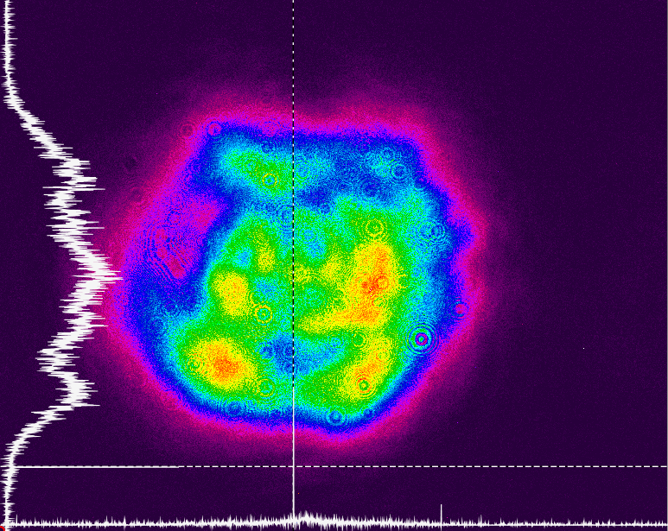
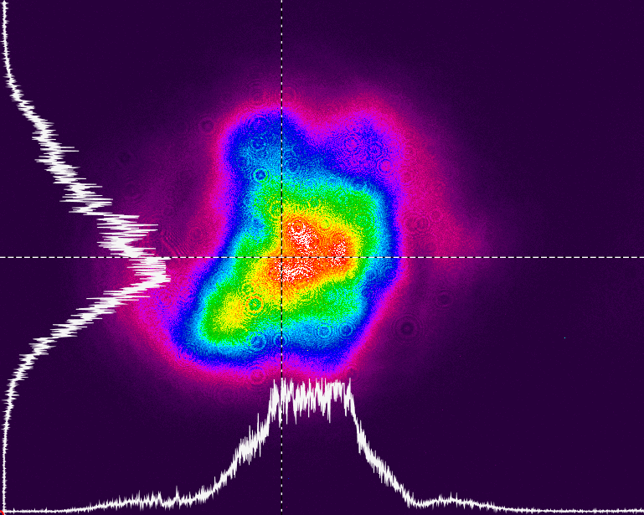
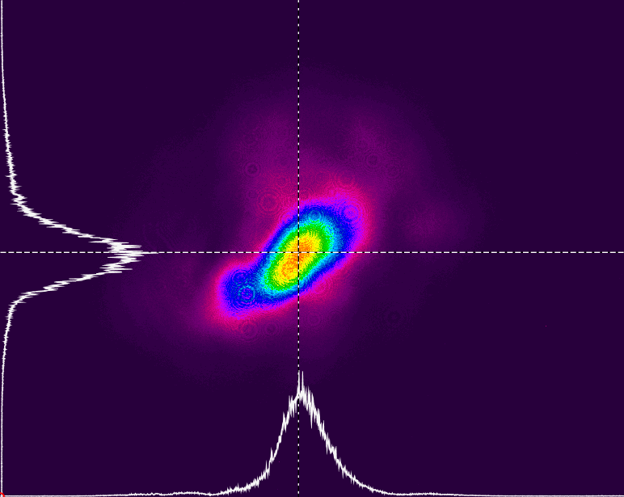
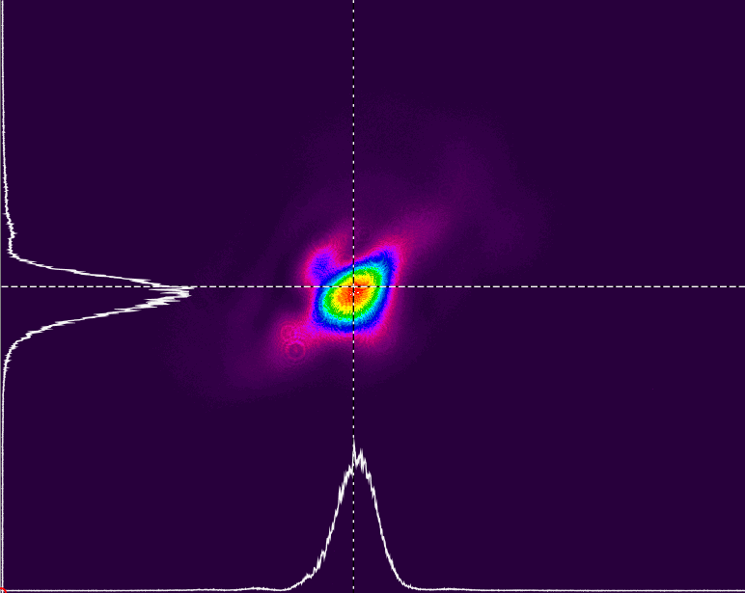
Thermal Lensing
6 Crystals; Strong distortions and size changes, unacceptable for operations
Trailer: 1W
Gun: 0.5W
3W
1.9W
5W
3.7W
7W
5.3W
10W
7.4W

Slide 9
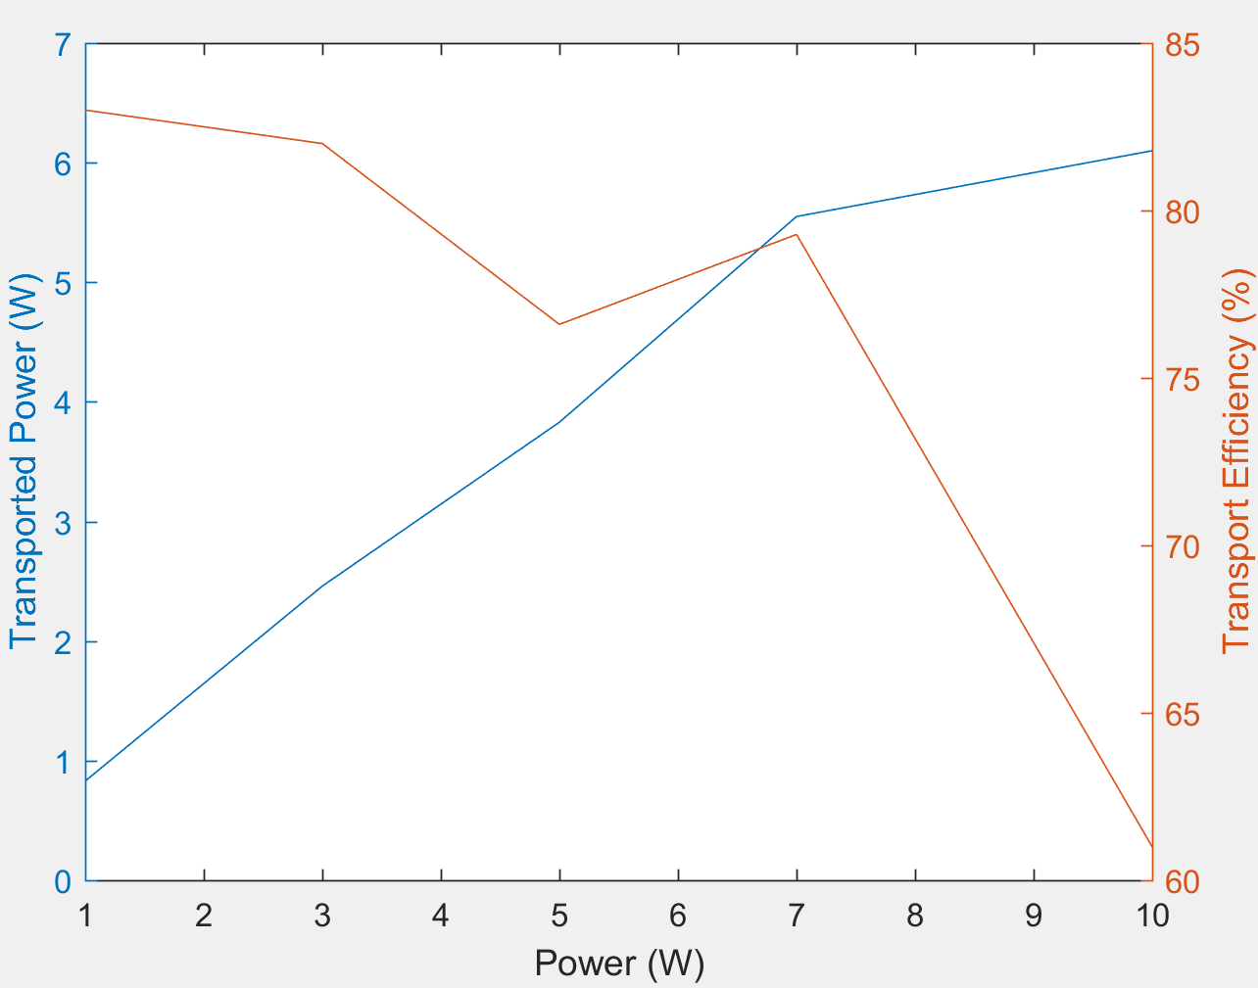
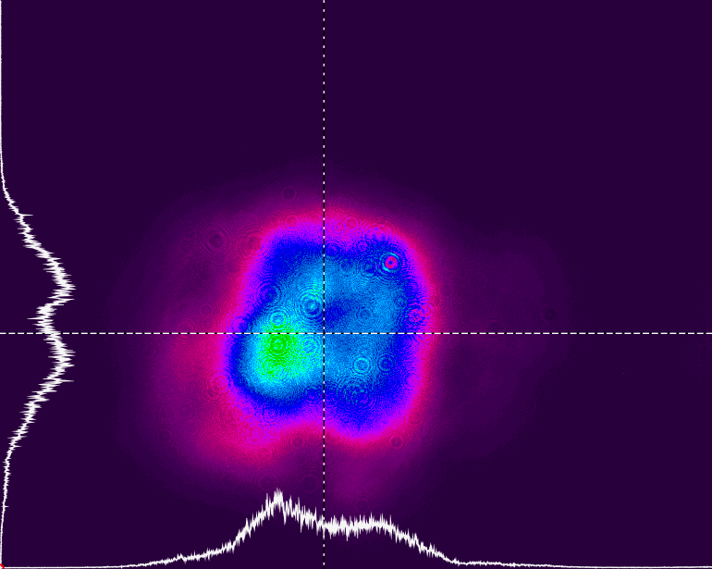
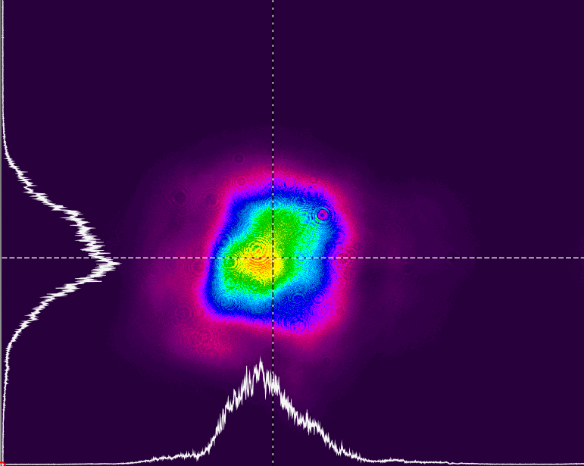
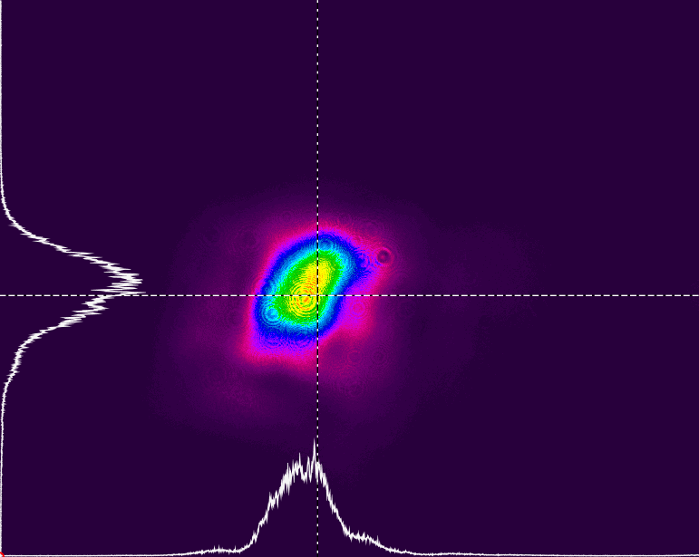
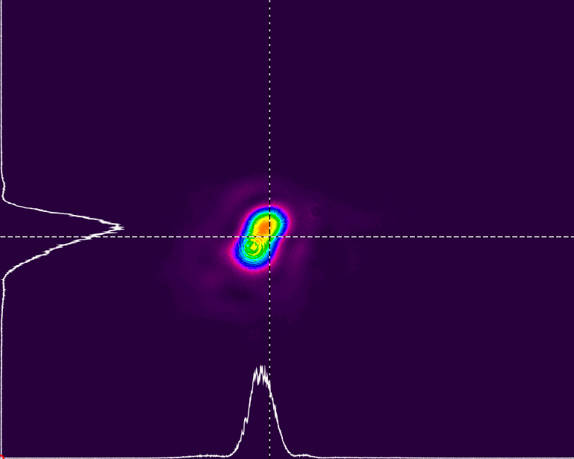
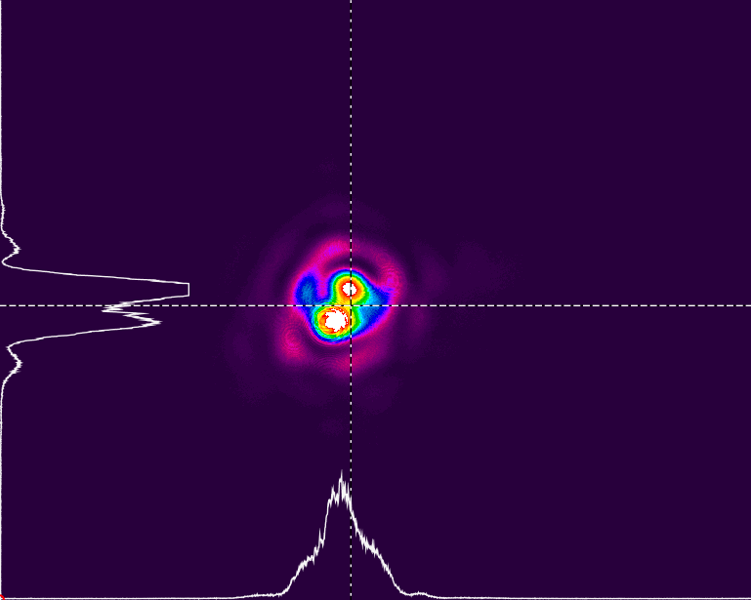
Thermal Lensing
4 Crystals + 1 Interferometer; Weak distortions and strong size changes, unacceptable for operations
Trailer: 1W
Gun: 0.8W
3W
2.4W
5W
3.8W
7W
5.5W
10W
6.1W

Slide 10
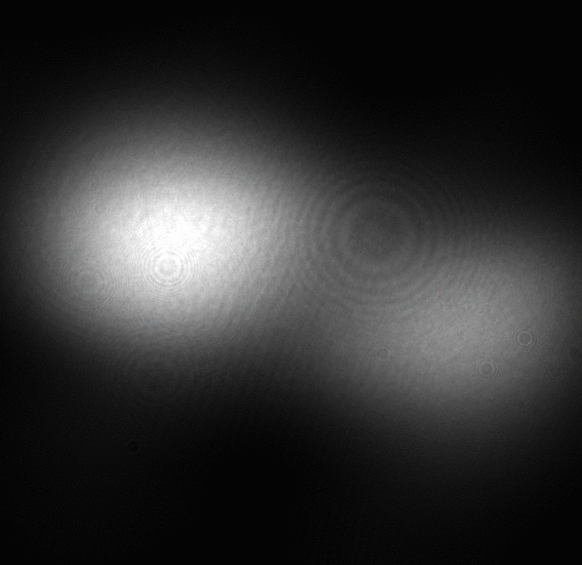
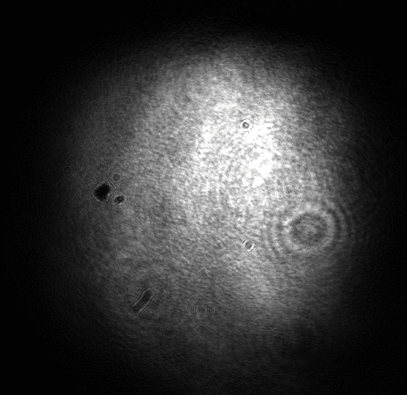
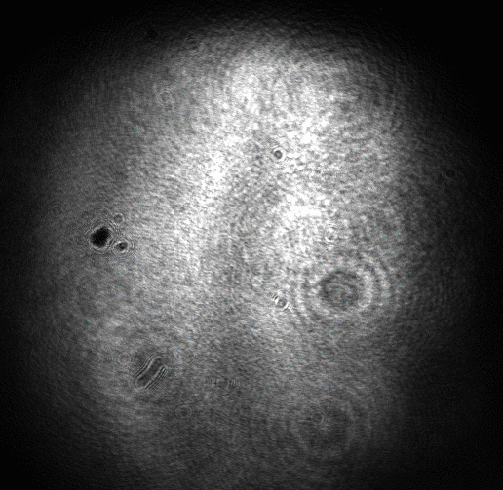
Thermal Lensing
3 Crystals + 1 Interferometer; No distortions, medium size changes, unacceptable for operations
10%
0.5W
50%
2.5W
100%
4.8W
Thermal lensing still present
Beamshape on Gun table no longer distorts, just enlarges
Seperated spots on Relay table due to coarse alignment of Interferometer Vertical stripes due to clipping in Transport
Goal is to make the size increase compensatable with the Zoom Lens

Slide 11
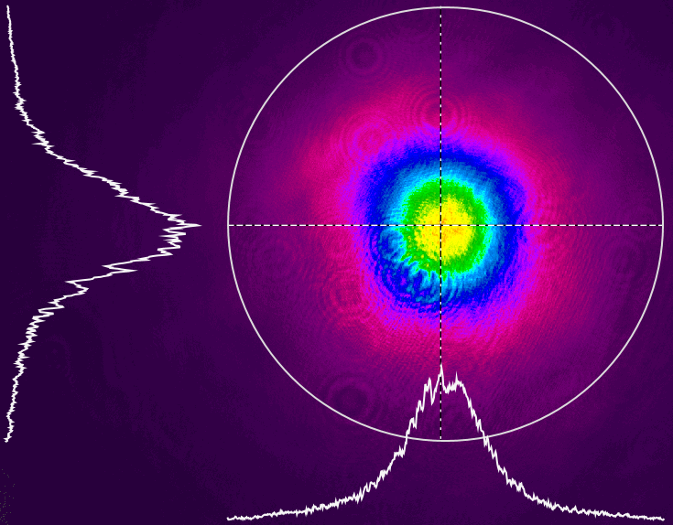
Thermal lensing Alternative Design
Beam after Temp. Shaping (18W)
Lense for Pulse Mode
HWP
YVO4 Crystals
Dump
PBS
Intensity control downstream of Temp. Shaping
Same power level in Shaping crystals at all time = same therm. Lens
Combines Intensity Control and Interferometer
For pulsed mode a lense is inserted that replaces the thermal lens

Slide 12
Temporal Shape Measurements
Need for an on-demand 1-2 minute measurement of the temporal laser profile exists
Crosscorrelation:
To alignment sensitive to be a maintenance free option
Streak camera:
Very expensive
Resolution not great
Takes up a lot of space

Slide 13
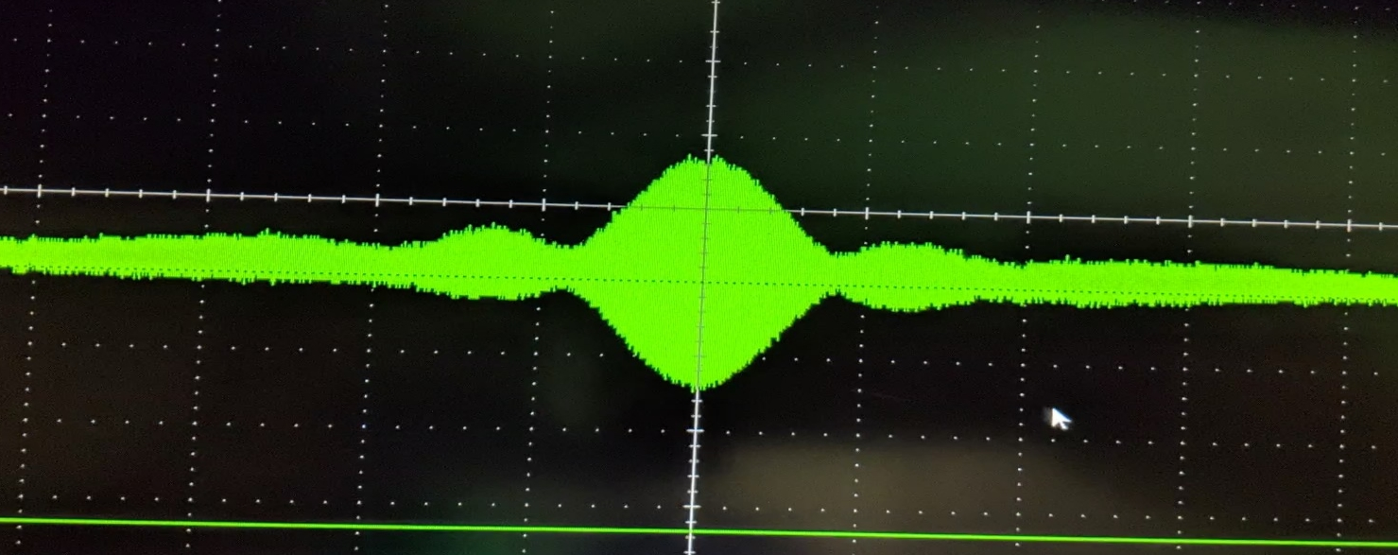
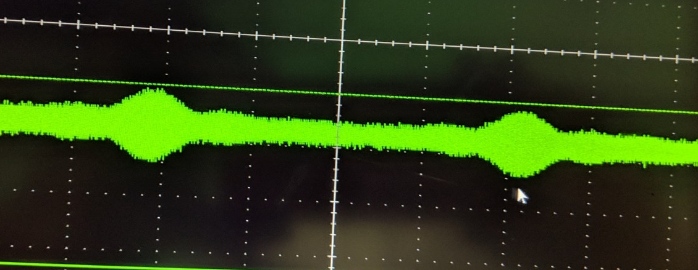
Temporal Shape Measurements Interference
The very short coherence length of the 2ps laser pulse can be used to obtain a measurement of the temporal shape by observing destructive interference
Temporal Shaping
Individual Laser Pulse @518nm
Diode
NPBS
HWP + Pol.
Temp. Shaped Pulse with ~8ps delay.
Motioncontrolled Mirror

Slide 14
Summary
Main problem to achieve high power on the Gun Table is the low transparancy of the Beam shaping stage
Optimization and simplification of that stage is main focus of the shutdown
Variable thermal lens cannot provide an acceptable beam for operations
Redesign of that stage to provide a constant lens for all modes of operation
On-Demand temporal shape measurement, not sensitive to alignment with a small footprint needed
Temporal Interference Method is being developed for Run19

Slide 15
Acknowledgements
Laser group: Michiko Minty, Brian Sheehy (retired), Zhi Zhao, Patrick Inacker & Linh Nguyen
Instrumentation, RF and Controls Hardware and Software Engineering
CAD Support groups

