Slide 1
Laser Synchronization
LLRF Team :
Kevin Mernick (LEReC RF Lead)
Geetha Narayan
Tom Hayes
Kayla Hernandez
Freddy Severino
Kevin Smith

Slide 2
Outline
Synchronization Requirements
Design Constraints
System Overview
Performance Metrics
New Development
Summary

Slide 3
Synchronization Requirements

Slide 4
LEReC laser requirements (October 2018)
 | Original | Updated
Power on cathode, W | 10 | 6.5
Power on Gun table before iris, W | 15-20 | 10-13
Beam diameter on the cathode, mm | 4-6 | 4-6
Transverse profile | Uniform | Truncated Gaussian (3mm sigma)
Longitudinal profile | Uniform, “flat top” | Stacking with < 40% peak-to-peak modulation
Pulse length after stacking, ps | 80 | 40-80
Time jitter rms, ps | < 1 | < 1
Intensity rms, shot-to-short. % | < 2 | < 2
Spatial stability C.O.M. on iris rms, um | 10 | 50 (<10um on cathode)
Extinction ratio (power leakage, pulsed mode) | 10^6:1 | 10^6:1
MPS extinction ratio (between MPS interlock and slow shutter closed, full current CW) | 100:1 (5 msec response) | 300:1 (15 msec)

Slide 5
Design Constraints

Slide 6
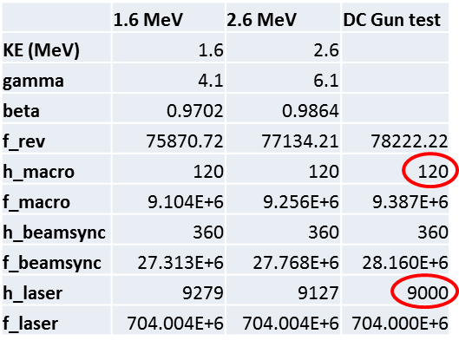
Fixed Laser Reference Frequency
For commissioning during FY18, a bunch frequency that is a multiple (x75) of the macrobunch frequency was used for the interim timing system
For cooling, the electron bunch repetition rate must be a harmonic of the RHIC revolution frequency. The macrobunch repetition rate must match the RHIC bunch spacing. It is also limited by the tuning range of the laser and RF cavities

Slide 7
Laser Macrobunch Pattern
Using 1.6 MeV e- beam as an example, we need to generate 120 macrobunches every 9279 periods of the laser oscillator. Macrobunches are 30 periods long. This leaves 5679 periods to be distributed between the 120 off periods between macrobunches.
Each off time must be an integer number of periods of the laser oscillator (i.e. the control signal needs to be synchronous with the oscillator frequency).
5679 = 47*81 + 48*39
On
30
On
30
On
30
On
30
Off
48
Off
47
Off
47
Off
48

Slide 8
Laser Macrobunch Pattern Generation
Patterns for 2.0 MeV and 2.6 MeV alternate between 46 and 47 RF periods for the off time.
Duty cycle variation from pulse to pulse complicates the logic of the timing controller.
Gigabit transceiver (GTX) has a PLL that will generate a serial bit clock synchronous with the RF clock. Logic runs on a subharmonic, and loads the pattern piece-wise into the GTX output shift register. Frequency is locked to RF. Phase can be adjusted by shifting the reference clock.

Slide 9
System Overview

Slide 10
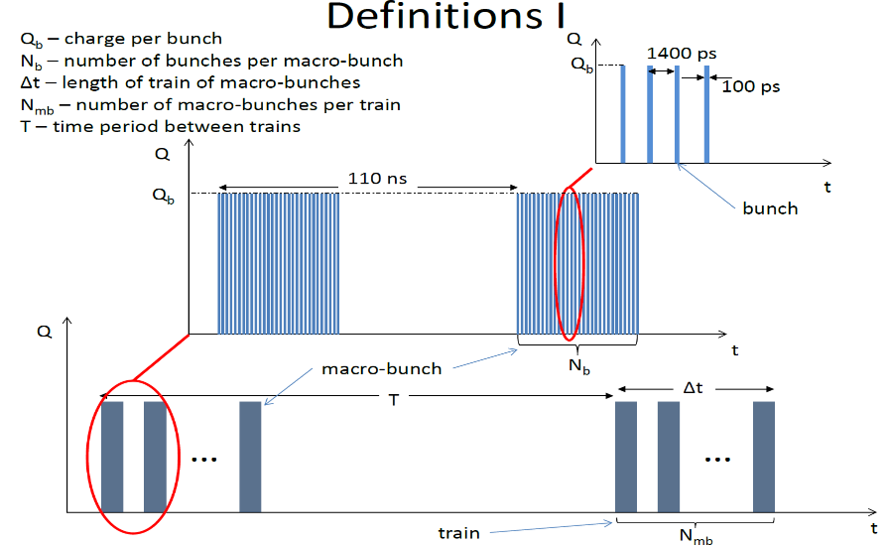
Block Diagram
…
Gun
704 MHz Seed
EOM
Pockels Cell
SHG
Amplitude Control
Slow
Shutter
Fast
Shutter
PD
EOM Bias Controller
AND
AND
User Control
Fast Timing Chassis
Macrobunch Generation
Macrobunch
Selection
MPS
Ref
Clk
Sync
Data
From S. Seletsky
Laser
Ref
Laser
Phase
Clk
LLRF
Beam Sync
INSTR
revtick
Master
Event
BPM reference clock

Slide 11
Laser Timing
Components
  EOM (Electro-Optical Modulator)
    Generates the 9 MHz macrobunch structure
    Needs fast control synchronized with 704 MHz laser oscillator
  PSPL5865 Driver
    Generates the control voltage for the EOM with fast response
    Amplitude & Bias control to optimize EOM On/Off contrast
  Pockels Cell
    Generates the train structure
    With the current laser design, this allows a 1 Hz repetition rate with train lengths up to 50 ms (5% duty cycle limit)
    For 78 kHz mode, the repetition rate increases, but the duty cycle limit remains

Slide 12
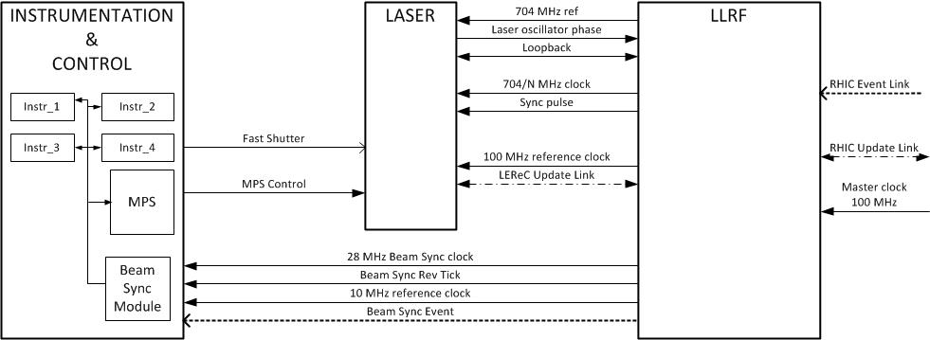
Timing System Overview
Modes of Operation:
1 Hz
CW (Continuous train of 9 MHz macrobunches)
78 kHz (1 to 6 macrobunches, repeated at Revolution Frequency)
No changes needed in LLRF setup to switch between modes

Slide 13
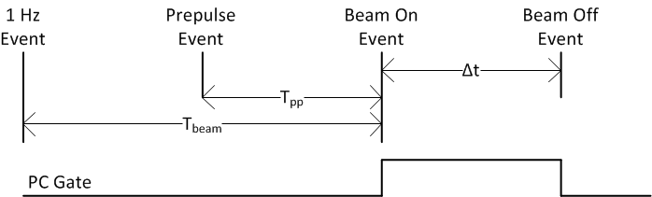
Timing Control
All events will be synchronized to the RHIC Event Link 1 Hz event
Three events will be encoded onto the LEReC Beam Sync Link:
  Prepulse, BeamOn, BeamOff
Timing Manager will control Pockels Cell gate (Δt parameter). T_{beam} and T_{pp} will be constants
Instrumentation can use a trigger delayed from Prepulse to arm pre-beam
Measurement triggers could be derived from either Prepulse or BeamOn events (qualified by Beam Sync rev_tick event)
In CW modes, these events are not really used
T = 1s, 106 ns ≤ Δt ≤ 50 ms

Slide 14
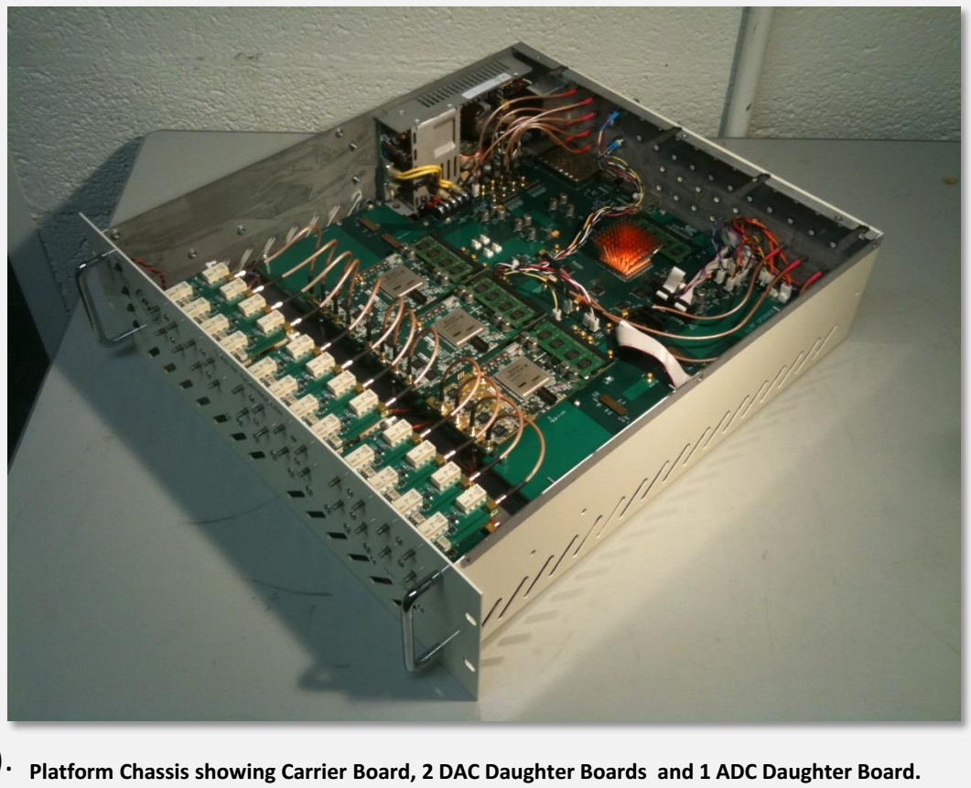
LLRF Platform
LLRF Controller is a stand-alone configurable, modular, hardware / software platform
  Carrier Board
    Control system interface, daughter host platform, communication hub, timing, data acquisition management, power …
  Daughter Module
    Provide system specific functionality (ADCs, DACs, DSP, etc.) and signal processing horsepower
‘Update Link’
  Downstream deterministic (i.e. fixed latency) 2 Gb/s serial link distributing encoded timing and data.
  Key to ease of system integration, flexibility, scaling and synchronization
RF Asynchronous Fixed frequency clocking/sampling.
  We used fixed almost everywhere because it affords significant advantages for us.
  RF synchronous clocking used for certain trigger generation applications (e.g. e-gun lasers).
  Can use fixed, RF synchronous, both or other

Slide 15
Performance Metrics

Slide 16
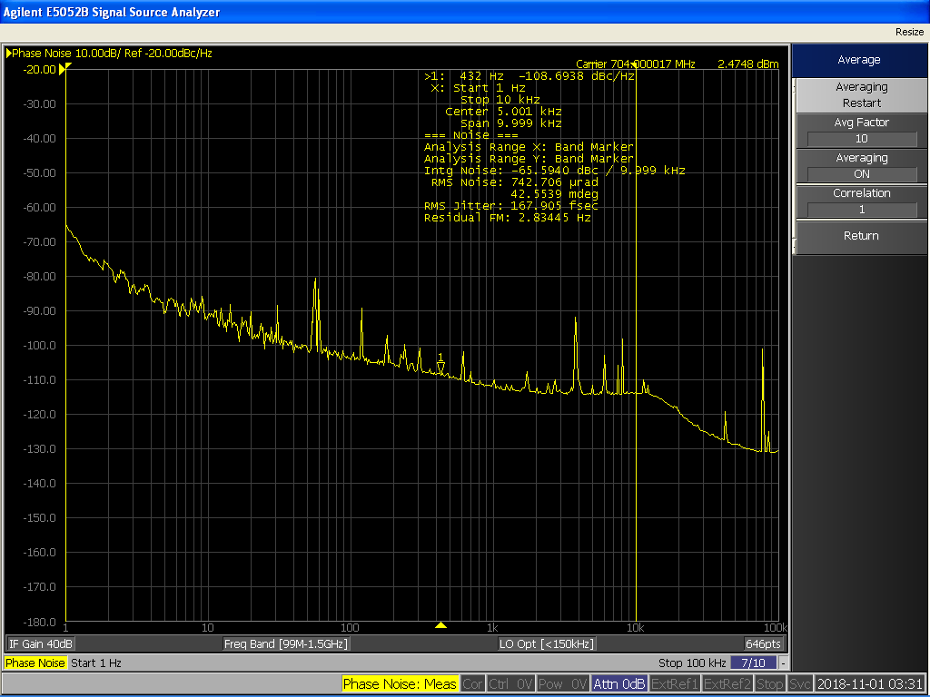
704 MHz Reference
Span : 1Hz to 10 kHz
RMS Jitter : 167.905 fsec
Although well within specification, as a result of a separate effort to upgrade the 100 MHz master clock, we expect to realize further improvements to the integrated phase noise.
Laser Control Objective :
704 MHz phase reference with < 1 ps RMS jitter
Phase Noise (dBc/Hz)
Frequency (Hz)

Slide 17

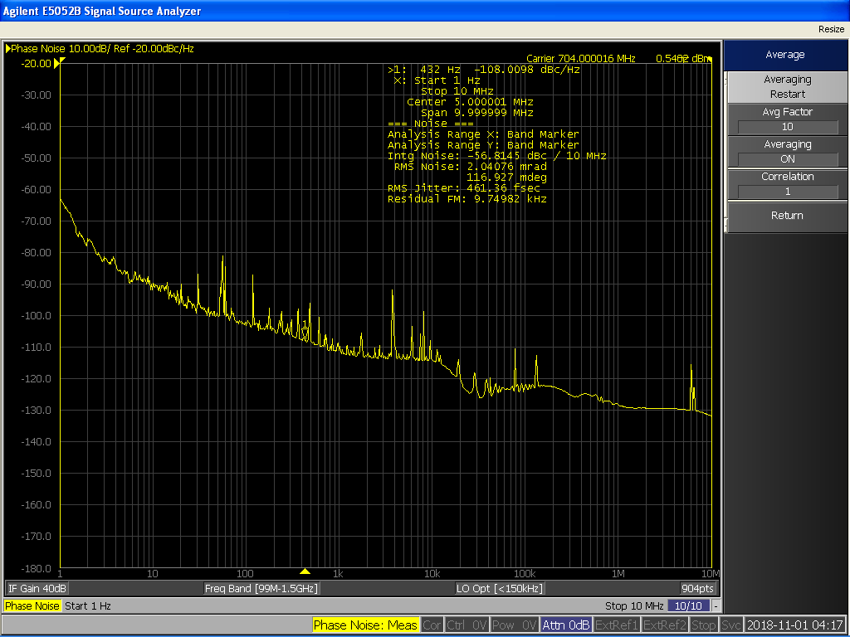
704 MHz Laser Phase
(Signal from Photodiode before EOM)
Span: 1Hz to 10 kHz
RMS Jitter : 182.36 fsec
Span: 1Hz to 10 MHz
RMS Jitter : 461.36 fsec
Instrument : Agilent E5052B Signal Source Analyzer

Slide 18
New Development

Slide 19
Timing System Upgrade
FY18
Interim Timing System
FY19
Fixed repetition rate and bunch rate harmonics to 120 and 9000
EOM gate signal is from a LLRF DAC daughtercard. RF synchronous clock (h=1800) is used to control this output
EOM gate only supports macrobunch lengths that are multiples of 5 bunches
Pockels cell gate is generated from the LLRF from a beam synchronous source
Support for different modes of operation
Selectable bunch patterns
Not limited to same EOM on/off duty cycle for all macrobunches
Signals locally generated in laser trailer

Slide 20
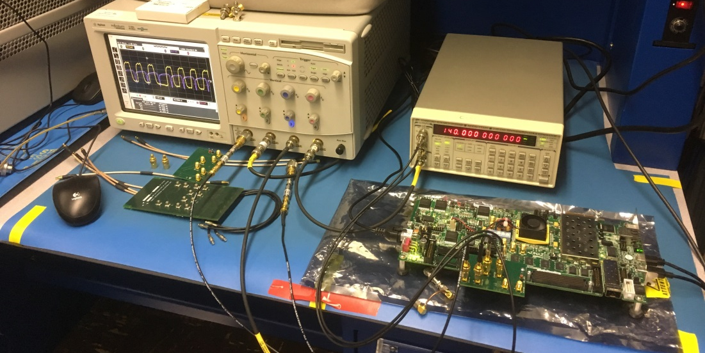
Fast Timing System
A Xilinx ZC706 Zynq evaluation board is configured to function as a daughter card to LLRF Controller
A multi-gigabit transceiver (MGT) in ZC706 will generate the EOM gate signal
The fast gate signal is synchronized with an external clock reference
Also provides significant processing power and many inputs/outputs for other necessary features
A custom FMC daughtercard provides the interface between the ZC706 and the rest of the system

Slide 21
Summary

Slide 22
Upgrade Status
Zynq ZC706 development board and new FMC daughter cards have been verified for operation (power-up, clock routing, IO check)
Update link receiver and pattern generation logic have been integrated and are functional
DACs on FMC daughter have been programmed and tested
Working on establishing Aurora Link between LLRF controller and the Zynq board
  Allow for remote configuration and control

Slide 23
Conclusion
RF reference signal to Laser meets LEReC Laser requirement specification for RMS jitter < 1ps
We are on schedule to complete development on ZC706 integration. Installation of Fast Timing chassis will be completed and ready for system level tests at startup FY19
Beam commissioning with different modes of operation and bunch patterns will be supported

