Slide 1
LEReC Laser Review
Laser related MPS Patrick Inacker-Mix

Slide 2
Agenda
LEReC Machine Protection requirements
Pulsed Mode
CW Mode
Laser System Protection

Slide 3
LEReC MPS requirements
Parameter | Target Value | Achieved Pulse Mode | Achieved CW Mode
Reaction Time | 15µs | < 1µs | < 1µs
Extinction Ratio (Before Shutter closes) | 180 (30mA) 300 (50mA) | 10^7 | > 200 -
Required Extinction Ratios based on a Shutter closing time of 15ms.

Slide 4
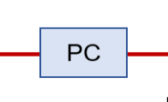
LEReC Machine Protection (Pulsed Mode)
976nm Pump
1W
976nm Pump
DC
YDF
SC
YDF
SC
YDF
Mach-Zehnder
Pockels Cell extinction ratio 800 – 1000 SHG: 5*10^5-10^6
704 MHz High-Order-Modelocked Oscillator
EOM
ISO
60W
976nm Pump
160-200W
Non-Critically Phase-Matched LBO Crystal
85µm, 80cm fiber rod
PC
SHG
Polarizer
Power
~22W
Fast / Slow Shutter
Temporal Shaping
Intensity Control
EOM
PC

Slide 5
LEReC Machine Protection (CW Mode)
976nm Pump
1W
EOM extinction ratio is strongly correlated to Crystal temperature and drifts around
Bias Voltage 0 for Fail-Safe operation
CW Pockels Cell extinction ratio stable around 30 (Degraded within 1Week due to permanently applied HV
976nm Pump
DC
YDF
SC
YDF
SC
YDF
Mach-Zehnder
704 MHz High-Order-Modelocked Oscillator
EOM
ISO
60W
976nm Pump
160-200W
Non-Critically Phase-Matched LBO Crystal
85µm, 80cm fiber rod
PC
SHG
Polarizer
Power
~22W
Fast / Slow Shutter
Temporal Shaping
Intensity Control
Pockels Cell extinction ratio 25-35 EOM extinction ratio 10-500
EOM
PC

Slide 6
EOM extinction ratio Measurements
EOM extinction ratio over 9 hours
EOM extinction ratio sensitive to laser power fluctuations
EOM alone is not capable of providing the needed extinction ratio for extended periods of time.
Added cw Pockels Cell to boost extinction by a factor of 20-30

Slide 7
LEReC Machine Protection (CW Mode)
976nm Pump
1W
976nm Pump
DC
YDF
SC
YDF
SC
YDF
Mach-Zehnder
AOM will replace EOM + CW PC
AOM operates by deflecting the beam using a standing pressure wave. Refractive index changes due to temperature changes does not translate to power leakage but changes in deflection angle
704 MHz High-Order-Modelocked Oscillator
EOM
ISO
60W
976nm Pump
160-200W
Non-Critically Phase-Matched LBO Crystal
85µm, 80cm fiber rod
PC
SHG
Polarizer
Power
~22W
Fast / Slow Shutter
Temporal Shaping
Intensity Control
EOM
PC
AOM

Slide 8
Laser System Protection

Slide 9
Laser System Protection
Room Interlock
Personal Protection
Interlock Box
System Protection (Laser MPS)
Independent systems
Both have to Agree to enable the Laser
Sensor Box
Laser
Power/Fluorescence
Temperature
Chiller
Temperature
Flow

Slide 10
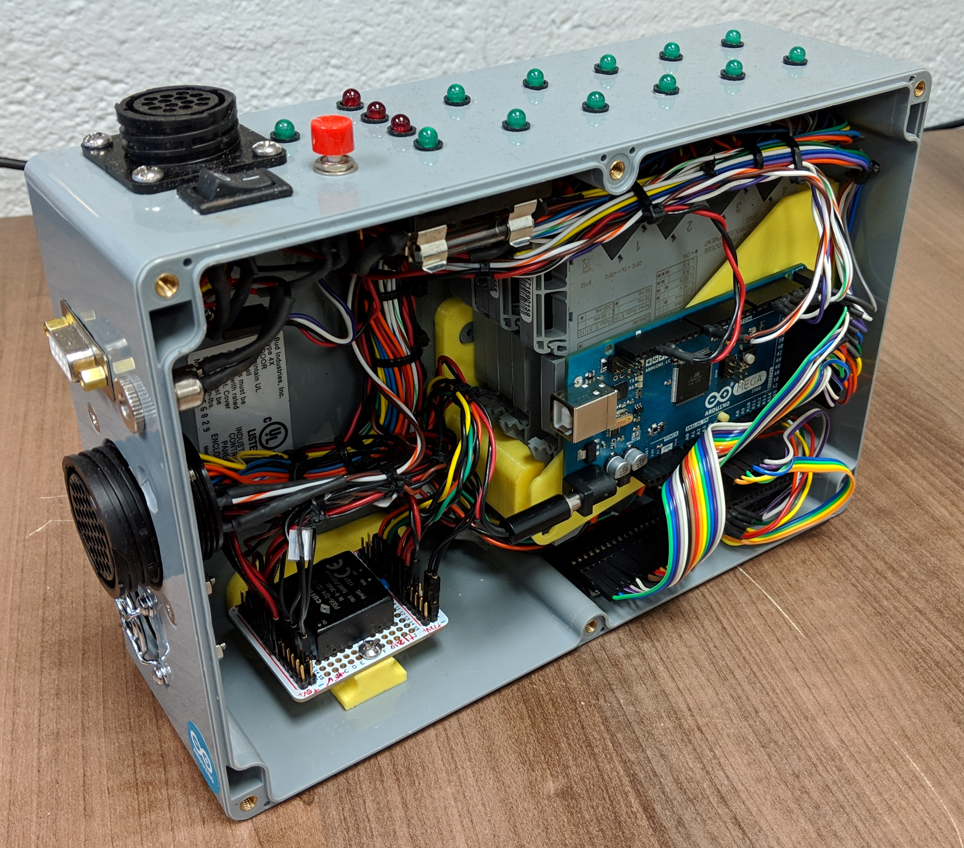
Laser System Protection Sensor Box
Arduino driven, stand-alone system
Network access through RS232 for readout and remote control.
Full local control. Fully customizable sensor array (Analog&Digital)
Version 3:
5 RTD Temperature Sensor inputs
4 Flow Sensor inputs
2 Dry contact inputs
8 Individually controllable Interlock Channels
Programmable fault scenarios and system conditions. In continous, maintenance free 24/7 operations since 05/2018

Slide 11
Laser MPS Flow Chart
If not Interlocked Enable System
Interlock according to Fault Scenario
Reset
Local / Remote
Monitored Parameters
In Range to SetPoints?
YES
Look up Fault Scenario
Chiller Temp.
Chiller Flow
Module Temp.
Power
...
if Main_Amp_Chiller_Flow == 0 Interlock_Main_Amp;
Alert_Operators;
If Chiller_Pre_Amp_Flow == 0
Interlock_Entire_System;
Alert_Operators;
...
NO
Monitoring Loop

Slide 12
Summary
Experience from last year requires upgrade of CW MPS setup
EOM+PC will be replaced by single AOM
Added Laser Protection enabled 24/7 operations
Runs flawlessly since installation
Can support design changes and new requirements

Slide 13
Acknowledgements
Laser group: Michiko Minty, Brian Sheehy (retired), Zhi Zhao, Patrick Inacker & Linh Nguyen
Instrumentation, RF and Controls Hardware and Software Engineering
CAD Support groups

