Slide 1
Laser Beam Position Stabilization
Linh Nguyen

Slide 2
Current Status
Parameter | Target Value | Current Value
Pointing stability on cathode | <10 µm c.o.m rms | <75 µm c.o.m rms
During Run18, the laser beam exhibited two types of position instabilities:
- fast jumping - slow drifting

Slide 3
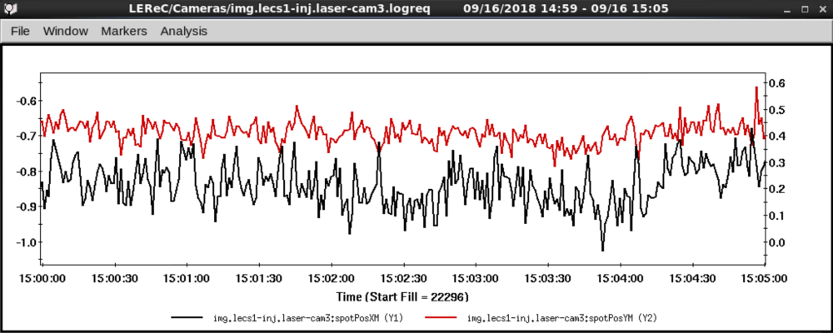
Fast Jumping
The fast jumping was easily observable while watching cameras and routinely logged by the gun-table camera (1 Hz refresh rate)
X position
Y position
It is the fast instability that drives the values in the table (see next slide)

Slide 4
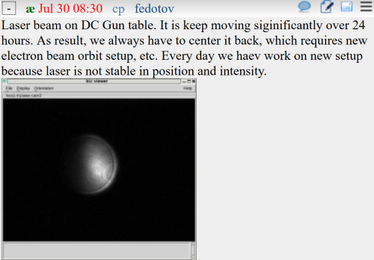
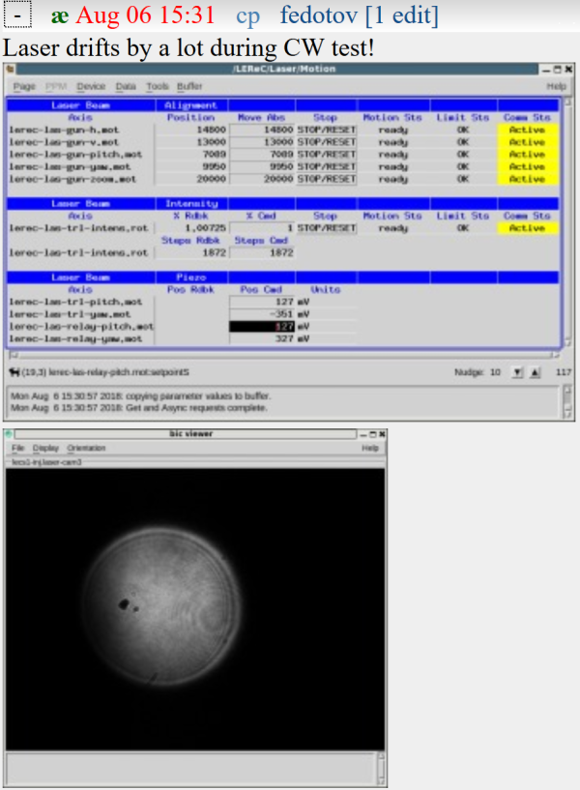
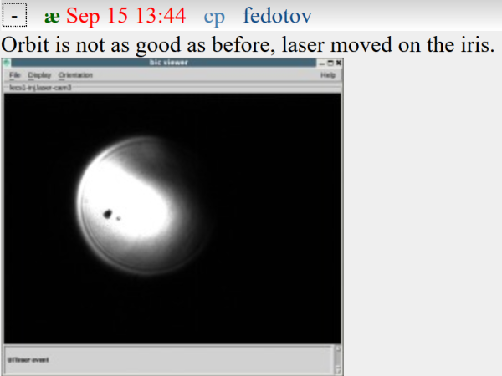
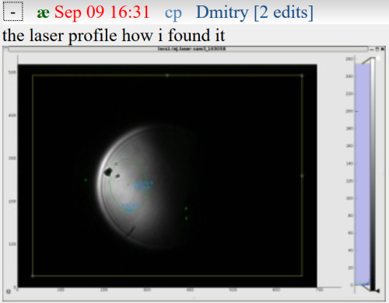
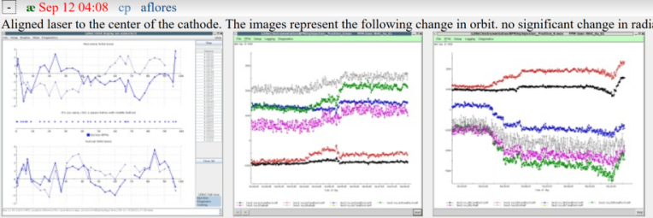
Slow Drifting
The slow drift was typically noticed in-between shifts and when orbits degraded:
Measurable effect on electron beam orbit
If left uncorrected, it will simply move the beam off the cameras (no bounded value)

Slide 5
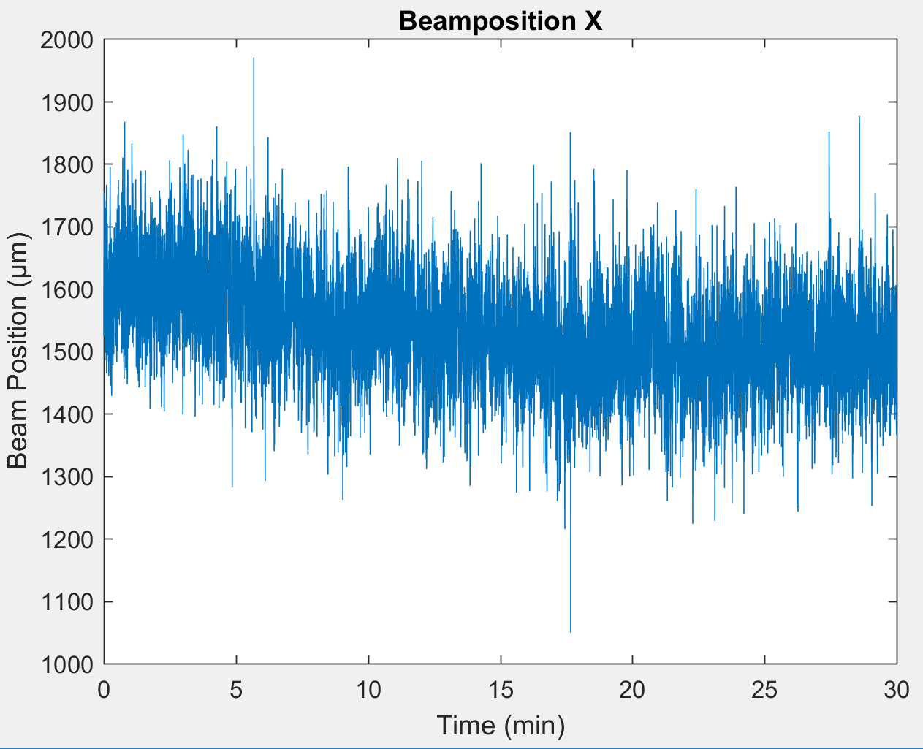
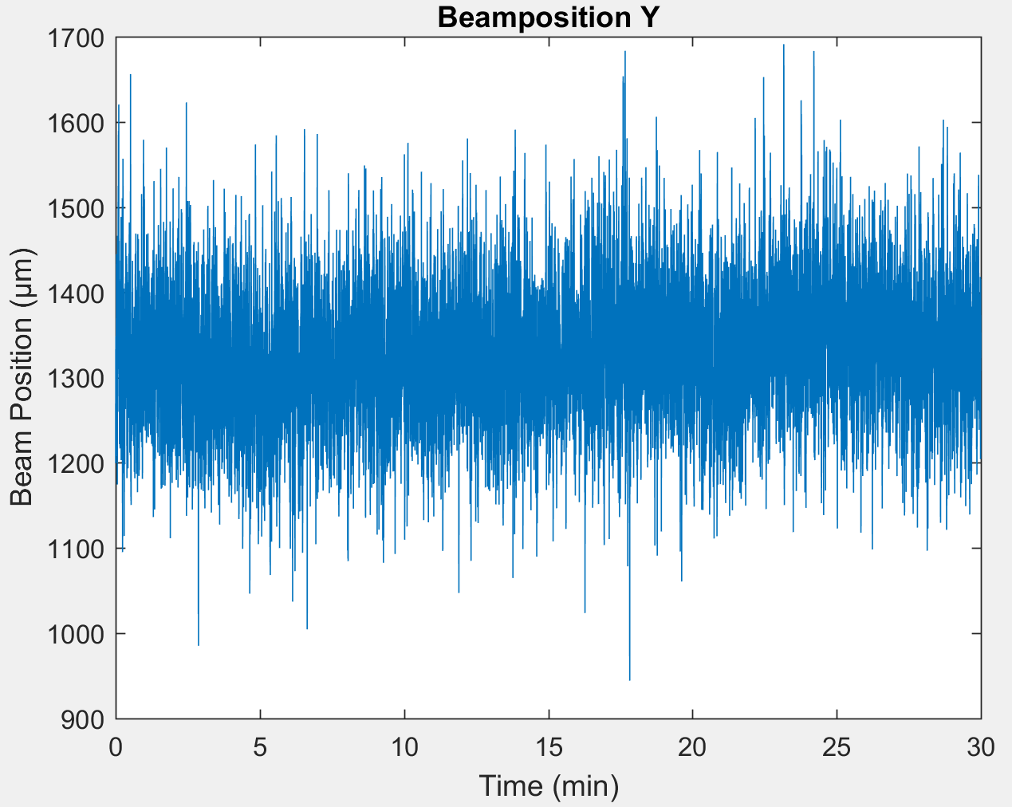
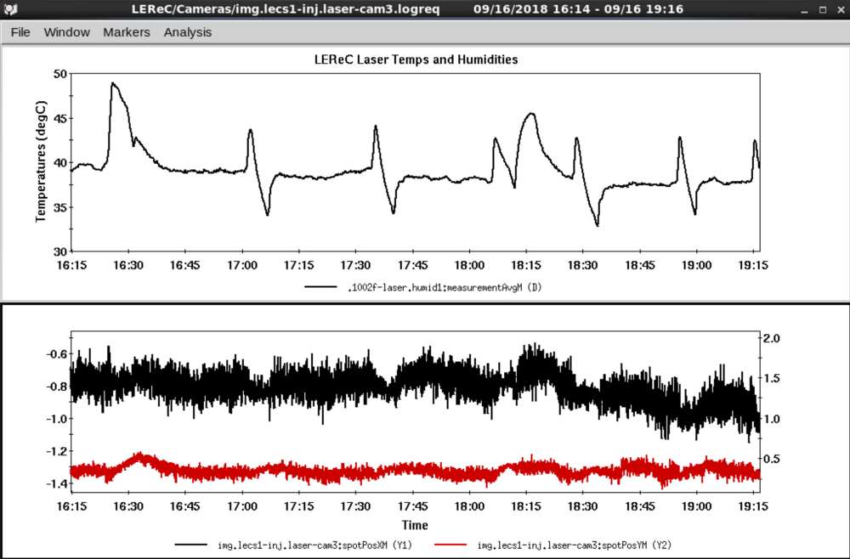
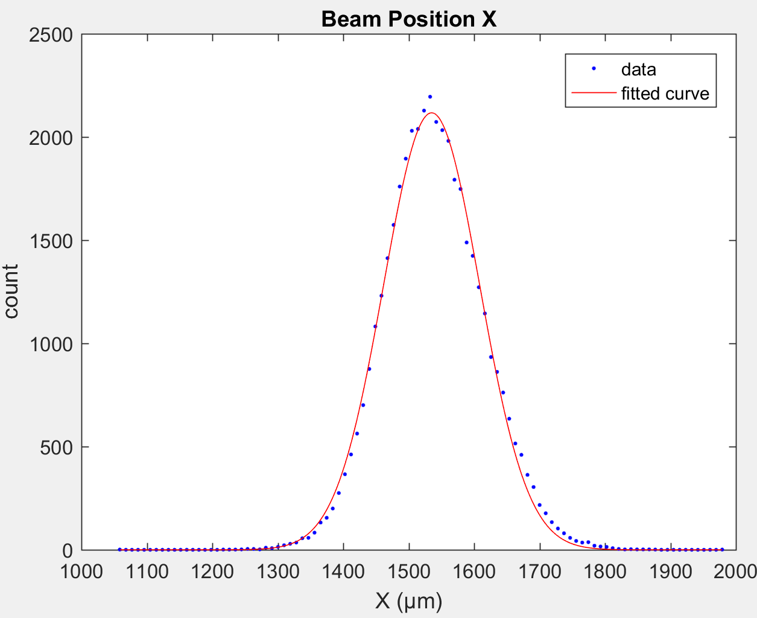
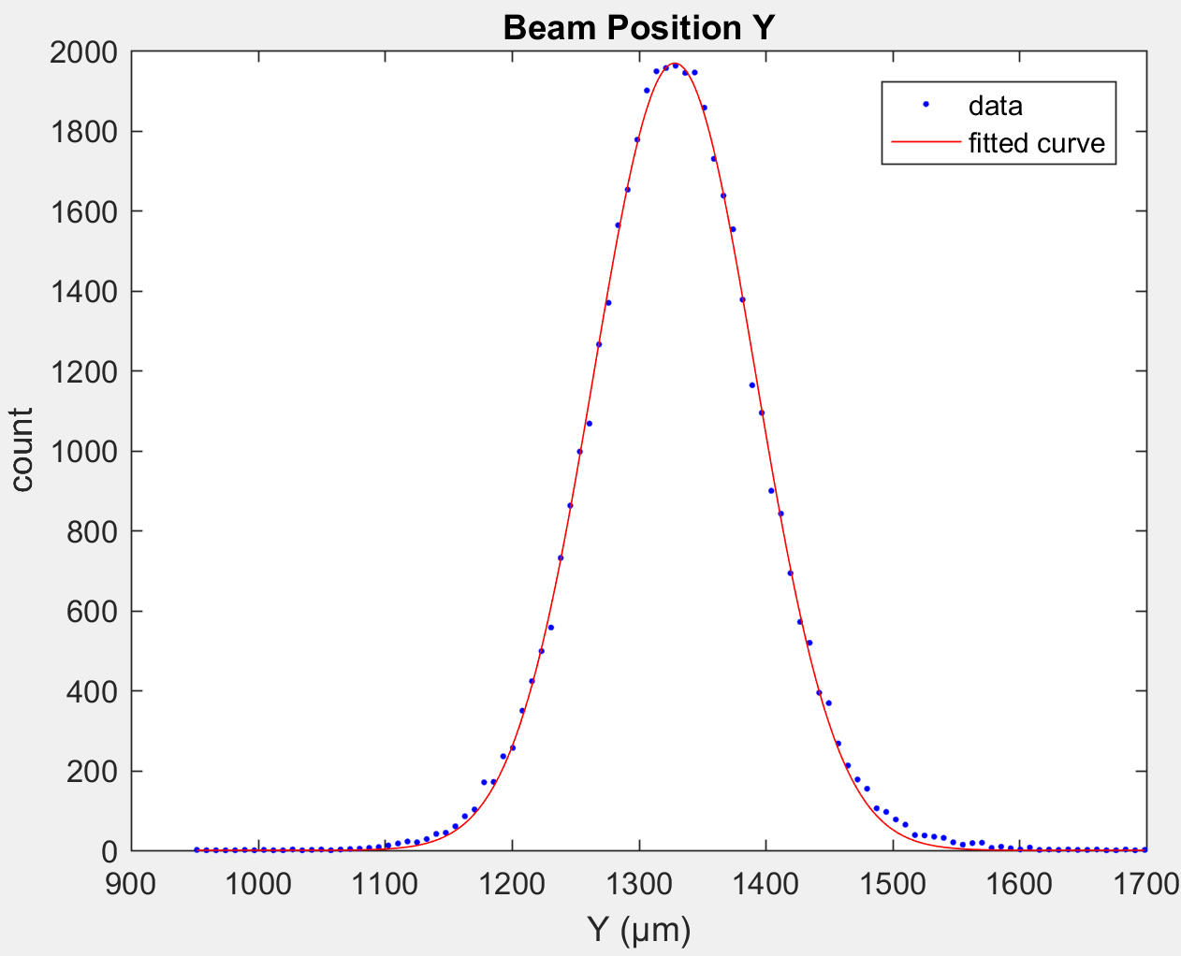
Sources of Fast Jumping
Previously collected data showed that the high-frequency component of the instability has a gaussian (non-deterministic) distribution, suggesting turbulence and random vibrations
However, the air turbulence is well correlated with humidity in the trailer
Data over 30 minutes at 23 Hz

Slide 6
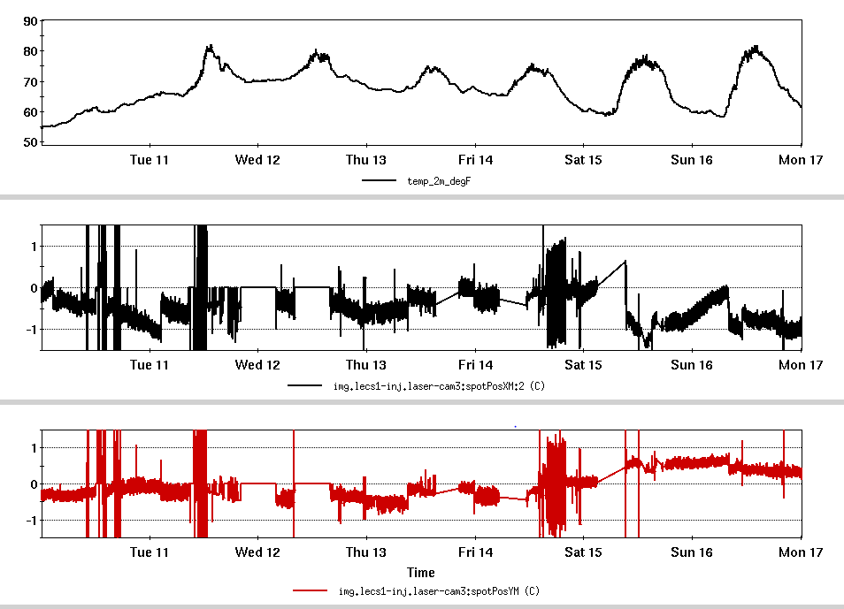
Sources of Slow Drifting
This is due to slow movement of tables and structures relative to one another with changing outside temperature
Abrupt transitions and periods of fluctuations correspond to changes in mode of operation (cw vs. pulsed vs. no beam)
Note that most drift occurs in x-direction, which translates into vertical motion in the trailer (change of orientation occurs in transport)

Slide 7
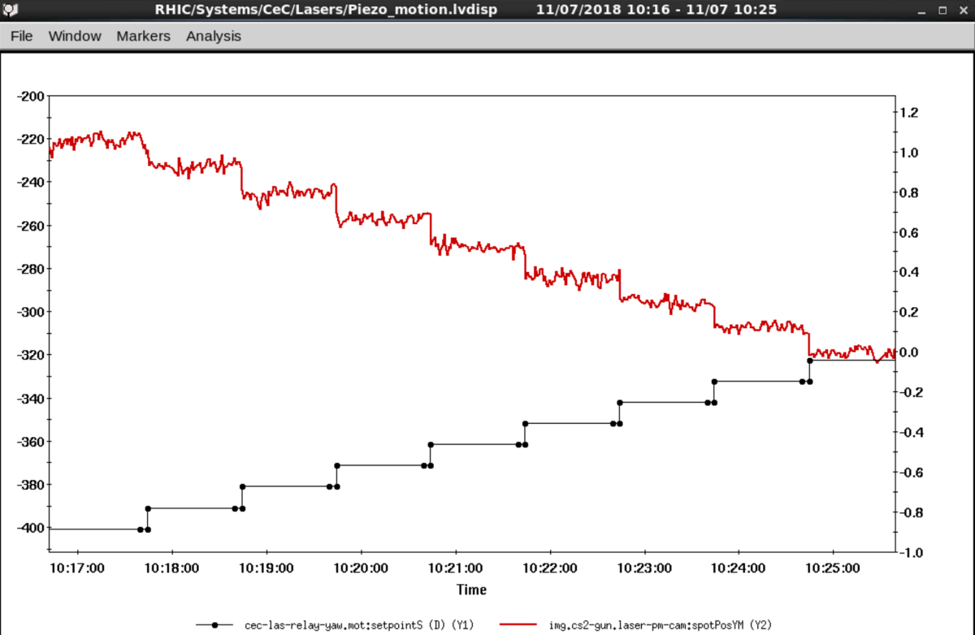
Past Experience
Previous testing aimed at implementing a commercial fast stabilization system using quad diodes in transport showed limitations when used with LEReC
Exception handling of shutter showed poor zeroing properties—beam would simply get lost upon resuming operation due to long transport
Recently collected data using CeC’s ~40 m transport arm between the relay table and the gun table. Each step is +10 mV on the steering mirror. ~Δ80 mV of change takes the beam through ~Δ1 mm of position. Corresponding LEReC arm is ~20 m.

Slide 8
Other Obstacles
LEReC’s large and structured beam in the transport might complicate tracking (manufacturer specifies a 6mm beam on a 10mm x 10mm sensor)
Beam is smaller and looks better in the trailer
Pulsed beam is outside the manufacturer’s specified bandwidth, which is 100 kHz
Latency in electronics would not allow us to catch the same pulsed beam for differential measurement performed by quad diodes—might give spurious responses

Slide 9
Current Approach
Separate fast- and slow-stabilization systems to maximize the impact of each system
Fast, commercial unit in trailer before shutters
Places fast correction where essentially all the air turbulence is
Presence of ~50 µW of leakage light increases likelihood of effectiveness in pulsed mode
Avoids problems with shutters opening and closing
Slow, in-house, camera-based system corrects along the transport
Leverages structure in beam to analyze and track changes
Pulsed and cw beams appear identical with dynamic exposure and gain settings
Built-in and expandable exception handling to handle shutters, etc.
Transport
Moving air
Slow Stabilization
Fast Stabilization
Laser
Shutters
Relay Table
Gun Table
Cathode
Laser Trail
Tunnel

Slide 10
Fast-Feedback System Mock-Up
Initial test set-up in the temporary laser development area:
Detector 2 (quad diode)
Actuator 1 (piezo mirror)
Laser
Camera
Distance between detectors ~1m
Actuator 2 (piezo mirror)
Detector 1 (quad diode)

Slide 11
Results
Initial 1m distance was too short. The following videos show the results when the distance was increased to ~1.4 m:
Without stabilization
With stabilization
Environment was inherently noisy, with a lot of ambient light. Bandpass filters will be necessary in front of the quad diodes (the video above used none)

Slide 12
Slow-Feedback System
Uses camera and continuous image processing
Dedicated local loop—only interacts with Controls System via existing steering mirrors
Transport
Shutters
Relay Table
New Camera
Cathode
Existing piezo mirror
Gun Table
New Camera
Existing piezo mirror
Laser Trail
Tunnel

Slide 13
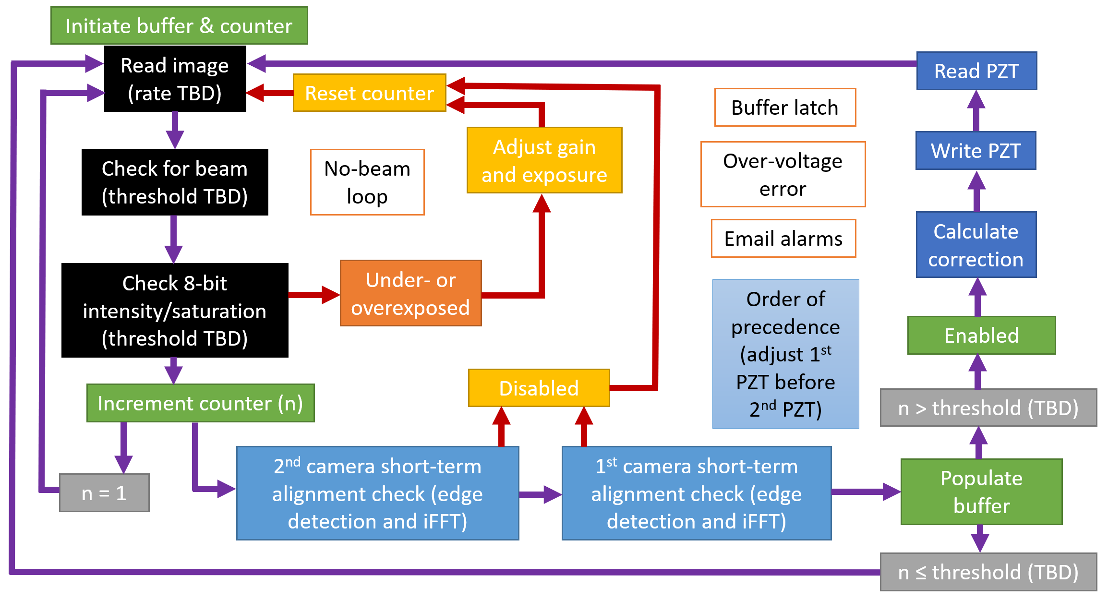
Slow-Feedback Algorithm
Built-in exception handling and camera setting

Slide 14
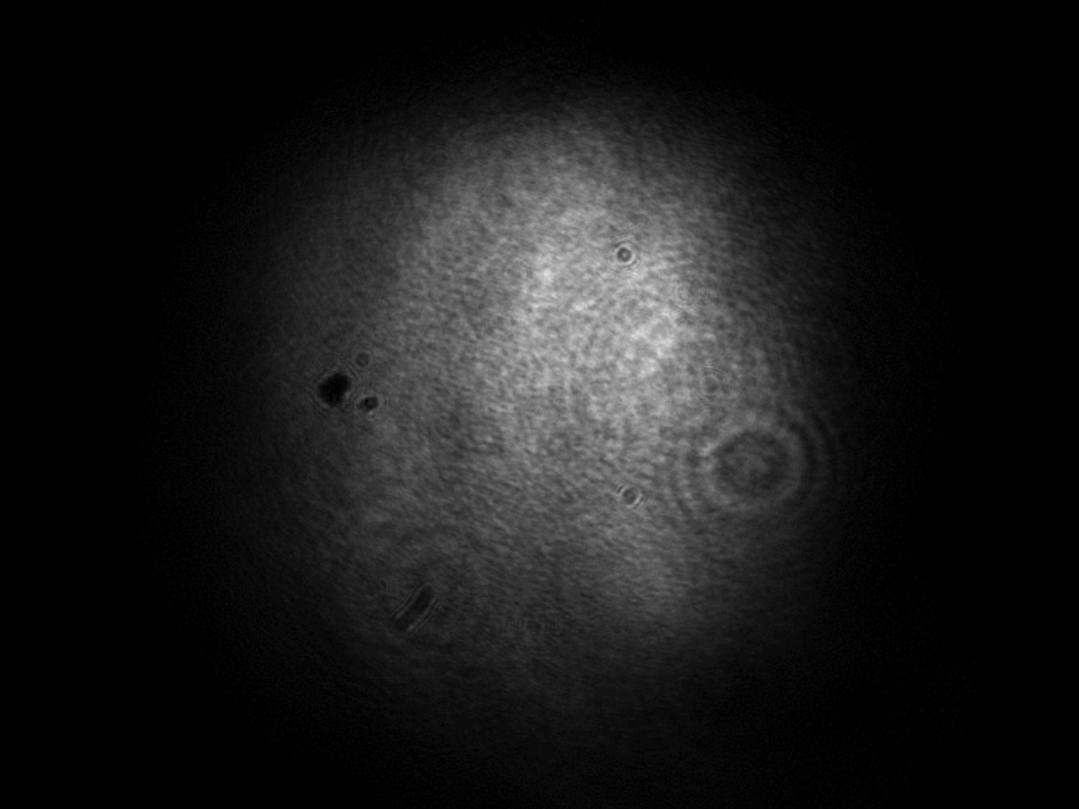
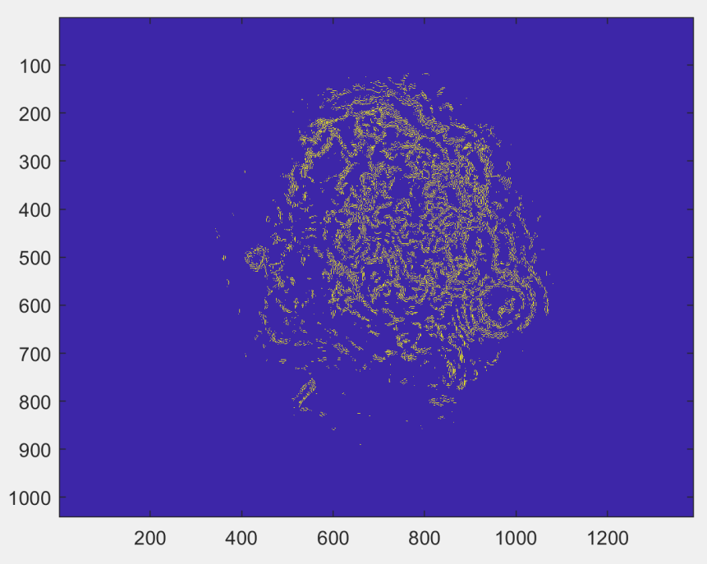
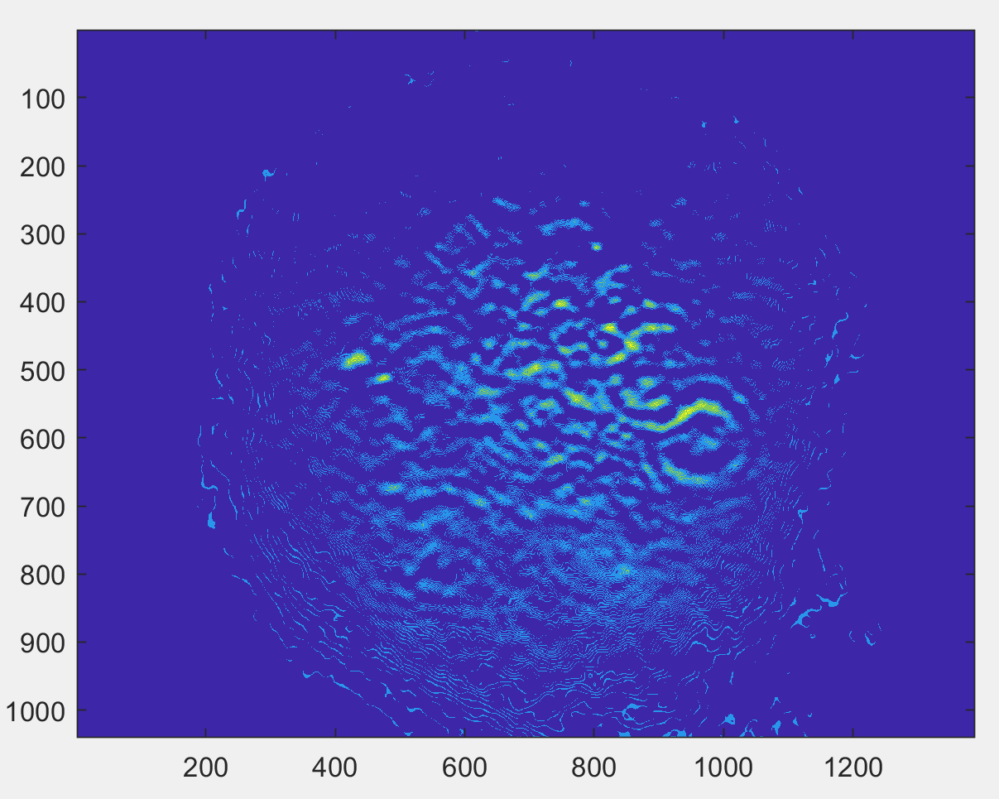
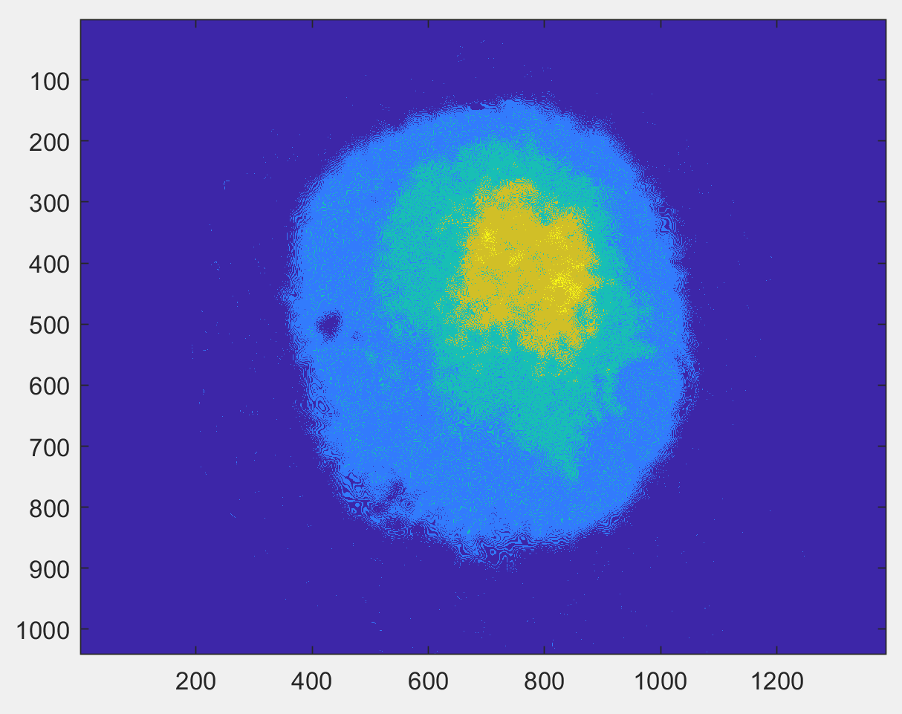
Edge-Based Image Processing
Highly structured beams are handled as easily (if not better) than purely gaussian beams
Optical artefacts, which are fixed features, essentially drop out
Image → gaussian 4-sigma linear filter → edge detect → difference → count (set threshold here)
Normal intensity fluctuations register less of a change than displacement. The opposite is true for a simple difference calculation.
LEReC beam at the start of shutdown
Example showing edge detection of 3 pixels (~16 μm)
Images showing a strict difference analysis for movement (left) and intensity change (right)

Slide 15
Summary
Addressing the fast and slow instabilities separately will allow the final dual system not to have to make unnecessary compromises, which usually come with such huge dynamic ranges
With ~2m distance in the fast-stabilization system, we can expect to achieve the <50 µm rms fast stability requirement on the aperture, which becomes the <10 µm on the cathode
Based on data collected with CeC’s transport, we have enough grain to correct the slow drift to within 25 µm (corresponding to 5 mV on the piezos), which is also within the requirement
Timeline:
Commercial fast-stabilization system is already on-site and verified as operational. Can be implemented in the trailer in about half a day once preceding stages (AOM and temporal shaping) are finalized
Cables are expected to be pulled by mid-December, and a dedicated workstation is already available. Once hardware is in place, programming can continue into run if needed (non-invasive work)

