Slide 1
Environmental Controls
1002 F Laser Building
Past – Present – Future
RHIC Tunnel @ 1002
Brian Streckenbach

Slide 2
Definitions and FYI’s
Ton – unit of cooling capacity
12,000 BTU/H
~3500 watts
HVAC unit
HVAC companies
Bard
Mitsubishi
Trane/Carrier
Laser Trailer nomenclature
Broken into two rooms
Laser Room (proper)
Foyer/ Anteroom
DX – Direct expansion
Or known as a split unit
Direct Digital Controls - DDC
Automated Logic Corporation (ALC – BNL Standard)
Building automation
Notes:
Amount of Energy to melt 1 Ton of ice in 24 hours @ 32 degrees

Slide 3
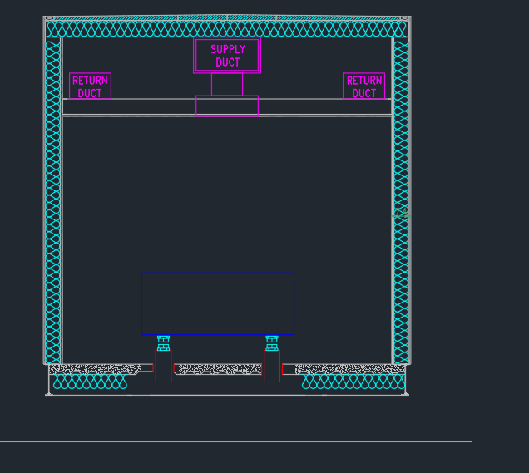
Laser Building HVAC Layout - Original
Notes:
Defines the Cooling distribution.

Slide 4
General Overview of HVAC controls (Laser Trailer)
5 Ton Bard unit (past)
Original Design
Based on original Environmental conditions
3 Ton Bard unit (Laser room) and a 2 Ton Mitsubishi unit (Anteroom) (Present)
Due to Change in heat load conditions
3 Ton Bard with Variable capacity (Future)
Separate Humidity control
Proposed 2018 Changes
Response to request for increase stability
ALC controls with ductwork modifications and HVAC overhaul.
Proposed 2019+ changes
Extensive invasive rework required; too disruptive to commissioning program

Slide 5
LEReC Laser Parameters
Parameters, and changes to Room | Temperature Regulation | Humidity Regulation | AC System Implemented
Original configuration (CeC laser only) | +/- 1 degree | 50% +/- 5 | Bard 5 Ton
Added Lasers and Chillers, Heat load in Foyer Increased | +/- 0.5 degree (winter) +/- 1 degree (summer) | 40% +/- 10% | Bard 3 Ton / Mitsubishi 2 Ton
Decouple Dehumidification from AC unit | +/- 0.5 degree (winter) +/- 1 degree (summer) | 40% +/- 5% | Added in Separate Dehumidifier
Change AC input from step input to Ramp input | +/- 0.5 degree (no 20min Cycle) | 40% +/-5% (no 20min. Cycle) | Change to Variable Capacity Bard Unit
Dedicated HVAC system with ALC control (if needed) | +/- 0.5 degree | 40% +/-2.5% | New DX unit with ALC controls
Good
Bad
Somewhere in between
Notes:
Conditions where we are

Slide 6
Original HVAC System
5 Ton cooling
4 Tons in Laser room
1 Ton in the Anteroom
6KW reheat section
Condition Changed
Issues that arose
Too much heat load in Anteroom from Chillers
Excessive temperature excursions in Anteroom and Laser room
Anteroom saw temperatures of 100 Degree F

Slide 7
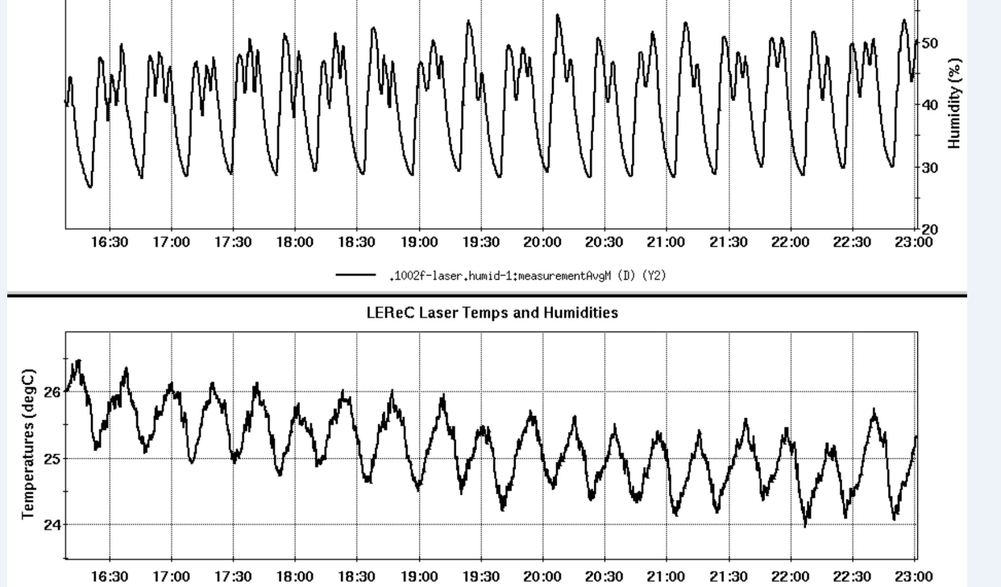
June 2017
(Laser room)
5 Ton bard unit

Slide 8
Foyer
Large temperature Rise

Slide 9
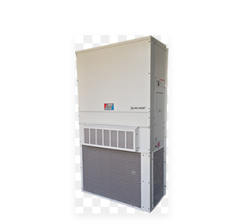
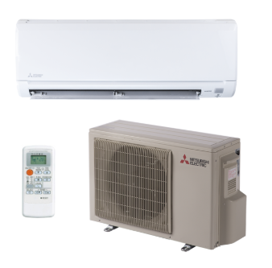
Initial Proposed Fix
Separate Cooling for Laser room and Anteroom
3 Ton Bard unit
2 Ton Mitsubishi
Mitsubishi 2 Ton
Bard 3 Ton

Slide 10
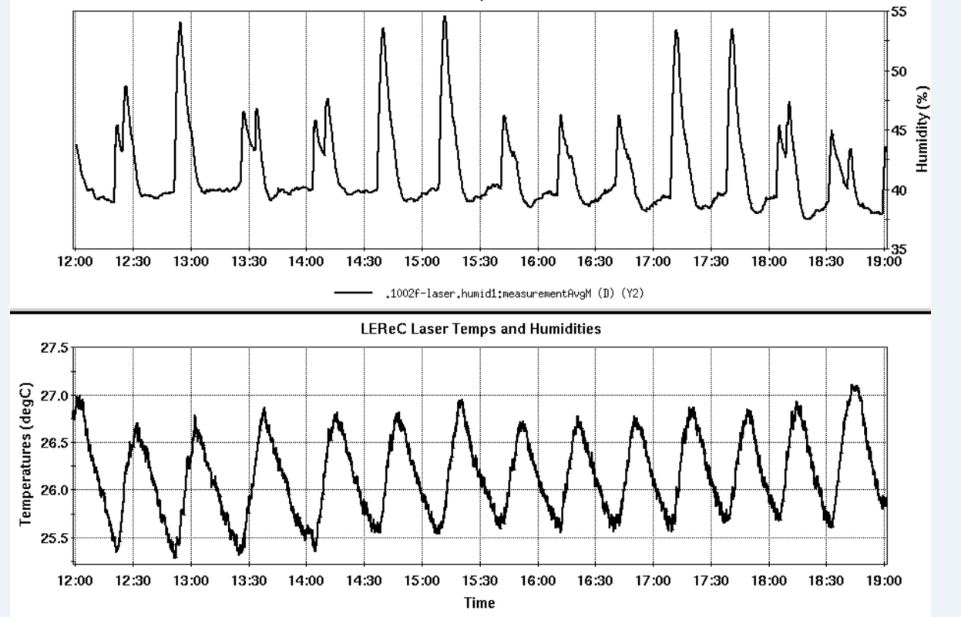
Results
August 2018
3 Ton Bard
Notes:
Greater temperature stability in anteroom and Laser room
20 Minute temperature and humidity swing cycle
Short Cycling of AC unit (Bard unit)
Due to how Bard unit functions and low load conditions in winter

Slide 11
Foyer
Mitsubishi 2 Ton – after install

Slide 12
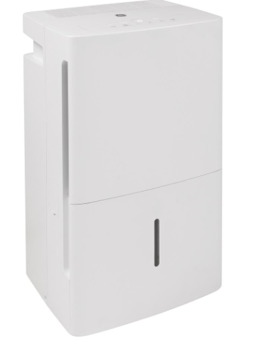
Current Changes
Place Dehumidifiers in laser room to further reduce humidity and increase environmental stability
Larger Floor unit in place now (as shown)
Replace with two wall mount up-flow units (for redundancy)
Replace the 3 Ton Bard unit with an equivalent footprint Bard unit – Variable Capacity
Variable Capacity units are terrible for Humidity control
Great for temperature stability
20% - 100% capacity
Reduce short cycling
Further increase humidity stability
Lead time for Proposed work
Delivery to BNL on Tuesday November 20th
Work completed by Friday November 23rd
Electricians
Insulation shops
Sheet metal shops
AC shop
Notes:
Decoupled the Bard unit Humidistat, and humidity coil

Slide 13
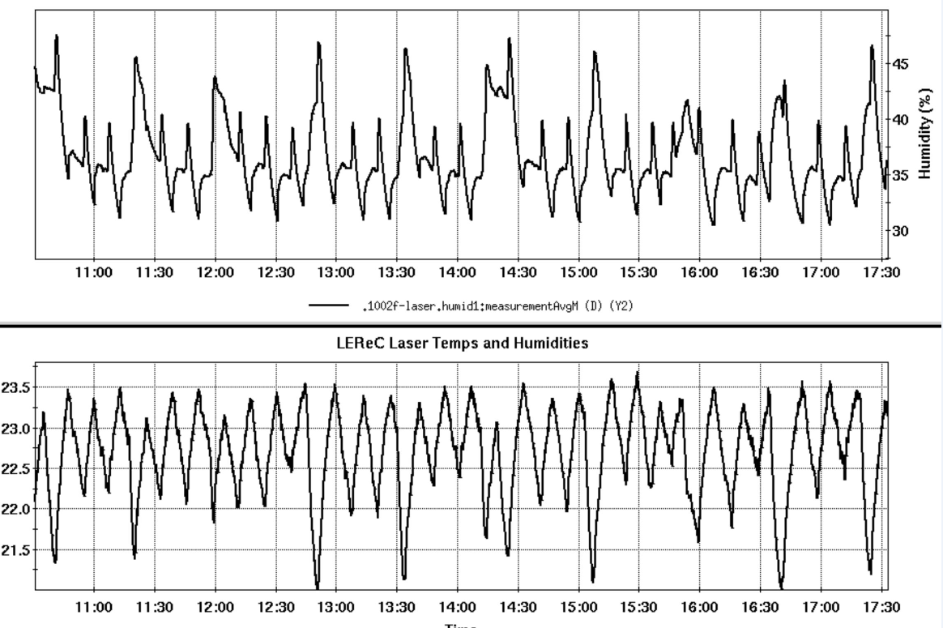
Results
September 2018
Added Dehumidifier
Notes:
Increased environmental stability
With temperature/ humidity upset
Upsets are on a small scale
Temperature anomalies do not affect system

Slide 14
Future upgrade: Variable Capacity
Variable Capacity Bard Unit
3 Ton unit – with ramp function input
Flatten out Temperature and Humidity
Trane/ Carrier system with new duct work
DX system for just the laser room
Ductwork to laser room only
Keep Mitsubishi unit
ALC control system for laser to achieve greater room stability

Slide 15
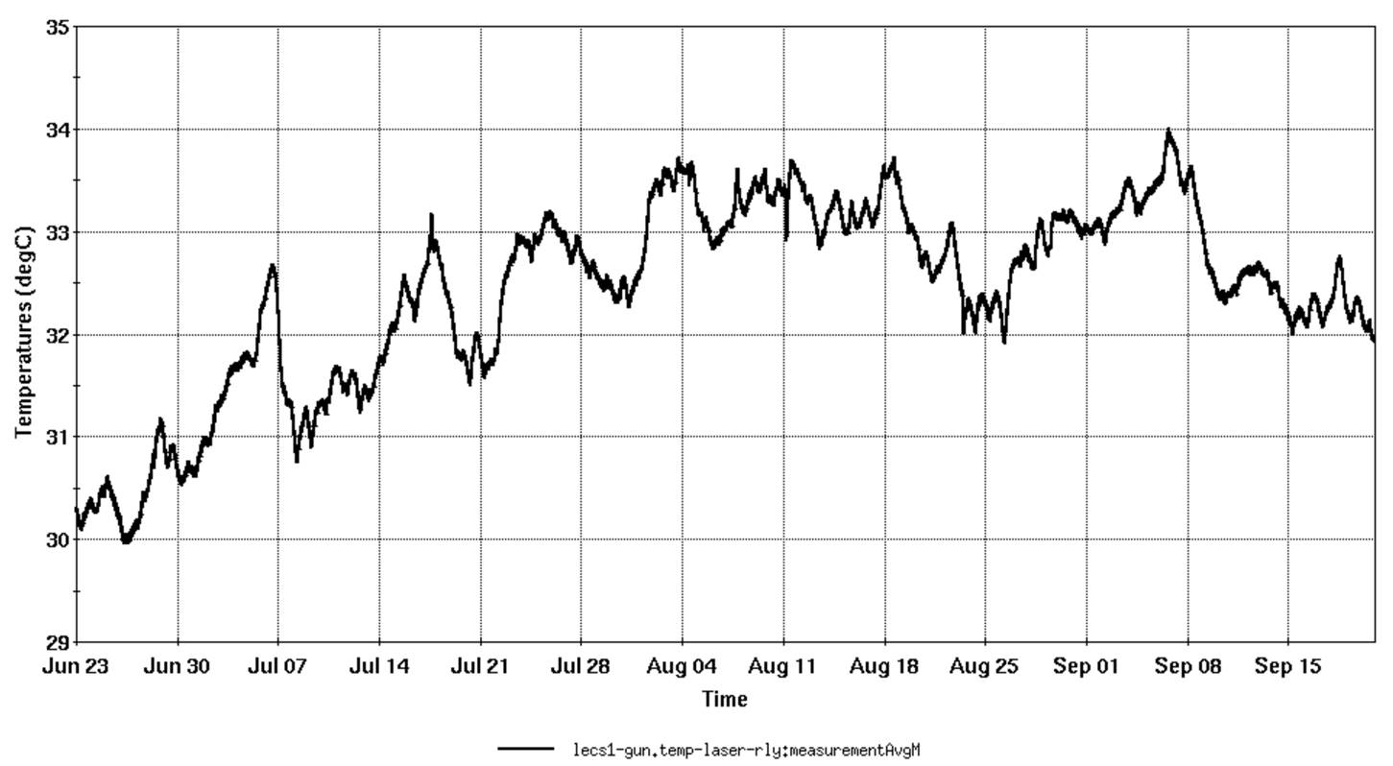
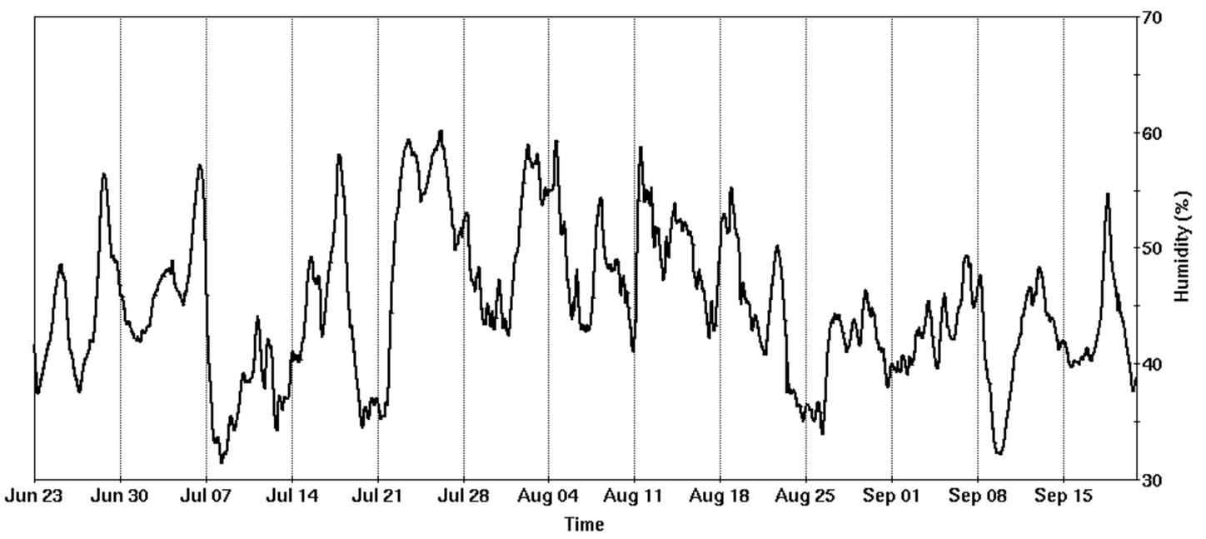
1002 Tunnel HVAC
2017 repair of AC units feeding the IR
General AC stability for 1002 IR is considered good

Slide 16
Summary
Tighter equipment requirements and new laser equipment caused original HVAC system obsolescence.
Variable Capacity bard unit will provide better environmental stability
Bard units used for more stringent requirements may not be adequate – DX/ALC alternative (backup) work plan
Notes:
DX ALC package in back pocket

