Slide 1
Progress and Technical Update
4rd OHCal steel sector order will be received at BNL Friday.
TEC (Production) accounts open for the Long Lead Time Procurement Orders
We have ordered all 100k SiPMs from Hamamatsu LLP-1
Scintillating fiber order is the next LLP-2 to be placed
The production scintillating tile LLP-3 and W powder LLP-4 orders waits for additional preproduction work.
We are working on the MVTX stave and Read Out unit order. The price is set. The order will be placed to CERN through Univ Tennessee.
Order for the SAMPA v5 multi-project run at TSMC has been placed with a lot of help from USP and SBU. Expect prototype ASIC components at USP for testing in January.

Slide 2
Issues to Address
The Chinese institutions, particularly Fudan and U Peking, want to commit to building the forward eta coverage for the EMCal.
They would like to send BNL funds to purchase the scintillating fibers and SiPMs for this part of their portion of the production.
GSI/FAIR/CBM wants to get in on our buy of the FELIX boards. They need to send funds to BNL to participate.
BNL did not succeed in getting a contract placed with IMEC for the SAMPA production. Future SAMPA orders with IMEC will get placed through SBU.
Need to replace our chief mech engineer Don Lynch who is retiring in one month.
Awarding the tile production contract with Uniplast may be challenging but is very important to the project. John Lajoie recently visited Uniplast and was impressed by their facility. They have made 24 pilot tiles for us that will be tested by us at BNL/GSU. They have started on the 1500 preproduction tiles.

Slide 3
sPHENIX MVTX Integration Review
Will be either Nov 19 or 20. The date is driven by Ming’s availability. John Haggerty is organizing the review.

Slide 4
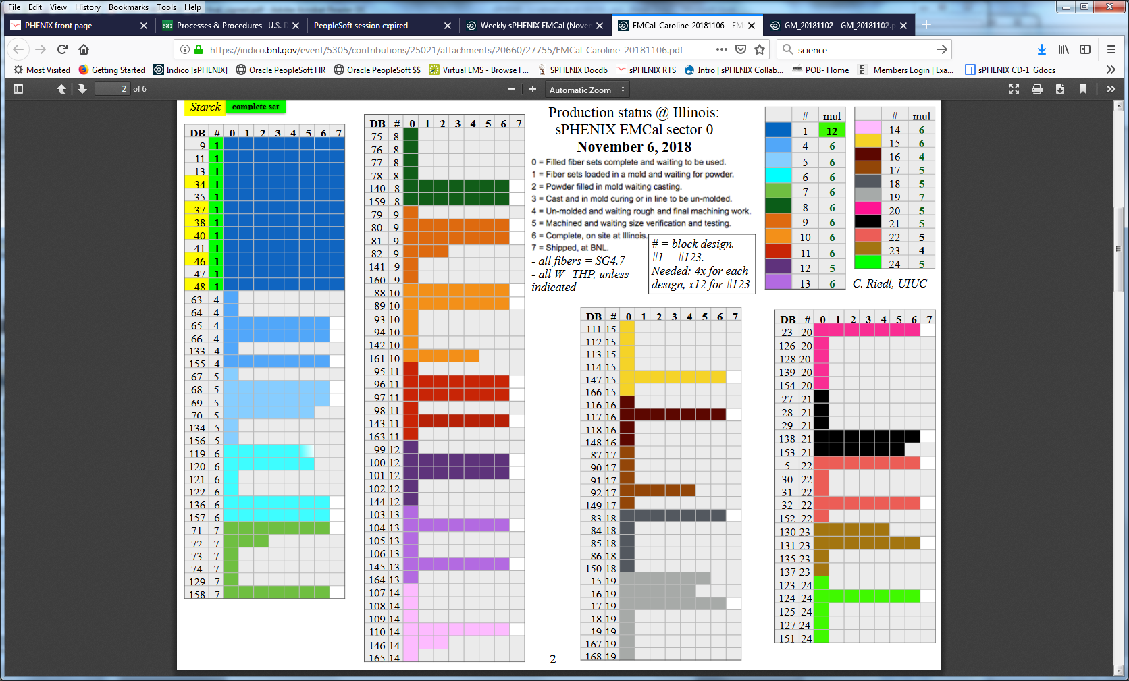
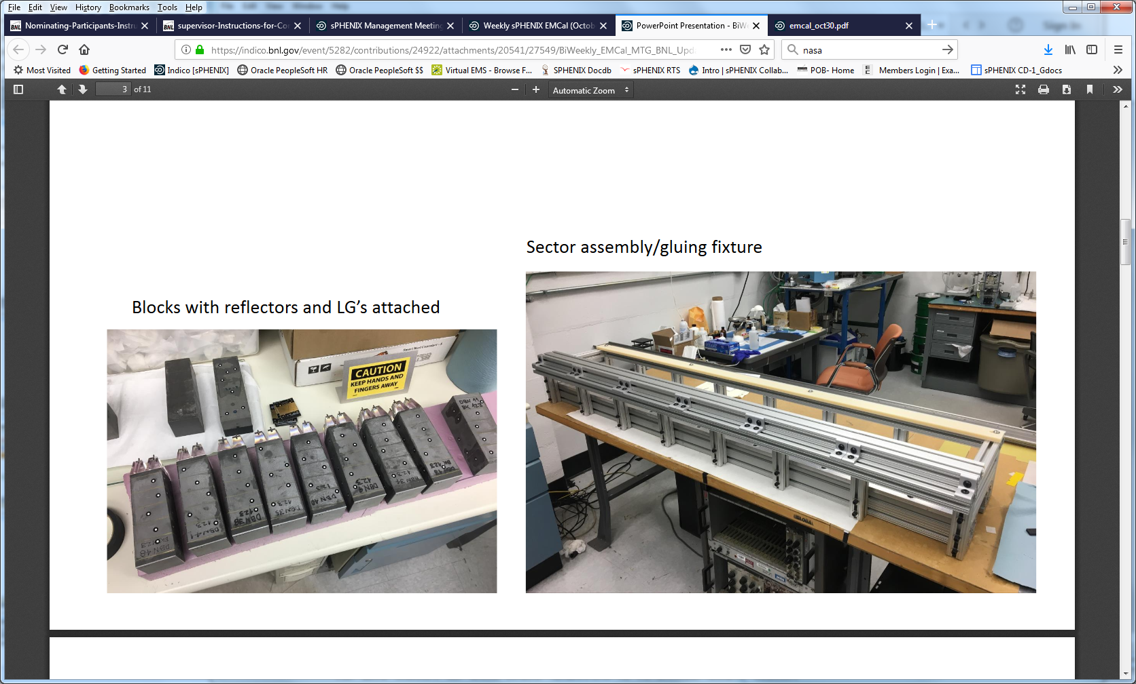
EMCal Sector 0

Slide 5
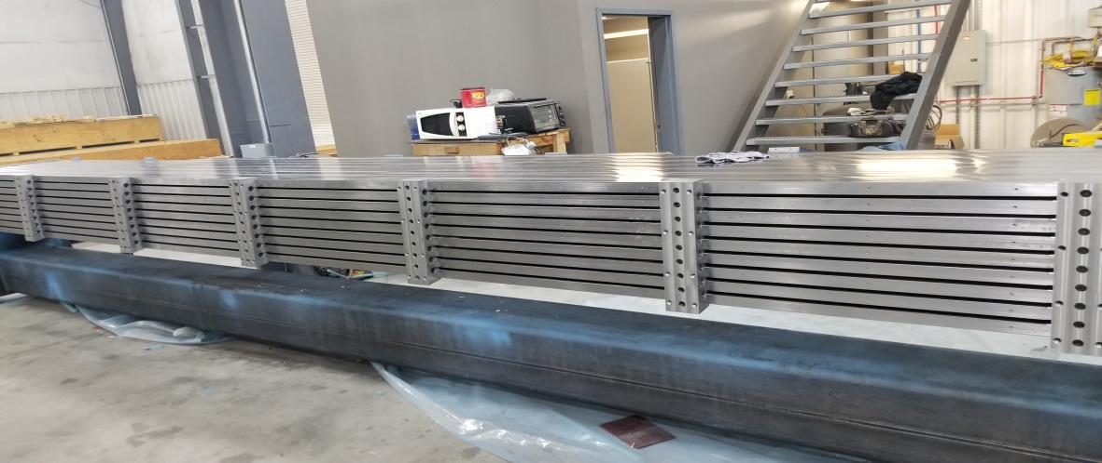
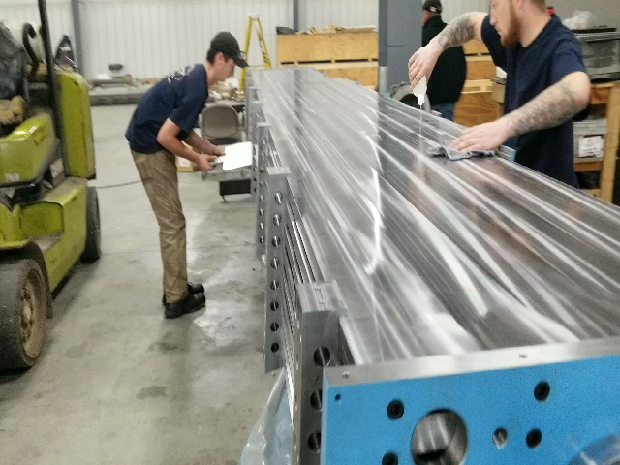
sPHENIX Barrel Magnet Steel/ HCal

Slide 6
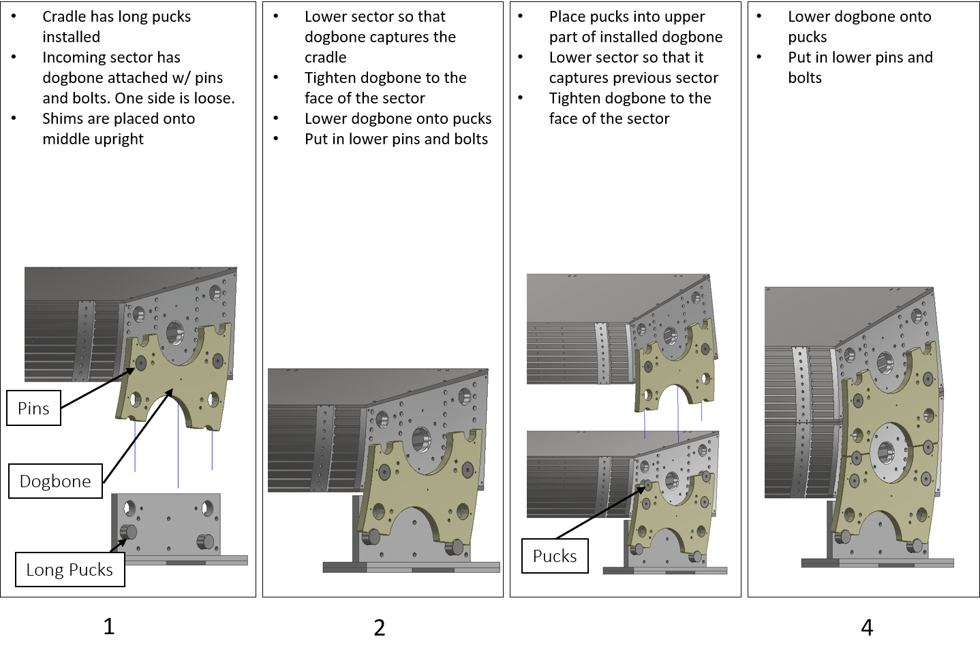
Technical Progress on HCal
Assembly test procedure for the outer HCAL sectors using the go/no-go cradle. One sector will be fit into the cradle, with additional sectors being test fit to the first sector using the “dogbones” and pucks.

Slide 7
Status of MoA/MoU’s
All BNL MoA’s MoU’s written and signed except
One MoA subcontract remains to be written: CAD 1008 conventional facilities. We have had 2-3 meetings with CAD to agree on the scope of each task.
Water
Electrical power
HVAC
Safety systems
Gas
Beam pipe
etc
MoA with SMD has been written with signatures started. Need signature of new SMD Division Director.

Slide 8
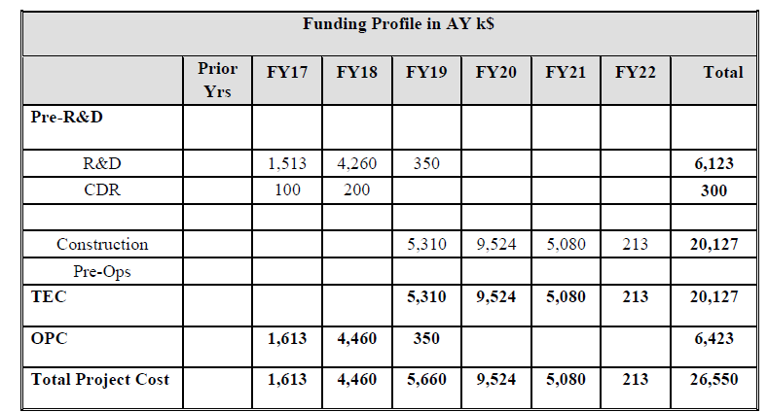
sPHENIX Funding Profile
We will receive the full FY19 allocation this year. To date we have received 1/12 of the total. The funds go primarily to the four LLPs but a small amount is available for post PD-3 purchases in Q4FY19. The OPC procurements continue with FY18 carry over.

Slide 9
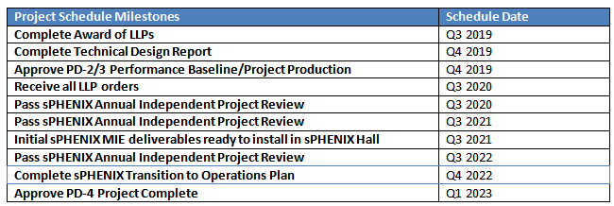
Project Schedule Milestones as Potential PEMPs

