Slide 1
OpenAFS changes required for IPA migration.
OpenAFS DB and fileservers will be using the rxkad-k5 authentication model.
afs@RHIC.BNL.GOV Kerberos service principal will be replaced by afs/rhic.bnl.gov@SDCC.BNL.GOV
Only OpenAFS 1.6.5 and newer clients will be able to authenticate and get an AFS token.
OpenAFS clients will have to use the SDCC.BNL.GOV Kerberos realm instead of the current RHIC.BNL.GOV realm.
The KDC servers will be idm05.sdcc.bnl.gov, idm06.sdcc.bnl.gov, idm07.sdcc.bnl.gov.
Automatic OpenAFS token retrieval on login will not work anymore after the IPA upgrade.
Changing Kerberos password will only be allowed on the SSH user gateways after the IPA upgrade.

Slide 2
[root@rcas6005 ~]# kinit raot
Password for raot@RHIC.BNL.GOV:
[root@rcas6005 ~]# aklog
[root@rcas6005 ~]# klist -e
Ticket cache: KEYRING:persistent:0:0
Default principal: raot@RHIC.BNL.GOV
Valid starting Expires Service principal
11/15/2018 09:23:43 11/20/2018 09:23:36 afs@RHIC.BNL.GOV
renew until 11/22/2018 09:23:36, Etype (skey, tkt): des-cbc-crc, des-cbc-crc
11/15/2018 09:23:40 11/20/2018 09:23:36 krbtgt/RHIC.BNL.GOV@RHIC.BNL.GOV
renew until 11/22/2018 09:23:36, Etype (skey, tkt): aes256-cts-hmac-sha1-96, aes256-cts-hmac-sha1-96
OpenAFS Security Advisory 2013-003
The weakness of DES's 56 bit key space has long been
known, however it has recently become possible to use that weakness
to cheaply (around $100) and rapidly (approximately 23 hours) compromise
a service's long term key.

Slide 3
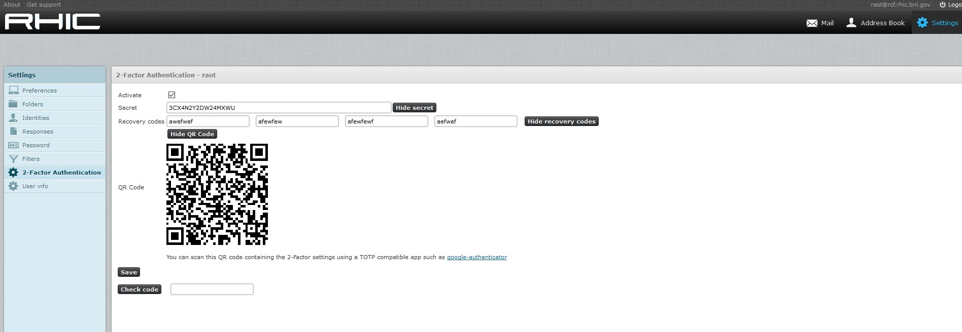
Two factor authenticator for Roundcube

