Slide 1
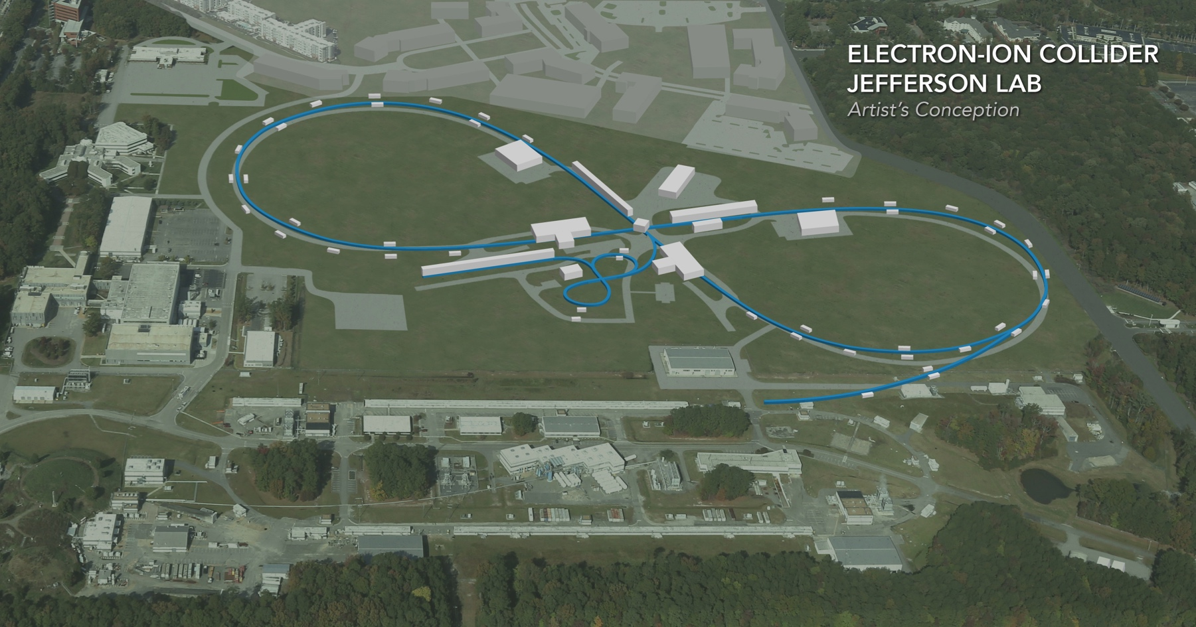
JLEIC Machine Parameters Critical for Polarimetry
Vasiliy Morozov
Inaugural Meeting for the EIC Polarimeter WG
November 30, 2018

Slide 2
Outline
Electron polarization
Electron beam parameters and bunch structure
Polarization scheme
Polarization life time and top off
Polarimetry setup
Ion polarization
Polarization scheme
Zero-integer spin resonance
3D spin rotator
Bunch structure
Polarimetry setup and calibration

Slide 3
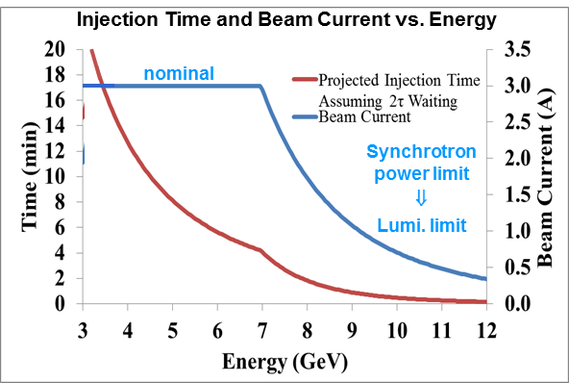
Electron Beam Parameters
Electron beam
3 A at up to 7 GeV
Normalized emittance 58 µm @ 5 GeV
Synchrotron power density < 10 kW/m
Total power up to 10 MW
Beam energy | GeV | 3 | 5 | 6.9 | 9 | 10 | 12
Beam current | A | 3 | 3 | 3 | 1 | 0.69 | 0.33
Total SR power | MW | 0.4 | 2.7 | 9.6 | 9.3 | 9.8 | 9.7
Energy loss per turn | MeV | 0.12 | 0.88 | 3.2 | 9.3 | 14.2 | 29.4
Energy spread | 10⁻⁴ | 2.8 | 4.6 | 6.4 | 8.4 | 9.3 | 11.1
Transverse damping time | ms | 389 | 84 | 32 | 14 | 11 | 6
Longitudinal damping time | ms | 194 | 42 | 16 | 7 | 5 | 3
Normalized Emittance | um | 13 | 58 | 152 | 337 | 462 | 799

Slide 4
Electron Bunch Structure
Electron injection scheme: f_{ring} / f_{CEBAF} = 476.3 MHz / 1497 MHz = 7 / 22
Bunch structure in the electron collider ring
injector pulse train up polarization from gun
injector pulse train down polarization from gun
68.05MHz bunch train, 3.6µs 247 bunches (I_{pulse} up to 1 mA @ 5GeV)
14.69 ns, 68.05 MHz (22 CEBAF buckets, 7 ring buckets)
2.1ns, 476.3 MHz (1 ring bucket)
1ps, 14.7 pC bunch
……
……
Waiting for damping or kicker recovery 10-400ms
Waiting for damping or kicker recovery 10-400ms
I_{ave} = 44 nA
3.6 μs (1714 bunches, 5.9 nC/bunch up to 7 GeV)
rms bunch length is 1 cm
3.6 μs (1714 bunches, 5.9 nC/bunch up to 7 GeV)
rms bunch length is 1 cm
0.16 μs
(78 empty bunches)
0.16 μs
(78 empty bunches)
2.1 ns (476.3 MHz)
…
…
7.52 μs (132.9 kHz, ~2.26 km, 2.8 A)

Slide 5
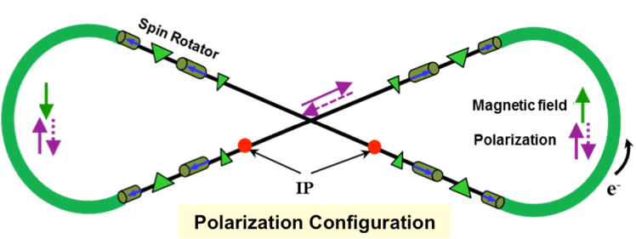
Electron Polarization
Two highly polarized bunch trains maintained by top-off
Universal spin rotator
Minimizes spin diffusion by switching polarization between vertical in arcs and longitudinal in straights
Two polarization states with equal lifetimes
Basic spin match

Slide 6
Radiative Polarization Effects
Sokolov-Ternov polarization change rate
$$τ_{ST}^{−1}=\frac{5\sqrt{3}}{8}\frac{r_{e}γ^{5}h/2π}{m_{e}}\frac{1}{C}\oint{ds{\left\langle \frac{1−\frac{2}{9}{\left(\hat{n}⋅\hat{s}\right)}^{2}}{{\left|ρ\left(s\right)\right|}^{3}}\right\rangle }_{s}}$$
$\hat{n}$ is the invariant spin field, a 1-turn periodic unit 3-vector field over the phase space satisfying the T-BMT equation along particle trajectories, $\hat{s}$ is a unit vector along the particle velocity, and $2πℏ$ is Planck’s constant.
Depolarization rate due to spin diffusion
$$τ_{SD}^{−1}=\frac{5\sqrt{3}}{8}\frac{r_{e}γ^{5}h/2π}{m_{e}}\frac{1}{C}\oint{ds{\left\langle \frac{{11\left({∂\hat{n}}/{∂δ}\right)}^{2}}{18{\left|ρ\left(s\right)\right|}^{3}}\right\rangle }_{s}}$$
${∂\hat{n}}/{∂δ}$ is the spin-orbit coupling function
Total polarization change rate
$$τ_{DK}^{−1}=τ_{ST}^{−1}+τ_{SD}^{−1}$$
Equilibrium polarization
$$P\left(t\right)=P_{ens,DK}\left(1−e^{−t/{τ_{DK}}}\right)+P_{0}e^{−t/{τ_{DK}}}$$
where $P_{ens,DK}=P_{DK}{\left\langle \hat{n}\right\rangle }_{s}$ is the value of ensemble average of $P_{DK}$ independent of $s$ and $P_{0}$ is the initial polarization
Average over phase space,
emittance dependent

Slide 7
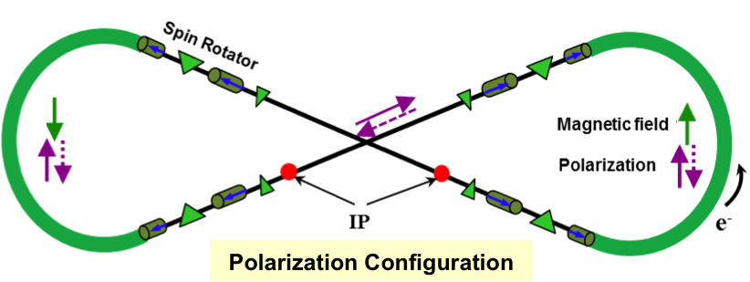
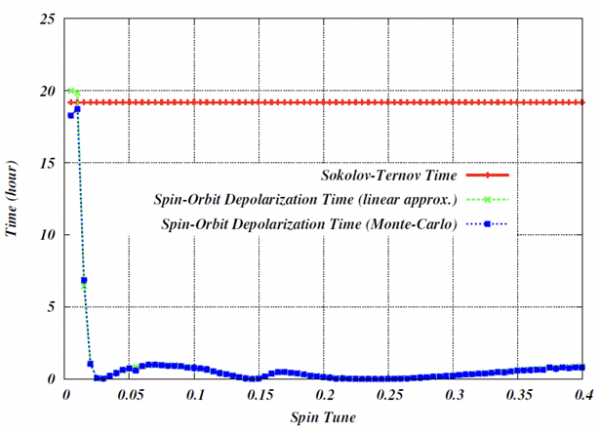
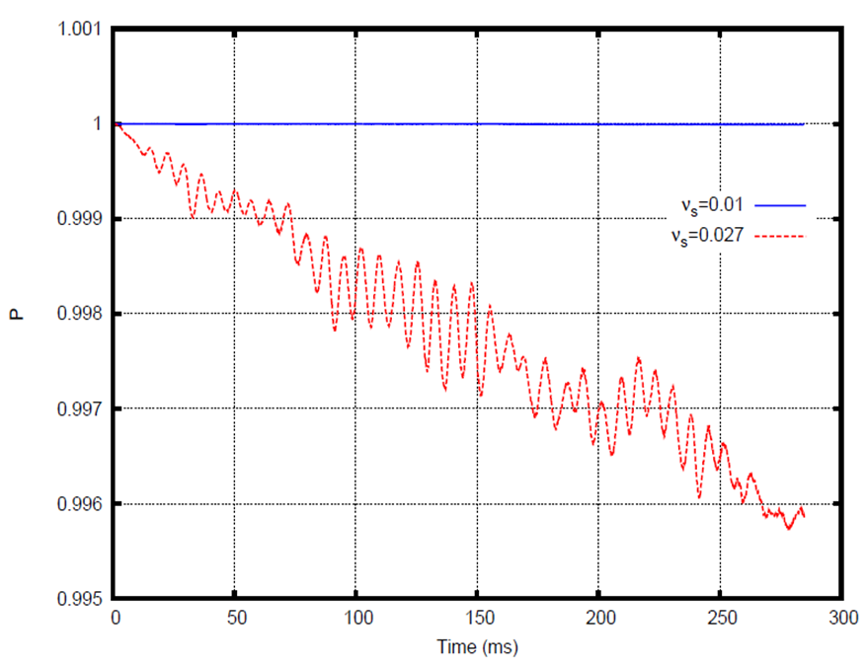
Spin Tracking
Spin tune scan using a spin tuning solenoid in SLICK/SLICKTRACK
Demonstrates suppression of synchrotron sideband spin resonances
Verified by Zgoubi’s Monte-Carlo spin tracking
Spin tuning solenoid
ν_{s}=0.01 (optimum spin tune)
ν_{s}=0.027 (synchrotron tune)
Spin tune scan using SLICKTRACK
Synchrotron sideband spin resonances suppressed compared to a racetrack
Spin tracking using ZGOUBI.
~ 3τ_{x,y}

Slide 8
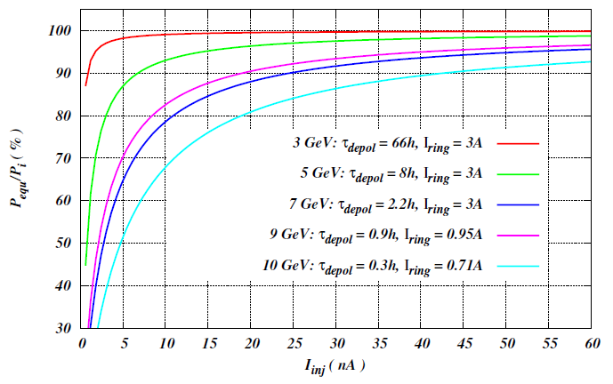
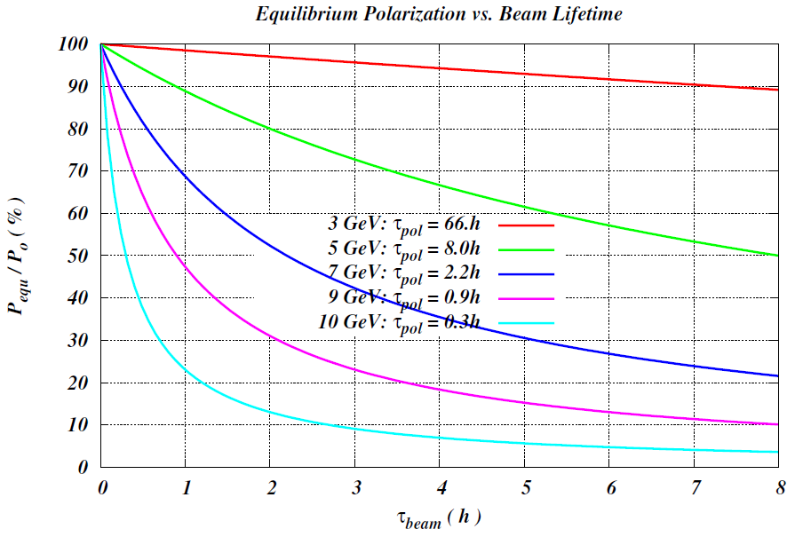
Polarization Lifetime and Continuous Injection
Estimated polarization lifetime
Constant polarization is maintained by continuous injection of highly polarized electron beam from CEBAF
Equilibrium polarization $P_{equ}=P_{0}{\left(1+\frac{T_{rev}I_{ring}}{τ_{DK}I_{inj}}\right)}^{−1}$
A relatively low average injected beam current of tens-of-nA level can maintain a high equilibrium polarization in the whole energy range
Beam lifetime must be balanced with the beam injection rate and $τ_{beam}≪τ_{pol}$
Energy (GeV) | 3 | 5 | 7 | 9 | 12
Lifetime (hours) | 116 | 9 | 1.7 | 0.5 | 0.1

Slide 9
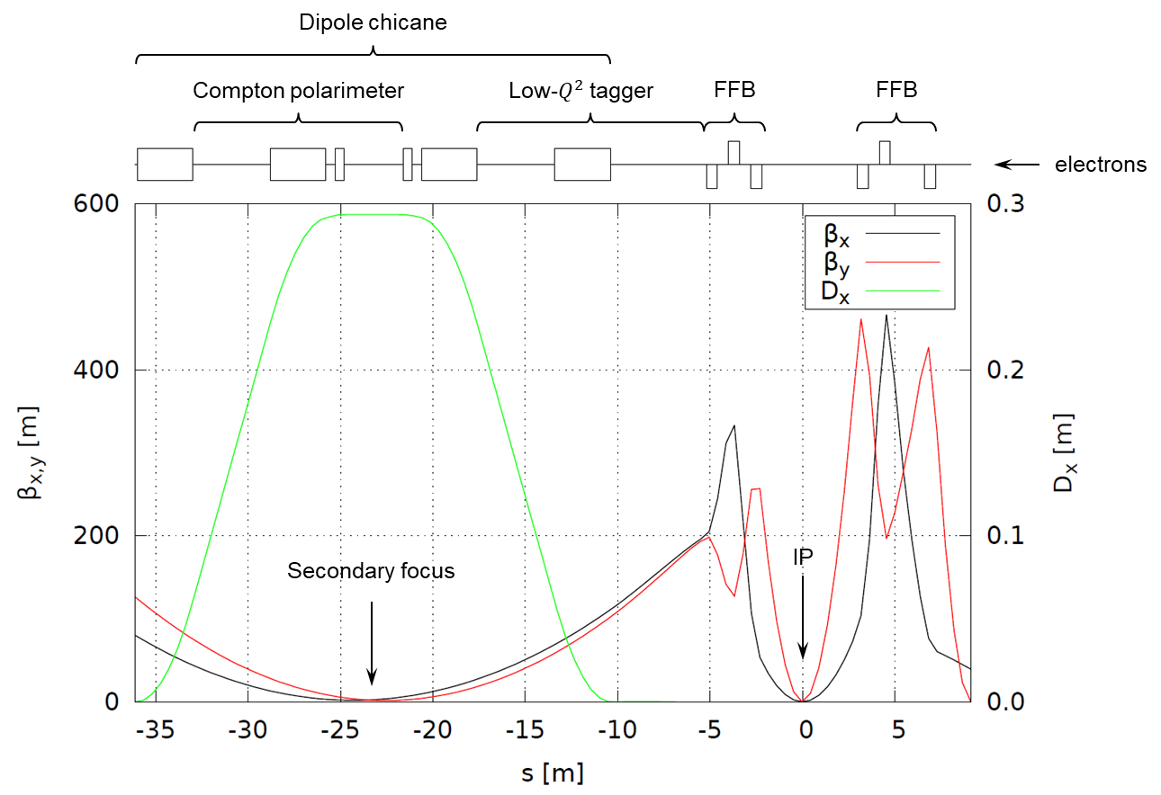
Polarization Measurement
Dipole chicane downstream of IP: same polarization at laser as at IP due to zero net bend
Compton polarimetry: non-invasive monitoring of electron polarization
Optics optimized for polarimetry

Slide 10
Discussion of Electron Polarization Measurement Requirements
Ideally, one would like to have a bunch-by-bunch luminosity and polarization measurement. However, this is difficult and one should consider relaxing this requirement.
The two electron polarization states have the same life times. Beam lifetime is short compared to Sokolov-Ternov time. Even in case of error, equilibrium asymmetry would be negligible. Any error in spin rotator setting would manifest itself in reduction of polarization life time. It would be beneficial to have a direct measurement of vertical polarization in the arcs for spin rotator setup. This also have the benefit of cross checking the Compton polarimeter.
Polarizations of the bunches in each train should be the same. Processes that can vary polarization along the train are:
Systematic variation of polarization along the injected train. This can be tested experimentally.
RF transient and collective effect such as ion instability. They do not affect the polarization directly. The impact on polarization may come through change in emittance. This can be studied in simulations.
With the above caveats, it may be sufficient to measure the average polarization of each train.

Slide 11
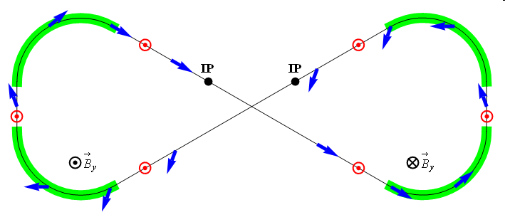
Ion Polarization
Figure-8 concept: Spin precession in one arc is exactly cancelled in the other
Without additional fields, spin rotation is a priori unknown and occurs only due to closed orbit excursion and beam emittances
Spin stabilization by small fields: ~3 Tm vs. ~1200 Tm for deuterons at 100 GeV
Criterion: induced spin rotation >> spin rotation due to orbit errors
3D spin rotator: combination of small rotations about different axes provides any polarization orientation at any point in the collider ring
No effect on the orbit
Polarized deuterons
Frequent adiabatic spin flips
ν = 0

Slide 12
Zero-Integer Spin Resonance and Spin Stability Criterion
Total zero-integer spin resonance strength
$${\vec{w}}_{0}={\vec{w}}_{coherent}+{\vec{w}}_{emittance} , \left|{\vec{w}}_{emittance}\right|≪\left|{\vec{w}}_{coherent}\right|$$
is composed of
coherent part $w_{coherent}$ due to closed orbit excursions (due to imperfections); it does not lead to depolarization but causes coherent spin rotation about a priori unknown direction
incoherent part $w_{emittance}$ due to transverse and longitudinal emittances (proportional to beam emittance), it causes spin tune spread potentially leading to depolarization
Spin stability criterion
the spin tune induced by a spin rotator must significantly exceed the strength of the incoherent part of the zero-integer spin resonance
$$ν≫\left|{\vec{w}}_{emittance}\right|$$
for proton beam $ν_{p}={10}^{−2}$
for deuteron beam $ν_{d}={10}^{−4}$

Slide 13
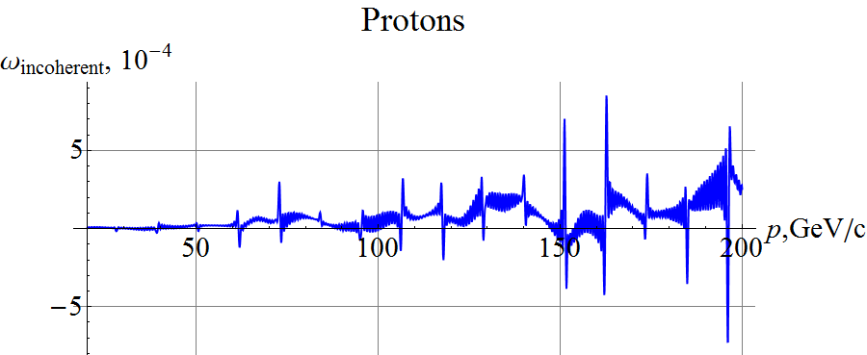
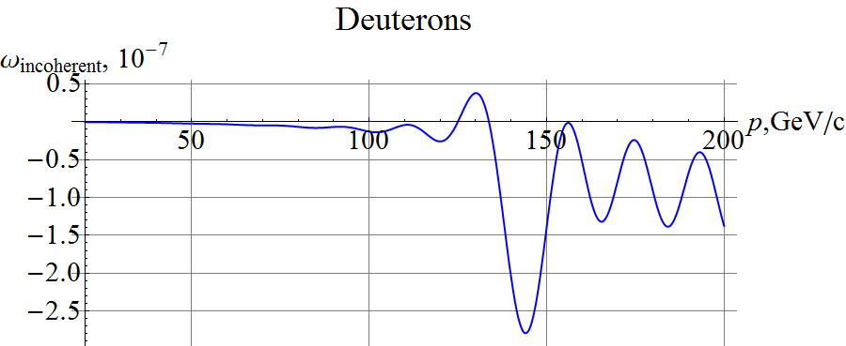
Incoherent Part of Zero-Integer Spin Resonance Strength
$ν_{p}^{max}=0.5⋅{10}^{−2}$, $ν_{d}^{max}=0.5⋅{10}^{−4}$ at 200 GeV/c are sufficient to stabilize the polarization
Assuming normalized vertical beam emittance of 0.07 μm rad

Slide 14
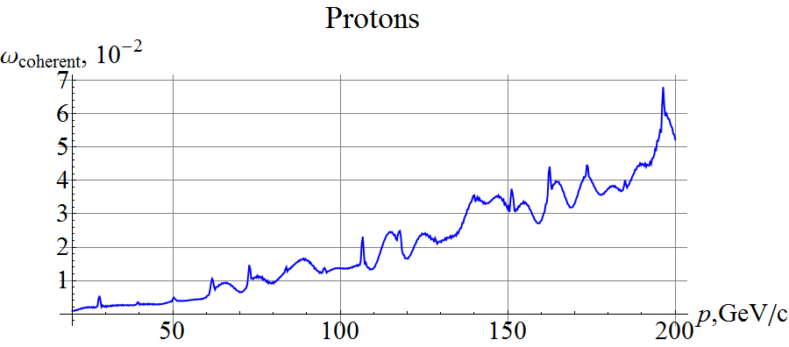
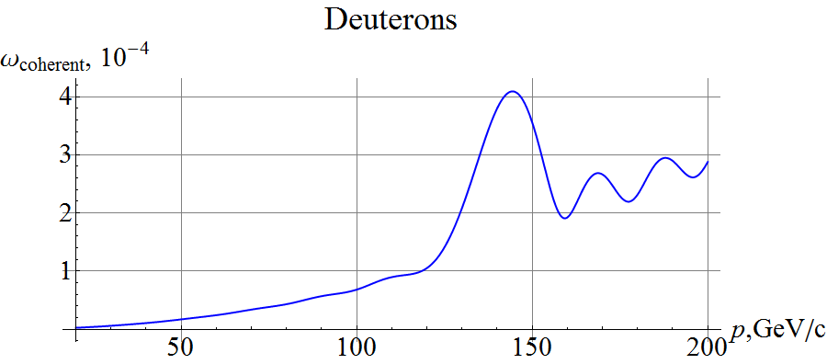
Coherent Part of Zero Integer Spin Resonance Strength
The coherent component does not depolarize the beam. However, it has to be compensated or taken into account when setting the polarization direction.
Assuming RMS closed orbit distortion of ~200 μm

Slide 15
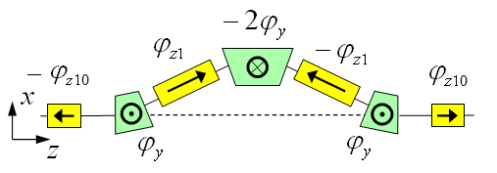
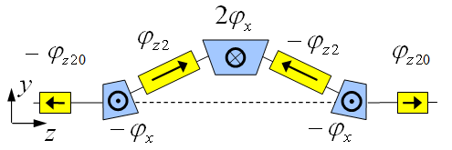
3D Spin Rotator in Ion Collider Ring
Provides control of the radial, vertical, and longitudinal spin components
Module for control of radial component (fixed radial orbit bump)
Module for control of vertical component (fixed vertical orbit bump)
Module for control of longitudinal component
Can be placed anywhere and has no effect on optics
3D spin rotator
$$L_{tot}=7 m, Δx=16 mm, B_{dip}^{max}=3 T, B_{sol}^{max}=2 T$$
IP
ions
$$L_{x}=L_{y}=0.6 m, L_{zi}=2 m,$$
$$L_{zi0}=1 m, α_{orb}={0.31}^{∘}$$

Slide 16
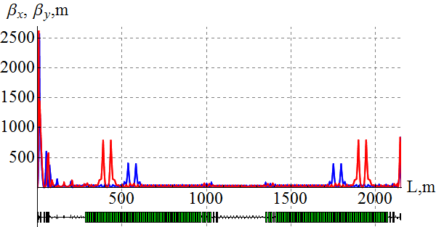
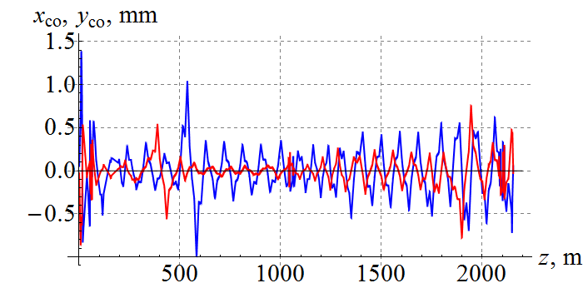
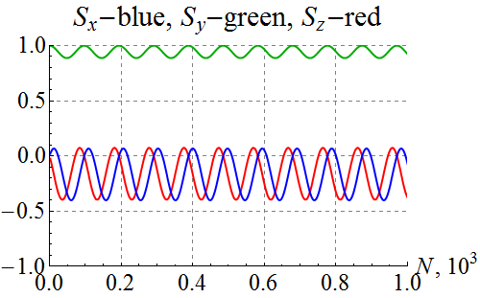
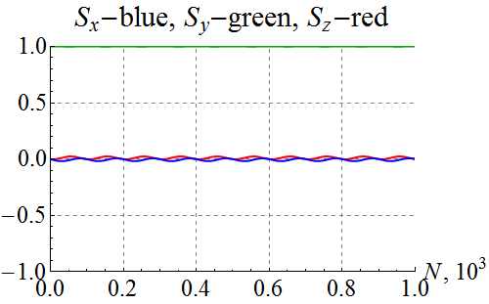
Polarization Control in Ion Collider Ring
100 GeV/c figure-8 ion collider ring with transverse quadrupole misalignments
Example of vertical proton polarization at IP. The 1st 3D rotator: ν = 10⁻² , n_{y}=1. The 2nd 3D rotator is used for compensation of coherent part of the zero-integer spin resonance strength
1st 3D rotator for control
2nd 3D rotator for compensation
without compensation
with compensation

Slide 17
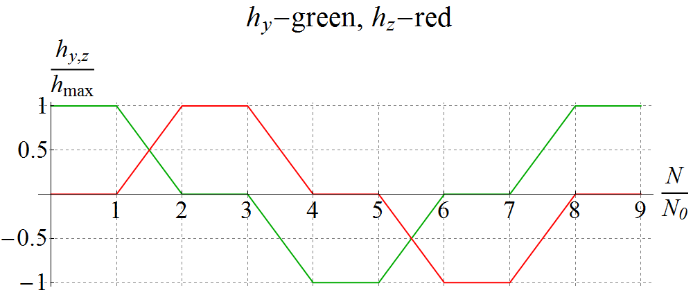
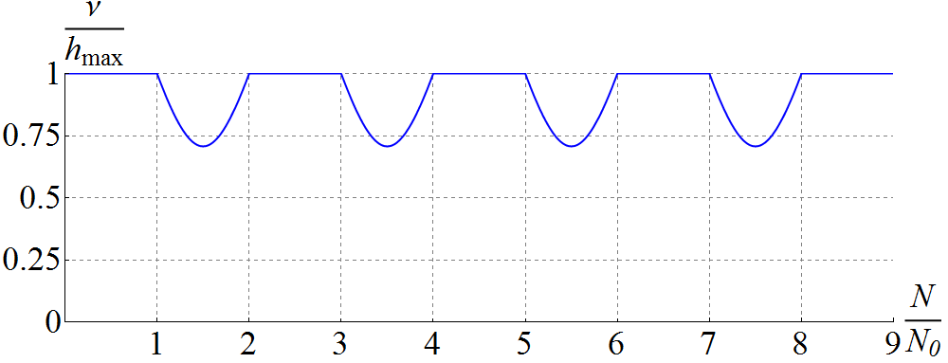
Spin Flipping
Adiabaticity criterion: spin reversal time must be much longer than spin precession period ⇒ τ_{flip} >> 1 ms for protons and 0.1 s for deuterons
Vertical (h_{y}) & longitudinal (h_{z}) spin field components as set by the spin rotator vs time ⇒ Spin tune vs time (changes due to piece-wise linear shape)
$N$ is the number of particle turns
Vertical & longitudinal components of proton polarization vs time at 100 GeV/c
$$\vec{P}:↑ → ↓ ← ↑$$
Zgoubi
simulation
$$N_{0}=50⋅{10}^{3}$$

Slide 18
Ion Bunch Structure
Ion bunch formation
Injection bunches may be prepared with different polarizations
Each injection bunch is split in half up to 7 times
Bunch structure in the ion collider ring

Slide 19
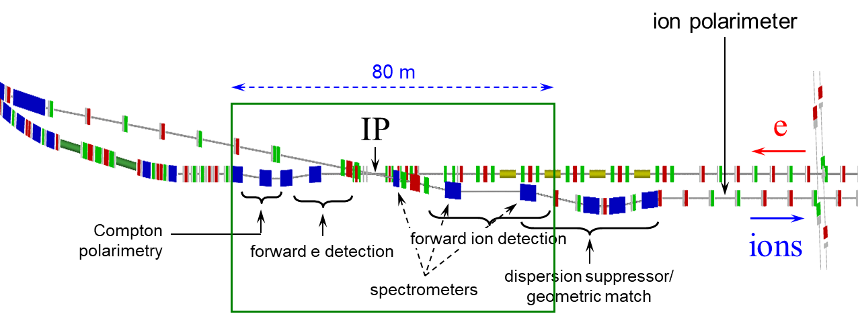
Ion Polarimeter Location
Ion polarization in the straight section upstream of the IP is the same at the IP, however:
Polarimeter target would generate detector background
Polarimeter only measures transverse polarization, placing polarimeter upstream does not help with measurement of the longitudinal polarization
Polarization is rotated at any other potential polarimeter location
Determining polarization at IP becomes a question of knowing
Polarization rotation angle from IP to polarimeter
Polarization orientation at the polarimeter
Calibration of the spin rotator

Slide 20
Extracting Polarization at IP
Polarization rotation from IP to the polarimeter
$$θ_{sp}^{IP→Pm}=Gγθ_{orb}^{IP→Pm}$$
$$Δθ_{sp}=\sqrt{{\left(Gγ\right)}^{2}Δθ_{orb}^{2}+{\left(Gγθ_{orb}\right)}^{2}{\left(\frac{Δγ}{γ}\right)}^{2}}$$
$θ_{orb}$ should be small, e.g. polarimeter placed in the straight downstream of IP
$$Gγ\sim {10}^{2}, Δθ_{orb}\sim {10}^{−3}, θ_{orb}\sim {10}^{−1}, \frac{Δγ}{γ}\sim {10}^{−2} ⇒ Δθ_{sp}\sim {10}^{−1}, \sim 6^{∘}$$
What precision level of polarization alignment is required at the IP?
Polarization orientation at the polarimeter and spin rotator calibration
$$P_{Pm}=P\sin\left(θ_{sp}^{Pm}\left(B_{sol}^{1}, B_{sol}^{2}\right)\right)$$
Experimentally measure $P_{Pm}$ as a function of $B_{sol}^{1}$ and $B_{sol}^{2}$ and extract calibration of $θ_{sp}^{Pm}$ in terms of $B_{sol}^{1}$ and $B_{sol}^{2}$

Slide 21
Spin Rotator Calibration
Without limiting the generality, assume that the spin rotator is in the same straight as the polarimeter and consider polarization on the orbit plane
Polarization at the polarimeter
$${\vec{P}}_{Pm}=P_{0} \frac{\left[ν_{x}\left(BL_{x}\right)+w_{x}\right] {\vec{e}}_{x}+\left[ν_{z}\left(BL_{z}\right)+w_{z}\right]{\vec{e}}_{z}}{\sqrt{{\left[ν_{x}\left(BL_{x}\right)+w_{x}\right]}^{2}+{\left[ν_{z}\left(BL_{z}\right)+w_{z}\right]}^{2}}}$$
where
$$ν_{x}\left(BL_{x}\right)=\frac{\sin\left(Gγα_{y}\right)}{π}\frac{(1+G)}{Bρ}BL_{x}≡C_{x}BL_{x} , ν_{z}\left(BL_{z}\right)=\frac{\left(1+G\right)}{2πBρ} BL_{z}=C_{z}BL_{z}$$
are the spin rotations (normalized to $2π$) in the radial and longitudinal modules of the spin rotator
The polarimeter measures
$${\left(P_{Pm}\right)}_{x}=P_{0} \frac{ν_{x}\left(BL_{x}\right)+w_{x}}{\sqrt{{\left[ν_{x}\left(BL_{x}\right)+w_{x}\right]}^{2}+{\left[ν_{z}\left(BL_{z}\right)+w_{z}\right]}^{2}}}=P_{0}\frac{BL_{x}+{w_{x}}/{C_{x}}}{\sqrt{{\left(BL_{x}+{w_{x}}/{C_{x}}\right)}^{2}+{\left(C_{z}BL_{z}/C_{x} +{w_{z}}/{C_{x}}\right)}^{2}}}$$
Polarization angle at the polarimeter
$$θ_{Pm}=\operatorname{atan}\left(\frac{BL_{z}{C_{z}}/{C_{x}}+{w_{z}}/{C_{x}}}{BL_{x}+{w_{x}}/{C_{x}}}\right)$$

Slide 22
Spin Rotator Calibration
Assume that polarization behaves according to ${\left(P_{Pm}\right)}_{x}$ formula on previous page
Assume typical parameters of a 100 GeV/c proton beam
Assume that polarization is measured with a random error of 0.02 rms
Fit randomly generated data to ${\left(P_{Pm}\right)}_{x}$ formula and extract input parameters
Parameter | Input | Fit
$$P_{0}$$ | $$0.8$$ | $$0.803±0.003 (0.35\%)$$
$w_{x}/C_{x}$ (Tm) | $$0.2183$$ | $$0.2185±0.0007 (0.31\%)$$
$$C_{z}/C_{x}$$ | $$0.582$$ | $$0.590±0.007 (1.24\%)$$
$w_{z}/C_{x}$ (Tm) | $$0.131$$ | $$0.132±0.002 (1.31\%)$$

Slide 23
Discussion of Ion Polarization Measurement Requirements
It is difficult to resolve individual bunches in a polarimeter with JLEIC’s short bunch spacing
It may be possible to measure polarizations of individual bunch trains
There are 26 trains of 128 bunches each
Individual bunches within each train have identical polarizations because of the way they are formed
Polarimeter data may be gated during transitions between trains
Variation of the bunch polarization along a train can be caused by variation in the bunch emittances due to RF transient and beam instabilities. However, impact of emittance on the polarization stability is negligible. We were not able to observe any effect of higher-order spin resonances in simulations.
The RHIC scheme with a fast relative polarimeter and a slow absolute polarimeter appears adequate.
Since it is hard to distinguish the individual bunches, one may consider using scalers counting all particles for each train and then calibrating detection efficiencies and effective analyzing powers. This may be adequate if the polarimeter background is constant.
To simplify polarized beam setup, there should be additional polarimeters at the source, after the linac, and in the booster.

Slide 24
BACKUP

Slide 25
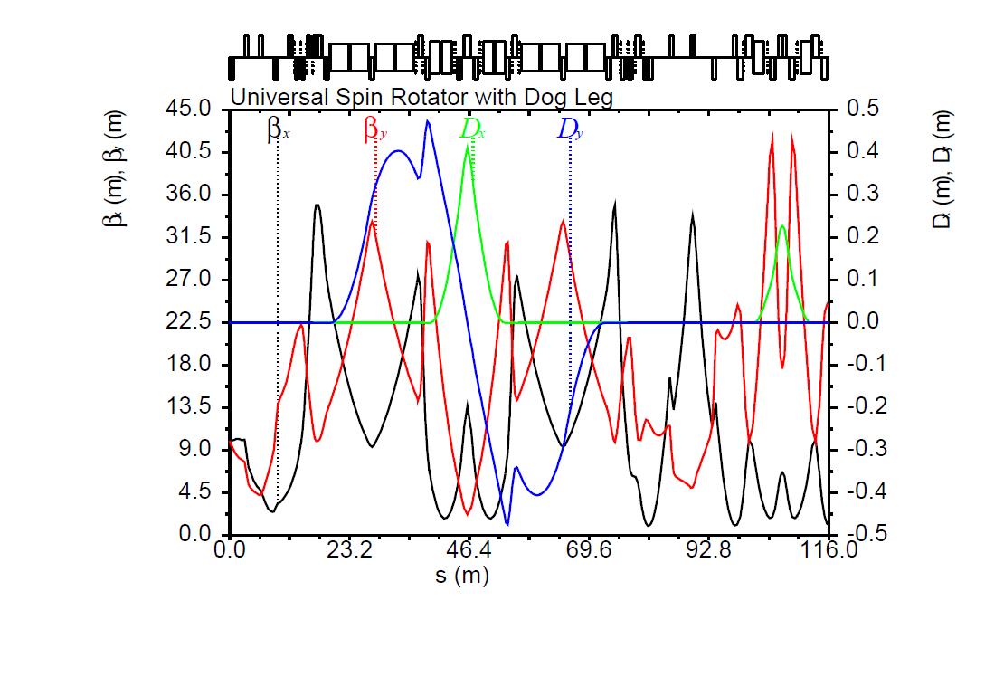
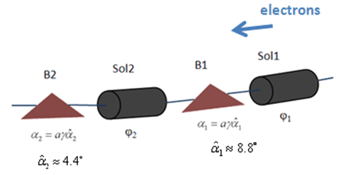
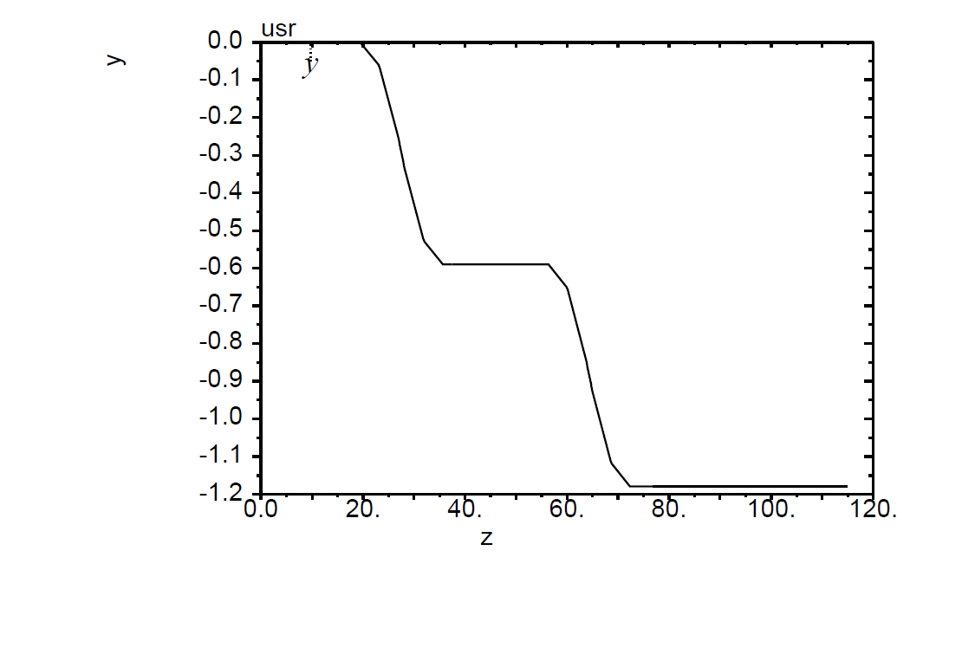
Electron Spin Rotators with Doglegs
Universal spin rotator
Sequence of solenoid and dipole sections
Geometry independent of energy
Vertical dogleg 2
Arc
IP
$$\vec{s}$$
$$\vec{s}$$
Vertical dogleg 1
E | Solenoid 1 |  | Dipole set 1 | Solenoid 2 |  | Dipole set 2
 | Spin Rotation | BDL | Spin Rotation | Spin Rotation | BDL | Spin Rotation
GeV | rad | T·m | rad | rad | T·m | rad
3 | π/2 | 15.7 | π/3 | 0 | 0 | π/6
4.5 | π/4 | 11.8 | π/2 | π/2 | 23.6 | π/4
6 | 0.62 | 12.3 | 2π/3 | 1.91 | 38.2 | π/3
9 | π/6 | 15.7 | π | 2π/3 | 62.8 | π/2
12 | 0.62 | 24.6 | 4π/3 | 1.91 | 76.4 | 2π/3
Sol. 1 + dec. skew quads + matching quads
Sol. 2 + dec. skew quads + matching quads
Vertical dogleg 2
Vertical dogleg 1
Horizontal DBA 1
Horizontal DBA 2

