Slide 1

Measuring PDFs at an EIC
Relevant Papers all published in PRD:
Collinear PDFs: arXiv:1902.10663
Helicity:: arXiv:1509.06489 & arXiv:1309.5327
TMD: arXiv:1805.05290
GPD: arXiv:1304.0077
Electron Ion Collider

Slide 2


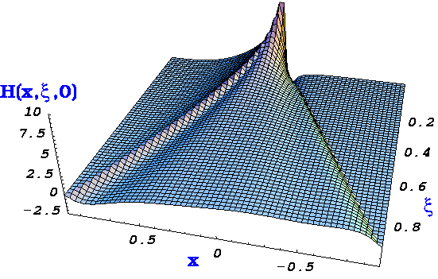

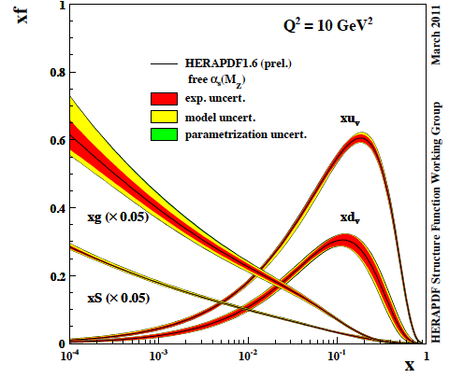
The Path to Imaging Quarks and Gluons
Wigner function
4+1-D
not related by
Fourier transf.
2+1-D
transv. mom. dep. PDF
impact par. dep. PDF
generalized PDF
semi-inclusive DIS
exclusive processes
1-D
parton densities
form factor
Questions:
PDFs at high x → searches at high mass @ LHC
flavor separation at high and low x → strangeness
Proton spin puzzle → helicity PDFs
2+1d momentum and spatial structure → TMDs and GPDs
non-pertubative sea-quark structure → ubar < dbar, Δubar > Δdbar, δubar > δdbar or δubar < δdbar ?

Slide 3
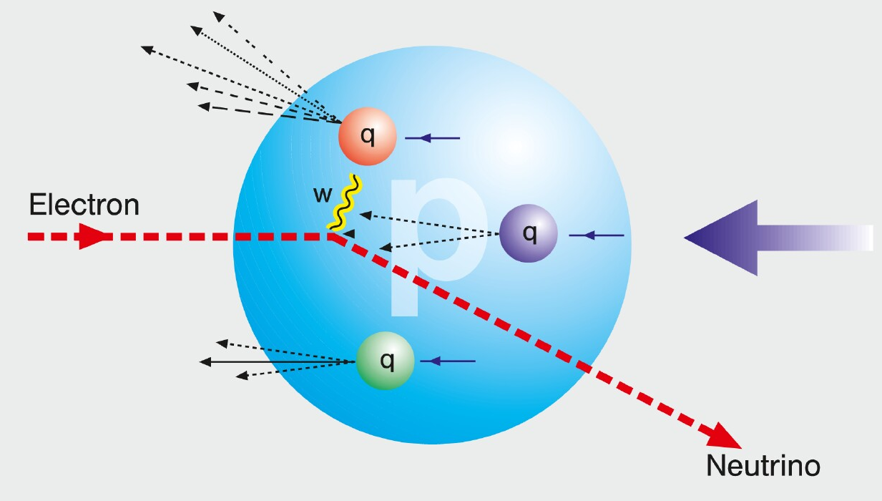
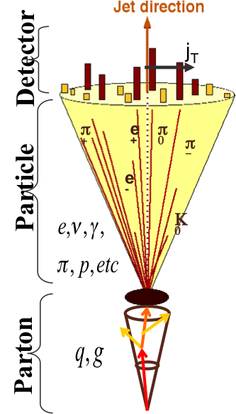
HOW TO ACCESS PARTONS IN DIS
SIDIS:
Detect identified hadrons in coincidence to
scattered lepton
needs fragmentation functions to correlate
hadron type with parton
→ Detector: PID over a wide range of η
Charge Current:
W-exchange: direct access to the quark flavor
no FF – complementary to SIDIS
→ Detector: large rapidity coverage and large √s
Jets:
tag sea-quarks through the sub-processes and
jet substructure
→ Detector: large rapidity coverage and PID

Slide 4
How to access Gluons in DIS
Several different complementary channels to access gluons
Scaling Violation
all x-Q² x_{g} = x_{Bj}
only limited by detector acceptance
Scaling Violation | F_{L}
all x-Q² x_{g} = x_{Bj} | only accessible if y is large x_{g} = x_{Bj}
only limited by detector acceptance | need several beam energies
 |  | Photon Gluon Fusion
Scaling Violation | F_{L} | Di-jets
all x-Q² x_{g} = x_{Bj} | only accessible if y is large x_{g} = x_{Bj} | wide coverage in x_{Bj}-Q² x_{g} =x_{Bj}(1+M²/Q²⁾ > x_{Bj}
only limited by detector acceptance | need several beam energies | need a wide acceptance detector
 |  | Photon Gluon Fusion
Scaling Violation | F_{L} | Di-jets | Charm
all x-Q² x_{g} = x_{Bj} | only accessible if y is large x_{g} = x_{Bj} | wide coverage in x_{Bj}-Q² x_{g} =x_{Bj}(1+M²/Q²) > x_{Bj} | same coverage in x_{Bj}-Q² as incl. F₂ x_{g} ≳x_{Bj}
only limited by detector acceptance | need several beam energies | need a wide acceptance detector | needs excellent m-vertex detector and particle ID

Slide 5

The inner life of hadrons
Parton distribution functions

Slide 6
Proton PDFs at high x
A. Accardi et al.
Baseline: CJ-15
Relative error improvement:
pseudo-data for 0.01 < x < 0.9
NC Cross sections on
proton target
F₂^{n} from deuterium with
tagged proton spectator
10x100 GeV² at 100 fb⁻¹,
energy scan √s=57, 49, 28 GeV
at 10 fb⁻¹
→ more studies in progress

Slide 7
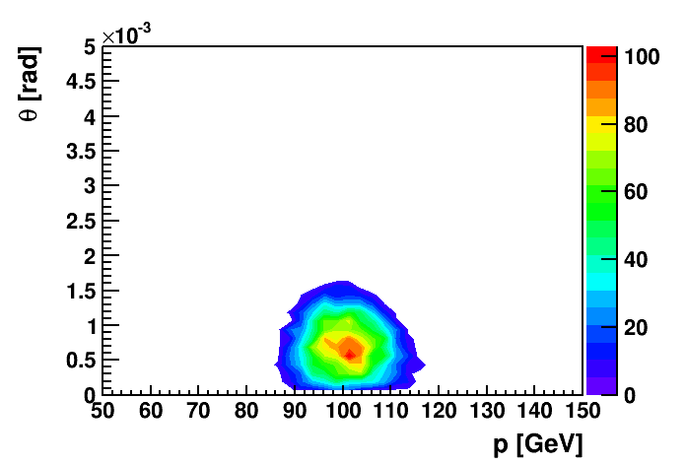
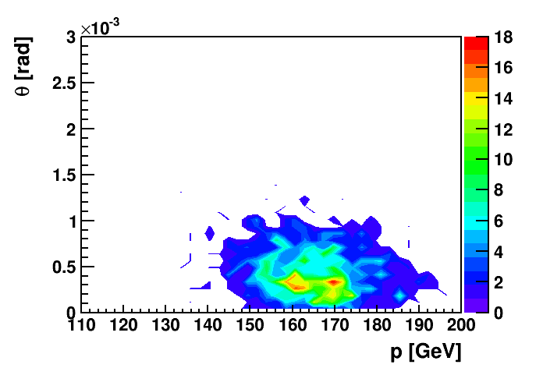
Observables: Charge Current in ep and eA
W-exchange:
direct access to the quark flavor
Ws are maximally parity violating
→ Ws couple only to one parton helicity
Complementary to SIDIS:
high Q²-scale: > 100 GeV²
best way to measure at very high x
extremely clean theoretically
No Fragmentation function
stringent test on theory
approach for SIDIS
UNIVERSALITY of PDFs
EIC:
first time charge current physics
in polarized ep and eA collisions
effective neutron target:
(un)polarized Deuterium or /and He-3
through tagging the spectator proton(s)
Deuterium spectator protons:
He-3 spectator protons:
10 GeV x 100 GeV
10 GeV x 166 GeV

Slide 8
Observables: Charge Current in ep
EIC has a large kinematic coverage for charge current events ( )

Slide 9

CC@EIC: Impact on PDFs
Generated 10 fb⁻¹ worth of ep CC events with DJANGOH for 20 GeV x 250 GeV
is used to get the impact on PDFs
good agreement between pseudo-data and prediction

Slide 10
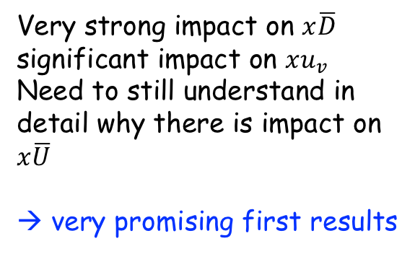
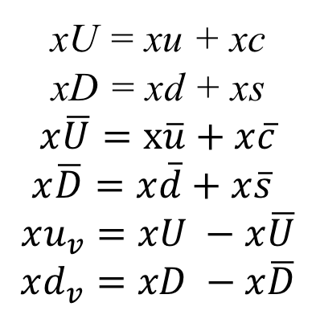
Impact of CC@EIC to PDFs
xU = xu + xc
xD = xd + xs
$$x\overline{U}=x\overline{u}+x\overline{c}$$
$x\overline{D}=x\overline{d}+x\overline{s}$
$$xu_{v}=xU −x\overline{U}$$
$$xd_{v}=xD −x\overline{D}$$
Very strong impact on $x\overline{D}$
significant impact on $xu_{v}$
Need to still understand in detail why there is impact on $x\overline{U}$
→ very promising first results

Slide 11
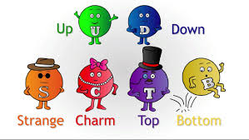
Access the Flavor Structure: SIDIS

Slide 12
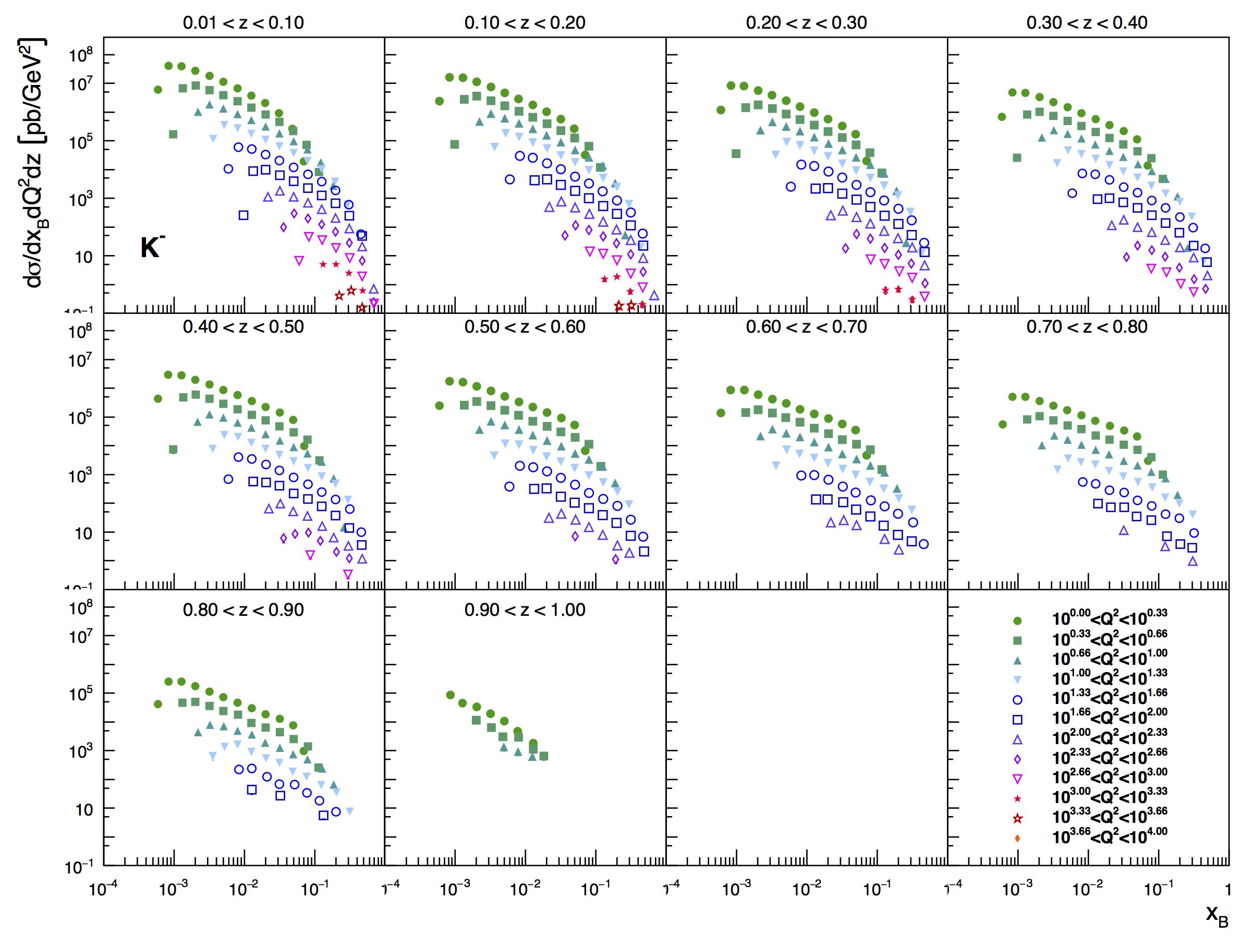
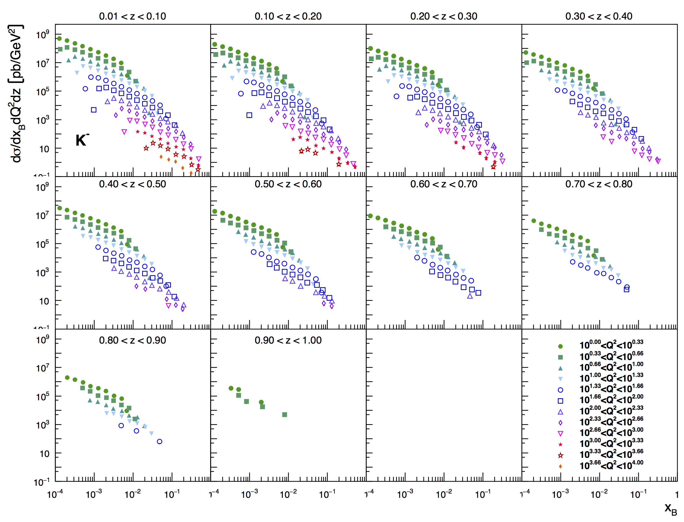
What can SIDIS@EIC Teach us
very precise 3d cross section
covering a wide kinematics in
z,x,Q²
5 GeV x 100 GeV
20 GeV x 250 GeV

Slide 13
PDFs: flavor separation from SIDIS@EIC
Use reweighting method to define EIC SIDIS data impact on
collinear unpolarized PDFs and Fragmentation functions
δ𝓞 : exp. uncertainty
Observable
Correlation factor of observable 𝓞 to a flavor i
account for
uncertainties
Δ PDF in Observable

Slide 14
PDF Constrain from SIDIS@EIC
√s=45 GeV
√s=145 GeV
Impressive constrain of
light quarks for x < 0.1
need to investigate x>0.1 more
→ impact grows with √s

Slide 15
PDF Constrain from SIDIS@EIC
√s=45 GeV
√s=145 GeV
If you want to know
s-PDF ask the EIC
→ impact grows with √s

Slide 16
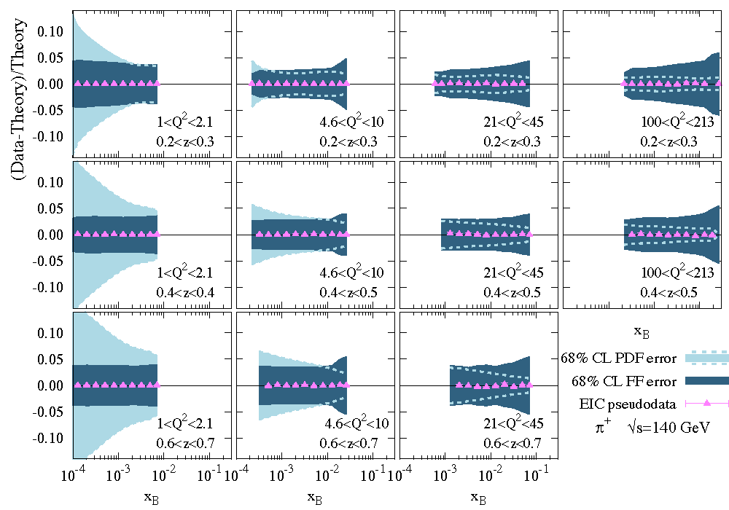
Lesson learnt
If one wants to obtain the best PDF and FF constrain it will be critical
to perform a combined fit

Slide 17
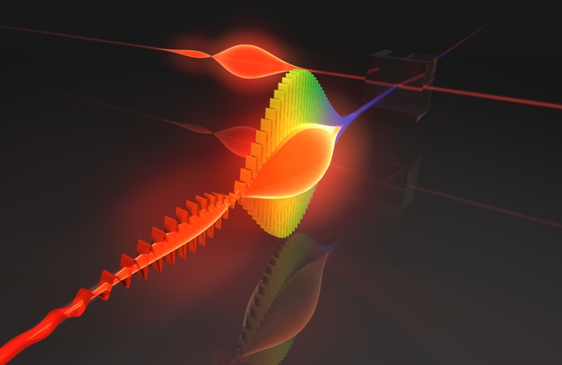
Example for Jet Physics at an EIC:
Unpolarized and polarized photon structure
Details: X. Chu, ECA arXiv:1705.08831

Slide 18
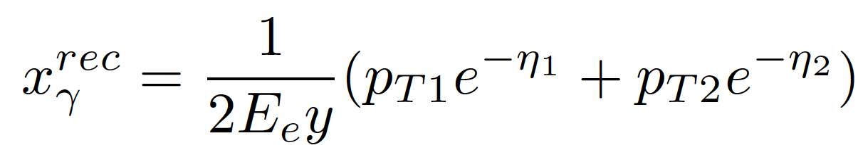
Photon Parton Structure
In high energy ep collision, two types of processes lead to the production of di-jets:
direct: point-like photon
resolved: hadronic photon
Di-jets@EIC ideal probe to constrain (un)polarised Photon-PDFs
  Direct/resolved contributions can be separated reconstructing xγ

Slide 19
Photon Parton Structure
unpolarized cross section:
polarized cross section:
Input: proton-CTEQ-5 & g: SAS
Input: proton-DSSV &
γ: PLB 337 373 (1994)

Slide 20
Photon Parton Structure
Jets from photon and proton side
are well separated in η for quark
initiated processes
It would be wonderful to have unpolarised photon PDFs with
all data (LEP & HERA and before) fitted with uncertainties
identified hadron tagging in jet
enhances flavor sensitivity

Slide 21


What else can be done
The Spin Sum Rules
Xiangdong Ji
Jaffe & Manohar
The Holy Grail

Slide 22
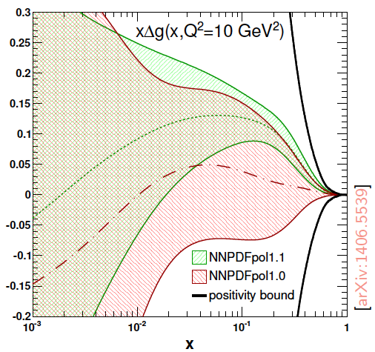
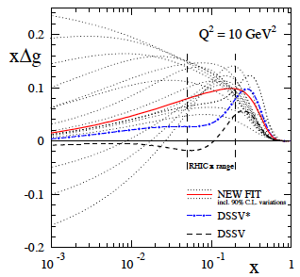
What we have now: ∫Δg(x)
DSSV: arXiv: 1404.4293, PRL 113, 012001
Impact in NNPDF
DSSV: arXiv:0904.3821
DSSV*: DSSV + all new (SI)DIS
DSSV: DSSV* & RHIC 2009
First time a significant
non-zero Dg(x)
strong constrain on
first
completely consistent with
DSSV* in 90% C.L.
only STAR jets included

Slide 23
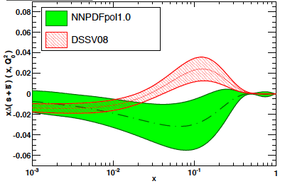
Why is separating quark flavors important?
Why is separating quark flavors important?
nuclear structure is encoded in parton distribution functions
understand dynamics of the quark-antiquark fluctuations
flavor asymmetry in the light quark sea in the proton
unpolarized: ubar < dbar Helicity: Δubar > Δdbar TMDs: ?????
shape of polarized sea-quark PDFs critical for quark contribution to spin
ΔΣ does not converge at low x
due to current constrains put in the fits
strangeness was identified to be one of the least known quantities
  both unpolarized and polarized
from
SIDIS
K-data
SIDIS
data
indirect
from
inclusive
DIS-data
1st moment
constrained
by 3F-D

Slide 24
present vs EIC kinematic coverage
likewise for Q²
EIC extends x coverage
by ~2 decades
Details: R.Sassot, M. Stratmann, ECA, arXiv:1206.6014, arXiv:1509.06489

Slide 25
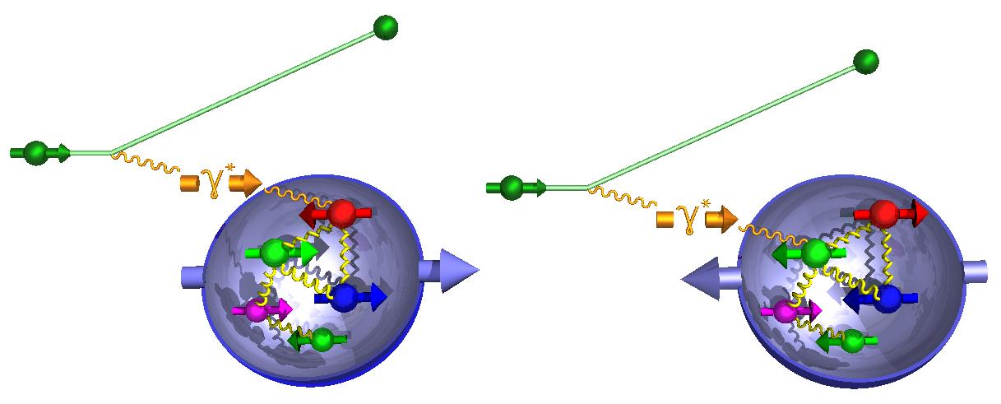
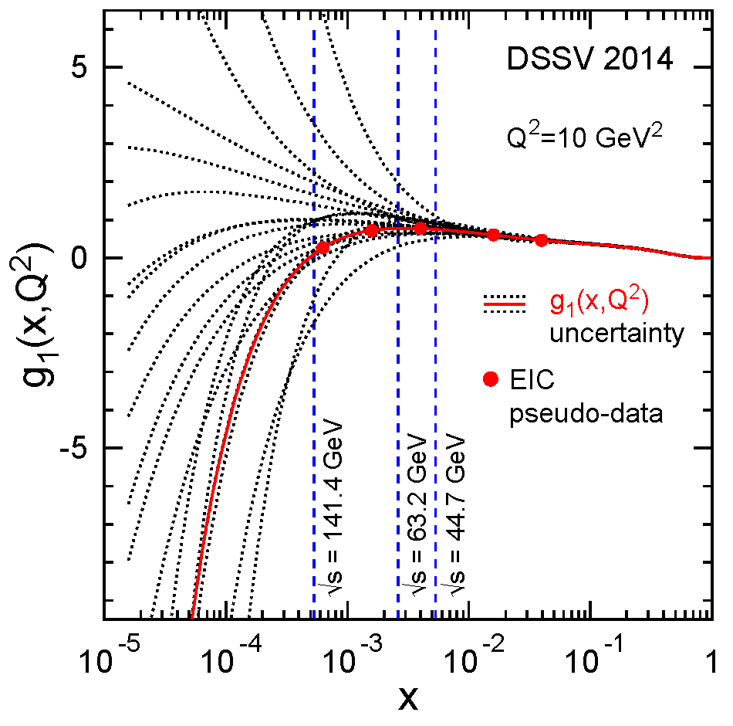
How to decompose the Spin of the Proton
To determine the contribution of quarks and gluons
to the spin of the proton, one needs to measure
the cross section difference g₁ as function of x and Q²
The current knowledge about g₁
as function of x at Q²=10 GeV²
g₁ ~
-
quark contribution:
The integral of Δq over x from 0 to 1
gluon contribution:
dg₁(x,Q²)/dlnQ² → Δg(x,Q²)

Slide 26
What forms the Spin of the Proton
The polarized SF g₁(x,Q²) as
measured by EIC for low to high √s
The polarized SF g₁(x,Q²) as
measured by EIC for low √s
Only with the center-of-mass energies
available at EIC the different contributions
to the spin of the proton can be disentangled
arXiv:1509.06489
PRD 92, 094030

Slide 27
Where does the Spin of the proton hide
total
quark
spin
“Helicity sum rule:”
gluon
spin
angular
momentum
1/2 -
-
orbital angular
momentum
Gluon
Quarks
=

Slide 28
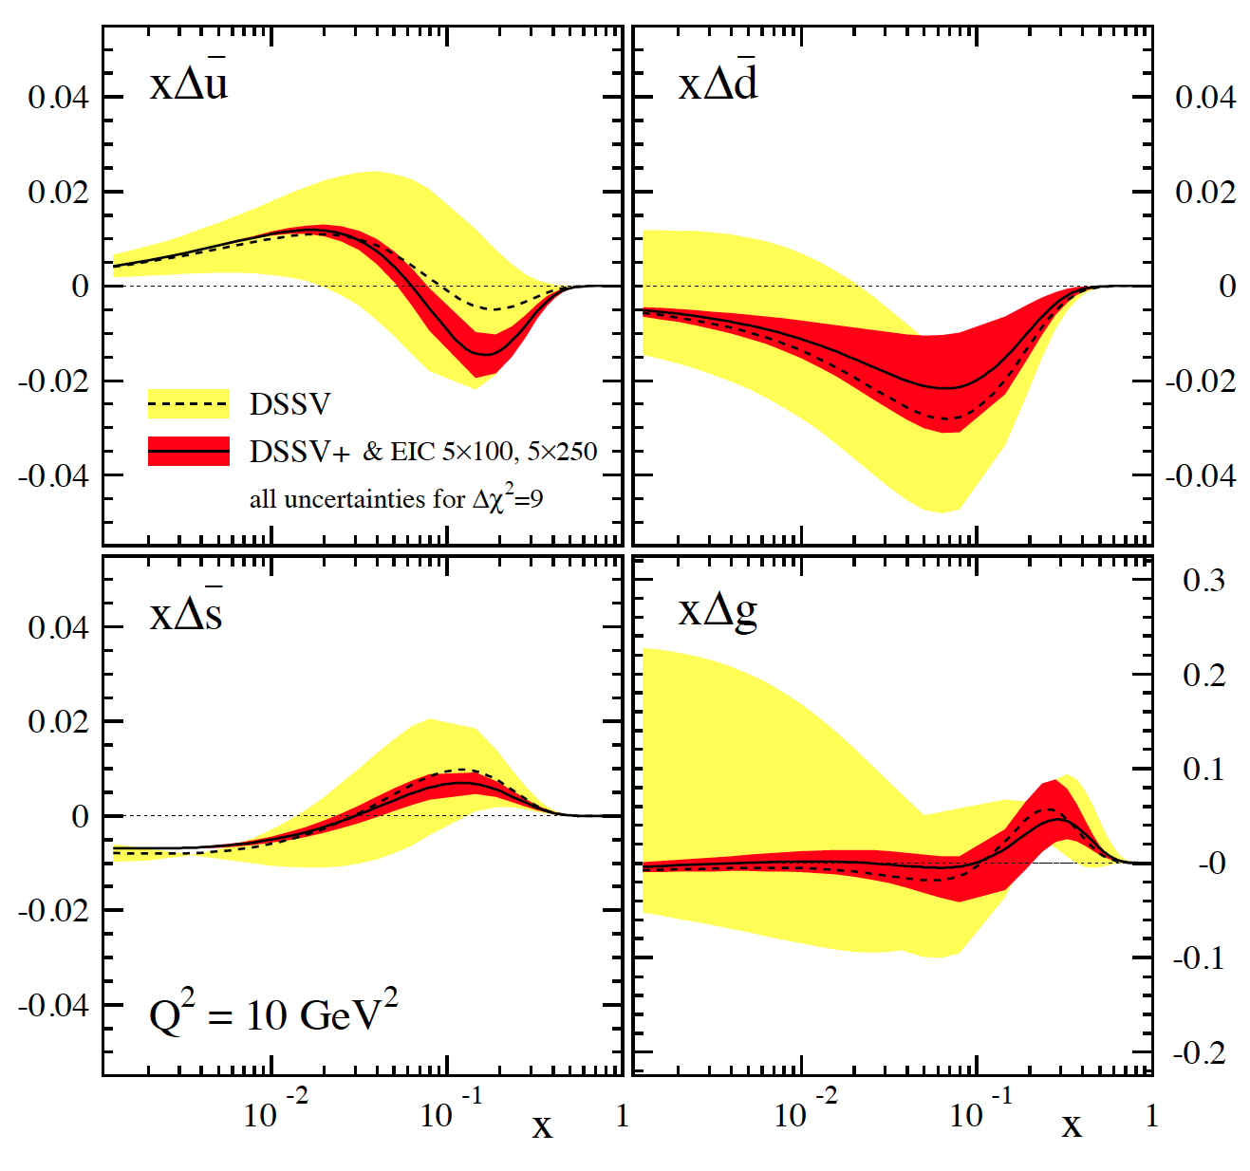
SIDIS@EIC: HELICITY PDFs
Can cover the same kinematics for g₁^{π,K} as for g₁
→ will constrain Δq
yet, small x behavior completely
unconstrained
→ determines x-integral,
which enters proton spin sum
includes data for
√s=45 GeV & 70 GeV
can be pushed to x=10⁻⁴ with
√s=140 GeV data
Lox x-behavior for Δs is artificial
due to constrains put in the fits
3F-D
→ EIC can remove all constrains
“issues”:
(SI)DIS @ EIC limited by
systematic uncertainties
need to control rel. lumi,
polarimetry, PID performance,
… very well

Slide 29
Observables: Charge Current in polarized ep
Polarized CC cross section
Approximate behavior of the LO single spin asymmetry
y → 0
y = 1/2
y → 1
similar to what is seen in
W production in polarized pp
Details: Th. Burton, T. Martini, H. Spiesberger, M. Stratmann, ECA, arXiv:13095327 PRD 88 (2013) 114025

Slide 30
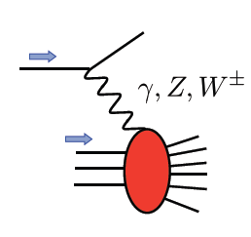
Polarized EW PHYSICS
ν
e
W^{+/-}
More Details: arXiv:1309.5327
QCD
fit

Slide 31
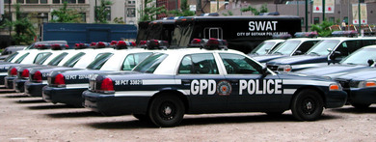

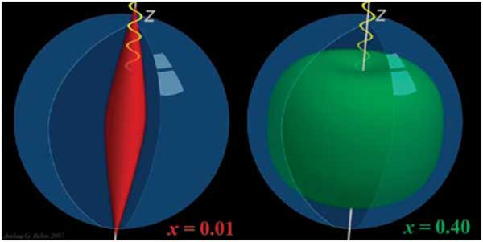
Generalized Parton Distributions (GPDs)
or

Slide 32
The DVCS Phase Space
HERA results on GPDs
very much limited by
lack of statistics
imaging in
valence region
but limited t-range
X
quantum numbers of final state → selects different GPD
DVCS: wide range of observables (σ, A_{UT}, A_{LU}, A_{UL}, A_{C}) to disentangle GPDs

Slide 33
DVCS Asymmetries
→ different charges: e⁺ e⁻:
~
Δσ_{C} ~ cosφ ∙Re{ H + ξH +… }
H
→ polarization observables:
~
Δσ_{LU} ~ sinφ∙Im{H + ξH + kE}
H
~
Δσ_{UL} ~ sinφ∙Im{H + ξH + …}
H
Δσ_{UT} ~ sinφ∙Im{k(H - E) + … }
H, E
ξ = x_{B}/(2-x_{B} ) k = t/4M²
kinematically suppressed

Slide 34


DVCS at eRHIC
e’
γ
e
γ_{L}*
(Q²)
DVCS: Golden channel
theoretically clean
wide range of observables
(σ, A_{UT}, A_{LU}, A_{UL}, A_{C})
to disentangle different GPDs
x+ξ
x-ξ
~
~
p
H, H, E, E (x,ξ,t)
p’
t
DVCS data at end of HERA
D. Mueller, K. Kumericki
S. Fazio, and ECA
arXiv:1304.0077

Slide 35
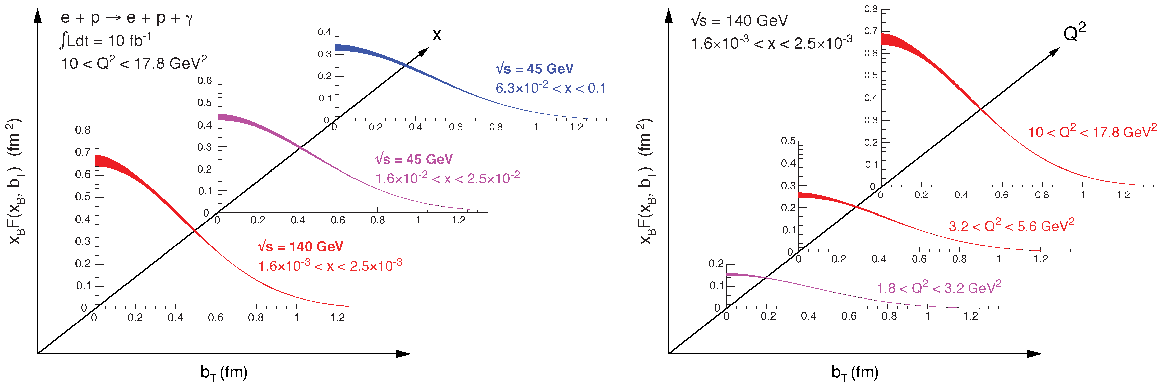

2+1d-Imaging in coordinate space
High precision
imaging at EIC
at low and high x
pion cloud
effects seen
at high b_{T}

Slide 36
Disentangle different GPDs
Vary electron and proton beam spin directions:
electron
beam
longitudinal
polarised
proton
beam
transverse
polarised
proton
beam
longitudinal
polarised
Δσ_{UT}
beam target

Slide 37
What will we learn about 2d+1 structure of the proton
GPD H and E 1d+1
arXiv:1304.0077
GPD H and E as function of t, x and Q²
A global fit over all pseudo data was done, based on the GPDs-based model:
[K. Kumerički, D Müller, K. Passek-Kumerički 2007]
Known values q(x), g(x) are assumed for H^{q}, H^{g}
(at x=0, t=0 forward limits E^{q}, E^{g} are unknown)
Excellent reconstruction of H^{sea}, H^{sea} and good reconstruction of H^{g} (from dσ/dt)
GPD H and E 2d+1 structure for sea-quarks and gluons

Slide 38
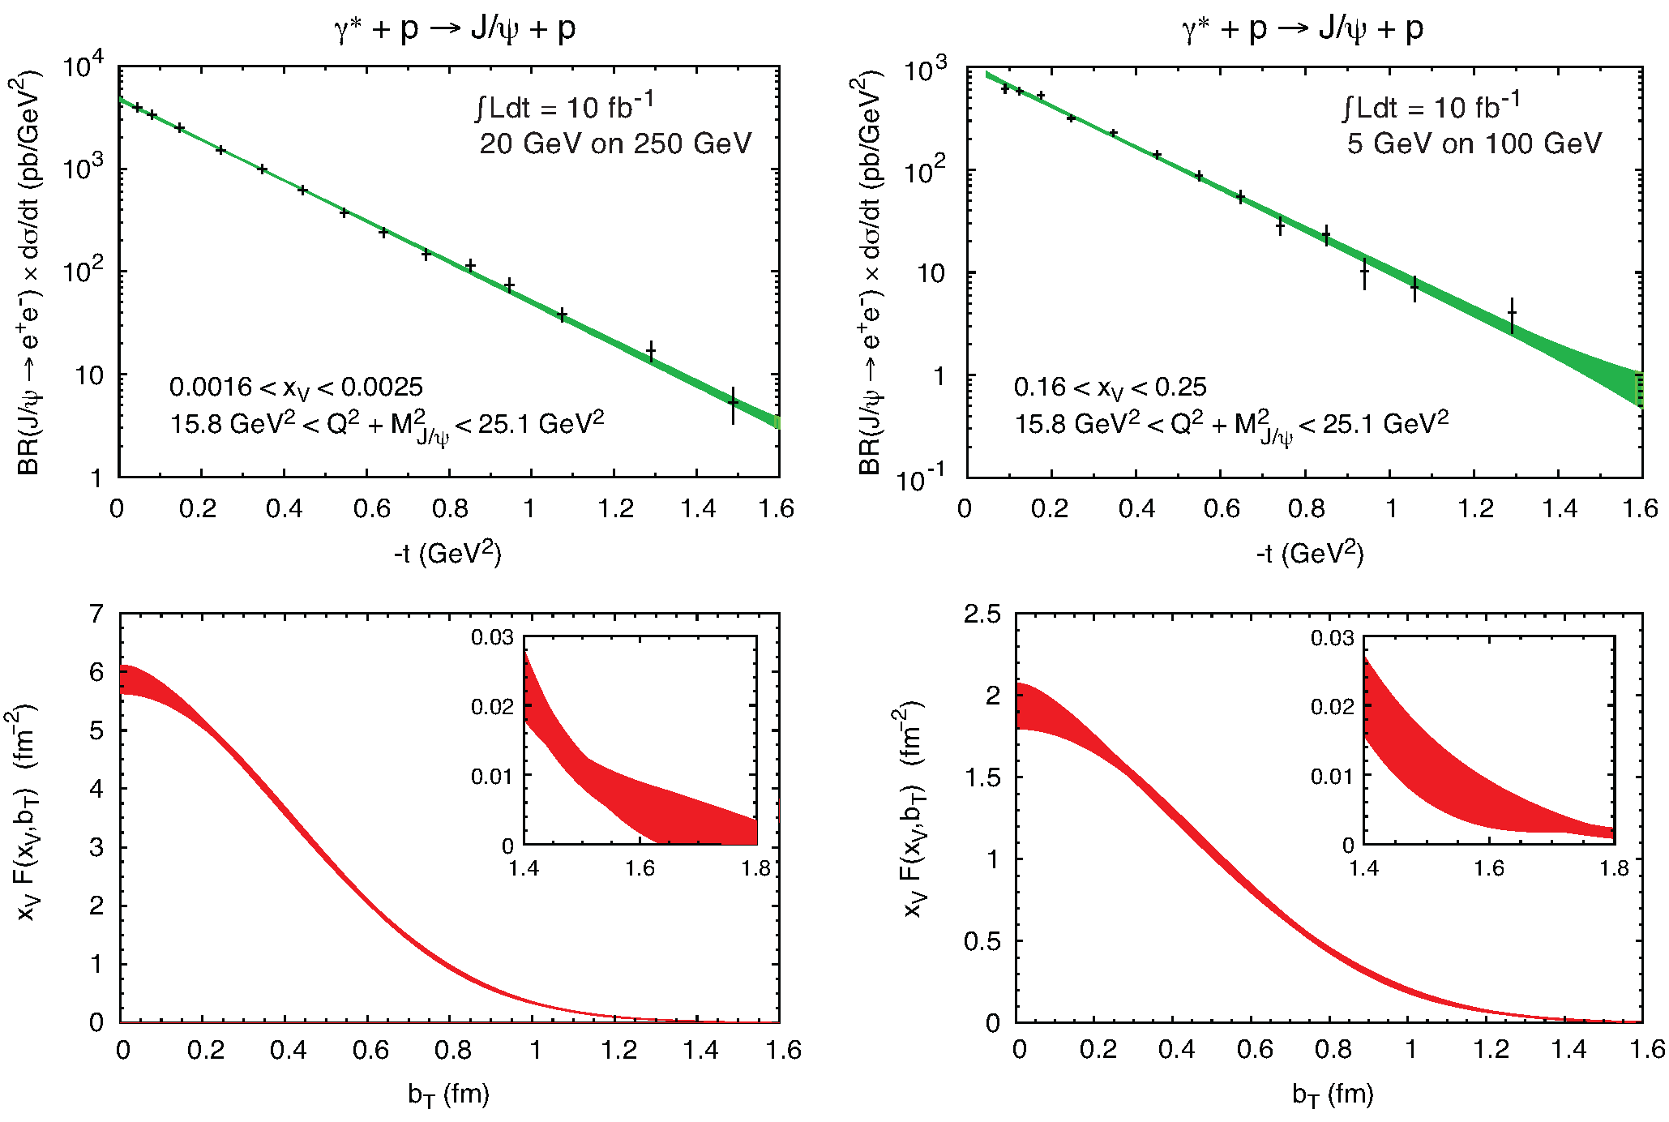
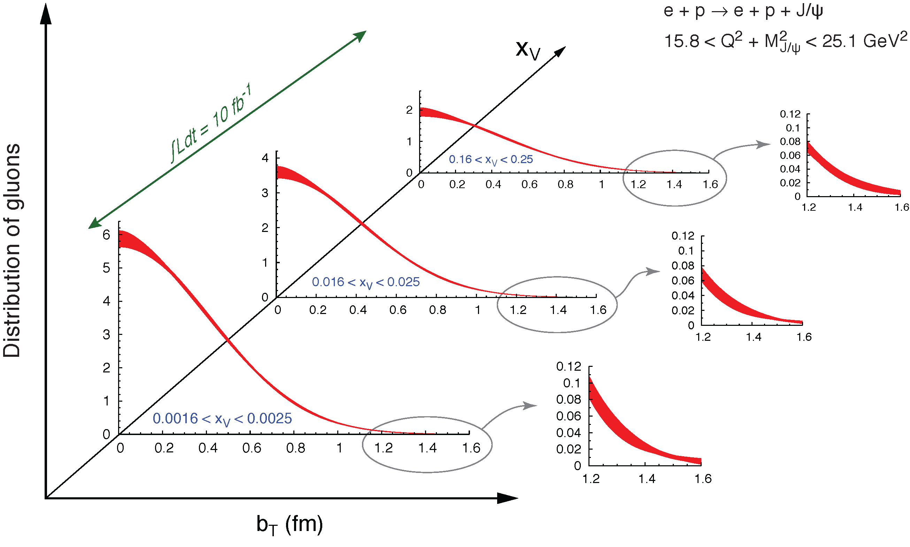
GPD H^{g}: J/ψ
To improve imaging on gluons
add J/ψ observables
cross section
A_{UT}
…..

Slide 39
Transverse momentum dependent distributions (TMD)

Slide 40
TMDs at STAR
Before STAR TMDs came only from fixed target data → high x @ low Q²
needed to establish concept at high Q² and wide range in x
polarised pp at RHIC
STAR unique kinematics: from high to low x at high Q²

Slide 41
TMDs @ EIC
Sivers fct. before and after
Sivers asymmetry for p+:
√s=140 GeV / 45 GeV / 15 GeV
can be viewed as parton flow
inside nucleus
Other quarks look similar
What about the gluon ? → arXiv:1805.05290

Slide 42

Summary
EIC will provide highest precision data to constrain all different types of PDFs
and provide complementary information to challenge the lattice PDF calculations
Let’s get to work
and built EIC

Slide 43


Slide 44
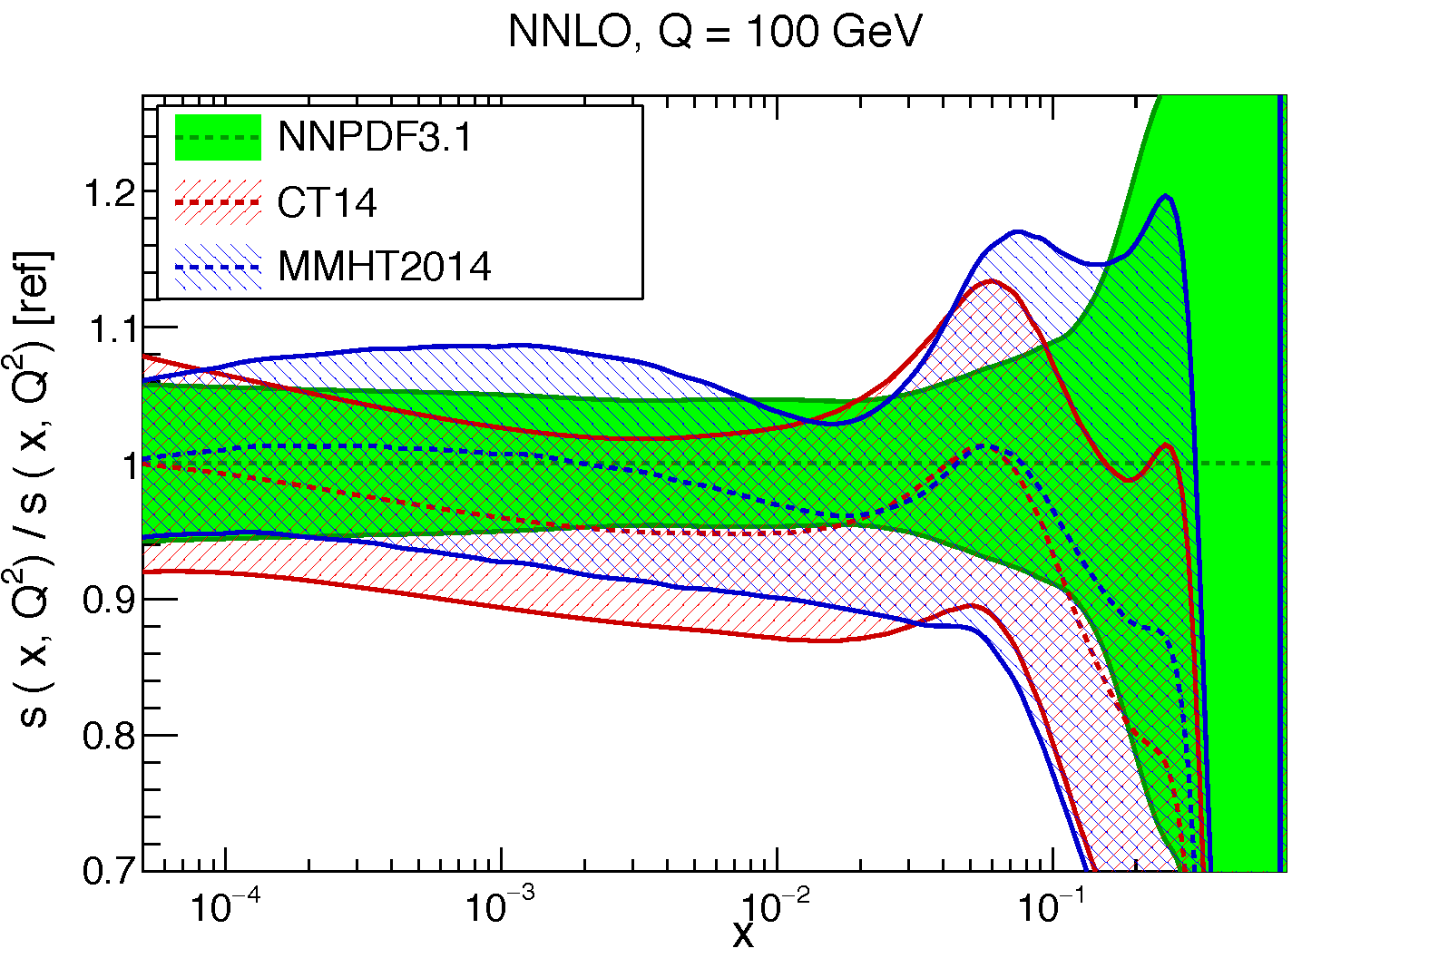
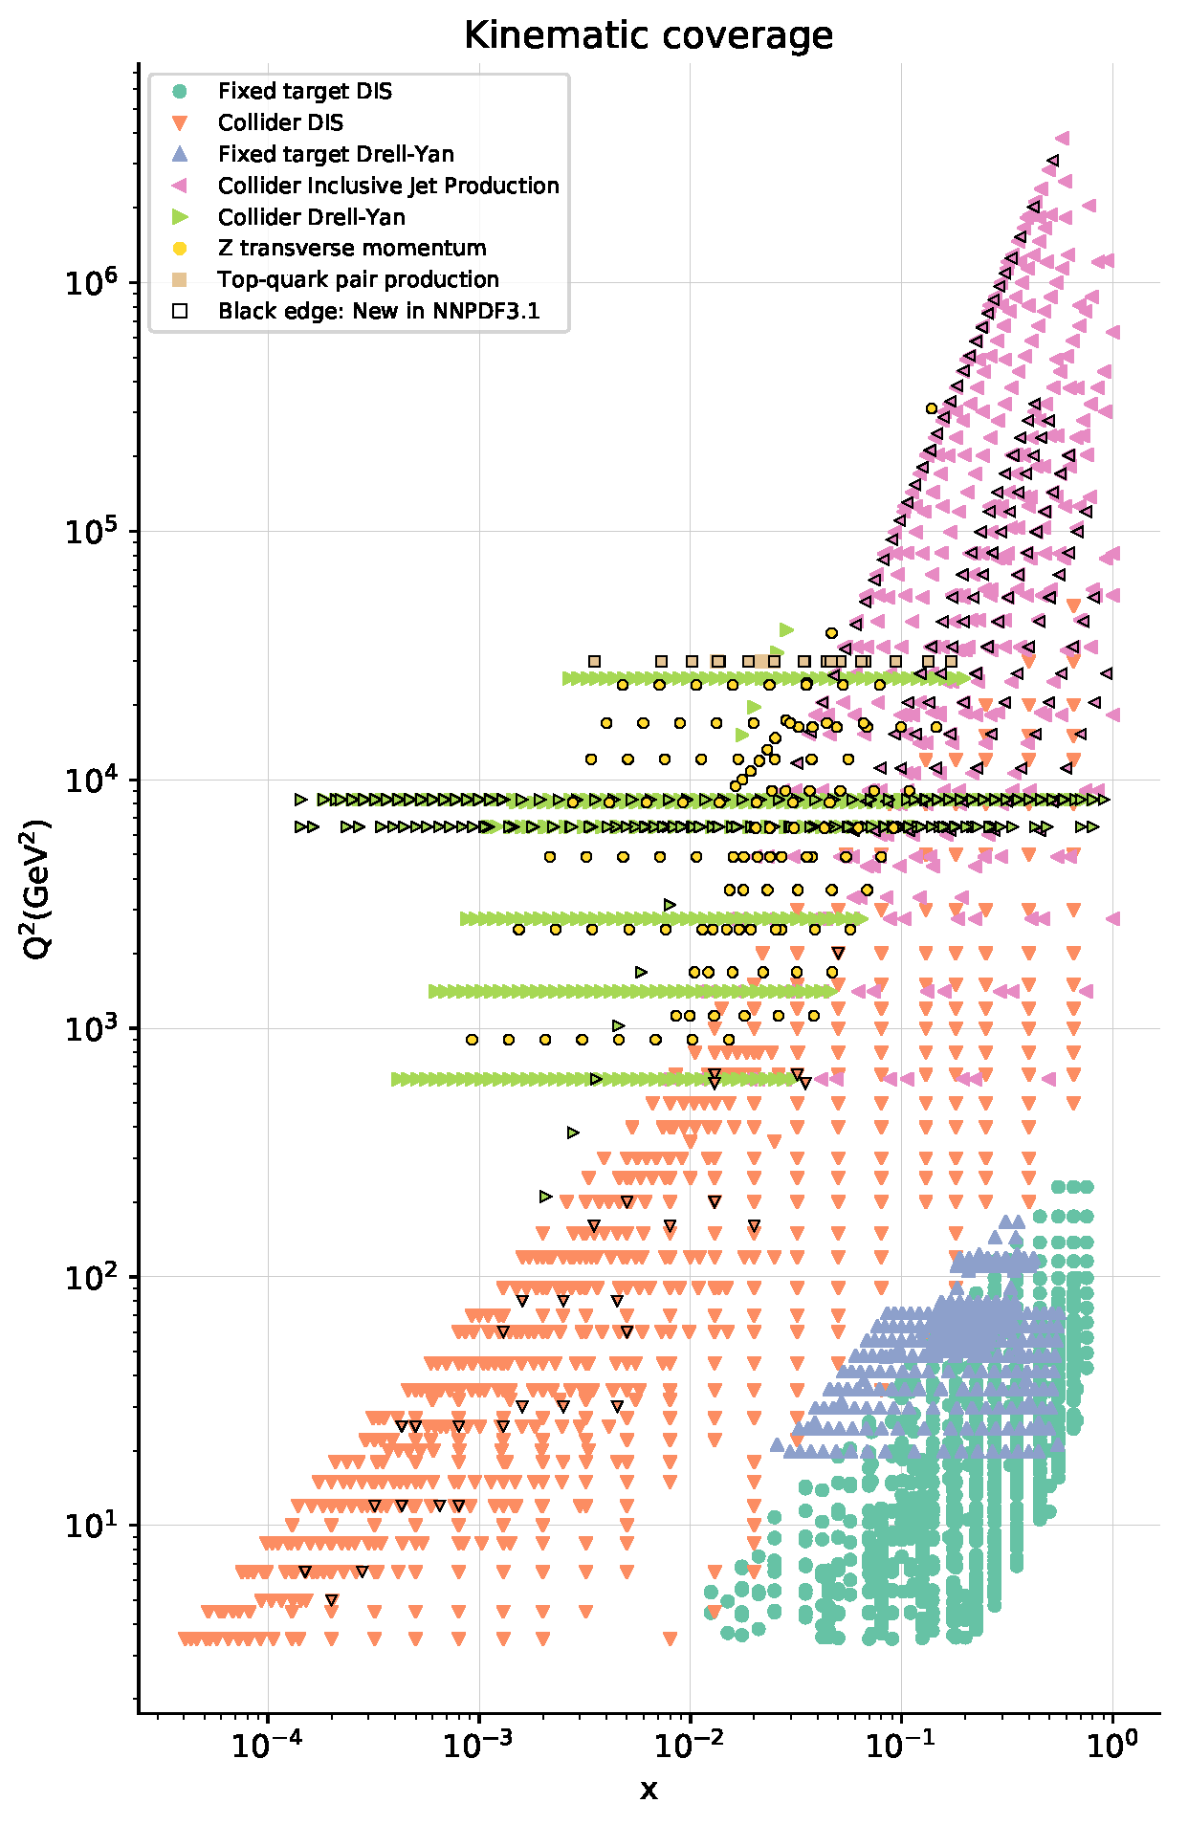
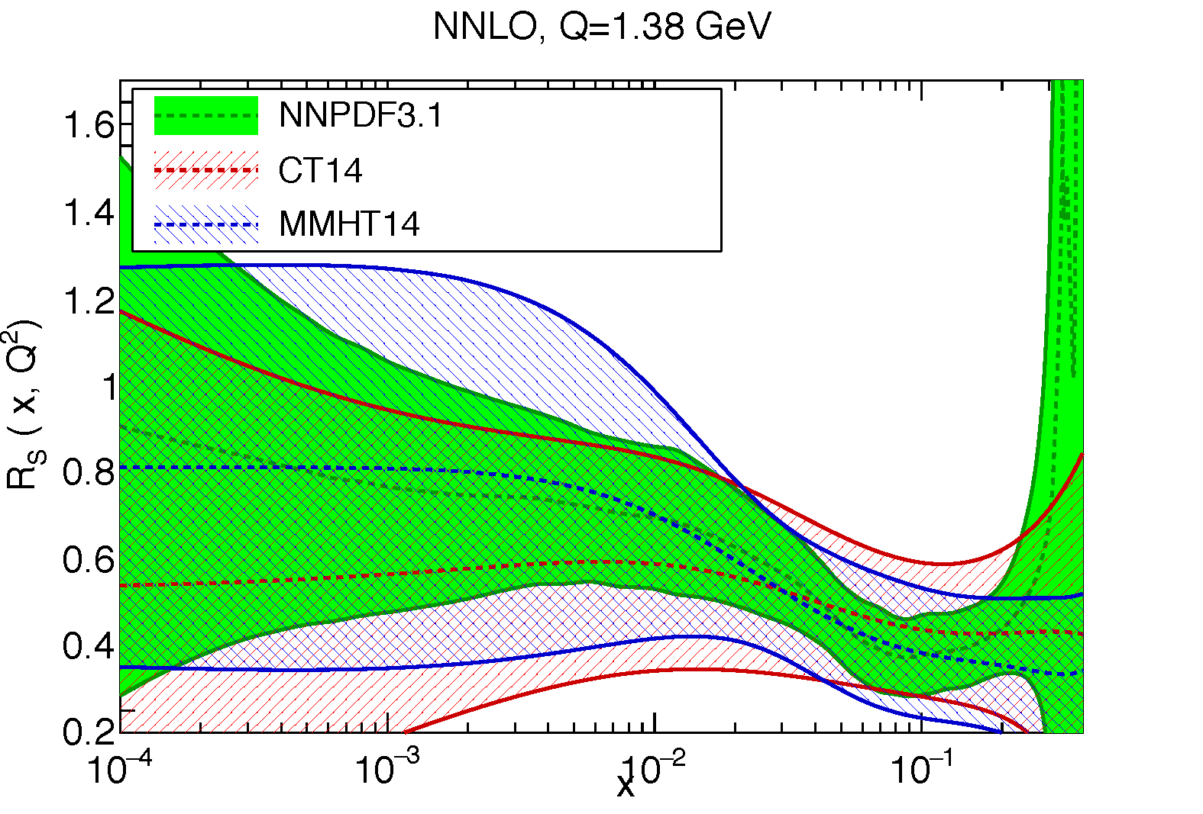

s(x) and sbar(x) where do we stand?
NNPDF 3.1 arXiv:1706.00428

Slide 45
Observables: Charge Current in ep and eA
Just some of the physics opportunities:
polarized ep/en:
test models based on helicity retention Δd/d → 1
(Phys.Rev.Lett. 99 (2007) 082001)
precision test models assuming charge symmetry violation
precision test handiness of Ws
tag charm in coincidence with CC event → Δs
unpolarized ep/en:
impact on PDFs → high x quark PDFs
  tag charm in coincidence ot CC event → s
precision constrain on light quark weak neutral current couplings a_{u}, v_{u}, a_{d} v_{d}
unpolarized eA:
Test Models for the EMC-effect
  charge symmetry violation
  Isovector EMC effect
(Cloet, Bentz, Thomas et. al., PRL 102 252301 )

Slide 46
What can an EIC Do?
Should study what NC and CC cross sections at EIC can tell us on the
vector and axial-vector weak neutral current couplings

Slide 47
PDFs: flavor separation from SIDIS@EIC
Use reweighting method to define EIC SIDIS data impact on
collinear unpolarized PDFs and Fragmentation functions
δ𝓞 : exp. uncertainty
Observable
Correlation factor of observable 𝓞 to a flavor i
account for
uncertainties
Δ PDF in Observable

Slide 48
Why should we care?
Spin ideal tool to understand the dynamics of sea quarks and gluons inside the hadron
Despite decades of QCD – Spin one of the least understood quantities
Consequence very few models, but several physics pictures, which can be tested
with high precision data
the pion/kaon cloud model
→ rooted in deeper concepts → chiral symmetry
→ generated q-qbar pairs (sea quarks) at small(ish)-x are predicted to be unpolarized
→ gluons if generated from sea quarks unpolarised → spatial imaging
→ a high precision measurement of the flavor separated polarized quark and gluon
distributions as fct. of x is a stringent way to test.
the chiral quark-soliton model
→ sea quarks are generated from a "Dirac sea" with a rich dynamical
structure but excludes gluons at its starting scale
→ sea quarks are polarized → asymmetry
→ a high precision measurement of the flavor separated polarized quark
as fct. of x is a stringent way to test
stringent test of lattice calculations
→ the relative importance of lattice graphs
→ probe quark is connected to the proton wave function or
is created from the 'gluon soup' inside the proton

Slide 49
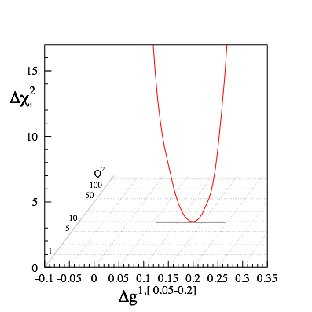
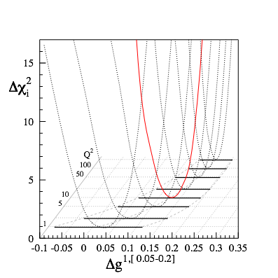
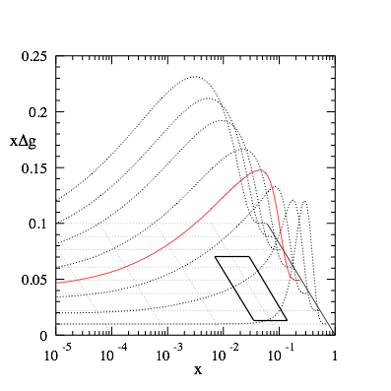

Q²-Dependence
high Q²
very fast evolution
in RHIC kinematics
medium Q²
low Q²

Slide 50
What forms the Spin of the Proton
Spin is more than the number ½ ! It is the interplay between
the intrinsic properties and interactions of quarks and gluons
total
quark spin
gluon
spin
angular
momentum
What do we know:
⟼
⟼
data
data
1/2 -
Gluon
--
Quarks
=
orbital angular
momentum
40%
30%

Slide 51
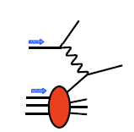
g₁^{p} the way to find the Spin
M.Stratmann, R. Sassot, ECA: arXiv:1206.6014 & 1509.06489
unseen precision and x-Q² coverage
cross section:
-
g₁ ~
pQCD scaling violations

Slide 52
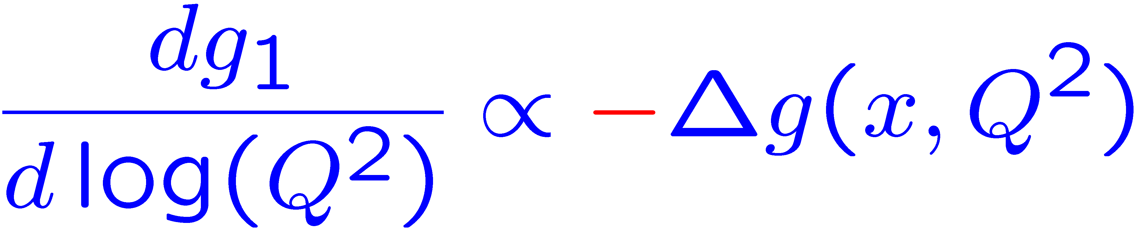
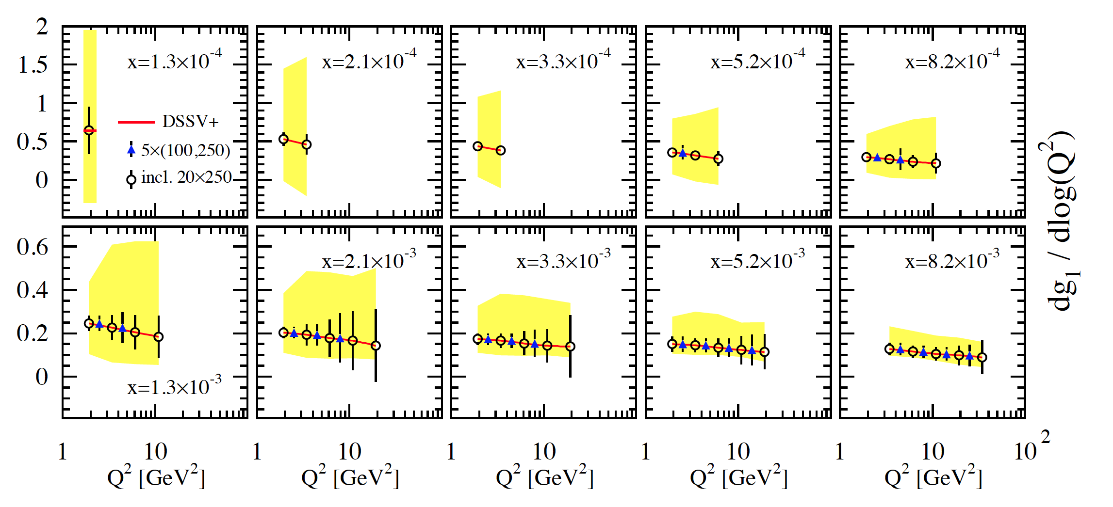
scaling violations at small x
rough small-x approximation to Q²-evolution:
spread in Δg(x,Q²) translates into
spread of scaling violations for g₁(x,Q²)
need x-bins with a least two Q² values to compute derivative (limits x reach somewhat)
smallest x bins require 20 x 250 GeV
⟼ √s < 70 GeV
error bars for moderate 10fb⁻¹ per c.m.s. energy; bands parameterize current DSSV+ uncertainties

Slide 53
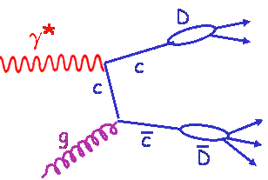
Inclusive Cross-Sections in eA
arXiv:1708.05654
Direct Access to gluons at
medium to high x by tagging
photon-gluon fusion through
charm events
Gluon distribution ~ dσ(x,Q²)/dlnQ²

Slide 54
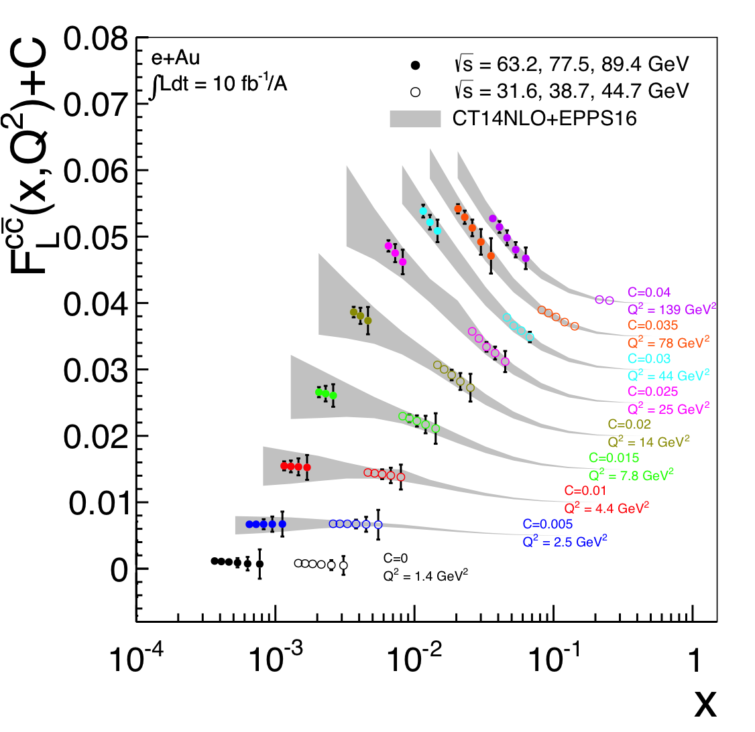
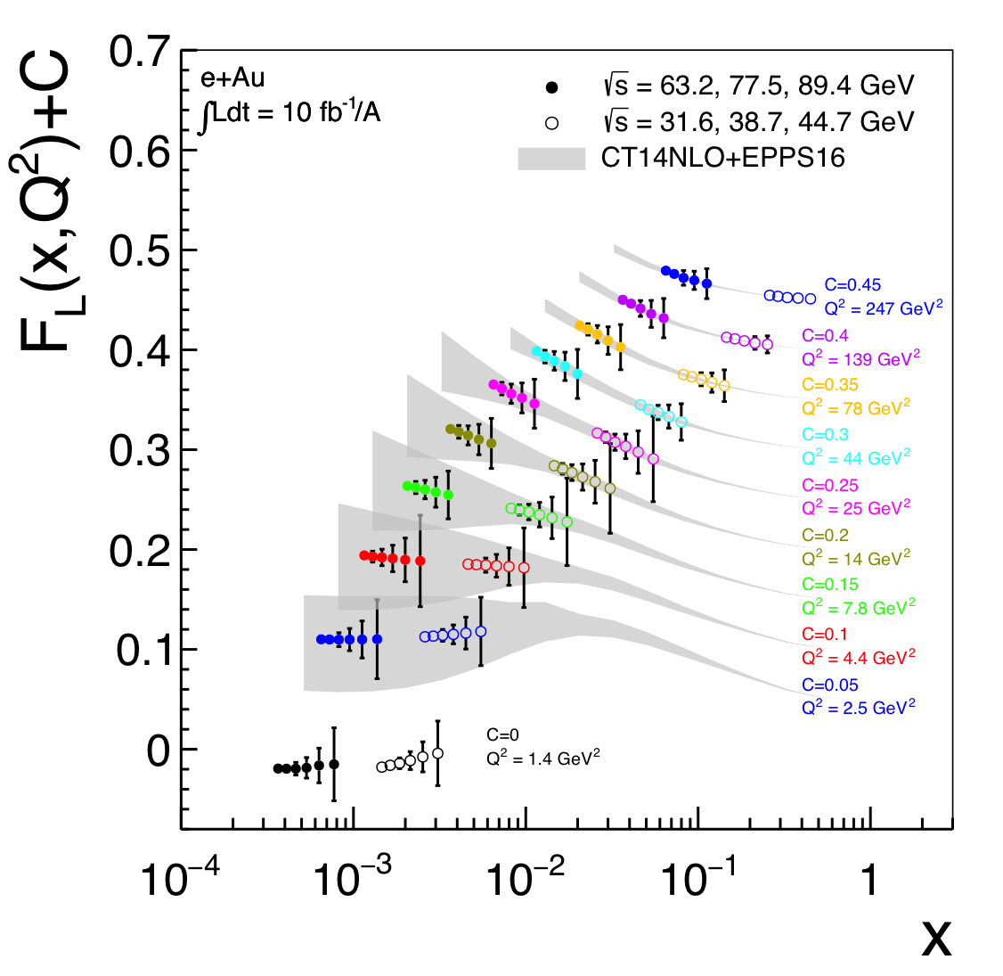
Direct Access to Gluons in eA
For Details: arXiv:1708.05654
Direct Access to gluons at
medium to high x by tagging
photon-gluon fusion through
charm events
high precision F_{L}^{charm} will offer an
opportunity to benchmark different
GM-VFNS schemes with an
unprecedented precision.

Slide 55
EIC: Impact on the Knowledge of 1D Nuclear PDFs
√s < 45 GeV
√s < 90 GeV
Ratio of PDF of Pb over Proton
Without EIC, large
uncertainties
→ With EIC significantly
reduced uncertainties
Complementary to RHIC
and LHC pA data.
Provides information on
initial state for heavy ion
collisions.
Does the nucleus behave
like a proton at low-x?
→ relevant to very
high-energy cosmic
ray studies
→ critical input to AA
submitted to PRD
arXiv:1708.05654

Slide 56

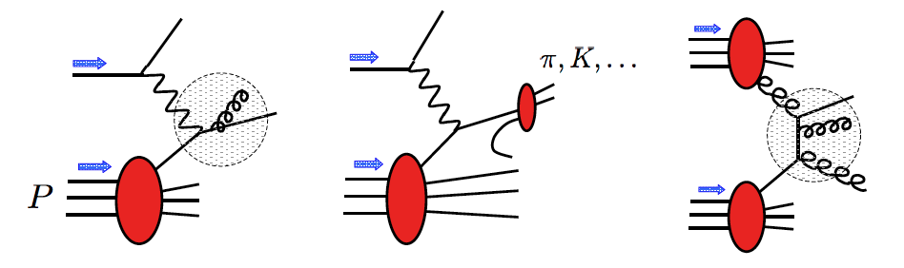

probes of nucleon helicity structure
DIS
SIDIS
pp
pions, kaons
1-jet, 1-hadron
charm, 2-hadrons
W^{+/-} bosons
guiding principle: factorization
e.g.
DIS
essential: QCD corrections
need DIS + SIDIS + pp to constrain all aspects of PDFs (a way to test factorization)

Slide 57
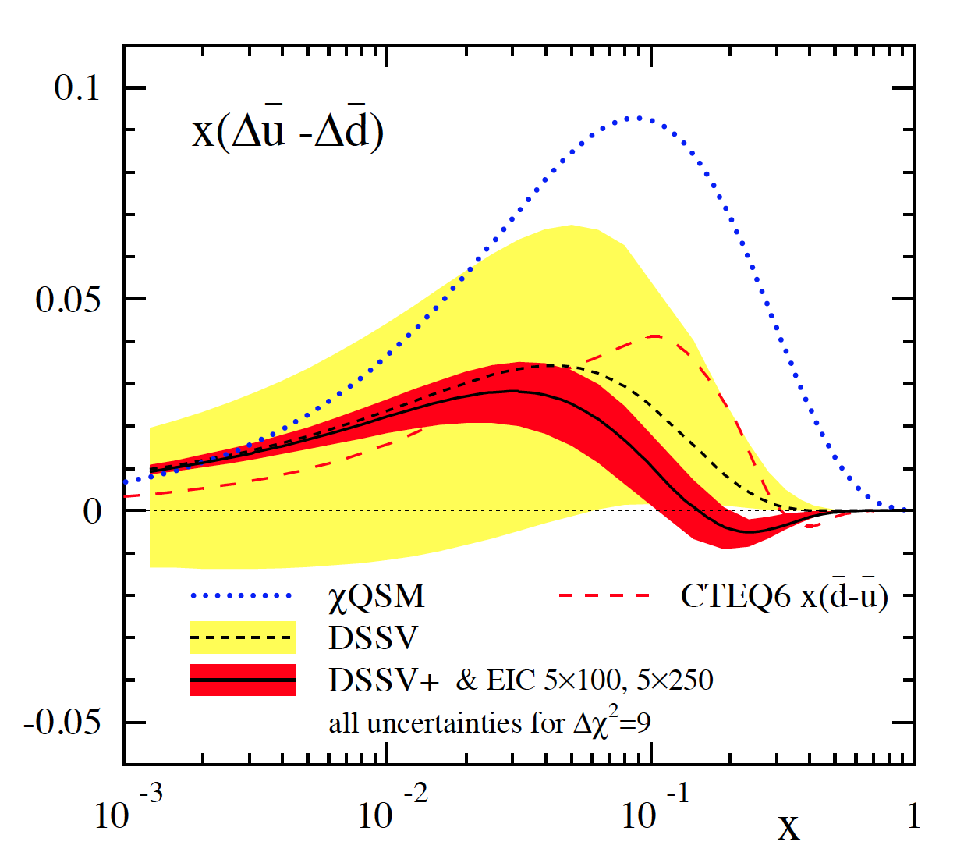
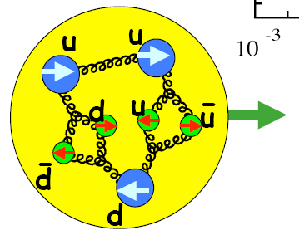
probing a possible asymmetry in the polarized sea
current SIDIS data not sensitive to (known to be sizable for unpol. PDFs)
many models predict sizable asymmetry [large N_{C} , chiral quark soliton, meson cloud, Pauli blocking]
Thomas, Signal, Cao; Holtmann, Speth, Fassler;
Diakonov, Polyakov, Weiss; Schafer, Fries; Kumano;
Wakamatsu; Gluck, Reya; Bourrely, Soffer, …
can be easily studied at an EIC
main effect expected to be at not too small x
→ can test x dependence
can try to look into a possible
with K^{+/-} SIDIS data

