Slide 1
Experimental overview: what do we know about the initial stages of heavy ion collisions
Soumya Mohapatra
(Columbia University)
IS-2019
New York
24th June 2019

Slide 2
Understanding the initial stages of a HI collision
Main tool: Flow and Correlation measurements
Very sensitive to initial collision geometry and its fluctuations
Sensitive to hydrodynamic response
“Double edged sword” Sensitivity to both => difficult to constrain either
How to proceed?

Slide 3
Understanding the initial stages of a HI collision
Main tool: Flow and Correlation measurements
Very sensitive to initial collision geometry and its fluctuations
Sensitive to hydrodynamic response
“Double edged sword” Sensitivity to both => difficult to constrain either
How to proceed?
More careful look at previous measurements
Measure new observables:
That are more sensitive to initial conditions than to response and vice-versa
Ex: v_{n}-v_{m} correlations, symmetric & asymmetric cumulants + …
Measure across different systems
Xe+Xe (LHC), Cu+Au, Cu+Cu, U+U (RHIC)
Correlation in Small systems
p+A, d+A, ³He+A, pp
+ Many other measurements: Femtoscopy, HF flow, v₁.

Slide 4
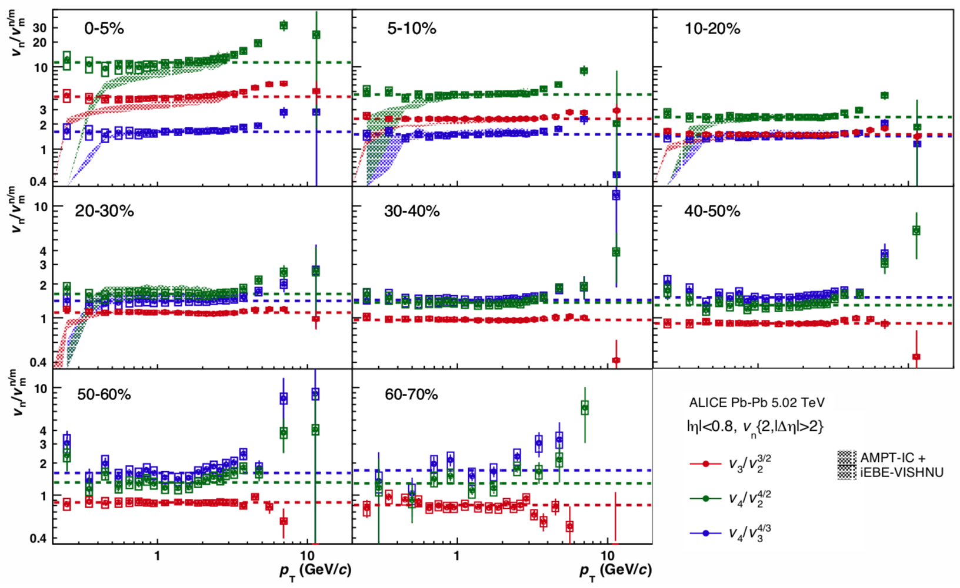
Scaling behavior in v_{n}{2}
4
Observe scaling :
v_{n}/v_{m}^{n/m} is constant
independent of p_{T},
Also observe that at
low-p_{T}: v_{n}(p_{T})~p_{T}^{n/3}
However scaling works out to higher p_{T} values and is more precise than this power law behavior
Viscous hydro calculations (shaded bands) reproduce
Scaling over 0.5-3 GeV range.
ALICE
arXiv:1804.02944
Scaling works even well outside hydro regime.

Slide 5
Universal shape in hydro response?
5
Shape of v_{n}(p_{T}) changes across different centralities
ATLAS
arXiv:1808.03951

Slide 6
Universal shape in hydro response?
6
Shape of v_{n}(p_{T}) changes across different centralities
Identical shape of v₂ across different centralities up to overall scaling along axes
ATLAS
arXiv:1808.03951

Slide 7
Universal shape in hydro response?
7
Shape of v_{n}(p_{T}) changes across different centralities
Identical shape of v₂ across different centralities up to overall scaling along axes
Scaling also holds for v₃
Origin of such scaling is unclear
Only two free parameters that determine what changes from one centrality to another
ATLAS
arXiv:1808.03951

Slide 8
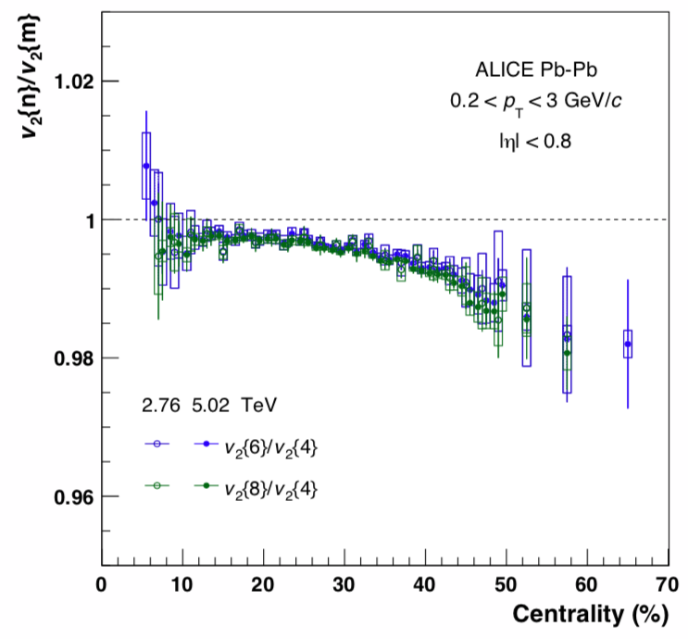
Higher order cumulants
8
Very precise measurements of higher order flow.
For Bessel-Gaussian fluctuations: v₂{4}=v₂{6}=v₂{8}
See deviations of up to 2% that increase from central → mid-central→ peripheral.
No dependence on collision energy!
ALICE
arXiv:1804.02944
Measurements are now precise enough to observe small deviations from gaussian behavior!

Slide 9
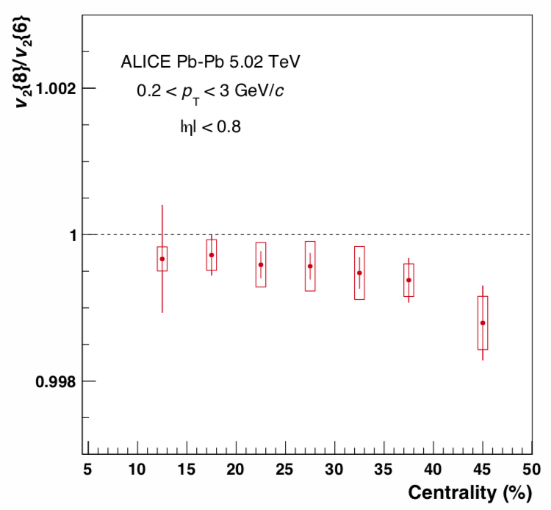
Higher order cumulants
9
Very precise measurements of higher order flow.
For Bessel-Gaussian fluctuations: v₂{4}=v₂{6}=v₂{8}
See deviations of up to 2% that increase from central → mid-central→ peripheral.
No dependence on collision energy!
ALICE
arXiv:1804.02944
Measurements are now precise enough to observe small deviations from gaussian behavior!
Also see 0.05% difference between v₂{6} and v₂{8}.
Tighter constraint on models!

Slide 10
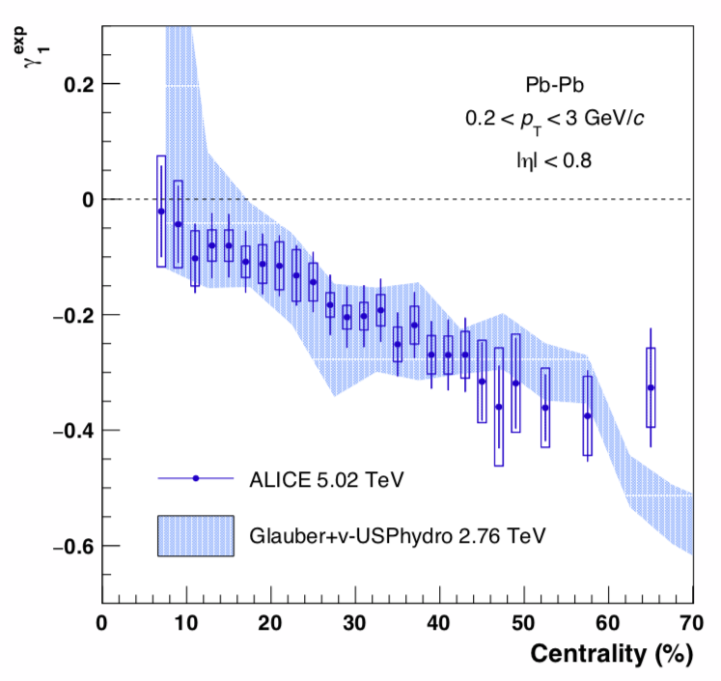
Measure skewness of distributions
10
ALICE arXiv:1804.02944
Quantify deviations from Bessel-gaussian behavior by skewness : 𝛾₁
Observed to be negative:
Distribution is left-skewed,
This is expected
Well reproduced by Glauber-IC+USPHydro

Slide 11
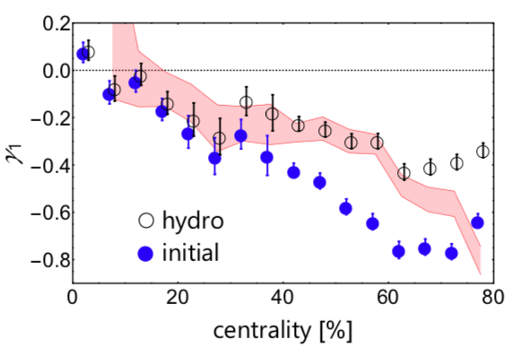
Measure skewness of distributions
11
Giacalone et. al.
Phys. Rev. C 95, 014913 (2017)
Quantify deviations from Bessel-gaussian behavior by skewness : 𝛾₁
Observed to be negative:
Distribution is left-skewed,
This is expected
Well reproduced by Glauber-IC+USPHydro
Driven by initial geometry but sensitive to hydro as well

Slide 12
p_{T} dependence of flow fluctuations
12
Define “normalized cumulants”: Nc_{n}{4}=c_{n}{4}/(c_{n}{2})²
If v_{n} ∝ ϵ_{n} then such ratios should be independent of p_{T.}
ATLAS measurements show small but significant p_{T} dependence of such ratios
Can constrain “intra-event” p_{T} dependent fluctuations in v_{n} and event-plane angles 𝜳_{n.}
Normalized-c₂{4}=c₂{4}/(c₂{2})²
Related talk
Arabinda Behera:
Initial conditions for hydrodynamics …
ATLAS arXiv: 1904.04808

Slide 13
p_{T} dependence of flow fluctuations
13
ATLAS
arXiv: 1904.04808
c₂{4}/(c₂{2})²
c₃{4}/(c₃{2})²
c₄{4}/(c₄{2})²
For 2nd order harmonic: higher p_{T} interval has smaller |Nc₂{4}|
Larger relative-fluctuations at higher p_{T}
For 3rd order harmonic trend is opposite
For 4th order harmonic sign flips from central to peripheral events
Non-linear response to ϵ₂
Location of sign-change depends on p_{T}
Important to check if existing Hydro models reproduce these trends
Related talk
Arabinda Behera:
Initial conditions for hydrodynamics …

Slide 14
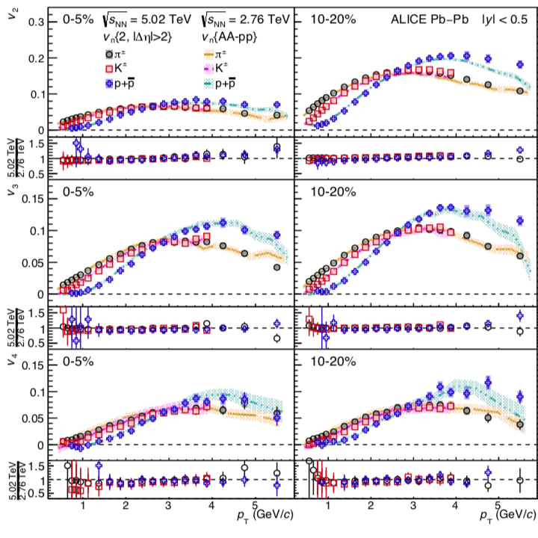
Energy dep of identified-particle v_{n}
14
ALICE
arXiv:1805.04390
No energy dependence observed in inclusive v_{n}(p_{T}).
Precise identified particle v_{n} (p_{T}) also indicate no change within uncertainties
Increased radial flow but no change in anisotropy.
Can provide constraints on the poorly understood coalesence/hadronization mechanism

Slide 15
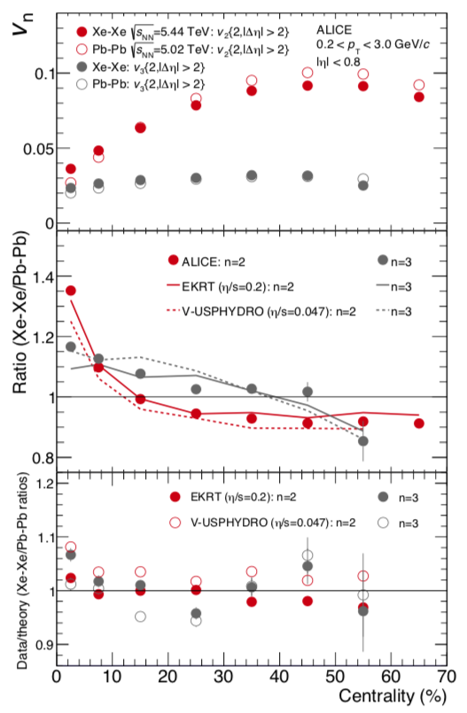
XeXe vs PbPb
15
Major breakthrough at RHIC came from study of Cu+Cu collisions:
Importance of event-by event fluctuations
Reaction plane vs participant-plane
Can Xe+Xe at LHC have same impact?
Most central Xe+Xe collisions have larger v₂, v₃ and v₄ than Pb+Pb
Difference decreases for mid-central events.
Eventually Xe+Xe v_{n} become smaller
Hydro calculations qualitatively reproduce trends, but possibility for fine-tuning 𝜂/s and initial state information.
ALICE : arXiv 1805.01832

Slide 16
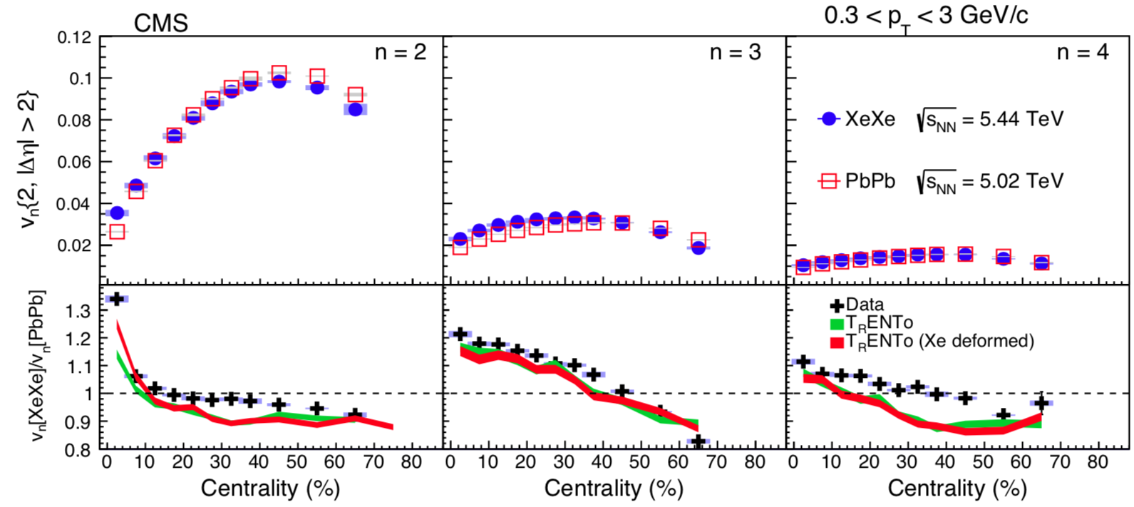
XeXe vs PbPb : model constraining power
16
CMS arXiv 1901.07997
Hydro calculations qualitatively reproduce trends, but possibility for fine-tuning 𝜂/s and initial state information.
For example ~15% of v₂ in central XeXe collisions for model calculation arises from deformation of Xe nucleus

Slide 17
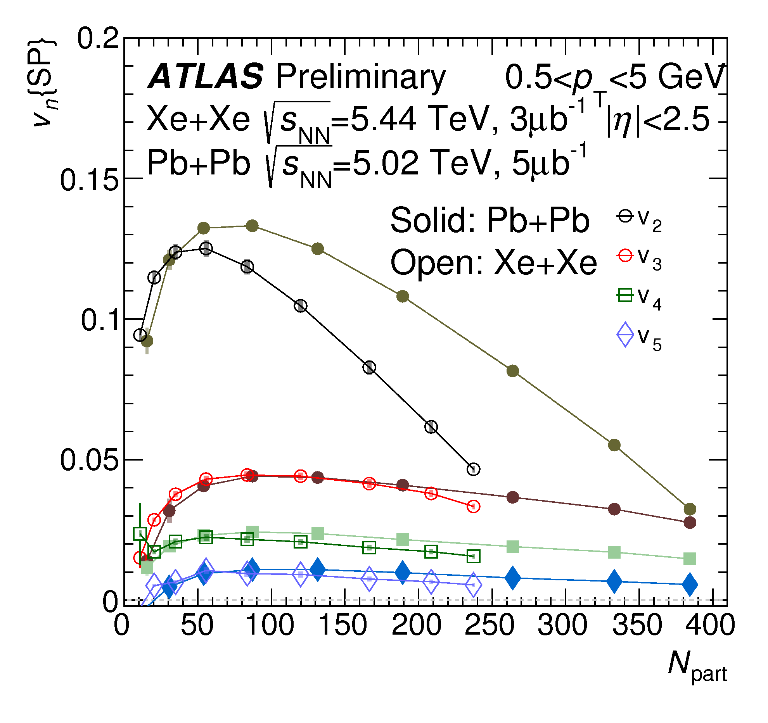
XeXe vs PbPb : N_{part} dependence
17
v₃ values at same centrality very different
but at same N_{part} are quite similar.
ATLAS-CONF-2018-11

Slide 18
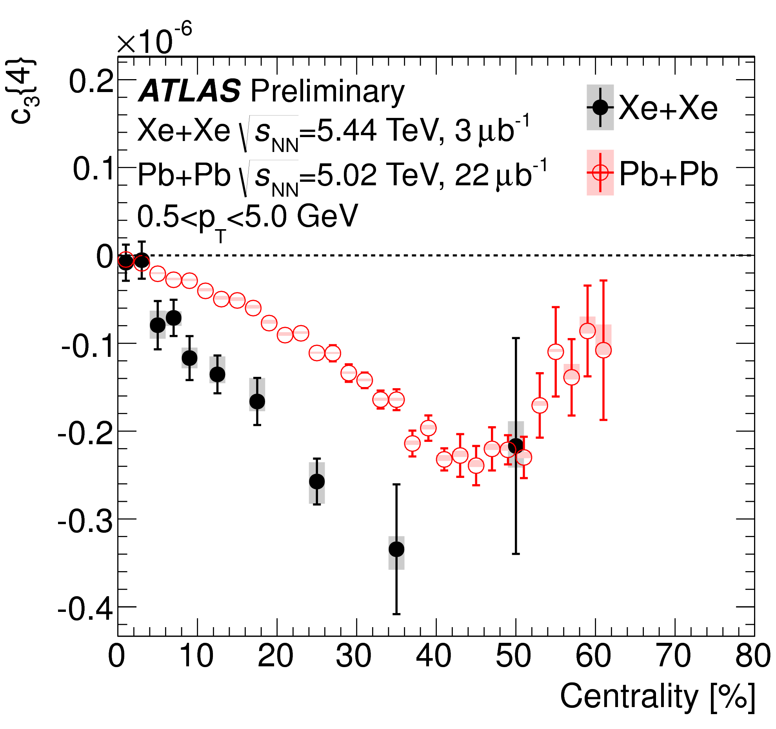
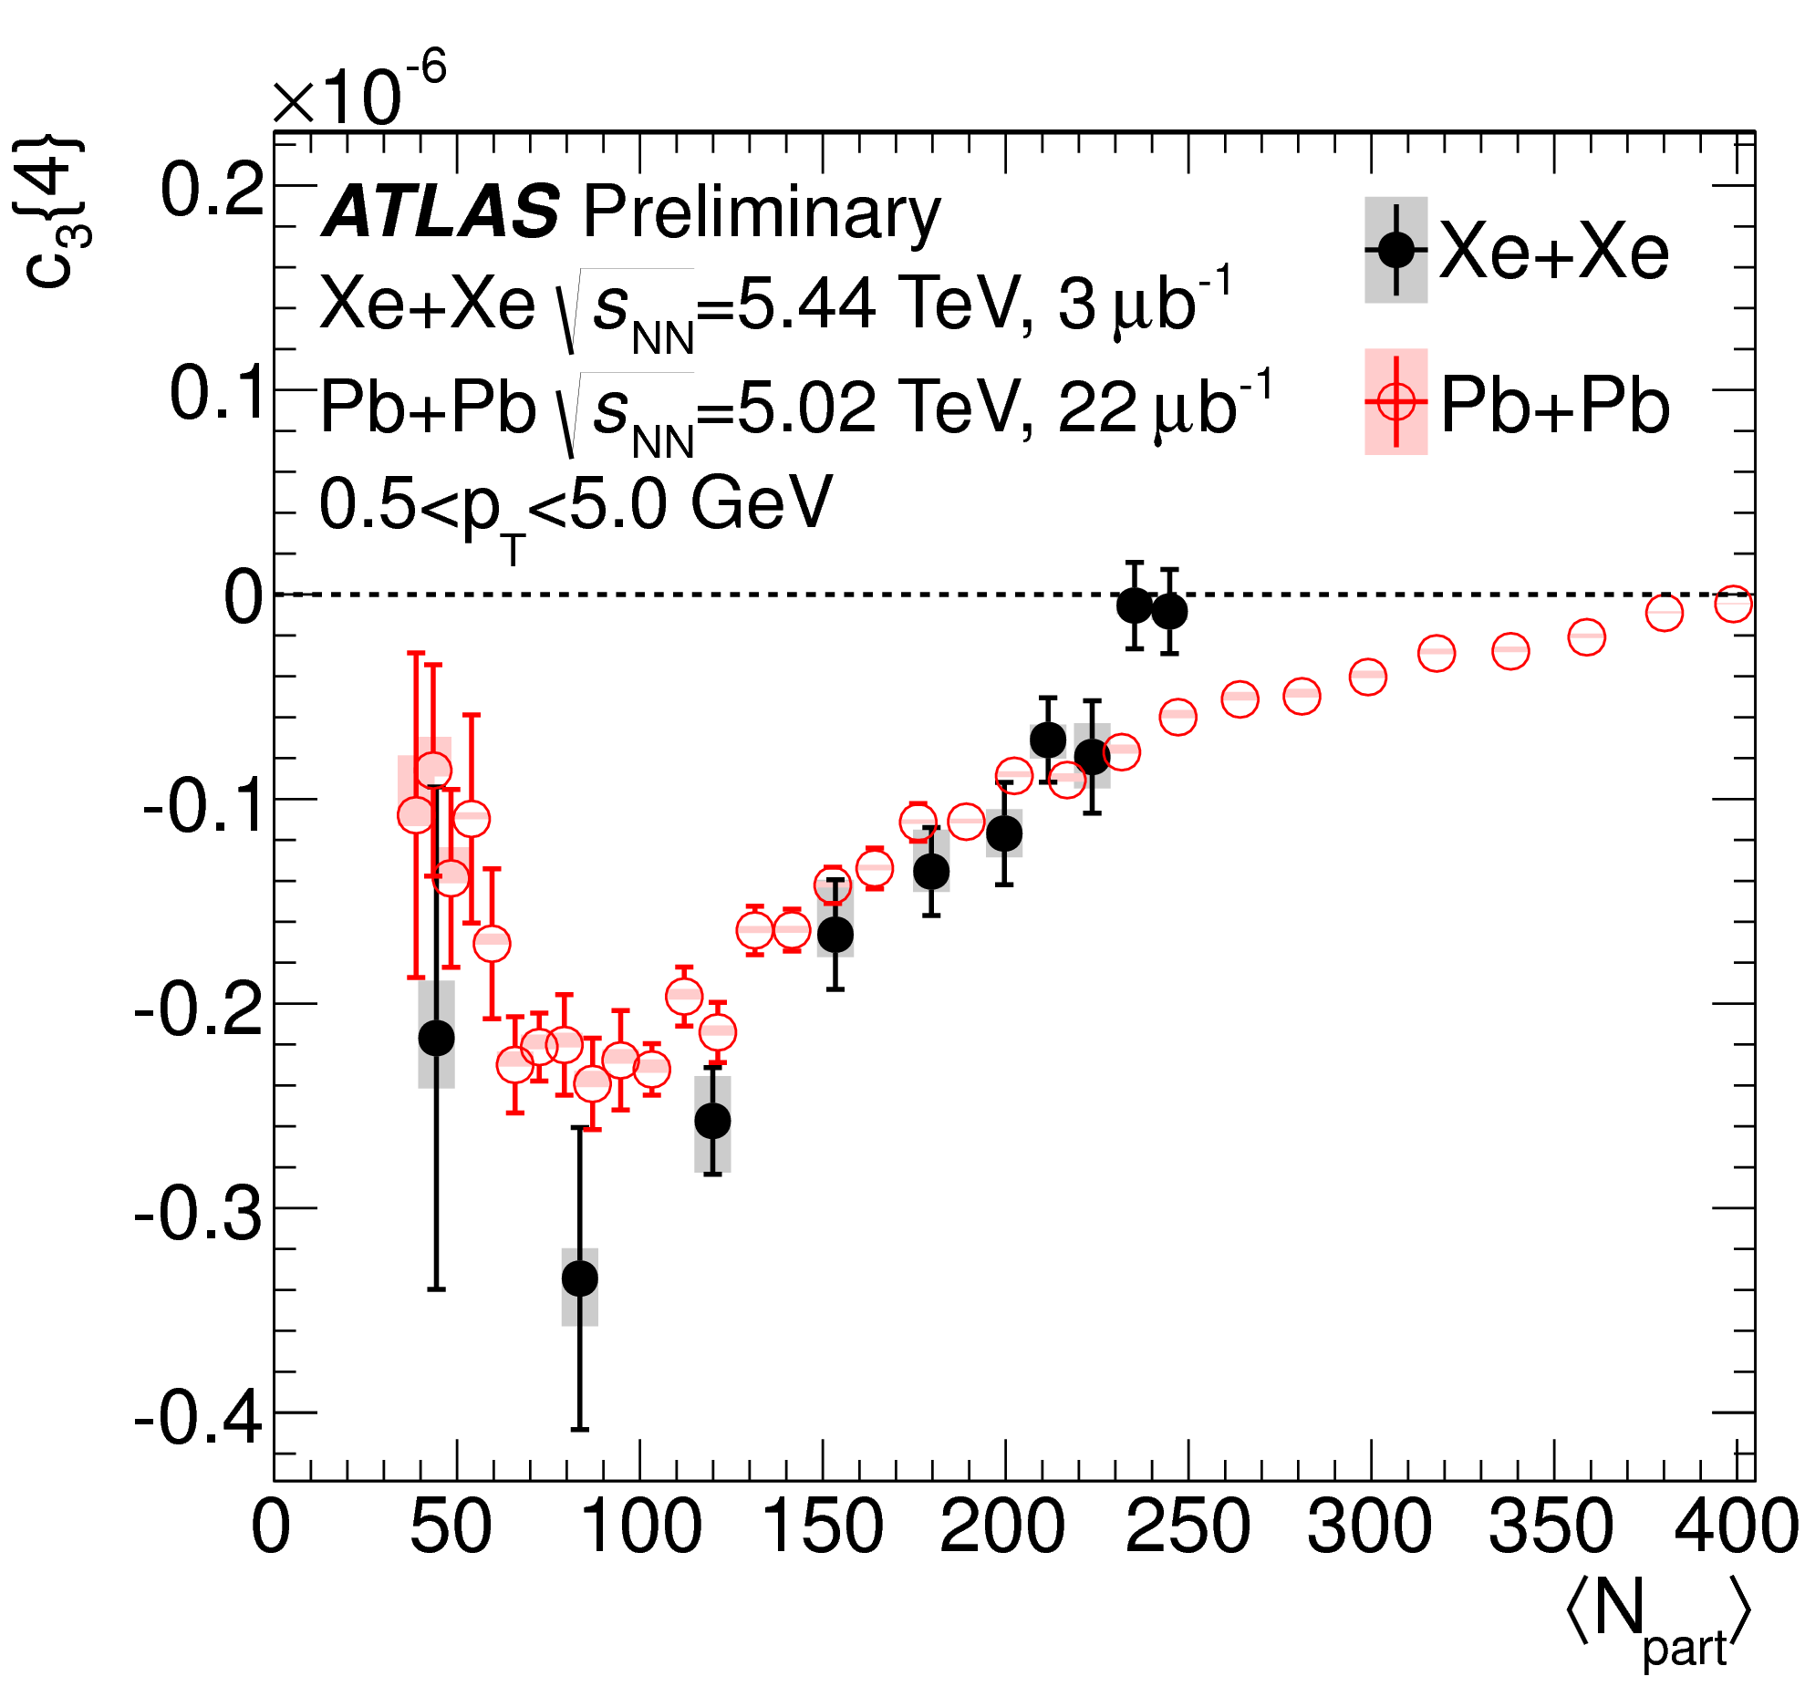
XeXe vs PbPb : N_{part} dependence
18
v₃ values at same centrality very different
but at same N_{part} are quite similar.
True for both v₃{2} and v₃{4}:
Should study dependence on multiplicity
Good motivation for running O-O in LHC run-3
ATLAS-CONF-2018-11

Slide 19
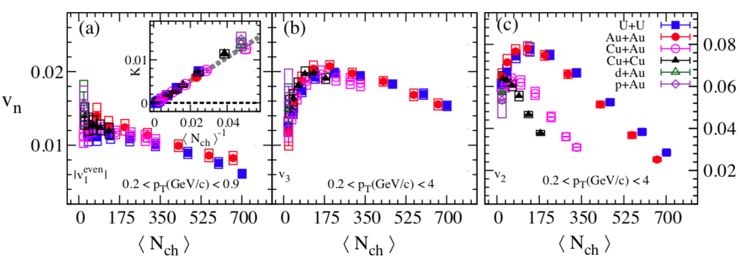
Flow across multiple systems
19
v₁
v₃
v₂
STAR arXiv:1901.08155
Scan of small and large systems at RHIC (200 GeV)
U+U, Au+Au, Cu+Au, Au+Cu, d+Au, p+Au
Multiplicity dependence of : v₁, v₃ and v₂
Nearly identical v₁ and v₃ across all systems but very different v₂
v₁, v₃ driven by fluctuations : which are identical/similar at same <N_{ch}>
v₂ has average-geometry component.

Slide 20
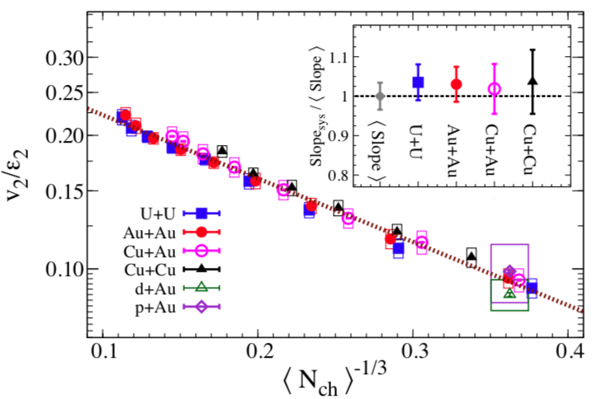
Fits to “Acoustic flow” model
20
STAR Collaboration
arXiv:1901.08155
Acoustic description of flow (R. Lacey et. al. arXiv:1804.04618)
v₂/ $ε$₂ ratio described across all systems
Perhaps acoustic model can also describe the v_{n}(p_{T}) power-law and shape scaling

Slide 21
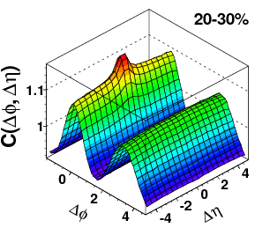
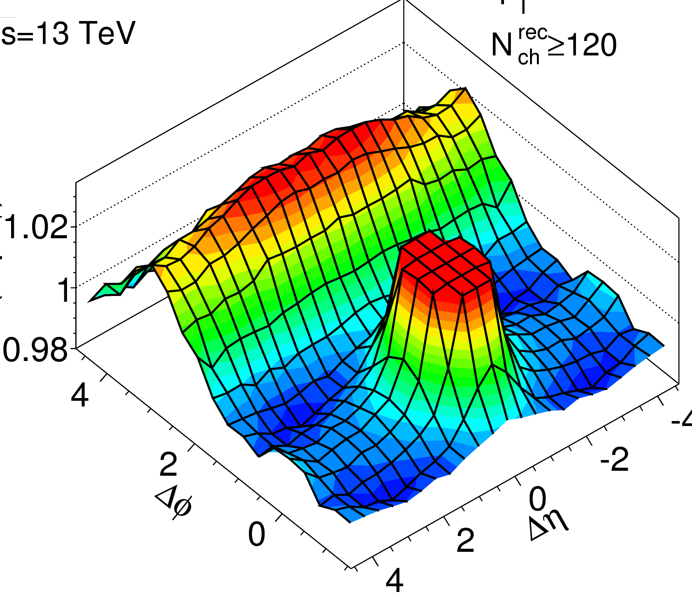
Ridges in A+A, p+A and pp
21
A+A ridge
p+A ridge
pp ridge
Are they produced from the same or different mechanisms?
If hydro, what are the implications?
How small can the smallest droplet of QGP be?
If different mechanism
Can we established this?

Slide 22
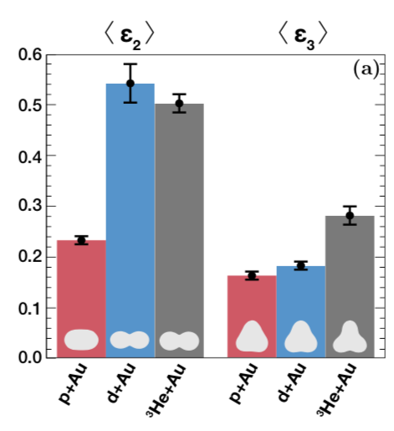
Phenix small system results
22
PHENIX
arXiv:1805.02973
Is anisotropy geometry driven?
2nd and 3rd order eccentricities in central p/d/He+Au collisions from Galuber
$ε$₂: p+A < d+A ~ He+A
$ε3$: p+A ~ d+A < He +A
Related talk
Qiao Xu:
Collectivity in small systems 2

Slide 23
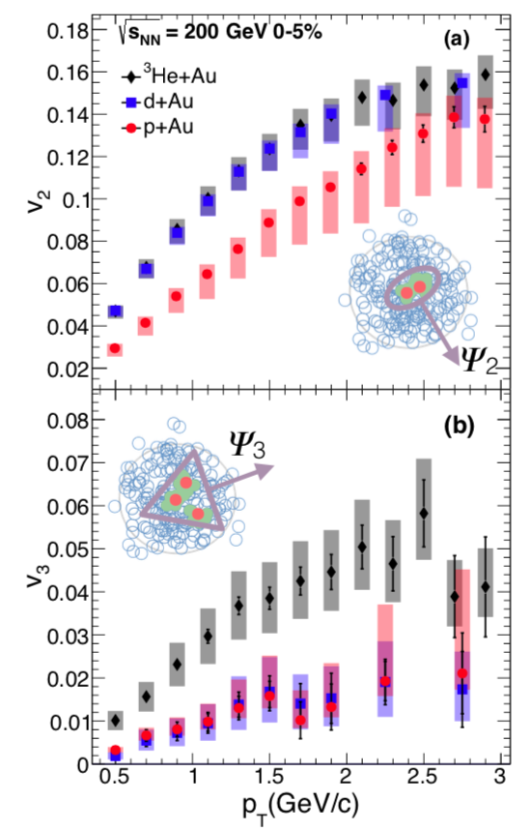
Phenix small system results
23
PHENIX
arXiv:1805.02973
Is anisotropy geometry driven?
2nd and 3rd order eccentricities in central p/d/He+Au collisions from Galuber
$ε$₂: p+A < d+A ~ He+A
$ε3$: p+A ~ d+A < He +A
Related talk
Qiao Xu:
Collectivity in small systems 2

Slide 24
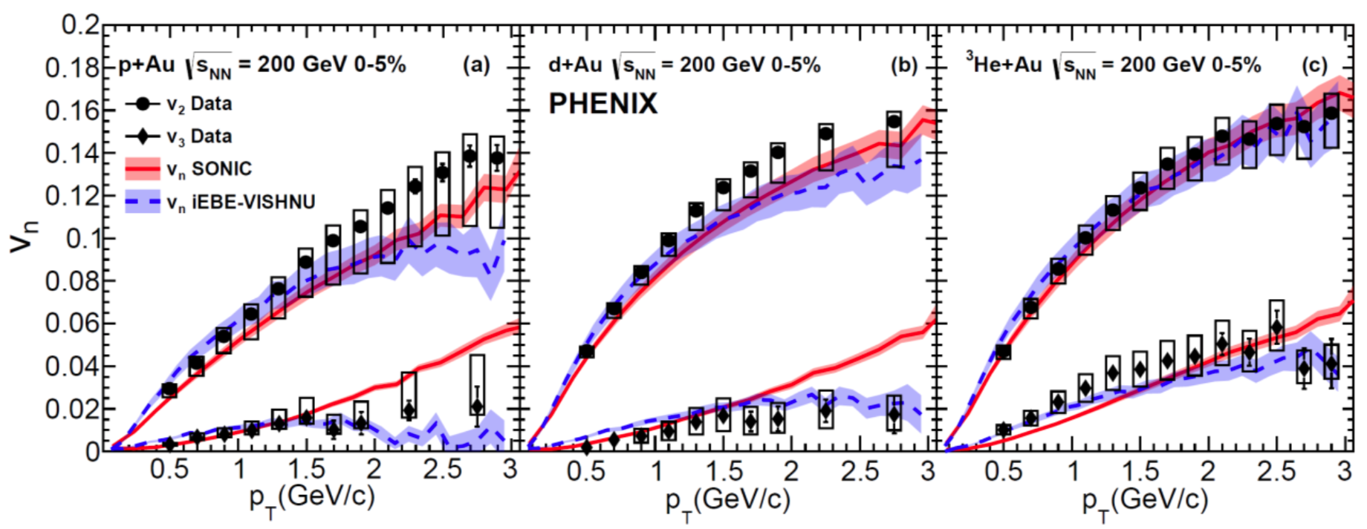
Comparison to models
24
Hydro calculations reproduce trends in all three systems
SONIC :p-value = 0.9
EBE-VISHNU :p-value = 0.1
AMPT :p-value ~0 (not shown)
Calculations are not adjusted to fit data
They are predictions
Related talk
Qiao Xu:
Collectivity in small systems 2
PHENIX
arXiv:1805.02973

Slide 25
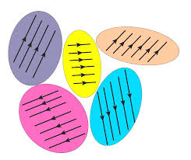
Color-domain (CGC) picture
25
³He+A
p+A
d+A
Size~1/Q_{s} ~0.2fm
Image credit: Julia Velkovska
Are correlations arising from coherent scattering from color domains?
Coherent scattering from individual domains would imply
Not consistent with what is observed in data.
Not possible to draw this conclusion with just p+A data
needed d+A and ³He+A to show this

Slide 26
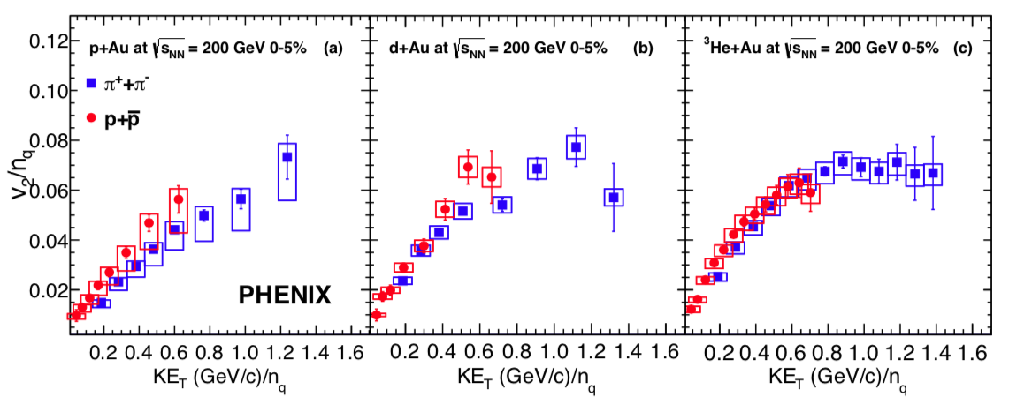
Constituent quark scaling
26
Works better and better from p+A → d+A → ³He+A
Trends qualitatively reproduced by SONIC and AMPT model
Related talks
Sanghoon: Phenix Overview talk
Qiao Xu: Collectivity in small systems 2
PHENIX
arXiv:1710.09736

Slide 27
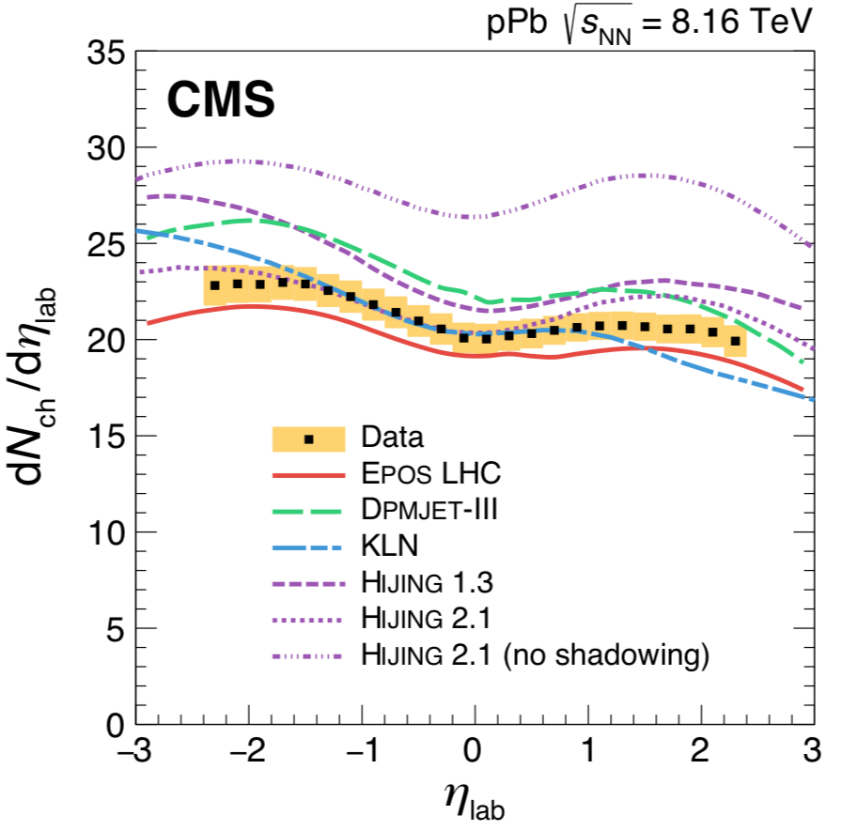
Importance of saturation models
27
Anisotropies well described by Hydro, not so well by CGC
Does this mean gluon saturations models are incorrect?
Not at all!
Multiplicity distributions at mid-rapidity in p+Pb (|ƞ|<1) well reproduced by KLN
Saturation models might be more accurate in describing initial entropy and eccentricities.
But need hydro to generate final anisotropies
CMS
arXiv:1710.09355

Slide 28
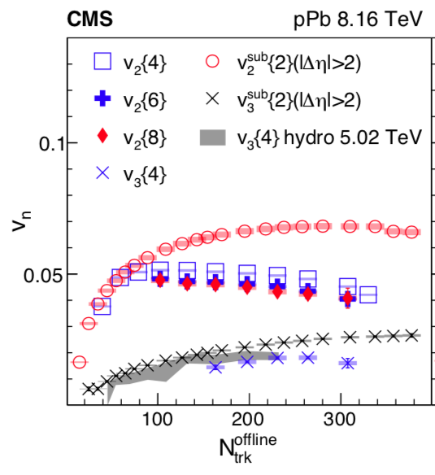
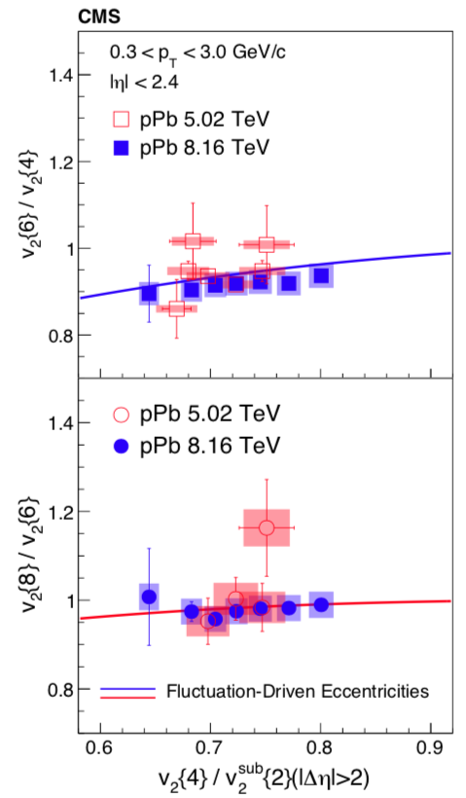
Non-gaussian fluctuations in p+Pb
28
CMS
arXiv:1904.11519v1
Precise measurements of v₂{4}, v₂{6}, and v₂{8} now available
Allows to see difference between higher order-cumulants
Much stronger constraints on initial geometry.
Caveat : non-flow correlations might still be present, especially in v₂{2} and v₂{4}

Slide 29
Non-gaussian fluctuations in p+Pb
29
Difference in v₂{2} and v₂{4} between ATLAS and CMS
ATLAS values much flatter with multiplicity
Not due to difference in Detector!
But due to difference in measurement methods (More on this later)
Should be careful when interpreting % level differences between v₂{4}, v₂{6}, and v₂{8}

Slide 30
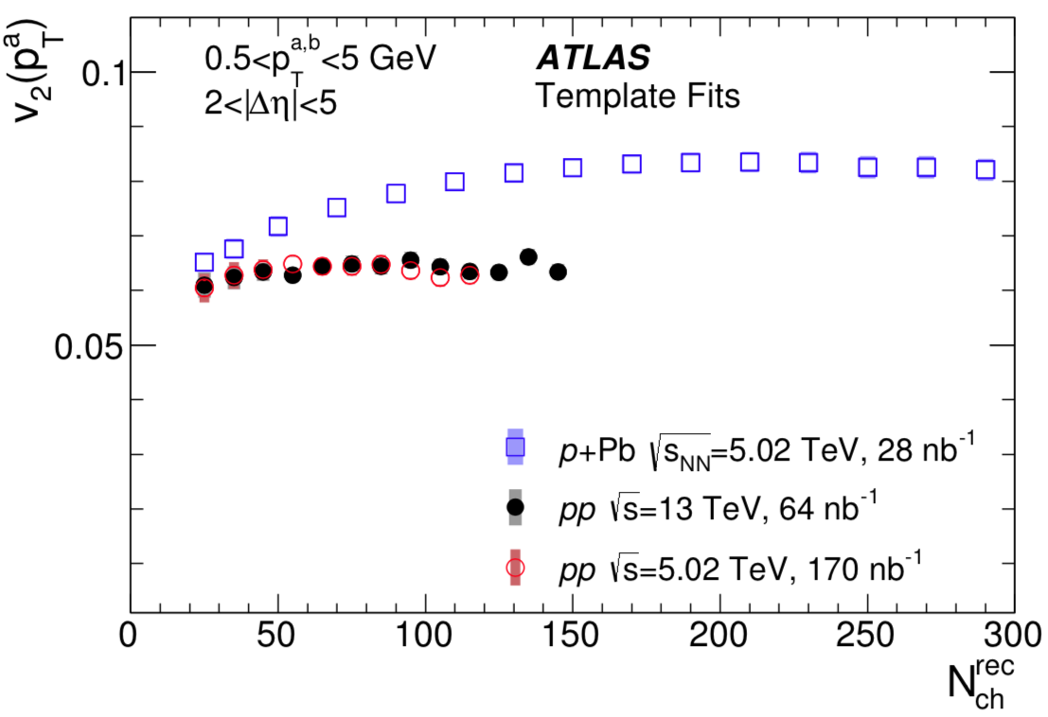
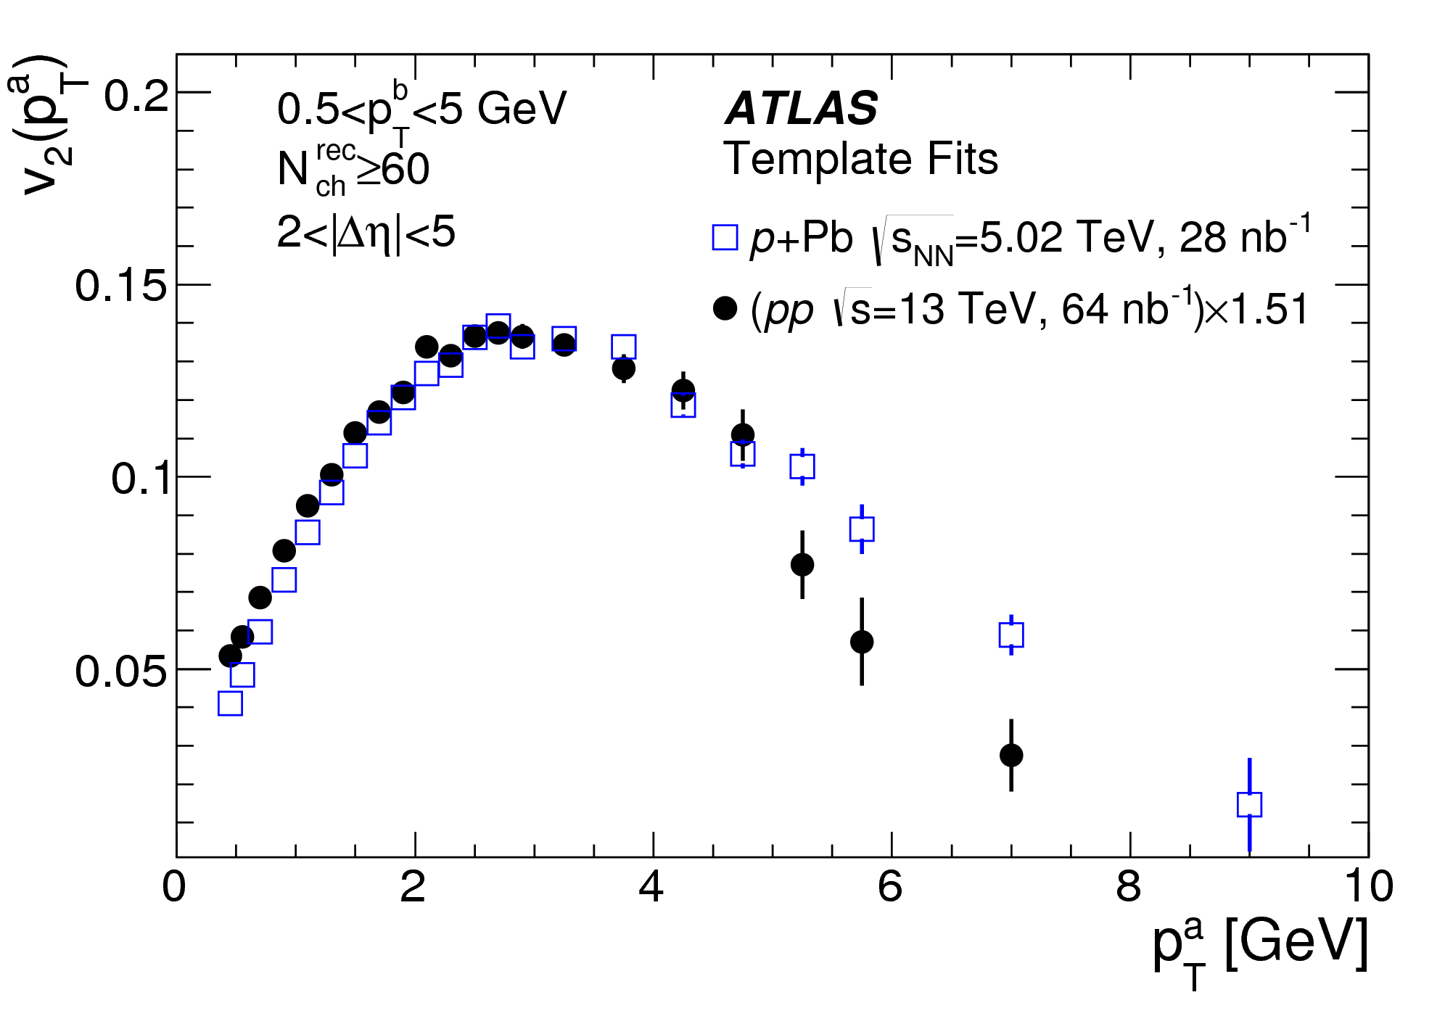
Azimuthal anisotropies in pp collisions
30
Consistent values for pp v₂ between 5.02 TeV and 13 TeV collisions.
No dependence of v₂ (or v₃ and v₄) on collision energy
Similar to A+A and p+A collisions
Similar shape of v₂(p_{T}) between pp and p+Pb, and A+A
Indicates similar origin?
Extensive studies, based on multi-particle cumulants done in last two years to investigate this
Related talks
Blair Seidlitz: Collectivity in small systems 1
Kurt Hill : Collectivity in small systems 1

Slide 31
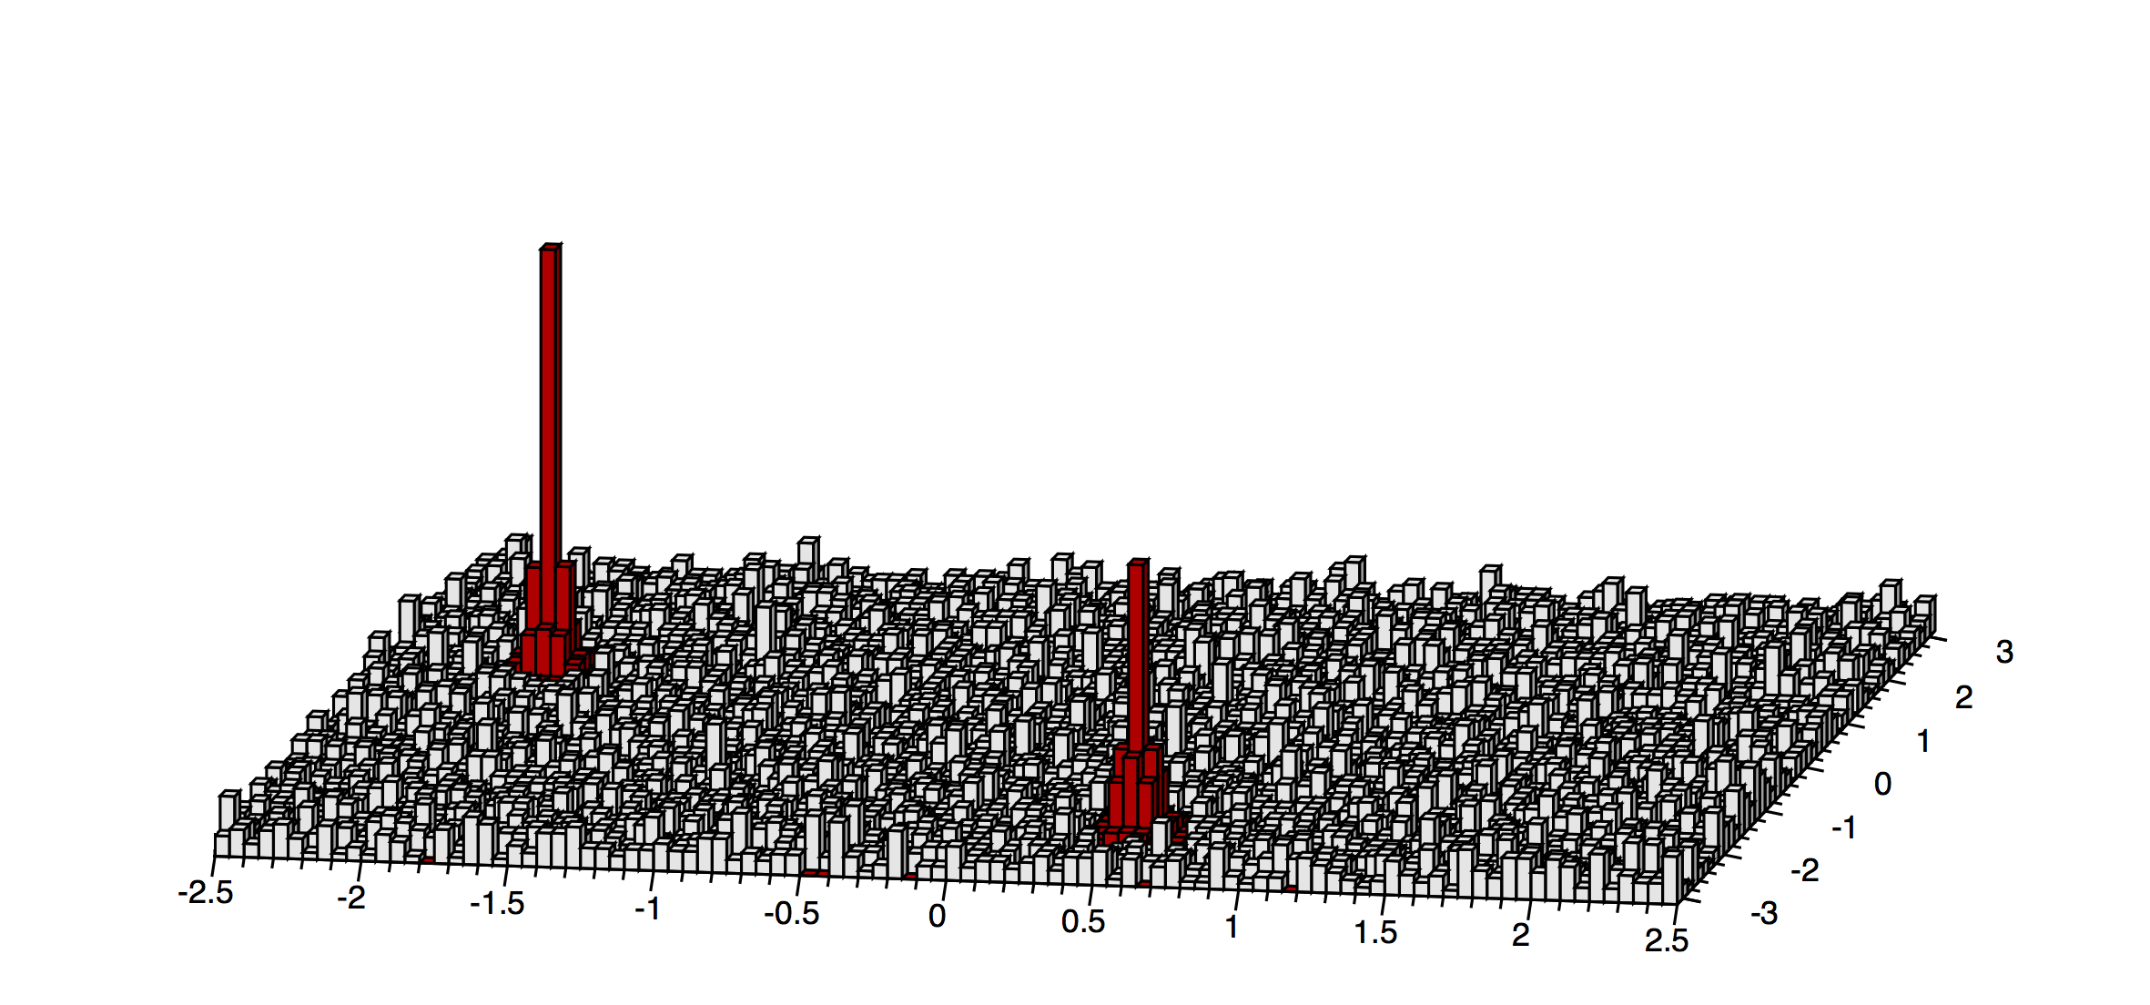
Multi-particle correlation measurements
5
31
In “standard cumulant”, non-flow sources contribute to four-particle correlation $\left\langle 4\right\rangle ;$
$$\left\langle 4\right\rangle ≡\left\langle e^{2i\left(φ_{i}+φ_{j}−φ_{k}−φ_{l}\right)}\right\rangle$$
$$φ$$
$$η$$
$$C_{2}\left\{4\right\}≡\left\langle 4\right\rangle −2{\left\langle 2\right\rangle }^{2}≡{\left\langle 4\right\rangle }_{non−flow}+\left\langle v^{4}\right\rangle −2{\left\langle v^{2}\right\rangle }^{2}$$

Slide 32
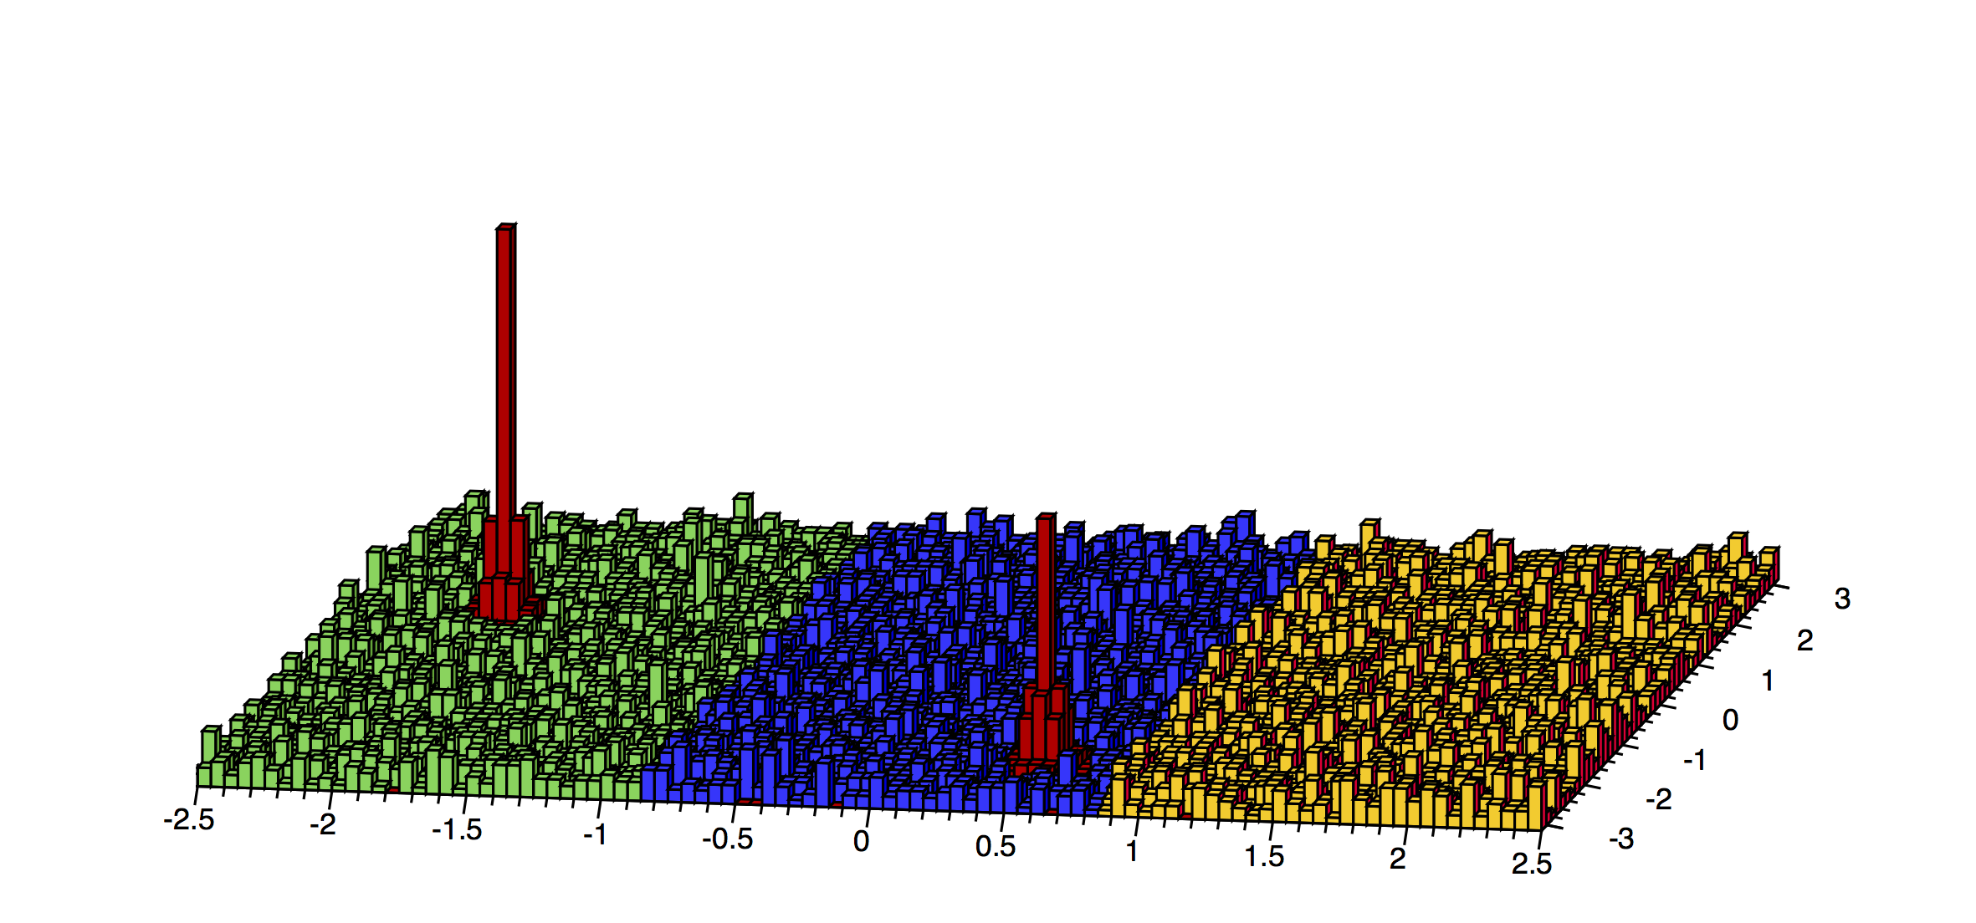
Subevent cumulants
5
32
In “standard cumulant”, non-flow sources contribute to four-particle correlation $\left\langle 4\right\rangle$
In the “subevent” method, particles are correlated across all subevents (long-range).
3 subevent cumulant can further suppress away-side jet contribution
$$\left\langle 4\right\rangle ≡\left\langle e^{2i\left(φ_{i}+φ_{j}−φ_{k}−φ_{l}\right)}\right\rangle$$
$$φ$$
$$b$$
$$a$$
$$c$$
$$η$$
$$C_{2}^{2a|b,c}\left\{4\right\}≡{\left\langle 4\right\rangle }_{2a|b,c}−2{\left\langle 2\right\rangle }_{a|b}{\left\langle 2\right\rangle }_{a|c}$$
J. Jia et. al. Phys. Rev. C 96, 034906 (2017)

Slide 33
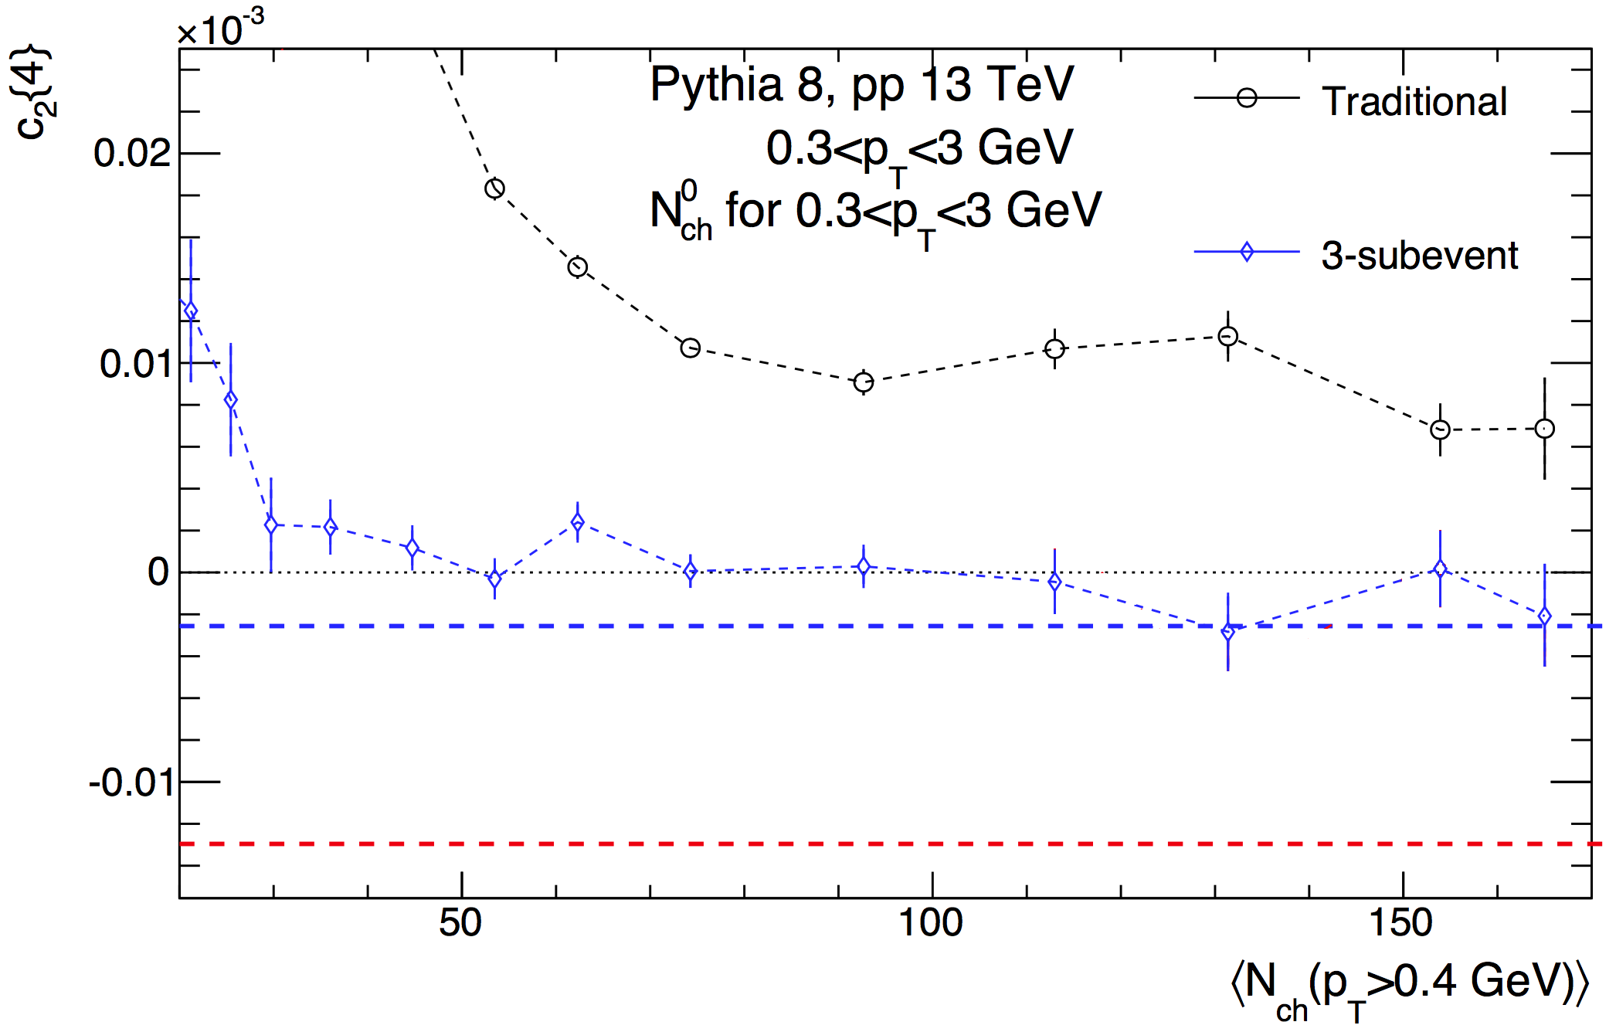
Subevent cumulants
5
33
In “standard cumulant”, non-flow sources contribute to four-particle correlation $\left\langle 4\right\rangle ;$
In the “subevent” method, particles are correlated across all subevents (long-range).
3 subevent cumulant can further suppress away-side jet contribution;
New method validated in PYTHIA
Also check data-driven way.
$$\left\langle 4\right\rangle ≡\left\langle e^{2i\left(φ_{i}+φ_{j}−φ_{k}−φ_{l}\right)}\right\rangle$$
4% flow
$$φ$$
$$b$$
$$a$$
$$c$$
6% flow
$$η$$
$$C_{2}^{2a|b,c}\left\{4\right\}≡{\left\langle 4\right\rangle }_{2a|b,c}−2{\left\langle 2\right\rangle }_{a|b}{\left\langle 2\right\rangle }_{a|c}$$
J. Jia et. al.Phys. Rev. C 96, 034906 (2017)

Slide 34
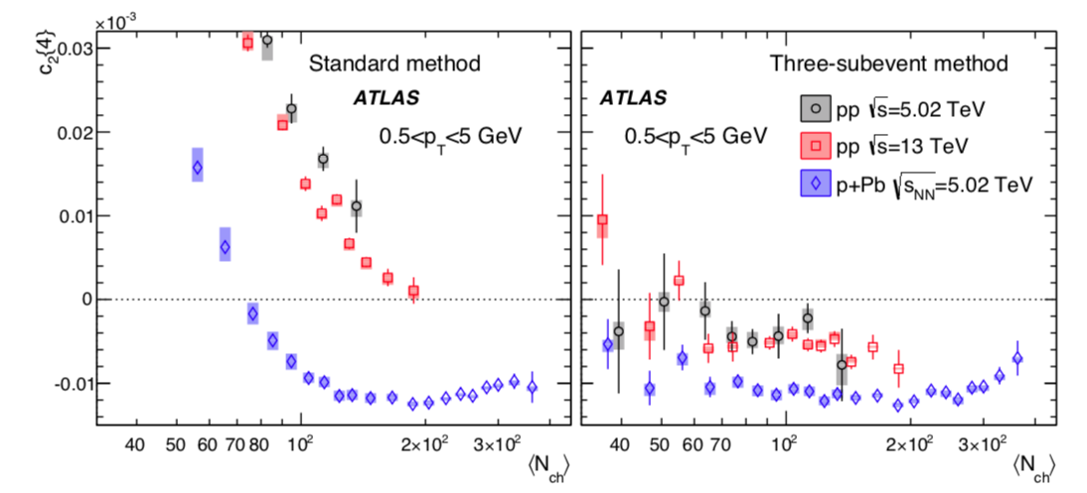
v_{n} from multi-particle Cumulants
11
34
4-particle cumulant c₂{4} indicates no-collectivity in pp at any multiplicity
And in p+Pb collisions with ~80 and fewer tracks
pp results from standard cumulants show energy dependence
No such dependence was seen in the Template (or 2PC) v₂
Does this indicate non-collectivity in pp?

Slide 35
v_{n} from multi-particle Cumulants
11
35
Nope!
Real culprit is non-flow contribution in standard cumulant measurements
Sub-event cumulants yield negative c₂{4} values down to the lowest measured multiplicity

Slide 36
v₂{4}: Multiplicity dependence
13
36
$v_{2}\left\{2\right\}$ from template fit
$v_{2}\left\{2\right\}$ from peripheral sub
$v_{2}\left\{4\right\}$ from 3 subevent
$v_{2}\left\{4\right\}$ in pp
Consistent with no. multiplicity dependence (For N_{ch}>50)
No dependence on collision energy
$v_{2}\left\{4\right\}<v_{2}\left\{2\right\}$ (template fit):
Implies presence of fluctuations
p+Pb v₂{4} also has negligible multiplicity dep

Slide 37
Symmetric cumulants: v_{n}-v_{m} correlations
37
pp p+Pb Pb+Pb
v₂-v₃ correlation
Phys. Rev. Lett. 120, 092301 (2018)
v₂-v₄ correlation
Correlation between different order harmonic flows using symmetric cumulants in pp, p+Pb and Pb+Pb collisions
In Pb+Pb, central p+Pb :v₂--v₃ anti-correlated, v₂--v₄ correlated.
Across most multiplicities in pp and in peripheral p+Pb: v₂--v₃ correlated: is there any “physics” behind this?

Slide 38
Symmetric cumulants: v_{n}-v_{m} correlations
38
Phys. Lett. B 789 (2019) 444
13
v₂-v₃
v₂-v₄
Measurements re-done using sub-event cumulants to suppress non-flow.
Across all systems and multiplicities: v₂--v₃ anti correlated, v₂--v₄ correlated.
Global (anti)correlations.
present between particles selected from different |eta| ranges

Slide 39
Final Thoughts
Large number of measurements covering small and large systems performed at RHIC and at the LHC in the last few years.
Measurements have become quite precise:
Constraints in interpreting result in many cases is not experimental precision
but the bias introduced by the measurement technique itself
Measurements establish collective flow like behavior in small+large collision systems: p/d/³He+A
Correlations in pp collisions qualitatively and in many cases quantitatively similar to p+A and A+A collisions.
No way reduces importance of saturation models in describing initial conditions
Multiple other measurements will be presented at this conference:
Heavy-flavor flow,
Directed flow
HBT
EW probes + many others

Slide 40
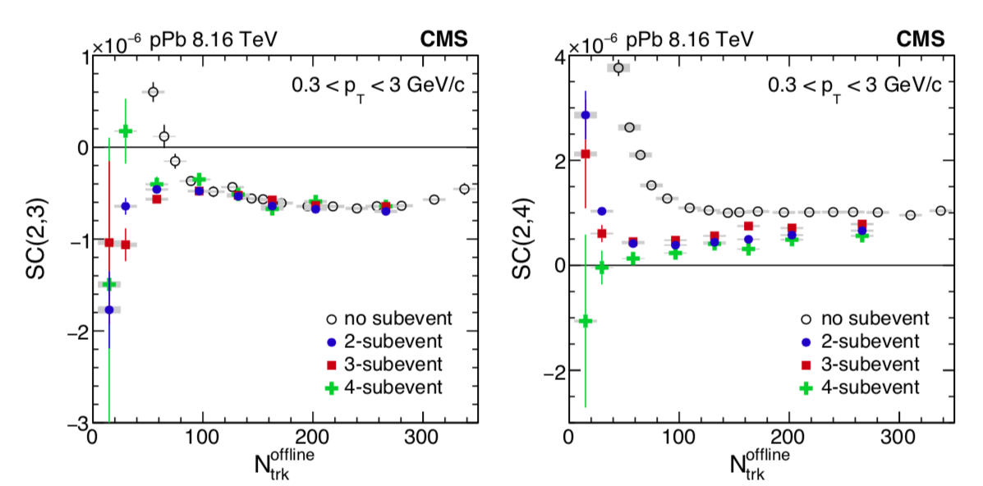
Symmetric cumulants: standard vs sub-event
40
13
CMS: arXiv 1905.09935
Side by side comparison of difference
Shown for 8.16 TeV p+Pb collisions
For SC(2,3) differences are small for >100 tracks
But for SC(2,4) difference persists to higher multiplicities

