Slide 1

Spin at Low x
Matthew D. Sievert
work done with Yuri Kovchegov and Daniel Pitonyak
Initial Stages 2019
Fri. June 28, 2019
M. Sievert
Spin at Low x
1 / 26

Slide 2
The Significance of “Low x”

Slide 3



3 Meanings of “Low x”
Low-x Kinematics
Linear Evolution
Nonlinear Evolution
$$\text{x}\text{ < 0.01}$$
$$\text{x}\text{ <} e^{−1/α_{s}}$$
$$Λ_{QCD} \text{<} Q_{s}(x)$$
M. Sievert
Spin at Low x
2 / 26

Slide 4
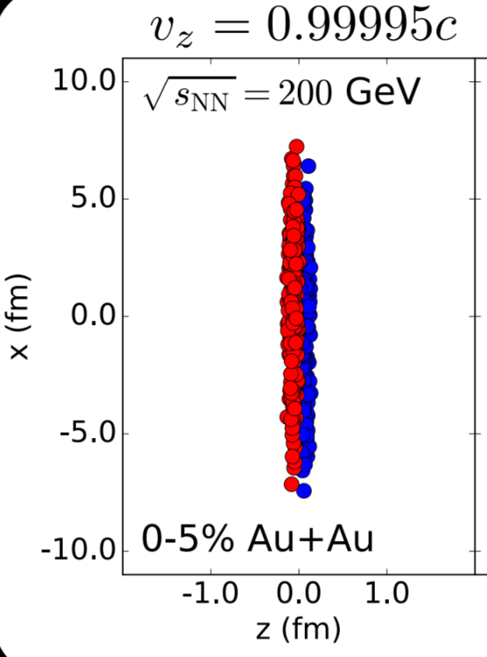
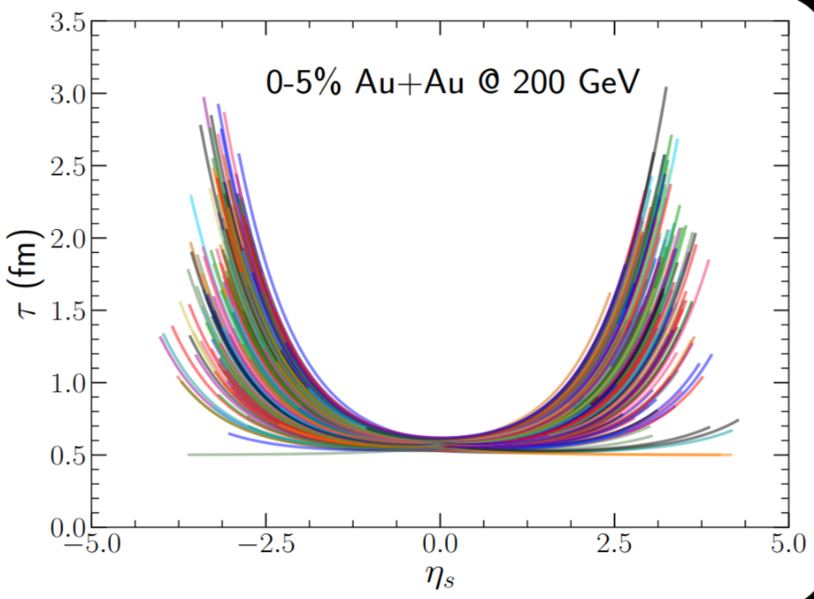
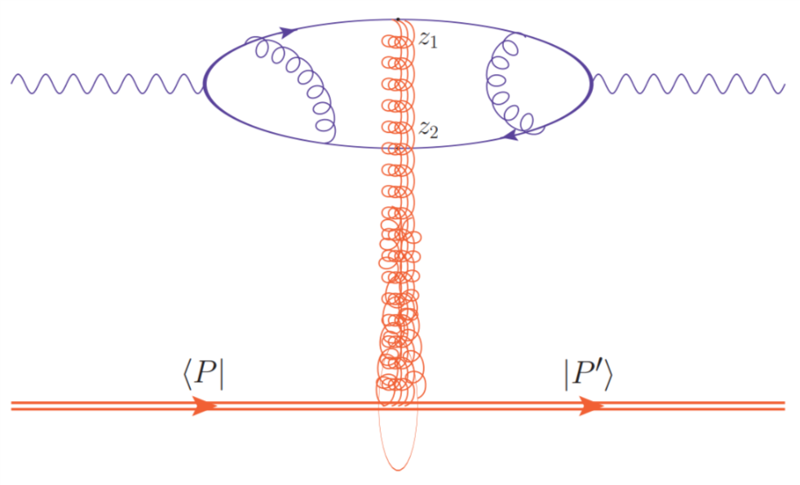

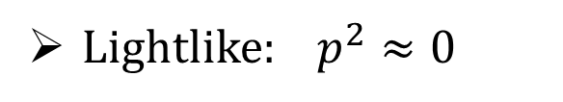
3 Meanings of “Low x”
“Boost invariance”
Low-x Kinematics
C. Shen talk
Lightlike: $p^{2}≈0$
“Shockwave
Picture”
Soft gluons
$μ_{B}≈0$
R. Boussarie talk
$$\text{x}\text{ < 0.01}$$
$$\text{x}\text{ <} e^{−1/α_{s}}$$
$$Λ_{QCD} \text{<} Q_{s}(x)$$
M. Sievert
Spin at Low x
2 / 26

Slide 5
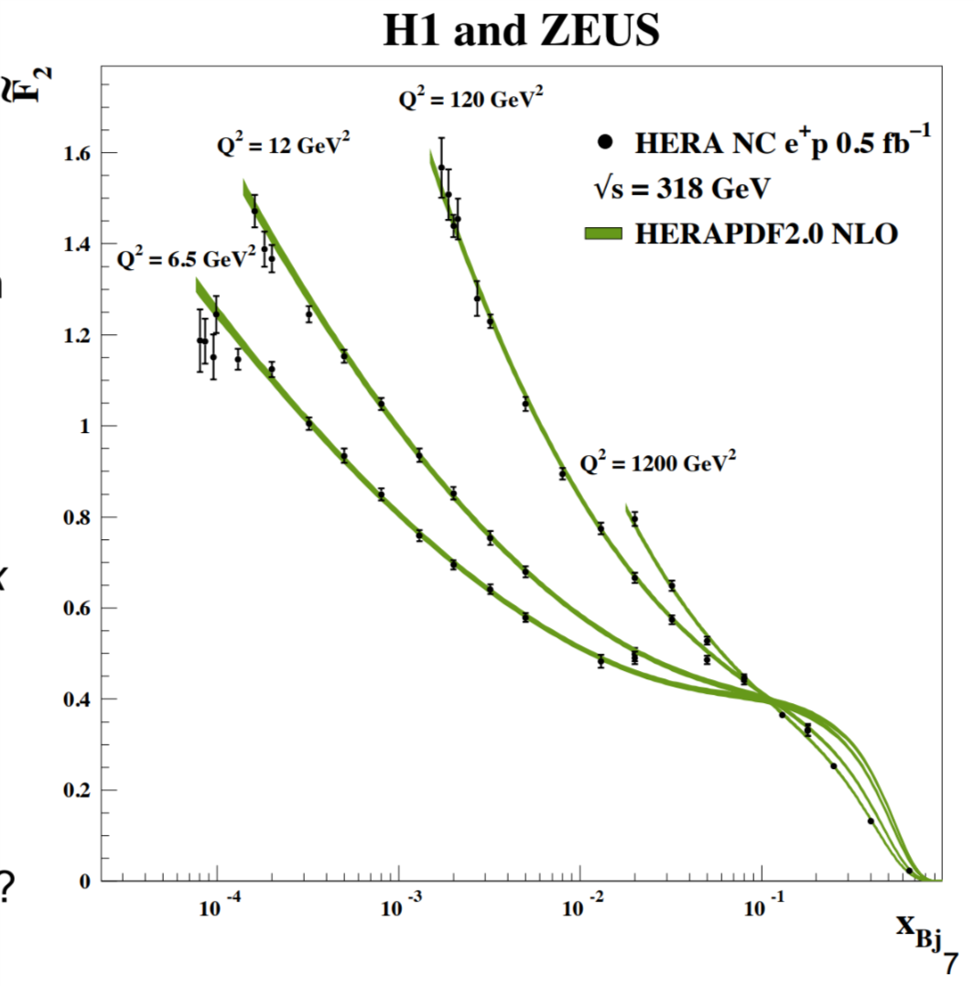
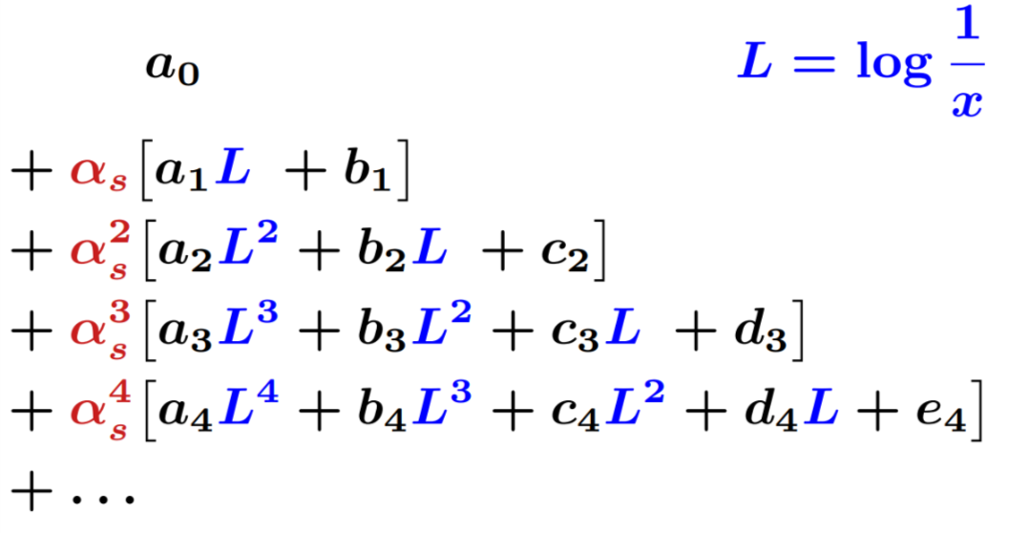
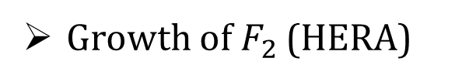


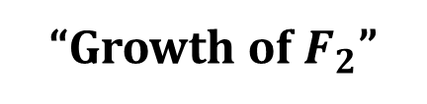
3 Meanings of “Low x”
“Growth of $F_{2}$”
“Leading Log
Resummation”
Low-x Kinematics
Linear Evolution
Lightlike: $p^{2}≈0$
Soft gluon cascade
Soft gluon emission
Growth of $F_{2}$ (HERA)
M. Bonvini talk
$μ_{B}≈0$
BFKL equation
$$\text{x}\text{ < 0.01}$$
$$\text{x}\text{ <} e^{−1/α_{s}}$$
$$Λ_{QCD} \text{<} Q_{s}(x)$$
M. Wing talk
M. Sievert
Spin at Low x
3 / 26

Slide 6
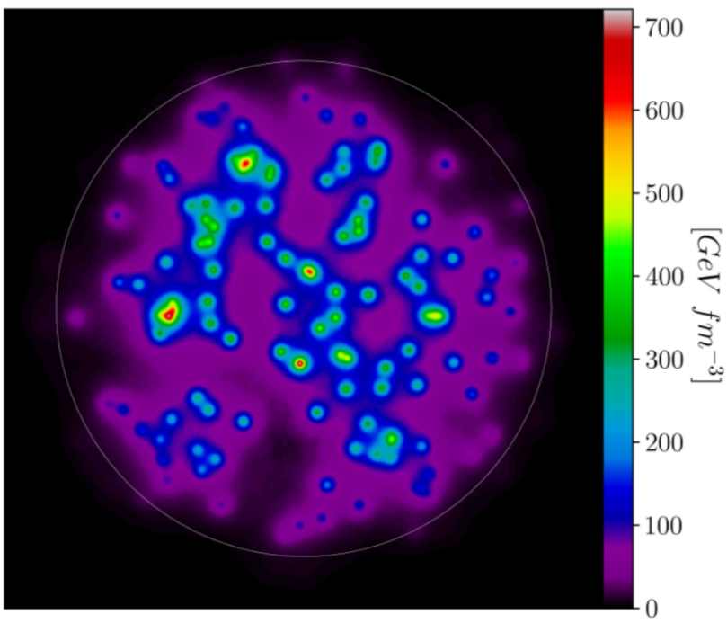
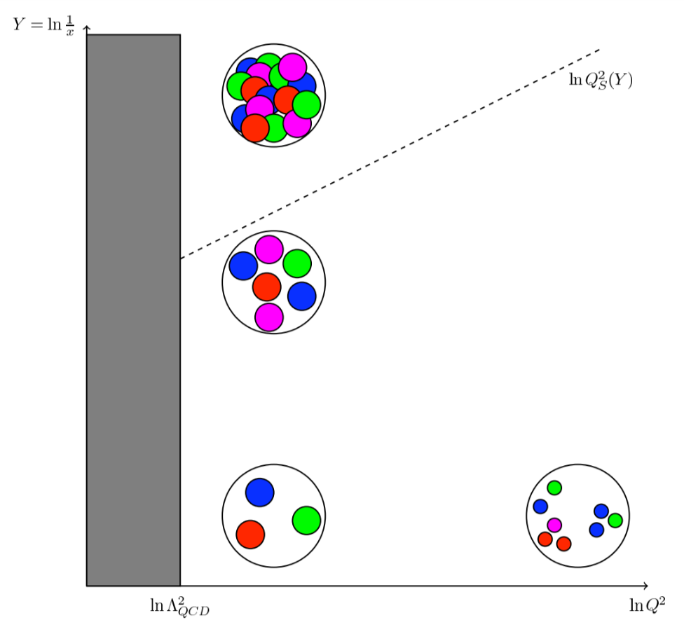
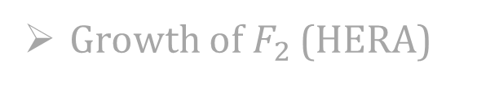
3 Meanings of “Low x”
G. Giacalone talk
“Classical
Gluon Fields”
Low-x Kinematics
Linear Evolution
Nonlinear Evolution
Lightlike: $p^{2}≈0$
Soft gluon cascade
BK / JIMWLK eqns.
“Yang-Mills”
Soft gluon emission
Growth of $F_{2}$ (HERA)
Multiple scattering
“Color-Glass
Condensate”
$μ_{B}≈0$
BFKL equation
Gluon saturation
$$\text{x}\text{ < 0.01}$$
$$\text{x}\text{ <} e^{−1/α_{s}}$$
$$Λ_{QCD} \text{<} Q_{s}(x)$$
T. Altinoluk talk
M. Sievert
Spin at Low x
4 / 26

Slide 7
3 Meanings of “Low x”
Low-x Kinematics
Linear Evolution
Nonlinear Evolution
Lightlike: $p^{2}≈0$
Soft gluon cascade
BK / JIMWLK eqns.
Soft gluon emission
Growth of $F_{2}$ (HERA)
Multiple scattering
$μ_{B}≈0$
BFKL equation
Gluon saturation
$$\text{x}\text{ < 0.01}$$
$$\text{x}\text{ <} e^{−1/α_{s}}$$
$$Λ_{QCD} \text{<} Q_{s}(x)$$
M. Sievert
Spin at Low x
4 / 26

Slide 8
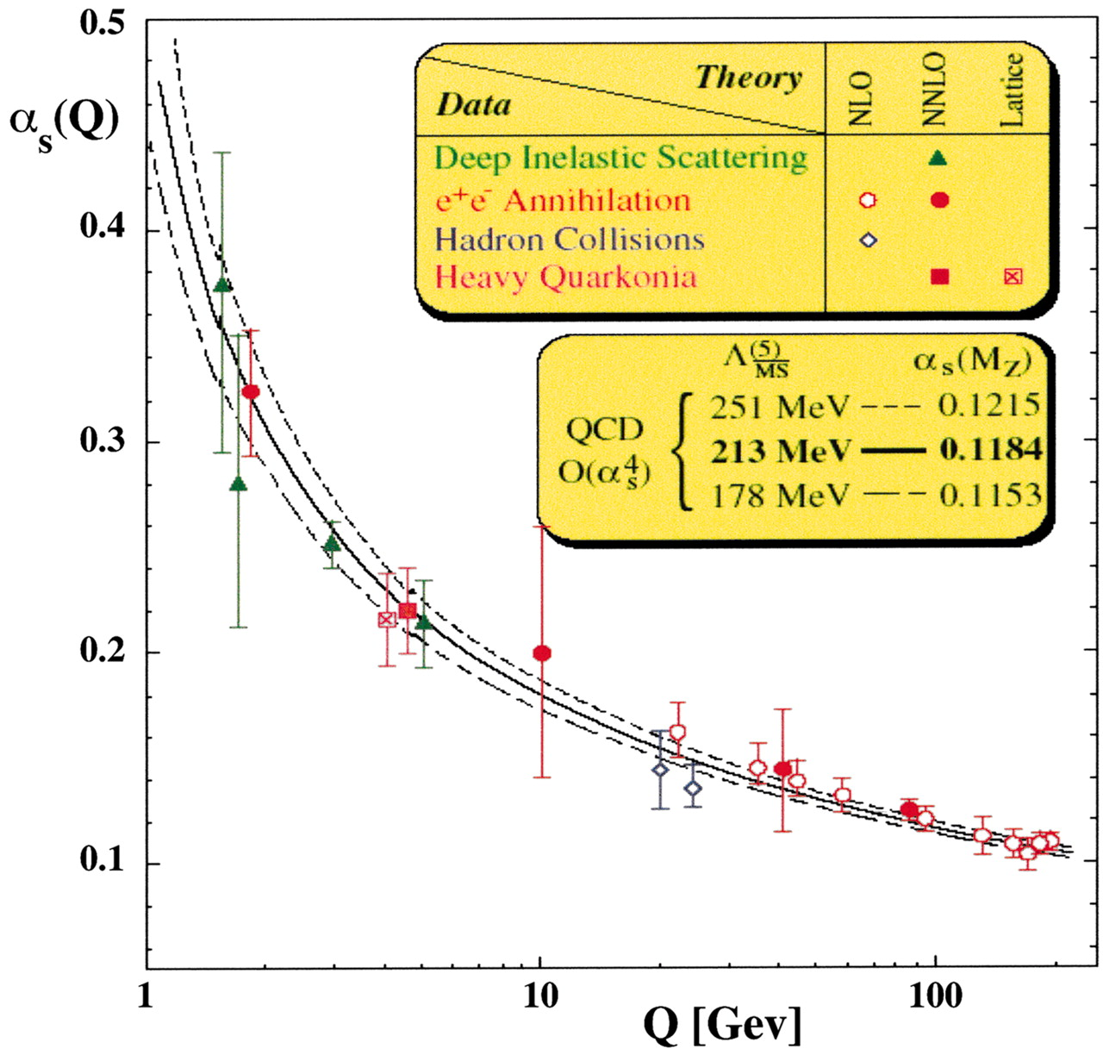
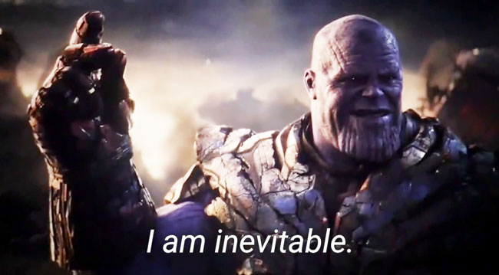
Low-x Saturation: Bigger than QCD
Asymptotic Freedom
Density Explosion
Saturation + Unitarization
“Saturation is a non-negotiable consequence of QCD.” - N. Armesto
A fundamental consistency test of UV completeness in the S.M.
M. Sievert
Spin at Low x
5 / 26

Slide 9
What Causes
the Small-x Explosion?

Slide 10
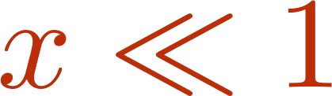
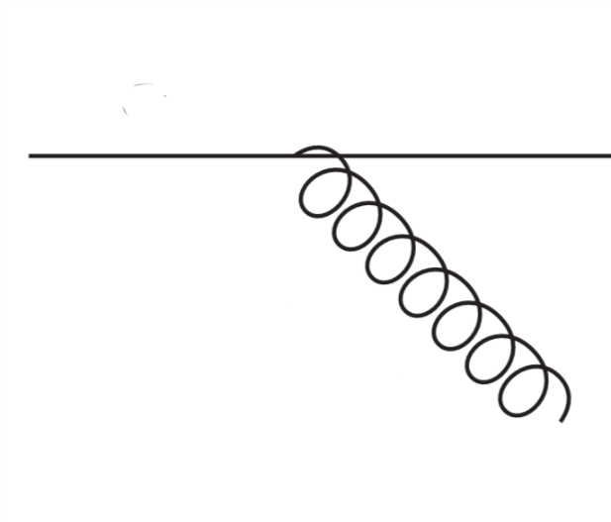
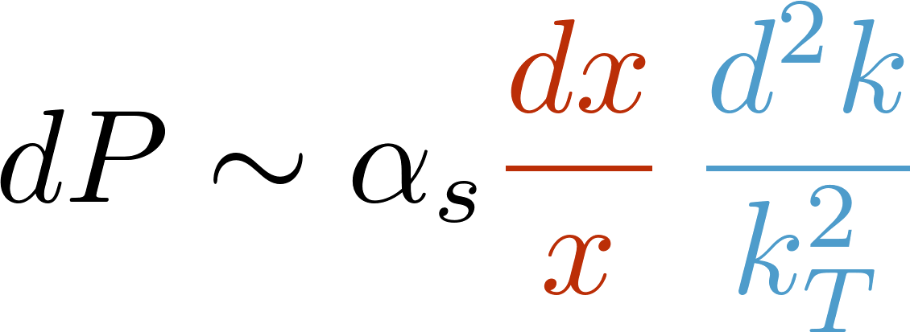
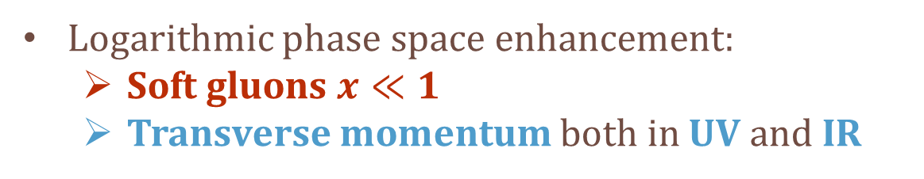
Phase Space for Soft Radiation
Elementary splitting wave functions:
Logarithmic phase space enhancement:
  Soft gluons $x≪1$
  Transverse momentum both in UV and IR
M. Sievert
Spin at Low x
6 / 26

Slide 11
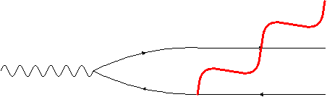

Screening of the Transverse Phase Space
(Color) charge neutrality:
  Long wavelength radiation is screened
  Cancellation of quark + antiquark radiation
Color transparency:
  Short wavelength radiation doesn’t interact
  Unitarity: real / virtual cancellations
Transverse logarithms are screened
  No preferred transverse ordering
M. Sievert
Spin at Low x
7 / 26

Slide 12
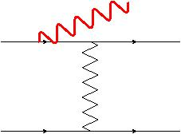
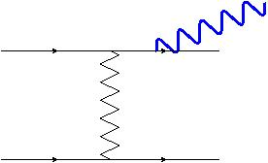
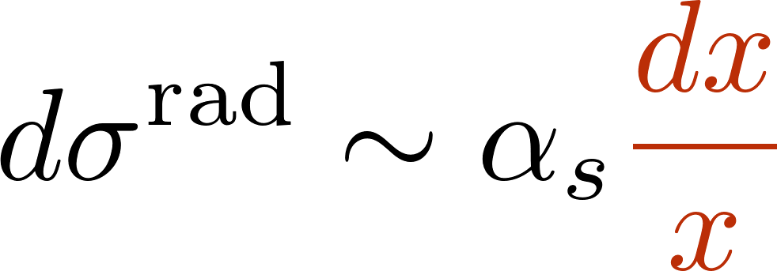
Small-x Enhancement: A Non-Abelian Phenomenon
ISR
FSR
The total cross section arises from an interference of initial- and final-state radiation
They interfere with perfect phase coherence in eikonal kinematics
  Cancellation of radiation for Abelian theories (QED)
  Commutator for non-Abelian theories (QCD)
The high-energy, small-x limit is uniquely sensitive to non-Abelian dynamics
M. Sievert
Spin at Low x
8 / 26

Slide 13
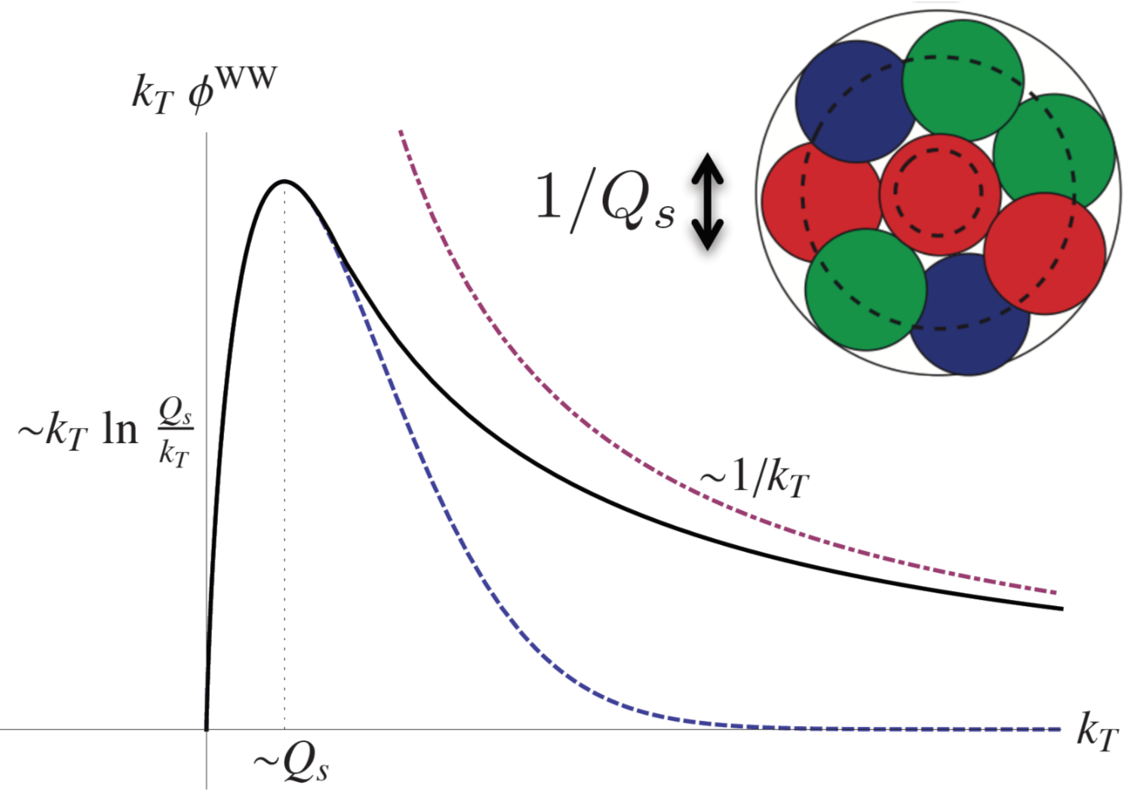
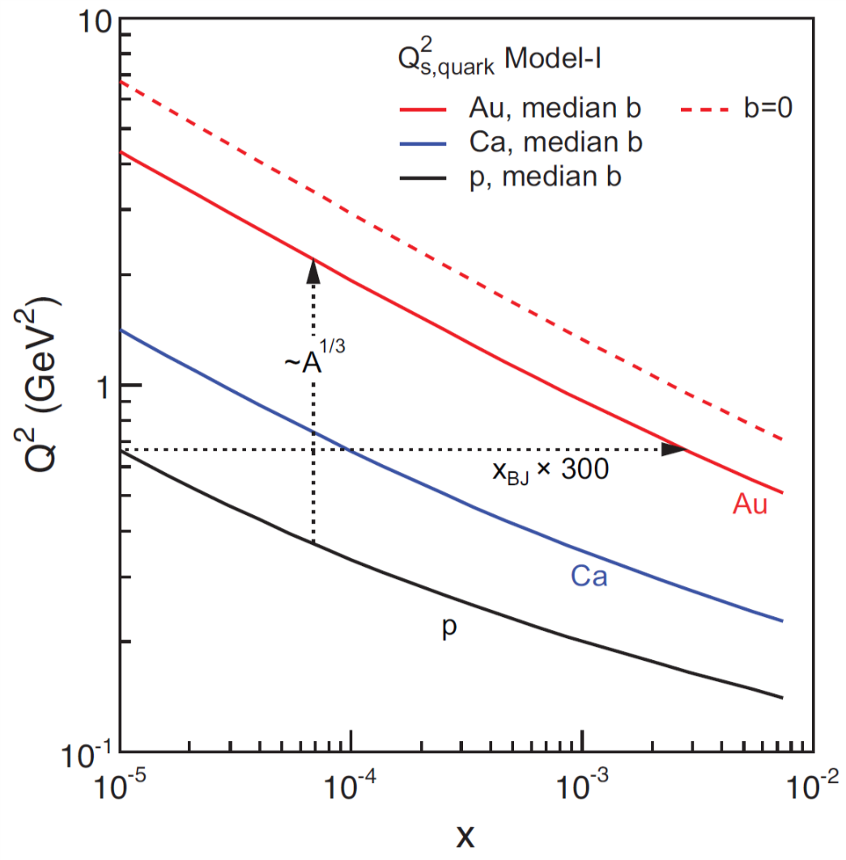
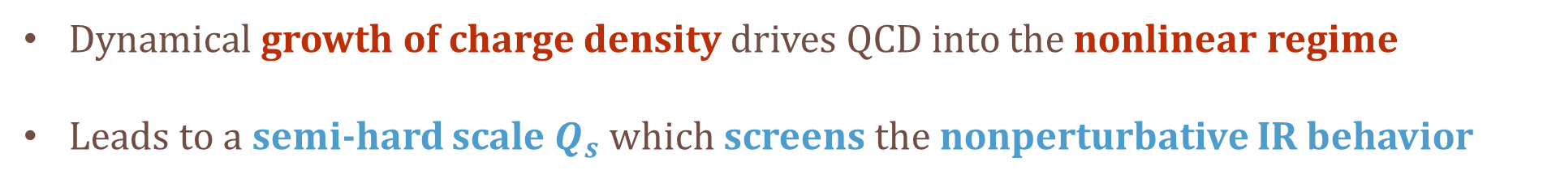
Confronting the Small-x Gluon Cascade
Dynamical growth of charge density drives QCD into the nonlinear regime
Leads to a semi-hard scale $Q_{s}$ which screens the nonperturbative IR behavior
M. Sievert
Spin at Low x
9 / 26

Slide 14
Looking for Spin
at Small x

Slide 15
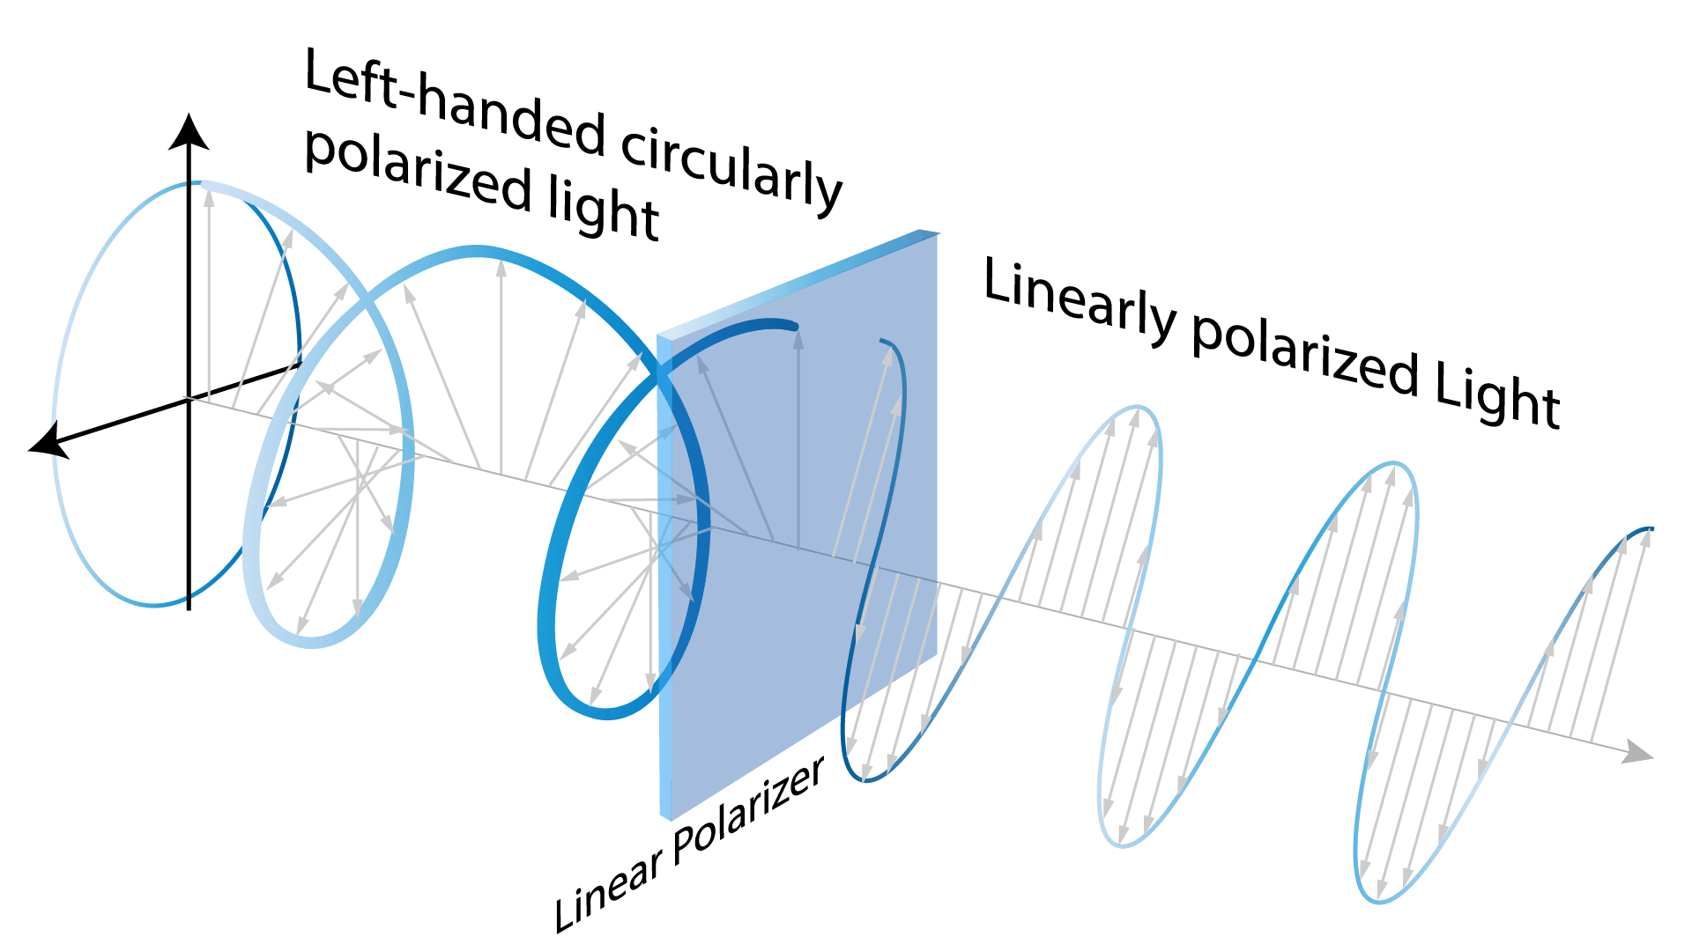
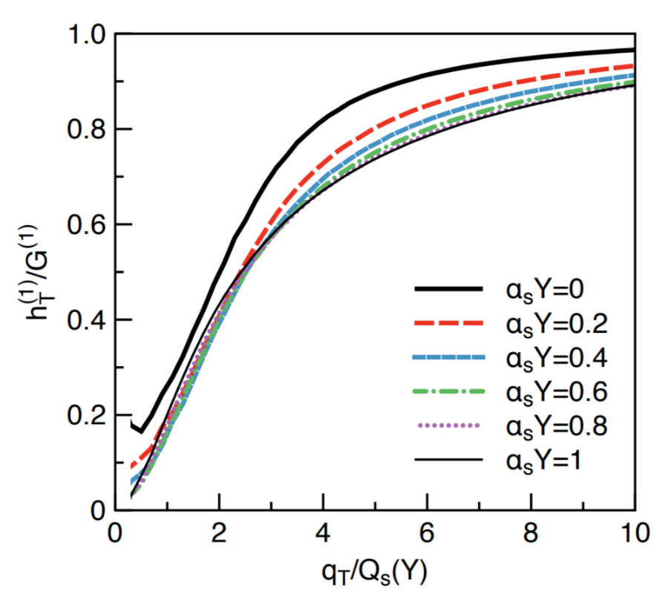
The Small-x Cascade is Highly Polarized….
The gluon cascade possesses a high / maximal degree of linear polarization
Dumitru, Lappi, & Skokov,
Phys. Rev. Lett. 115 (2015)
Metz & Zhou, Phys. Rev. D84 (2011)
R. Boussarie talk
M. Sievert
Spin at Low x
10 / 26

Slide 16
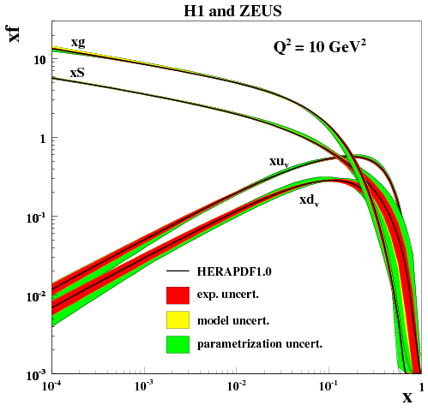
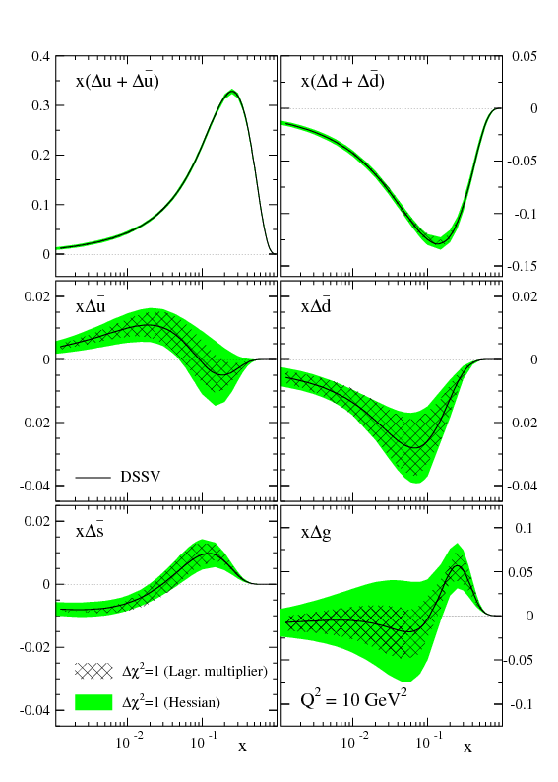
…But Carries No Angular Momentum
JHEP 1001 (2010) 109
De Florian et al., Phys. Rev. D80 (2009) 034030
While unpolarized parton densities grow at small x, helicity distributions fall
M. Sievert
Spin at Low x
11 / 26

Slide 17
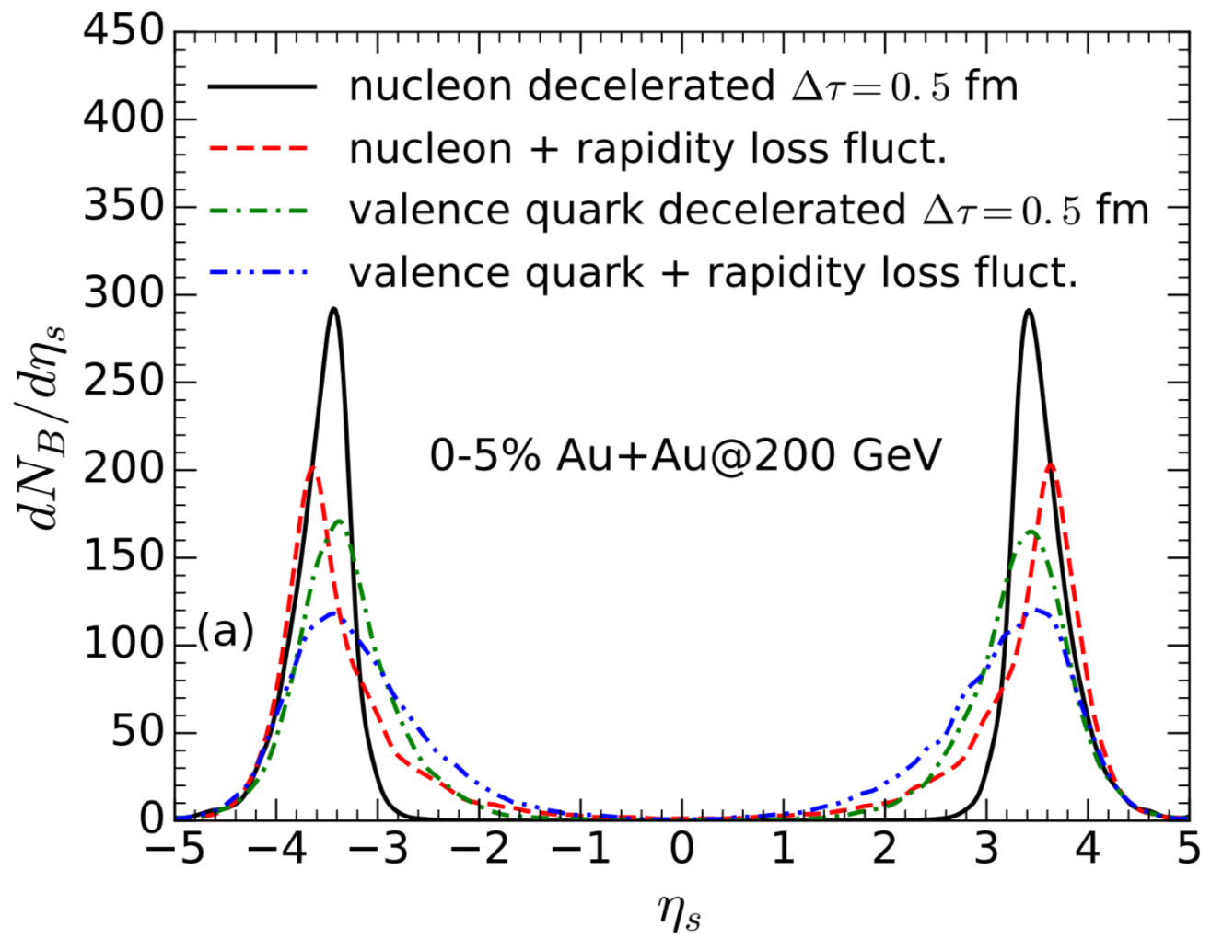
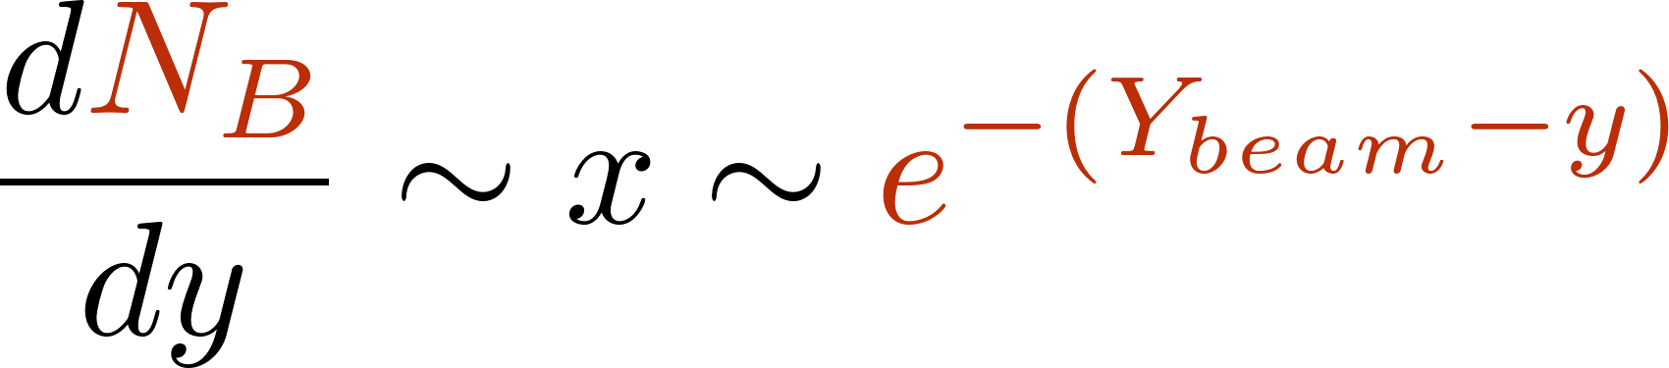
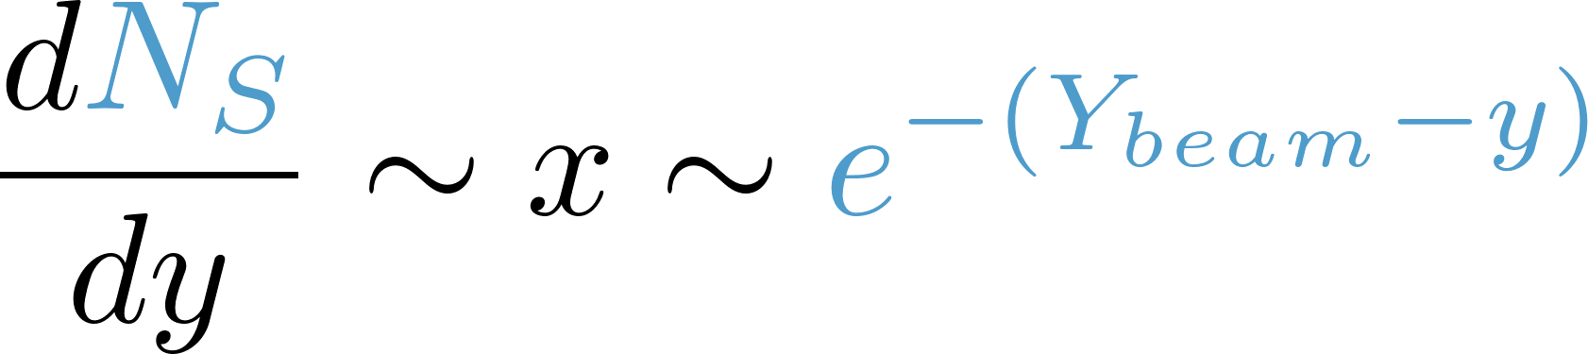
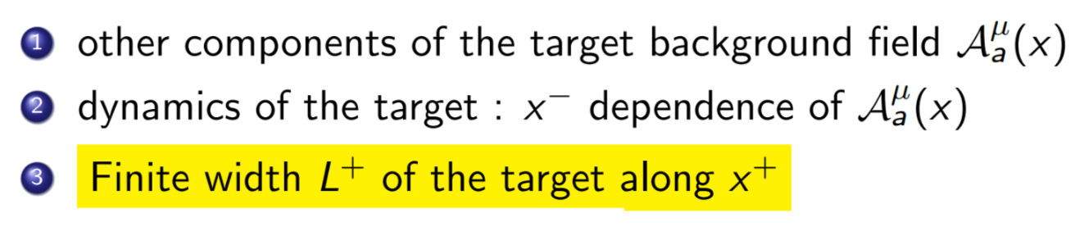
“Spin Stopping” is a Sub-Eikonal Effect
Just like baryon stopping, spin transfer is power suppressed at small x.
Other sub-eikonal corrections:
Shen & Schenke, Phys. Rev. C97 (2018)
C. Shen talk
T. Altinoluk talk
M. Sievert
Spin at Low x
12 / 26

Slide 18
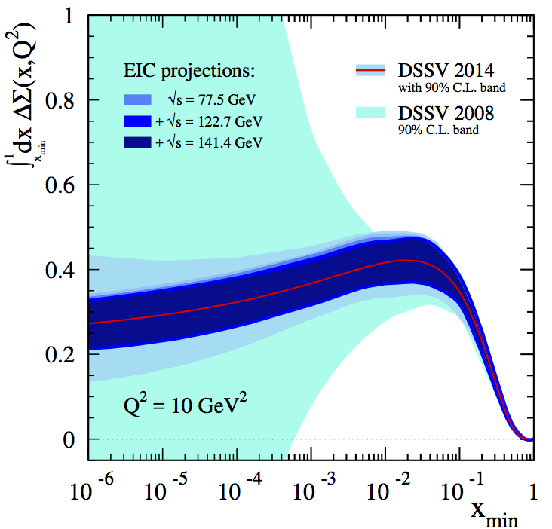
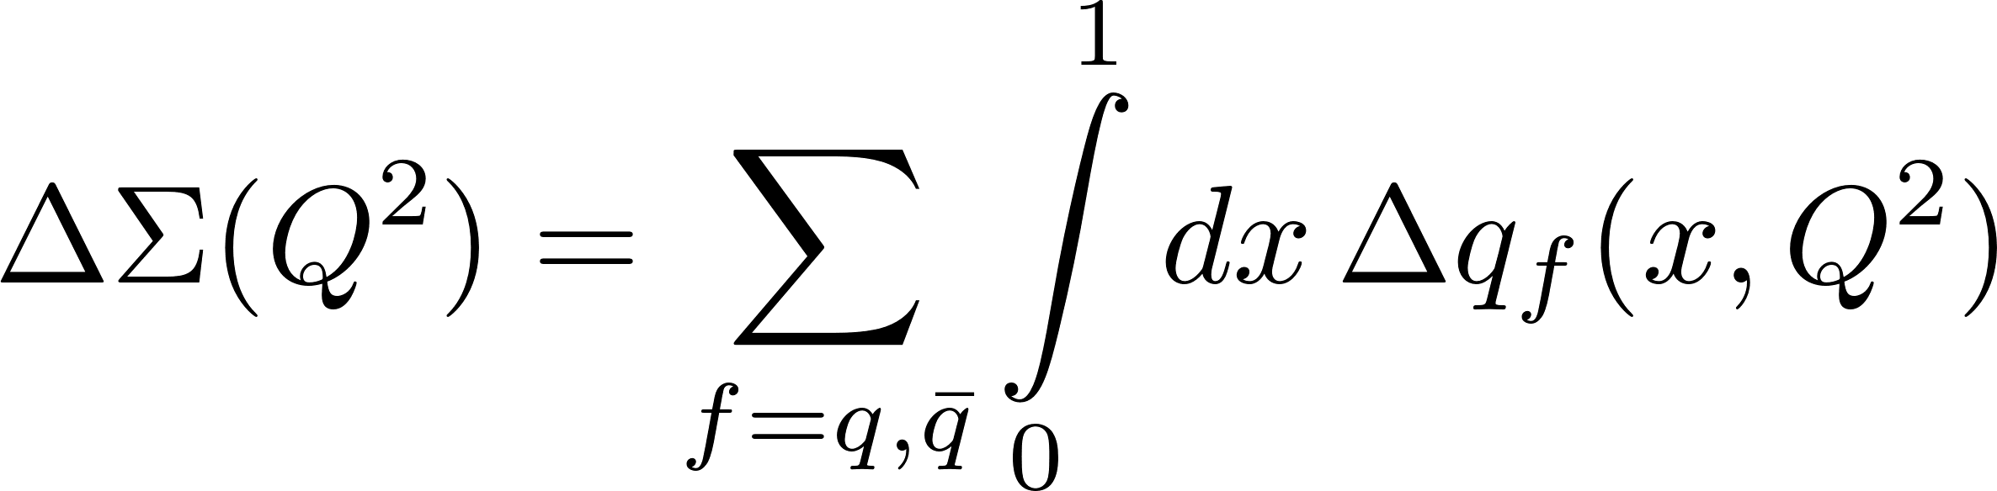
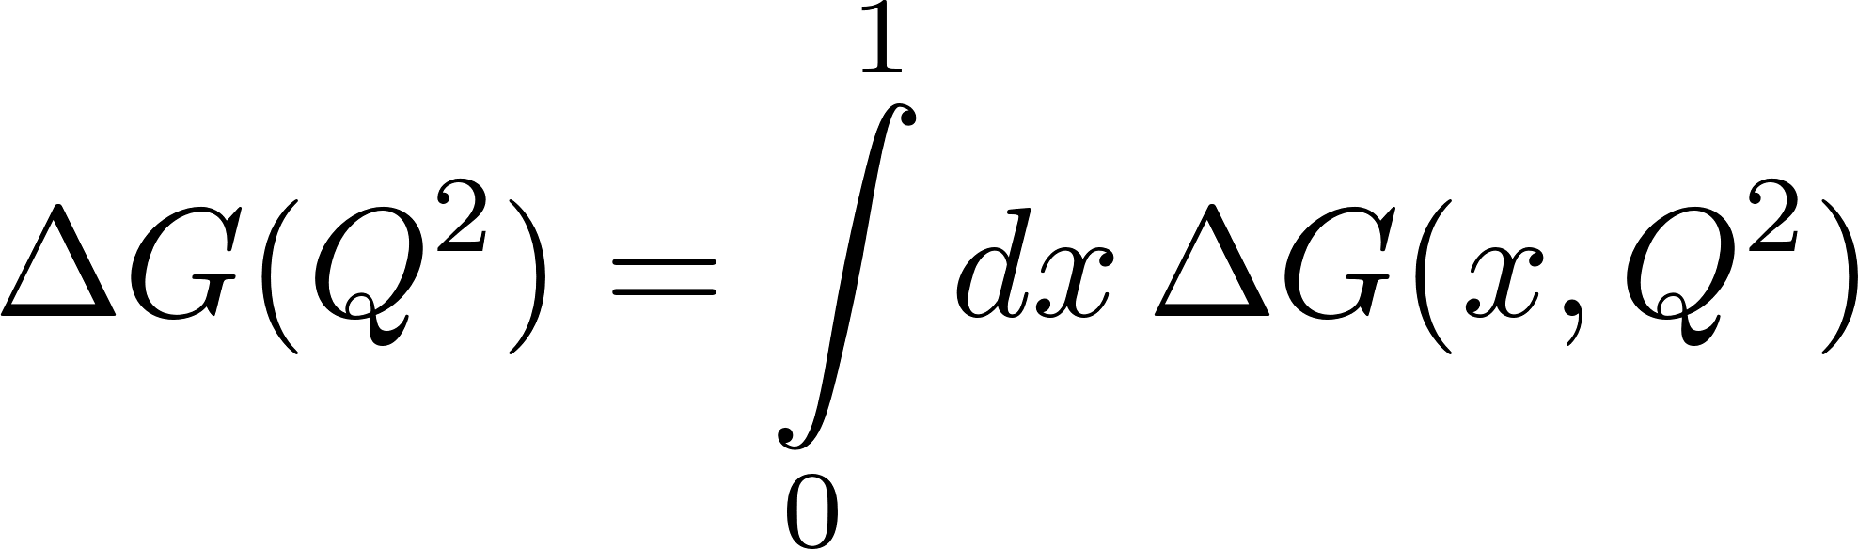
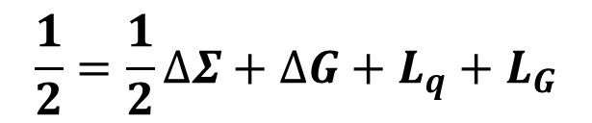
The Need for Small x in the Proton Spin Budget
E.-C. Aschenauer et al., Phys. Rev. D92 (2015) 094030
$$\frac{1}{2}=\frac{1}{2}∆Σ+∆G+L_{q}+L_{G}$$
The proton spin budget requires integrating spin contributions down to x = 0
  Will always require extrapolation beyond finite-x data
M. Sievert
Spin at Low x
13 / 26

Slide 19
Quark and Gluon Helicity Distributions
Quarks:
Massless quarks always conserve helicity
Gluons:
Circular polarization requires azimuthal correlations
M. Sievert
Spin at Low x
14 / 26

Slide 20
The Challenge of Spin at Low x
Tree-Level Spin Transfer
As a power-suppressed effect, spin transfer challenges the whole small-x framework
  A measurable subset of all sub-eikonal corrections
  Quark exchange now competes with sub-eikonal gluon exchange
  Effects which only enter the unpolarized sector at NLO are leading effects for spin
M. Sievert
Spin at Low x
15 / 26

Slide 21
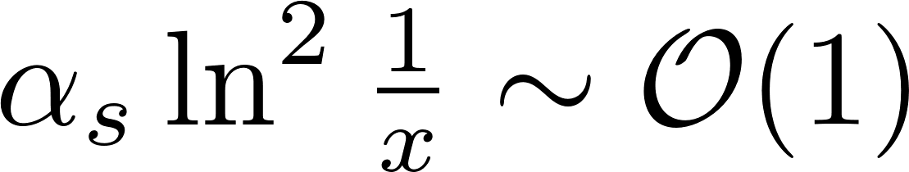
The Crucial Difference: UV Dominance
Spin-dependent scattering discriminates between short-wavelength fluctuations
  Color transparency doesn’t guarantee cancellation with spin degrees of freedom
The transverse phase space is logarithmic in the UV for spin at small x
Helicity evolution is double-logarithmic at small x
M. Sievert
Spin at Low x
16 / 26

Slide 22
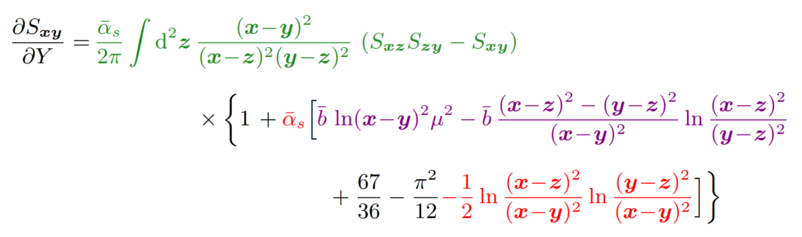
Implications: The Complexity of Polarized Evolution
Double logarithmic evolution is very sensitive to the UV structure
  Dominated by linear evolution (“Polarized BFKL”)
  Strict transverse ordering
  Elements which only appear at NLO in the unpolarized sector
B. Ducloue talk
M. Sievert
Spin at Low x
17 / 26

Slide 23
Some Calculations
on the Market

Slide 24
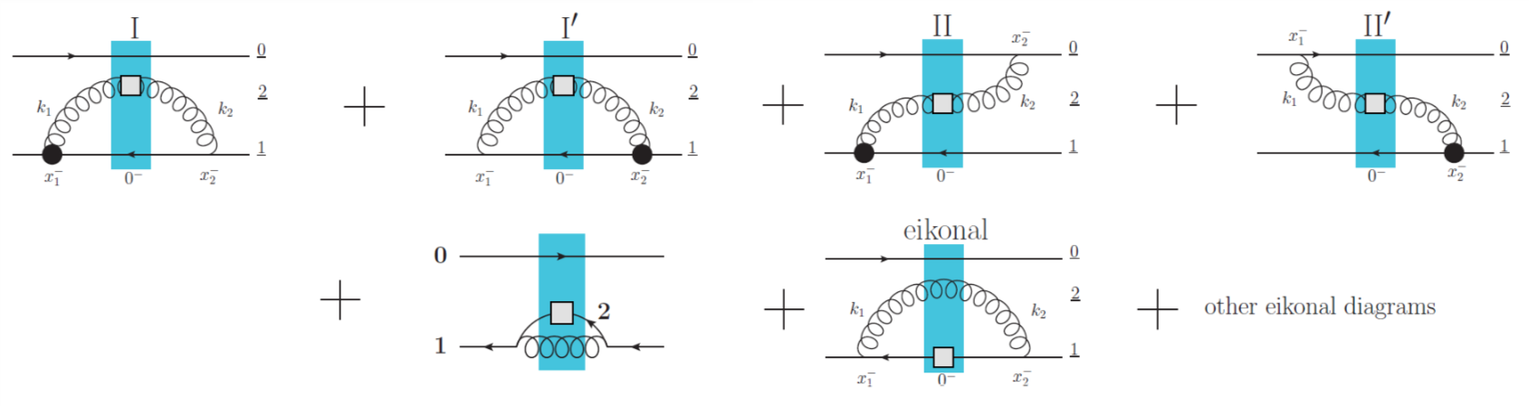
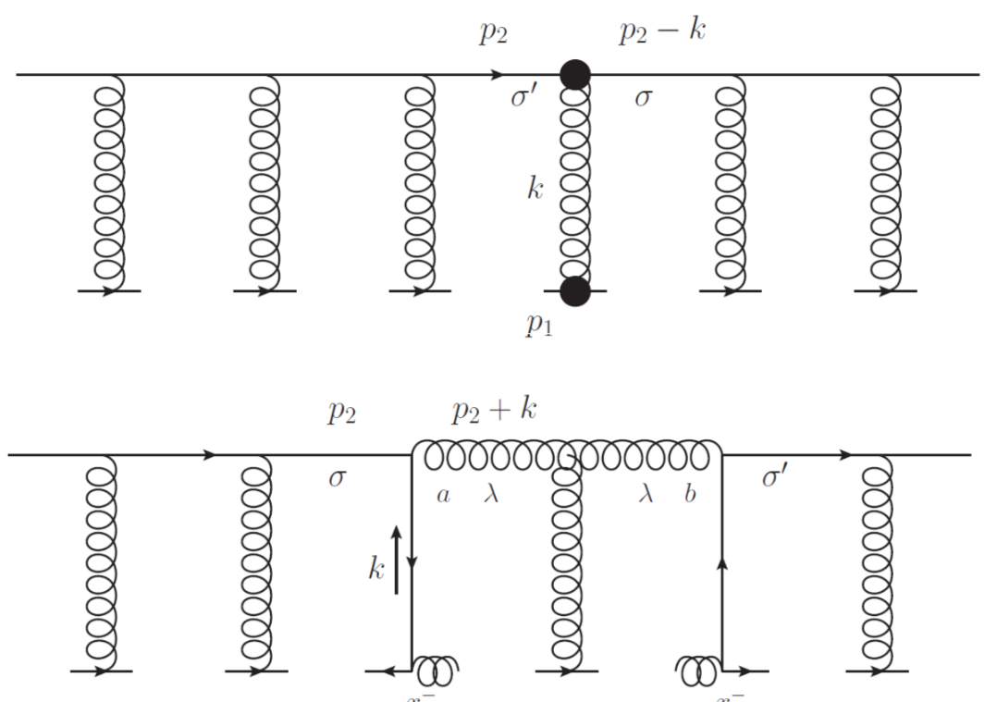
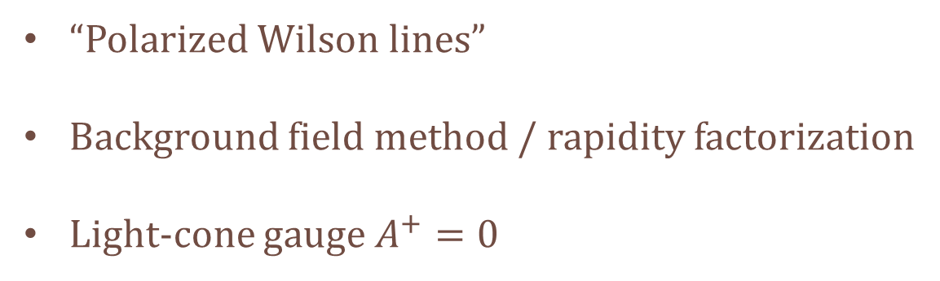
Method: Evolution of Polarized Dipoles
M.S., Kovchegov, &
Pitonyak:
JHEP 1601 (2016),
Phys. Rev. Lett. 118 (2017), Phys. Rev. D95 (2017),
Phys. Lett. B772 (2017), JHEP 1710 (2017),
Phys. Rev. D99 (2019)
“Polarized Wilson lines”
Background field method / rapidity factorization
Light-cone gauge $A^{+}=0$
M. Sievert
Spin at Low x
18 / 26

Slide 25
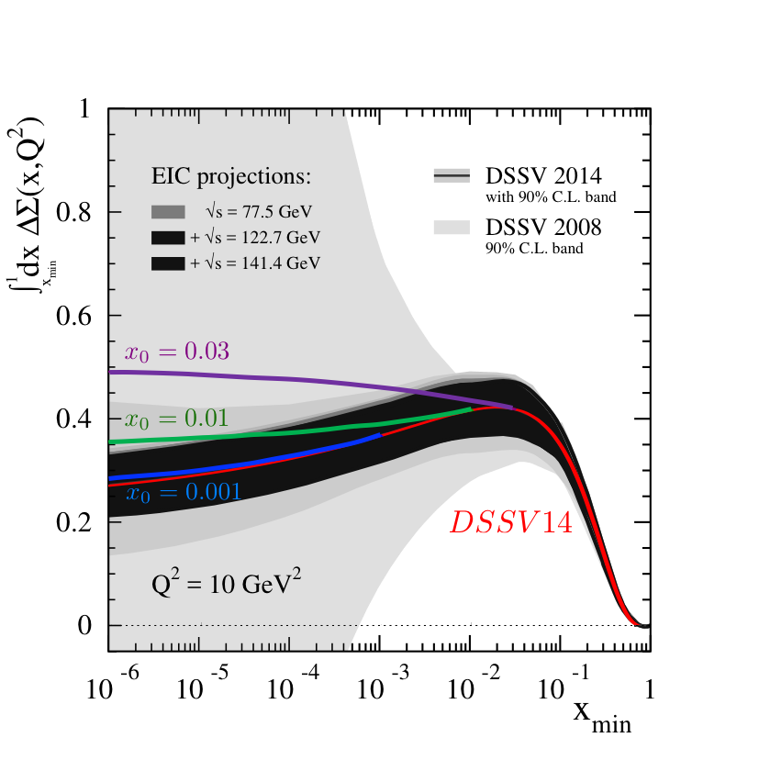
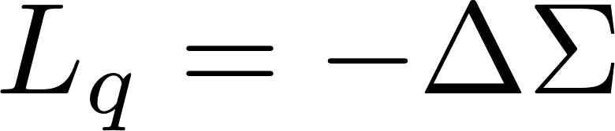
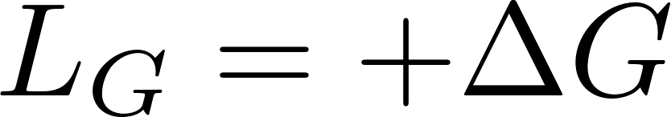
Results: Evolution of Polarized Dipoles
Quarks
Gluons
Y. Kovchegov,
JHEP 1903 (2019)
Significant but finite enhancement for quark helicity
Much smaller effect for gluons, because they can become azimuthally decorrelated
M. Sievert
Spin at Low x
19 / 26

Slide 26
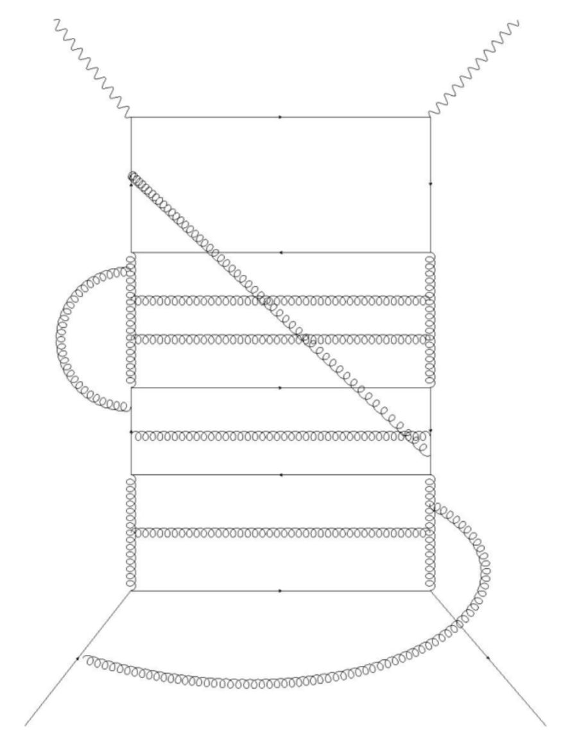
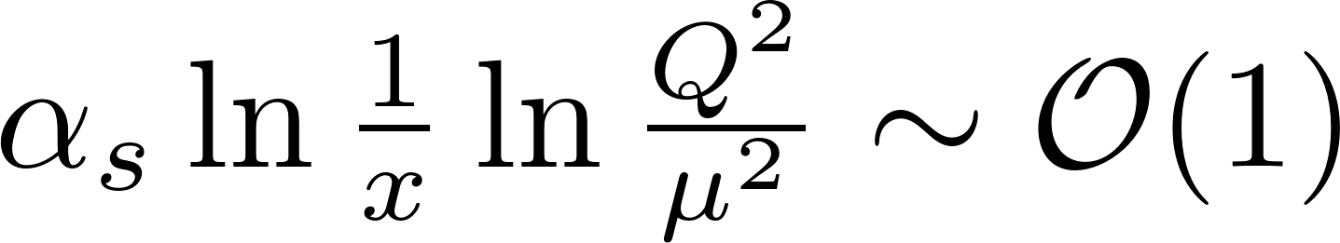
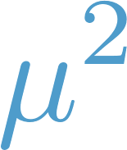
Method: Infrared Evolution Equations
Bartels, Ermolaev, & Ryskin,
Z. Phys. C70 (1996), Z. Phys. 72 (1996)
Based on identifying where the softest momentum scale lives in a complex diagram
Goal is to resum all double logarithms
Close relation to DGLAP
Hatta & Yao, arXiv:1906.07744
Boussarie, Hatta, & Yuan, arXiv:1904.02693
Hatta & Yang, Phys. Lett. B781 (2018)
Hatta et al., Phys. Rev. D95 (2017)
Feynman gauge
M. Sievert
Spin at Low x
20 / 26

Slide 27
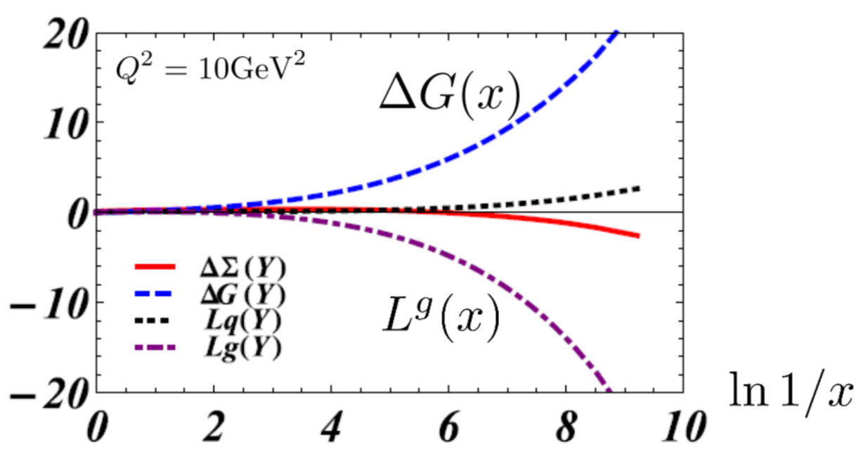
Results: Infrared Evolution Equations
Individual contributions are separately divergent at small x
  Possible role for nonlinear saturation effects to regulate individual divergences?
  Delicate cancellation among competing terms
  “The solution of the spin puzzle is not at small x” in this picture
M. Sievert
Spin at Low x
21 / 26

Slide 28
A Growing Field
Very difficult to directly compare the “polarized Wilson line” and “infrared evolution equation” methods…
  But very important to resolve the full picture.
Other recent progress:
  Background field propagators
  Small-x gluon Sivers function
  Spin-dependent odderon
  Rapidity evolution framework
  … and more …
G. Chirilli, JHEP 1901 (2019)
Yao, Hagiwara, & Hatta, Phys. Lett. B790 (2019)
J. Zhou, Phys. Rev. D89 (2014)
Balitsky & Tarasov, JHEP 1510 (2015)
M. Sievert
Spin at Low x
22 / 26

Slide 29
A Take-Home Message:
“Why Should I Care?”

Slide 30
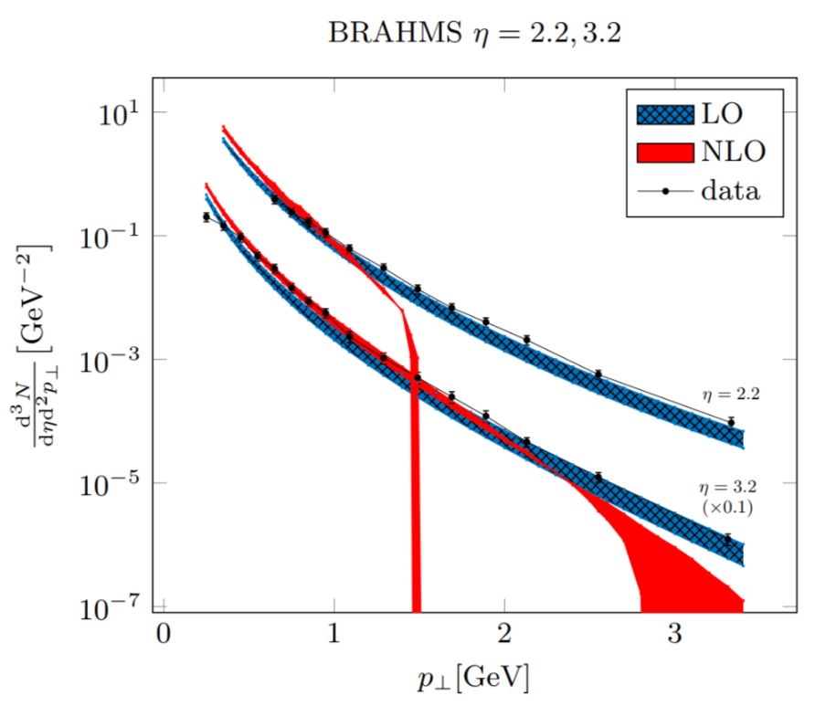
For the Small-x Community: We Should Care About Spin
There are many approaches to small x which all agree at leading order and leading power.
  Crucial differences appear beyond this simple starting point
  These differences challenge us to broaden and question the small-x paradigm
The challenges of NLO and sub-eikonal corrections
Spin at small x touches on all of these issues
  Concrete, observable subset of the corrections
T. Altinoluk & B. Ducloue talks
M. Sievert
Spin at Low x
23 / 26

Slide 31
For the EIC Community: We Should Care About Small x
Proton structure requires constraints from small x
Global properties of the proton are constrained by QCD sum rules
  Always require information from the unmeasured small-x regime
  Not just for the proton spin puzzle, but to connect any QCD sum rule to measured structure functions
Must be taken into account when formulating the design needs for the EIC.
M. Sievert
Spin at Low x
24 / 26

Slide 32
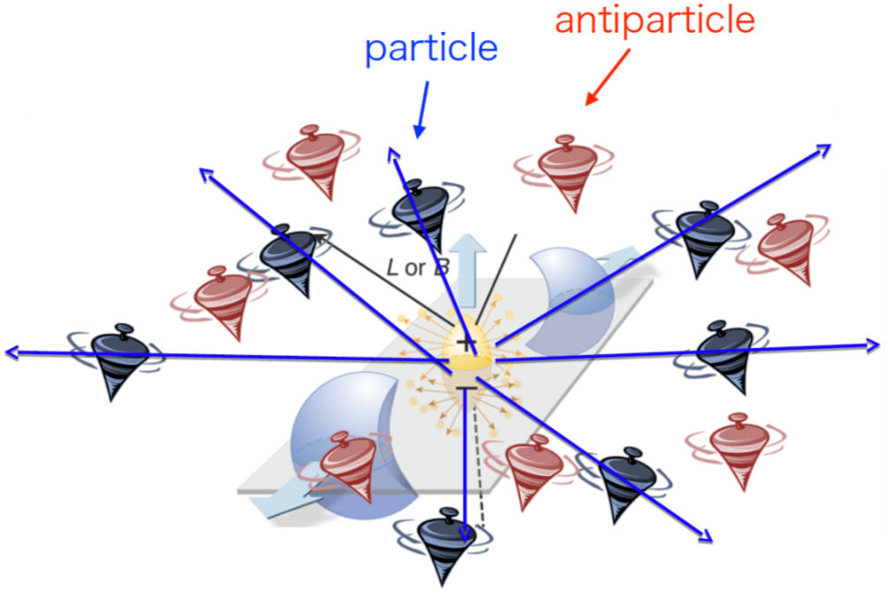


For the Heavy Ion Community: We Should Care About Both
Interest in new probes, new levers to study the quark-gluon plasma
  Orbital angular momentum conversion to spin of polarized hyperons
  Polarized light ions as geometry control
Small-x kinematics and hadron structure determine the initial conditions
  At lower $\sqrt{s}$, sub-eikonal corrections (spin, baryon stopping) become more important
W. Broniowski &
R. Ryblewski talks
M. Sievert
Spin at Low x
25 / 26

Slide 33
A Niche Field, of Universal Interest
Spin at Low x
M. Sievert
Spin at Low x
26 / 26

