Slide 1



RHIC/LHC Forward Physics and Upgrades
John Lajoie
Iowa State University

Slide 2
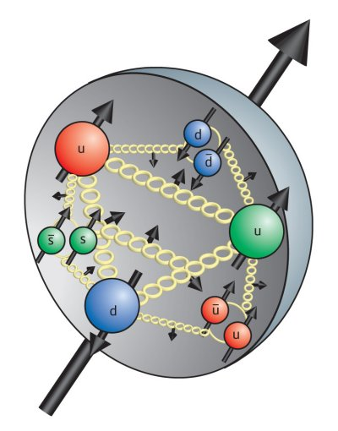
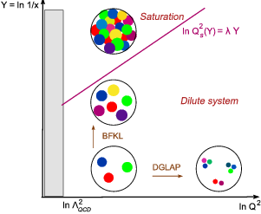
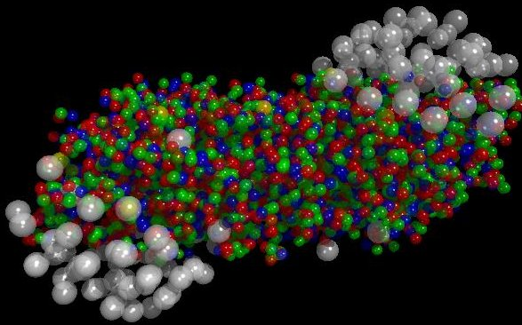
The Big Picture at LHC/RHIC/EIC…
p+A Collisions
A+A Collisions
How do collective, many-body phenomena arise from first-principles QCD?

Slide 3

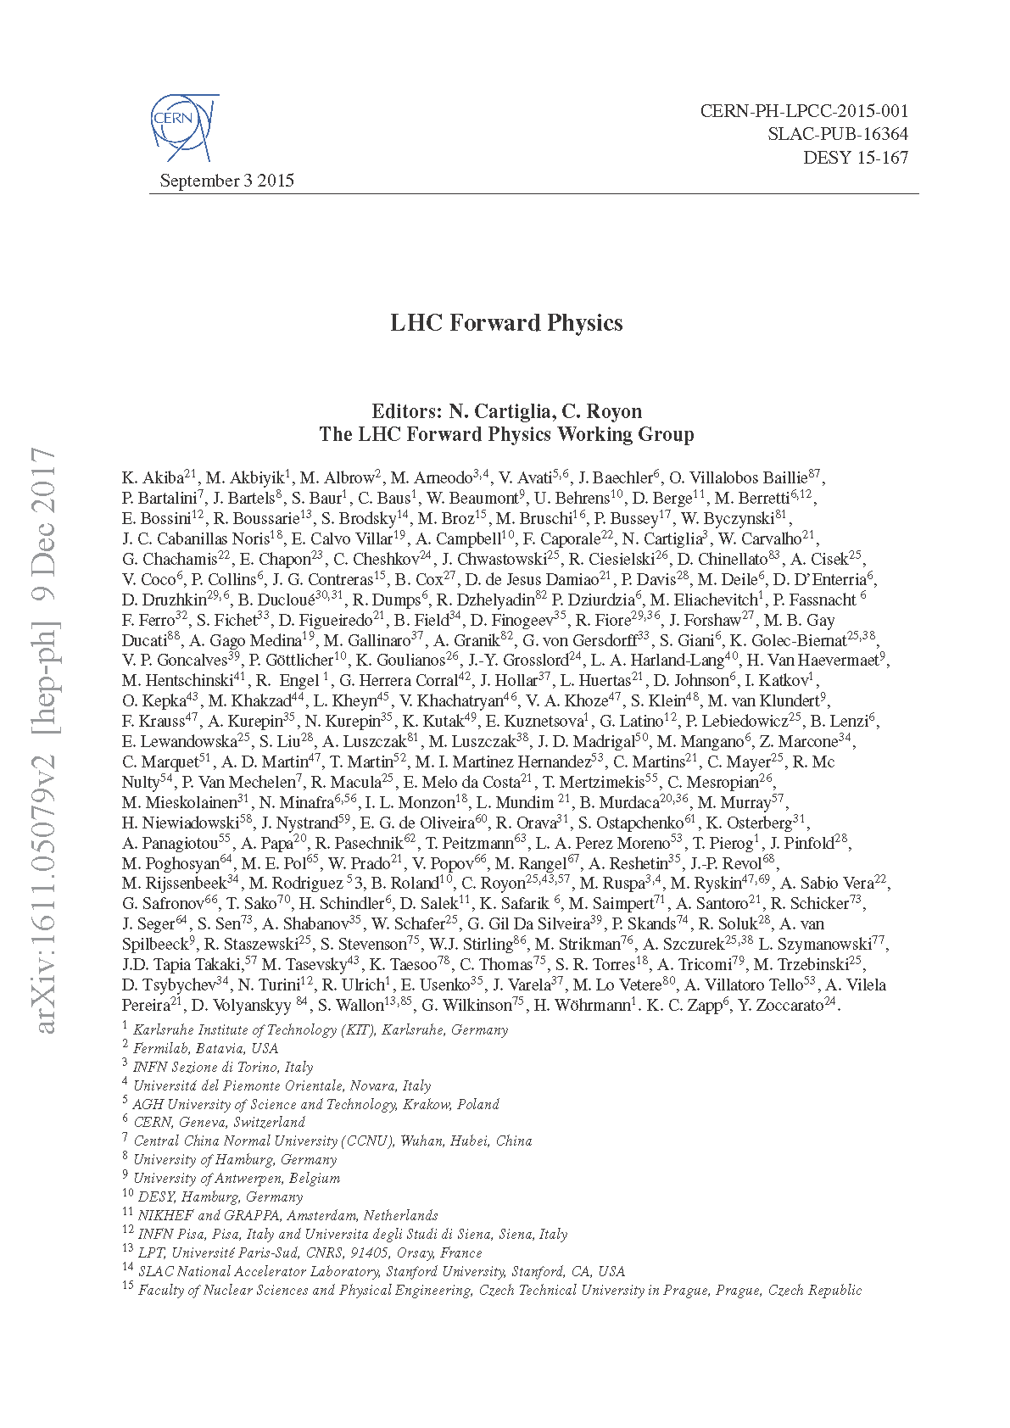
Plans for Forward Physics
arXiv: 1602.03922
  Total Elastic/Inelastic Cross Section
  Diffraction
  Coherent Central Production
  Cosmic Rays
  nPDF’s and nFF’s
  Ultraperipheral Collisions
  A+A Collisions
  Polarized Measurements (RHIC)
The bulk of the physics portion of this talk…
arXiv: 1611.05079

Slide 4
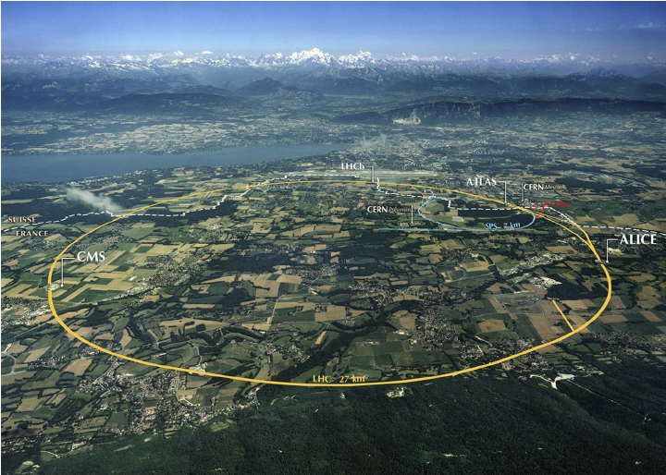
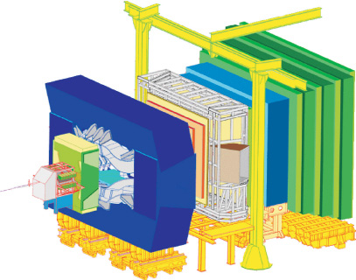
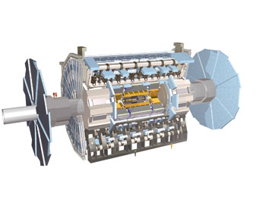
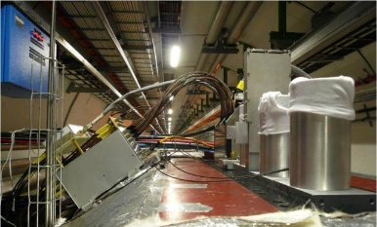
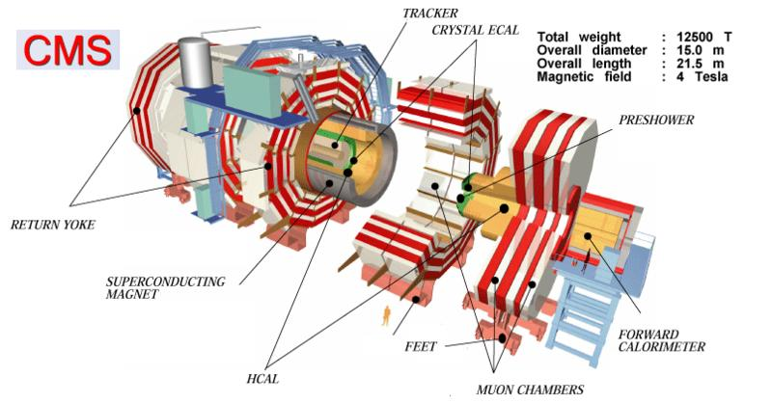
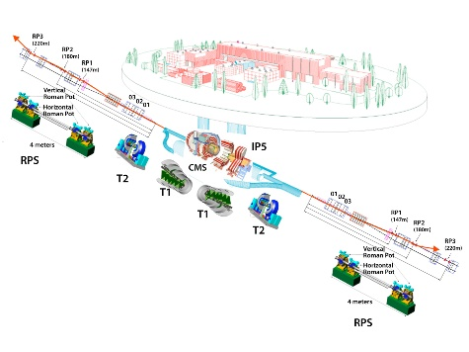
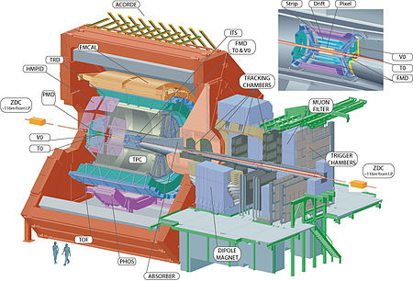
Forward Facilities/Upgrades at the LHC
ATLAS (LHCf)
LHCb
ALICE (FoCAL – LS3)
CMS
(TOTEM, CASTOR)
Future improvements at the LHC (Run-3) will be mostly quantitative (reduced statistics and systematics).
see talk by Martin Rybar (Thursday)

Slide 5
ALICE FoCAL
Decision later this year – Installation during LS3 (2024-26) for use in LHC Run-4.

Slide 6
Cosmic Ray Physics
arXiv: 1611.05079
Strong need for p+O collisions to further constrain models for cosmic ray air showers!
arXiv: 1902.08124
Excess of muons and muon “bundles” at highest cosmic ray energies
see also talk by Pasquale Di Nezza (Wednesday,
LHC p+He antiprotons)

Slide 7
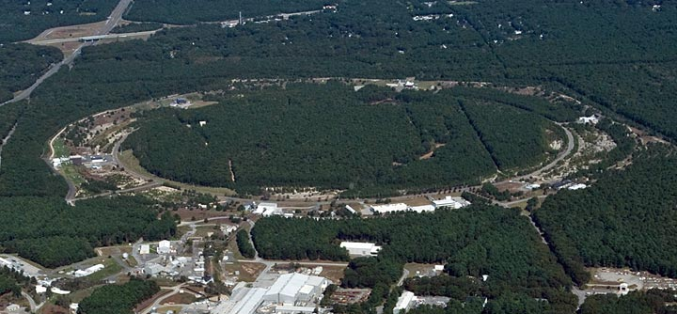
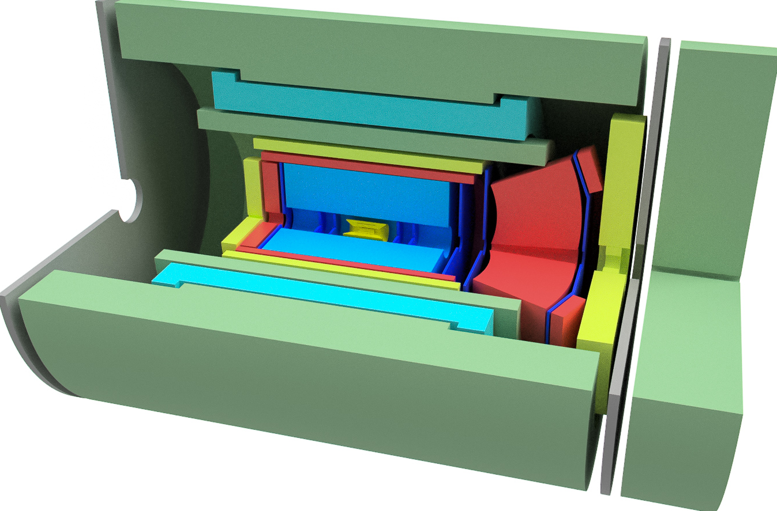
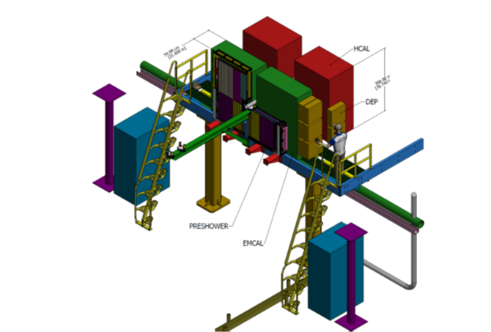
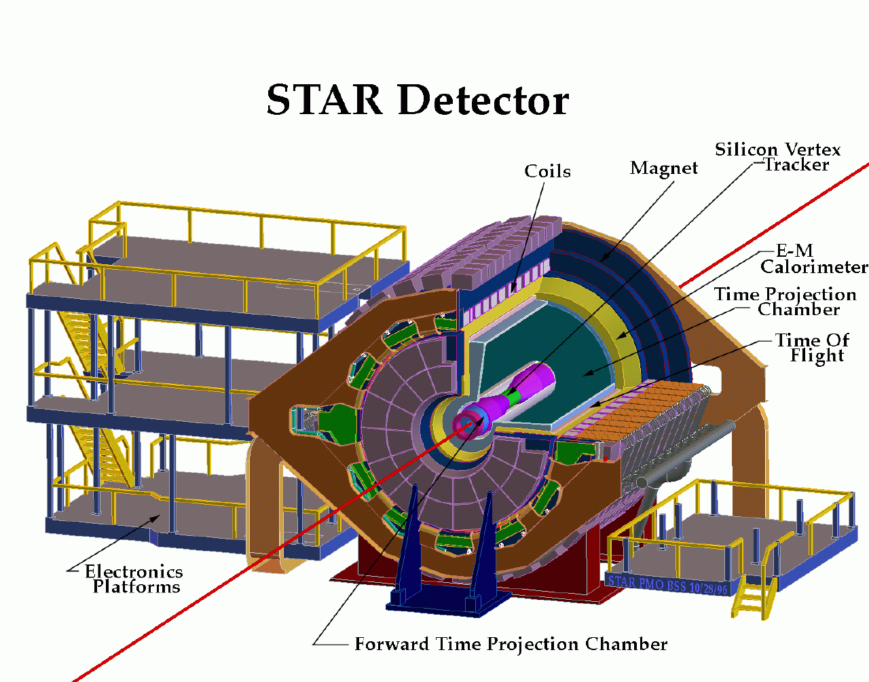
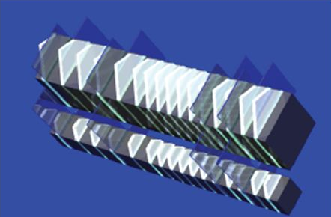
Forward Facilties/Upgrades at RHIC
sPHENIX (plus forward)
STAR (fSTAR)
RHICf

Slide 8

STAR Forward Implementation
see talk by Daniel Brandenburg (Wednesday)
3 Silicon disks: at 90, 140, 187 cm from IP
Built on successful experience with STAR IST
Single-sided double-metal mini-strip sensors
  Granularity: fine in φ and coarse in R
Status of fSTAR
4 sTGC disks: at 270, 300, 330, 360 cm from IP
(outside Magnet)
Position resolution: ~100 μm
Material budget: ~0.5% per layer, 2 layers / disk
Readout: reuse current STAR TPC electronics
1st sTGC prototype to be installed in STAR in 2019
A five-member review panel (S. Boose, C. Miraval, G. van Nieuwenhuizen,
Tricoli, and chaired by G. Young) conducted a review of the resource
requirements for the proposed forward upgrades to the STAR detector on
November 19, 2018. The panel noted good progress on the proposed concept
for a cold-QCD experiment to run in late 2021 at RHIC, with plausible plans for
funding and conservative designs for all detector components, electronics, and
support infrastructure. The panel opined that the major project risks are
identified and that the experiment appears positioned to be ready for first
operation in 2021, with the caveat that the critical path, which is the silicon
detector, presently has very little float. BNL management has begun
discussions with ONP about the implementation of the proposed upgrade.
June 2019 : NSF indicates they will fund the HCAL NSF MRI.
Substantial re-use of existing equipment and infrastructure. Extensive R&D program underway, leverages STAR and EIC detector R&D.
from ECA, BNL 2019 PAC presentation
Momentum resolution: 20-30%
for 0.2 < p_{T} < 2 GeV/c
track finding efficiency: 80%@100 tr/ev

Slide 9
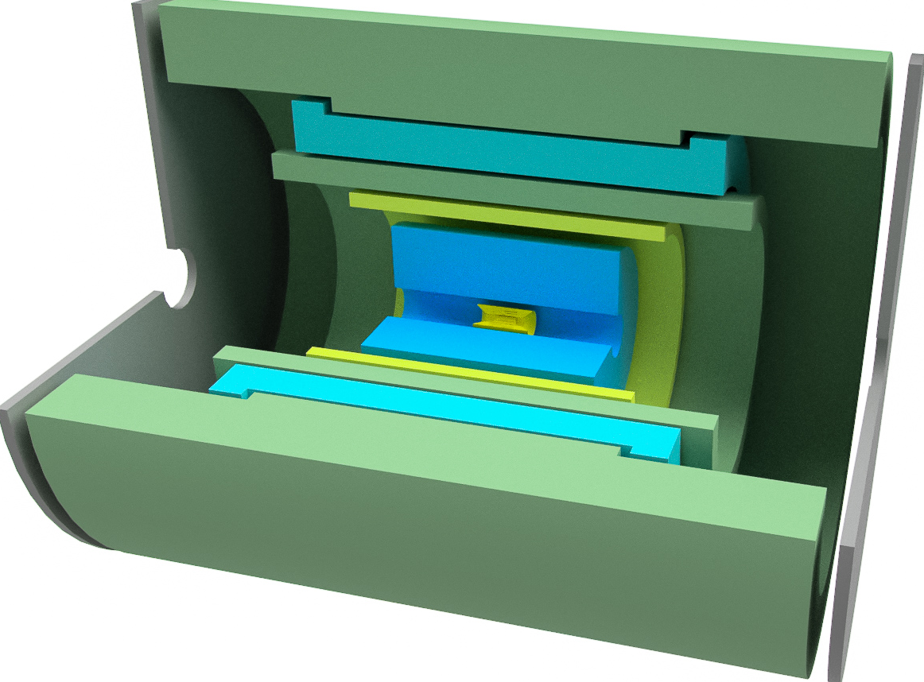
sPHENIX Forward Implementation
A solid foundation for EIC physics!!
https://www.sphenix.bnl.gov/web/system/files/eic-sphenix-loi-draft-2018-09-14.pdf
A next-generation state-of-the-art jet detector for A+A physics at RHIC. Successful PD-2/3b review!
EIC-sPHENIX detector
  HCal/Flux return
  Solenoid
  Extended Central EMCal
  Central hadron PID
  TPC
  MAPS
  Forward and backward tracking
  Forward and backward hadron PID
  Backward crystal EMCal
  Forward EMCal
  Forward HCal
sPHENIX
  HCal/Flux return
  Solenoid
  Central EMCal
  Silicon strip tracking
  TPC
  MAPS
Cold QCD program enabled by early realization of some EIC-sPHENIX detector components!
see talk by Rosi Reed (Wednesday)

Slide 10
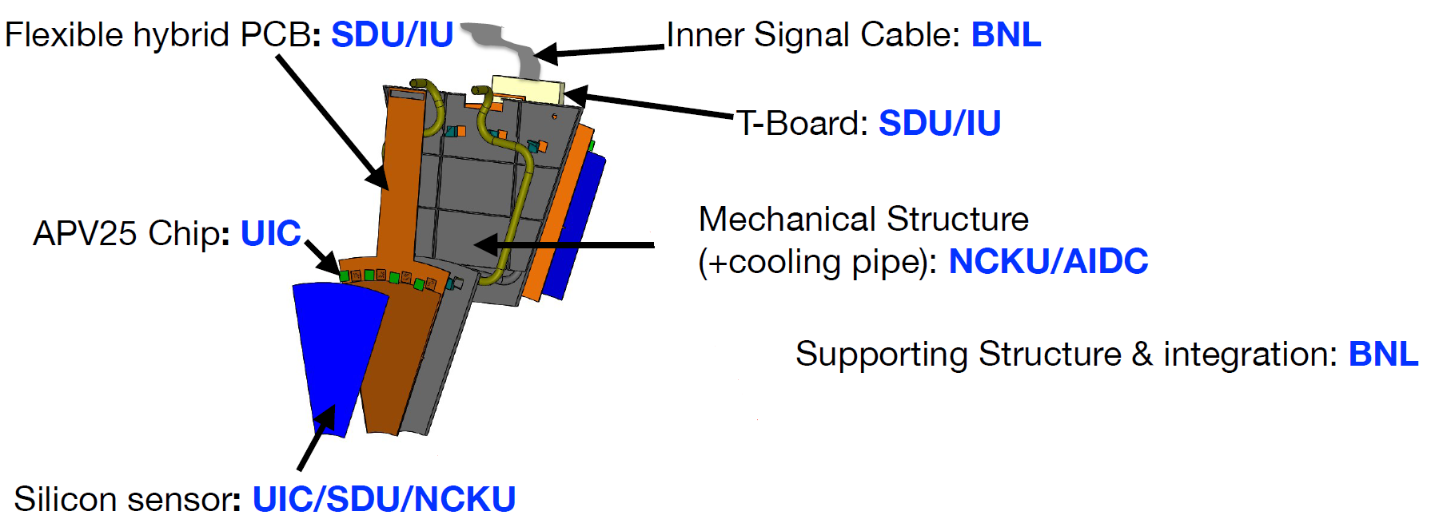
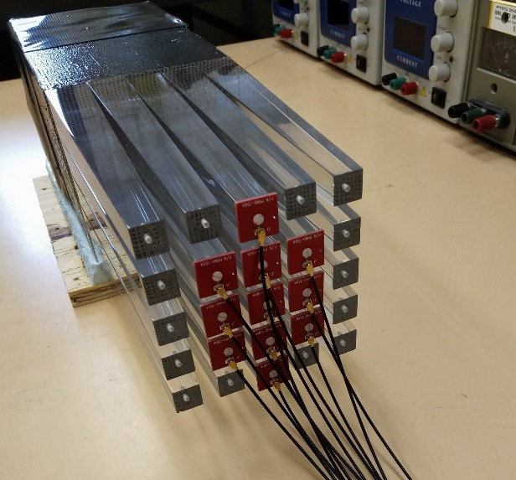
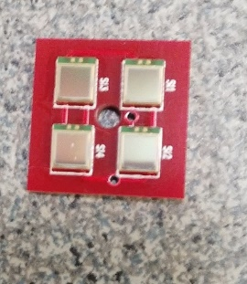
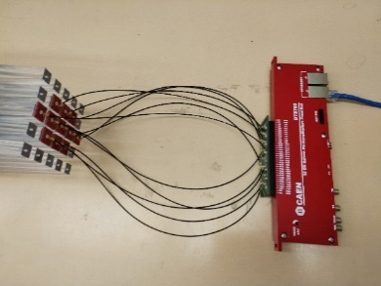
RHIC Forward Hardware Development
sTGC Development (SDU, China)
HCAL Prototypes (STAR and sPHENIX)
sPHENIX fEMC Prototype
STAR Si tracker design
STAR fEMC Prototypes

Slide 11
nPDF’s
see talk by Maria Zurita (Monday)
nPDF’s are a phenomenological construct that encode information about the measured ratio of hard processes in p+A/p+p
  Works in a collinear factorization framework (DGLAP)
  Dependent on parametrization
  Assumptions made about flavor symmetry, nuclear density/centrality dependence
  Depend on what data is included
They tell us nothing about the underlying microscopic mechanism
Need a wide variety of data in x, Q², A, centrality…
Eskola , Paukkunen, Paakkinen, and Salgado,
Eur. Phys. J. C (2017) 77:136

Slide 12
nPDF’s at the LHC
Eskola , Paukkunen, Paakkinen, and Salgado,
Eur. Phys. J. C (2017) 77:136
DGLAP evolution suppresses nPDF effects – but high statistics for clean probes!
Dijets, W/Z and photons assumed to be the “key” measurements at the LHC.

Slide 13
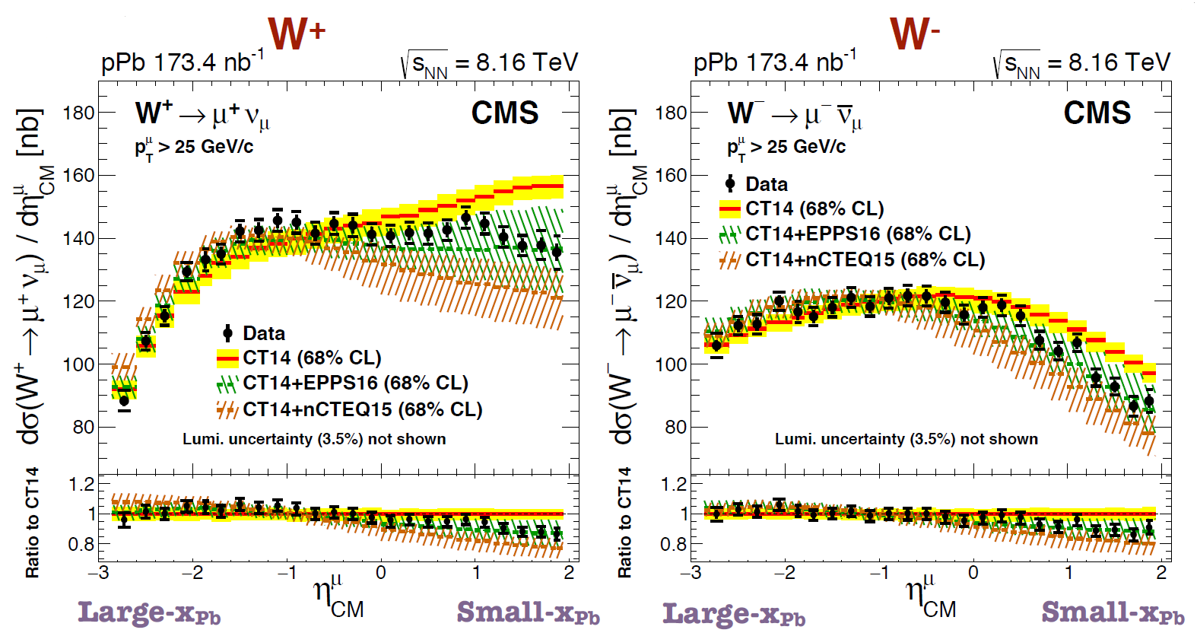
nPDF’s – Lots of new LHC data!
see talk by Jing Wang (Monday)
arXiv: 1812.05438
see talk by Jing Wang (Monday)
see talk by Jiangyong Jia (Monday),
Dennis Perepelitsa (Wednesday)

Slide 14
nPDF’s – D⁰ in LHCb
arXiv 1906.3943
Are we done with nPDF’s?
arXiv 1906.02512
New LHCb D⁰ data and improved theory provides significant new constraints on the gluon nPDF in Pb.
First real constraint on gluons at low-x!
see talk by Burkhard Schmidt (Monday)

Slide 15
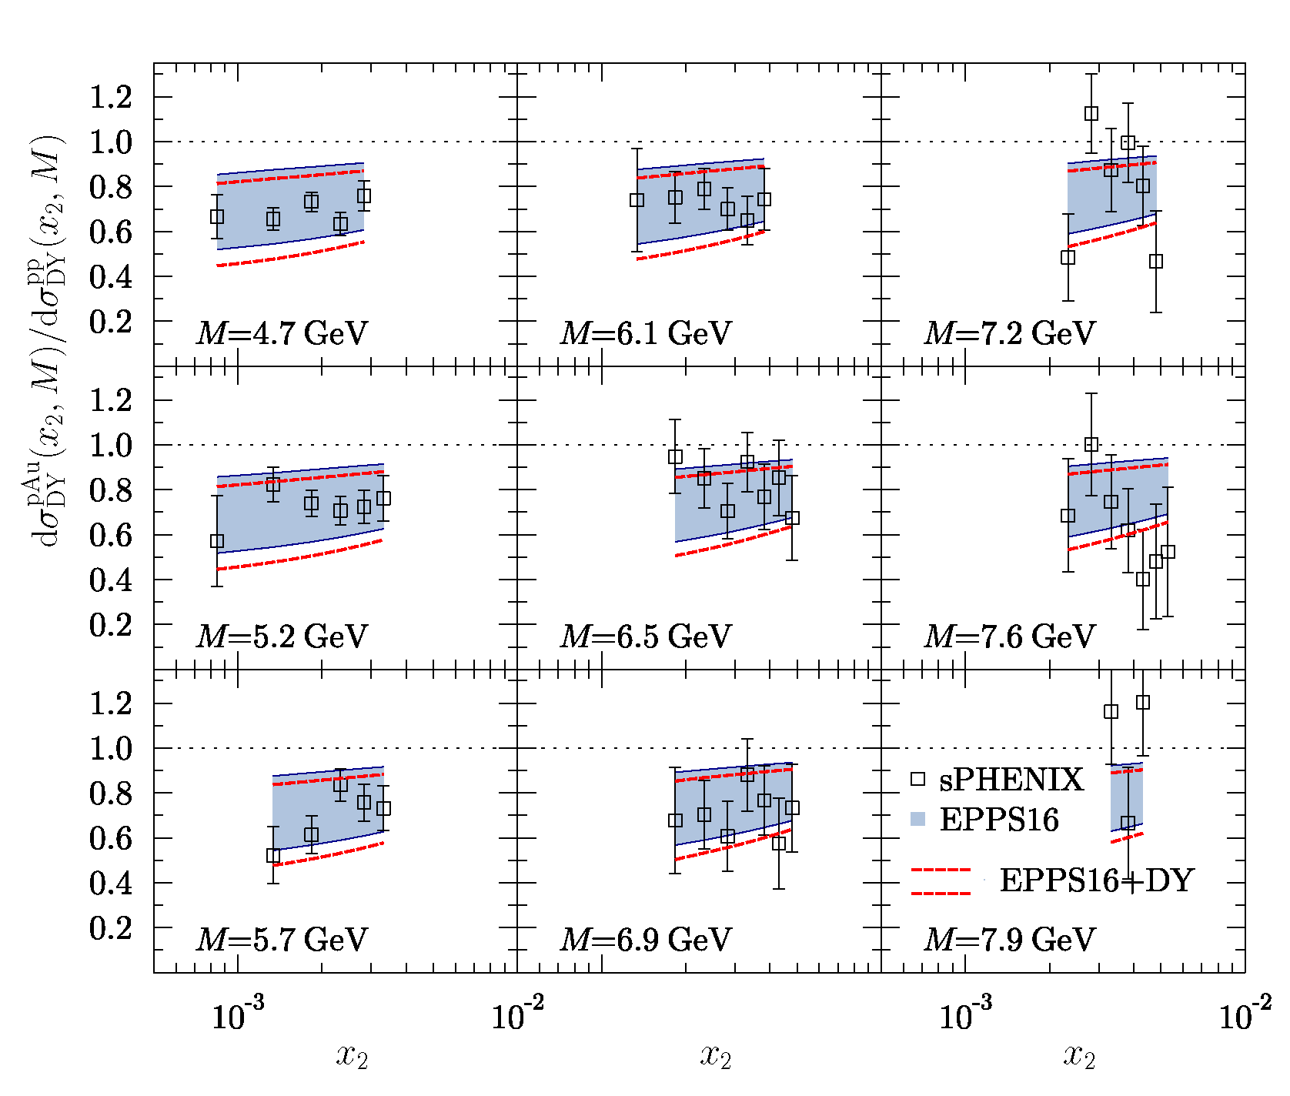
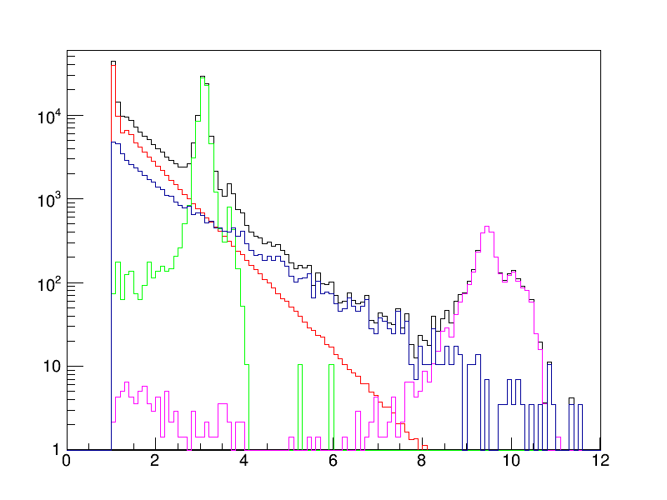
Future nPDF’s at RHIC (sPHENIX)
Assumptions:
Forward EM and HAD calorimetry (1.4<η<4.0)
Low-mass tracking with good momentum resolution:
197pb⁻¹ of p+p sampled lumi., 330nb⁻¹ of p+Au sampled lumi.
Include
pseudo data in EPPS16
Full G4 Simulation:
All Pairs
DY Pairs
MB Backgrounds
J/Ψ and Ψ’ Pairs
Counts Per Bin /50 pb⁼¹
Upsilon Pairs
Pseudo data included with statistical uncertainties and a 10% normalization systematic error – the normalization error defeats the power of the data!
Invariant Mass (GeV)
access down to x~10⁻³

Slide 16
A Multiobservable Approach (I)
Can we use multiple datasets (with similar systematics) to overcome the normalization limitation?
Central (|η|<1) gamma+jet
Central (|η|<1) + Forward dijets (1.6<η<3.6)
(used primarily to fix normalization)
Forward DY
(same pseudo data as
before)
(Central DY not shown)
arXiv 1904.09921v2

Slide 17
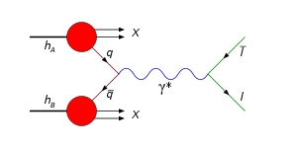
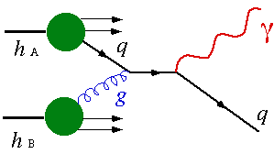
A Multiobservable Approach (II)
Indirect (LO) by scale evolution
Direct (NLO) contribution
l⁻
LO:
NLO:
l⁺
~15-40% of cross section
50% reduction in gluon nPDF uncertainties!
arXiv 1904.09921v2

Slide 18
Other nPDF benefits at RHIC
Prediction for Dijets at RHIC:
arXiv 1904.09921v2
Mass-number (A) dependence is not well-constrained between nPDF models. Light ion data at RHIC should have the power to improve this.
Test isospin asymmetry with (p+Ru)/(p+Zr) ratios.

Slide 19
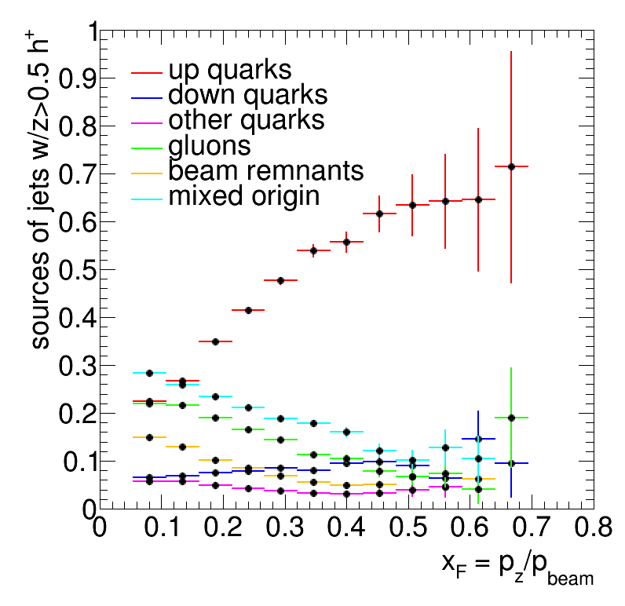
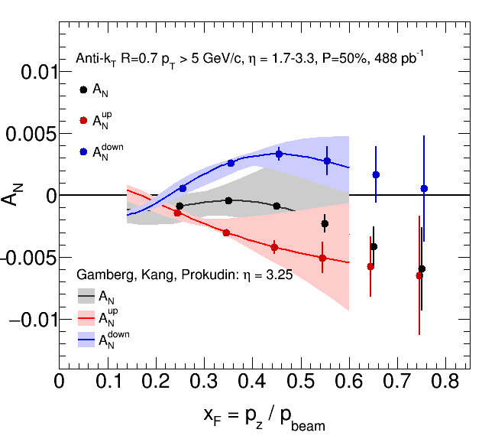
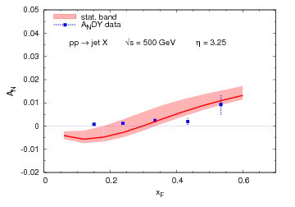
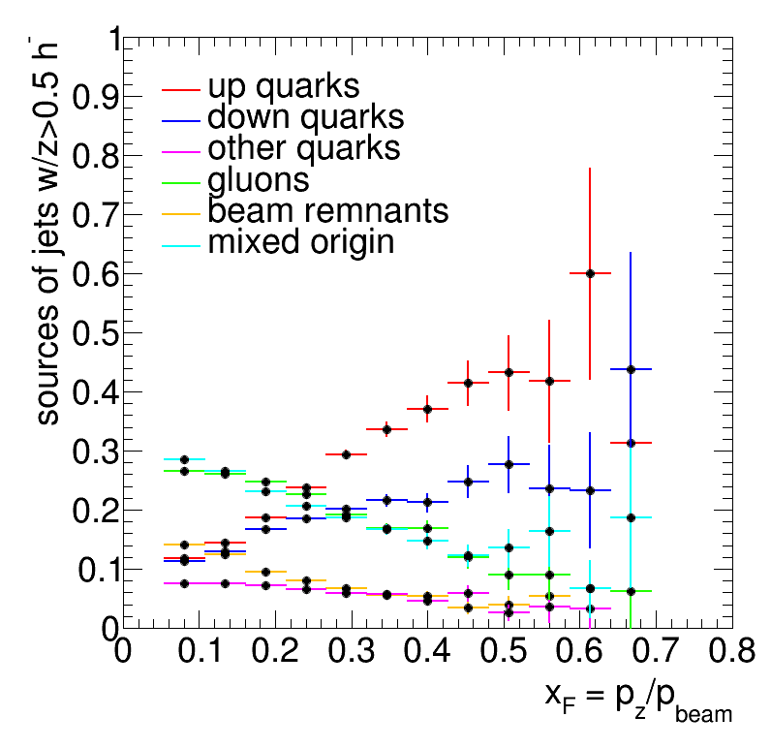
Unresolved Mysteries…
Jets with positive hadron z>0.5
AnDY: Phys. Lett. B750 (2015) 660
Jets with negative hadron z>0.5
A cut on the charge of the leading hadron changes the composition of the jet sample
(Pythia simulation).
arXiv: 1903.07422

Slide 20
Summary
Upgrades in capabilities and data at the LHC and RHIC coming soon…
  LHC:
    HL-LHC, increase in statistics, possible O+O (p+O), FoCAL(?)
  RHIC upgrades
    Both STAR and sPHENIX working to add forward instrumentation
      fSTAR first run in 2022, sPHENIX in 2023
    Broad program in Cold QCD and spin
    Will enhance the planned A+A program
    Investment could be recovered for a future EIC detector
An era of high-precision nPDF’s is available
  Multiobservable approach with multiple measurements from the same detector can limit systematics
  Test A-dependence, isospin, centrality, spin …
  RHIC and LHC data permit tests of evolution
  Allows tests of universality with EIC data

Slide 21
BACKUP

Slide 22
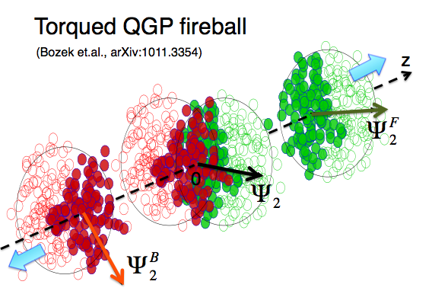
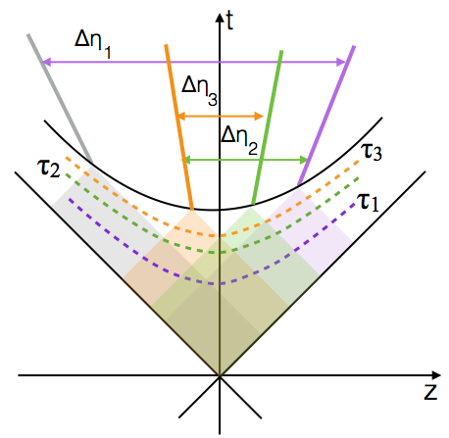
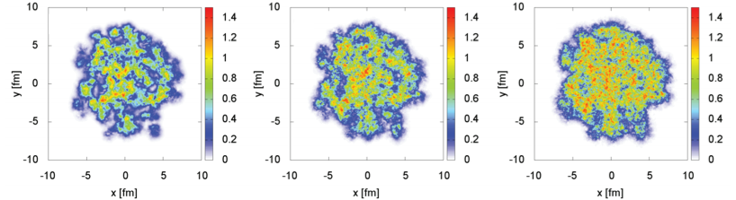
What about A+A?
PRC 83, 034911 (2011)
Wei Li QM17
y=+2.4
y=0
y=-2.4
Due to causality, correlations that are widely separated in rapidity probe the earliest times.
Schenke, Schlichting 1605.07158
Adding forward capabilities at RHIC will enable a new, complementary physics program to study the initial conditions in HI collisions.
De-correlation of the event plane can result from quantum fluctuations in the initial state.
Need to understand this to be able to extract η/s(T) from hydrodynamic models.

Slide 23
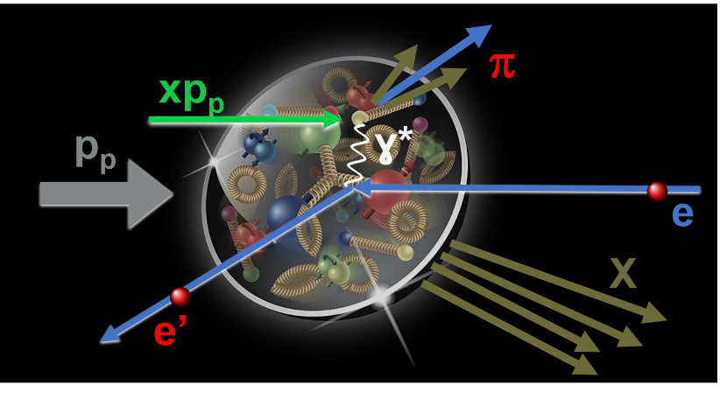
Fragmentation in a Nuclear Environment
Hadron production in e+A suppressed compared to e+p – must be a fragmentation effect!
Important measurement for SIDIS at the EIC!
Kaufmann, Mukherjee and VogelsangPhys.Rev.D 92 5, 054015
Access fragmentation
functions (FF) through
p+p(A) -> (jet h) X
see talk by Ivan Vitev (Wednesday)

Slide 24
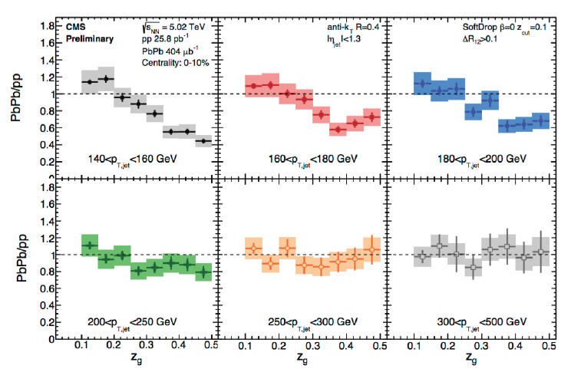
Jet Substructure
CMS PAS HIN-16-006
Soft-drop grooming combined with a Cambridge-Aachen type decomposition of a jet found with an anti-k_{T} algorithm – provides detailed information about the first parton splitting!
An excellent way to study cold QCD effects in fragmentation in detail!

Slide 25
Diffraction/UPC
Data taken in 2015/17 by STAR will elucidate the
diffractive contribution to A_{N} at RHIC.
UPC collisions in p+A will allow study of:
The gluon spatial distribution in nuclei (“proton shine”)
The gluon helicity flip Generalized Parton Distribution (GPD) E_{g} (“A-shine”)
Requires Roman Pots, good t-acceptance and high luminosity

Slide 26
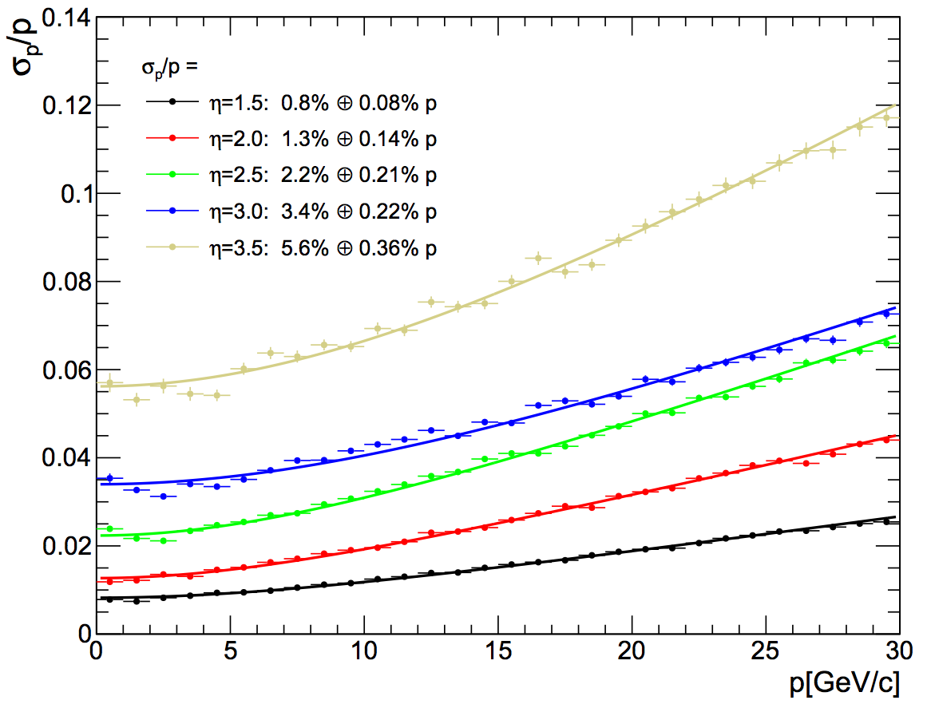
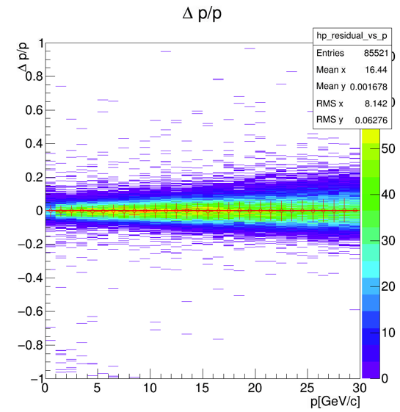
Forward Tracking
G4 Simulation and (PH)GenFit to extract (p_{Reco} – p_{True})/p_{True} vs. p_{True} (right plot)
For each slice of p_{True}, fit with Gaussian, extract mean as offset, sigma as resolution
η = 3
Excellent momentum resolution!
Tracking simulations by Haiwang Yu

Slide 27
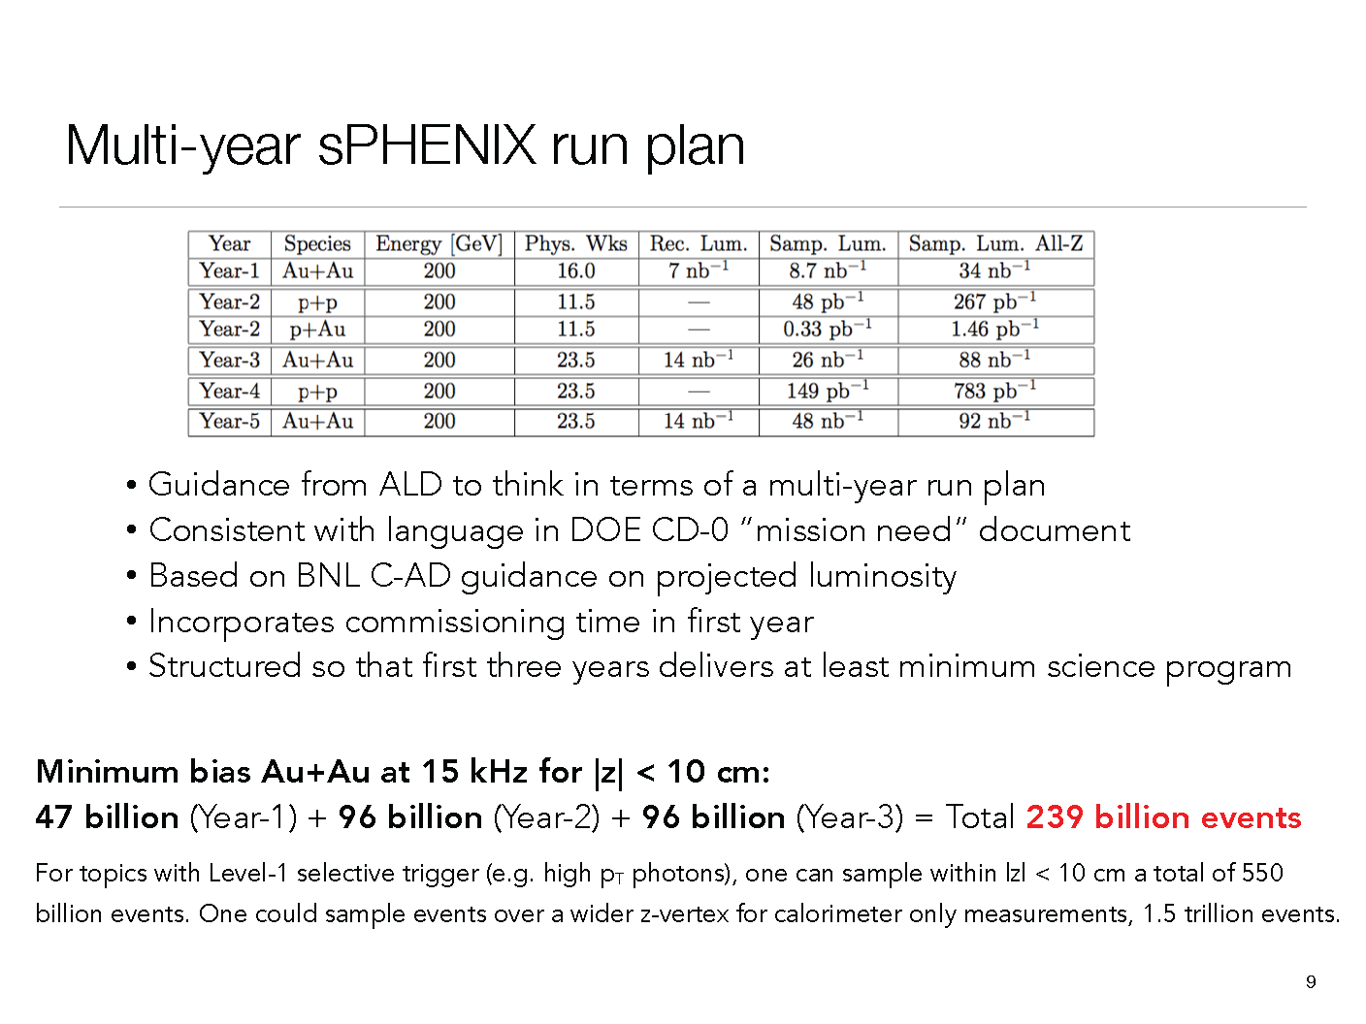

Slide 28
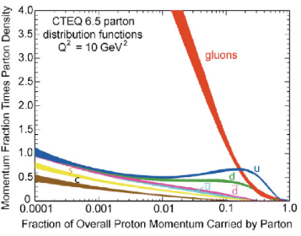

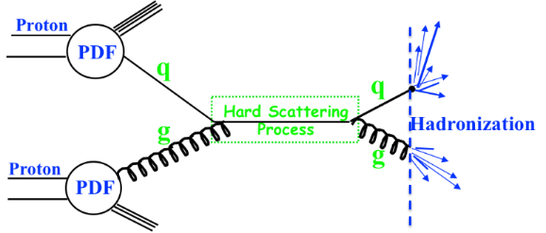
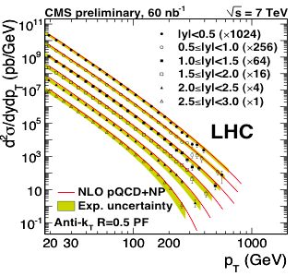
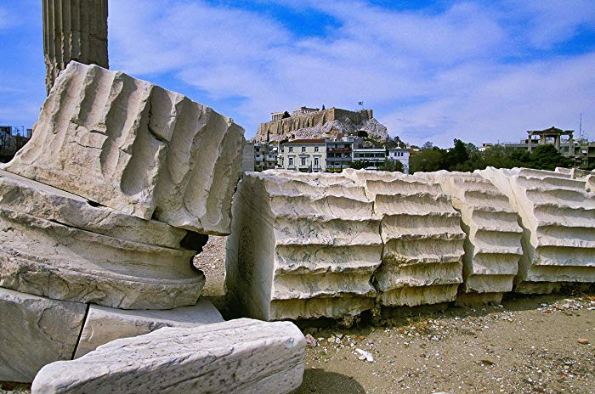
The Big Picture at RHIC (and the EIC…)
Long-distance physics
Extract PDF’s
from Hera..
Two Pillars of QCD:
Factorization
Calculate cross sections at LHC
Universality
pQCD
Factorization Breaking….
Advances in QCD theory over the past two decades have pushed us away from a simple collinear factorization approach and towards extreme regimes that challenege our underlying assumptions.

