Slide 1
A Tribute to Roy Glauber
presented at
Initial Stages 2019
Columbia University
June 27th, 2019
W.A. Zajc
Columbia University
This work was supported by the United States Department of Energy Grant DOE-FG02-86ER-40281

Slide 2
The Incredible Lightness of Being
presented at
Initial Stages 2019
Columbia University
June 27th, 2019
W.A. Zajc
Columbia University
This work was supported by the United States Department of Energy Grant DOE-FG02-86ER-40281

Slide 3
The Incredible Lightness of Being
Roy Glauber
presented at
Initial Stages 2019
Columbia University
June 27th, 2019
W.A. Zajc
Columbia University
This work was supported by the United States Department of Energy Grant DOE-FG02-86ER-40281

Slide 4
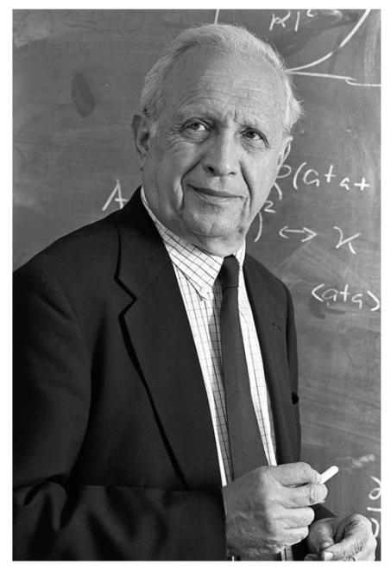
Roy J. Glauber 1925-2018
We lost Roy Glauber on December 26, 2018.
Roy was a good friend to the heavy ion community.
His name is invoked with at least the same frequency as Fermi and Feynman in discussions of heavy ion physics.
This talk: neither biography nor hagiography
Rather: Some physics, some anecdotes, some thoughts
Thanks to Brant Johnson, Mike Leitch and Jim Thomas for material !

Slide 5
Roy’s Worldline
Born in New York City September 1, 1925
Member of first graduating class at Bronx High School of Science (1941)
Entered Harvard September, 1941
Recruited to Los Alamos in 1943 at age of 18.
Harvard B.A. 1946, Ph.D. 1949 (Adviser: Julian Schwinger)
Intermediate states at IAS and Caltech

Slide 6
Roy’s Worldline
Born in New York City September 1, 1925
Member of first graduating class at Bronx High School of Science (1941)
Entered Harvard September, 1941
Recruited to Los Alamos in 1943 at age of 18.
Harvard B.A. 1946, Ph.D. 1949 (Adviser: Julian Schwinger)
Intermediate states at IAS and Caltech
“My research for the year was devoted to resolving a puzzle they had encountered in studying electron diffraction by molecules. Solving the problem didn’t interest me in molecules very much, but it did involve me deeply in scattering problems in which the incident particles were of wavelength much smaller than the ranges of interactions.”
Roy Glauber

Slide 7
Roy’s Worldline
Born in New York City September 1, 1925
Member of first graduating class at Bronx High School of Science (1941)
Entered Harvard September, 1941
Recruited to Los Alamos in 1943 at age of 18.
Harvard B.A. 1946, Ph.D. 1949 (Adviser: Julian Schwinger)
Intermediate states at IAS and Caltech
Returned to Harvard 1952
Nobel Prize in Physics 2005
Died December 26, 2018
“My research for the year was devoted to resolving a puzzle they had encountered in studying electron diffraction by molecules. Solving the problem didn’t interest me in molecules very much, but it did involve me deeply in scattering problems in which the incident particles were of wavelength much smaller than the ranges of interactions.”
Roy Glauber

Slide 8
Roy J. Glauber 1925-2018
We lost Roy Glauber on December 26, 2018.
Roy was a good friend to the heavy ion community.
His name is invoked with at least the same frequency as Fermi and Feynman in discussions of heavy ion physics.
This talk: neither biography nor hagiography
Rather: Some physics, some anecdotes, some thoughts
Thanks to Brant Johnson, Mike Leitch and Jim Thomas for material !

Slide 9
Roy J. Glauber 1925-2018
We lost Roy Glauber on December 26, 2018.
Roy was a good friend to the heavy ion community.
His name is invoked with at least the same frequency as Fermi and Feynman in discussions of heavy ion physics.
This talk: neither biography nor hagiography
Rather: Some physics, some anecdotes, some thoughts
Thanks to Brant Johnson, Mike Leitch and Jim Thomas for material !

Slide 10
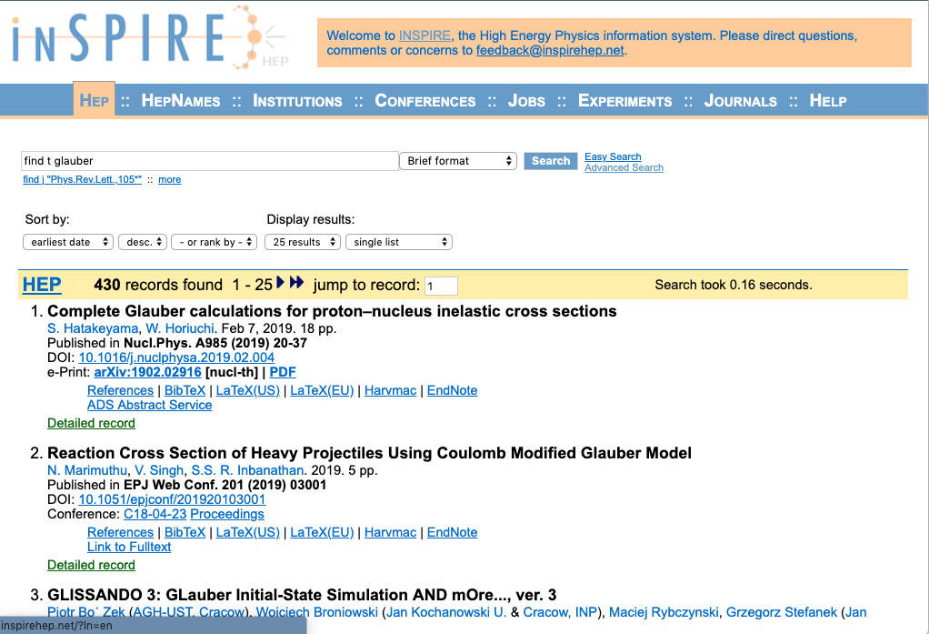
Evidence For That Statement
inSPIRE reports 430 records with “Glauber” in the title.
Roy was wryly amused by this.

Slide 11
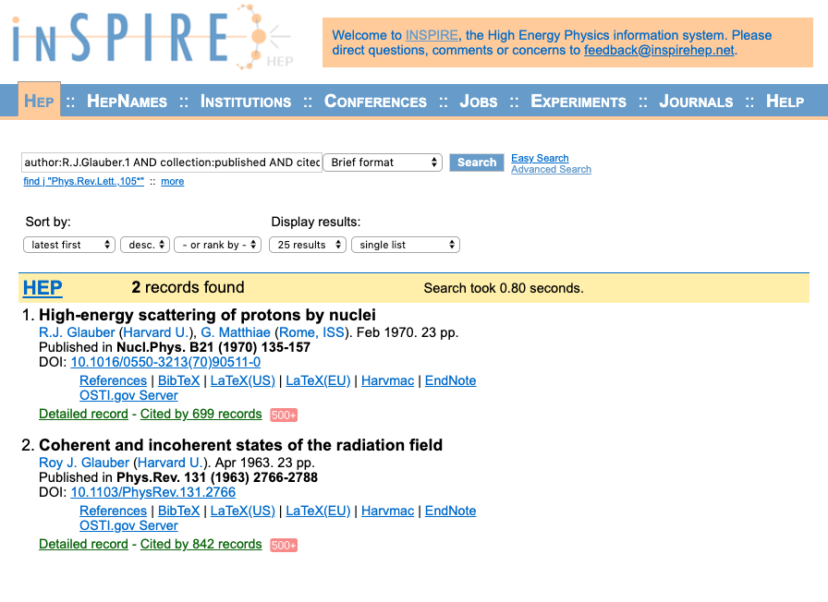
Roy’s Renowned Papers
( According to
inSPIRE )
“Our” Glauber paper
High-Energy Scattering of Protons by Nuclei
has been cited 699 times.

Slide 12
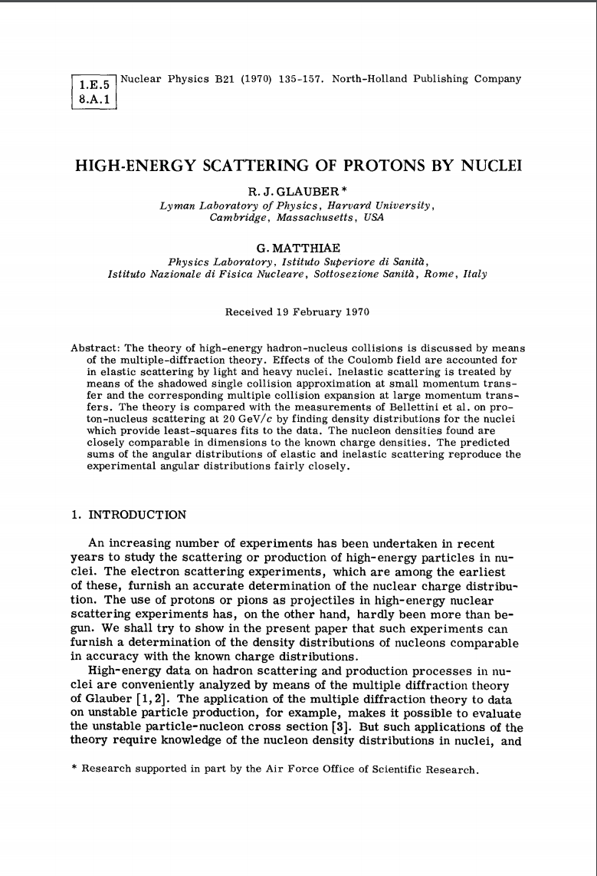
The First “Glauber” calculation
Actually, it’s not really in
the eikonal approximation
  “multiple-diffraction theory”
Nor is it a Monte Carlo
But we see familiar objects:

Slide 13
The First “Glauber” calculation
Actually, it’s not really in
the eikonal approximation
  “multiple-diffraction theory”
Nor is it a Monte Carlo
But we see familiar objects:
  Thickness function
  Probability of n wounded nucleons

Slide 14
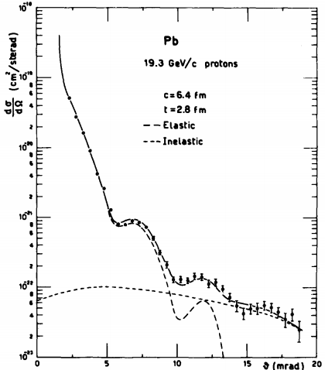
The First “Glauber” calculation
Actually, it’s not really in
the eikonal approximation
  “multiple-diffraction theory”
Nor is it a Monte Carlo
But we see familiar objects:
  Thickness function
  Probability of n wounded nucleons
  p+Pb collisions (at √s_{NN} = 6.17 GeV)

Slide 15
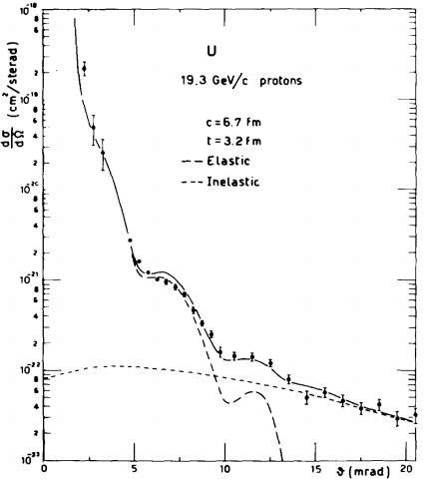
The First “Glauber” calculation
Actually, it’s not really in
the eikonal approximation
  “multiple-diffraction theory”
Nor is it a Monte Carlo
But we see familiar objects:
  Thickness function
  Probability of n wounded nucleons
  p+U collisions (at √s_{NN} = 6.17 GeV)

Slide 16
References to Roy’s “Glauber Modeling” Paper

Slide 17
References to Roy’s “Glauber Modeling” Paper

Slide 18
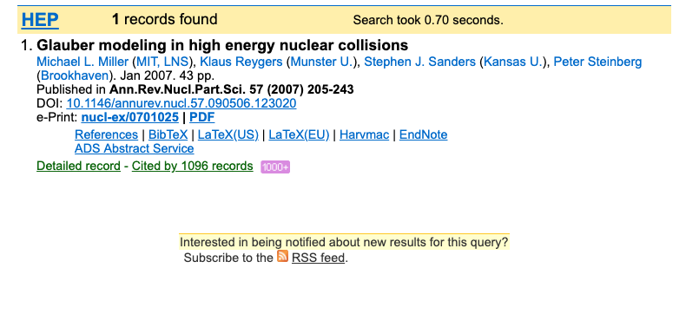
The Now-Standard Reference on “Glauber Modeling”

Slide 19
The Iconic Eikonal Glauber Modeling

Slide 20
The Iconic Eikonal Glauber Modeling
“Light always goes in straight lines – except when it doesn’t.” – Roy Glauber

Slide 21
The Iconic Eikonal Glauber Modeling
“Light always goes in straight lines – except when it doesn’t.” – Roy Glauber

Slide 22
The Iconic Eikonal Glauber Modeling
“Light always goes in straight lines – except when it doesn’t.” – Roy Glauber

Slide 23
Roy’s “Other” Renowned Paper
( According to
inSPIRE )
“Other” Glauber paper
Coherent and Incoherent States of the Radiation Field
has been cited 842 times.

Slide 24
Let’s Be a Little More Careful – Ask Google Scholar
Coherent and incoherent states of the radiation field, RJ Glauber - Physical Review, 1963

Slide 25
Let’s Be a Little More Careful – Ask Google Scholar
Coherent and incoherent states of the radiation field, RJ Glauber - Physical Review, 1963 Cited by 6755

Slide 26
Let’s Be a Little More Careful – Ask Google Scholar
Coherent and incoherent states of the radiation field, RJ Glauber - Physical Review, 1963 Cited by 6755
The quantum theory of optical coherence,
RJ Glauber - Physical Review, 1963 Cited by 4057
Photon correlations,
RJ Glauber - Physical Review Letters, 1963 Cited by 1446
Density operators and quasiprobability distributions,
KE Cahill, RJ Glauber - Physical Review, 1969 Cited by 1113
Ordered expansions in boson amplitude operators,
KE Cahill, RJ Glauber - Physical Review, 1969 Cited by 1030

Slide 27
Let’s Be a Little More Careful – Ask Google Scholar
Coherent and incoherent states of the radiation field, RJ Glauber - Physical Review, 1963 Cited by 6755
The quantum theory of optical coherence,
RJ Glauber - Physical Review, 1963 Cited by 4057
Photon correlations,
RJ Glauber - Physical Review Letters, 1963 Cited by 1446
Density operators and quasiprobability distributions,
KE Cahill, RJ Glauber - Physical Review, 1969 Cited by 1113
Ordered expansions in boson amplitude operators,
KE Cahill, RJ Glauber - Physical Review, 1969 Cited by 1030
“Studying light is easy because it’s cheap stuff.” – Roy Glauber

Slide 28
Most Directly Relevant to HB-T Measurements
Coherent and incoherent states of the radiation field, RJ Glauber - Physical Review, 1963 Cited by 6755
The quantum theory of optical coherence,
RJ Glauber - Physical Review, 1963 Cited by 4057
Photon correlations,
RJ Glauber - Physical Review Letters, 1963 Cited by 1446
Density operators and quasiprobability distributions,
KE Cahill, RJ Glauber - Physical Review, 1969 Cited by 1113
Ordered expansions in boson amplitude operators,
KE Cahill, RJ Glauber - Physical Review, 1969 Cited by 1030

Slide 29
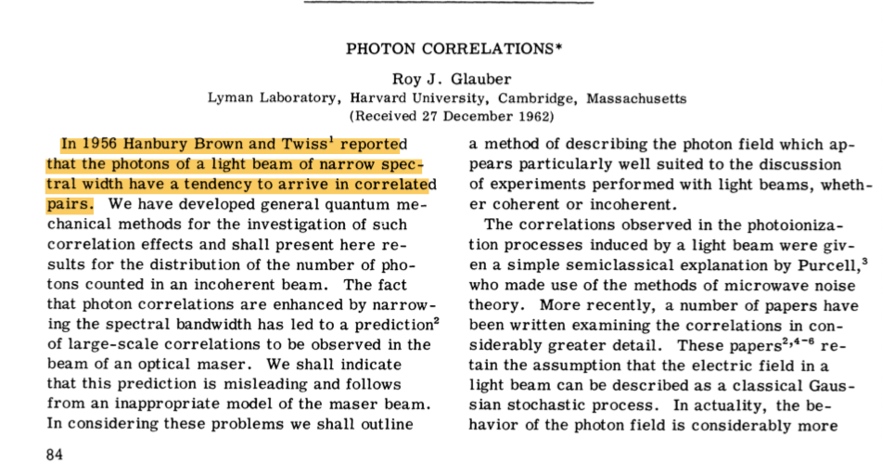
Photon Correlations, Roy J. Glauber, PRL 10, 84 (1963)

Slide 30
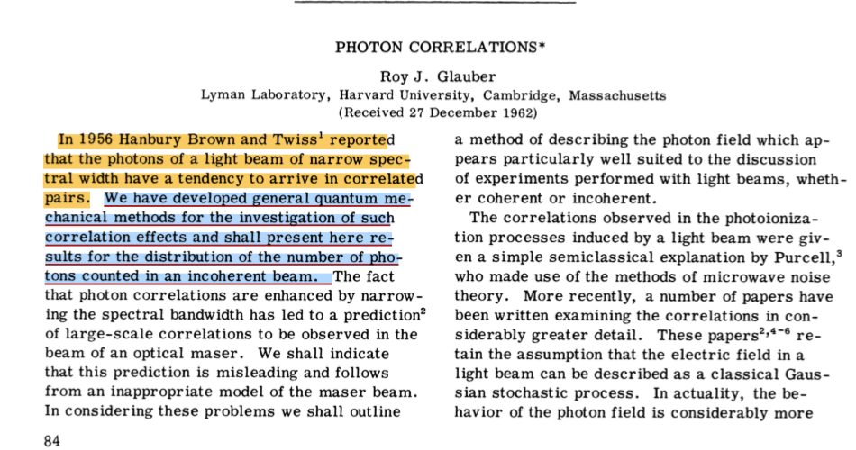
Photon Correlations, Roy J. Glauber, PRL 10, 84 (1963)

Slide 31
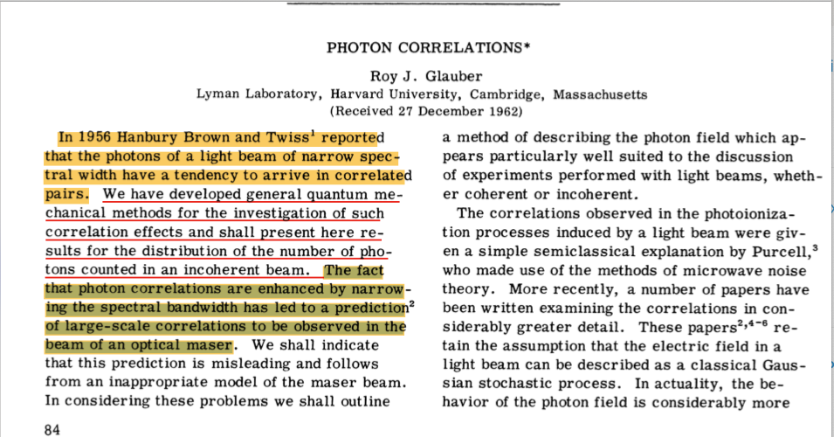
Photon Correlations, Roy J. Glauber, PRL 10, 84 (1963)

Slide 32
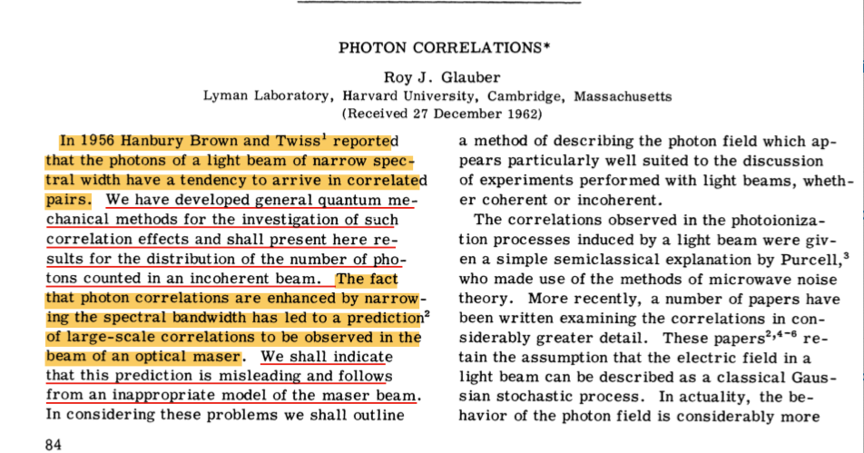
Photon Correlations, Roy J. Glauber, PRL 10, 84 (1963)

Slide 33
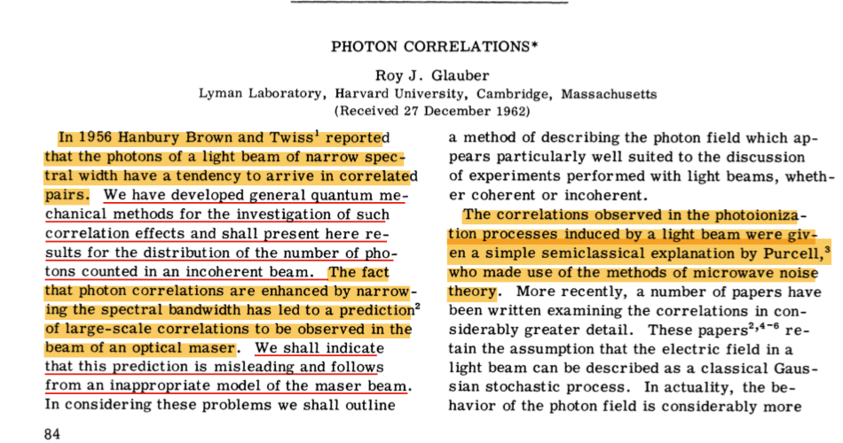
Photon Correlations, Roy J. Glauber, PRL 10, 84 (1963)

Slide 34
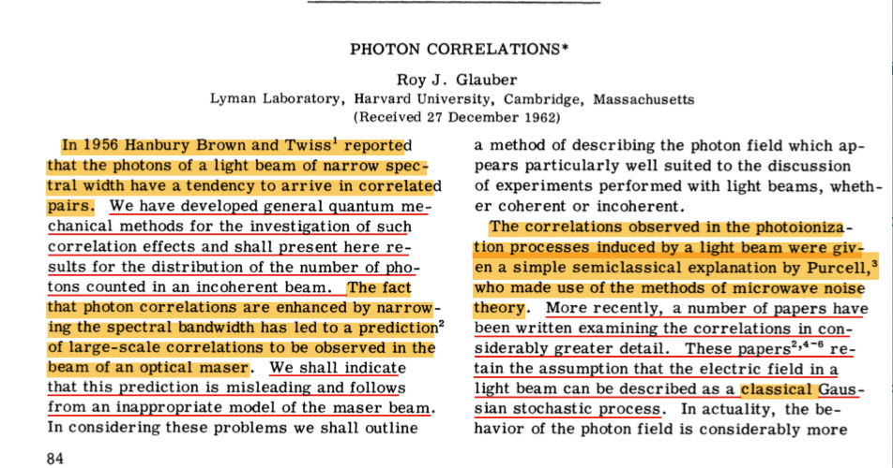
Photon Correlations, Roy J. Glauber, PRL 10, 84 (1963)

Slide 35
The Essential Point
LASER
Thermal Source
Shot noise
Wave noise

Slide 36
Roy’s Magnus Opus
Coherent and incoherent states of the radiation field, RJ Glauber - Physical Review 131, 2766 (1963) Cited by 6755
Development of the
complete quantum
theory of higher-order
coherence of EM field

Slide 37
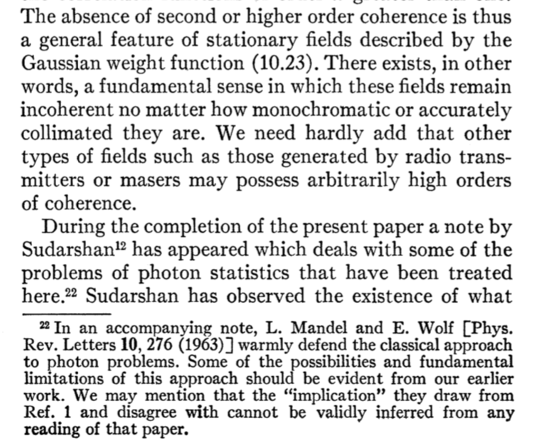
Roy’s Magnus Opus
Coherent and incoherent states of the radiation field, RJ Glauber - Physical Review 131, 2766 (1963) Cited by 6755
Development of the
complete quantum
theory of higher-order
coherence of EM field

Slide 38
Roy’s Magnus Opus
Coherent and incoherent states of the radiation field, RJ Glauber - Physical Review 131, 2766 (1963) Cited by 6755
Development of the
complete quantum
theory of higher-order
coherence of EM field

Slide 39
Roy’s Magnus Opus
Coherent and incoherent states of the radiation field, RJ Glauber - Physical Review 131, 2766 (1963) Cited by 6755
Development of the
complete quantum
theory of higher-order
coherence of EM field
And some snark for
the snipers:

Slide 40
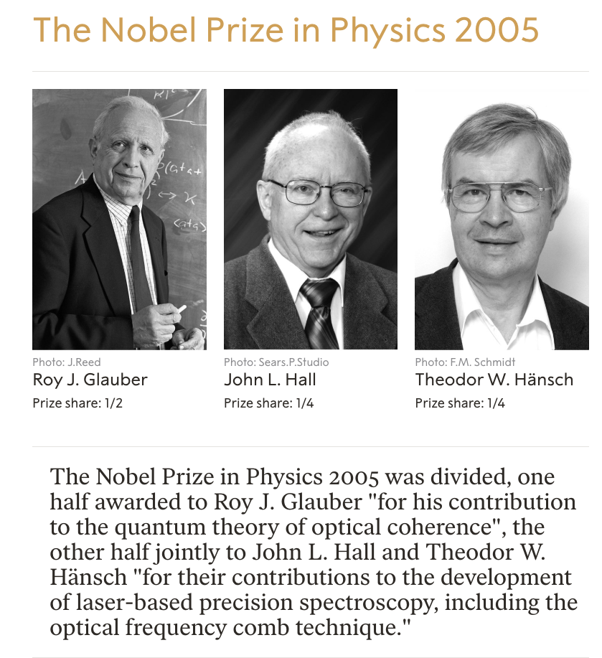
And of course the wonderful news in 2005

Slide 41
Roy J. Glauber, Nobel Prize in Physics 2005

Slide 42
Roy J. Glauber, Nobel Prize in Physics 2005

Slide 43
Roy J. Glauber, Nobel Prize in Physics 2005

Slide 44
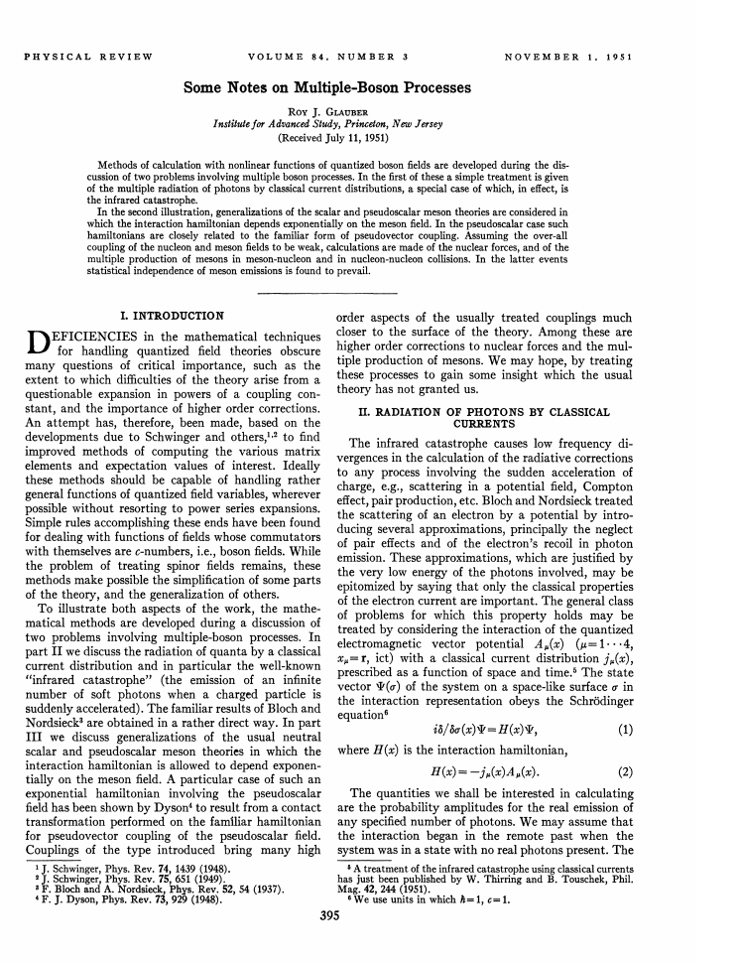
Something I Learned from Roy’s Nobel Lecture
Some Notes on Multiple-Boson Processes,
RJ Glauber - Physical Review 84, 395 (1951) Cited by 165
User Schwinger-inspired
source methods.
Shows classical current
produces Poisson distribution.
Background for future work
on optical coherence

Slide 45
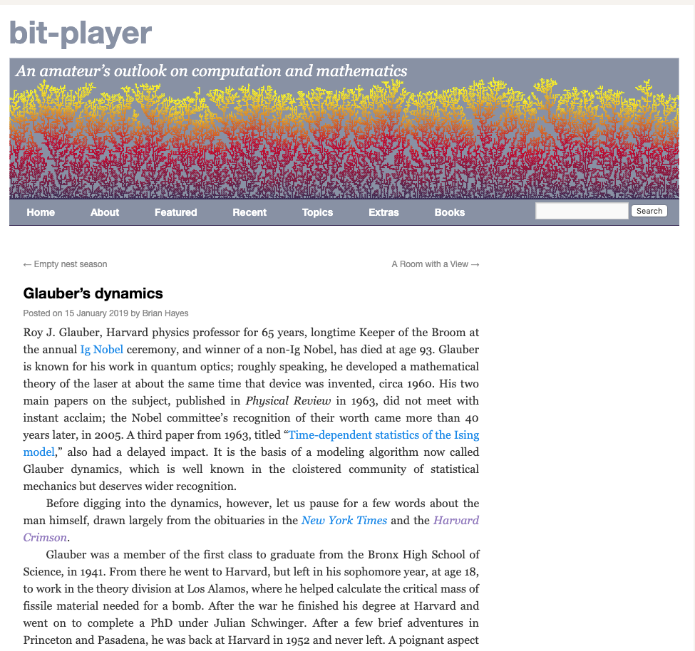
Something Else I Learned in Preparing This Talk
Time-Dependent Statistics of the Ising Model,
RJ Glauber – Journal of Mathematical Physics, 4, 294 (1963)
Cited by 3730

Slide 46
Something Else I Learned in Preparing This Talk
Time-Dependent Statistics of the Ising Model,
RJ Glauber – Journal of Mathematical Physics, 4, 294 (1963)
Cited by 3730
If the mathematical problems of equilibrium statistical mechanics are great, they are at least relatively well-defined. The situation is quite otherwise in dealing with systems which undergo large-scale changes with time. The principles of nonequilibrium statistical mechanics remain in largest measure unformulated. While this lack persists, it may be useful to have in hand whatever precise statements can be made about the time-dependent behavior of statistical systems, however simple they may be.

Slide 47
Roy at Quark Matter 2005 (August 4th )

Slide 48
Roy at Quark Matter 2005 (August 7th)

Slide 49
Prior to Installation of the Royal Court

Slide 50
Roy’s Coronation

Slide 51
A Queen Is Chosen

Slide 52
And A Jester…

Slide 53
And …

Slide 54
An Editor !

Slide 55
Who Was Appropriately Sentenced

Slide 56
Festivities Continued Into The Evening

Slide 57
Roy Continued as “The Keeper of the Broom” at Ig Nobels
Roy at the 2012
Ig Nobels.
Roy on reporters
at the Nobel Ceremony:

Slide 58
Roy Continued as “The Keeper of the Broom” at Ig Nobels
Roy at the 2012
Ig Nobels.
Roy on reporters
at the Nobel Ceremony:
“But all they wanted to ask about was that damn broom and the paper airplanes.”

Slide 59
Roy Continued as “The Keeper of the Broom” at Ig Nobels
Roy at the 2016 Ig Nobels
Notes:
Eric Maskin, 2007 Economics, foundations of mechanism design theory
Rich Roberts, 1993 Medicine, introns and gene-splicing
Dudley Herschbach, 1986 Chemistry, crossed molecular beams for elucidating the dynamics of chemical elementary processes

Slide 60
Roy Continued as “The Keeper of the Broom” at Ig Nobels
Roy at the 2016 Ig Nobels
Nobel laureates Eric Maskin, Rich Roberts, Dudley Herschbach, and Roy
Notes:
Eric Maskin, 2007 Economics, foundations of mechanism design theory
Rich Roberts, 1993 Medicine, introns and gene-splicing
Dudley Herschbach, 1986 Chemistry, crossed molecular beams for elucidating the dynamics of chemical elementary processes

Slide 61
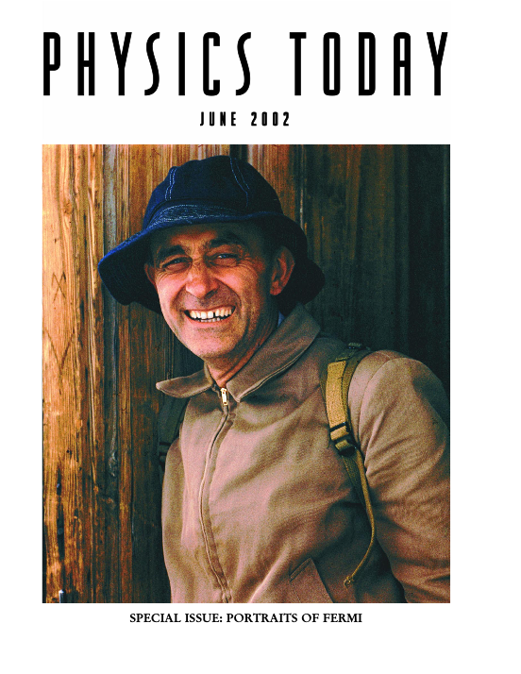
Two of Roy’s Other Great Contributions to Physics

Slide 62
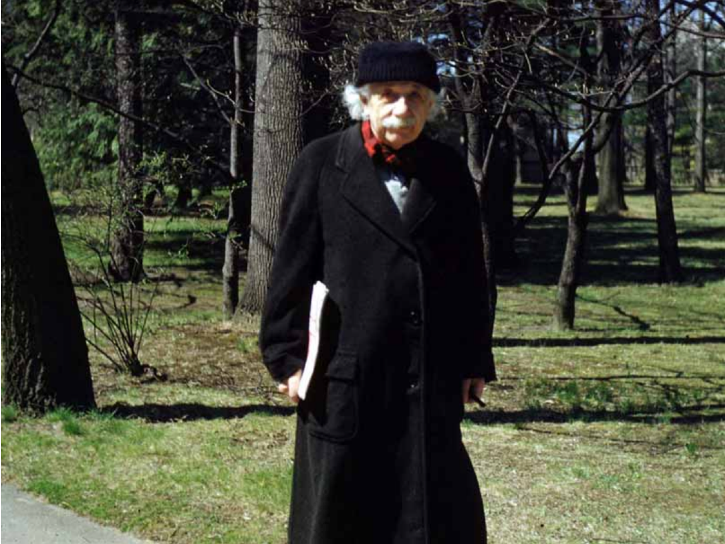
Two of Roy’s Other Great Contributions to Physics

Slide 63
Some Words on Career Development
(Induced) Serendipity – those whom I nudged to help me:
  Abraham Pais
    Influence of Bose-Einstein statistics in the anti-proton annihilation process,
    G. Goldhaber, S. Goldhaber, W.Y. Lee and A. Pais, Physical Review 120, 300 (1960)
    Cited by 761
  Ed Purcell
    The question of correlations between photons in coherent light rays,
    E.M. Purcell, Nature 178, 1449 (1956)
    Cited by 347
  Roy (see this talk)

Slide 64
Some Words on Career Development
(Induced) Serendipity – those whom I nudged to help me:
  Abraham Pais
    Influence of Bose-Einstein statistics in the anti-proton annihilation process,
    G. Goldhaber, S. Goldhaber, W.Y. Lee and A. Pais, Physical Review 120, 300 (1960)
    Cited by 761
  Ed Purcell
    The question of correlations between photons in coherent light rays,
    E.M. Purcell, Nature 178, 1449 (1956)
    Cited by 347
  Roy (see this talk)
(Reduced) Productivity – advice on priorities
“I’m sure there is some number of papers I never got to write as a result, but … was not an experience I would trade for the missing papers or any sort of recognition.”
Roy Glauber

Slide 65
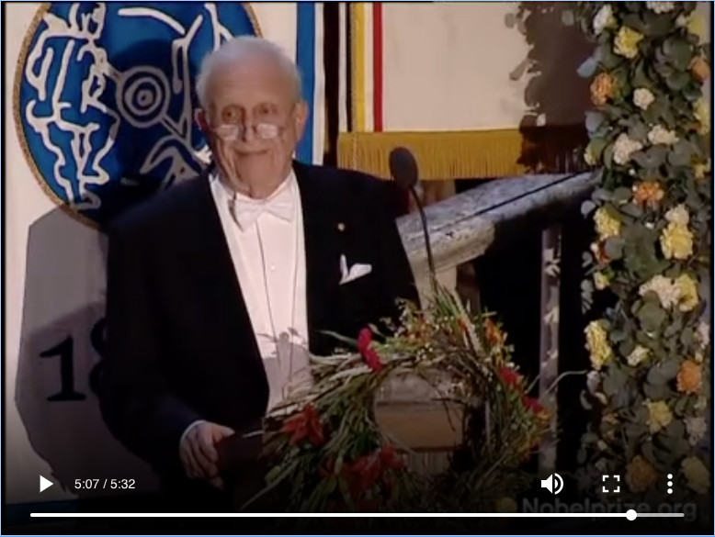
Recommended Resources
Roy’s Nobel lecture:
https://www.nobelprize.org/prizes/physics/2005/glauber/lecture/
Roy’s wonderful
autobiographical essay:
https://www.nobelprize.org/prizes/physics/2005/glauber/biographical/
Roy’s luminous banquet
speech on light:
https://www.nobelprize.org/prizes/physics/2005/glauber/speech/

Slide 66
In Summary
Roy – Thank you for lighting the way, and for illuminating our lives with your grace, dignity and geniality.

Slide 67
In Summary
Roy – Thank you for lighting the way, and for illuminating our lives with your grace, dignity and geniality.
Our sorrow is tempered by knowing that your light is now shining from a higher place.

Slide 68
Thank You!

Slide 69
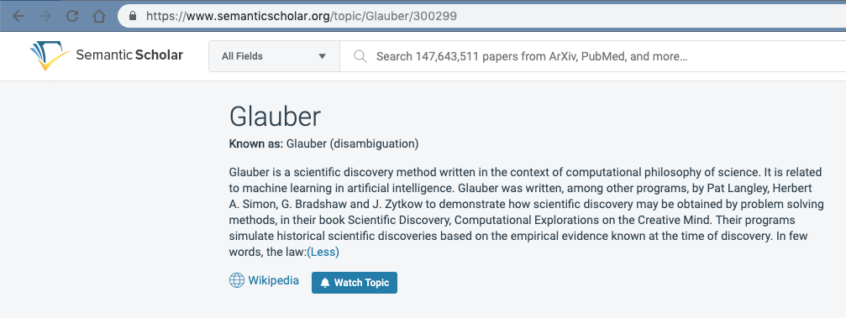
We All Know What “Glauber” Is…

