Slide 1
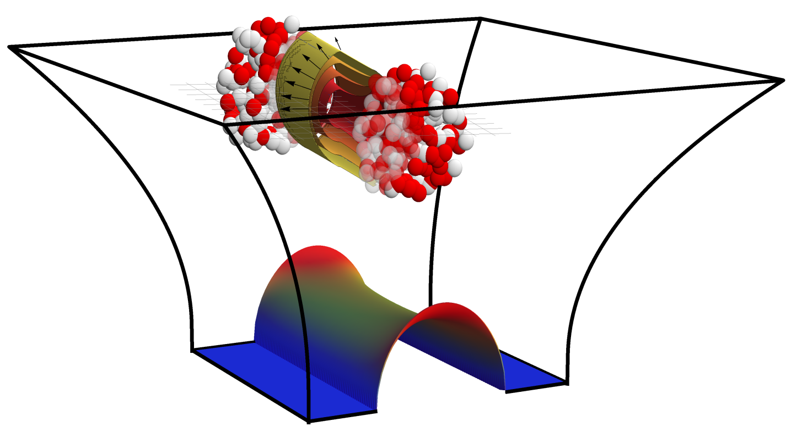
Holographic collisions with baryon number at intermediate coupling
Holography beyond η/s=1/4π
Based on work Åsmund Folkestad, Sašo Grozdanov and Krishna Rajagopal
References: 1501.04952, 1507.08195, 1610.08976 (PRL), 1907.xxxxx
Wilke van der Schee

Slide 2
Outline
Wilke van der Schee, MIT/Utrecht
Holography to model QCD
AdS/CFT: first principle non-perturbative QFT computations
Limitations: QCD(-like) theory with intermediate coupling is hard
Baryon number is interesting: collision transparent?
Not so at infinite coupling: baryon charge follows energy
Finite coupling corrections, including baryon number
Extra terms in the AdS Lagrangian
Following baryon charge for thick and thin holographic collisions
Depending on extra parameter β: much more transparency
Notes:
Many states + linearized

Slide 3
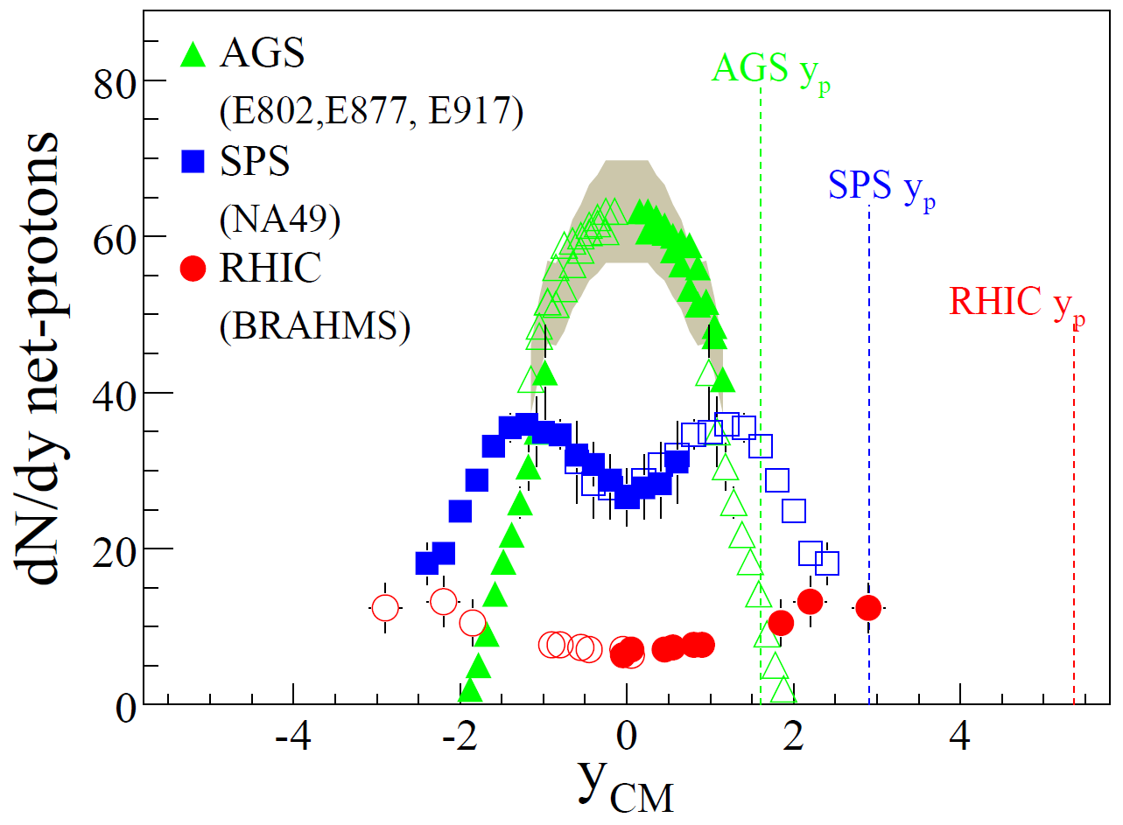
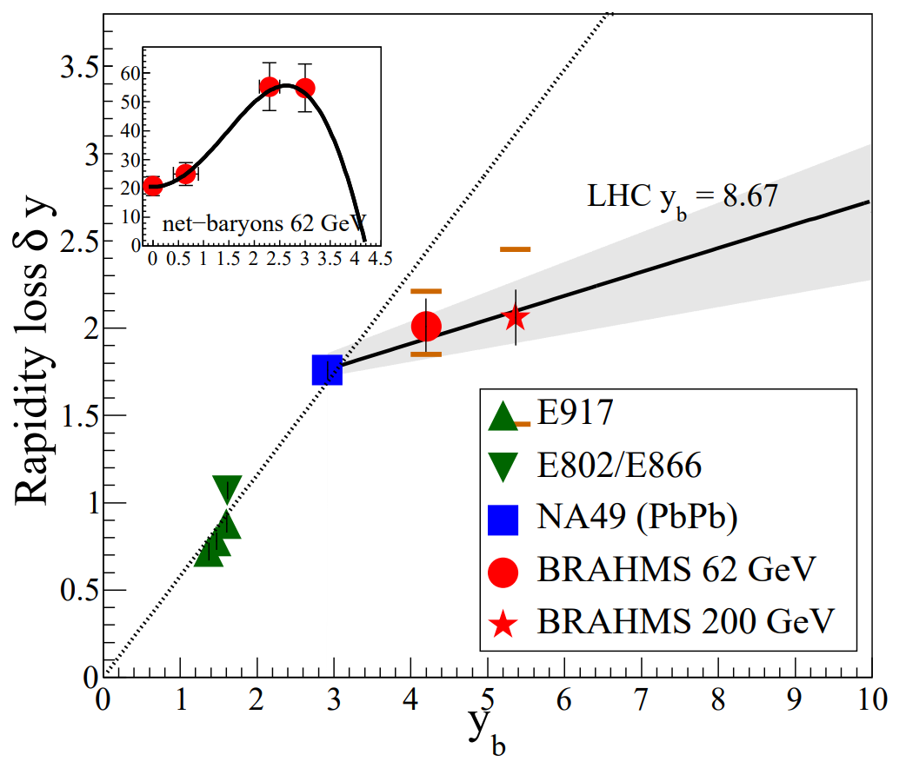
Following baryon number
Wilke van der Schee, MIT/Utrecht
Input: ~400 baryons, conserved: more protons than anti-protons
Picture: transparent baryon flow, energy created at mid-rapidity
Depending on beam rapidity (y_{b} ) baryons lose 1 – 2.5 units of rapidity (δy)
(5, 17, 200) GeV
BRAHMS, Nuclear stopping and rapidity loss in Au+Au collisions at √s_{NN} =62.4 GeV (2009)
BRAHMS, Nuclear Stopping in Au+Au Collisions at √s_{NN} = 200 GeV

Slide 4
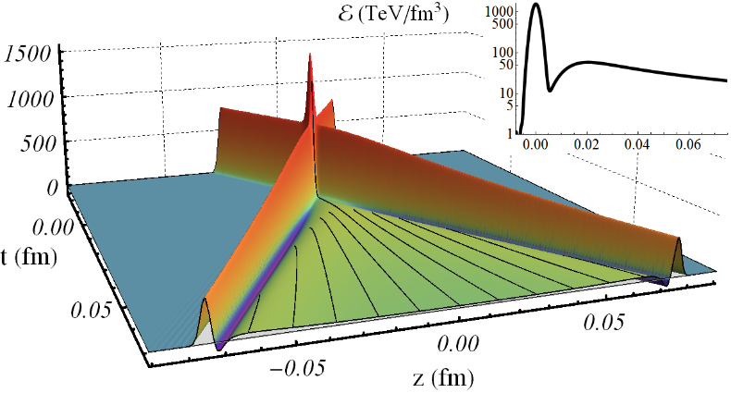
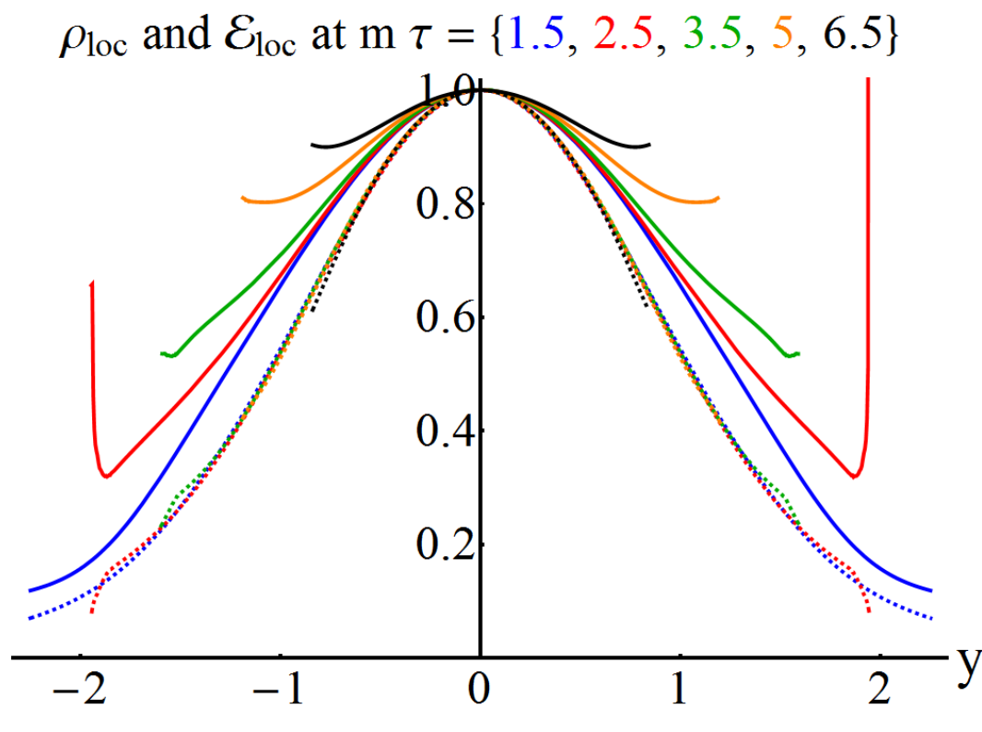
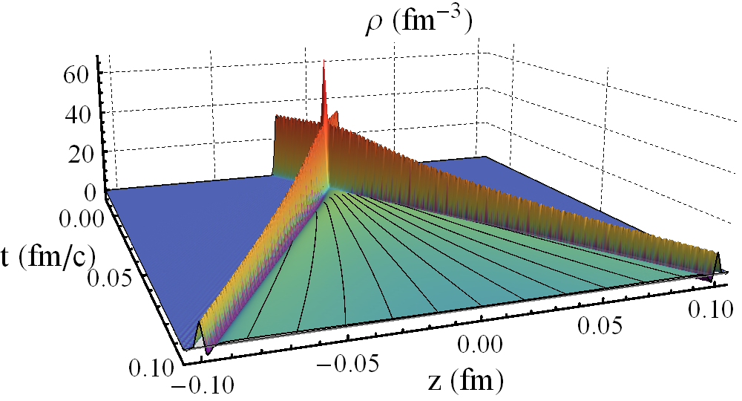
Rapidity profile at infinite coupling
Wilke van der Schee, MIT
Collide shocks with energy and charge (=general conserved current)
Charge rapidity (solid) similar to energy (dashed), but grows in time
J. Casalderrey-Solana, D. Mateos, WS and M. Triana, Holographic heavy ion collisions with baryon charge (2016)

Slide 5
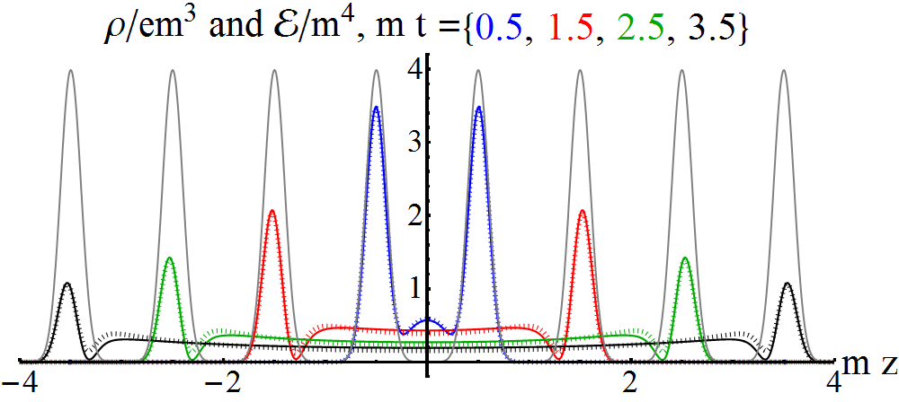
A puzzle: decay charge on light-cone:
Wilke van der Schee, MIT
Charge (solid) and energy (dashed) decay exactly the same way
Non-trivial from equations
Charge distribution flatter in plasma
J. Casalderrey-Solana, D. Mateos, WS and M. Triana, Holographic heavy ion collisions with baryon charge (2016)

Slide 6
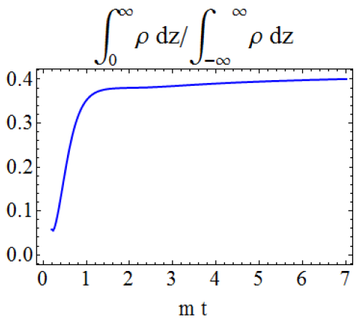
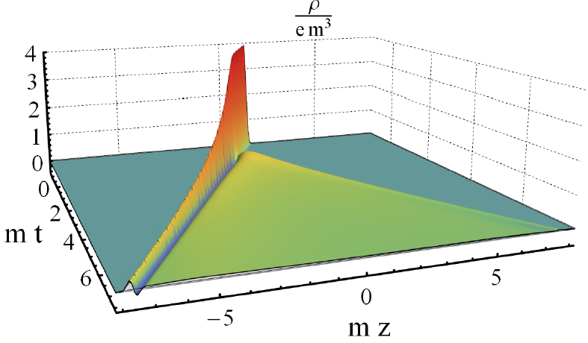
A new quantitative insight
Wilke van der Schee, MIT
Collide shocks with energy and charge
Now collide neutral with charged shock
41% of charge changes direction → strong interactions
J. Casalderrey-Solana, D. Mateos, WS and M. Triana, Holographic heavy ion collisions with baryon charge (2016)

Slide 7
Ads/cft and holography
Wilke van der Schee, MIT/Utrecht
Heavy ion physics: a weak/strong coupling interplay?
A ‘hybrid’ approach: make a model inspired by strong and weak models
Bolder approach: strong coupling entirely
Qualitative/quantitative trends can inspire better modelling
In either approach some amount of fitting is required
Here: try to bridge gap by including (important) corrections in AdS:
With R Riemann tensor, F Maxwell field; two new couplings: λ_{GB}, β
Bottom-up: field theory interpretation only known qualitatively
Notes:
Note ihQCD: is possible to change from N=4 SYM

Slide 8
Ads/cft and holography
Wilke van der Schee, MIT/Utrecht
Here: try to bridge gap by including (important) corrections in AdS:
Effect on i.e. transport coefficients and charge susceptibility:
`Reasonable’ values are and
and
But all computations done perturbatively in λ_{GB} and β
Notes:
Note ihQCD: is possible to change from N=4 SYM

Slide 9
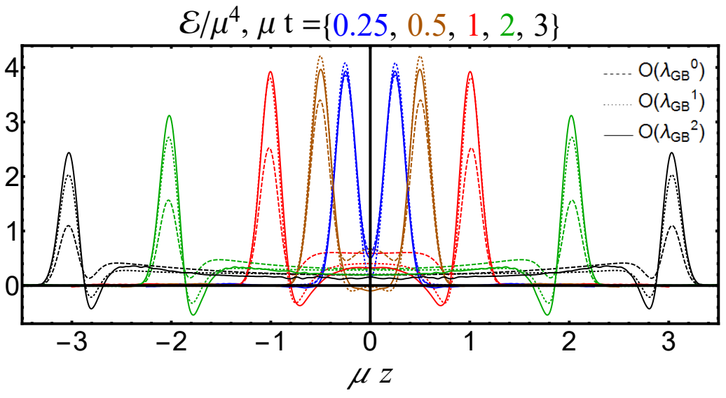
Collisions at Finite coupling - narrow
Wilke van der Schee, MIT/Utrecht
Results presented for, i.e (solid)
Initial condition constructed such that energy is the same
Much more energy on lightcone (more transparent, less stopping)
Energy in plasma flatter
Sašo Grozdanov and WS, Coupling Constant Corrections in a Holographic Model of Heavy Ion Collisions (2017)

Slide 10
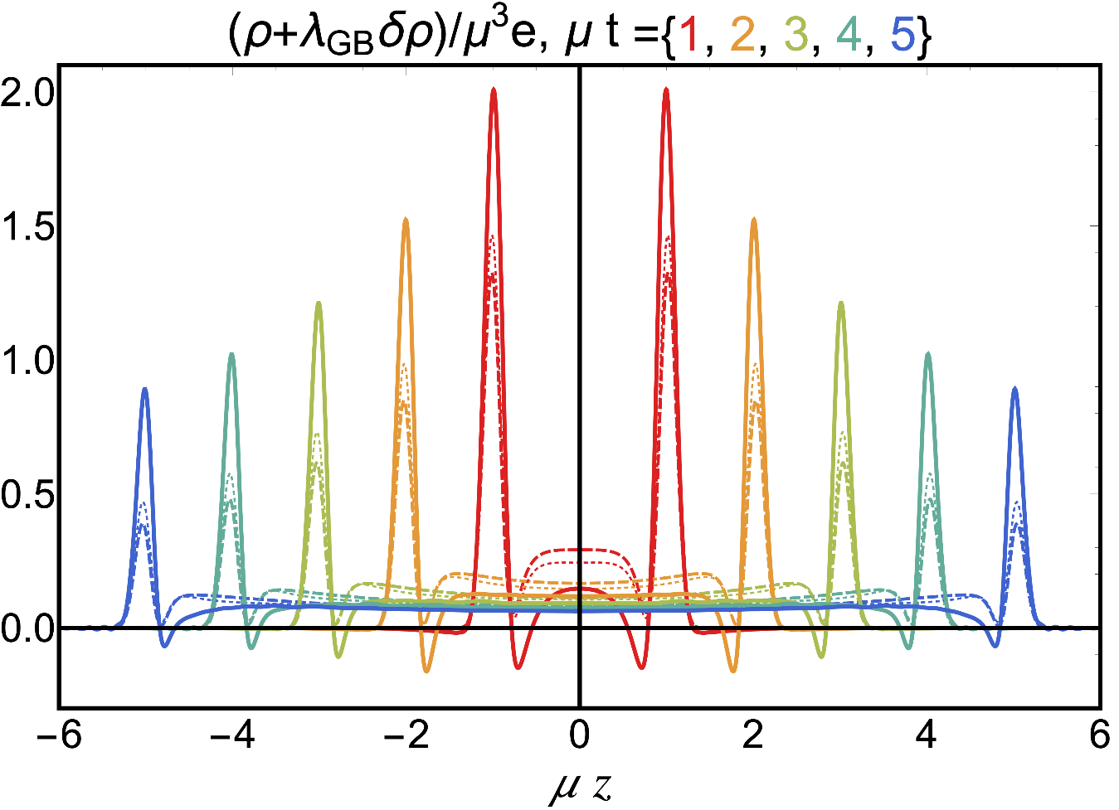
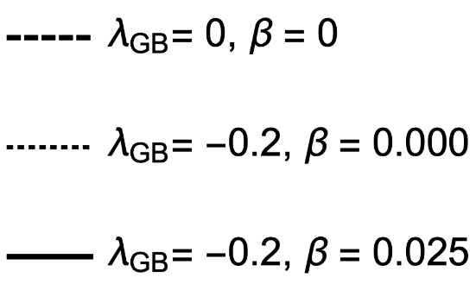
Baryon Charge collisions
Wilke van der Schee, MIT/Utrecht
Results presented for, i.e (solid)
Result strongly depends on β, especially on light-cone
Much more baryon charge on light-cone (more transparent)

Slide 11
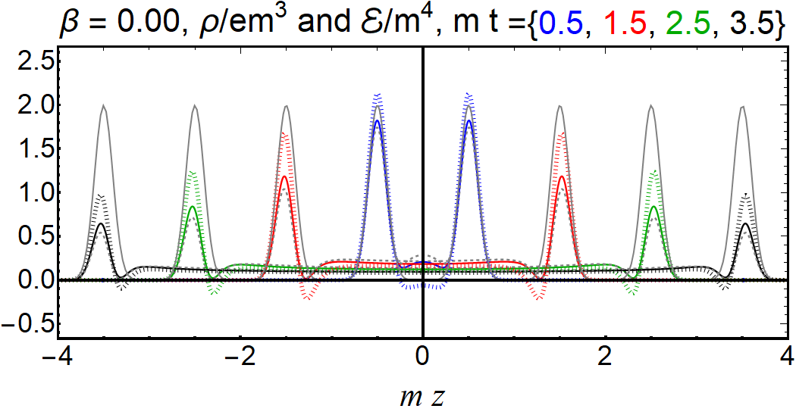
decay charge on light-cone:
Wilke van der Schee, MIT
Baryon charge (solid) and energy (dashed) decay differently
β = 0: much more energy on light-cone, a bit more charge
J. Casalderrey-Solana, D. Mateos, WS and M. Triana, Holographic heavy ion collisions with baryon charge (2016)

Slide 12
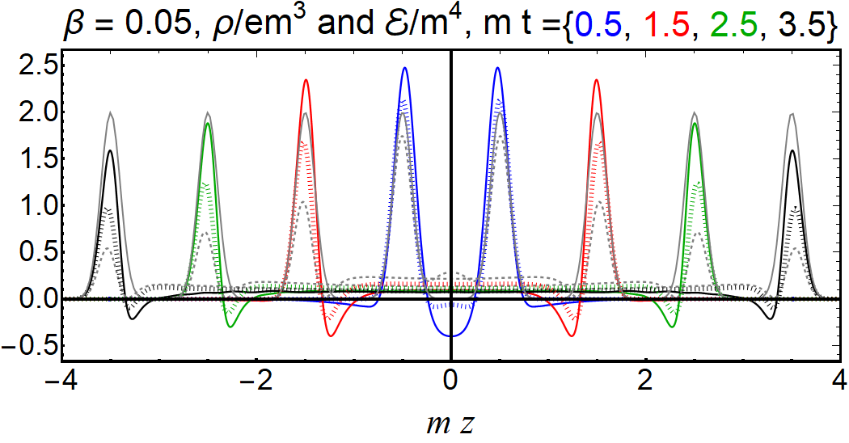
decay charge on light-cone:
Wilke van der Schee, MIT
Baryon charge (solid) and energy (dashed) decay differently
β = 0.05: much more charge on light-cone
J. Casalderrey-Solana, D. Mateos, WS and M. Triana, Holographic heavy ion collisions with baryon charge (2016)

Slide 13
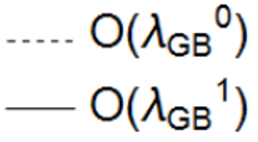
Collisions at Finite coupling - rapidity
Wilke van der Schee, MIT/Utrecht
Initial rapidity shape differs from Gaussian
Narrow
Wider and lower initially (energy on lightcone not shown) Around time 3 similar
Later more entropy, similar width

Slide 14
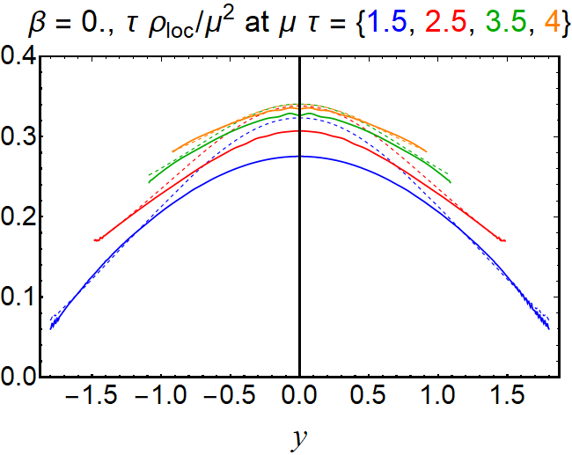
charge - rapidity
Wilke van der Schee, MIT/Utrecht
Rapidity shape similar at β = 0:
Narrow
Wider and lower initially, similar at μ τ = 3.5

Slide 15
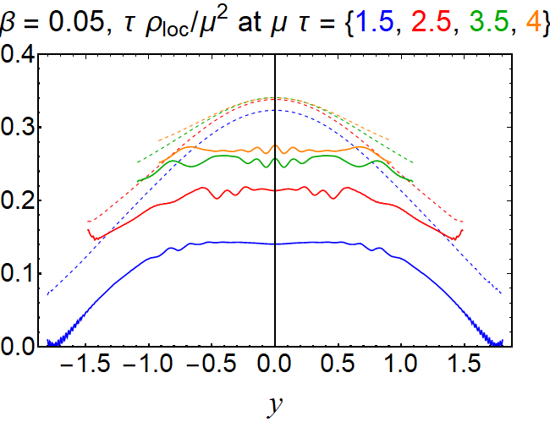
charge - rapidity
Wilke van der Schee, MIT/Utrecht
Rapidity shape similar at non-zero β:
Narrow
Always lower, more baryon charge on the light-cone (total conserved)

Slide 16
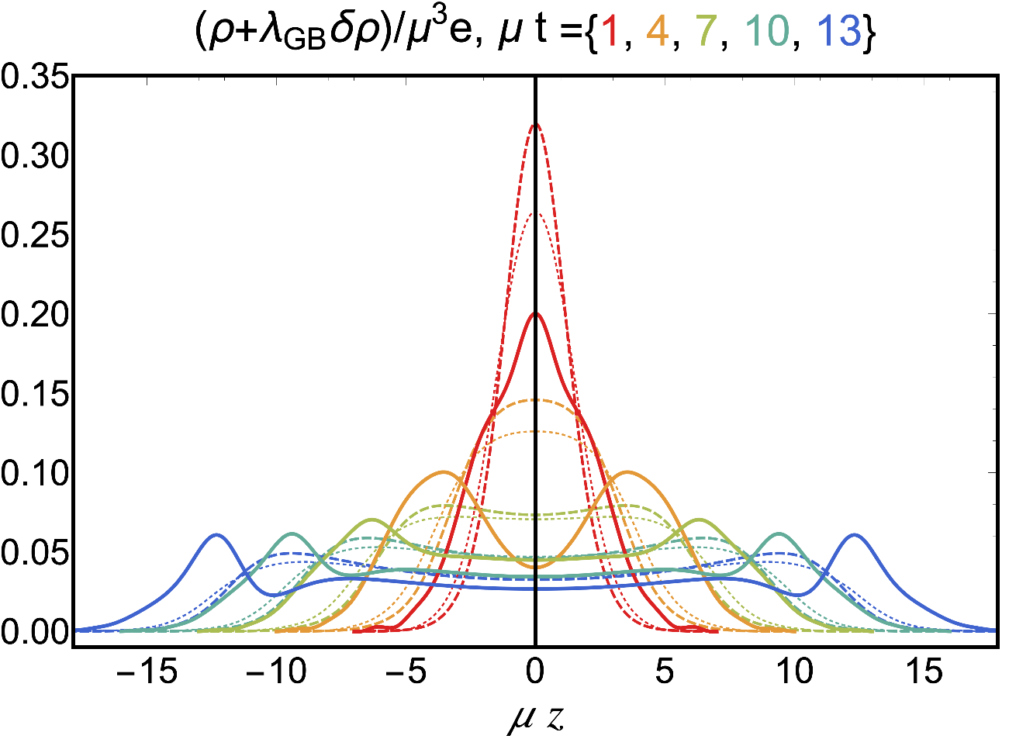
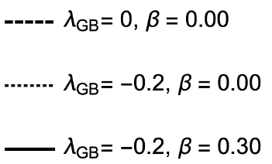
Wide shock collisions
Wilke van der Schee, MIT/Utrecht
Landau-like: hydrodynamic explosion
Here larger β needed for similar effects as compared to narrow
Effects of β = 0.3 probably not be perturbative

Slide 17
Discussion
Wilke van der Schee, MIT/Utrecht
Holography and heavy ion collisions
AdS/CFT essential tool for insights in strongly coupled matter
Can we get closer to `realistic’ baryon number transparency?
Holographic collisions at finite coupling
New parameter β: `coupling between stress and (baryon) charge’
Charge on light-cone: crucial dependence on β
Rapidity spectrum charge plasma initially: wider and more transparent
Outlook
Improved models closer to QCD, include coupling changing with time
Notes:
Many states + linearized

Slide 18
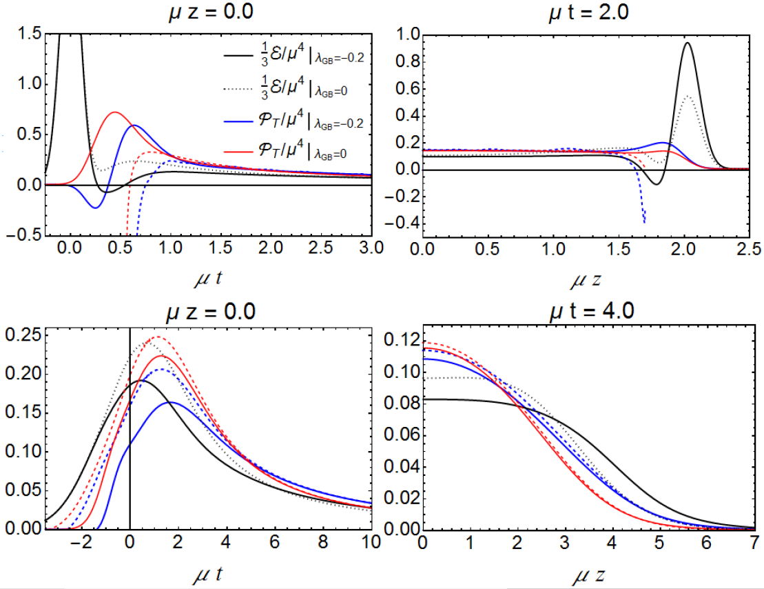
Collisions at Finite coupling - hydro
Wilke van der Schee, MIT/Utrecht
Hydro applies about 25% later for narrow shocks (subtler for wide)
Only transverse pressure: longitudinal from conformal symmetry
Can be seen as either non-trivial check on viscosity or numerics…
Narrow
Hydro later (blue), and further from lightcone
Wide
Hydro later (blue), and further from lightcone, smaller transverse pressure early on, bigger later

Slide 19
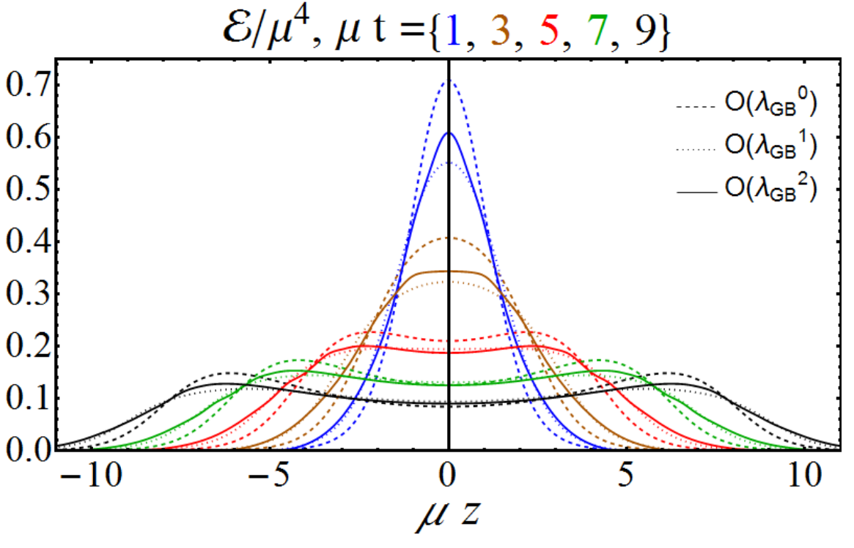
Collisions at Finite coupling - wide
Wilke van der Schee, MIT/Utrecht
Results presented for, i.e
Initial condition constructed such that energy is the same
Energy does not `pile up’, i.e. maximum 217% instead of 271%
Also includes λ_{GB}² corrections (small opposite contribution)

Slide 20
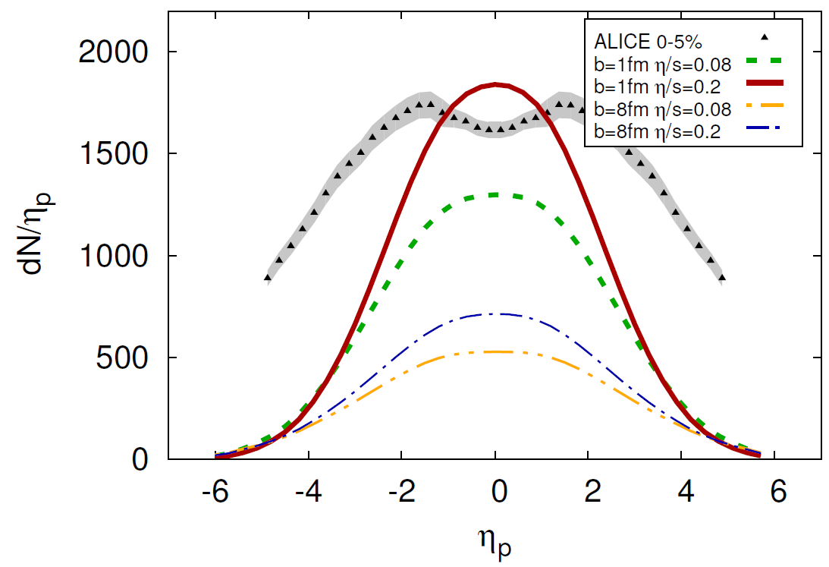
Rapidity profile + music
Wilke van der Schee, MIT/Utrecht
Particle spectra in longitudinal direction:
Rescaled initial energy density by factor 20
Profile is about 30% too narrow
WS and B. Schenke, Rapidity dependence in holographic heavy ion collisions (2015)
ALICE, Bulk Properties of Pb-Pb collisions at √s_{NN} = 2.76 TeV measured by ALICE (2011)

