Slide 1
Principal Component Analysis
And its application to Relativistic
Heavy-Ion Collisions
For Initial Stages 2019
Ziming Liu
Peking University
June 25, 2019

Slide 2
Overview
Introduction to PCA
Paper I:
PCA Analysis of Collective Flow
Paper II:
PCA Analysis of flow factorization breaking

Slide 3
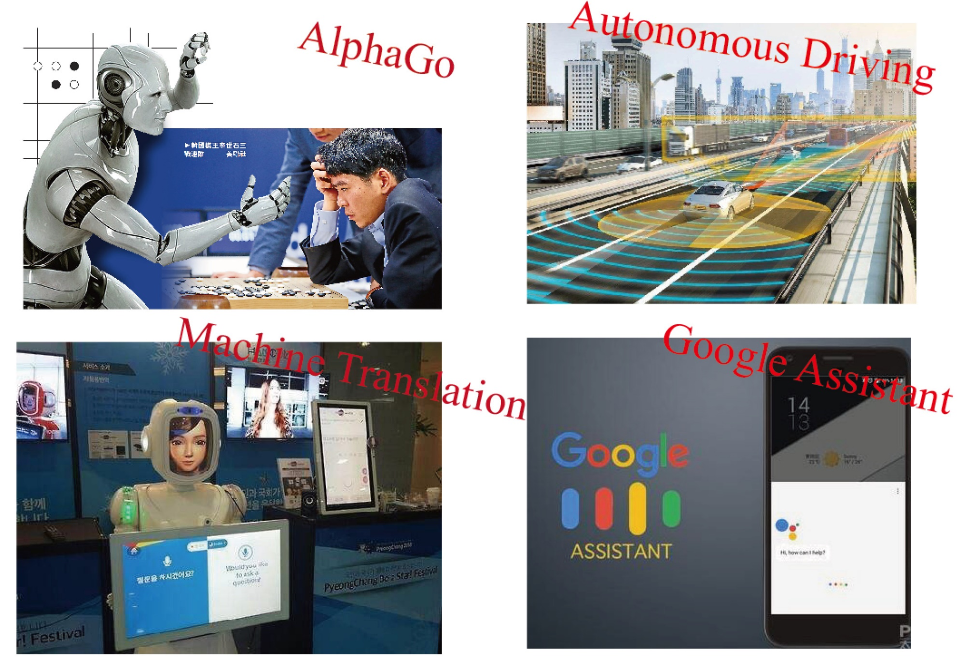
Machine learning

Slide 4
What is PCA?

Slide 5
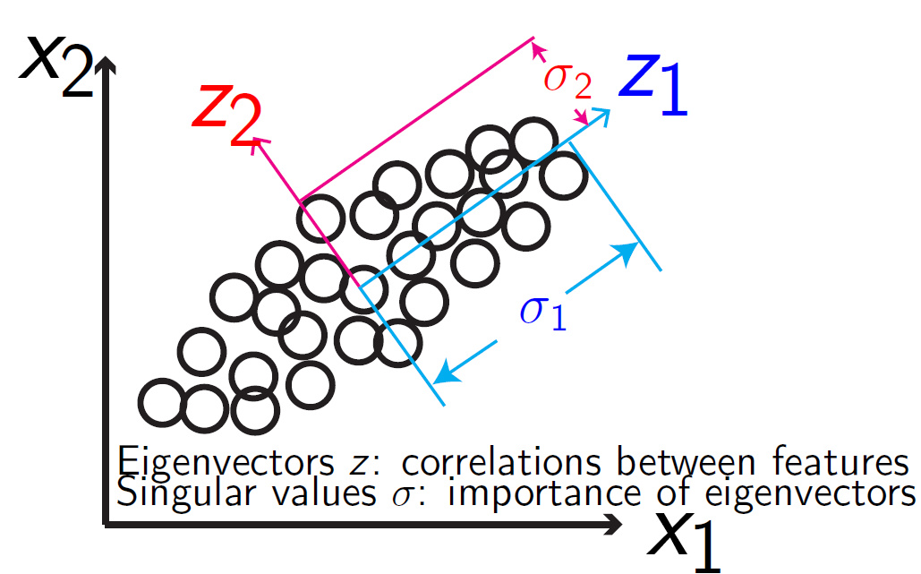
An intuitive way for PCA

Slide 6
Principal component analysis ——Application

Slide 7
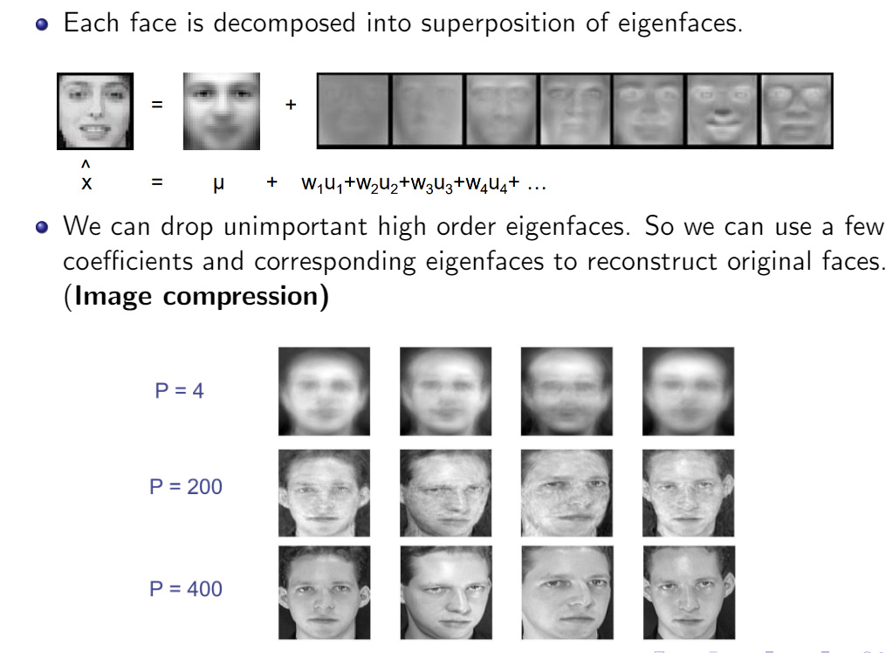
Principal component analysis ——Application

Slide 8
Principal component analysis --math
Theorem: SVD(Singular Value Decomposition)
For a complex (real) matrix $A∈R^{n×m},∃$ unitary (orthogonal) matrices
$U_{n×n}$ and $V_{m×m},$ along with a sub-diagonal matrix $Σ_{n×m}$ such that
$$A=UΣZ$$
Where $Σ=diag\left(σ_{1},σ_{2},…,\right)$ such that $σ_{1}≥σ_{2}≥=…≥0$
$$V$$
$σ$: singular values
$v_{i,:}$: eigenmodes/ eigenvectors/principal components
(features)
V

Slide 9
Principal component analysis --math
Now, the $i$th event can be decomposed as summation of eigenvectors $z_{j}$：
$$A_{i,:}≈\sum_{j=1,2,…,k}{σ_{j}u_{i,j}v_{:,j}}$$
$k$ is the cut we choose to drop out minor modes.
The $i$th event
n numbers
k numbers
$$A_{i,1∼n}$$
$$U_{i,1∼k}$$

Slide 10
PCA in physics

Slide 11
PCA in physics

Slide 12
PCA in Heavy-Ion

Slide 13
Principal Component Analysis(PCA) in Heavy-ion Physics
arXiv: 1903.09833
Ziming Liu, Wenbin Zhao, Huichao Song
Principal Component Analysis (PCA) of Collective Modes
in Relativistic Heavy-Ion Collisions
Recent work, paper in preparation
Ziming Liu, Arabinda Behera, Huichao Song, and Jiangyong Jia
Reconsideration on studying sub-leading flow with PCA

Slide 14
Can a machine automatically
discover flow?
arXiv: 1903.09833
Ziming Liu, Wenbin Zhao, Huichao Song
Principal Component Analysis (PCA) of Collective Modes
in Relativistic Heavy-Ion Collisions

Slide 18
Singular values
Degeneracy $→$
Rotational symmetry

Slide 19
Eigenvectors/ Principal components
Elliptic flow Triangular flow ……
Machines can automatically discover flow
without any guidance from human beings!

Slide 20
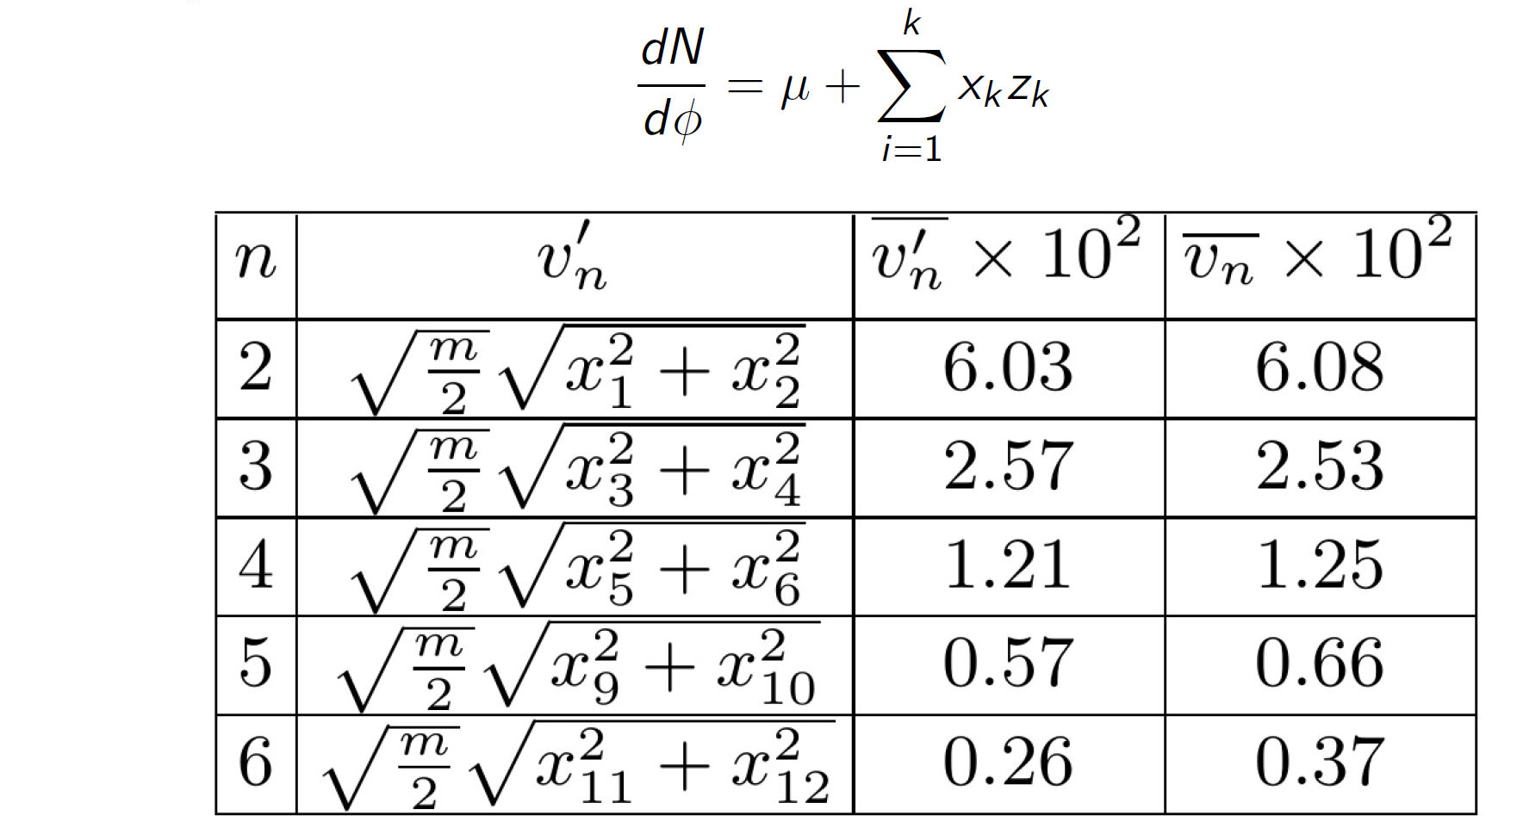
Define flow harmonics
with PCA
Event average comparisons
Define flow harmonics
with Fourier (Tradition)
PCA flow harmonics
$$≈$$
Traditional flow harmonics
Event-by-event comparisons
?
?
?

Slide 21
Symmetric cumulants
Fourier : $SC^{v}\left(m,n\right)=\left\langle v_{m}^{2}v_{n}^{2}\right\rangle −\left\langle v_{m}^{2}\right\rangle \left\langle v_{n}^{2}\right\rangle$
PCA : $SC^{v^{′}}\left(m,n\right)=\left\langle {v^{′}}_{m}^{2}{v^{′}}_{n}^{2}\right\rangle −\left\langle {v^{′}}_{m}^{2}\right\rangle \left\langle {v^{′}}_{n}^{2}\right\rangle$
Correlation between different harmonics decrease for PCA !

Slide 22
Pearson correlation between initial and final
PCA
Fourier
Off-diagonal correlation ↓
Diagonal correlation ↑

Slide 23
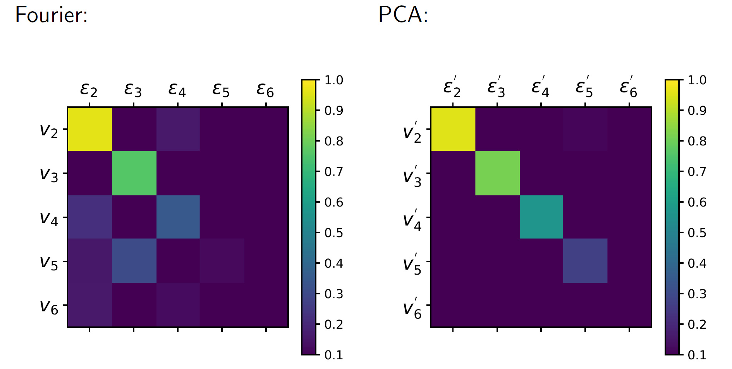
Pearson correlation between initial and final
20%-30% centrality data
PCA has a more diagonal pattern!

Slide 24
Conclusion for paper 1
Without defining Fourier bases, PCA can automatically discover flow.
We use PCA bases to re-define flow harmonics and find that
PCA bases lead to less correlations between different flow harmonics.
PCA flow harmonics have a more diagonal pattern with initial eccentricities as compared to traditional one.

Slide 25
The limitation of studying sub-leading flow with PCA
Recent work, paper in preparation
Ziming Liu, Arabinda Behera, Huichao Song, and Jiangyong Jia
Reconsideration on studying sub-leading flow with PCA

Slide 26
Principal component analysis of event-by-event fluctuations
PRL 114, 152301 (2015)
Rajeev S. Bhalerao, Jean-Yves Ollitrault, Subrata Pal, and Derek Teaney
Single particle distribution
Two-particle correlation
$$\frac{dN}{dp}=\sum{V_{n}\left(p\right)e^{−inφ}}$$
$$\left\langle V_{nΔ}\left(p_{a},p_{b}\right)\right\rangle =\left\langle V_{n}\left(p_{a}\right)V_{n}^{∗}\left(p_{b}\right)\right\rangle$$
diagonalization
Decompose $V_{n}\left(p_{T}\right)$ with PCA modes
$V_{n}\left(p_{T}\right)=ζ_{n}^{\left(1\right)}V_{n}^{\left(1\right)}\left(p_{T}\right)+ζ_{n}^{\left(2\right)}V_{n}^{\left(2\right)}\left(p_{T}\right)+ζ_{n}^{\left(3\right)}V_{n}^{\left(3\right)}\left(p_{T}\right)+…+$ $ζ_{n}^{\left(k\right)}V_{n}^{\left(k\right)}\left(p_{T}\right)$
Leading
flow
Sub-leading
flow
Sub-sub-leading
flow
k-th mode

Slide 27
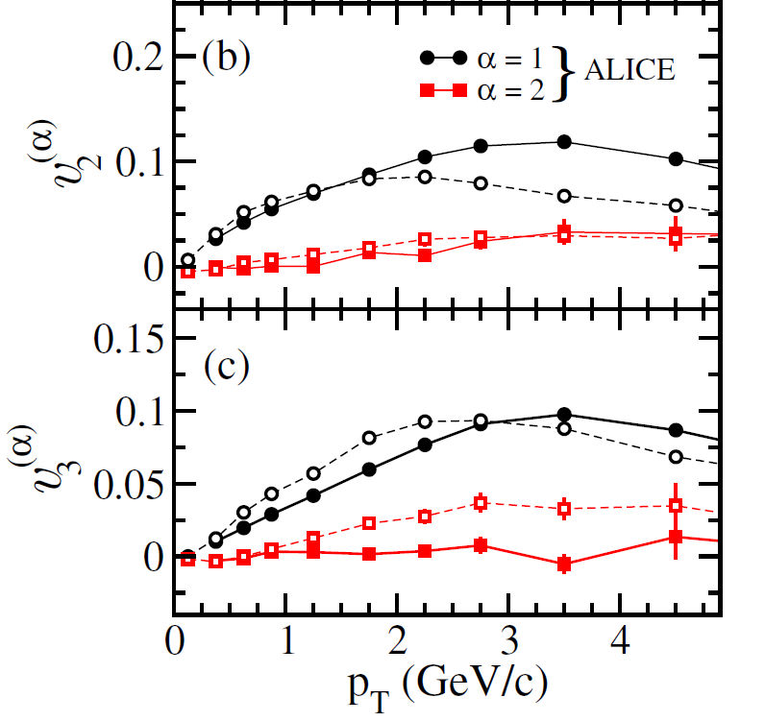
Principal component analysis of event-by-event fluctuations
PRL 114, 152301 (2015)
Rajeev S. Bhalerao, Jean-Yves Ollitrault, Subrata Pal, and Derek Teaney
Non-zero sub-leading flow?

Slide 28
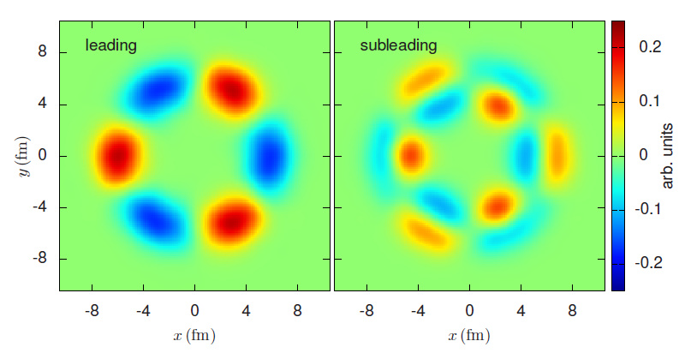
Cause for Sub-leading flow
Phys.Rev. C91 (2015) no.4, 044902
Aleksas Mazeliauskas, Derek Teany
$$V_{3}(p_{T})$$
Radial excitation leads to sub-leading flow!
Sub-leading flow is theoretically important!!!

Slide 29
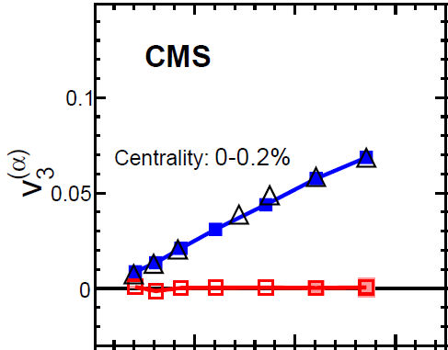
Experimental results
Phys. Rev. C 96, 064902
The CMS Collaboration
🔺 $v_{3}\left\{\left|Δη\right|>2.0\right\}$, CMS ★${ v}_{3}\left\{\left|Δη\right|>0.8\right\}$, ALICE
Leading flow
Leading flow
Sub-leading flow
Sub-leading flow

Slide 30
Think more about it.
Model setup:
AMPT model
1M UCC events
subevent method
(paper in preparation)
Ziming Liu, Arabinda Behera, Huichao Song, and Jiangyong Jia

Slide 31
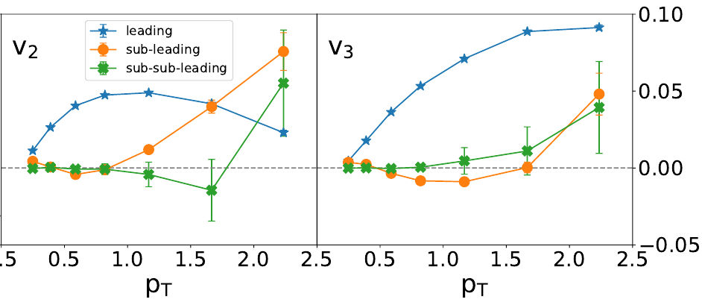
Reproduce CMS results
0.0
Same $p_{T}$ cut and proper $η$ gap $|Δη|<0.8$ .
Our model can properly reproduce the results @CMS

Slide 32
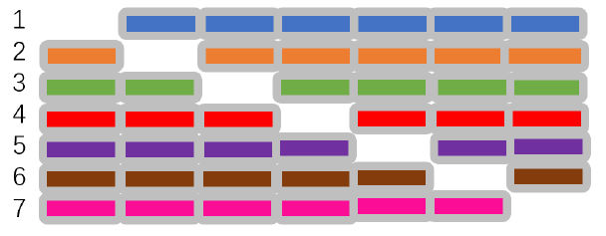
Problem 1: How to choose $p_{T}$ bins?
Orthogonal on this large interval
Drop one $p_{T}$ bin each time,
and redo the PCA
Not orthogonal on this small interval
PCA will try to mix these two modes!
Will the modes still be stable?

Slide 33
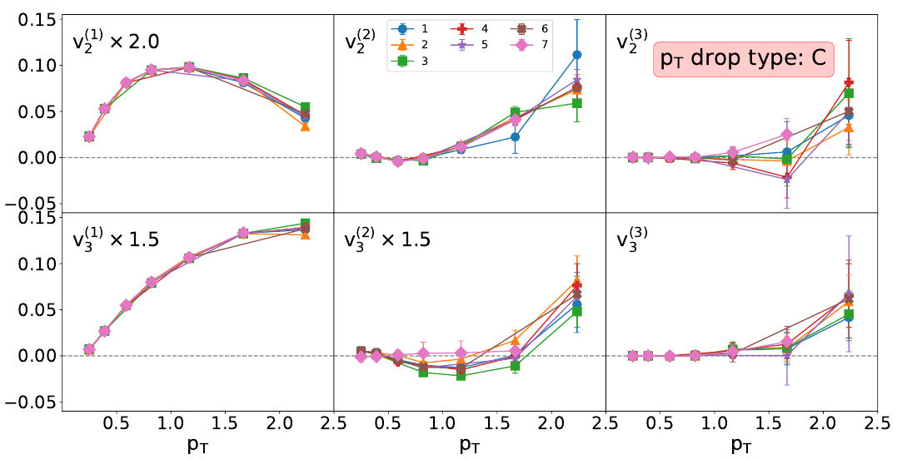
Problem 1: How to choose $p_{T}$ bins?
Leading flow
Sub-leading flow
Sub-sub-leading flow
Elliptic flow
Triangular flow
Different choice of $p_{T}$ bins can introduce systematic errors!
PCA modes are sensitive to our choice of $p_{T}$ bins!

Slide 34
Problem 2 : Normalization
Traditional PCA
New PCA
$$\left\langle V_{nΔ}\left(p_{a},p_{b}\right)\right\rangle =\left\langle V_{n}\left(p_{a}\right)V_{n}^{∗}\left(p_{b}\right)\right\rangle$$
$$\left\langle V_{nΔ}\left(p_{a},p_{b}\right)\right\rangle =\left\langle V_{n}\left(p_{a}\right)V_{n}^{∗}\left(p_{b}\right)\right\rangle$$
Normalize
with $\left\langle M\left(p_{T}\right)\right\rangle$
PCA
$$v_{nΔ}\left(p_{a},p_{b}\right)=\frac{\left\langle V_{nΔ}\left(p_{a},p_{b}\right)\right\rangle }{\left\langle M(p_{a})\right\rangle \left\langle M\left(p_{b}\right)\right\rangle }$$
$${\tilde{v}}_{n}\left(p_{T}\right)=\frac{V_{n}(p_{T})}{\left\langle M\left(p_{T}\right)\right\rangle }$$
$$V_{n}\left(p_{T}\right)=ζ_{n}^{\left(1\right)}V_{n}^{\left(1\right)}\left(p_{T}\right)+ζ_{n}^{\left(2\right)}V_{n}^{\left(2\right)}\left(p_{T}\right)$$
$+ζ_{n}^{\left(3\right)}V_{n}^{\left(3\right)}\left(p_{T}\right)+…+$ $ζ_{n}^{\left(k\right)}V_{n}^{\left(k\right)}\left(p_{T}\right)$
Normalize
with $\left\langle M\left(p_{T}\right)\right\rangle$
PCA
$$v_{n}^{\left(α\right)}(p_{T})=\frac{V_{n}^{\left(α\right)}\left(p_{T}\right)}{\left\langle M\left(p_{T}\right)\right\rangle }$$
$${\tilde{v}}_{n}\left(p_{T}\right)=ζ_{n}^{\left(1\right)}{\tilde{v}}_{n}^{\left(1\right)}\left(p_{T}\right)+ζ_{n}^{\left(2\right)}{\tilde{v}}_{n}^{\left(2\right)}\left(p_{T}\right)$$
$$+ζ_{n}^{\left(3\right)}{\tilde{v}}_{n}^{\left(3\right)}\left(p_{T}\right)+…+ ζ_{n}^{\left(k\right)}{\tilde{v}}_{n}^{\left(k\right)}\left(p_{T}\right)$$
Different?
$${\tilde{v}}_{n}^{(α)}\left(p_{T}\right)$$

Slide 35
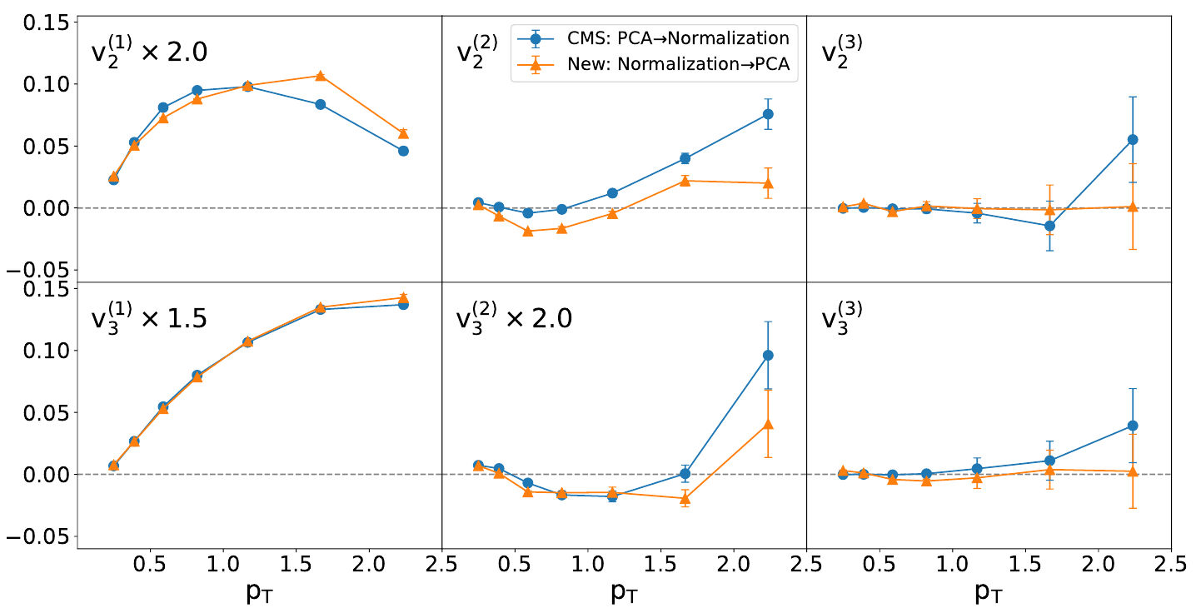
Problem 2 : Normalization
Different!
Leading flow
$v_{n}^{(α)}\left(p_{T}\right)$ or ${\tilde{v}}_{n}^{(α)}\left(p_{T}\right)$ ?
Sub-sub-leading flow
Elliptic
Sub-leading flow
Sub-sub-leading: real or fake?
Triangular
But which scheme can reveal more physics about initial profiles?
More analysis should be done to fully unravel the mystery of PCA!

Slide 36
Conclusion for paper 2
The choice of $p_{T}$ bins introduces systematic errors, but we have no guidance from physics about how to choose them
Technically, the normalization procedure before/after PCA also lead to different results. Which is the real physics? Need more discussion.

Slide 37
Summary & Outlook

Slide 38
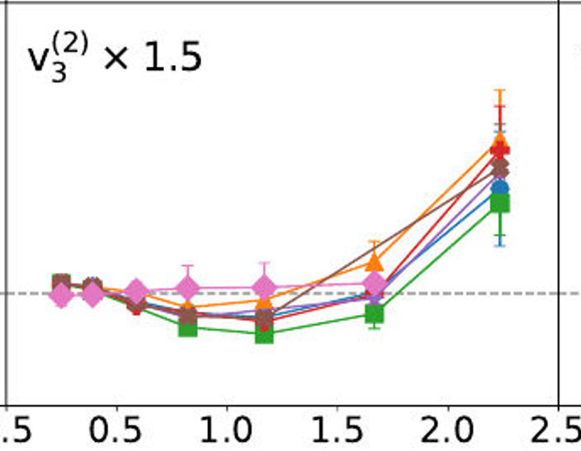
Principal Component Analysis:
Unsupervised learning (dimensionality reduction)
Good at discovering hidden correlations in data
$$φ$$
$$p_{T}$$
PCA for flow discovery
Integrate $p_{T}$, so stable
discover flow automatically
Reduce mode coupling
PCA for sub-leading flow
$p_{T}$ differential, sensitive to $p_{T}$ bins
Ambiguity in normalization
All in all, PCA is a transparent yet powerful machine learning
tool to extract main information/ hidden correlations in data!
But we should also be more careful about its results.

Slide 39
More advanced PCAs ……
High-order PCA
Suitable for high-order data, not constrained to 2-part correlation matrix
Kernel PCA
Able to capture non-linearity.
Hope can help study non-linearity in hydro.
Robust PCA
Hope: Eliminate non-flow
in the single particle distribution
level, without the trouble to
construct 2-part data.
Observed = Collective Flow + non-flow

Slide 40
Thank you
for your attention!

Slide 41
VI. Back up

Slide 42
Model Details
2.76 A TeV Pb+Pb
Viscous Hydro: VISH2+1
EOS: s95-PCE
Initial condition: TRENTo
Hydrodynamic starting time $τ_{0}=0.6fm/c$
Decoupling temperature $T_{sw}=\frac{148MeV}{c}$
$0.3<p_{T}<3GeV$, Pions only
0%-10%,……,50%-60% totally 6 centrality bins, 2000 events for each bin

Slide 43
PCA Implementation
Python – sklearn
From sklearn.decomposition import PCA
Mode cut $k=12$
https://scikit-learn.org/stable/modules/generated/sklearn.decomposition.PCA.html

Slide 44
Signal & Noise
Copper-Fryer:

Slide 45
Bases Mixing (2nd and 4th)

Slide 46
Bases Mixing (2nd and 4th)

Slide 47
PCA for Initial Profiles
Smoothing Procedure
$${\left(\frac{dS}{dφ}\right)}_{smooth}=\int{K(φ^{′},φ)}\frac{dS}{dφ^{′}}dφ^{′}$$
$$K\left(φ^{′},φ\right)=\frac{1}{\sqrt{2π}a}e^{−\frac{{\left(φ^{′}−φ\right)}^{2}}{2a^{2}}},a=0.251 rad$$
For initial states, PCA=Fourier

Slide 48
Angle shift
(Reaction Plane)
$$σ_{j}$$
$$j$$

Slide 49
Angle Shift
The PCA is implemented in the reaction plane, so that eigenvectors mix 2nd and 4th flow harmonics.
If randomly shifting every event (as in experiments), the bases will be exact Fourier bases due to rotational symmetry.

Slide 50
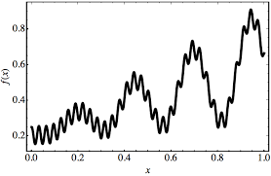
Good about Neural Networks
Universal Approximation Theorem:
A neural network with one layer but infinitely many neurons can approximate
any continuous function.
$$x$$
……
$$f(x)$$
Width v.s. Deep Theorem:
An exponentially number of neurons in one layer = linear number of layers
$$x$$
That is why we need DEEP learning!
$$⇔$$
$$x$$
……
$$f(x)$$
……
$2^{d}$ neurons
$$f(x)$$
$d$ layers, $2d$ neurons

Slide 51
How to train a model?

Slide 52
Train/Evaluate a model
Train a model $⇔$ Minimize the loss function
Ian Goodfellow, Yoshua Bengio, and Aaron Courville, http://www.deeplearningbook.org MIT Press, 2016

Slide 53
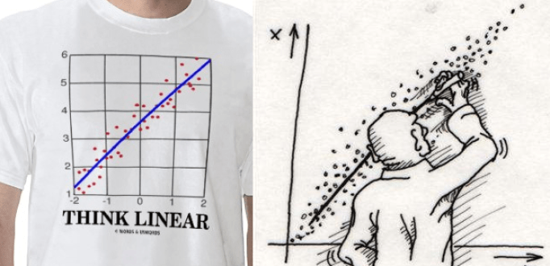
What is Machine Learning?
Machine learning (ML) is the scientific study of algorithms and statistical models that computer systems use to effectively perform a specific task without using explicit instructions.
——wikipedia
Linear Regression is also Machine Learning!

Slide 54
How PCA bases mix Fourier bases?

Slide 55
Bases Mixing (2nd and 4th)
$z$: PCA eigenmodes

Slide 56
Bases Mixing (2nd and 4th)

Slide 57
Bases Mixing (2nd and 4th)
A new observable
defined by PCA to
characterize v2/v4
correlation

