Slide 1
IP-JAZMA Critical Assessment of Physics Attributions
presented at
Initial Stages 2019
June 26th , 2019
(work done with Jamie Nagle)
W.A. Zajc
Columbia University
This work was supported by the United States Department of Energy Grant DOE-FG02-86ER-40281

Slide 2
Explication
continuation ;-)
Identification
Instantiation
Fluctuation
Illustration
Replication
Elucidation
Investigation
Clarification
Legislation
Summation
Inspiration
Realization
“Domaination”
Argumentation
Publication
Observation
Mystification
Expectation
Quantification
Desperation

Slide 3
Inspiration
Use intrinsic geometry to test applicability of hydrodynamics
in
small systems.

Slide 4
Realization
These geometries also could provide a critical test of initial-state models.

Slide 5

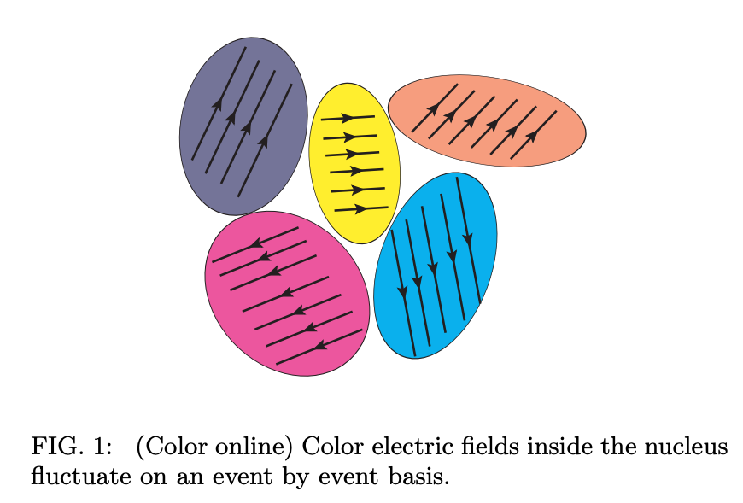
“Domaination”
T. Lappi, B. Schenke, S. Schlichting, R. Venugopalan, JHEP 1601, 061 (2016)
arXiv:1509.03499

Slide 6
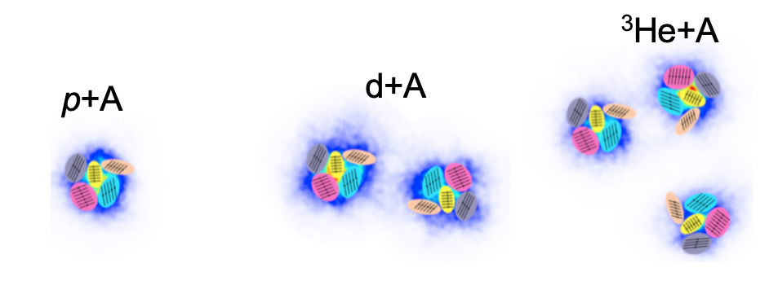
Argumentation
Independent orientation of color fields implies
as opposed to hydrodynamical translation of geometry

Slide 7
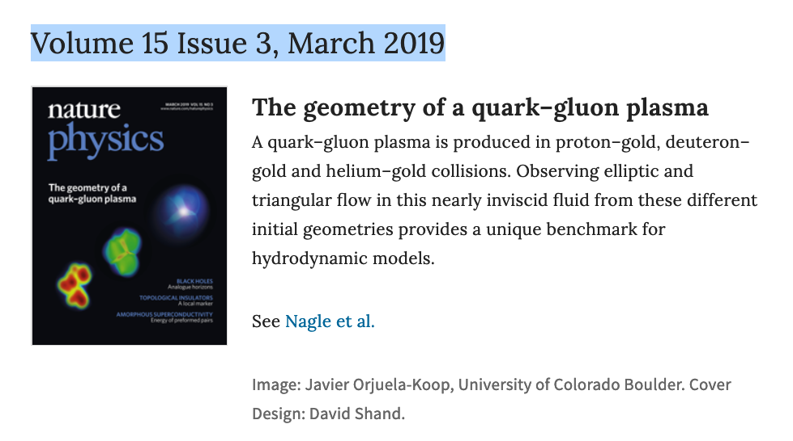
Publication
Creation of quark-gluon plasma droplets with three distinct geometries,
PHENIX Collaboration, Nature Physics 15, 214 (2019)

Slide 8
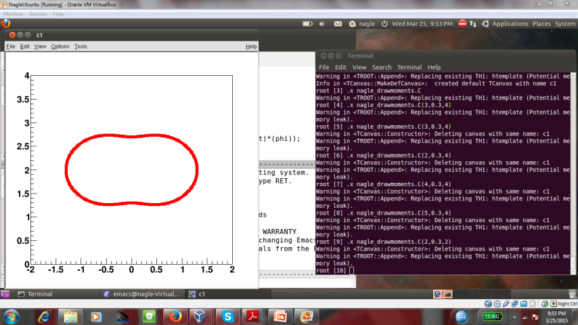
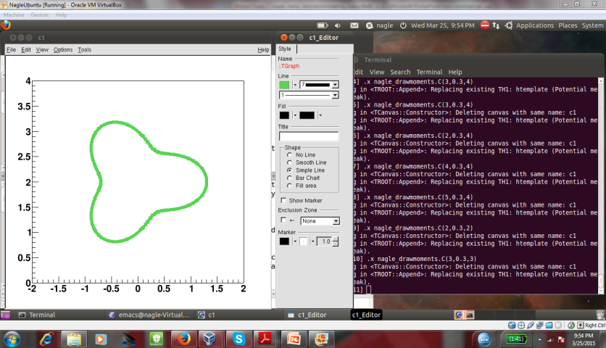
Observation
Hydro ordering!
Creation of quark-gluon plasma droplets with three distinct geometries,
PHENIX Collaboration, Nature Physics 15, 214 (2019)

Slide 9
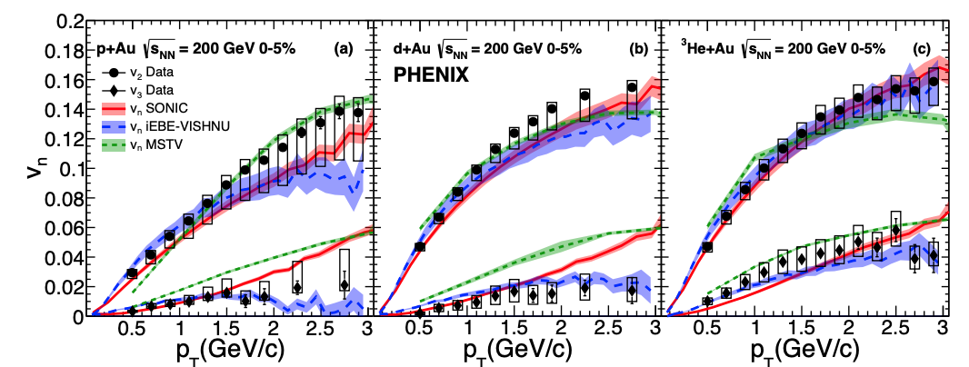
Mystification
How does MSTV reproduce hydro ordering ??
Hierarchy of azimuthal anisotropy harmonics in collisions of small systems from the Color Glass Condensate , M. Mace, V. Skokov, P. Tribedy, R. Venugopalan, Phys. Rev. Lett. 121, 052301 (2018) referred to as ”MSTV”

Slide 10
Expectation
Sensitive to scale for resolving domains:

Slide 11
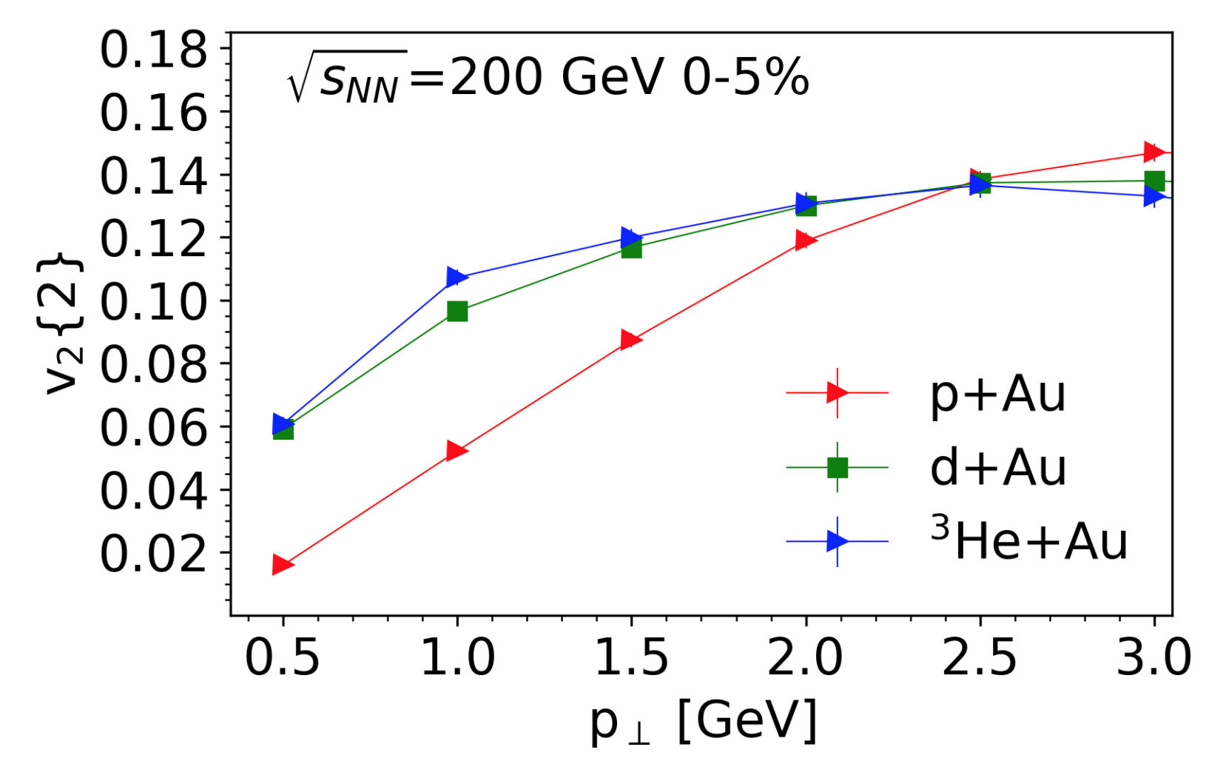
Quantification
Hint of domain ordering only for p_{T} > ~ 2.5 GeV
Hierarchy of azimuthal anisotropy harmonics in collisions of small systems from the Color Glass Condensate , M. Mace, V. Skokov, P. Tribedy, R. Venugopalan, Phys. Rev. Lett. 121, 052301 (2018) referred to as ”MSTV”

Slide 12
Desperation
Decided to develop simple model to “identify”
relevant input to initial state description
IP-JAZMA: Simplest possible model of initial state to test identification or attribution of final state features
Assessing saturation physics explanations of collectivity in small collision systems with the
IP-Jazma model , J.L. Nagle and W.A. Zajc,
Phys. Rev. C99, 054908 (2019).
Publicly available code: https://github.com/jamienagle/IPJazma

Slide 13
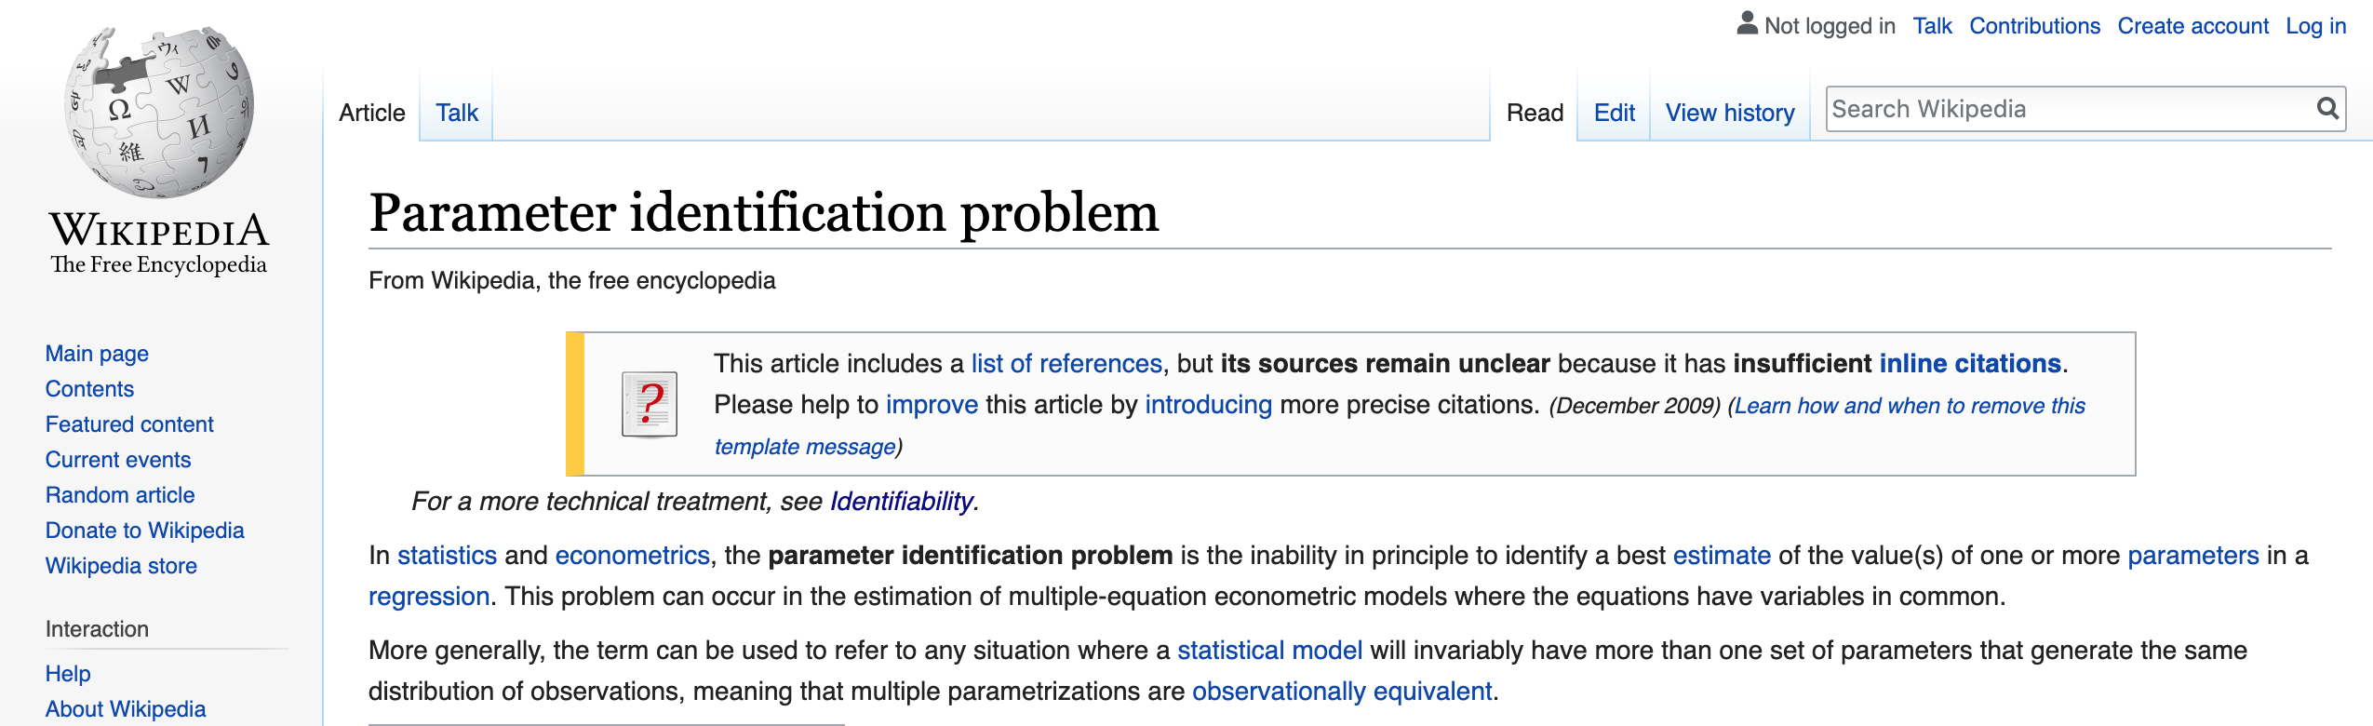
Identification
Phrase borrowed from econometrics
IP-JAZMA: Simplest possible model of initial state to test identification or attribution of final state features
More generally, the term can be used to refer to any situation where a statistical model will invariably have more than one set of parameters that generate the same distribution of observations, meaning that multiple parametrizations are observationally equivalent.

Slide 14
Instantiation
MC-Glauber to find transverse position for i-th interacting nucleon (x_{i},y_{i}) in each event
IP-Sat to find contribution to saturation scale:
  σ = 0.32 fm (RHIC) , 0.28 fm (LHC)
Linear sum to find local target and projectile saturation scales:
Assume:
  dense-dense limit:
  dilute- dense limit:

Slide 15
Fluctuation
Following MSTV and other CGC practitioners, IP-JAZMA has option for Q_{s} fluctuations:
Intrinsic Fluctuations of the Proton Saturation Momentum Scale in High Multiplicity p+p Collisions , L. McLerran and P. Tribedy, Nucl. Phys. A945, 216 (2016)

Slide 16
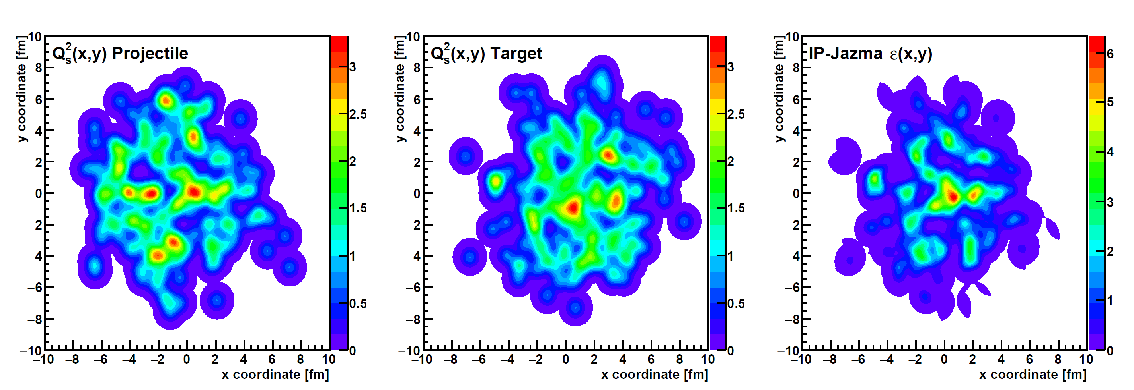
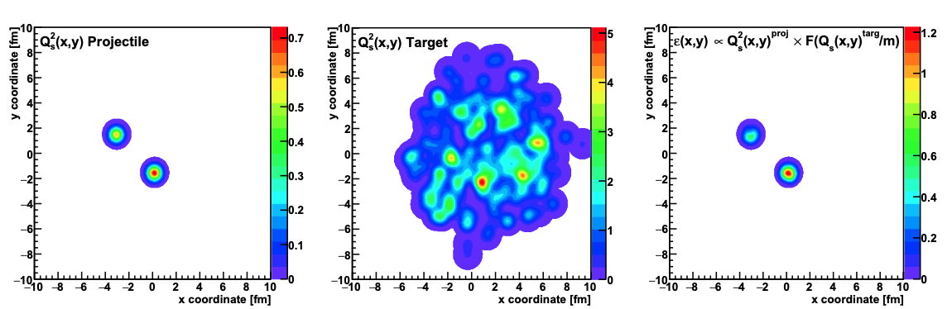
Illustration
IP-Jazma Au+Au event
IP-Jazma d+Au event

Slide 17
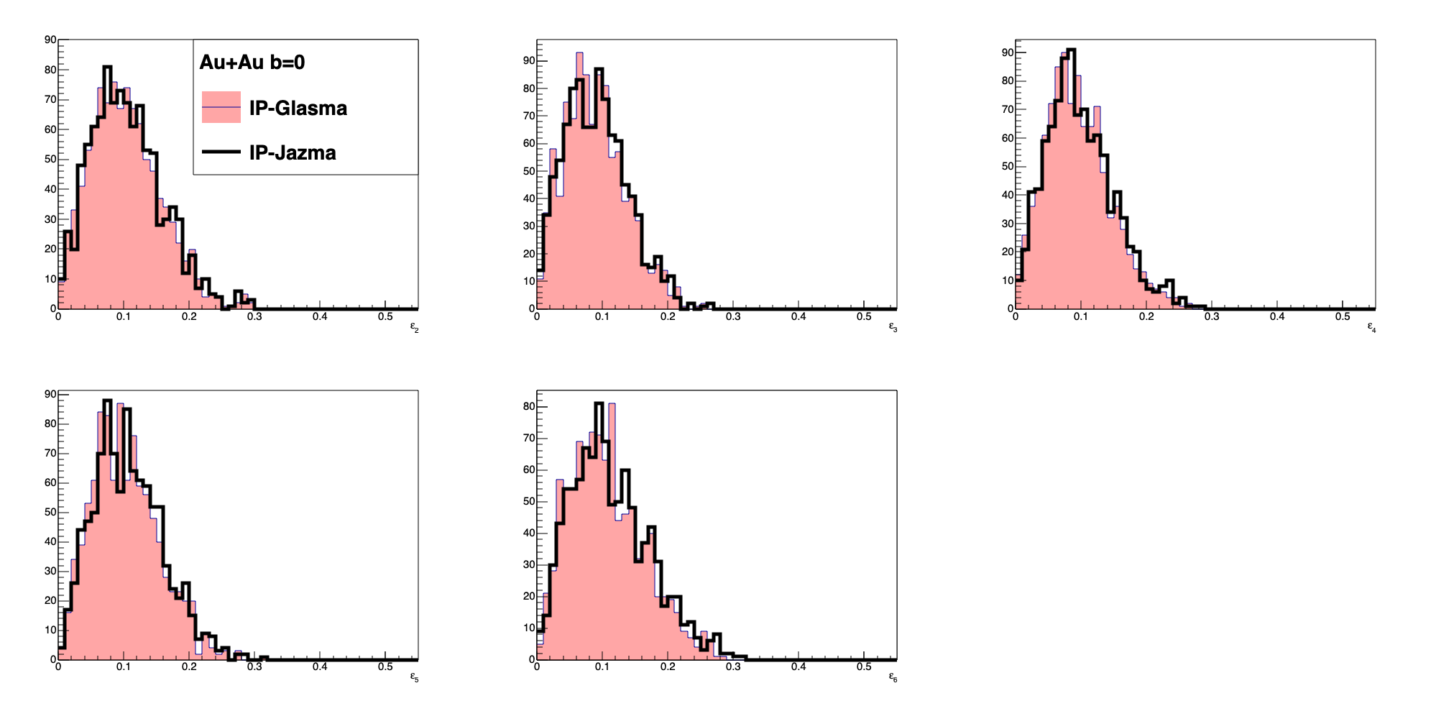
Replication
IP-JAZMA replicates eccentricities calculated in IP-Glasma at t = 0.000015 fm/c (Au+Au, b=0 fm)
Thanks to Sanghoon Lim
for running
IP-Glasma events.

Slide 18
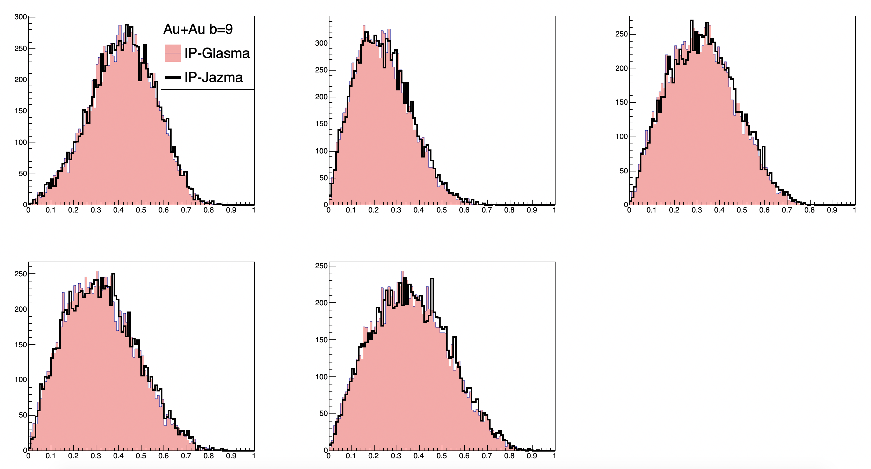
Replication
IP-JAZMA replicates eccentricities calculated in IP-Glasma at t = 0.000015 fm/c (Au+Au, b=9 fm)
Thanks to Sanghoon Lim
for running
IP-Glasma events.

Slide 19
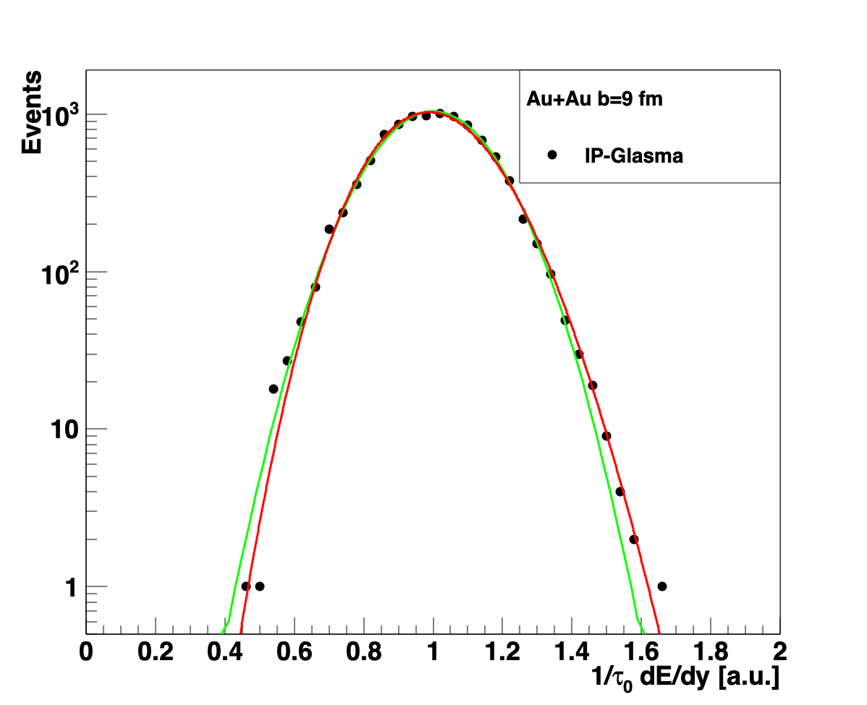
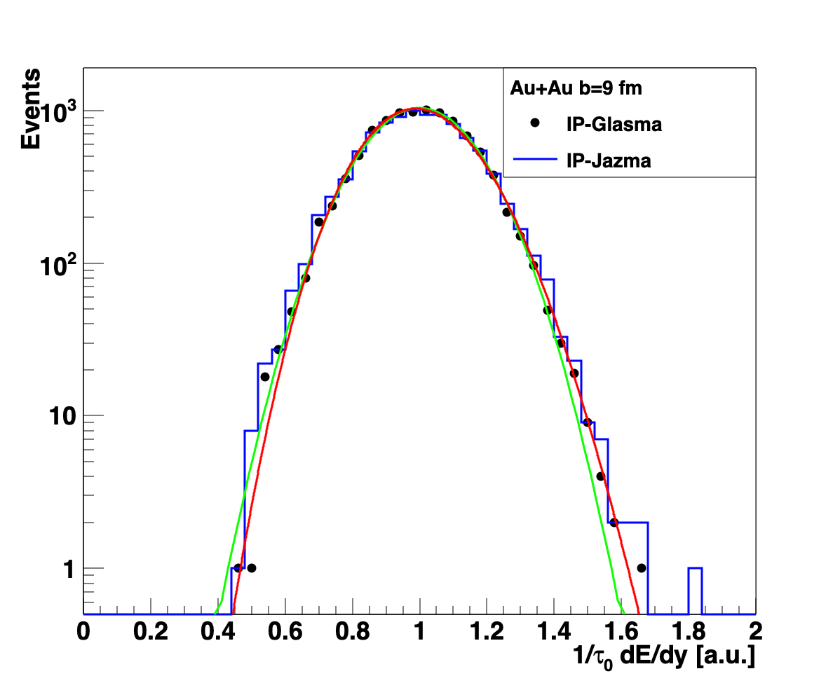
Elucidation
Yes, but …
  IP-JAZMA suggests these features result from geometry only,
  even without
  log-normal fluctuations.
  (Γ−dist, not NBD)
Gaussian
Gamma
Gaussian
“The best fit is given by a negative binomial (NBD) distribution, as predicted in the Glasma flux tube framework [37]; our result adds further confirmation to a previous non-perturbative study [38]”, B. Schenke, P. Tribedy, R. Venugopalan, arXiv:1202.6646

Slide 20
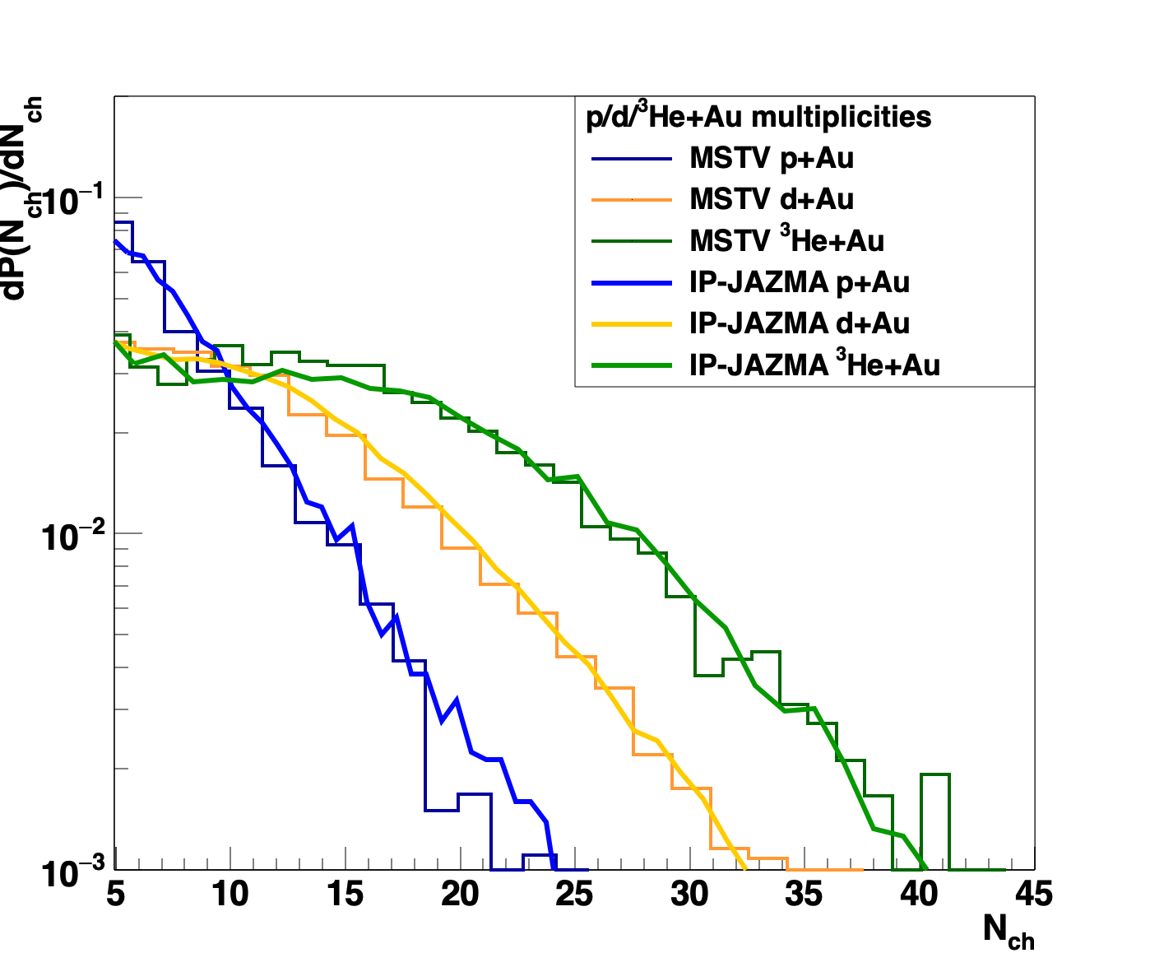
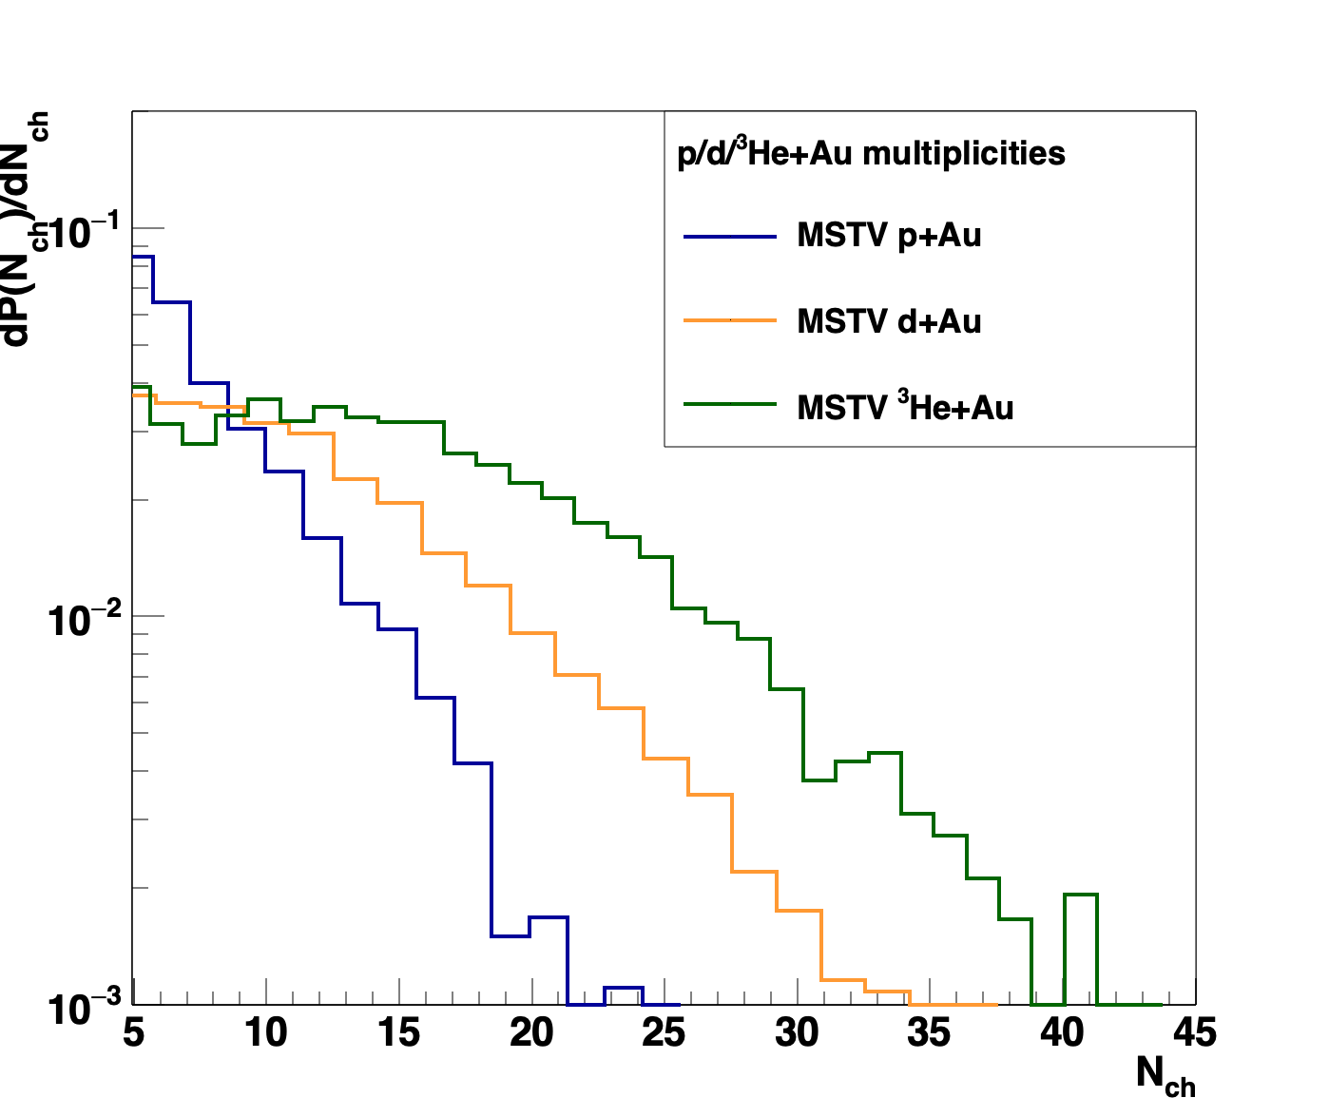
Elimination
But in IP-JAZMA we can trace it to the MC-Glauber and assumed
log-normal fluctuations used by MSTV.
“In the CGC, we can analytically trace the emergence of this approximate negative binomial distribution to the multiparticle Bose statistics of gluons. The enhancement of the high multiplicity tail in the configuration of the deuteron wavefunction with overlapping nucleons is a nontrivial result originating in from the Bose enhancement of gluons in QCD that is captured in the CGC EFT”, M. Mace, V. Skokov, P. Tribedy, R. Venugopalan, arXiv:1901.10506

Slide 21
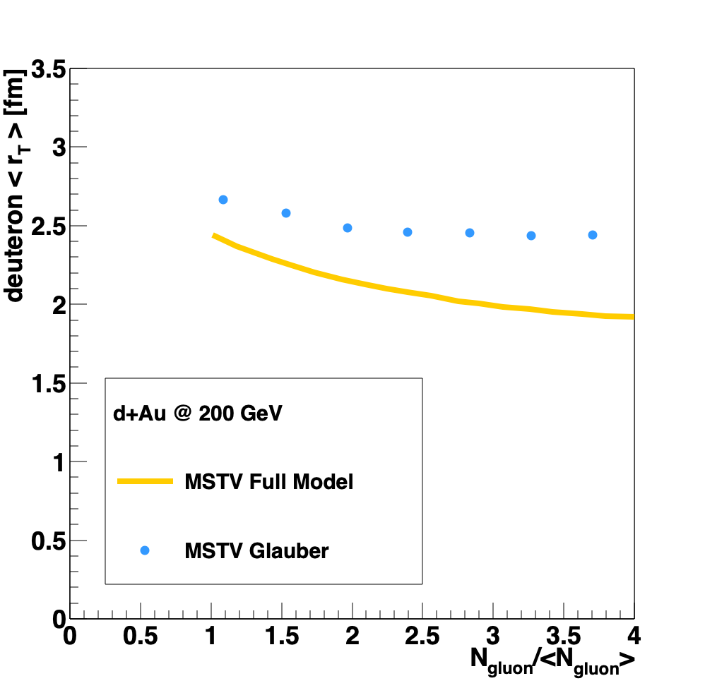
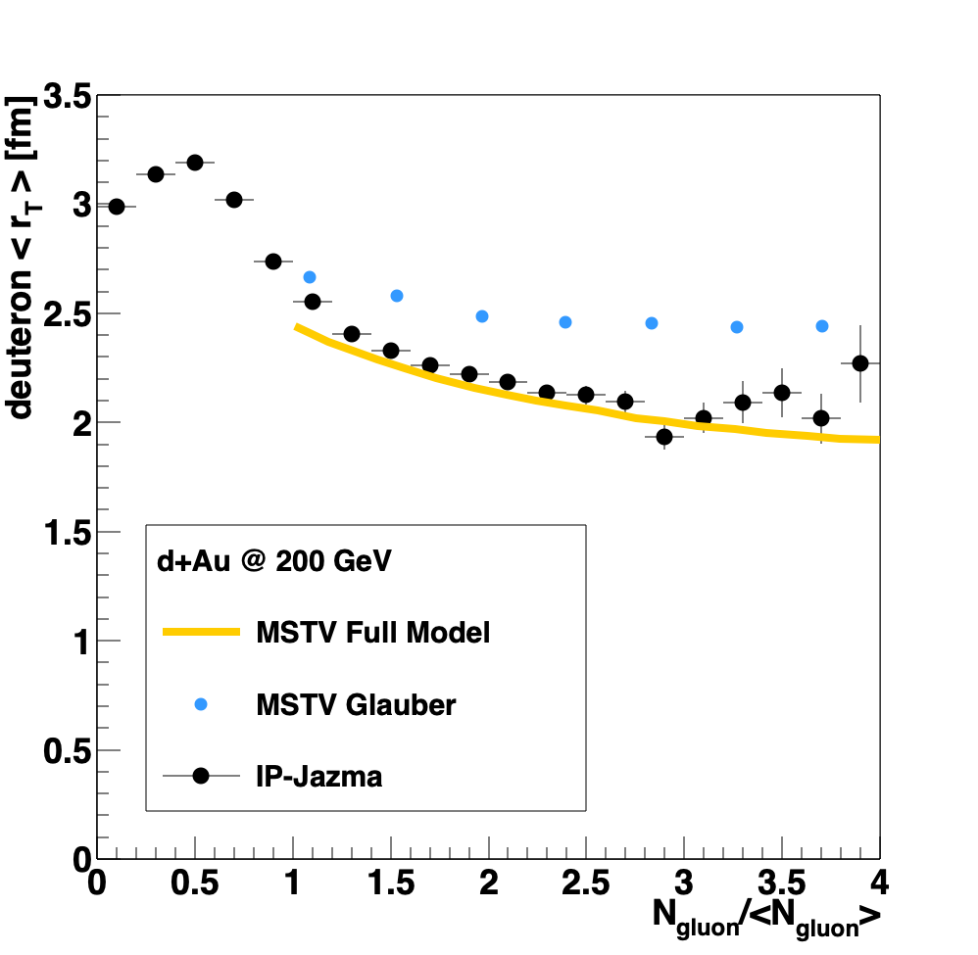
Application
Yes, but …
  IP-JAZMA reproduces this result out to
  (at least) 3 x the average multiplicity in d+Au collisions.
21
“albeit configurations with overlapping nucleons are suppressed by the available phase space, Bose statistics enhanced higher order correlations present in the CGC lead to a significant contribution of these configurations (in contrast to the MC Glauber model) in the high multiplicity tails of d+Au collisions.” , M. Mace, V. Skokov, P. Tribedy, R. Venugopalan, arXiv:1901.10506

Slide 22
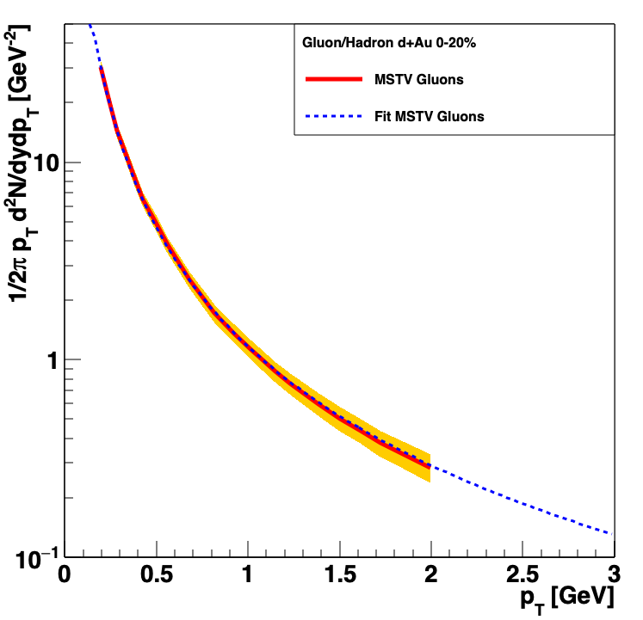
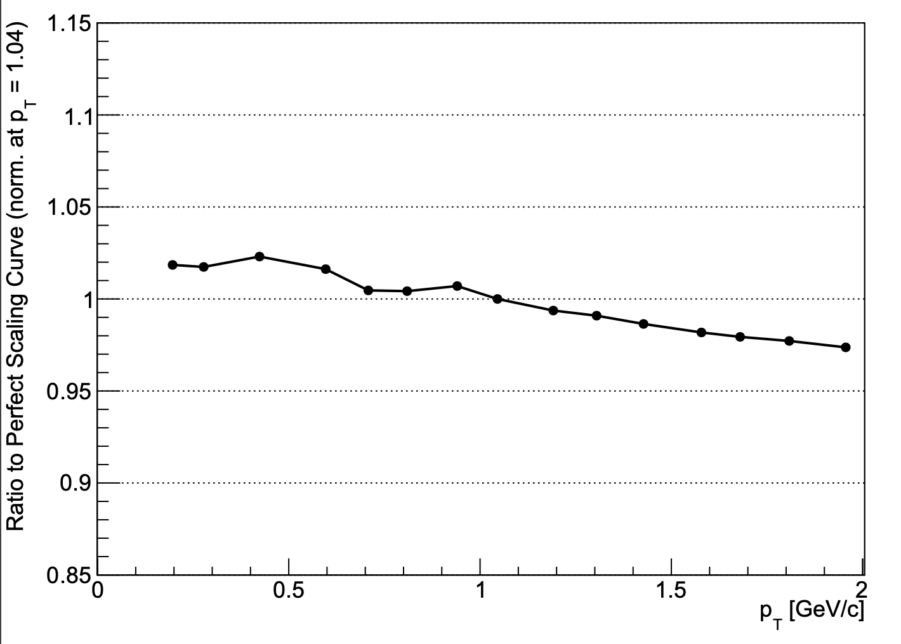
Investigation
Why does this complex expression show ~no deviation from pure 1/k²

Slide 23
Clarification
Hint of domain ordering only for p_{T} > ~ 2.5 GeV
Hierarchy of azimuthal anisotropy harmonics in collisions of small systems from the Color Glass Condensate , M. Mace, V. Skokov, P. Tribedy, R. Venugopalan, Phys. Rev. Lett. 121, 052301 (2018) referred to as ”MSTV”

Slide 24
Clarification
domain ordering for p_{T} > ~ 0.5 GeV

Slide 25
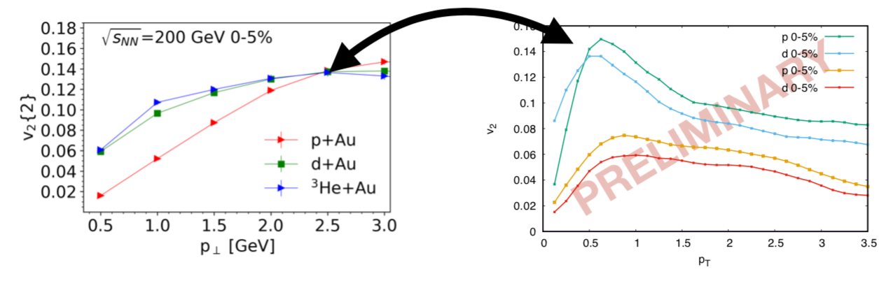
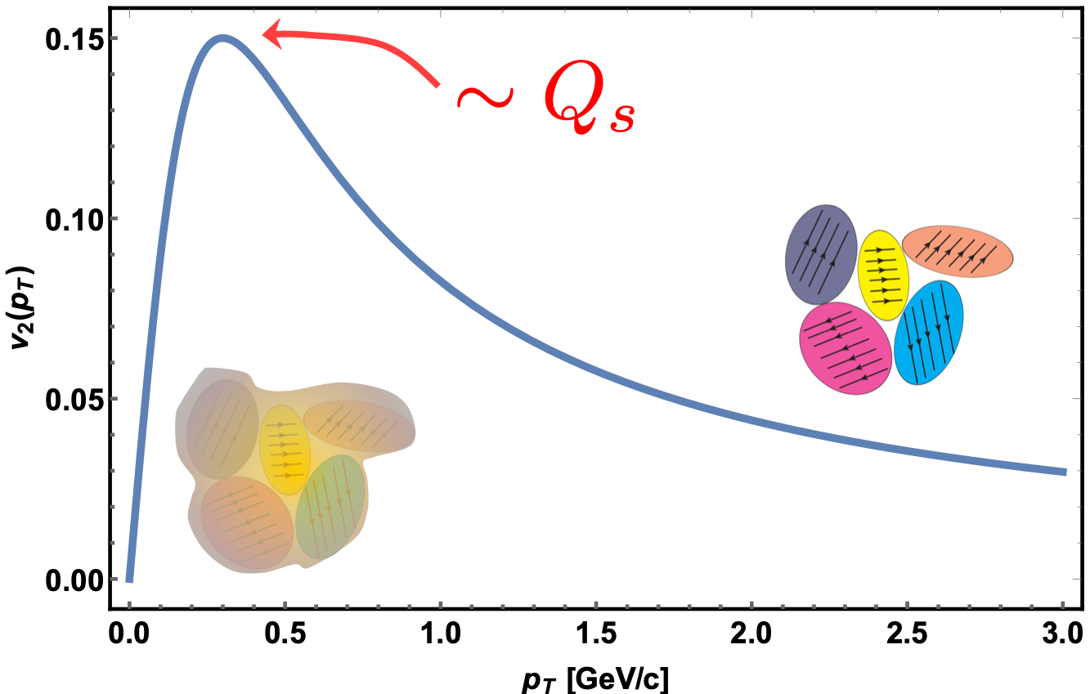
Clarification
domain ordering for p_{T} > ~ 0.5 GeV
http://www.int.washington.edu/talks/WorkShops/int_19_1b/People/Mace_M/Mace.pdf

Slide 26

Legislation
Science magazine:
We require that all computer code used for modeling and/or data analysis that is not commercially available be deposited in a publicly accessible repository upon publication.

Slide 27
Summation
The PHENIX v_{n} data from p/d/³He+Au coliisons are well-described by relativistic viscous hydrodynamics.
The same data are not described by existing initial-state models.
IP-JAZMA has proven to be a useful diagnostic tool for identification and attribution.
The demonstrable benefit of open-source code will lead to further progress in these investigations.

Slide 28
Back-Up Material
This work was supported by the United States Department of Energy Grant DOE-FG02-86ER-40281

Slide 29
Continuation (words I didn’t use)
Information
Reincarnation
Justification
Augmentation
Motivation
Affirmation
Hallucination
Verification
Explanation
Revelation
Implementation
Ramification
Dramatization
Reconciliation
Diversification
Unification
Recrimination
Abnegation
Validation
Moralization
Normalization
Animation
Abomination
Derivation
Invocation

Slide 30
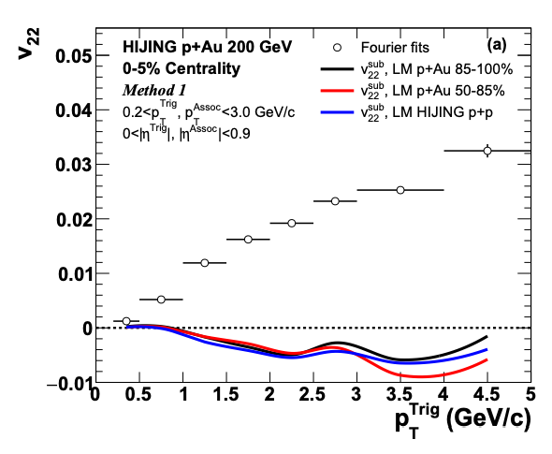
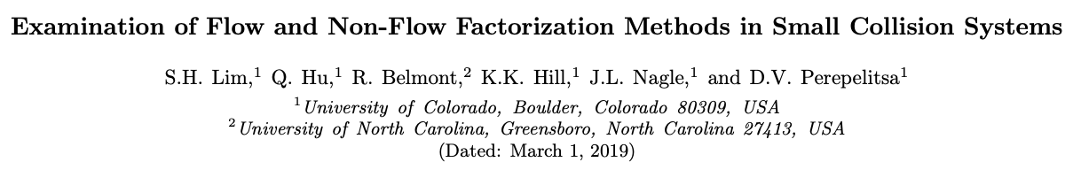
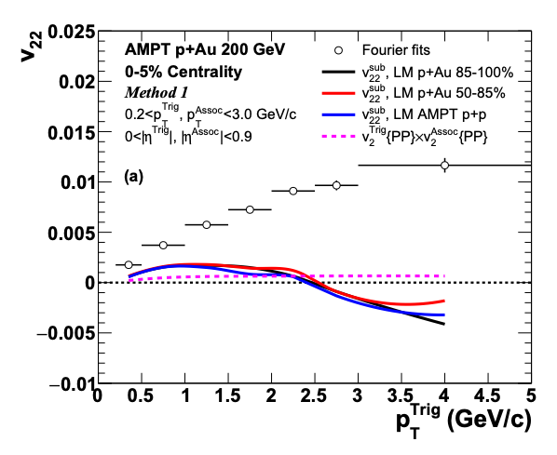
Flow and Non-Flow (Slide from J. Nagle)
Recent STAR preliminary result with small Δη gap, thus huge non-flow subtraction!
Very sensitive to non-flow subtraction.
https://indico.cern.ch/event/656452/contributions/2869833/attachments/1649479/2637419/QM18-smallsystem-shengli-10.pdf
https://arxiv.org/abs/1902.11290
HIJING and AMPT closure tests indicate significant over-subtraction by template method with STAR kinematics
Useful discussion moving forward, but details matter…
30

