Slide 1

ATLAS measurements of azimuthal anisotropy of heavy flavor hadrons in Pb+Pb, p+Pb and pp collisions
Kurt Hill
University of Colorado Boulder
for the ATLAS Collaboration

Slide 2
Do charm and bottom quarks flow with the quark-gluon fluid?

Slide 3
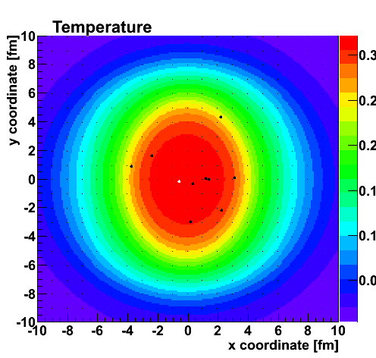
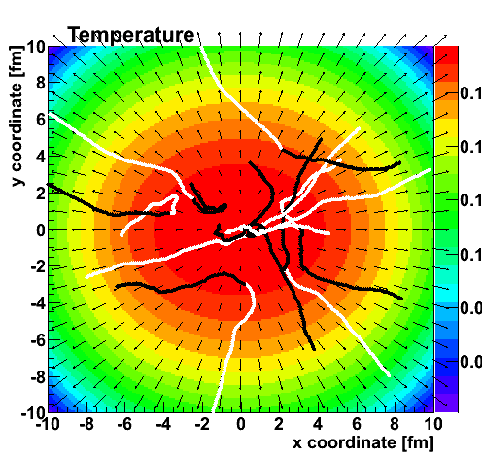
Do charm and bottom quarks flow with the quark-gluon fluid?
Langevin (drag & diffusion) type calculations indicate they should “flow”
Phys. Rev. C 90, 024911

Slide 4
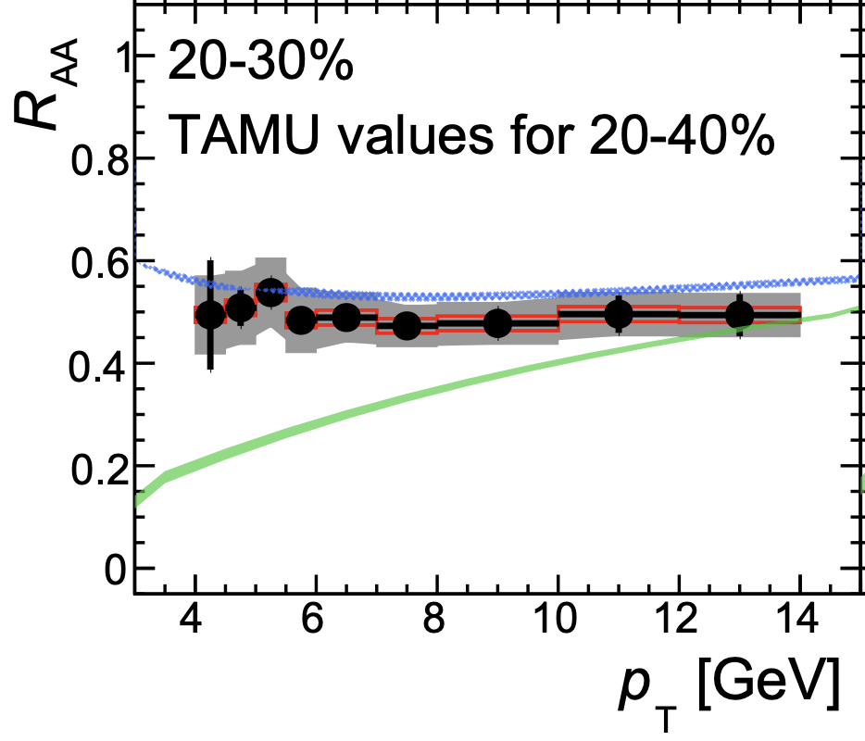
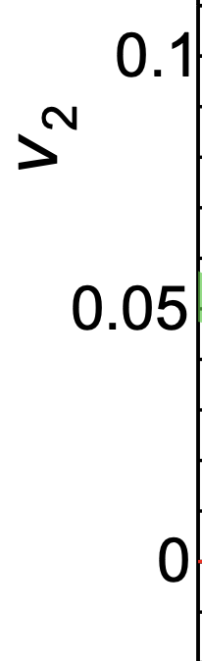
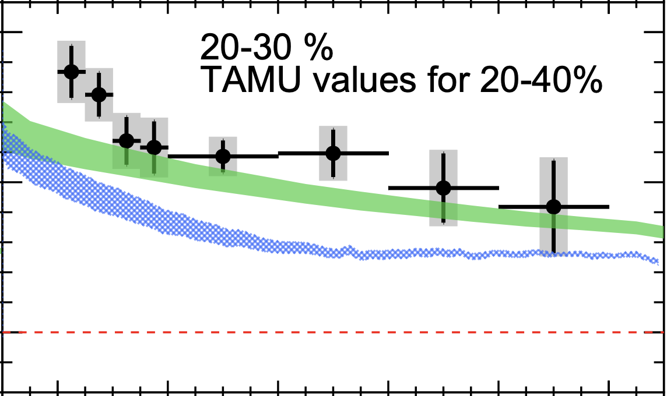
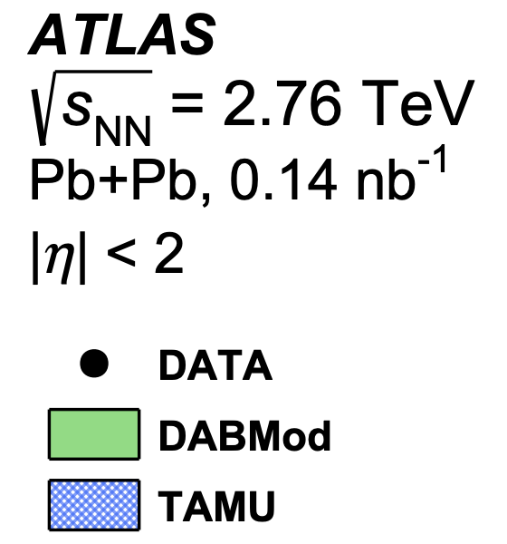
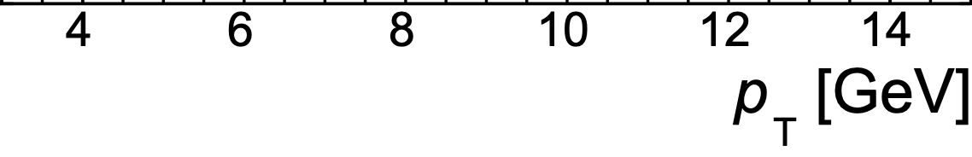
ATLAS Heavy-Flavor Muons in Pb+Pb
Significant modification of HF muon p_{T} distribution (R_{AA} suppression)
Significant non-zero elliptic flow (v₂) event at high p_{T}
ATLAS : Phys Rev. C 98, 044905

Slide 5
ATLAS Heavy-Flavor Muons in Pb+Pb
Significant modification of HF muon p_{T} distribution (R_{AA} suppression)
Significant non-zero elliptic flow (v₂) event at high p_{T}
ATLAS : Phys Rev. C 98, 044905
Heavy quark transport calculations have a tension to simultaneously describe both R_{AA} & v₂
Many measurements in Pb+Pb – see recent review (https://arxiv.org/abs/1903.07709)

Slide 6
ATLAS Heavy-Flavor Muons in p+Pb
https://atlas.web.cern.ch/Atlas/GROUPS/PHYSICS/CONFNOTES/ATLAS-CONF-2017-006/
Non-zero heavy-flavor muon v₂
Not so different magnitude from Pb+Pb v₂ at p_{T} ~ 4 GeV, though maybe dropping more quickly

Slide 7
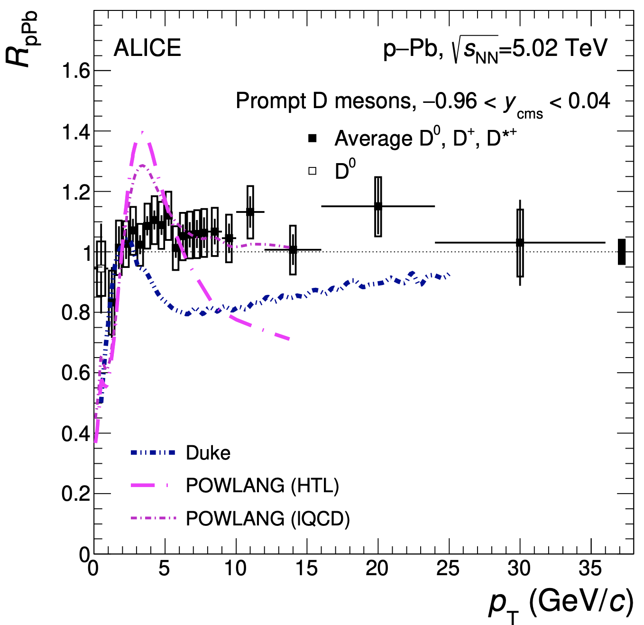
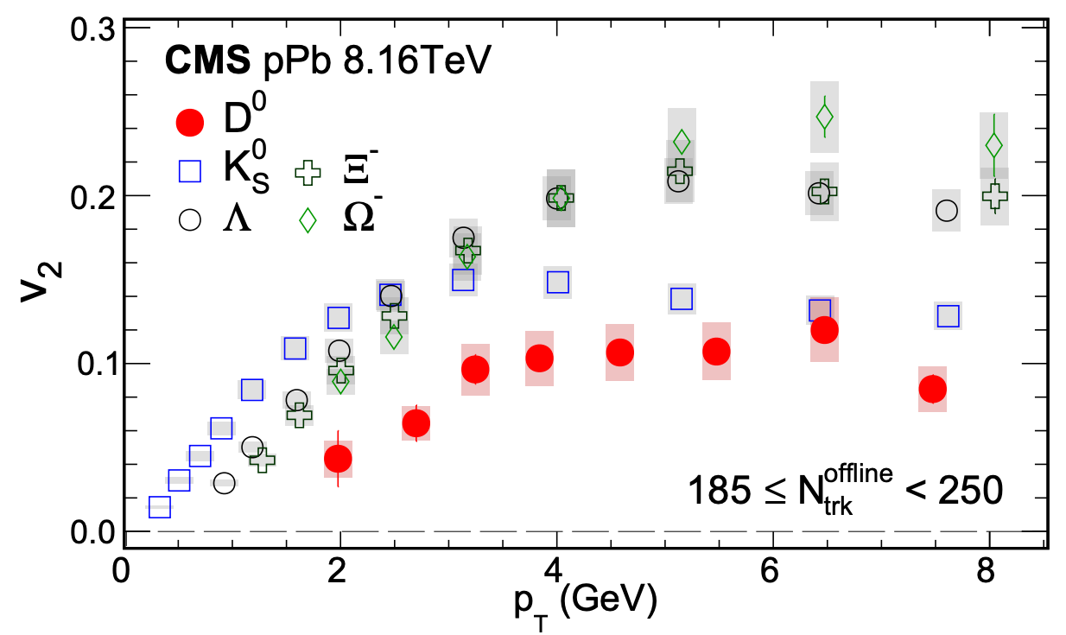
D mesons in p+Pb
CMS p+Pb D mesons show significant v₂, but the ALICE R_{pPb} is consistent with one – tension!
arXiv:1906.03425
Phys. Rev. Lett. 121, 082301

Slide 8
D mesons in p+Pb
CMS p+Pb D mesons show significant v₂, but the ALICE R_{pPb} is consistent with one – tension!
arXiv:1906.03425
Phys. Rev. Lett. 121, 082301
What about pp?

Slide 9
D mesons in p+Pb
CMS p+Pb D mesons show significant v₂, but the ALICE R_{pPb} is consistent with one – tension!
arXiv:1906.03425
Phys. Rev. Lett. 121, 082301
What about pp?
c
Do the experiment!
b

Slide 10
Analysis Details
Use single muons from heavy-flavor decays and measure elliptic flow
pp collisions at sqrt(s) = 13 TeV from 2017
  low luminosity 𝜇 ~ 2 sample
  integrated luminosity of 150 pb⁻¹
  muon triggers (p_{T} > 4 GeV) + high multiplicity triggers
First separate heavy-flavor muons (signal) decays, etc. (background).
Then separate charm and bottom within signal.
ATLAS-CONF-2019-023

Slide 11
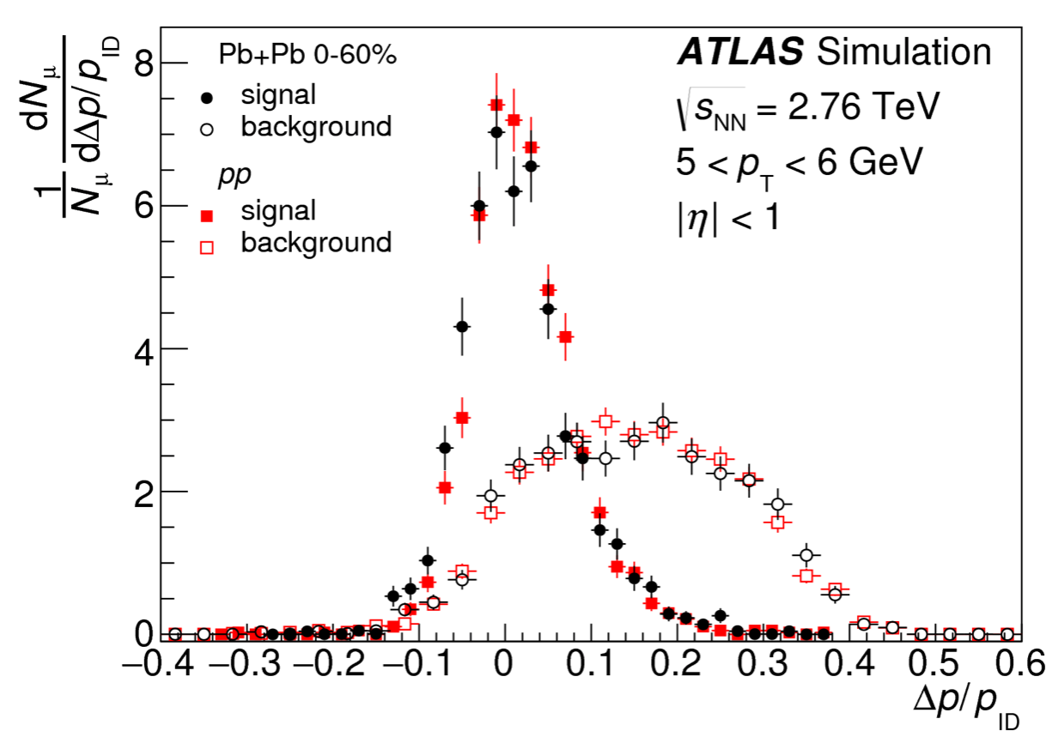
Muon Signal and Background Separation
𝛥p = p_{ID} - p_{muon}
Phys. Rev. C 98, 044905
* Note that in pp 13 TeV, the non-background contains ~ 2.5% from quarkonia, low mass resonances, and tau leptons (based on PYTHIA8 simulation)

Slide 12
Muon-Hadron Correlation Functions
Two-particle correlations and standard ATLAS template non-flow subtraction [Phys. Rev. Lett. 116, 172301]
Signal = 0.85, Background = 0.15
Signal = 0.23, Background = 0.77
$v_{2,2}(p_{T}^{μ},$ $p_{T}^{h}$)$=f^{sig}v_{2,2}^{sig}(p_{T}^{μ},$ $p_{T}^{h})+\left(1−f^{sig}\right)v_{2,2}^{bkg}(p_{T}^{μ},p_{T}^{h})$

Slide 13
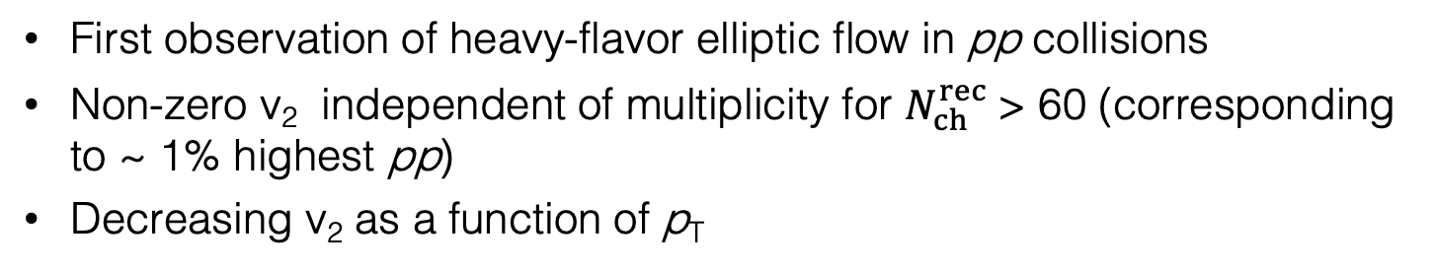
Heavy-flavor Muon Elliptic Flow in pp 13 TeV
$N_{ch}^{rec}:$ p_{T} > 0.4 GeV, |𝜂| < 2.5, no eff. correction
First observation of heavy-flavor elliptic flow in pp collisions
Non-zero v₂ independent of multiplicity for $N_{ch}^{rec}$> 60 (corresponding to ~ 1% highest pp)
Decreasing v₂ as a function of p_{T}

Slide 14
Charm and Bottom Separation
d₀ = impact parameter of muon relative to the associated vertex
Redo correlation analysis selecting regions in d₀ and momentum mismatch.
Extracted bottom fraction consistent with FONLL/PYTHIA8, which are used for additional systematic uncertainties.

Slide 15
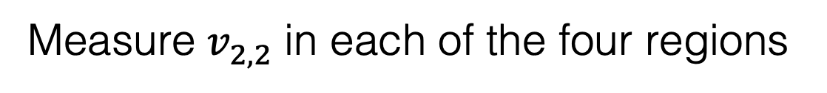
Charm and Bottom Separation
Measure $v_{2,2}^{}$ in each of the four regions

Slide 16

Charm and Bottom Separation
Extrapolate low d₀ region to f^{sig} = 1
$$v_{2,2}=f^{sig}v_{2,2}^{sig}+\left(1−f^{sig}\right)v_{2,2}^{bkg}$$
Measure $v_{2,2}^{}$ in each of the four regions

Slide 17
Charm and Bottom Separation
Extrapolate low d₀ region to f^{sig} = 1
$$v_{2,2}=f^{sig}v_{2,2}^{sig}+\left(1−f^{sig}\right)v_{2,2}^{bkg}$$
High d₀ region v_{2,2} determined directly
Measure $v_{2,2}^{}$ in each of the four regions

Slide 18
Charm and Bottom Separation
Extrapolate low d₀ region to f^{sig} = 1
$$v_{2,2}=f^{sig}v_{2,2}^{sig}+\left(1−f^{sig}\right)v_{2,2}^{bkg}$$
High d₀ region v_{2,2} determined directly
Two measurements of $v_{2,2}^{sig}$ with two different b fractions

Slide 19

Charm and Bottom Separation
Extrapolate low d₀ region to f^{sig} = 1
$$v_{2,2}^{sig}=f^{b→μ}v_{2,2}^{b→μ}+\left(1−f^{b→μ}\right)v_{2,2}^{c→μ}$$
Now can solve for v₂ charm and v₂ bottom

Slide 20
Charm and Bottom Elliptic Flow in pp 13 TeV
Charm decay muons show significant non-zero v₂!
Consistent with independent of N_{ch}^{rec} and decreasing with p_{T}
Bottom decay muons have v₂ consistent with zero within uncertainties
No theory calculations available yet. Excited to see possible physics explanations.

Slide 21
Comparison with Charged Hadrons
Muons from charm have v₂ similar to charged hadrons.

Slide 22
Comparison with Charged Hadrons
Muons from charm have v₂ similar to charged hadrons.
Caveat: kinematics really matter
Charm muons p_{T} =4-6 GeV come from charm hadrons with most probable p_{T} ~ 7 GeV
Also, there is an 𝛥𝜙 (hadron-muon) effect. This is modest.

Slide 23
Thank you!

Slide 24
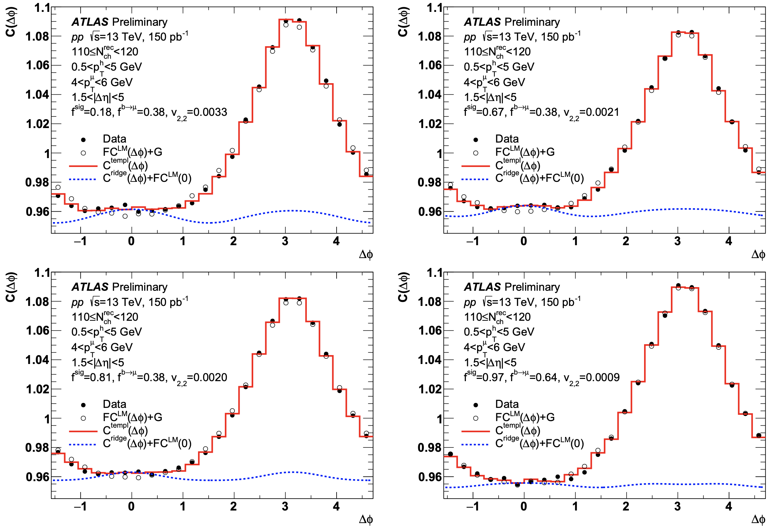
Charm and Bottom Separation

Slide 25
V_{2,2} Correlations

