Slide 1
Agenda
Update on R&R
Status of iHCAL
Status of MoAs
Status of LLPs
PPMP
MVTX Cost & Sschedule update
Any news/issues from the FSU meeting?
Decision on Silicon configuration (INTT+MVTX)
Sub-detector status

Slide 2
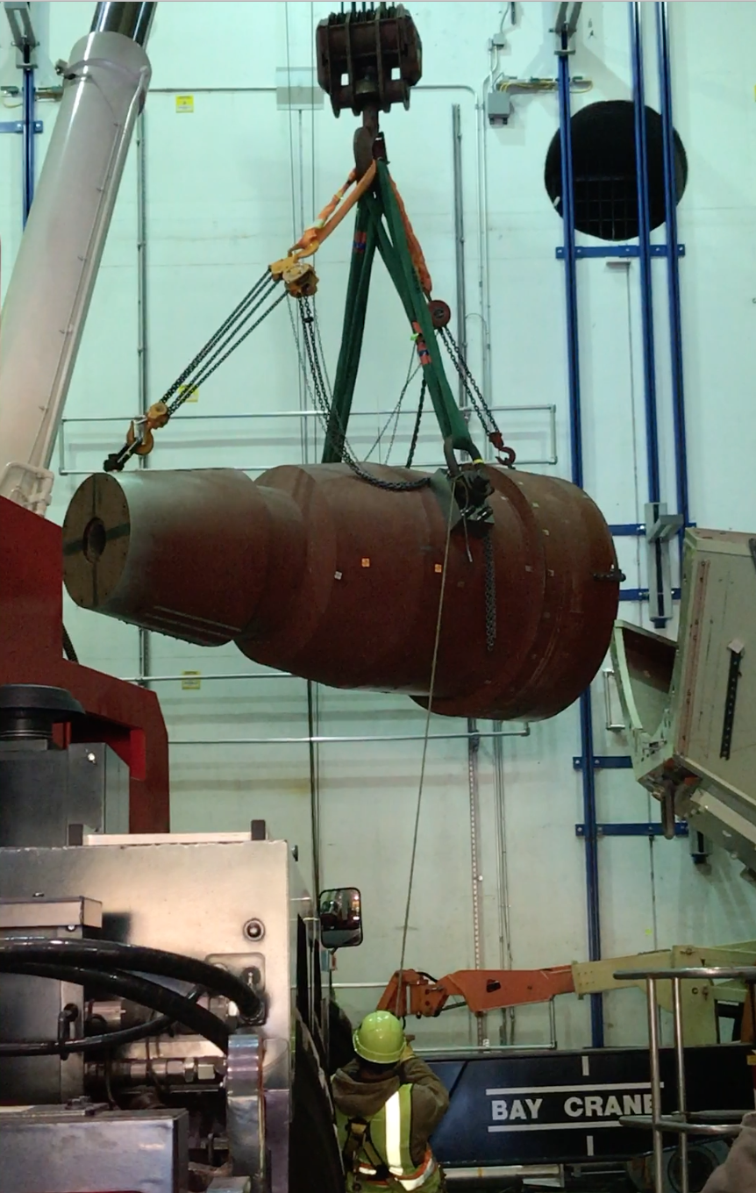
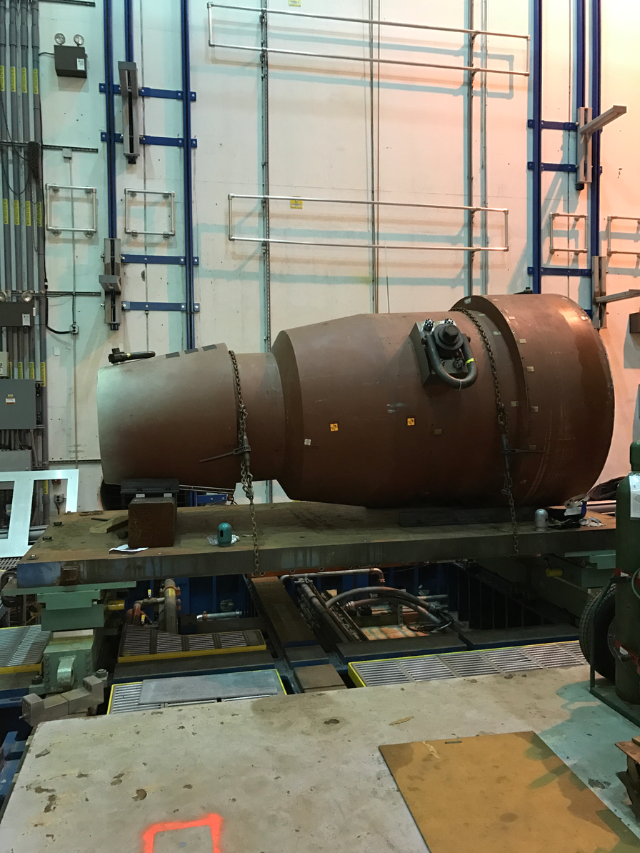
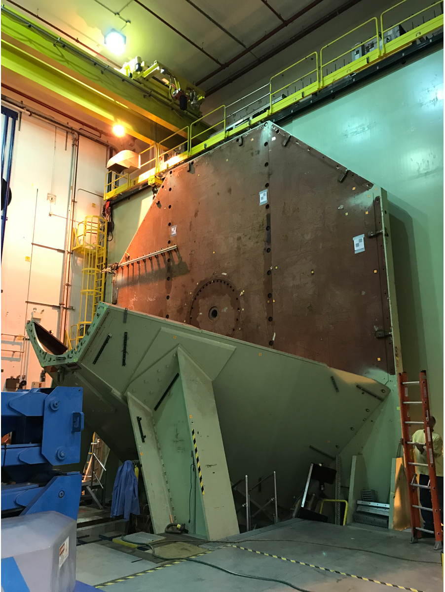
Status of 1008 Hall 12/13/18
Final PHENIX R&R rigging activity requiring rental of commercial equipment

Slide 3
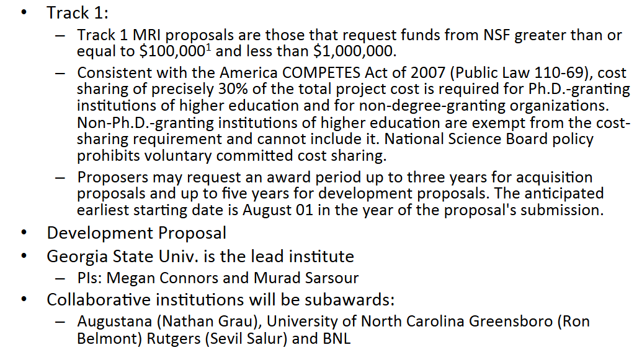
IHCal NSF MRI

Slide 4
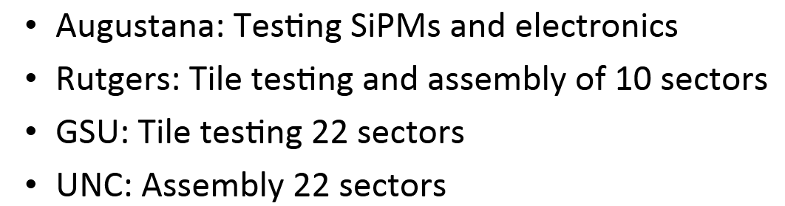
IHCal Collaborating Institution
We would like temporarily front this effort $60k for SiPM purchases now so that they can participate in the ongoing sPHENIX SiPM procurement that they will pay back when funding comes in fro NSF this summer.

Slide 5
MoA Status
All MoA’s complete and signed with the exception of the conventional facility MoA w/ CAD. Joe Tuozzolo and Jim Mills are working on this.

Slide 6
LLP Status
TEC accounts for LLPs are open.
LLP-1, 100k SiPMs has been placed. We have the delivery schedule from Hamamatsu for the production SiPMs.
Scintillating tile LLP-2 contract will be awarded if we can get DOE approval.
Scintillating fiber LLP-3 can be placed as soon as funding is available.
Tungsten powder LLP-4 order waits for additional preproduction work at UIUC.
Prototype EMCal blocks are being manufactured using powder from 2nd vendor
The tungsten order will wait until we have 85-90% of the FY19 funding available.

Slide 7
PPMP Status
All changes requested by BHSO incorporated into PPMP
Submitted to ALDs office for revision end of November
Revised PPMP with BNL Management proposal will be submitted to BHSO & DOE-NP early next week
DOE-NP/BHSO requested that BHSO Site Manager be part of the approval process for the PD’s and associated documentation like PMP approval.

Slide 8
MVTX Cost and Schedule Update
All resource and schedule information including burdens and rates at LANL, LBNL, MIT and U Texas in P-6.
Will have one more revision based on assignments of institutional responsibilities made at MVTX collaboration meeting last week.
Prior revisions to MVTX RLS
Installed all revised labor rates (LANL, LBNL, MIT, UT-Austin) w/overhead
Removed “Lead Coordinator” ($300K)
Removed cables to be bought from CERN via U Tennessee ($86K)
Moved Installation from WBS 3.2.4.5 over to WBS 2.5.10 for general installation of sPHENIX ($70K)
Moved about half of the hours for LANL PROF4 (Walt S.) to either MIT PROF or LBNL PROF, depending on task (lower labor rates)
Made explicit links to the 4 expected batches of “staves” coming from CERN to LBNL in order to drive the overall schedule, esp. at Berkeley
Made links to FY funding dates to ensure B.A. in hand

Slide 9
Estimated MVTX Cost
The revised MVTX cost estimate using the accurate labor and burden rates and making corrections as defined on the previous slides has the Total Project Cost w/o contingency totaling to $4.37M
DOE requires that the MVTX project has deliverables defined such that the Total Project cost is < $5M.
This implies that we are carrying a contingency under 15% which DOE won’t accept.
Will resolve this after final revision to RLS based on changes agreed to at MVTX Workshop Dec 5.

Slide 10
sPHENIX Collaboration Meeting, Dec 6-8, FSU
There is a general agreement between LANL, LBNL and MIT on MVTX tasks. All had representatives at the meeting
Dave Lee will provide a MS-Project file that reflects the updated tasks and any updated costs. The MVTX MS-Project file will be retired after this final release. The P-6 file will be our control document after the next revision.
It is very likely that the INTT will be two layers only.
sPHENIX EC meeting this week to finalize that task force recommendation.
Both Purdue Univ and NCU will join INTT project
Need some follow-up with CERN on the RU orders. Contact Luciano Musa?
Four new institutions on sPHENIX including USP, UNC-Greensboro, NCU -Taiwan and Sejong Univ

Slide 11
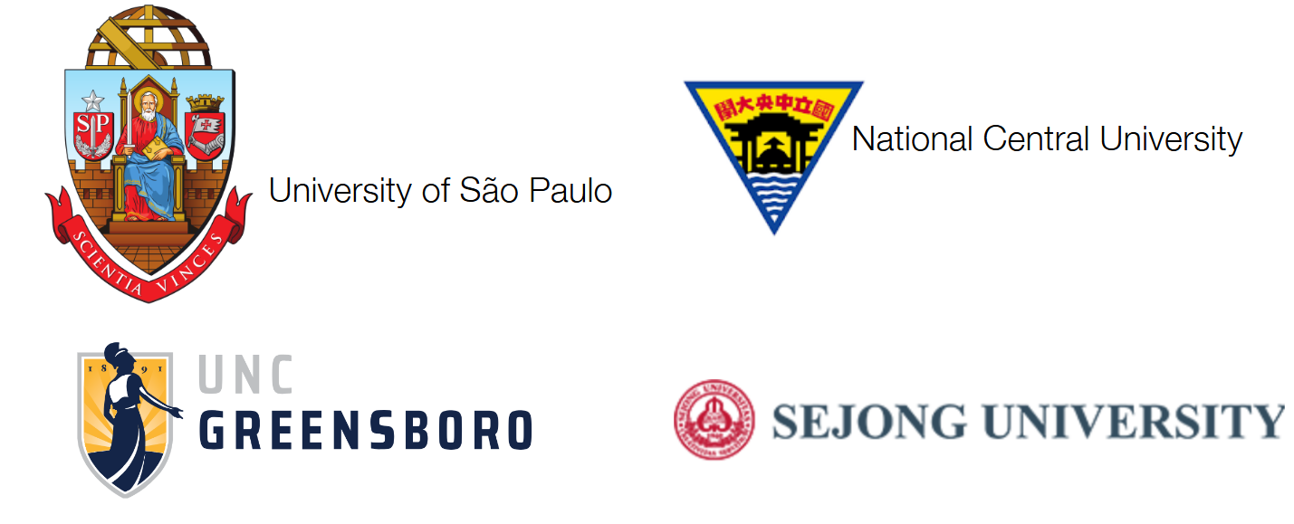
New Institutions Applying to Join sPHENIX

Slide 12
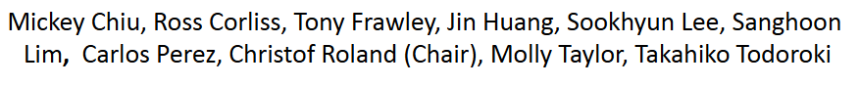
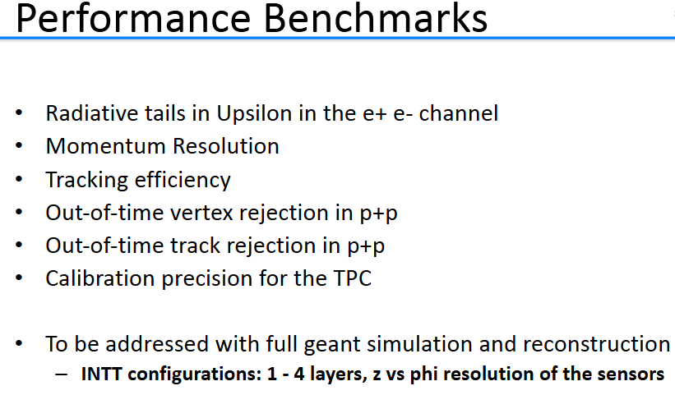
MVTX & INTT Configuration
The sPHENIX Collaboration charged an Inner Tracker Task Force in July 2018 to determine the optimal configuration of the INTT and MVTX
Task Force Membership:

Slide 13
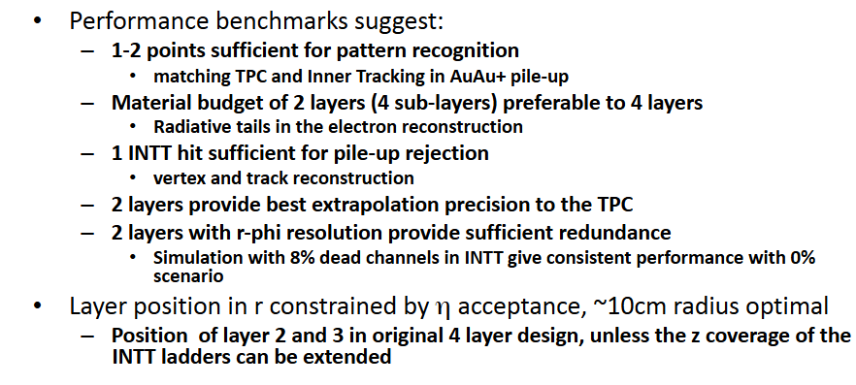
Recommendation for the Optimal MVTX + INTT Configuration
Conclusions presented by the Task Force at the Collaboration meeting:
sPHENIX will write this up for the record and release the final decision

Slide 14
Subsystem Issues
Two major issues and concerns:
Replacing two retiring engineers, Don Lynch and Paul Giannotti
We also need a temporary designer to fill in while someone is out sick.
Getting the scintillating tile order placed with Uniplast

