Slide 1
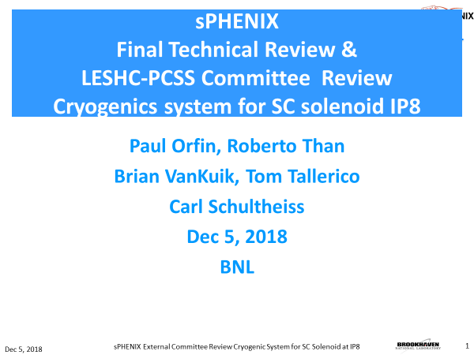
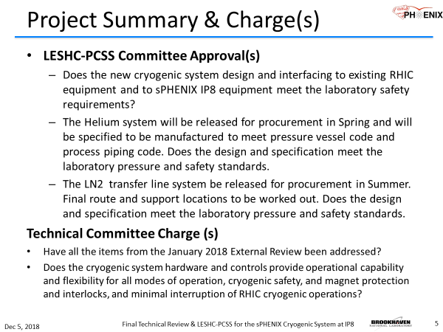
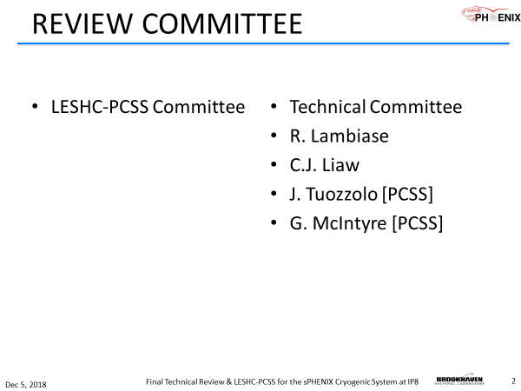
ESHC Review of the sPHENIX Cryogenic System

Slide 2
Presentation Outline
Project Summary System review summary/overview and charges
Present summary of previous reviews: LESHC of the magnet safety issues
Solenoid and SC bus extension
Magnet Power and quench protection System
  Vapor cooled Leads & Cooling
  Burn out time
  Voltage tap locations
  Quench detection system
    Detection time, Fast discharge: τ = 37 seconds
    Slow Discharge: τ = 40 min
High Power Tests Summary
Address Action items list from Jan 2018 Technical Review
System requirements
System description and layout
  PFD and P&ID’s
Layout
  1008B valvebox and interface - Transfer line system - IP8 valvebox - Jumper adjustment: Solenoid physics location range / Cradle platform adjustment
Summary of Design ratings
  400L reservoir, Relief system
  LN2 Cooling System: Boiler & sensible heat, heat exchanger
  Control valve sizing
Pressure drop profile calculations, updated
  Cooldown/Warmup 293K Supply 1010 Compressor, 45K supply RHIC 45K wave
  4.5K operation
  100K Hold summer shutdown
Controls logic summary
  Control logic during normal operations
  Control logic during Quench
    Dump valve and Reliefs
    Return to RHIC protection
LN2 transfer line system:
  Layout and rating specifications
  Procurement later in 2019.
ODH Analysis and Summary

Slide 3
Recommendations/Action Items
  The PCSS is satisfied with the design and gives permission for sPHENIX (C-AD Cryo Group) to proceed with the procurement plans for the system.
  Post Procurement Action Item
    A Failure Mode Effect Analysis (FMEA) is recommended for the cryo system prior to Vendor’s Preliminary Design Review
  Pre-Operational Action Items
    Coil voltage taps shall be calibrated prior to each run
    The Cryo Group should implement formal configuration management of different versions of the PLC controls program or justify why it is safe not to do it
    It was noted that the RHIC Accelerator Safety Envelope (ASE) will need to be revised to include the Credited Controls for the new ODH hazards in IR8. An Unreviewed Safety Issue (USI) document for the cryo revisions and ODH hazards must be created and submitted to the PCSS for review and approval

Slide 4
Path Forward
Complete Design and Prepare Bid Package – 12/18 to 5/19
Procurement Readiness Review – 6/19
Solicit Bid – 7/19
Vendor Selection and Contract Award– 11/19

