Slide 1
Agenda
Evolution of the HCAL Tiles contract
Plan to replace people retiring and timescale
Status of LLP procurements
Status of sub-detectors
Outcome of the MVTX review that took place in November ’18
Any issues / concerns

Slide 2
Status Tile Contract
Plan is to place the tile contract through ISU ($1.3M + overhead and shipping)
Phone meeting with ISU VP for Research
They seem amenable to placing the order but have not yet formally agreed
The overhead fee is being negotiated with ISU
  We’re asking for a flat fee rather than a percentage
There is a concern that BNL PPM will not agree to this approach. They have recommended going this route but have changed their minds in the past.
We would like to have a seamless transition from preproduction tile fab to production tile fab in April so getting a contract in place quickly is high priority

Slide 3
Status of Filling Positions Due to Retirements
Two P-10 engineers Don Lynch and Paul Giannotti are retiring this month.
We are opening reqs to fill both positions.
Based on experience it should take 6-8 weeks to have new people in those positions.

Slide 4
LLP Status
SiPM order has been placed.
  1st parts arrive in Feb.
  12 months for all 100k to arrive
Scintillating tile order has been discussed
Scintillating fiber order WebReq is being prepared. Start to get PO signatures in the next few days.
Tungsten powder LLP-4 order waits for additional preproduction work at UIUC.
  Placed in two parts FY19 and FY20 in order to free Budget Authority for TEC purchases later in FY19

Slide 5
Subdetector Status
Subdetector work focuses on completing the engineering designs and preproduction work.
Good progress is being made on all MIE subsystems, the major Infrastructure and Facility upgrade work (Cryo and Carriage/Cradle) and Si detectors

Slide 6
TPC Update
Machining of the TPC assembly frame has begun in the SBU shop.
The inner field cage mandrel was completed in the SBU shop.
We have succeeded in reading the full chain for FEE through FELIX 2.0 (DAM) cards into the sPHENIX DAQ, a significant milestone. This will allow us to use SAMPA chips in future test beam campaigns.
Multiple irradiation tests have been performed on the FEE electronics with no failures this far.
A new version of the HV divider board is complete. Revision minimizes surface fields via clever placement of parts. Will be manufactured used in the upcoming test beam.
Test results from the MPW run of the components of the SAMPA V5
Prep for an engineering run of SAMPA chips. If successful chip production follows

Slide 7
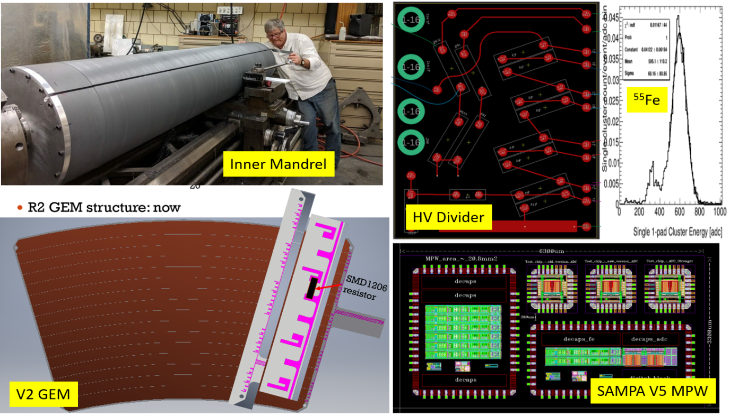
TPC Update
Upper left and moving clockwise: Machining of TPC inner field cage mandrel, HV voltage divider circuit board, measurement of ⁵⁵Fe signal in prototype GEM module, SAMPA v5 multi-project wafer run layout. 3D module of R2 GEM module.

Slide 8
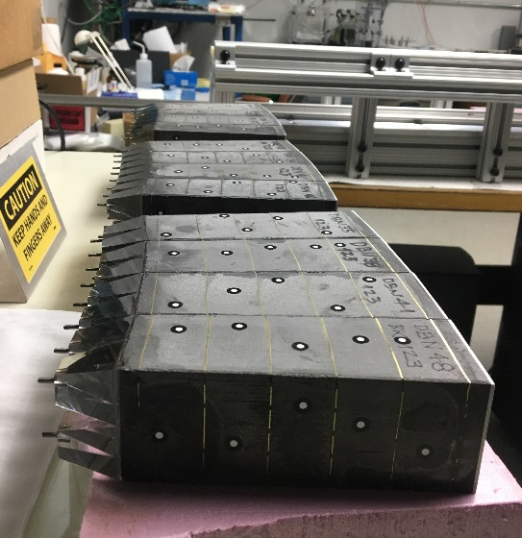
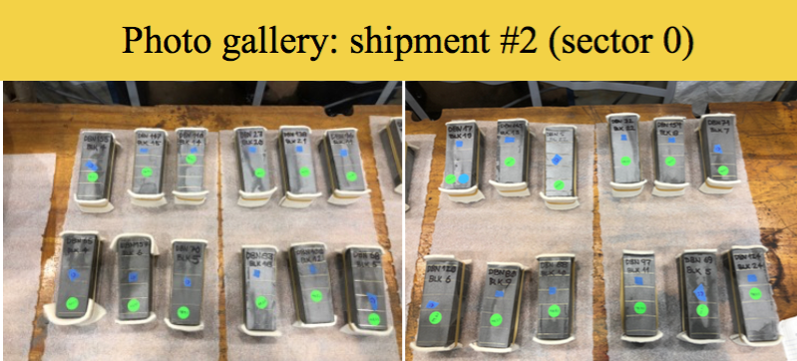
EMCal Update
The 800 km of fibers for preproduction Sectors 1-12 have all been delivered to UIUC and the screens are being delivered according to the schedule.
Tungsten powder has been delivered for the first 3 preproduction sectors.
Sector 0 blocks have started to be received at BNL from UIUC and they are being prepared for Sector assembly.
There is a modest delay in getting the sector 0 mechanics ordered. Primarily sheet metal work and small parts.

Slide 9
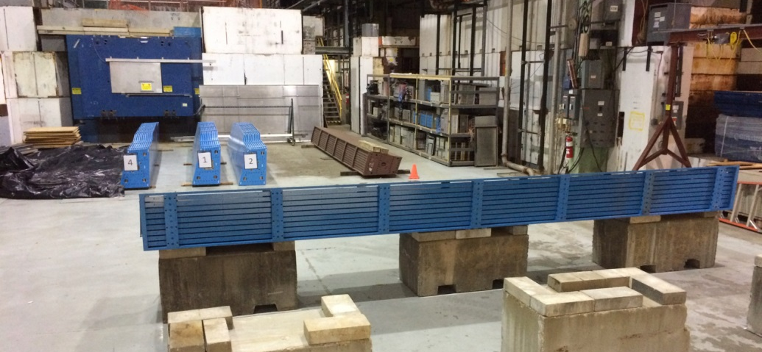
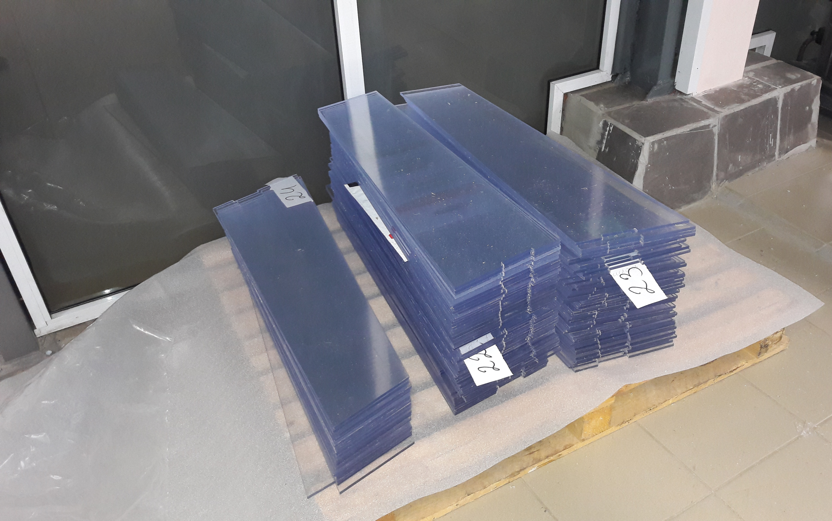
HCal Update
A pre-production order for 20% of the scintillating tiles for the outer HCAL has been placed with the vendor. The vendor will ship the first 200 tiles of the pre-production order by the end of December 2018. They will be tested at GSU and then forwarded to BNL.
Barrel Magnet steel sectors that will serve as the Outer HCal absorber are arriving at BNL at a rate of ~ 1/week. Eight of 32 steel sectors at BNL.
  All now pass inspection
We will instrument 6 OHCal sectors with preproduction tiles. This work starts in Feb.

Slide 10
OHCAL sectors piling up
8 sectors at BNL

Slide 11
Calorimeter Electronics Update
SiPM order has been placed with Hamamatsu. Delivery of first devices Feb 2019
Work continues to develop Q/A testing and sorting stands for the SiPM testing up at Debrecen University. Debrecen and Univ of Michigan will share the testing responsibilities.
The orders for the EMCal Sector 0 preamps and internal SiPM-to-Preamp flex cables have been delivered and Q/A tested.
The order for the EMCal Interface board has been placed. Delivery Dec 2018
HCal Preamp boards & Interface Boards for module 1-6 has been placed. Delivery Jan 2019 Components for a mock up installation on an HCal module have been assembled, with a mockup installation of electronics and cabling scheduled in December
Design of the next version of the sPHENIX Calorimeter Digitizer Crate Controller and Clock Module has been completed and modules assembled. Testing of the new modules has started and is expected to be completed before a design review currently now scheduled for the first week of January 2019.
SOW between Columbia University/Nevis Labs and Brookhaven National Lab for the assembly of a 7-Crate Calorimeter Digitizer System has been completed and submitted to BNL procurement. The 7-Crate system will be used to develop and test the full calorimeter readout chain.

Slide 12
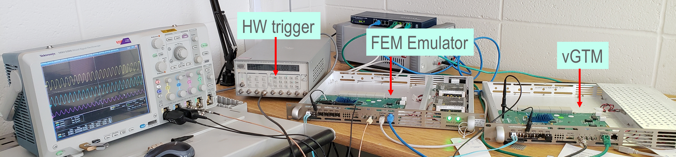
DAQ/Trigger Update
Prep for a January “down-select” review that will determine whether the Local-Level 1 hardware. we will consist of
  A new electronics boards designed by the Nevis group
  The ATLAS gFEX (“global Feature Extractor”) board.
  The Local-Level 1 system uses information from the detectors, to help the master Global Level-1 system (GL1) determine whether or not the data from a given RHIC collision should be recorded or discarded.
The development of the “Granule Timing Module” (GTM) firmware that has been completed.
  We refer to the sPHENIX GTM as “virtual GTM” (vGTM), because it is now entirely implemented in firmware on a FPGA.

Slide 13
Report from MVTX Review November 18, 2018
John Haggerty : Chair
Summary
There were no evident showstoppers in the presentations, and substantial progress was shown from the review in the summer of 2018.
Recommendations
The outline of the step-by-step assembly procedure for the MVTX showing installation of the barrel staves, power cables, and signal cables, should be written down and summarized in one or two slides. This does not have to be the final, more comprehensive assembly procedure, but should show the installation of major components and at what point tests are conducted.
The cables to the racks probably need to be longer than 8m, and this should be assessed conservatively.
A memo approving the halogenated cables should be on file from the fire protection group.
A proposal for extending the beam pipe to move the flanges further from the IP should be discussed with CAD and sPHENIX, as well as beginning a discussion of the beam pipe support.

Slide 14
Issues
Getting the Production Tile order placed is the project’s biggest challenge.

