Slide 1
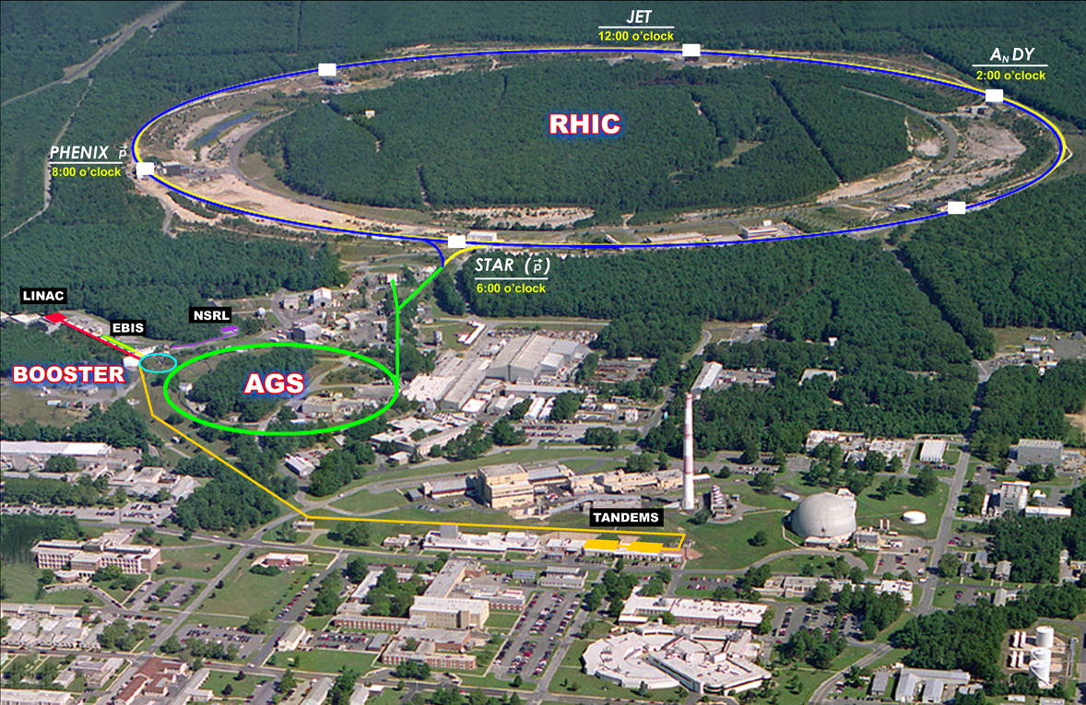
Path forward toward p+A collisions in RHIC Wolfram Fischer
8 January 2013
Workshop on p+A collisions at RHIC, BNL
Notes:
09:00, 45 min

Slide 2
Content
What do we have for p+Au collisions?
What do we still need for p+Au collisions?
Luminosity projection

Slide 3
What do we have for p+Au collisions?
RHIC was designed for p+Au collisions
Independent rings except DX magnets
DX magnets movable (~1 shift)
With stochastic cooling initial Au beam size is at its maximum
Allows for DX move in IR6 and IR8 only (~1 shift)
Solutions for lattice, injection and acceleration
Lattice takes advantage of stochastic cooling
Machine with fast setup (beam-based feedbacks), good reliability
Experience with asymmetric collisions (d+Au, Cu+Au)
Proton beam with N_{b} = 2x10¹¹, P = 55% with upgrades (OPPIS): N_{b} = 3x10¹¹, P = 65%
Au beam with N_{b} = 1.3x10⁹
with upgrades (EBIS/Booster/AGS/RHIC): 2.0x10⁹ (emittance?)

Slide 4
RHIC Design Manual
Run-11: L_{avg} = 30×10²⁶cm⁻²s⁻¹
Run-12: L_{avg} = 10.5×10³¹cm⁻²s⁻¹ (with P_{avg} = 53%)

Slide 5
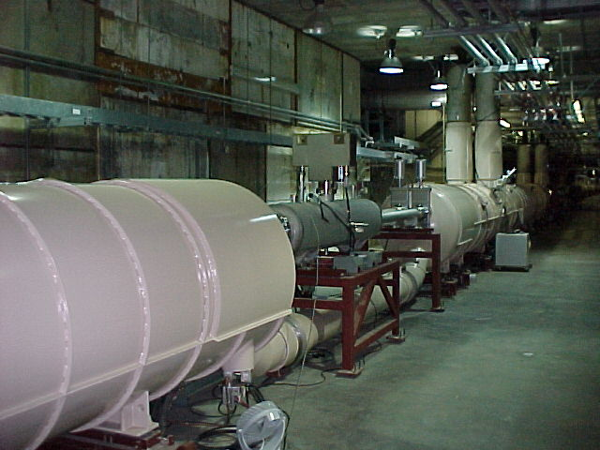
RHIC Design Manual (July 1998)
IR design with beam splitting DX dipoles first
DX dipoles
L_{mag} = 3.7 m, B_{max} = 4.3 T
large aperture (18 cm coil ID)
only magnets that need training (~5 for IR6/8 only)
D0,Q1—Q3
DX dipole
Notes:
MAKE REAL CALCULATION FOR DX MOVE

Slide 6
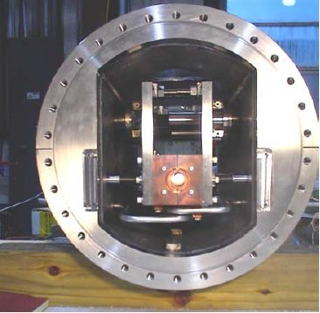
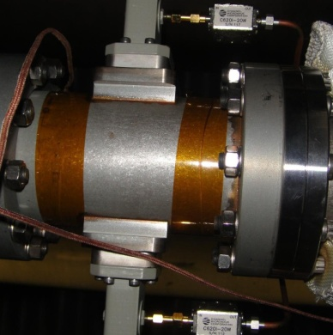
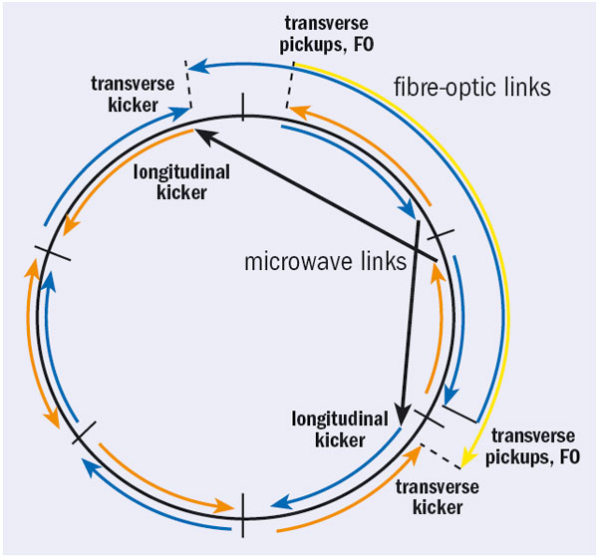
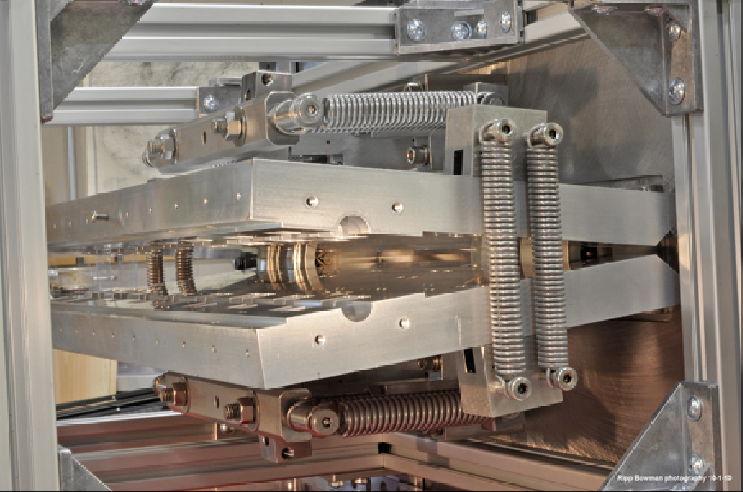
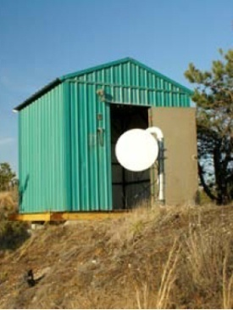
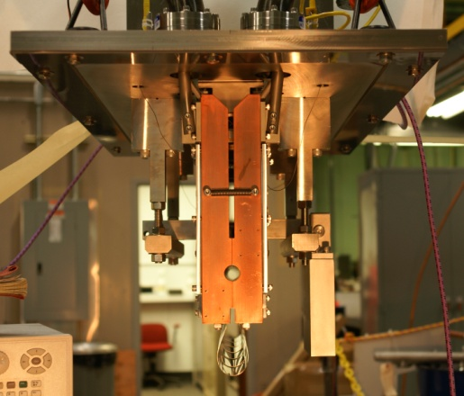
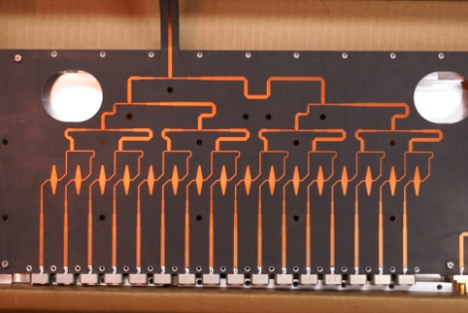
Now have full 3D stochastic cooling for heavy ions
longitudinal pickup
longitudinal kicker (closed)
horizontal kicker (open)
horizontal and vertical pickups
vertical kicker (closed)
5-9 GHz, cooling times ~1 h
M. Brennan, M. Blaskiewicz, F. Severino, PRL 100 174803 (2008); PRSTAB, PAC, EPAC
Notes:
Frequency range: 5-8 GHz transverse, 6-9 GHz longitudinal

Slide 7
Cu-Au store – new mode in 2012
10%/h
Cu and Au have different - intrabeam scattering growth rates (~Z⁴N_{b}/A²) r_{IBS,Au} ≈ 2x r_{IBS,Cu}
- cooling rates (~1/N_{b}) r_{SC,Au} ≈ 3x r_{SC,Cu}
beam loss rates
25 mm.mrad
Stores start with large ε after undergoing instability at transition
Possible with stochastic cooling
Increase bunch intensity until loss at transition
transverse emittances
120x10²⁶cm⁻²s⁻¹
luminosities
Notes:
Fillno 16991 06/15/12, last night

Slide 8
p+Au easier with stochastic cooling
only need to accommodate initial Au emittances
sufficient to move IR6 and IR8 DX magnets
colliding IR move DX by 1cm
S. Tepikian, D. Trbojevic, C-A/AP/447 (Jan. 2012)

Slide 9
p+Au easier with stochastic cooling
non-colliding IR
no DX move
S. Tepikian, D. Trbojevic, C-A/AP/447 (Jan. 2012)

Slide 10
Beam control improvement – feedbacks on ramp
0.3
M. Minty, A. Marusic et al.
Blue orbits
x_{mean}
x_{rms}
x,y_{rms} ≈ 20 μm (!) ≈ 3% of rms size
Orbit [mm]
Orbit feedback on every ramp allows for
Smaller y_{rms} (smaller imperfection resonance strength)
Ramp reproducibility (have 24 h orbit variation)
Tune/coupling feedback on every ramp allows for
Acceleration near Q_{y} = 2/3 (better P transmission compared to higher tune)
y_{mean}
y_{rms}
-0.2
0.7
Q_{x}
Tune
Q_{y}
ΔQ_{y} = 0.006
Q_{y} = 2/3
0.66
Notes:
Fillno 15443, one of best stores

Slide 11
Time-in-store as fraction of calendar time
85%
60%
Run-12 with low failure rates in all systems
Highest time-in-store ratios to date even with increased APEX time during 255 GeV protons, and few weeks per species

Slide 12
What do we still need for p+Au?
Demonstrate DX move by 1 cm
Can be done at end of Run-13
Move for p beam in Yellow, Au beam in Blue (different from d-Au)
If p beam in Blue is needed (and Au beam in Yellow)
Modify vacuum pump stands in IR6 and IR8
Modify shielding IR6 and IR8
Operate with new injection and acceleration scheme
Inject and accelerate Au to intermediate level above transition Then inject p and accelerate both beams

Slide 13
Moving IR6 and IR8 DX magnets by 1cm
Bellows allow for 1 cm movement
Installed shielding creates tight spaces but acceptable “6:00 the bellows and ion pump stand were swapped to make space for the shielding, … cannot be moved because of the ion pump stand” (M. Mapes)
Easier to do have p in Yellow, Au in Blue (different from d-Au!)
Can be done in ~ 2 shifts (i.e. during a run) when properly prepared in previous shut-down

Slide 14
p+Au injection and acceleration
Lorentz factor γ
collision p+Au
107.4
injection p⬆
acceleration p, Au
injection Au
25.4
10.5
acceleration Au (cross transition)
time
Note: now tolerate ion beam instabilities at transition obtain higher intensity (can be cooled down again), not possible with p+Au since have smaller aperture available

Slide 15
Asymmetric collisions (p+Au)
p+Au energies: 100.8 GeV p on 100.0 GeV/nucleon Au (γ_{p} = γ_{Au} = 107.4)
For energy scan need to match Lorentz factor γ of both beams
L_{NN}/week, min/max pb⁻¹ 15 37

Slide 16
Summary
p+Au is possible max energy 100 GeV/nucleon for both beams
Stochastic cooling helps: DX move only in IR6 & IR8, no Au beam growth
DX move in ~2 shifts possible upgrade for pp2pp in IR6 requires change of DX bellows will reduce flexibility, cannot move DX magnets during run
New injection/acceleration scheme store Au beam above transition for ~15 min
Luminosity estimate based on p⬆ beam available (anticipated), and Au beam available (anticipated)
L_{NN} = 15 pb/week min (now) L_{NN} = 37 pb/week max (few years)

