Slide 1
High-performance DIRC
Goal:
Very compact device with coverage up to 10 GeV/c for p/K, 6 GeV/c for π/K, and 1.8 GeV/c for e/π, pushing performance well beyond state-of-the-art
First DIRC aiming to utilize high-resolution 3D (x,y,t) reconstruction (performance and cost)
FY 19 progress:
A successful radiation hardness study was performed.
Purchase of two custom-made 3-layer lenses using sapphire and PbF₂ as the middle layer is almost finalized.
The successful beam test of the PANDA Barrel DIRC prototype.

Slide 2
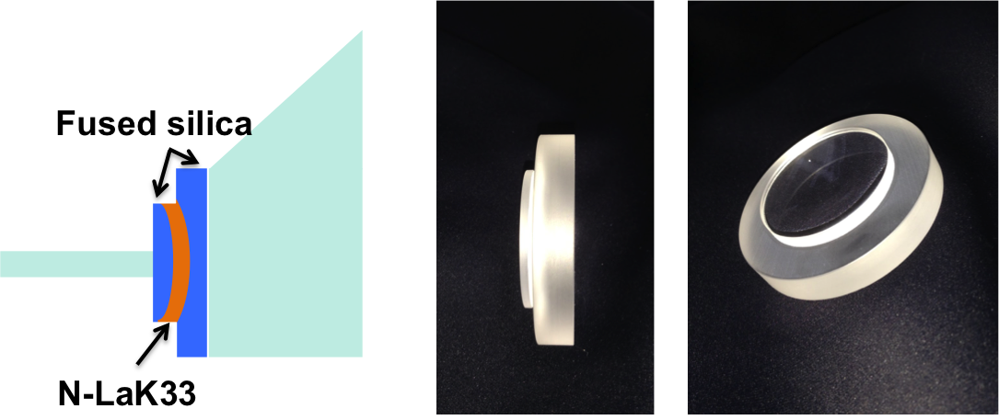
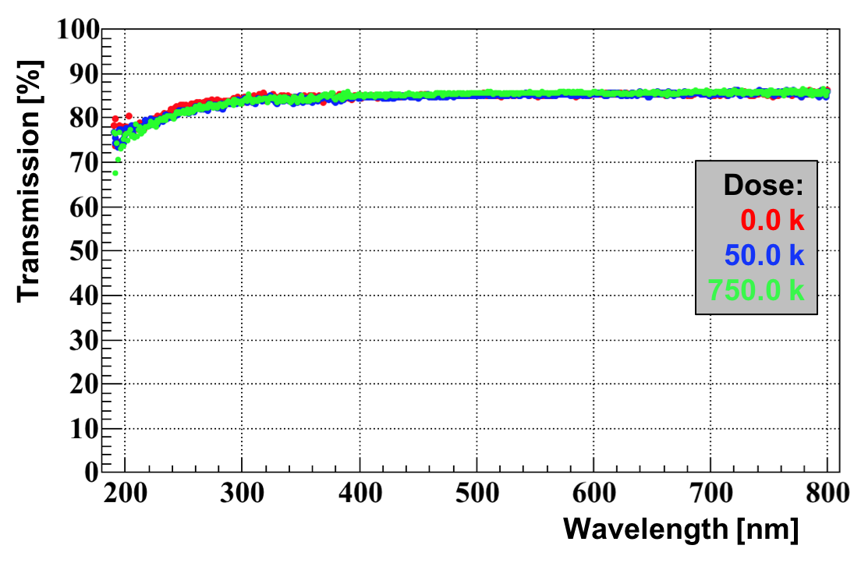
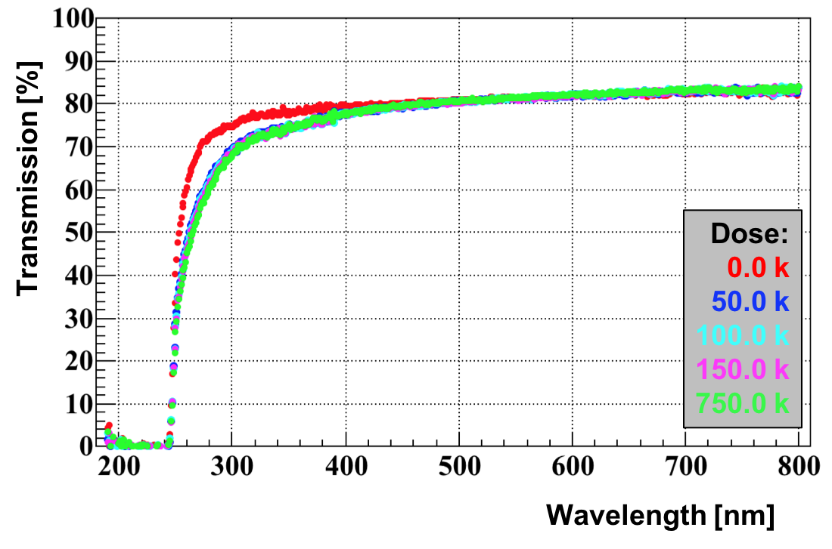
DIRC – overview
3-layer lens
Radiation hardness test
Detailed radiation hardness study was performed at BNL, and five materials were tested up to 750 krad.
Sapphire and PbF₂ were confirmed to be extremally radiation hard.
Sapphire
Radiation hard 3-layer lens prototypes
Both sapphire and PbF₂ present new manufacturing challenges that have to be addressed by potential vendors.
Discussion are in final stage to finalize the purchase of two custom-made 3-layer lenses using sapphire and PbF₂ as the middle layer.
PbF₂
Reducing sensors coverage
The successful beam test of the PANDA Barrel DIRC prototype identified the potential for a significant reduction in the number of sensors required to cover the detector plane.

Slide 3
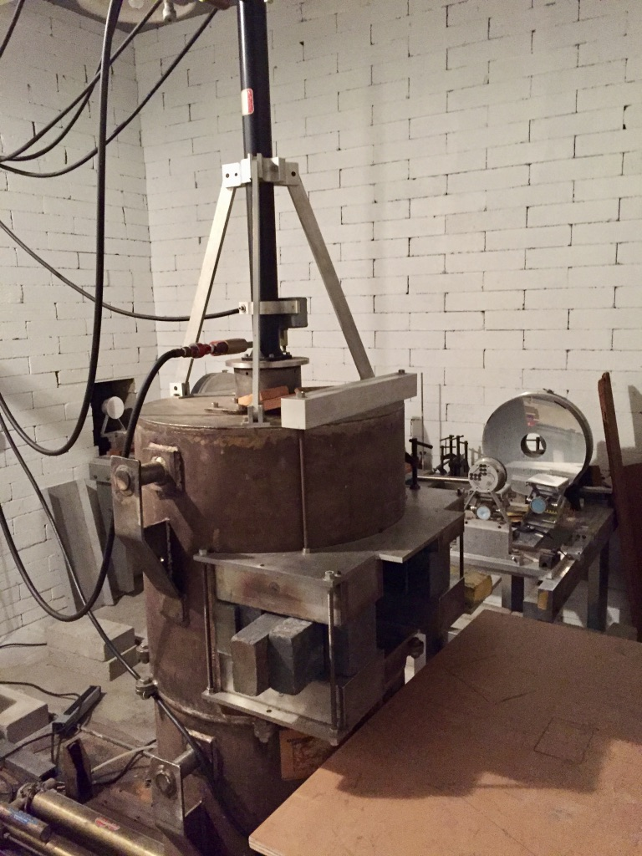
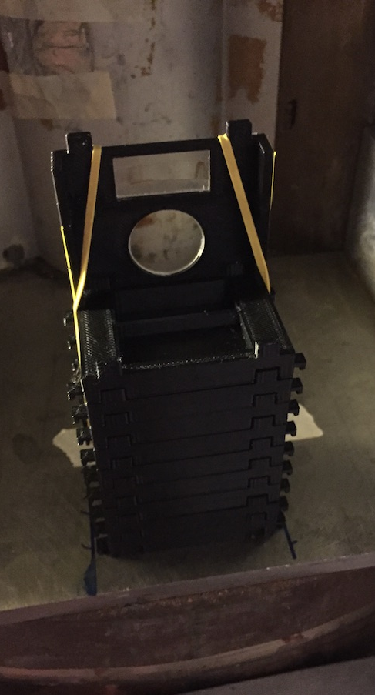
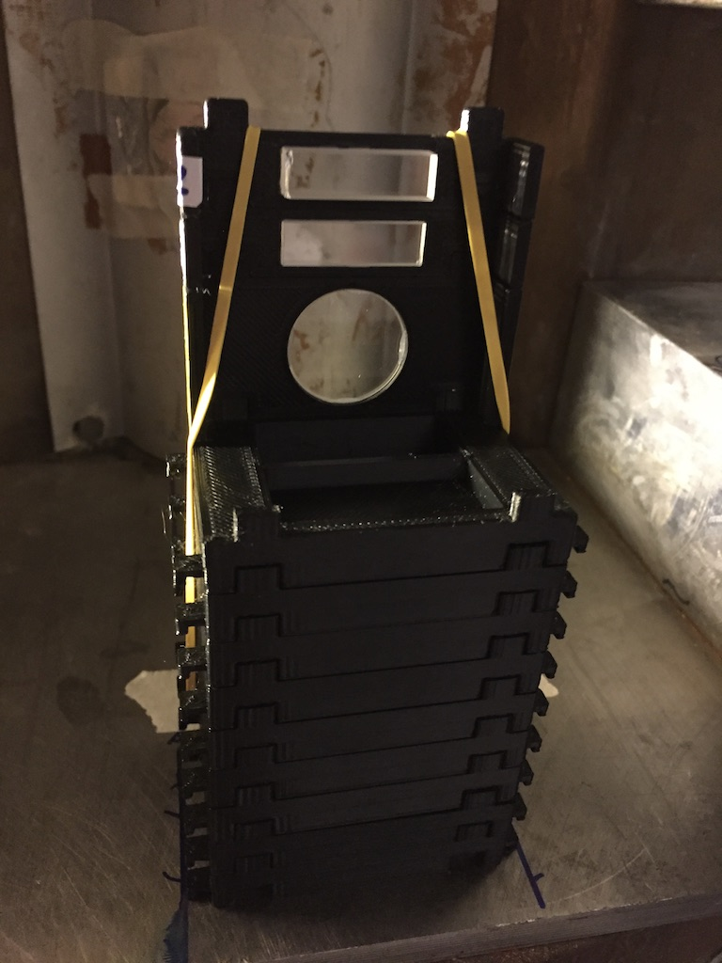
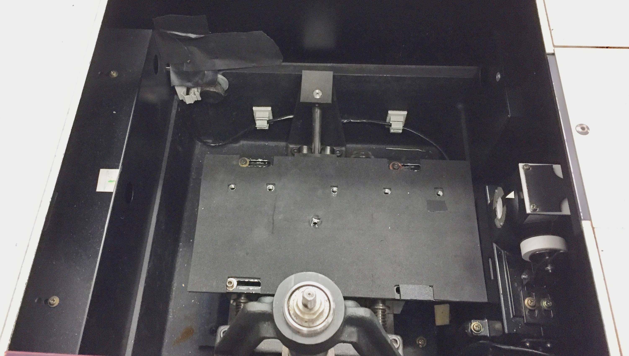
Radiation Hardness Test
Co⁶⁰ Chamber
⁶⁰Co setup at BNL
Radiation damage quantified by measuring the transmission in the 190-800 nm range in a monochromator.
Five materials studied.
Sapphire and PbF2 great radiation hardness confirmed.
Tested samples
Monochromator

Slide 4
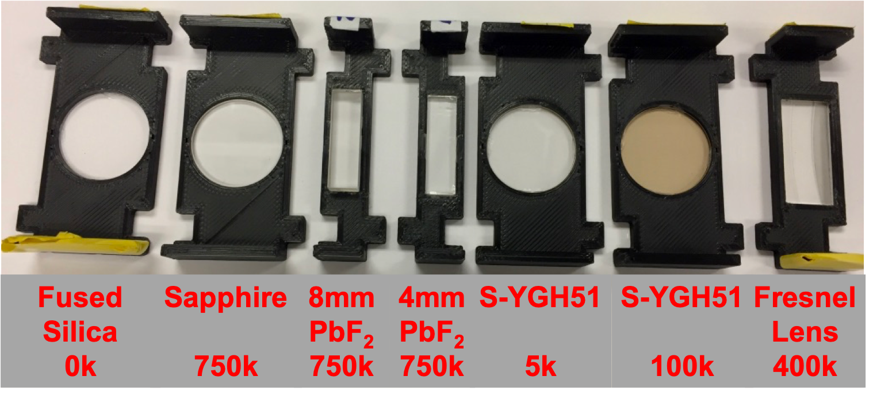
Radiation Hardness Test
Sapphire
⁶⁰Co setup at BNL
Radiation damage quantified by measuring the transmission in the 190-800 nm range in a monochromator.
Five materials studied.
Sapphire and PbF2 great radiation hardness confirmed.
PbF₂
Tested samples

Slide 5
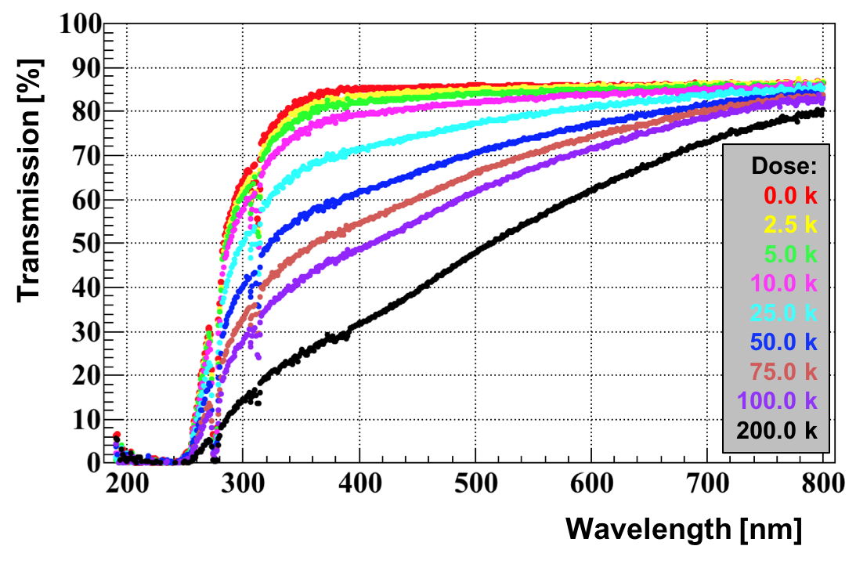
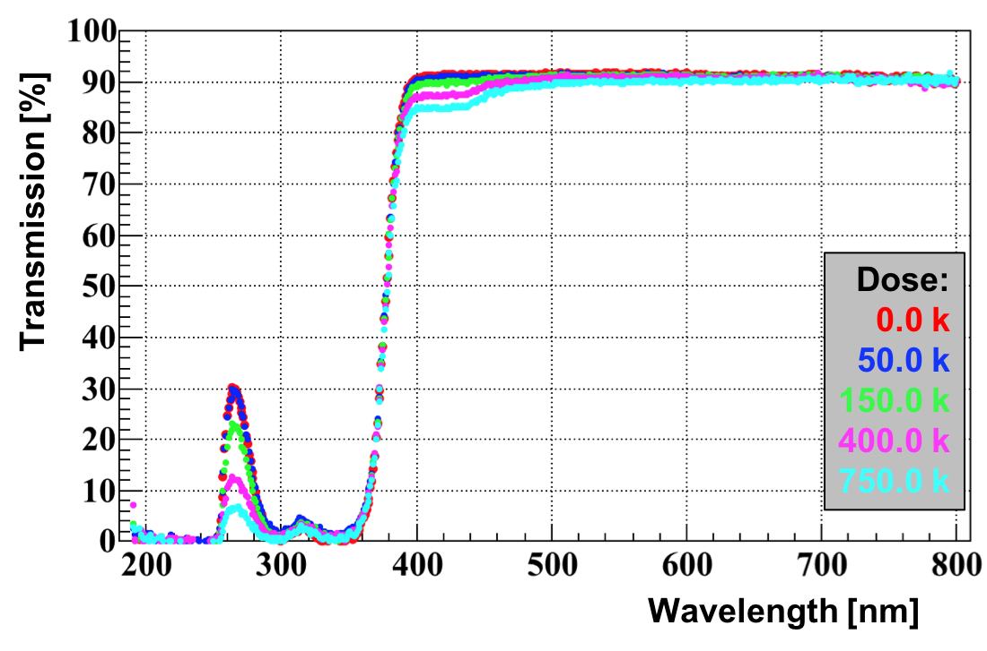
Radiation Hardness Test
S-YGH51 (NLaK33)
⁶⁰Co setup at BNL
Radiation damage quantified by measuring the transmission in the 190-800 nm range in a monochromator.
Five materials studied.
Sapphire and PbF2 great radiation hardness confirmed.
mRICH Fresnel lens
Tested samples

Slide 6
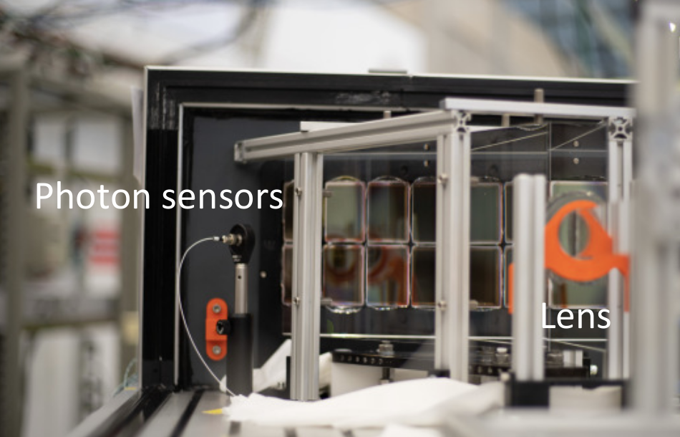
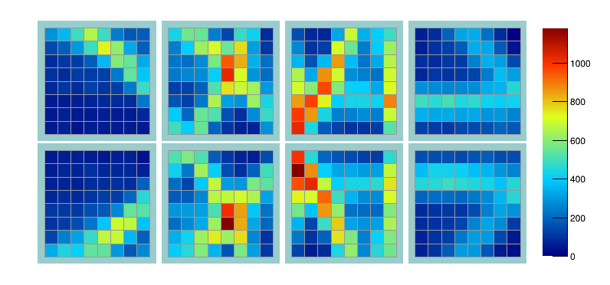
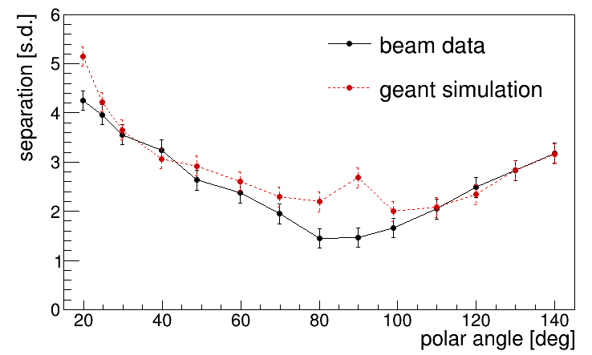
MCP-PMT arrangement
Reducing sensor coverage
The performance of new design ideas has been validated using the PANDA Barrel DIRC prototype at CERN PS
Larger sensor pixels, slower electronics than EIC DIRC: → prototype goal: 3σ π/K separation @ 3.5GeV/c
Optics similar to EIC DIRC design: narrow bar, fused silica prism, 3-layer spherical lens.
Measured photon yield, Cherenkov angle resolution per photon (SPR), and per particle (Δθ_{c}), and π/K separation power – all in good agreement with simulation (which is also used to predict the performance of the EIC DIRC)
CERN2018 data analysis in progress.
Sustained performance nevertheless a significant reduction in the number of sensors covering the detector plane was observed.
Impact of reducing number of sensors has to be tested in EIC simulation.
Example of hit pattern
π/p separation power

