Slide 1
MCP-PMT/LAPPDTM
Goal:
Adapt LAPPDTM to the EIC requirements:
Highly pixelated LAPPDTM working at 2~3 Tesla, to be used as photosensors
for mRICH, dRICH, and DIRC detectors, as well as TOF applications.
FY 19 Progress:
[1] Produce and test 6cm MCP-PMT with Incom 10 µm pore size MCPs, the spacing is the same as current standard design;
[2] Order glass components (side wall and spacer), design and prepare for another 10 µm MCP-PMT with reduced spacing;
[3] Convince Incom management to devote efforts on delivery of the pixelated LAPPDTM;
[4] Transfer SLAC MCP-PMT scanning system to ANL, establish 2D single photoelectron efficiency and TTS timing scan capability;
[5] Enhance MCP-PMT simulation effort to guide MCP-PMT design for high magnetic field;
[6] Perform an initial test of newly produced LAPPDTM without magnetic sensitive components.

Slide 2
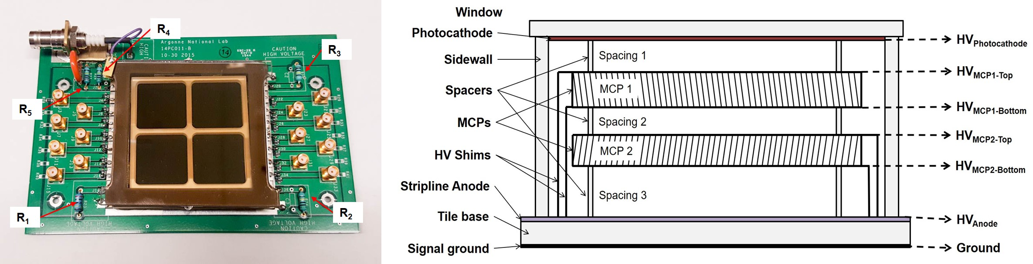
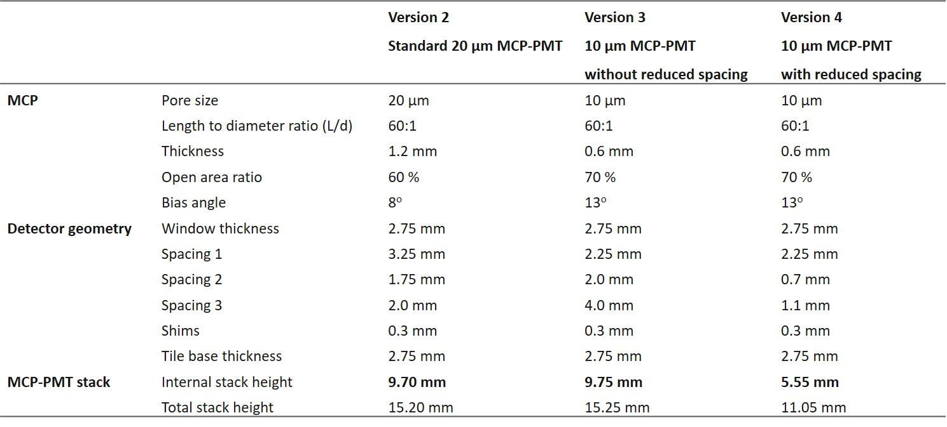
Fabrication of MCP-PMTs with 10 μm pore size MCPs

Slide 3
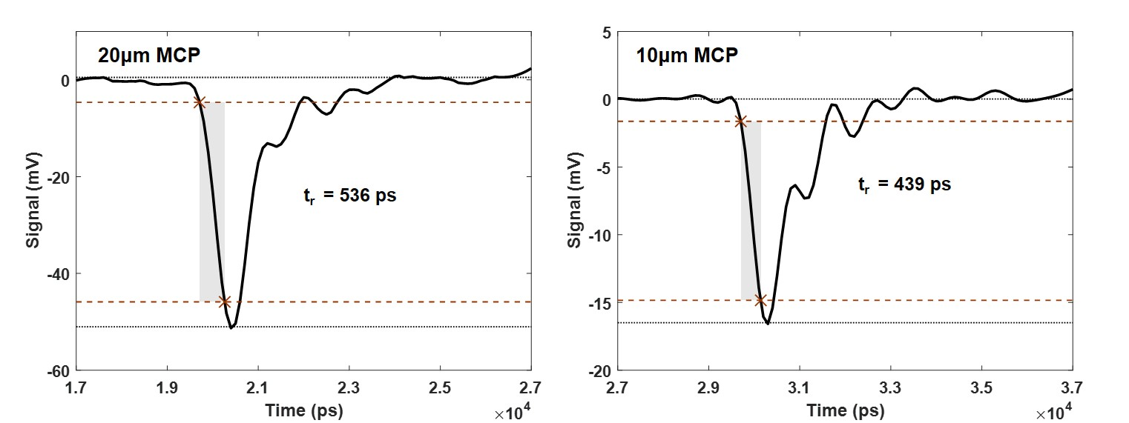
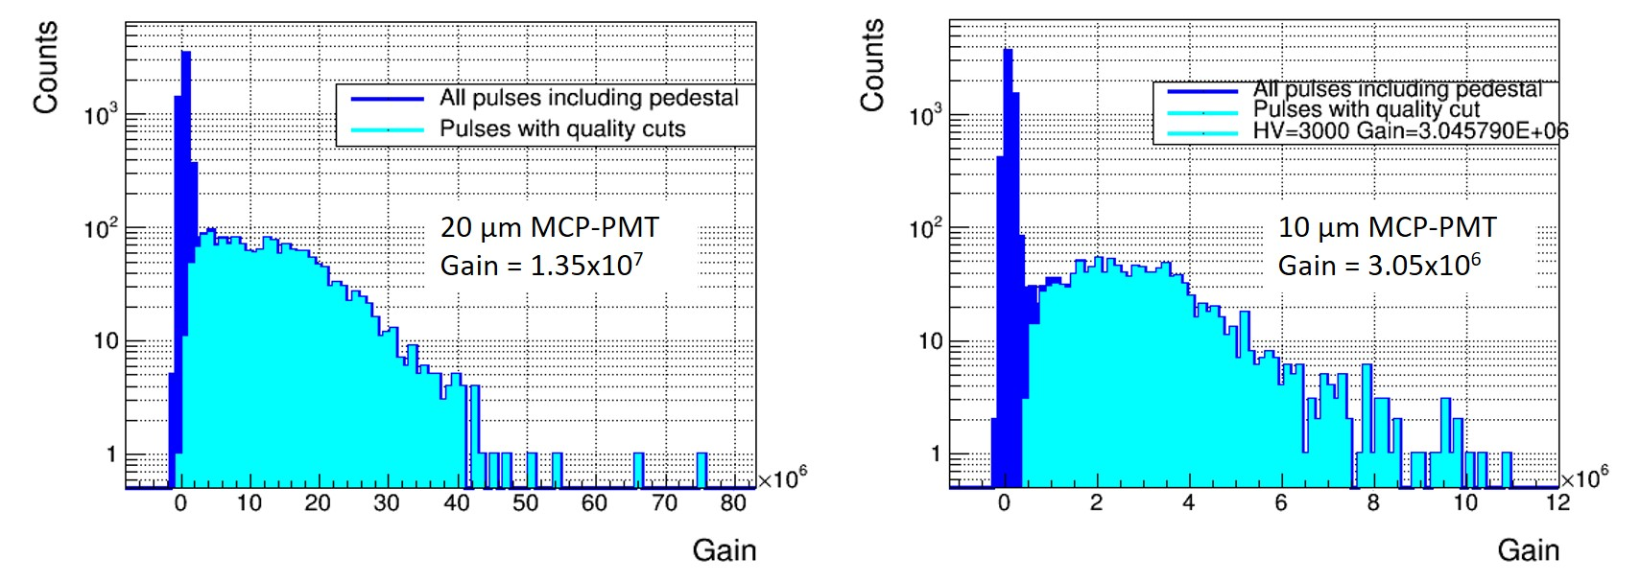
MCP-PMT performance improvement with 10 μm MCPs
- Same stack height, no spacing reduction yet
version 2: IBD design 20 μm
version 3: IBD design 10 μm
Rise time
Gain

Slide 4
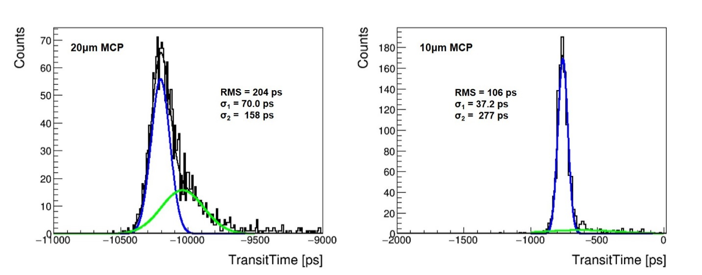
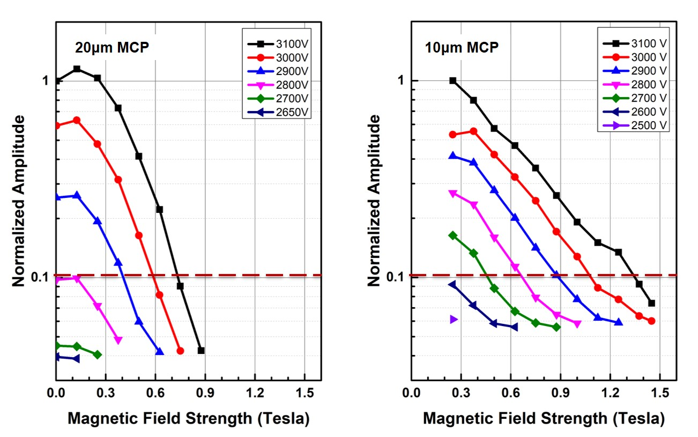

MCP-PMT performance improvement with 10 μm MCPs
- Same stack height, no spacing reduction yet
Timing resolution (SPE)
version 2
version 3
$$σ_{MCP−PMT}= \sqrt{σ_{1}^{2}−σ_{Laser}^{2}−σ_{Ele.}^{2}}$$
σ_{TTS} ~ 63 ps
σ_{TTS} ~ 20 ps
System: σ₁ = 37.2 ps
Laser jitter: σ_{Laser} = 30 ps
Electronics: σ_{Ele.} = 7 ps
10 μm MCP-PMT: σ = 20 ps
Magnetic field tolerance
20 μm MCP-PMT | 10 μm MCP-PMT
0.7 Tesla | 1.3 Tesla

Slide 5
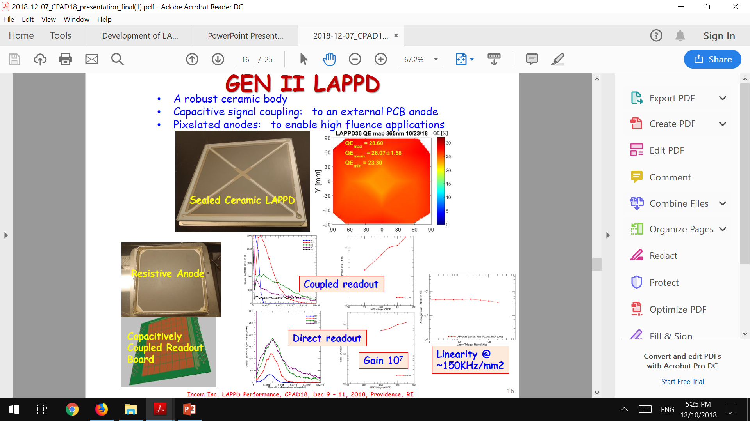
Enhanced communication with Incom on LAPPDTM
The advices and recommendations from the committee and feedbacks from EIC user groups were well explained and emphasized during ANL-Incom bi-weekly meetings.
Pixel LAPPDTM is available for the first time, negotiating one to be delivered at ANL.
Current demonstrated pixel size: 25 mm x 25 mm
QE uniformity issue was solved here!

Slide 6
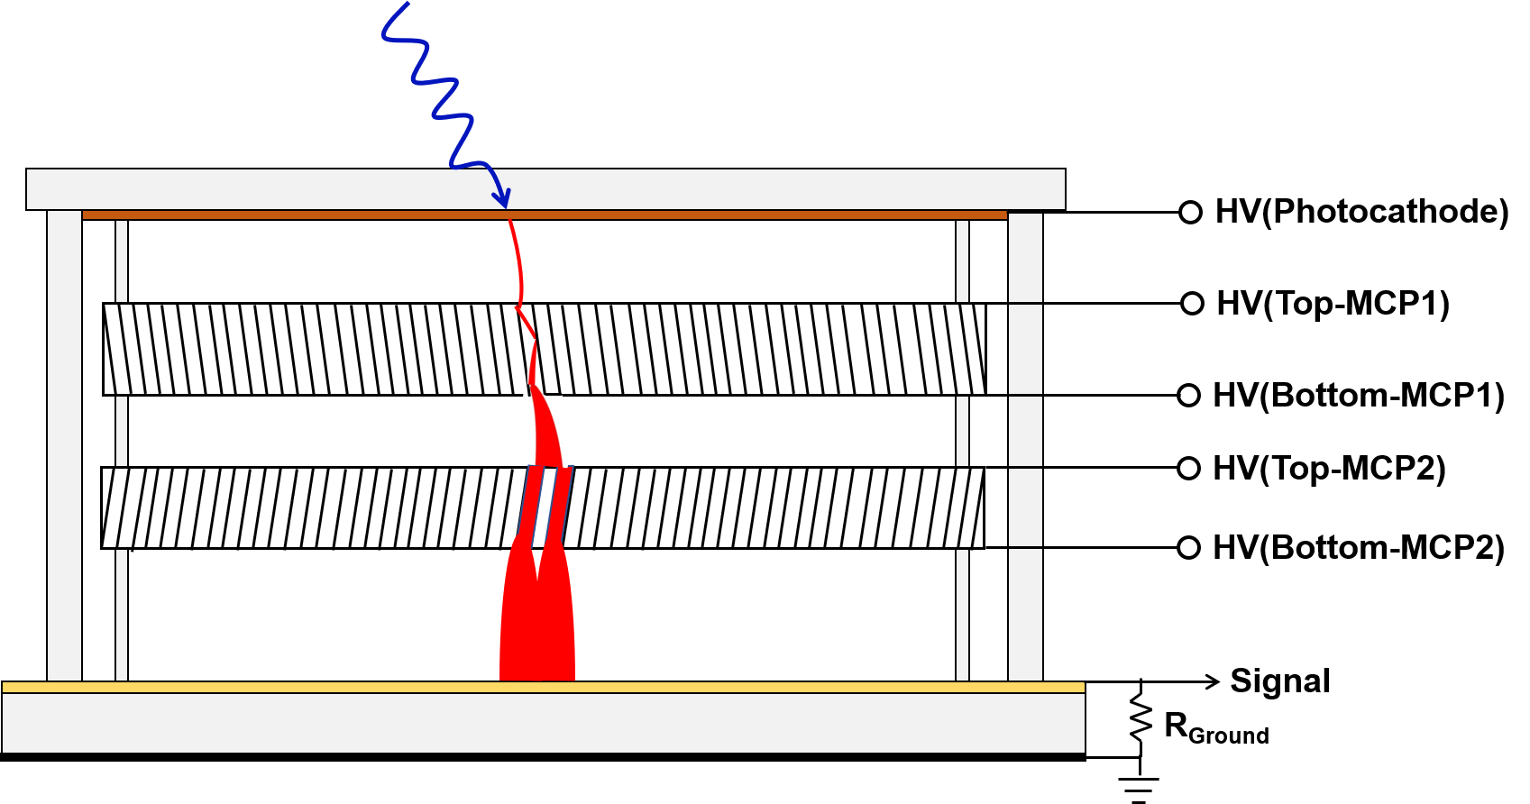
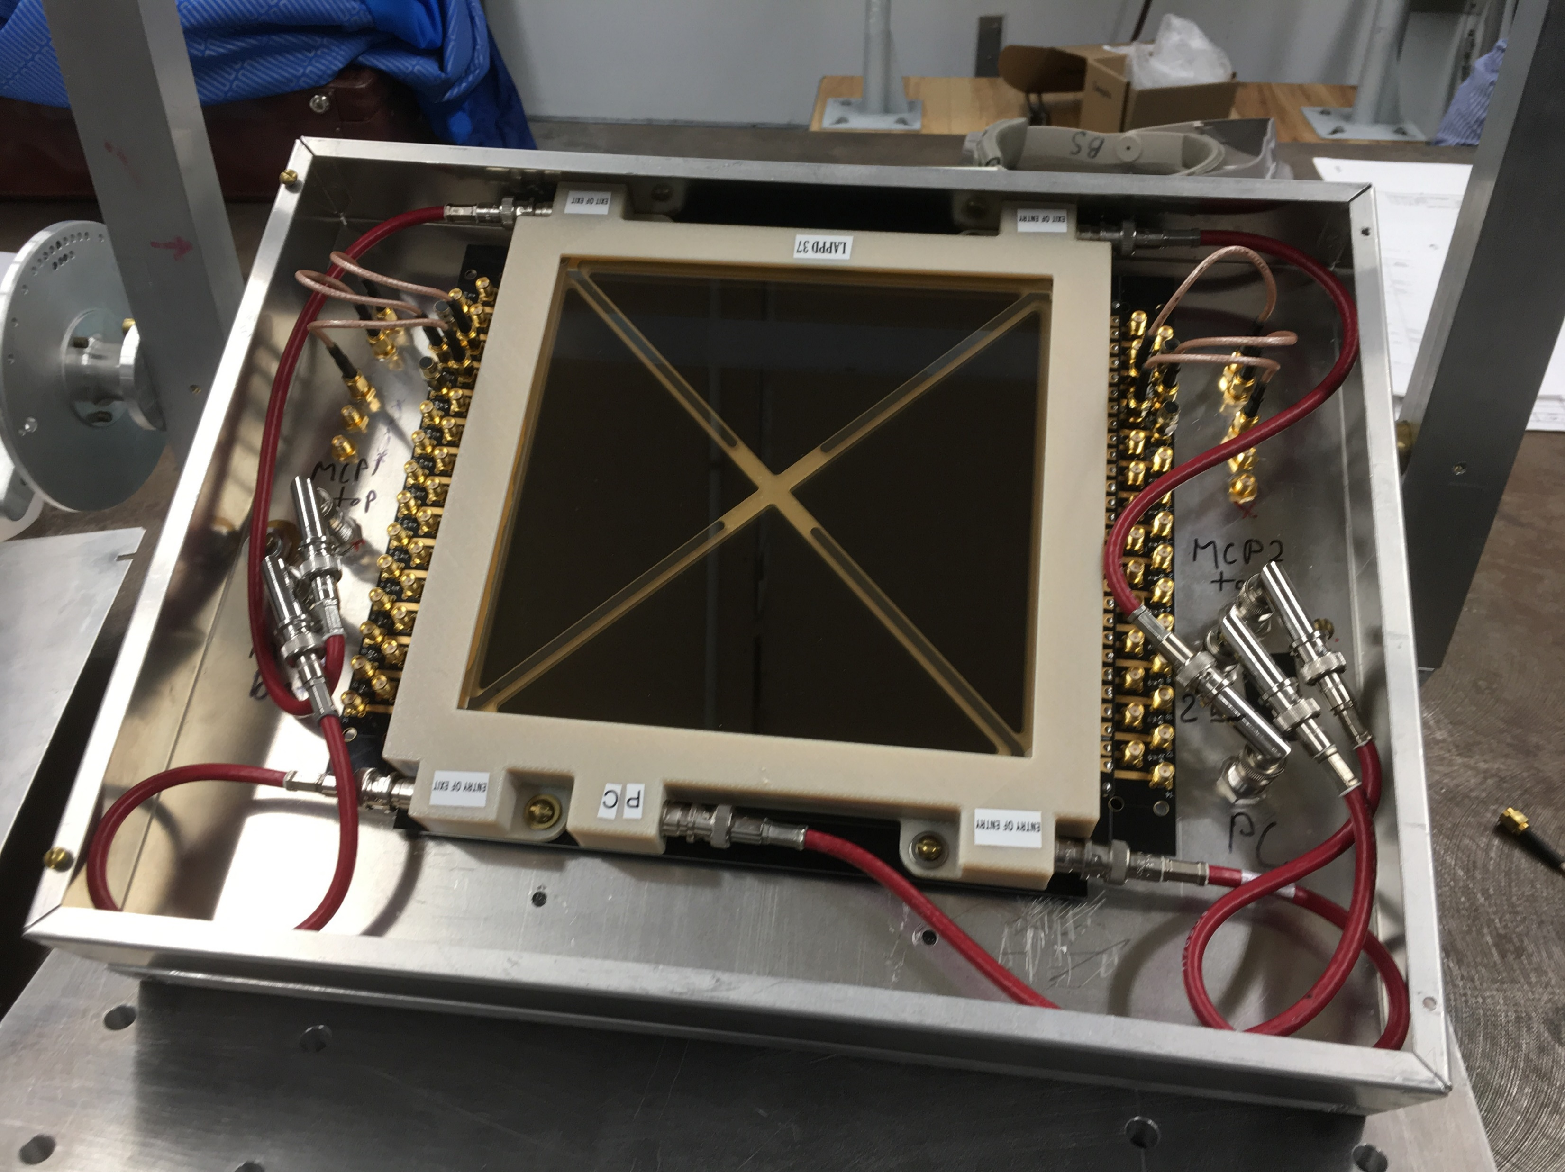
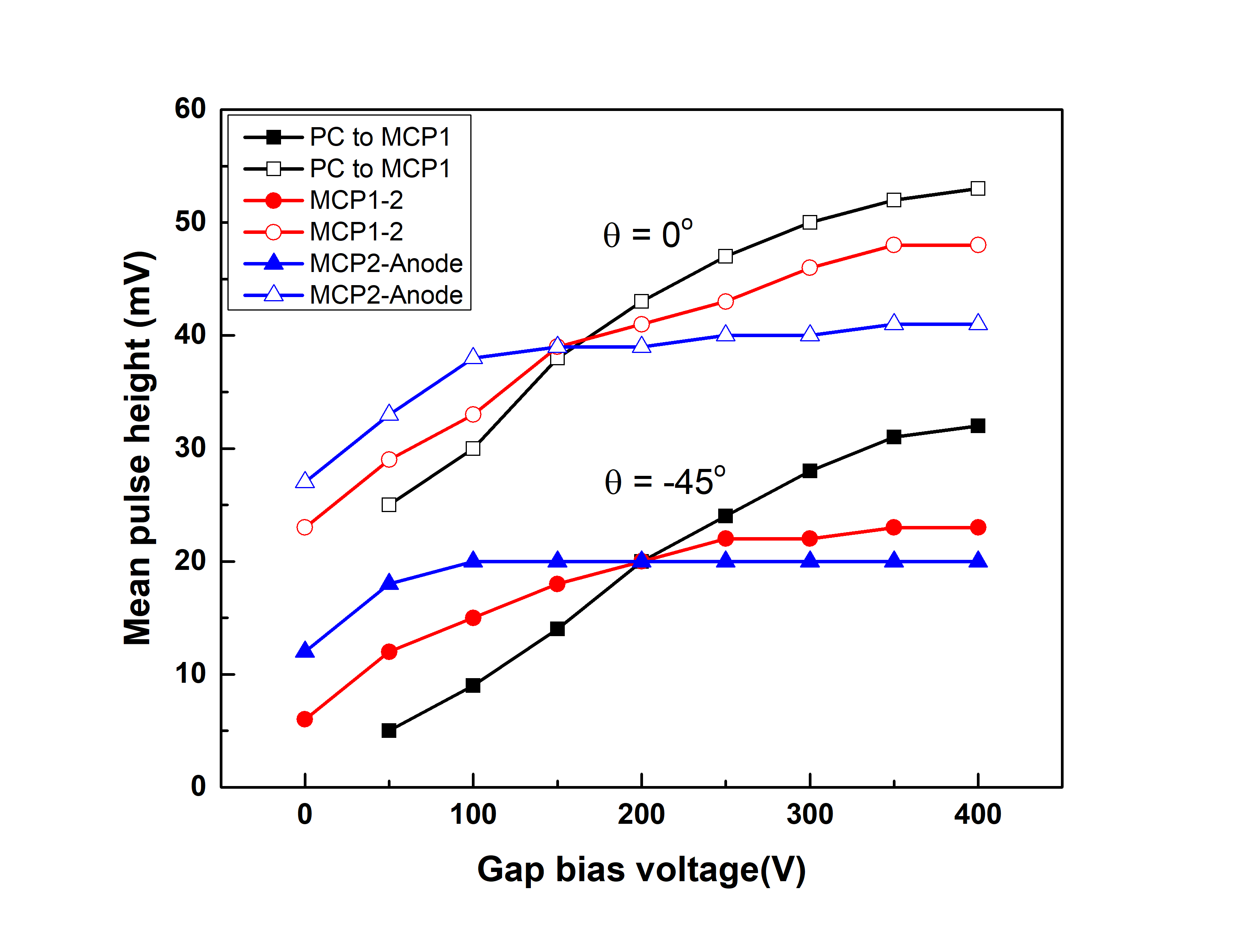
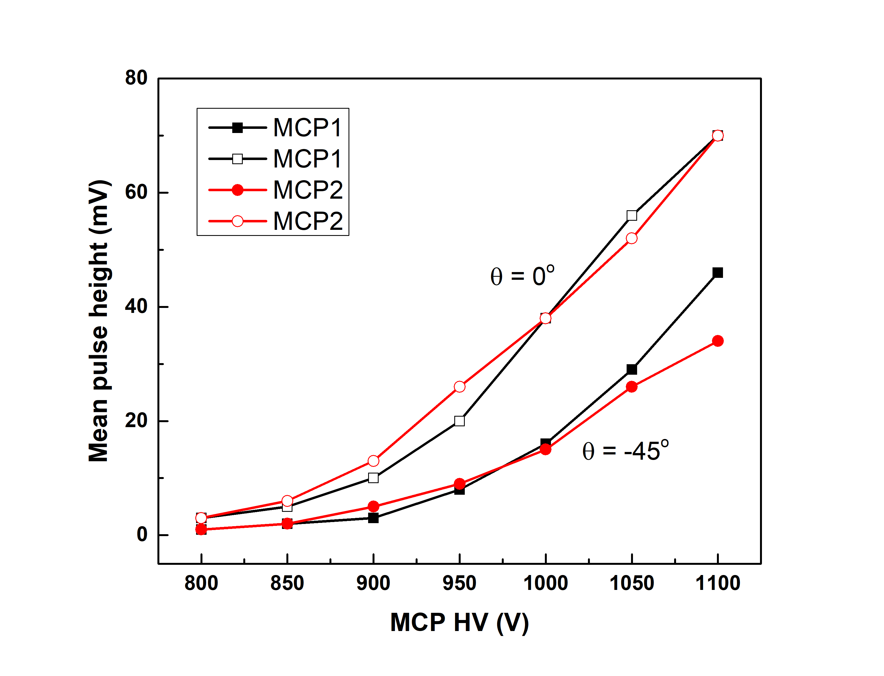
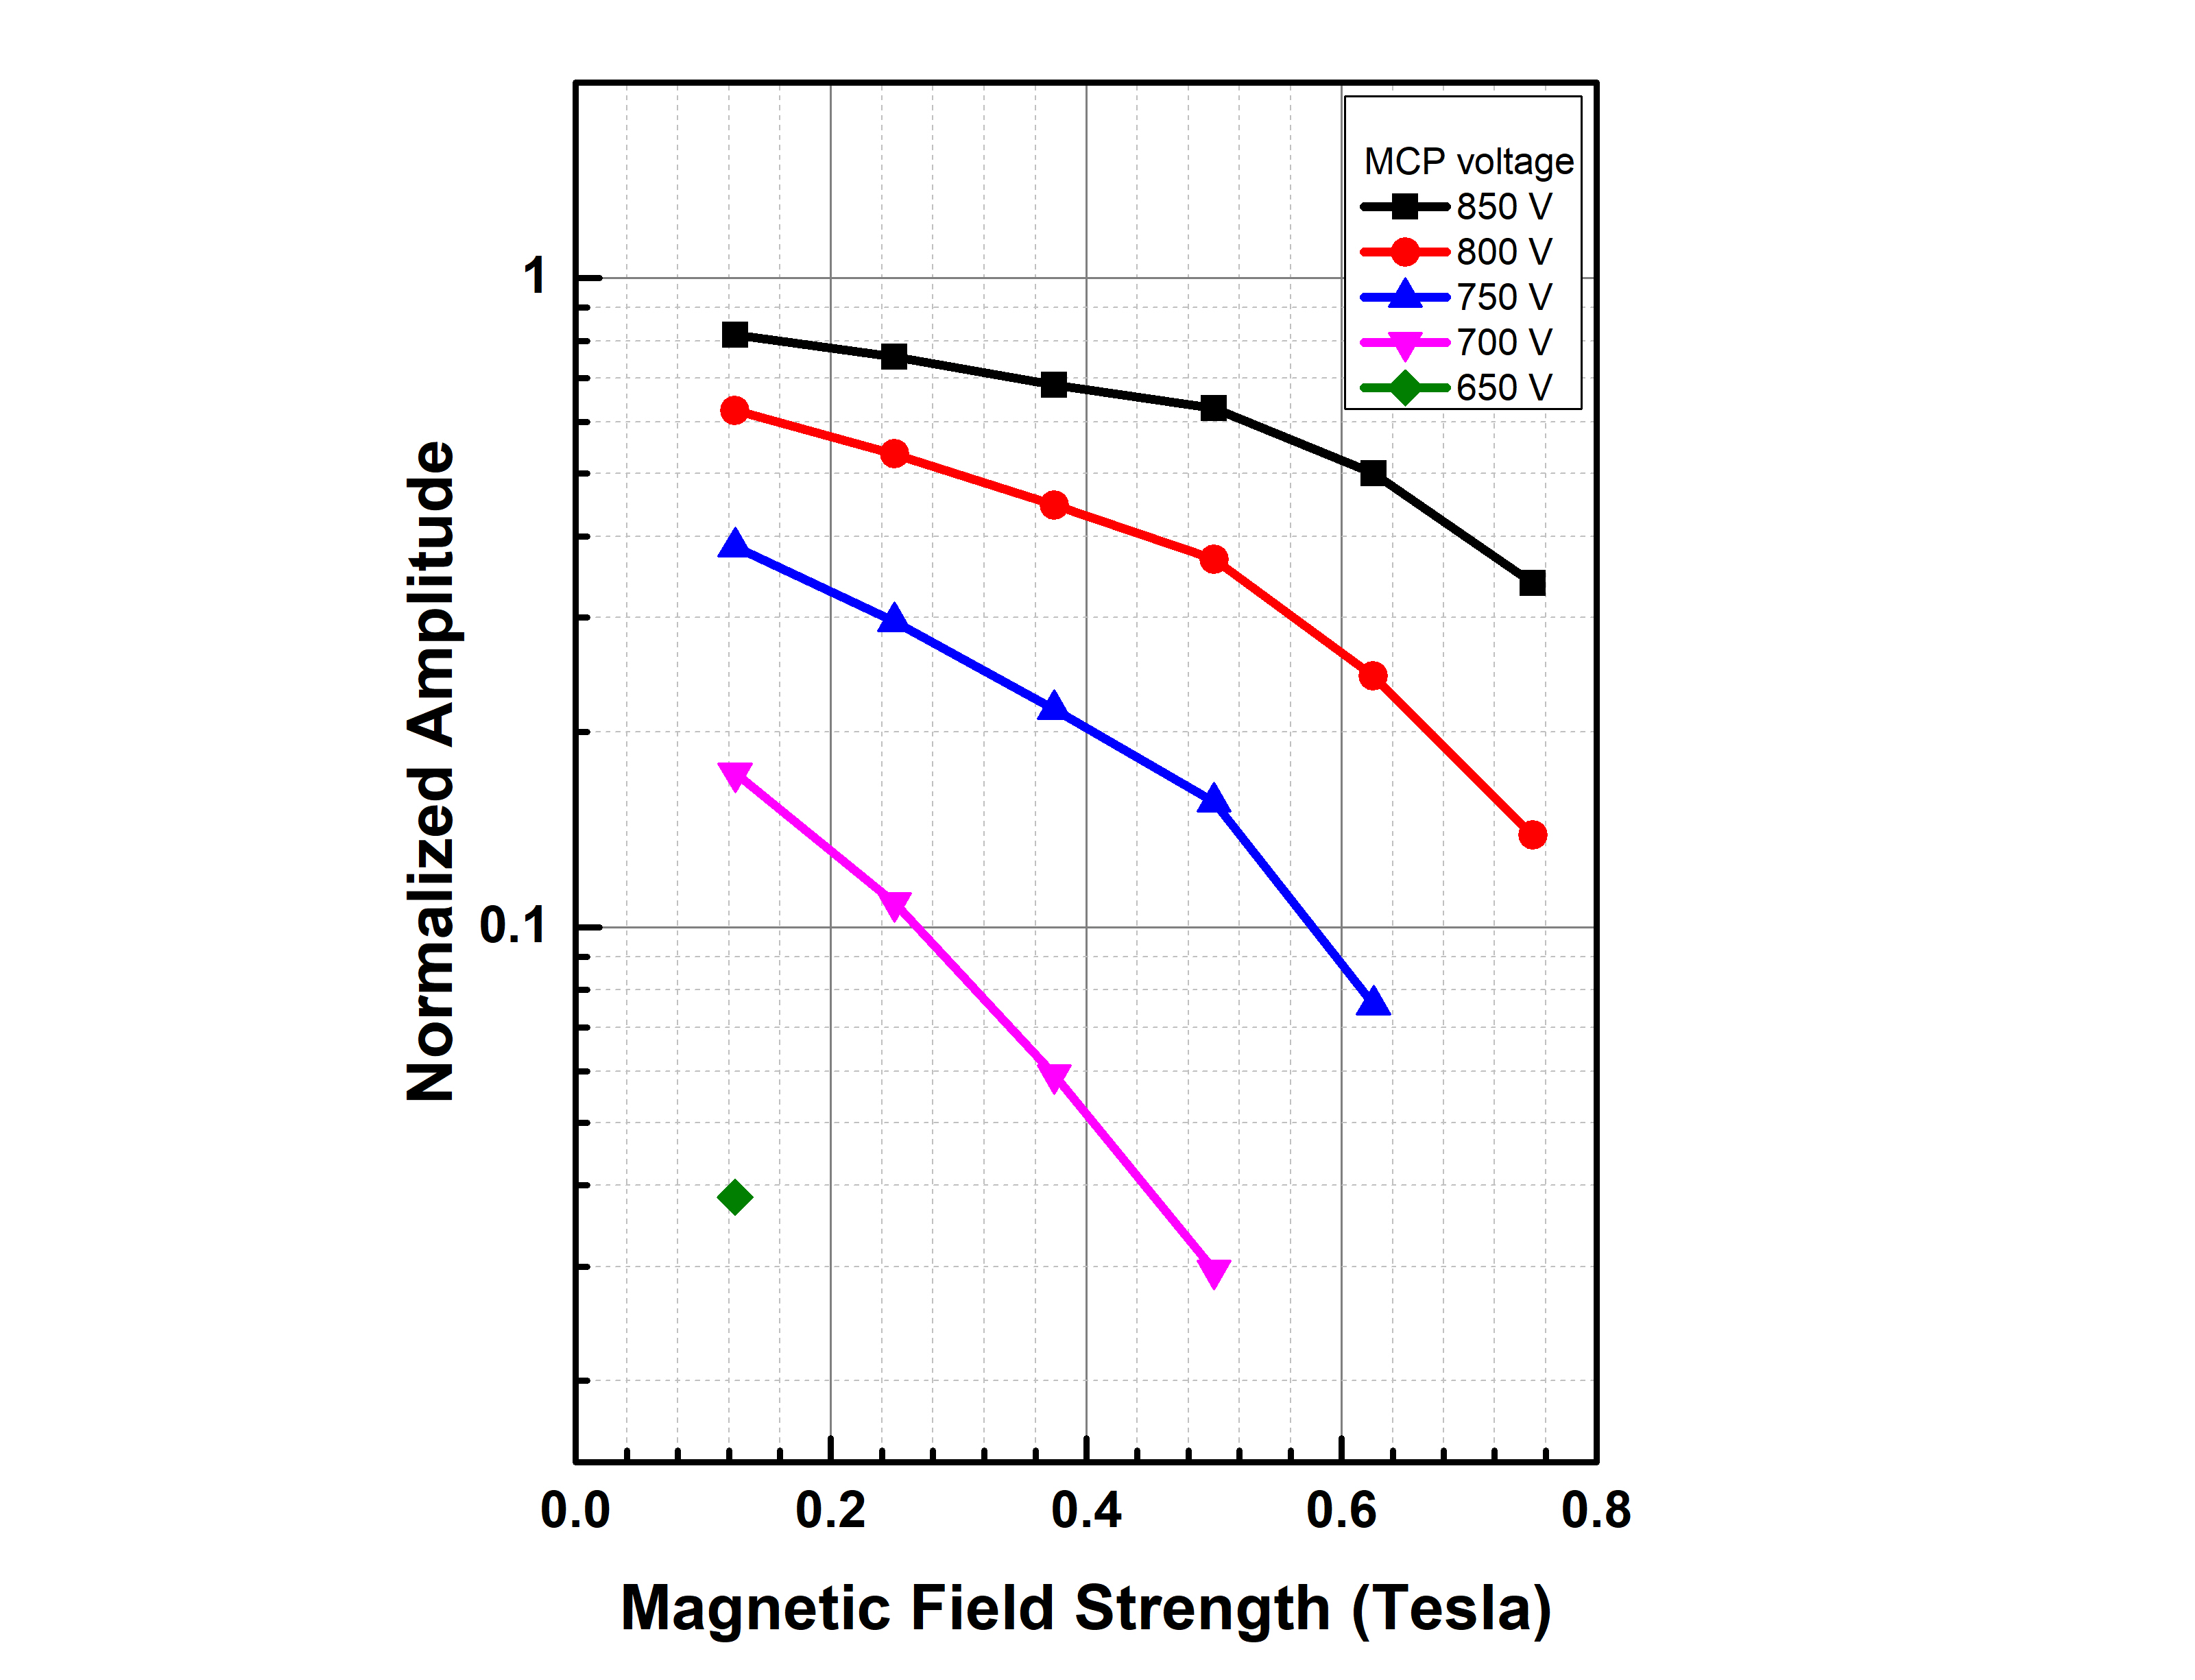
Magnetic field test on new LAPPDTM -without magnetic sensitive components
A new LAPPDTM without magnetic sensitive components was delivered at ANL for a one day test.
SBIR Phase I was fulfilled, Phase II will be submit at end of Jan. 2019.
5 HV bias connection
LAPPDTM shows better B field tolerance than the 6cm one with individual HV biases.
preliminary
preliminary
preliminary
The B field tolerance can also be further enhanced by adjusting the HVs, further study planned.

