Slide 1
Fermilab Facilities Report
Amitoj Singh
USQCD All-Hands Collaboration Meeting
26-27 April 2019

Slide 2
Introduction
To be deployed and existing Fermilab LQCD clusters.
Storage (disk and tape).
Allocation year 2018-2019 (PY18-19) Job statistics.
New user web portal.
Upcoming upgrades and changes.
User support.

Slide 4
I of VI: Fermilab FY19 LQCD Cluster – LQ1
Total 112 nodes connected by a 2:1 oversubscribed Intel Omni-Path network.
Per node configuration:
  dual socket Intel Xeon 6248 “Cascade Lake” 2.5 GHz
  20-cores/socket .. 40-cores total
  192GB 2933 memory
  Intel Omni-Path EDR (100Gbps)
  ~0.9 TB local scratch space
  333 GFlops/node**
$0.02/MFlop ($0.03/MFlop⁺⁺ for BNL-SKL).
CentOS 8.
Omni-Path attached to ~960TB of Lustre file-system.
Worker nodes have public net access via host router.
Release to “friendly user mode” June 14 and release to “production” July 1.
** average of P. Boyle’s Grid Benchmark for MILC and DWF on a single-node.
⁺⁺ price adjusted for current memory pricing.
LQ1 July 2019

Slide 5
I of VI: Fermilab FY19 LQCD Cluster – LQ1
1 CSL node-hour = 1.14 SKL node-hour
1 CSL node-hour = 220 Jpsi core-hour
LQ1 rating:
  981K node-hours
  1.1 M SKL node-hour
  215 M Jpsi core hours
Pi₀ rating:
  113.6 M Jpsi-core-hours

Slide 6
I of VI: Age of Fermilab LQCD clusters
LQ1
Lustre
pi₀
pi₀
pi₀g
pi₀
Today
b_{c}
d_{s}g
d_{s}
d_{s}

Slide 7
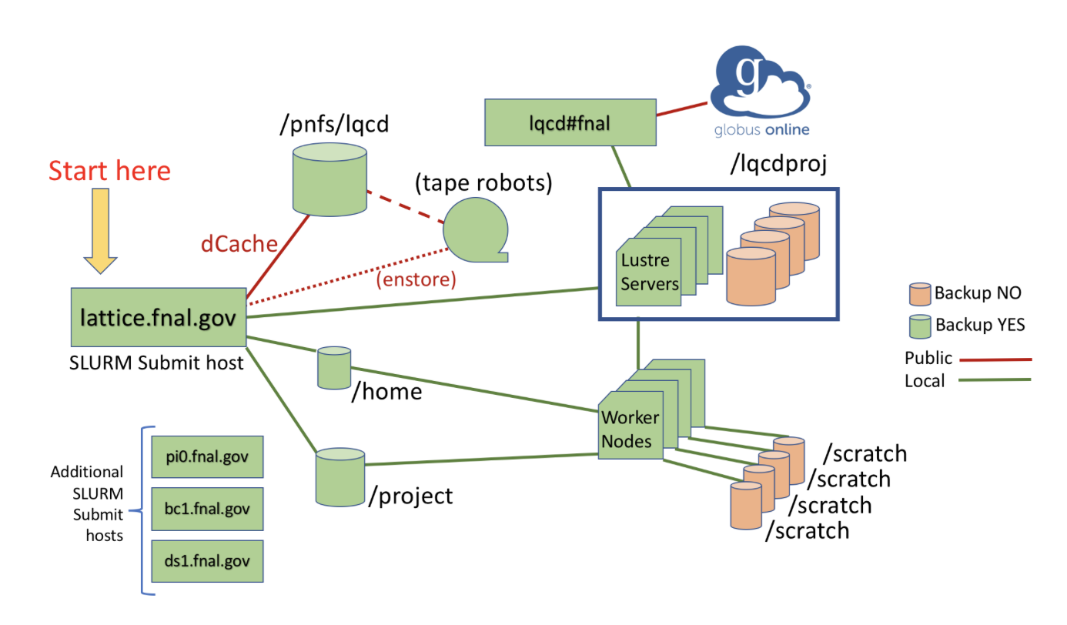
II of VI: Storage – Existing Clusters
776 TB
14.5 TB
Internet
250 GB

Slide 8
II of VI: Storage – LQ1
LQ1#fnal
LQ1-Lustre
960 TB
LQ1.fnal.gov
14.5 TB
Internet
900 GB
Host Router

Slide 9
II of VI: Tape data migration
Urgent push to migrate data on existing tape media to LTO8 !! Estimated cost of migrating ALL data is ~$69k. Please review and delete legacy data under /pnfs/lqcd.
LTO4 Media (0.8TB) Total: ~1.3 PB, 1,617 tapes
T10K Media (8.4TB), Total: ~4.2 PB, 564 tapes
Maintenance
$5.6k/year
Migration to LTO8
$6,400
Maintenance $12.4k/year
Migration to LTO8
$63,000
2004-2012
2012-YTD

Slide 10
II of VI: Tape data migration
Support for LTO4 tape media ends and replacement parts not available after September 2019.
Costly to USQCD to have all data migrated.
Data on tape is a mix of long-term data and short-term data.
We will need to help from users to...
  Identify long-term data of lasting scientific value such as gauge ensembles that need to be migrated to new media.
  Remove short-term data past its useful life, e.g., propagators, etc. belonging to projects that have ended.
We will be contacting affected projects shortly.

Slide 11
III of VI: Job & Memory Size Distribution (conventional) in PY18-19
32 node jobs
128GB/node 32 nodes = 4TB

Slide 12
III of VI: Job Size Distribution (accelerated) in PY18-19
Single node (4 GPU) jobs
Multi node multi GPU jobs

Slide 13
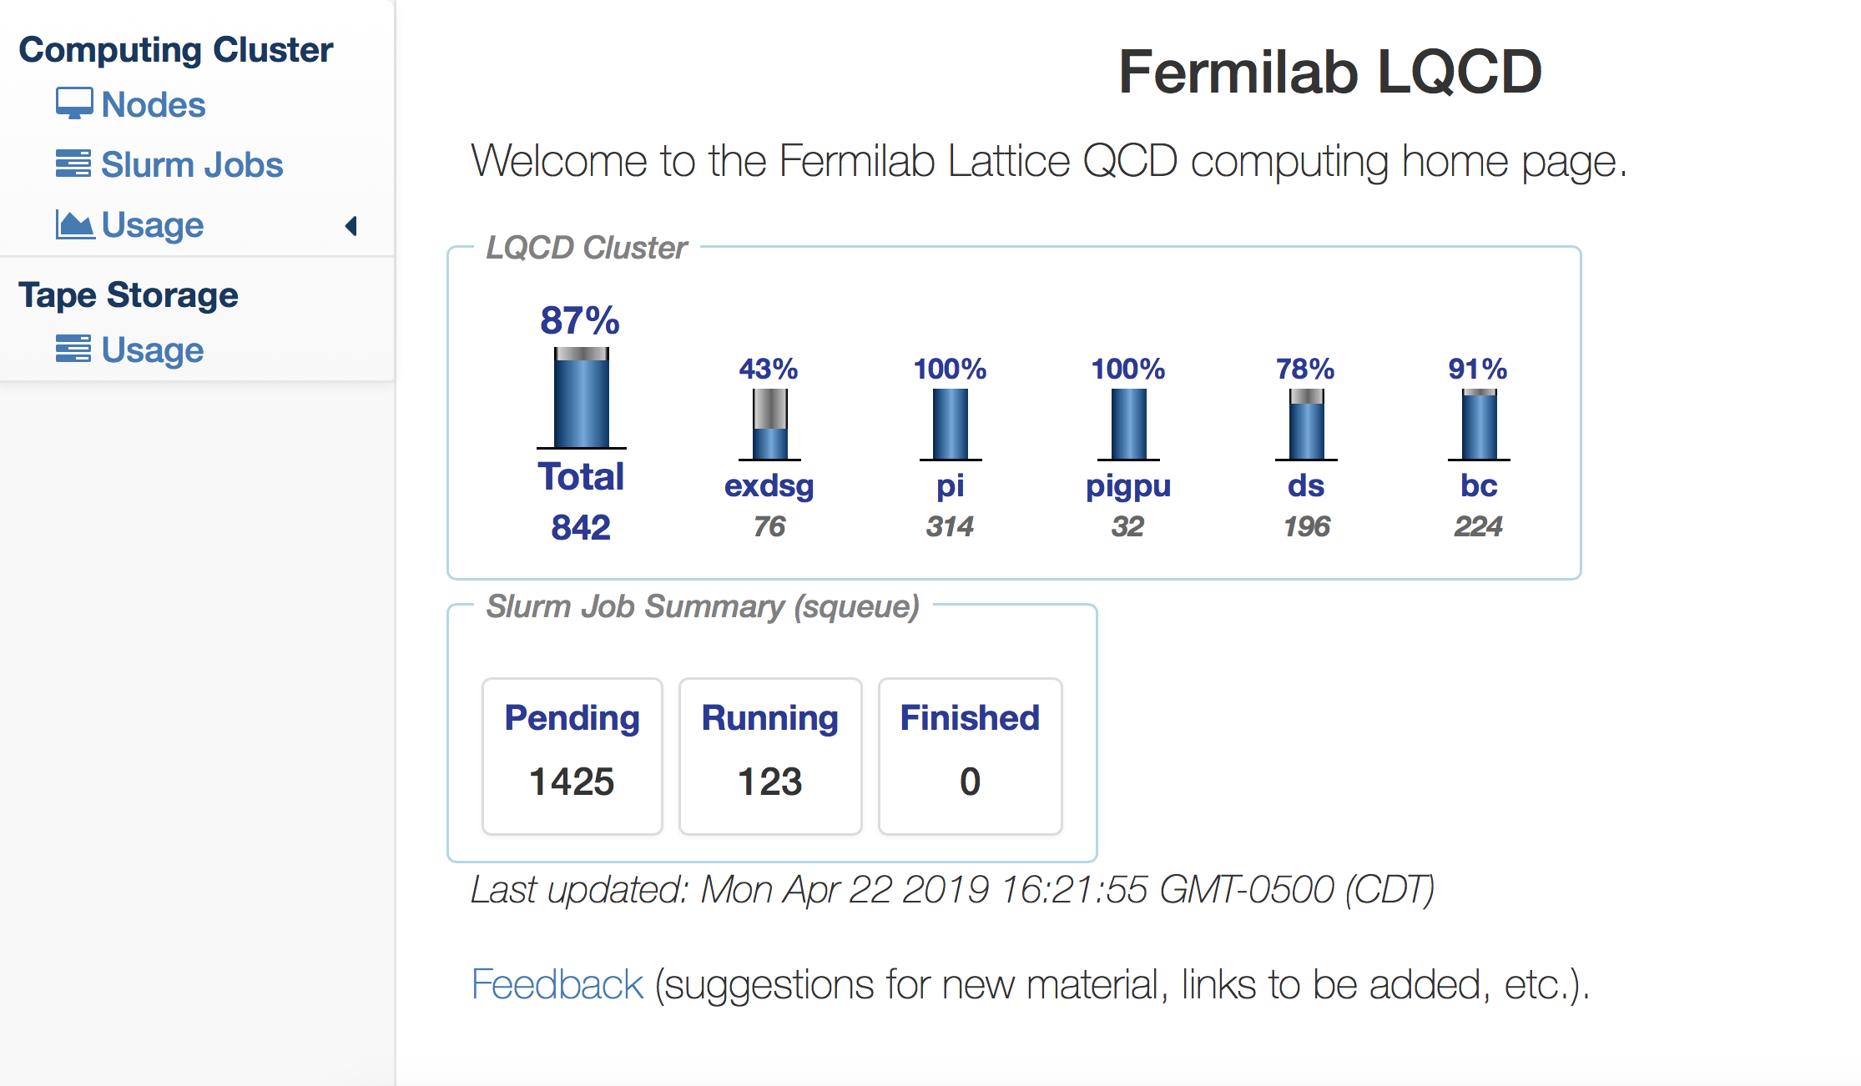
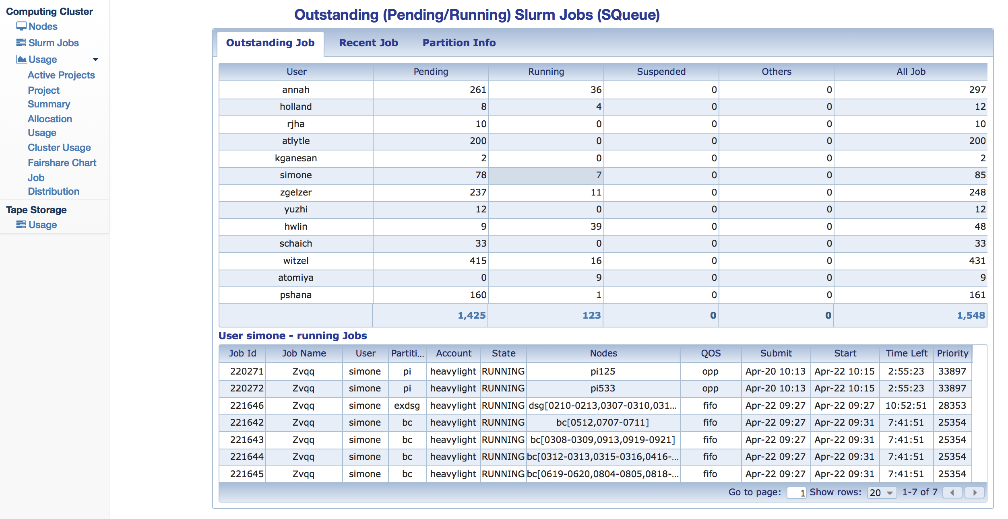
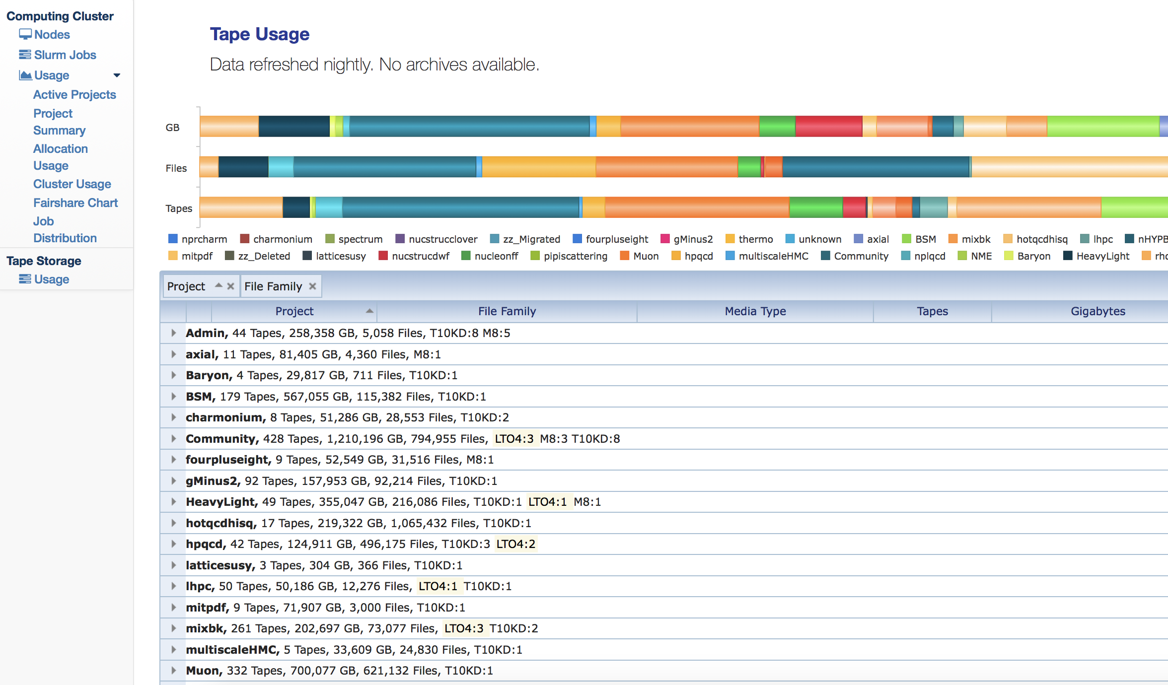
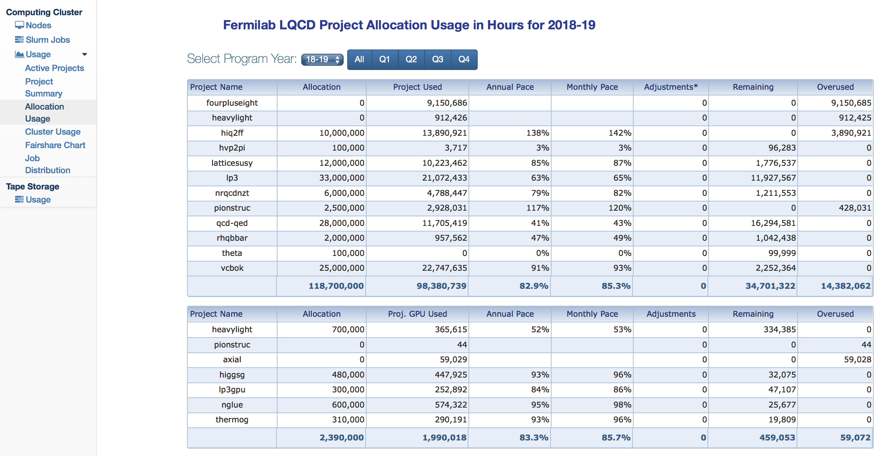
IV of VI: New web portal for Fermilab resources
http://www.usqcd.org/fnal/clusterstatus
Overview
Jobs List
Tape Usage
Allocation Used

Slide 14
V of VI: Upcoming upgrades and major changes
During the start of FY20 we plan to upgrade ALL existing clusters to CentOS 8 to match the OS on LQ1. This will require a prolonged downtime, stay tuned for details.
pi₀ cluster:
  Starting Oct 1, 2019 70% of pi₀ and all of pi₀g cluster will no longer be available as an allocated resource.
Batch queueing system
  We are adjusting SLURM configuration to better manage dispatch priority using QoS (Quality of Service) parameter:
    Billable partitions (pi₀, pi₀g) use normal and opp QoS
    Non-billable partitions (b_{c}, d_{s}, d_{s}g) use fifo QoS
    User’s can use test QoS for short test jobs (<=30 min, max 2 nodes) at high priority
  The default wall-time limit for users has been 24 hours, which is the maximum wall-time allowed. To improve scheduling, we are changing the default to 8 hrs.
    It is much easier to backfill idle nodes with smaller jobs of shorter duration.
    There is a demonstrated advantage when using realistic estimates of the wall-time needed for your jobs.

Slide 15
VI of VI: User Support
https://www.usqcd.org/fnal/ServiceDesk.html
  Please send email to lqcd-admin@fnal.gov as this autogenerates a support ticket.
    We may convert INCidents (something broken) to REQests (something asked for).
    Benefits:
      Escalations / SLA for INC tickets is 4 business hours, management gets reports on response and resolution times.
      Tracked to completion - Nothing falls “off-the-plate”
      Assigned to a staff member – Responsibility/owner of the issue
      We can add additional users to a Watchlist – Helps improve communication
  Please avoid sending support related emails directly to support staff members.

Slide 16
Questions?

Slide 17
Backup Slides

Slide 18
Fermilab LQCD Clusters
Name | CPU | Nodes | Cores GPUs | Network | Online
d_{s} | Quad 2.0 GHz Opteron 6128 (8-core) | 153 | 4,896 | Mellanox QDR | Sept 2010 Oct 2010
d_{s}g | Dual NVIDIA M2050 GPUs+Intel 2.53 GHz E5630 (4-core) | 38 | 304 Cores 0 GPUs | Mellanox QDR | Mar 2012
b_{c} | Quad 2.8 GHz Opteron 6320 (8-core) | 217 | 6,944 | Mellanox QDR | July 2013
pi₀ | Dual 2.6 GHz Xeon E2650v2 (8-core) | 314 | 5,024 | Mellanox QDR | Sept 2014 Apr 2015
pi₀g | Dual NVIDIA K40 GPUs+Intel 2.6 GHz E2650v2 (8-core) | 32 | 512 Cores 128 GPUs | Mellanox QDR | Sept 2014
LQ1 | Dual 2.5 GHz Xeon 6248 (20-core) | 117 | 4,480 Cores | Omni-Path EDR | July 1, 2019
Unallocated resource operated in DNR (Do Not Resuscitate) mode

Slide 19
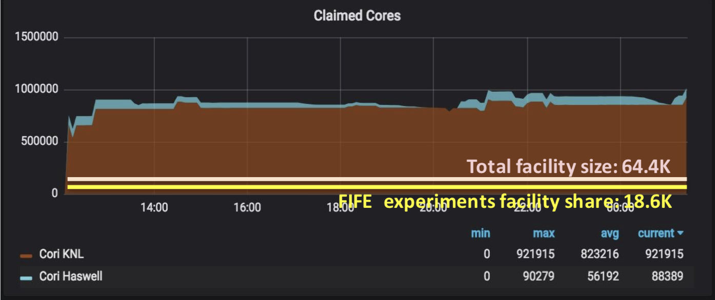
Future Fermilab Institutional Cluster Model
NOvA using HEPCloud to claim ~1M cores at NERSC to perform a large-scale analysis over a short timeframe.
LQ1
LQ2
Resource demand spikes that cannot be met by on-prem resources can be satisfied by routing jobs to commercial clouds, OSG resources or LCF’s.

Slide 20
II of VI: Storage Details
Global disk storage:
  960 TB (raw) Lustre file-system for LQ1 (not backed up)
  For existing clusters and will not be accessible from LQ1.
    776 TB Lustre file-system at /lqcdproj. (not backed up)
    14.5 TB “project” space at /project (backed up nightly)
    6 GB per user at /home on each cluster (backed up nightly)
Robotic tape storage is available via dccp commands against the dCache filesystem at /pnfs/lqcd.
  Some users will benefit from direct access to tape by using encp commands on lqcdsrm.fnal.gov or LQ1-IO.
  Please email us if you plan on transferring a large number of small (< 200MB) or big (>1TB) files. We may want to guide how these are written to avoid wasted space on tape.
Globus Online endpoint:
  lqcd#fnal - for transfers in or out of /lqcdproj Lustre file system.
  LQ1#fnal– for transfers in or out of LQ1 Lustre file-system.
Data integrity is your responsibility.

