Slide 1
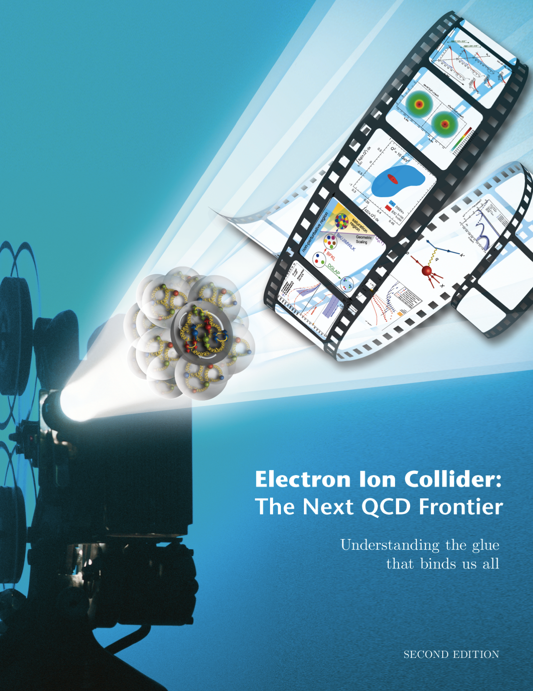

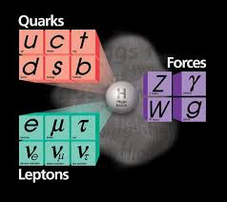



Electron Ion Collider:
The next QCD frontier
Why the EIC? ➔ “Gluon Imaging”
To understand the role of gluons in binding quarks & gluons into Nucleons and Nuclei
Nuclei
Abhay Deshpande

Slide 2

RECOMMENDATION:
We recommend a high-energy high-luminosity polarized EIC as the highest priority for new facility construction following the completion of FRIB.
Initiatives:
Theory
Detector & Accelerator R&D
Detector R&D money ~1.3M/yr since 2011
Significant increase anticipated soonr
Since FY 2017
EIC Accelerator R&D already assigned $7m/yr
http://science.energy.gov/np/reports

Slide 3
The Electron Ion Collider
For e-N collisions at the EIC:
Polarized beams: e, p, d/³He
e beam 5-10(20) GeV
Luminosity L_{ep} ~ 10³³⁻³⁴ cm⁻²sec⁻¹
  100-1000 times HERA
20-100 (140) GeV Variable CoM
2018
eRHIC Design Group
eRHIC pre-CDR
For e-A collisions at the EIC:
Wide range in nuclei
Luminosity per nucleon same as e-p
Variable center of mass energy
World’s first
Polarized electron-proton/light ion
and electron-Nucleus collider
Both designs use DOE’s significant investments in infrastructure
1212.1701.v3
Accardi et al
Eur. Phy. J. A, 52 9(2016)
JLEIC Collaboration
JLEIC Pre-CDR about to be finalized
Notes:
Contrast with HERA could be made more explicit. Table/column presentation.

Slide 4
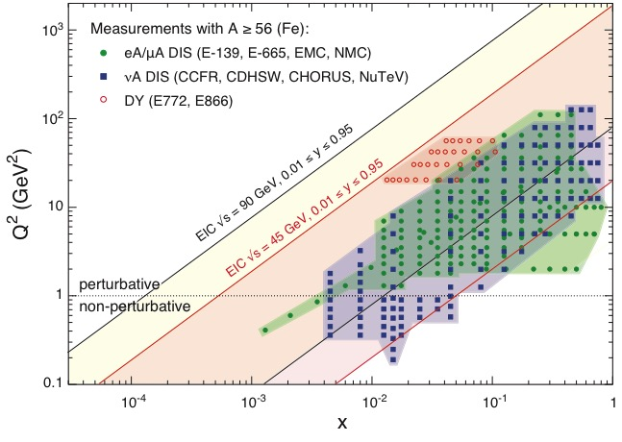
EIC: Kinematic reach & properties
For e-N collisions at the EIC:
Polarized beams: e, p, d/³He
Variable center of mass energy
Wide Q² range → evolution
Wide x range → spanning valence to low-x physics
For e-A collisions at the EIC:
Wide range in nuclei
Lum. per nucleon same as e-p
Variable center of mass energy
Wide x range (evolution)
Wide x region (reach high gluon densities)
Notes:
Minimize words, keep and enhance the figures….

Slide 5
Uniqueness of EIC among all DIS Facilities
All DIS facilities in the world.
However, if we ask for:
high luminosity & wide reach in √s
polarized lepton & hadron beams
nuclear beams
EIC stands out as
unique facility …

Slide 6
QCD at the EIC

Slide 7
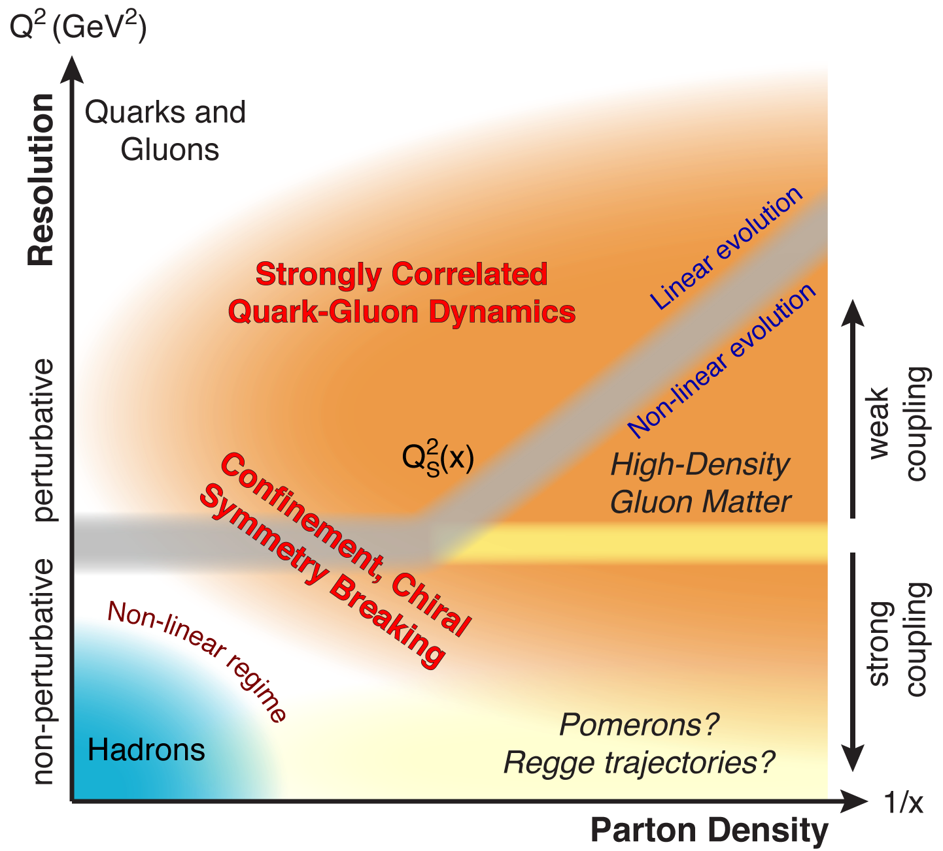
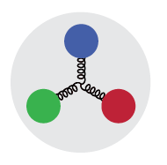
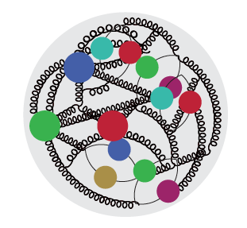

QCD Landscape to be explored by EIC
QCD at high resolution (Q²) —weakly correlated quarks and gluons are well-described
Strong QCD dynamics creates many-body correlations between quarks and gluons
→ hadron structure emerges
EIC will systematically explore correlations in this region.
arXiv: 1708.01527
An exciting opportunity: Observation by EIC of a new regime in QCD of weakly coupled high density matter

Slide 8

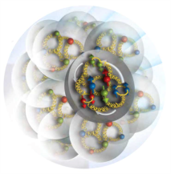
A new facility is needed to investigate, with precision, the dynamics of gluons & sea quarks and their role in the structure of visible matter
How are the sea quarks and gluons, and their spins, distributed in space and momentum inside the nucleon?
How do the nucleon properties emerge from them and their interactions?
How do color-charged quarks and gluons, and colorless jets, interact with a nuclear medium?
How do the confined hadronic states emerge from these quarks and gluons?
How do the quark-gluon interactions create nuclear binding?
How does a dense nuclear environment affect the quarks and gluons, their correlations, and their interactions?
What happens to the gluon density in nuclei? Does it saturate at high energy, giving rise to a gluonic matter with universal properties in all nuclei, even the proton?
gluon
emission
gluon recombination
?
=

Slide 9
Recent progress in Lattice QCD
Accessing Gluon Distribution in Large Momentum Effective Theory, Jian-Hui Zhang et al., PRL 122, 142001, April 2019
First Direct lattice-QCD calculation of the x-dependence of the pion PDF, J-W.Chen et al, arXiv 1804.01483
Parton Distribution functions and one loop matching, https://doi.org/10.1142/S2010194516600533 , X. Ji et al.
And many such papers …. For the first time PDFs are attempted to being calculated on the lattice! → Precision lattice calculations need precision experimental measurements!

Slide 10
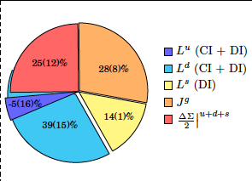
Solving the nucleon spin puzzle on the lattice
C. Alexandrou et al. PRL 119, 142002 (2017)
Spin and Lattice: Recent Activities
Gluon’s spin contribution on Lattice: S_{G} = 0.5(0.1): Yi-Bo Yang et al. PRL 118, 102001 (2017)
(Left panel) Nucleon spin decomposition. (Right panel) Nucleon momentum decomposition. All quantities are given in the MSbar scheme at 2 GeV. The striped segments show valence quark contributions (connected), and the solid segments the sea quark and gluon contributions (disconnected).
J_{q} calculated on Lattice QCD: 𝛘QCD Collaboration, PRD91, 014505, 2015

Slide 11
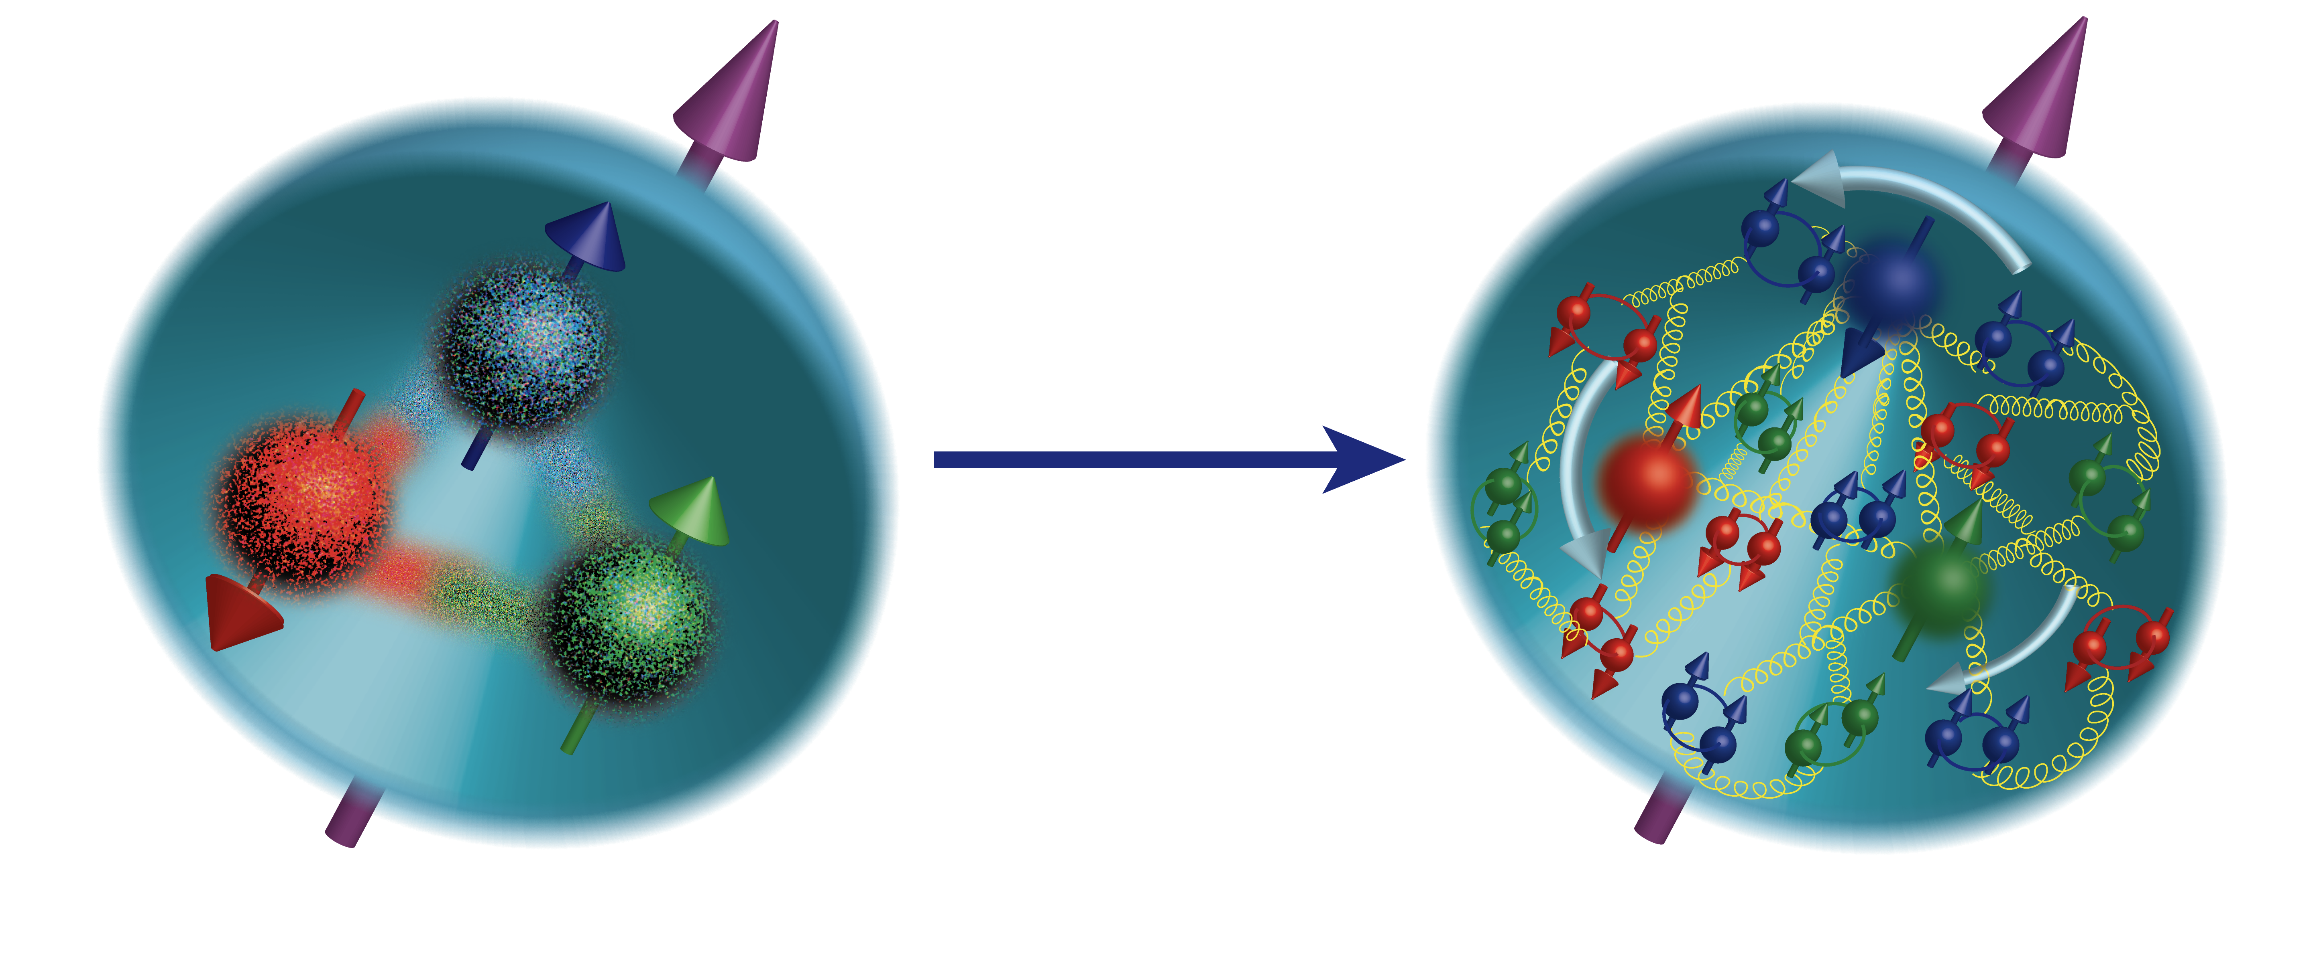

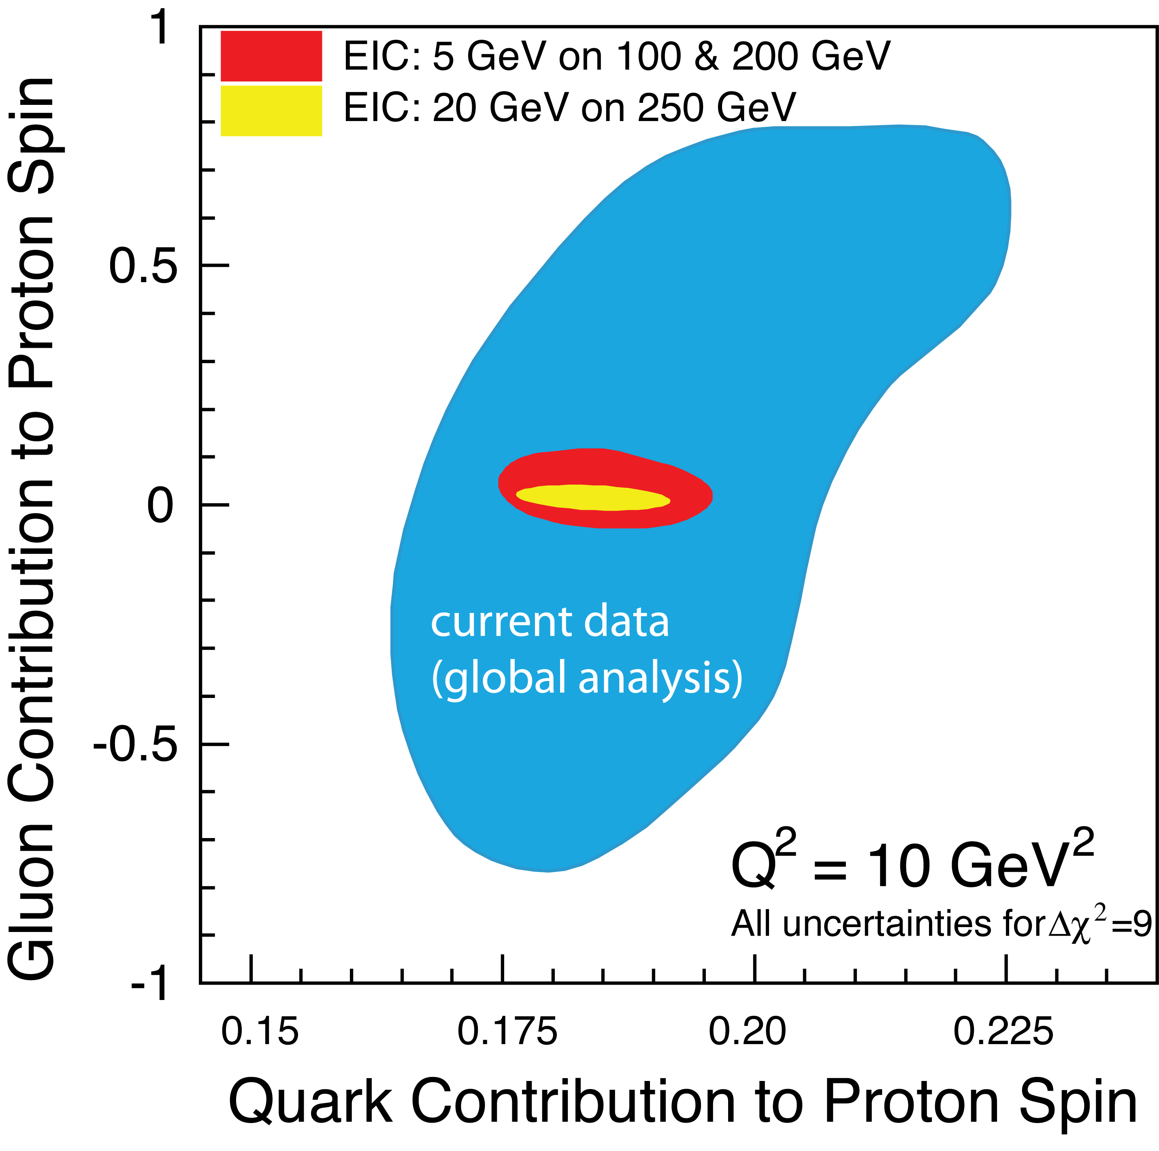

Understanding of Nucleon Spin
ΔΣ/2 = Quark contribution to Proton Spin
L_{Q} = Quark Orbital Ang. Mom
Δg = Gluon contribution to Proton Spin
L_{G} = Gluon Orbital Ang. Mom
Precision in ΔΣ and Δg ➔ A clear idea
Of the magnitude of L_{Q}+L_{G}
Notes:
Make the connection from measured x to unmeasured x very clear.
Figure on the right bottom: replace by the EIC money plot. Drop

Slide 12
3-Dimensional Imaging Quarks and Gluons
Wigner functions W(x,b_{T},k_{T})
offer unprecedented insight into confinement and chiral symmetry breaking.
W(x,b_{T},k_{T})
∫d²b_{T}
∫ d²k_{T}
Momentum
space
Coordinate
space
f(x,k_{T})
f(x,b_{T})
Spin-dependent 2D coordinate space (transverse) + 1D (longitudinal momentum)
images from exclusive scattering
→ GPDs
Spin-dependent 3D momentum space
images from semi-inclusive scattering
→ TMDs
Position and momentum → Orbital motion of quarks and gluons
Possible direct access to gluon Wigner function through diffractive di-jet measurements at an EIC: Y. Hatta et al. PRL 16, 022301 (2016
Notes:
added why wigner fcts. are important. and added reference statement that diffraction allows access to gluon wigner functions
Y. Hatta, Bo-Wen Xiao & F. Yuan, PRL 116, 022301 (2016)
10.1103/PhysRevLett.116.202301
Angular correlation between the nucleon’s recoil momentum and the di-jet transverse momentum carry non-trivial information about the phase space of the Wigner distribution.

Slide 13
2+1 D partonic image of the proton with the EIC
Spin-dependent 3D momentum space images from semi-inclusive scattering
Spin-dependent 2D coordinate space (transverse) + 1D (longitudinal momentum) images from exclusive scattering
Transverse Momentum Distributions
Transverse Position Distributions
u-Quark
Gluons

Slide 14
Emergence of Hadrons from Partons
Nucleus as a Femtometer sized filter
Unprecedented ν, the virtual photon energy range @ EIC : precision & control
Energy loss by light vs. heavy quarks:
Control of ν by selecting kinematics;
Also under control the nuclear size.
(colored) Quark passing through cold QCD matter emerges as color-neutral hadron ➔ Clues to color-confinement?
Identify π vs. D^{0 (charm)} mesons in e-A collisions: Understand energy loss of light vs. heavy quarks traversing the cold nuclear matter:
Connect to energy loss in Hot QCD
Need the collider energy of EIC and its control on parton kinematics
Notes:
Large nu measurements, Q2 large, so Shadowing effects are absent

Slide 15
Advantage of the nucleus over proton
300 GeV
Accessible range of saturation scale Q_{s} ² at the EIC with e+A collisions.
arXiv:1708.01527

Slide 16


Detector integration with the Interaction Region
Lessons learned from HERA
Possible to get ~100% acceptance for the whole event
Ion beamline
Electron beamline
Total acceptance detector (and IR)
Crossing angles:
eRHIC: 25 mrad
JLEIC : 50 mrad
Figure Courtesey: Rik Yoshida

Slide 17
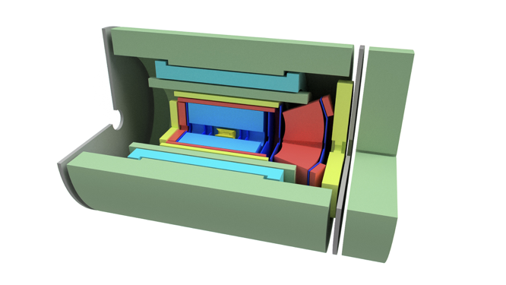
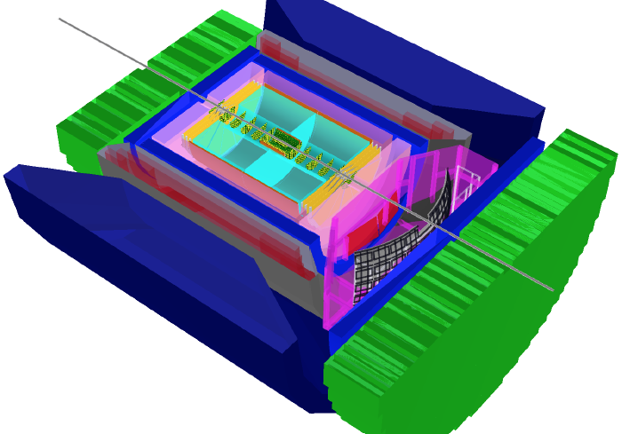
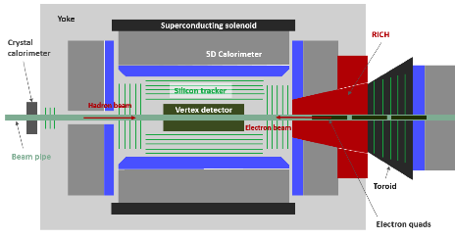
EIC Detector Concepts, others expected to emerge
EIC Day 1 detector, with BaBar Solenoid
BeAST at BNL
Ample opportunity and need for additional contributors and collaborators
TOPSiDE: Time Optimized PID Silicon Detector for EIC
JLEIC Detector Concept, with CLEO Solenoid
Notes:
Argonne National Lab: recently joined the effort and have proposed a new detector concept based on the particle flow in detectors: high precision Si tracker, coupled with high resolution calorimetry.

Slide 18

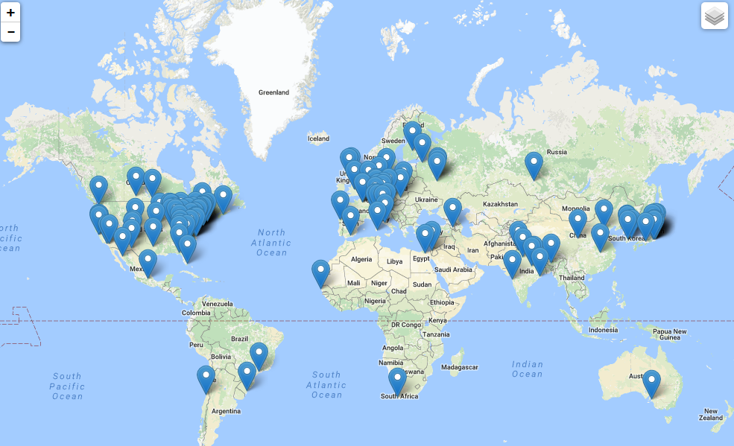
The EIC Users Group: EICUG.ORG
Formally established in 2016
864 Ph.D. Members from 30 countries, 184 institutions
Map of institution’s locations
EICUG Structures in place and active.
EIC UG Steering Committee (w/ European Representative)
EIC UG Institutional Board
EIC UG Speaker’s Committee (w/European Rep.)
Task forces on:
-- Beam polarimetry
-- Luminosity measurement
-- Background studies
-- IR Design
Annual meetings: Stony Brook (2014), Berkeley (2015), ANL (2016), Trieste (2017), CAU (2018), Paris (2019)
New:
Center for Frontiers in Nuclear Science (at Stony Brook/BNL)
EIC² at Jefferson Laboratory

Slide 19
The National Academy Review of the EIC
2017-2018

Slide 20
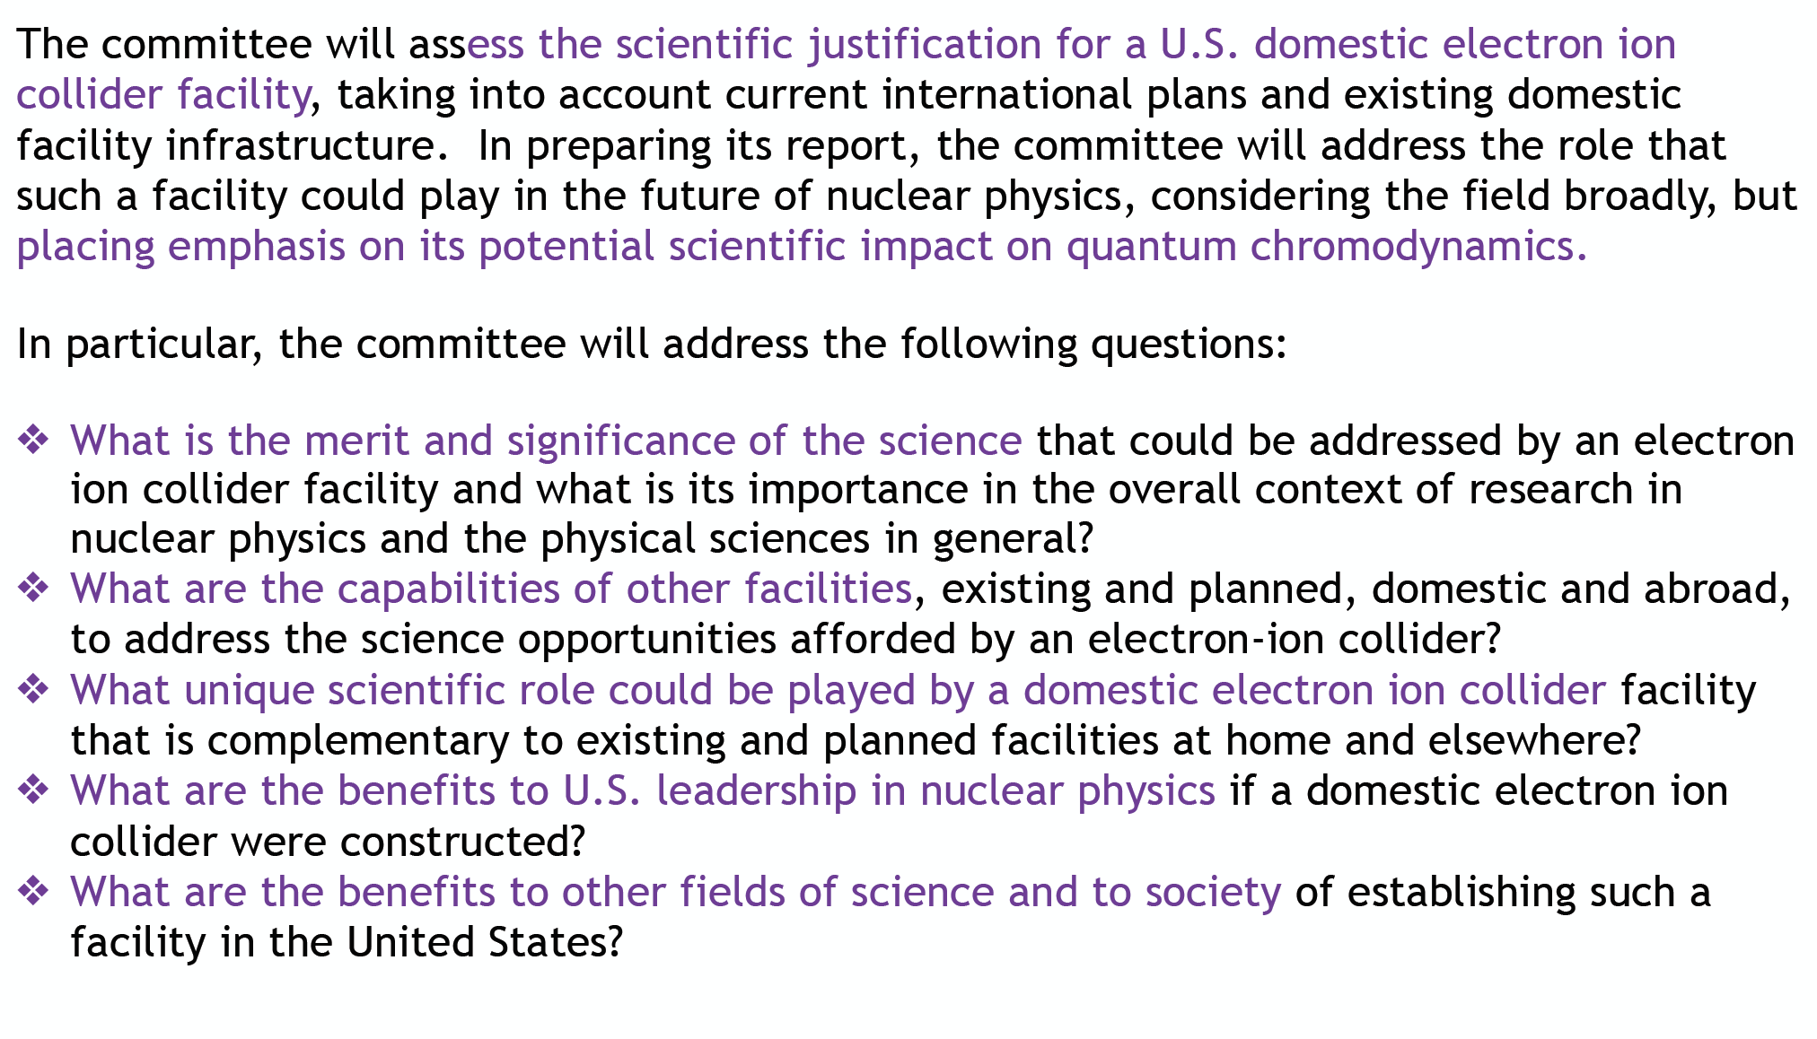
Statement of Task from the Office of Science (DOE/NSF) to the
National Academy of Science, Engineering & Medicine (NAS)

Slide 21

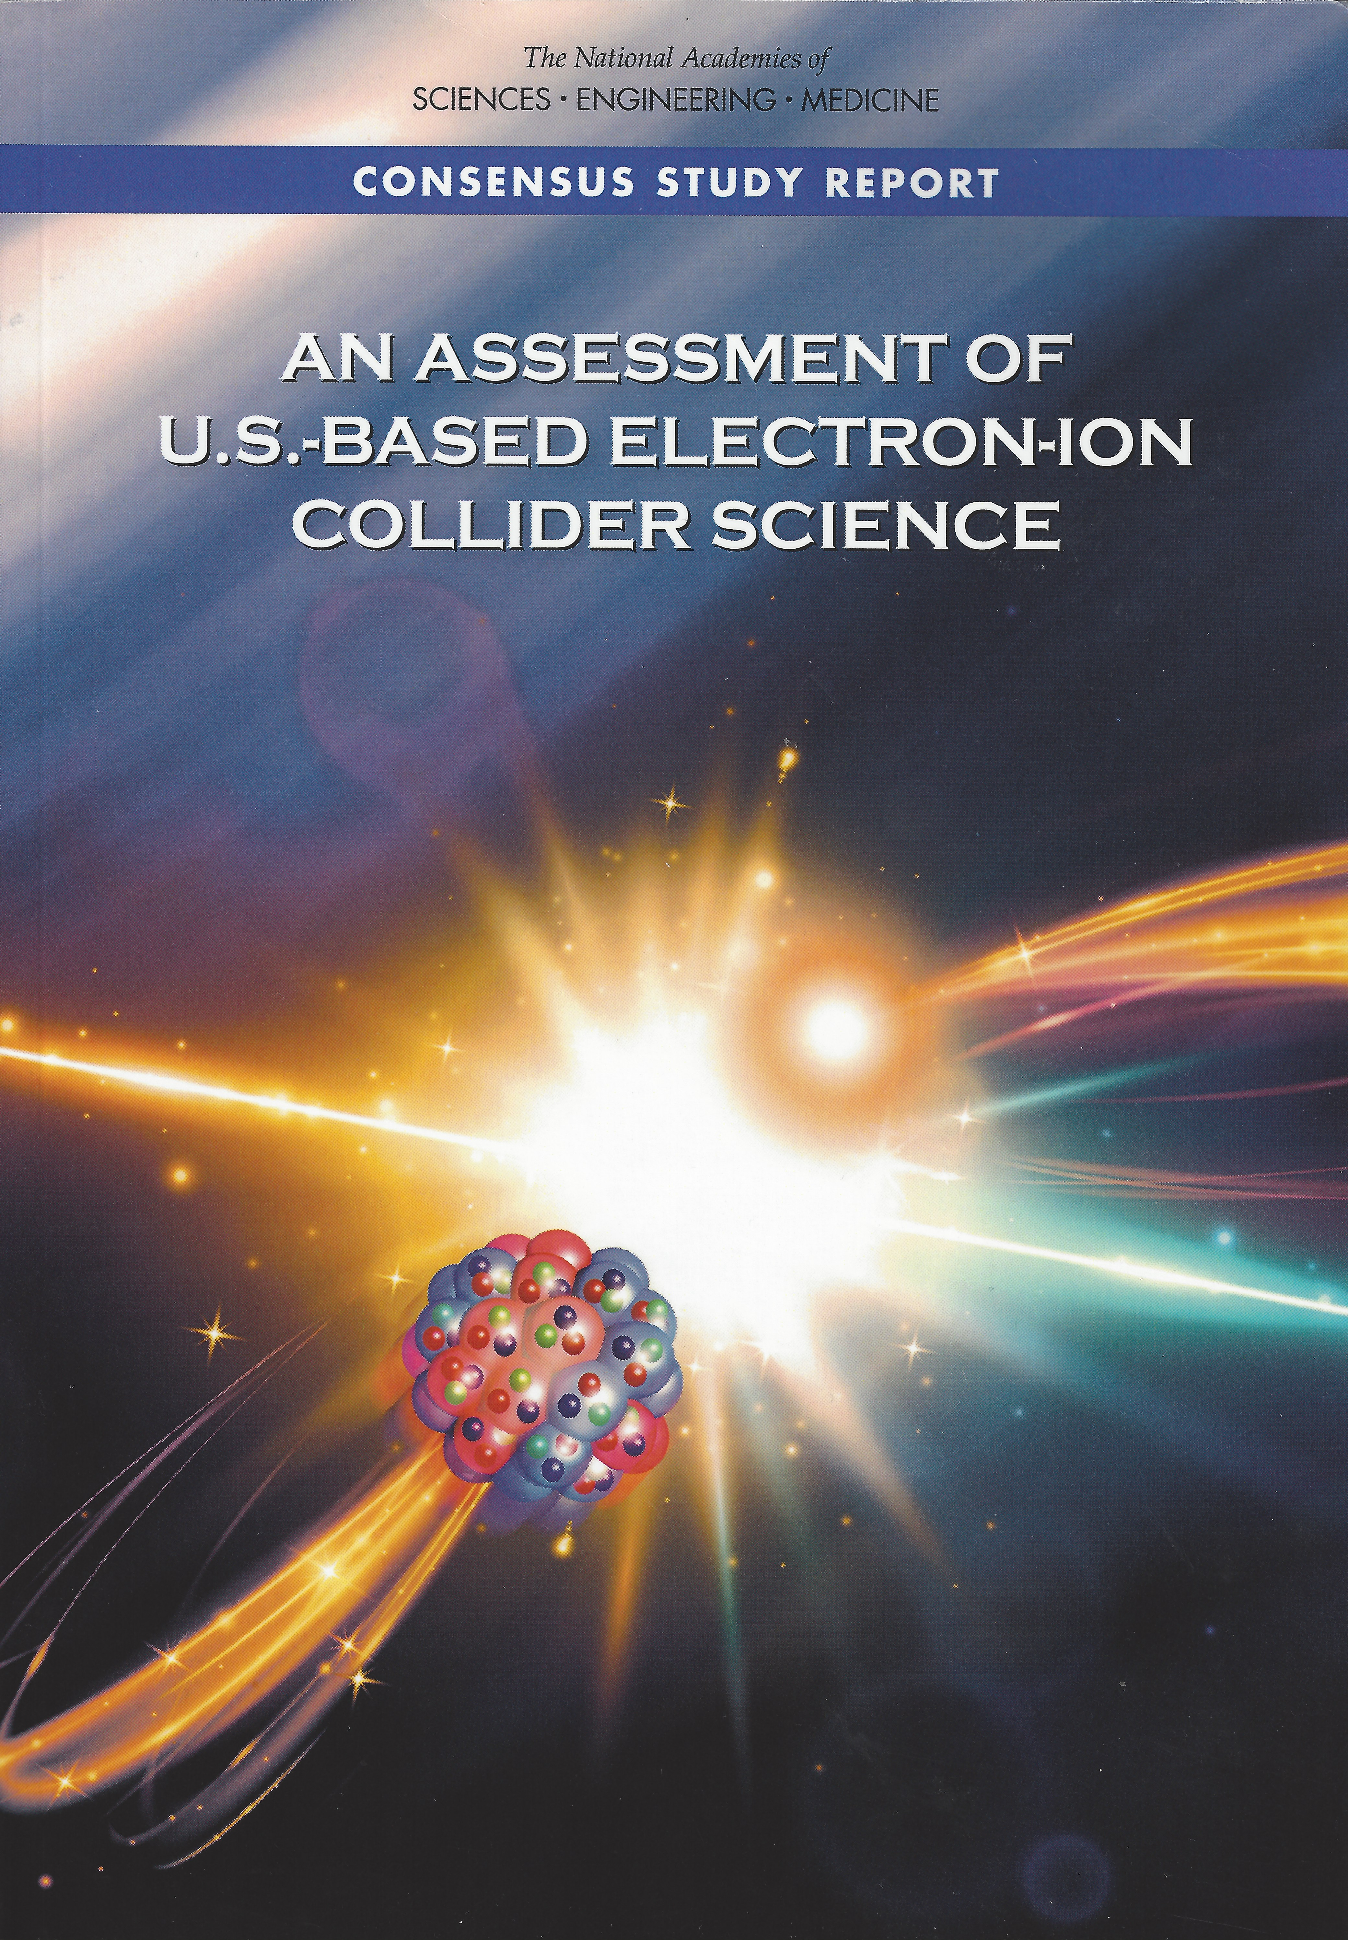
EIC Science Endorsed Unanimously by the NAS
A consensus report
July 26, 2018
EIC science:
compelling, fundamental
and timely
Developed by US QCD community
over two decades
Developed by NAS with
broad science perspective

Slide 22
National Academy’s Findings
Finding 1: An EIC can uniquely address three profound questions about nucleons—neutrons and protons—and how they are assembled to form the nuclei of atoms:
  How does the mass of the nucleon arise?
  How does the spin of the nucleon arise?
  What are the emergent properties of dense systems of gluons?
Finding 2: These three high-priority science questions can be answered by an EIC with highly polarized beams of electrons and ions, with sufficiently high luminosity and sufficient, and variable, center-of-mass energy.
Finding 3: An EIC would be a unique facility in the world and would maintain U.S. leadership in nuclear physics.
Finding 4: An EIC would maintain U.S. leadership in the accelerator science and technology of colliders and help to maintain scientific leadership more broadly.
Finding 5: Taking advantage of existing accelerator infrastructure and accelerator expertise would make development of an EIC cost effective and would potentially reduce risk.

Slide 23
National Academy’s Findings
Finding 6: The current accelerator R&D program supported by DOE is crucial to addressing outstanding design challenges.
Finding 7: To realize fully the scientific opportunities an EIC would enable, a theory program will be required to predict and interpret the experimental results within the context of QCD, and furthermore, to glean the fundamental insights into QCD that an EIC can reveal.
Finding 8: The U.S. nuclear science community has been thorough and thoughtful in its planning for the future, taking into account both science priorities and budgetary realities. Its 2015 Long Range Plan identifies the construction of a high-luminosity polarized EIC as the highest priority for new facility construction following the completion of the Facility for Rare Isotope Beams (FRIB) at Michigan State University.
Finding 9: The broader impacts of building an EIC in the United States are significant in related fields of science, including in particular the accelerator science and technology of colliders and workforce development.

Slide 24



NAS Study endorses machine parameters suggested by the 2012 White Paper and 2015 NSAC Long Range Plan

Slide 25

EIC science and required luminosity
2+1D imaging of quarks and gluons, dynamics, and emergence of spin & mass
Gluon imaging in nucleons
Gluons at high energy in nuclei:
(Gluon imaging in nuclei)
Color propagation, neutralization in nuclei & hadronization

Slide 26
Consensus Study Report on the US based Electron Ion Collider
Summary:
The science questions that an EIC will answer are central to completing an understanding of atoms as well as being integral to the agenda of nuclear physics today. In addition, the development of an EIC would advance accelerator science and technology in nuclear science; it would as well benefit other fields of accelerator based science and society, from medicine through materials science to elementary particle physics

Slide 27
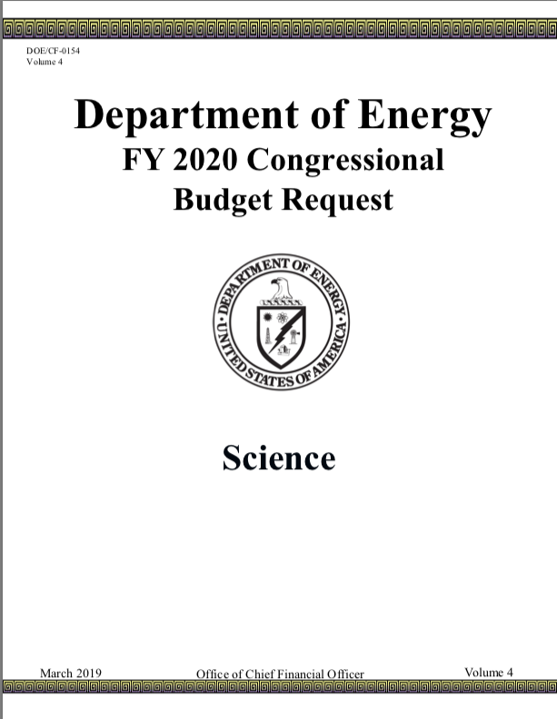
Critical Decision Process DOE
Expected
Soon (2019)
Technical feasibility
(~2030)
Volume 4, Page 272:
“..(EIC)..Critical Decision-0, Approve Mission Need, is planned for FY 2019.”
PED: Project Engineering & Design

Slide 28
EIC support, outreach and other news
European High Energy Physics Strategic Planning:
CERN management very well informed about the US EIC status, very supportive, suggested strong involvement and input on EIC in the European High Energy Strategy Planning activity (ongoing now)
EICUG presenting a science paper (led by its European contingent), and an accelerator design paper led by BNL and Jlab together
EIC at the Plenary session of ECFA meeting November 2018
Recent success in funding of EIC as part of the Hadron studies (Strong2020) in European Nuclear Physics $Eu 12M (Saclay, INFN and others) over 3 years
A Consortium of 5 California Universities and 3 national labs supported by UC Chancellor’s office for EIC in addition to contributions from the States of New York and Virginia.

Slide 29
Summary:
Science of EIC: Gluons that bind us all… understanding their role in QCD
EIC precision measurements ←→ Lattice QCD : essential interplay ➔ deeper understanding of QCD
The US EIC project has significant momentum on all fronts right now:
  National Academy’s positive evaluation → Science compelling, fundamental and timely
  EIC Users Group is energized, active and enthusiast: organized
    EICUG led working groups on polarimetry, luminosity measurement, IR design evolving
  Funding agencies taking note of the momentum: not just in the US but also internationally
The science of EIC, technical designs (eRHIC and JLEIC) moving forward
  Pre-CDRs prepared by BNL (eRHIC) and Jlab (under preparation) : machine & IR designs
  CFNS, EIC² Centers established in the US to help EIC Users
CD0 for the EIC project very near…. Exciting times ahead….

Slide 30
Thank you.

