Slide 1
IF & the lattice Amarjit Soni, BNL-HET 03/25/19 US-Japan IF meeting@BNL

Slide 2
outline
Desperately seeking lucy
CPV in heavy quark systems
CPV in charm
Strong phases
UT
B=> l nu gamma
tau on the lattice
Summary

Slide 3
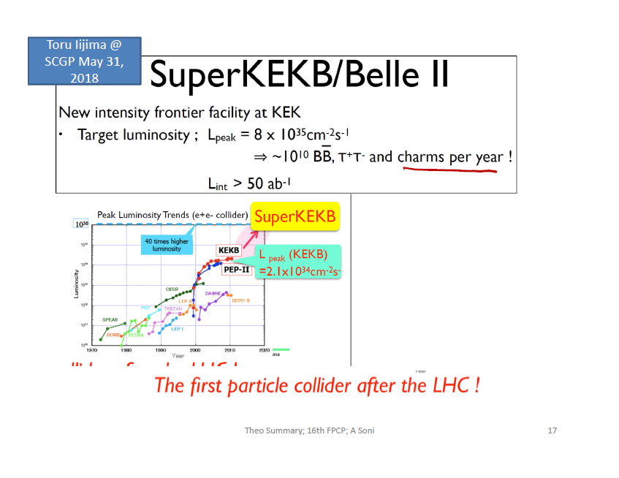
Physics is an experimental science
I. A new thousand pound gorilla is in our midst:
New physics discovery potential is no less than when we moved
From Tevatron to LHC!!!

Slide 4
Importance of the “IF”: score card
Beta decay => Gf => W….
Huge suppression of KL => mu mu; miniscule ΔmK=> charm
KL =>2 pi but very rarely; mostly to 3pi =>CP violation => 3 families
Largish Bd –mixing => large top mass
etc…….
=> extremely unwise to put all eggs in HEF
info from IF complementary to HEF can be a crucial guide
for pointing to new thresholds as well as to provide important clues
to the nature of the signals there from

Slide 5
An important message from the tree-level CC anomaly [RD(*)]
Likely scale is relatively low
Yet clean signal from a LQ of mass ~ TeV
may or may not be readily seen @ LHC13
See Bar-Shalom, Cohen, AS + Wudka; 1812.01378
=> Confirmation at the IF may well be essential!

Slide 6
Focus just on 1 outstanding question of our times
CP Violation i. p. BSM-CP-odd phase(s)
Lattice + IF have a very imp role in addressing this fundamental issue of our times

Slide 7
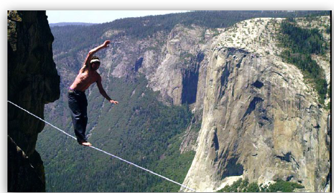
CP violation
BSM-CP phase(s) expected on naturalness grounds ……(remember the ν & even more so for BSM-CP phase);popular models of flavor, e.g. warpedXDim[see Agashe, Perez, AS’04] explicitly show
My license plate, used to be OSCILL8 (before ‘89 in CA, UCLA)
A firm believer in neutrino mass, a decade or more before oscillations were discovered.
So, we should hunt this BSM phase wherever we can and as vigorously as we can

Slide 8
Search for BSM-phase: Multi-prong
Any room via redundant, precise measurements & precise (lattice) computations for UT & more
Charm decays
b => d (s)
B => D(*) tau nu ; tau pol
B => gamma l/tau nu; tau pol
Mixing induced CP via radiative B decays to excl FS
eps’ since ~ ‘83 (originally with C Bernard) again over-riding motivation was/is naturalness

Slide 9
Best chance in a very long time of possible sightings of NP

Slide 10
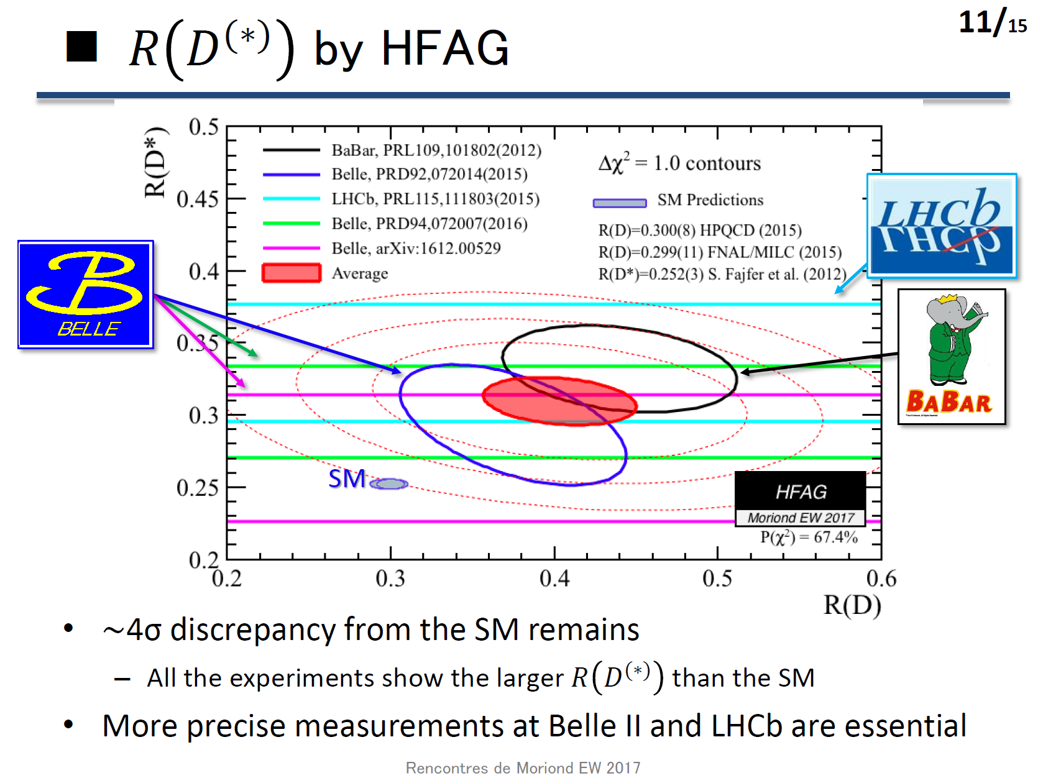
Hirose [BELLE]@EW MORIOND Mar. 2017
Belle deviations quite mild

Slide 11
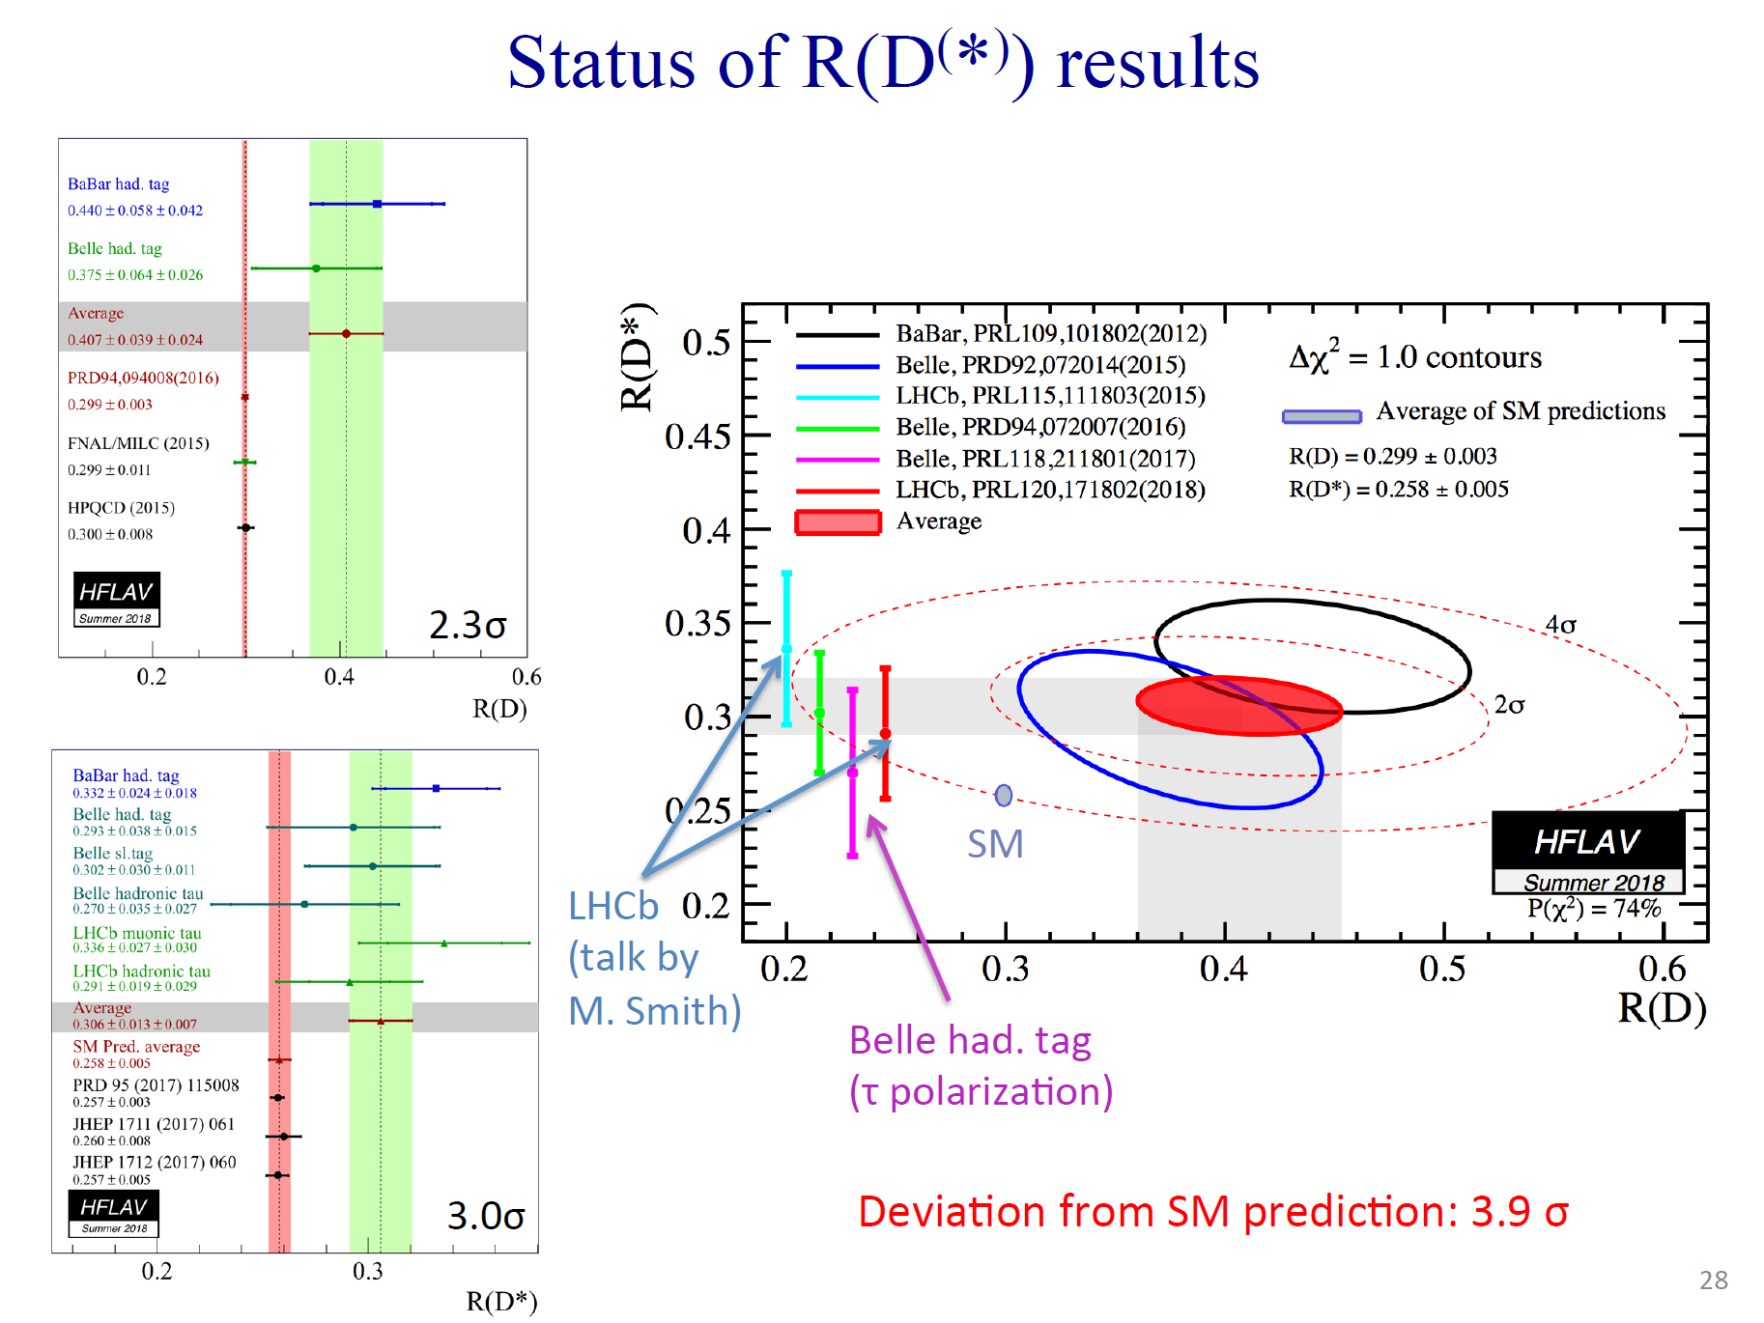

Slide 12
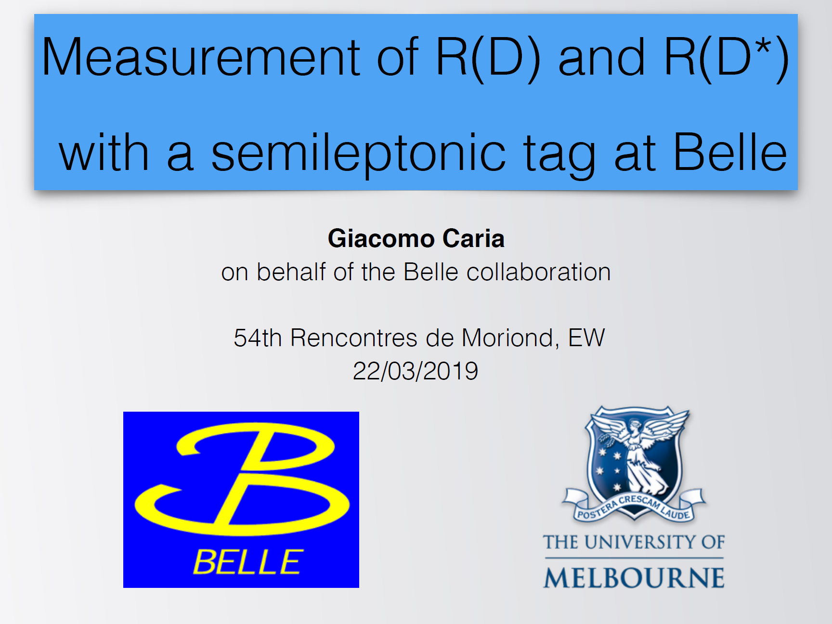

Slide 13
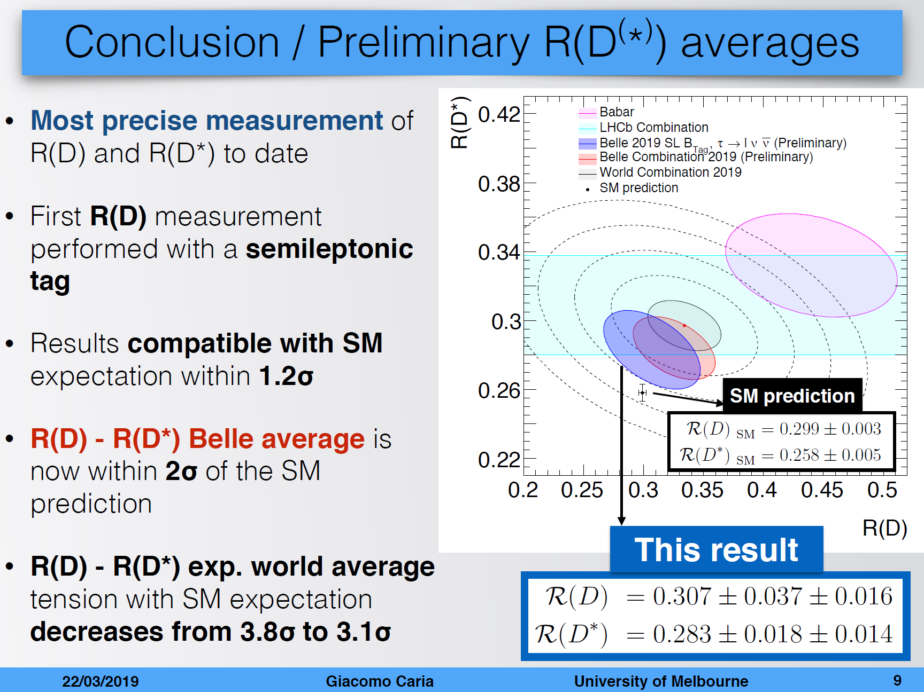

Slide 14
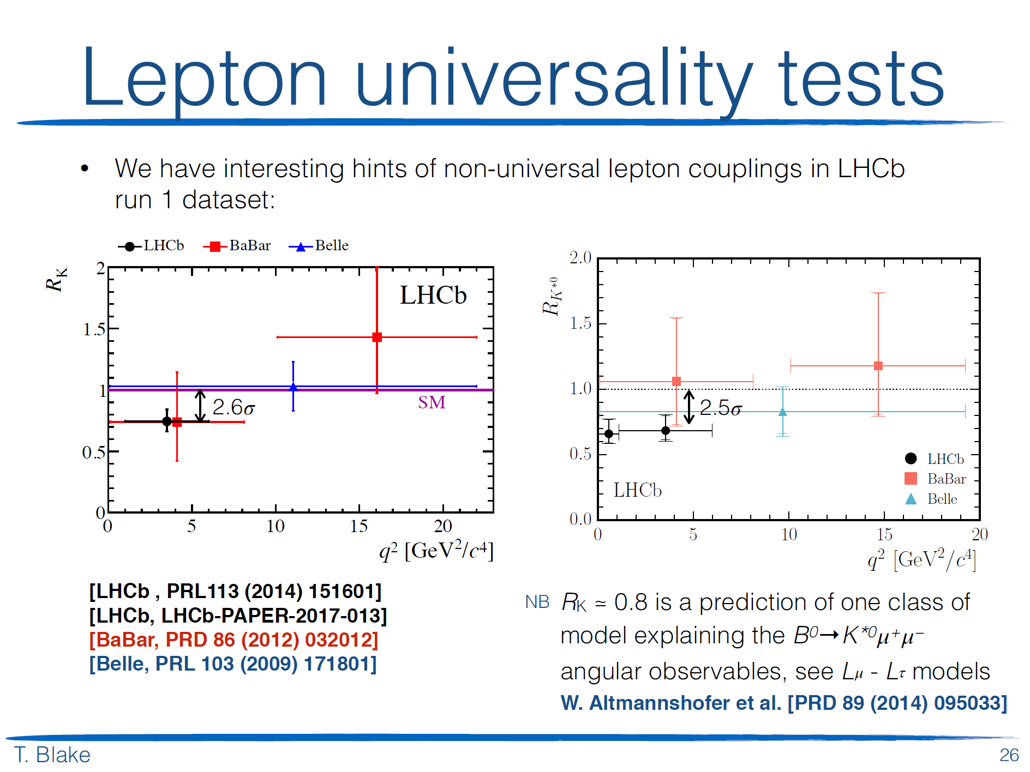

Slide 15
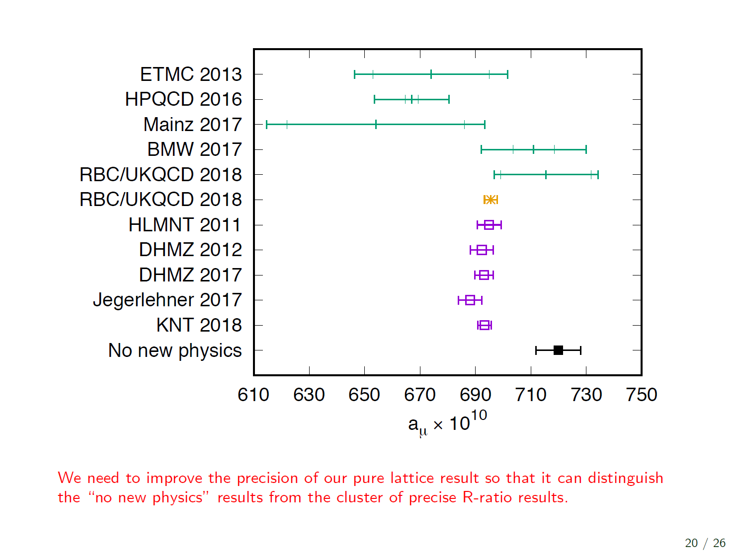

Slide 16
Possible sightings of new physics
An extremely important consequence of NP is that it is highly unlikely (i.e. unnatural) that it will not be accompanied by new CP-odd phase[s]….

Slide 17

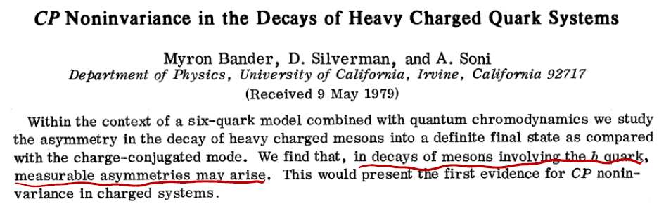
For many decades now, my professional
life has centered around B-physics!

Slide 18
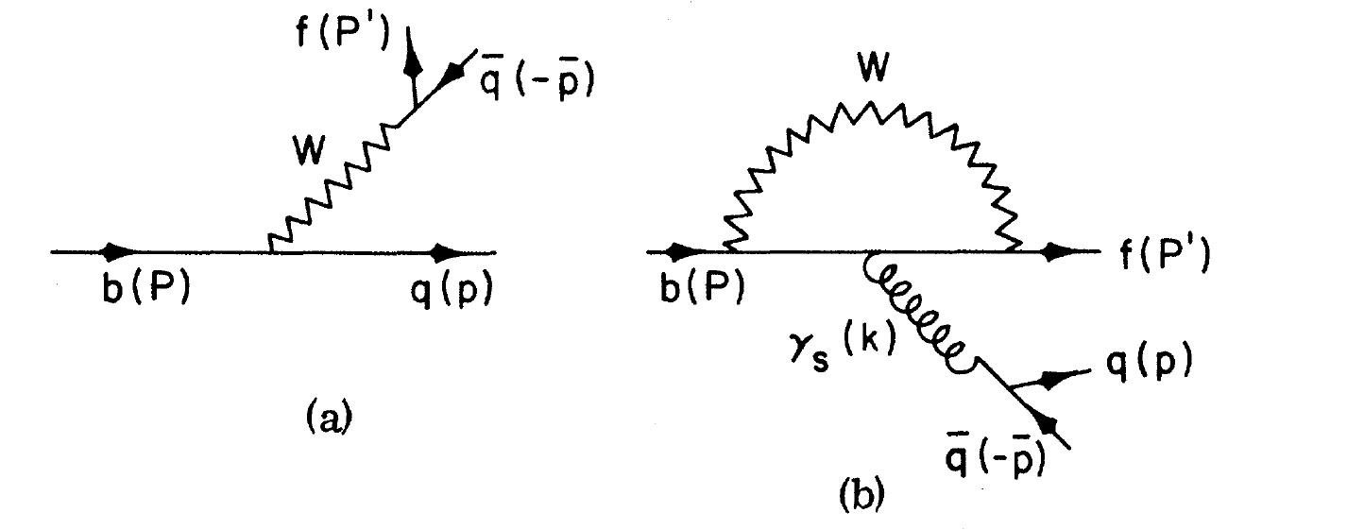
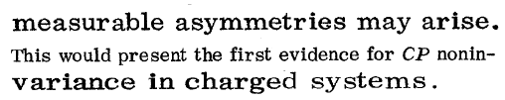

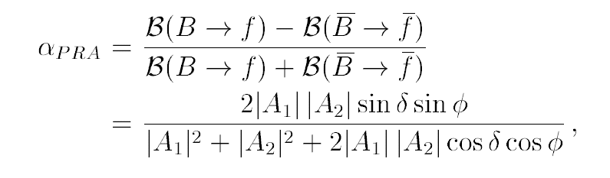
Simple ex. Of DCP in B-Physics: Tree-Penguin Interference
Bander, Silverman and A. S. PRL ’79
REGRETTABLY still CANNOT BE USED TO
RELIABLY TEST THE SM-CKM

Slide 19
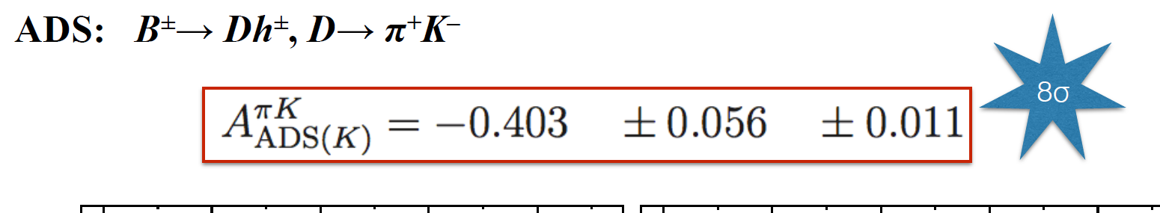
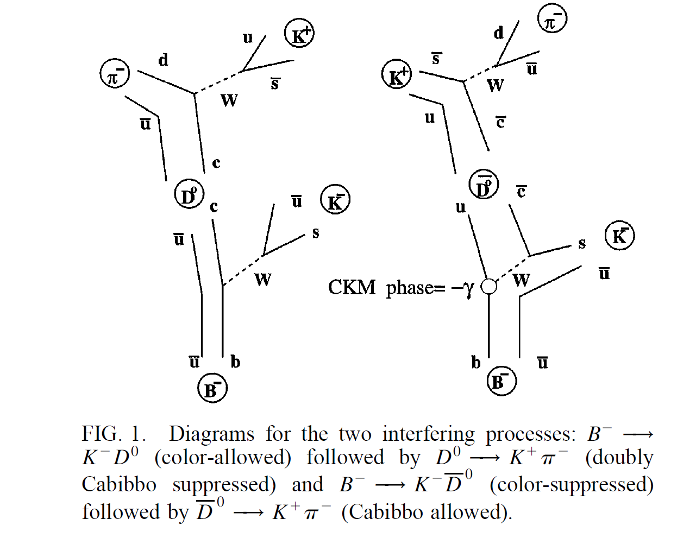
A great personal treat; thanks to LHCb
Malcolm John@EW MORIOND ‘16
Huge direct CP [tailor made] ~20 years
ago!
ADS PRL’97

Slide 20
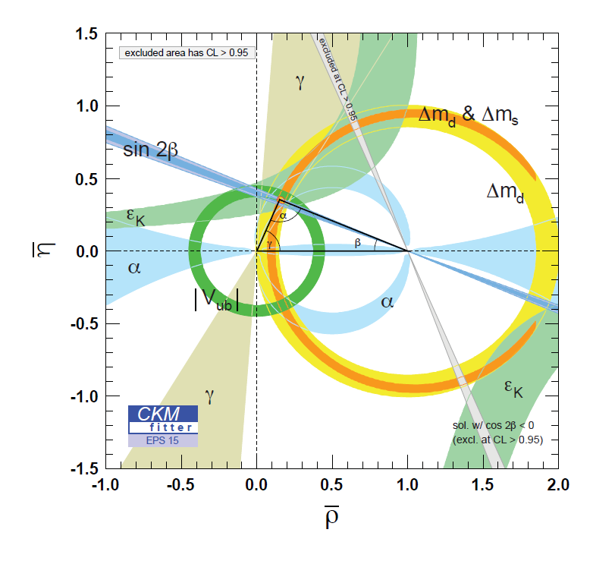

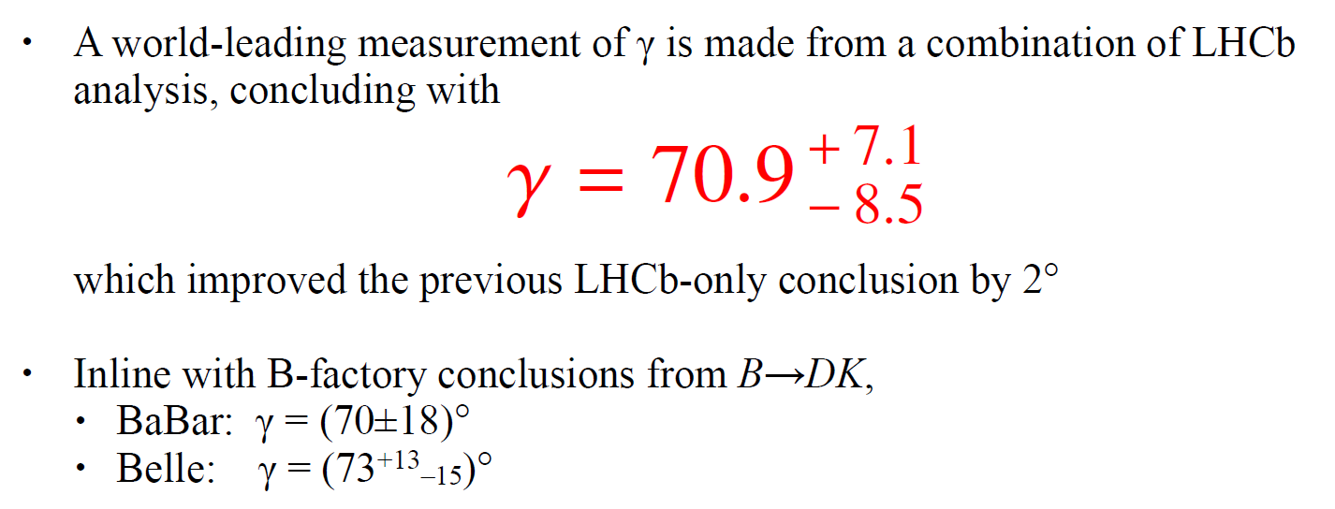
Efforts to overconstrain the CKM
Matrix & UT continue
Key new results from LHCb
Andreas Hoecker &
Malcolm John
EW Moriond ‘16
ITE ~ 1%
Mannel et al
ITE ~10⁻⁷ !!
Brod Zupan’14
STD. CANDLE
Compatible with SM-CKM to
~15% accuracy
O(5-10%) new physics is possible
and is HUGE

Slide 21
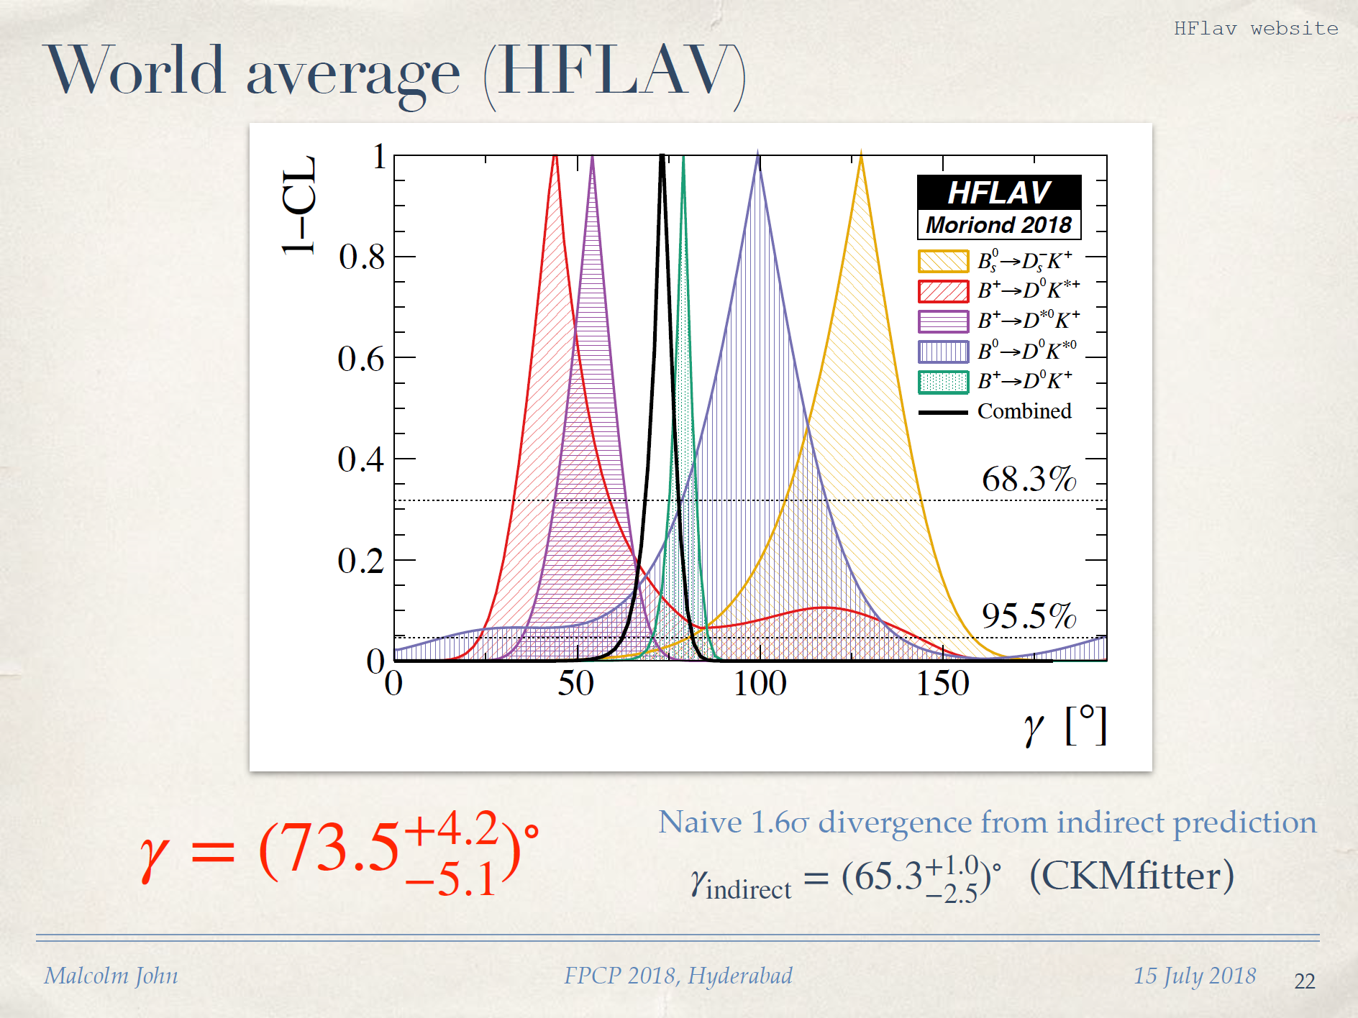
UTFIT: 65.8+-2.2; M. Bona fpcp2018

Slide 22
Charm system is unique
Distinct from K and B-mixings
Delta F=2 mixings are an extremely valuable treasure in providing stringent constraints on NP scenarios………..

Slide 23
Tree vs penguin
CBA tree
Penguin..partial cancellation between d,s
Also (mb/mW)² << (mt/mW)²
So corrections due to c-penguin are much muted compared K and B decays
Charm penguin is universal (~20%) due SU(3) flavor symmetry [not so b-penguin]

Slide 24
In charm decays the tree rules!
Tree goes as lambda ~0.22
Penguin as lamda^5 so is exceedingly small
Moreover lattice studies have demonstrated over and over again even for K =>pi pi decays,
And Delta I=1/2 enhancement,
Penguin contribution is <O(%) of tree at scales >~1.5 GeV
Thus for charm T >> P

Slide 25
I. Optimizing search strategies for DIR-CP in charm decays

Slide 26
Bearing all that in mind, Let’s stare some more at c-penguin
cb has no SM-CP …whereas likely it has BSM-CP
ub does have SM-CP …whereas likely it has no BSM-CP
MORAL…no matter what charm –penguin is; it is essential for DCP observation

Slide 27
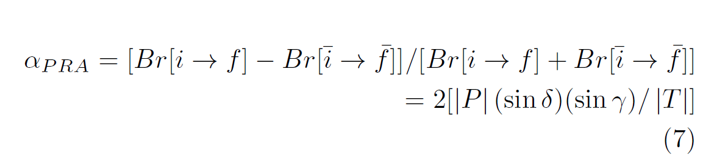
Partial rate asymmetry

Slide 28
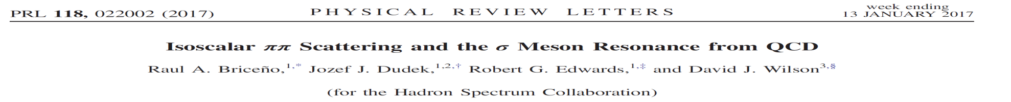
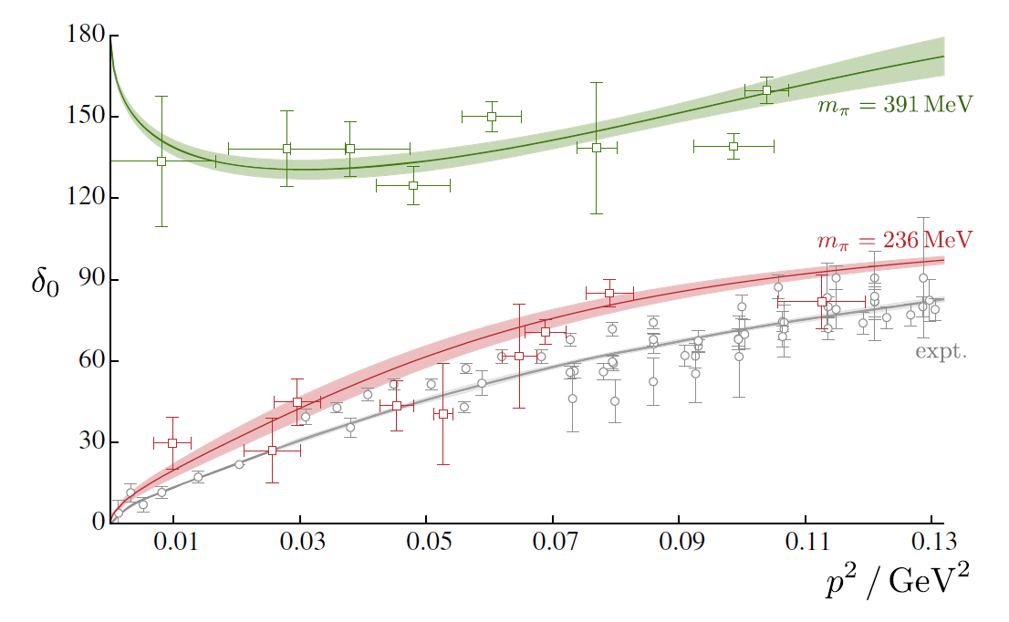

Slide 29
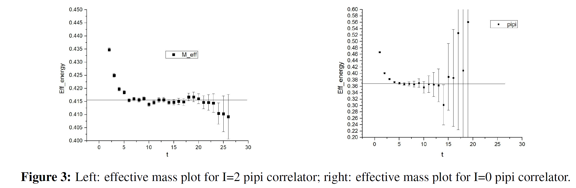

Slide 30
RBC-UKQCD phases WIP
From diff points of view:
Mattia Bruno
Dan Hoying
Chris Kelly
Aaron Meyer
Tianle Wang
Applications for K=> pi pi & Beyond

Slide 31
Understanding ΔA_{CP} ^{dir}

Slide 32
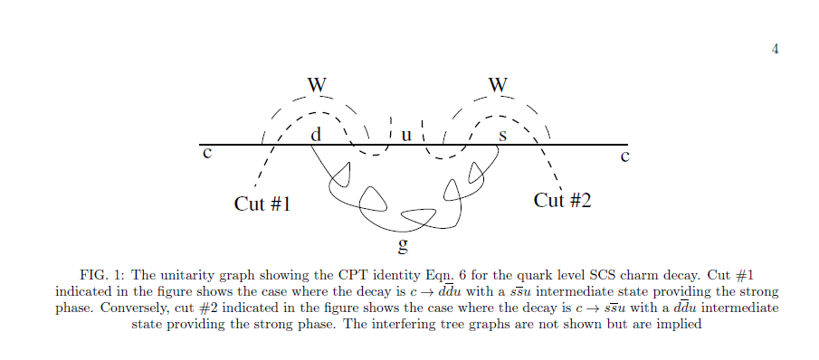


Slide 33
Due to CPT restrictions

Slide 34
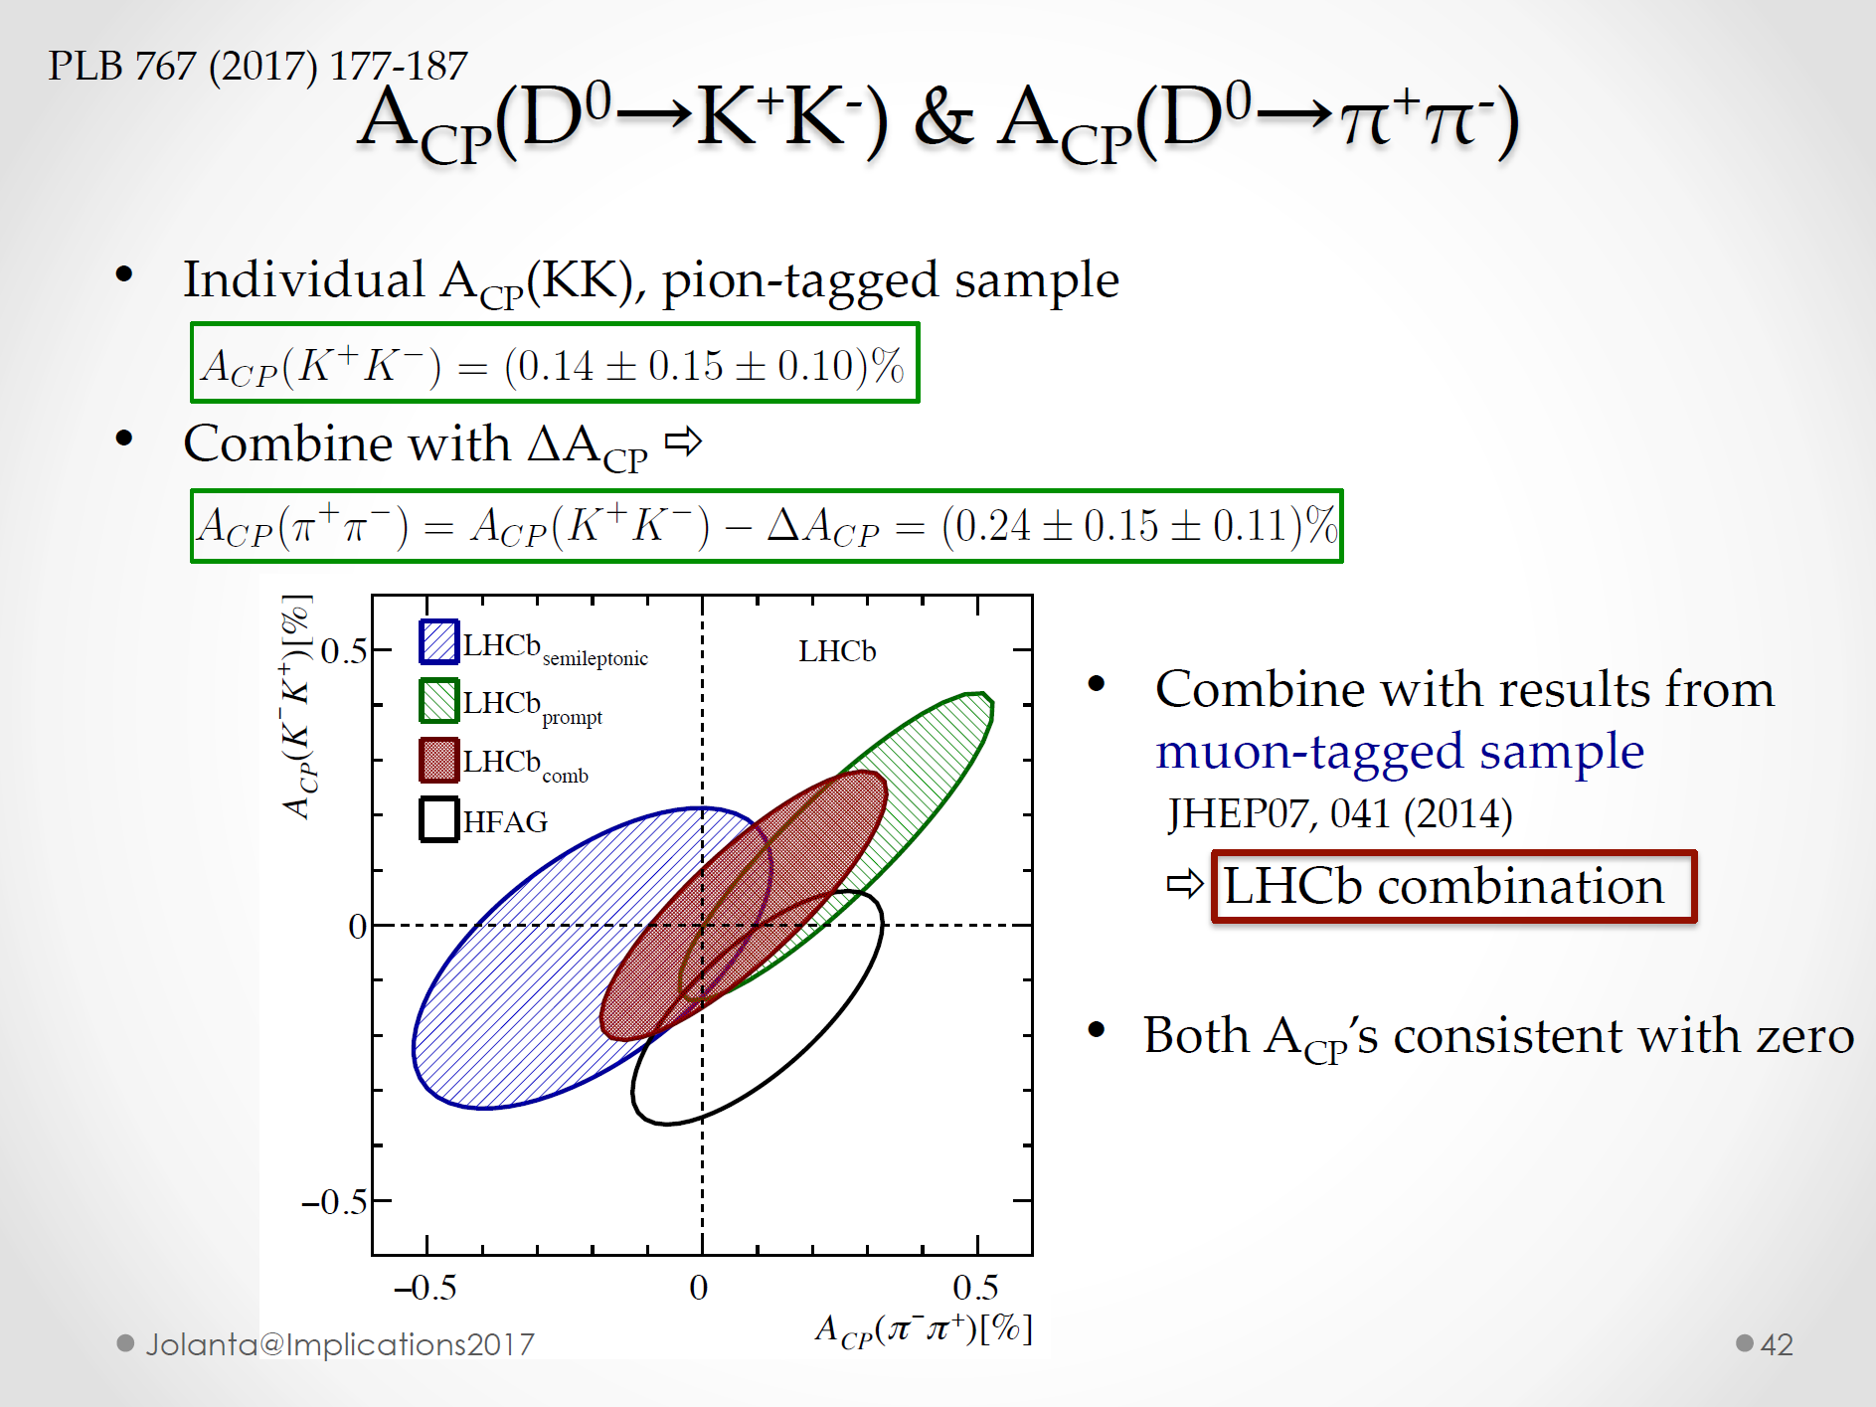
DeltaA_CP likely close to current value i.e. ~ fewX10⁻³

Slide 35
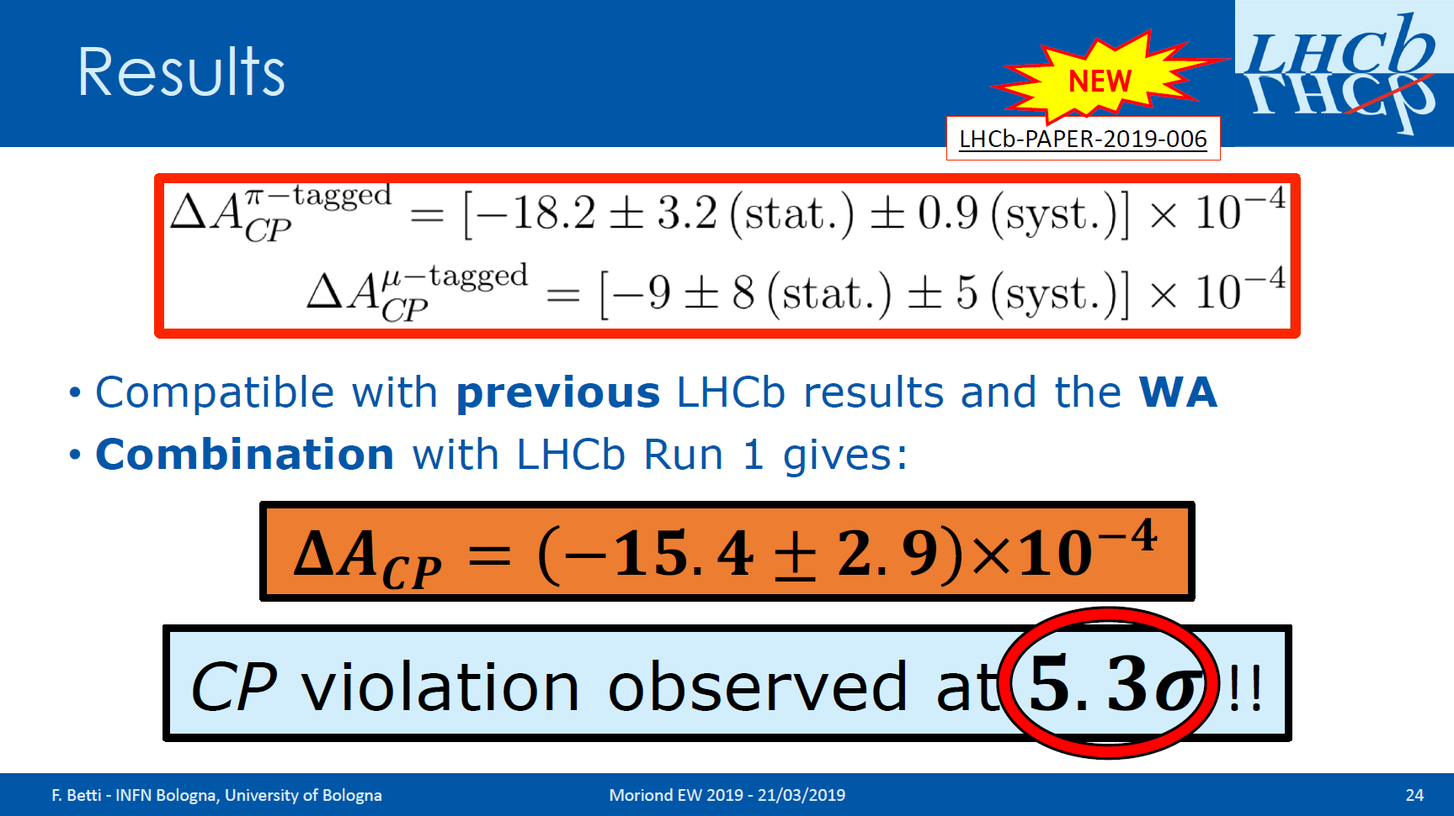

Slide 36
SM expectation…DCP
Dir CP….. See Bander, Silverman + AS, PRL 1979 for DCP when
mq >> lamda_QCD…anticipate large corrections for charm from s-quark[K-decays]
Key points: Penguin-Tree interference; SCS modes……Hall mark of BSS’79
Need suitable simple changes
SM CKM phase either in Vub or in Vtd
For charm decays relevant is Vub

Slide 37
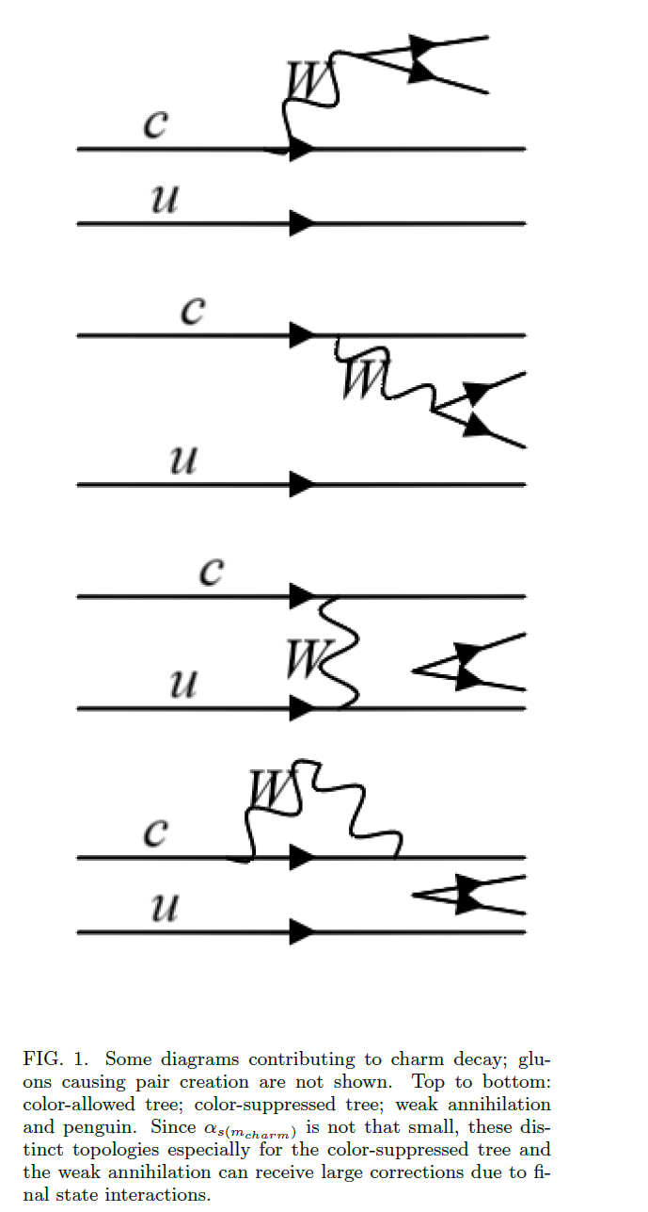

Slide 38
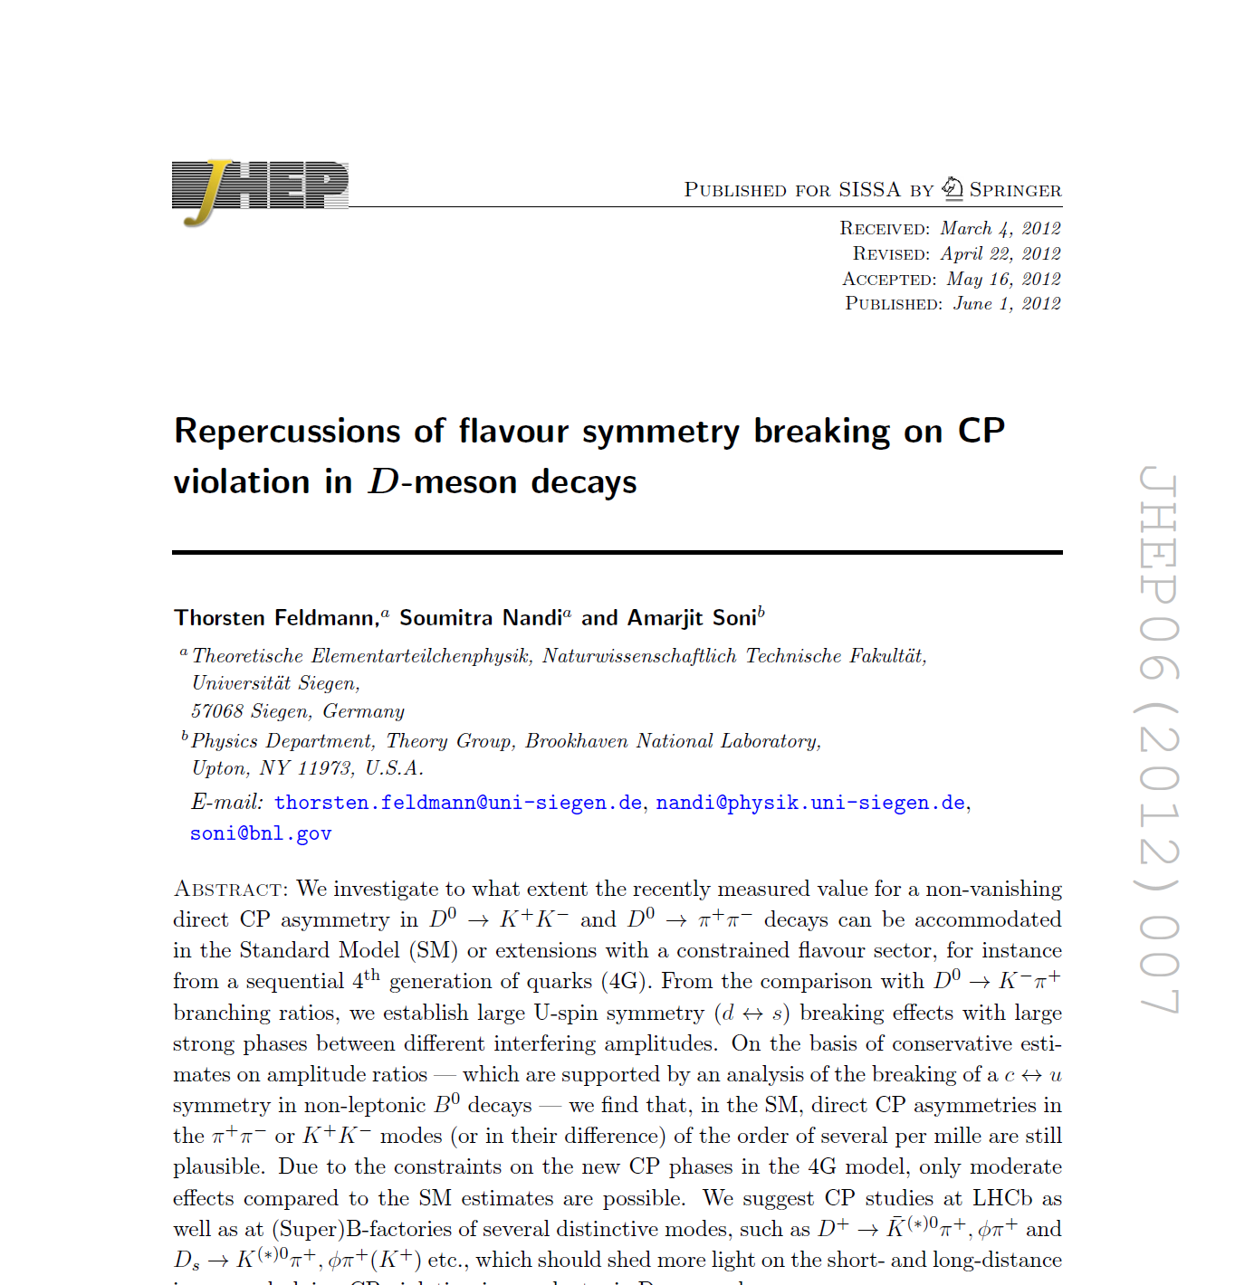

Slide 39
Summary on charm CP
Useful Inequality
ACP(K⁺K⁻) < ACP(π⁺ π⁻) < ACP(π⁰ π⁰)< ACP(K_{s}⁰K_{s}⁰)
ΔACP is expected to be close to its current limit around few x 10⁻³ and in SM its extremely difficult for it to get to 1%.
ACP(2 pi0), ACP(2Ks) may well be around ½ to 1%
LHCb, Belle-II in a few years should be able to reduce the current error (~0.15% ) by a factor of few and thus see non-vanishing asymmetries in several channels
Multibody modes are very powerful for exploiting the full power of CPV phenomena

Slide 40
Lattice & the IF
Search for NP via redundant precise measurements & precise lattice studies via the UT
lattice on-going [for a long, long, long time] eps’ effort
progress in non-local, LD, Matrix elements
some new applications of LQCD to pheno

Slide 41
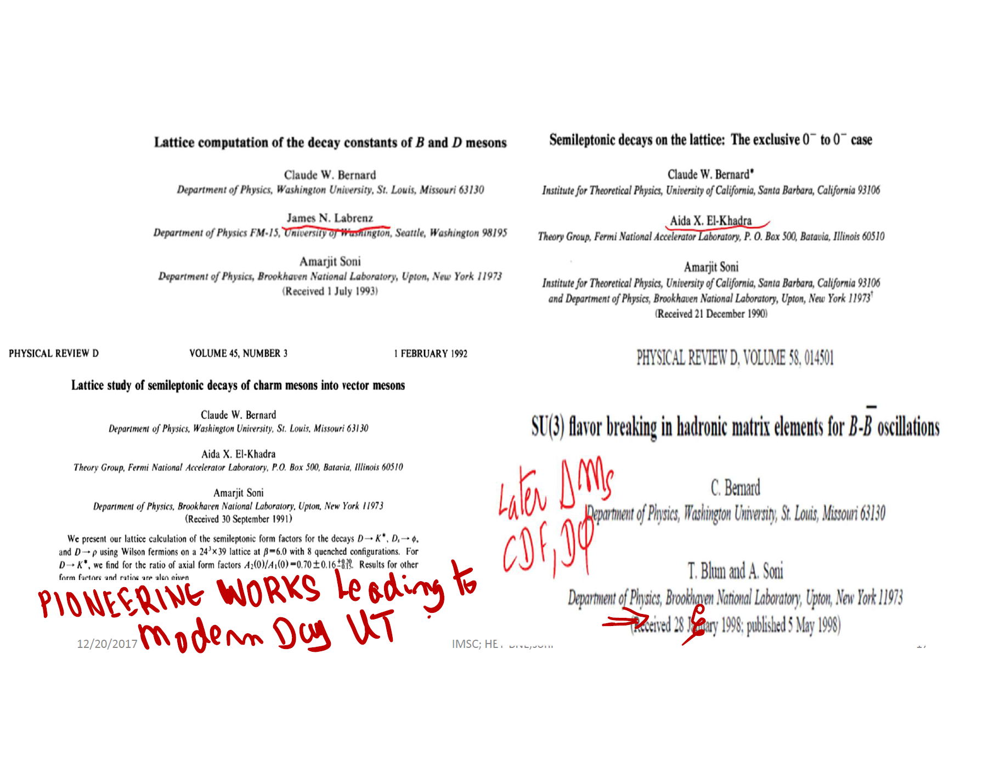

Slide 42
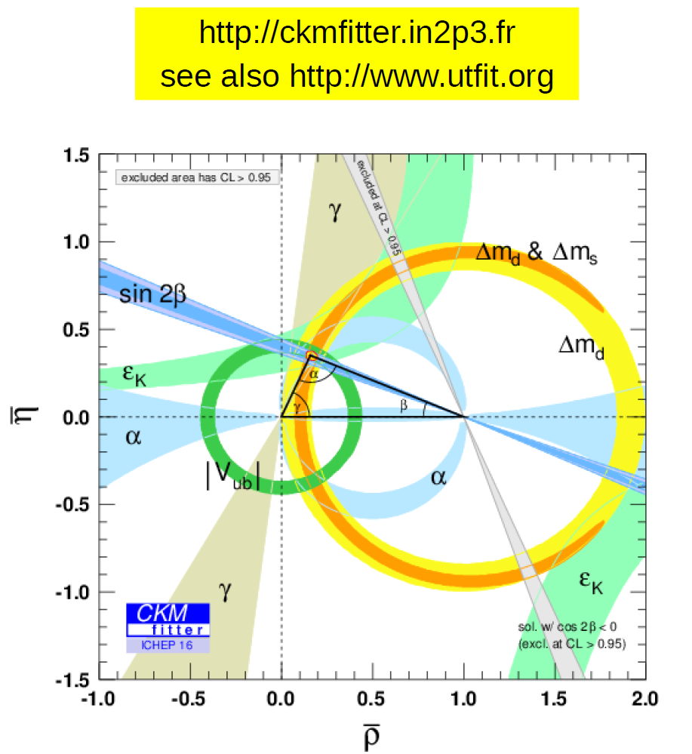
Use exptal data + lattice WME to test SM & search for new physics
Looks great; but looks
can be deceiving…
In fact at level of O(2σ)
tension(s) exist
O(10-15%) new physics is possible
and is HUGE!

Slide 43

Courtesy: Tom Browder
Critical Role of the B factories in the verification of the KM hypothesis was recognized and cited by the Nobel Foundation
A single irreducible phase in the weak interaction matrix accounts for most of the CPV observed in kaons and B’s.
CP violating effects in the B sector are O(1) rather than O(10⁻³) as in the kaon system.

Slide 44
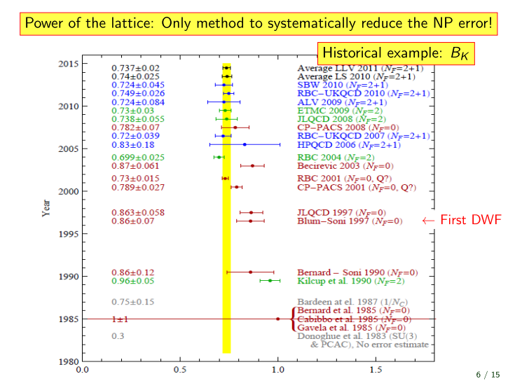

Slide 45
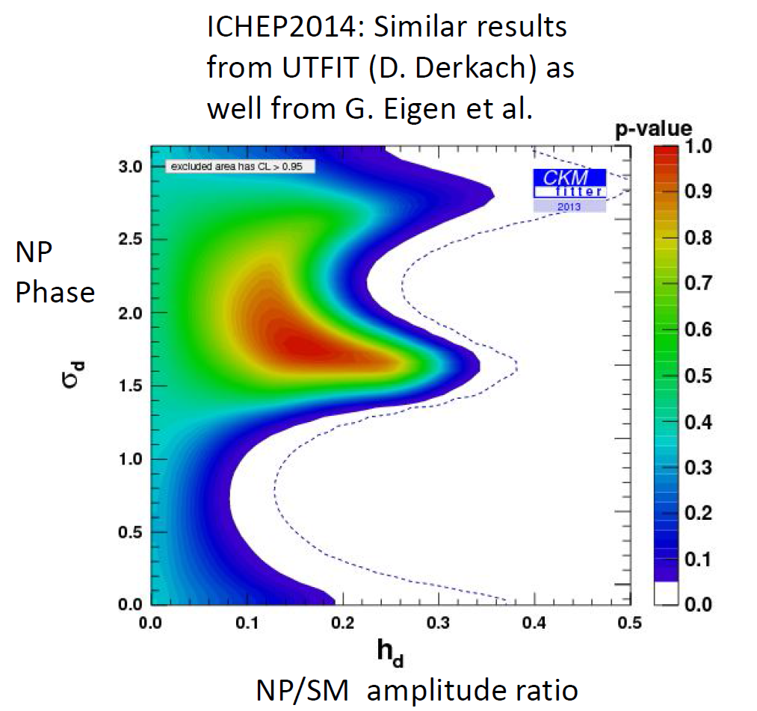
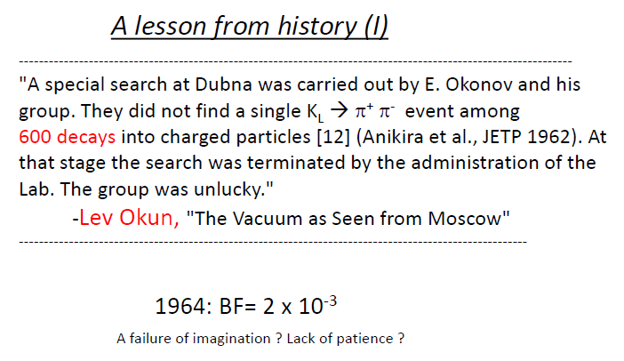
Current O(few%) tests are far away from O(0.1%) asymmetry in KL=>pi pi
Courtesy of Tom Browder
Had KL=>pi pi been abandoned, history of Particle Physics would have been significantly altered!
C also Marco C, Monika B….

Slide 46
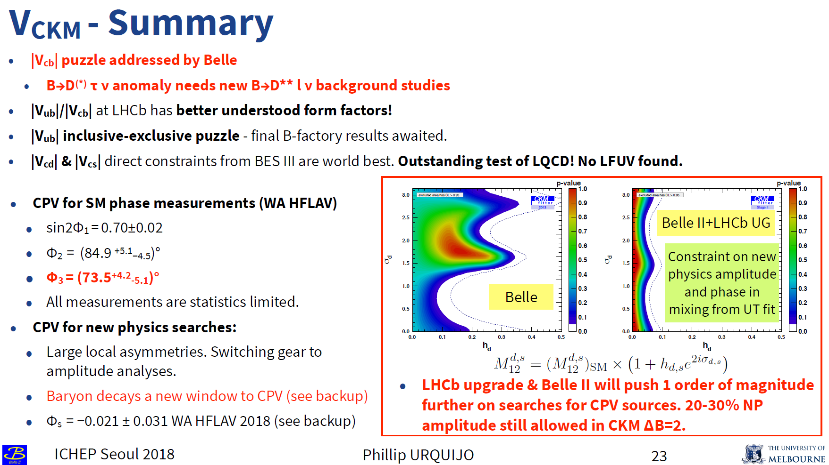

Slide 47
Non-local matrix elements evaluation….1st application to B(D)_{(s)} -physics

Slide 48
Testing LUV in the era of Belle-II
II. On the lattice technical front, RBC-UKQCD collab
has developed the methodology over the past ~6 years for calculating from 1st principles contributions from non-local operators
Here we illustrate this use in the simplest example that can have important phenomenological impact in light of larger data samples that will become available in the era of Belle-II
The simplest illustrative reaction to display developments in the exptal and in the lattice front that we choose is B,Ds =>
Lets start with a very simple observation that LUV is very difficult to test with respectable accuracy via the simplest reaction
Br because the denominator suffers from severe helicity suppression. Indeed,
Br[B+ =>mu+ nu] ~ 2 X 10^-7
Note, however that naïve models seem to suggest
Br [B => mu nu gamma]/Br[B=> mu nu] ~16

Slide 49
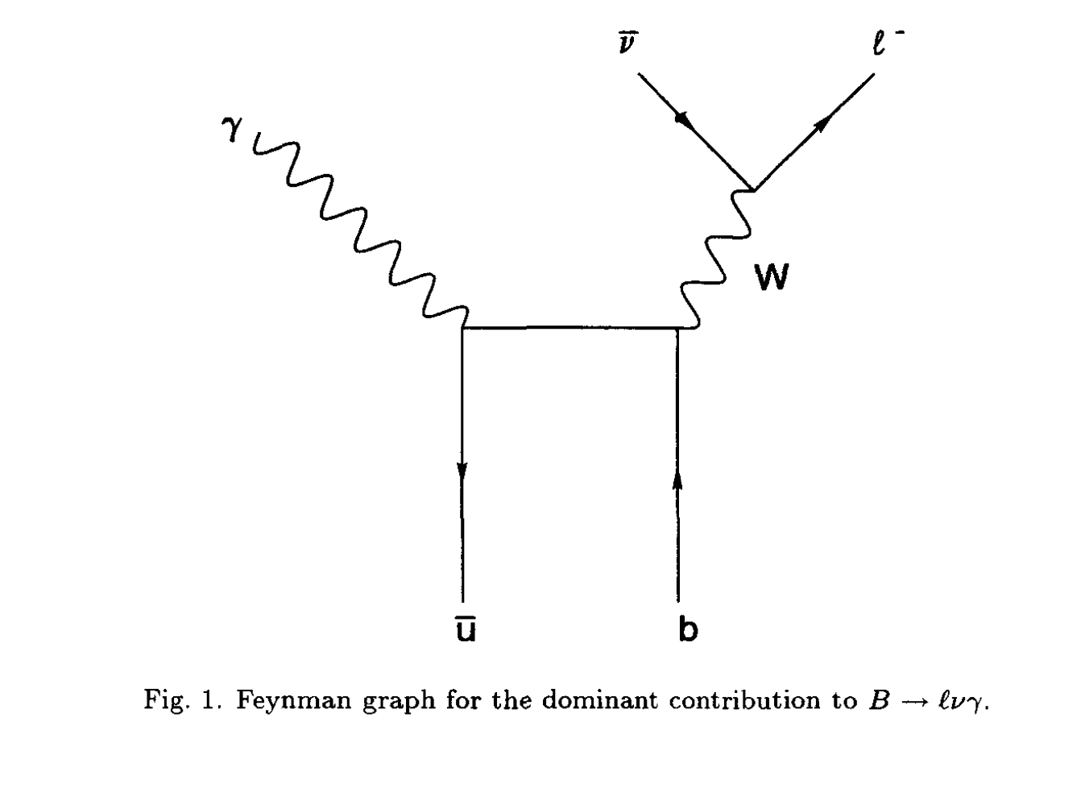
Radiative leptonic decays of heavy-light mesons

Slide 50
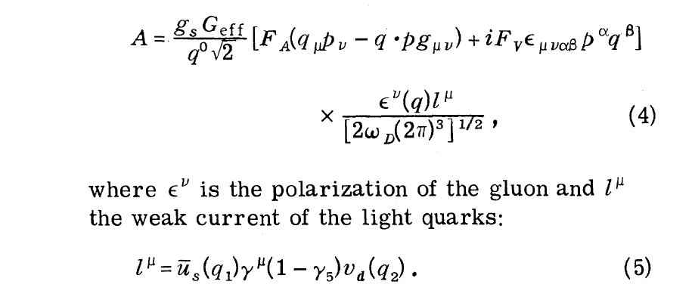

Slide 51
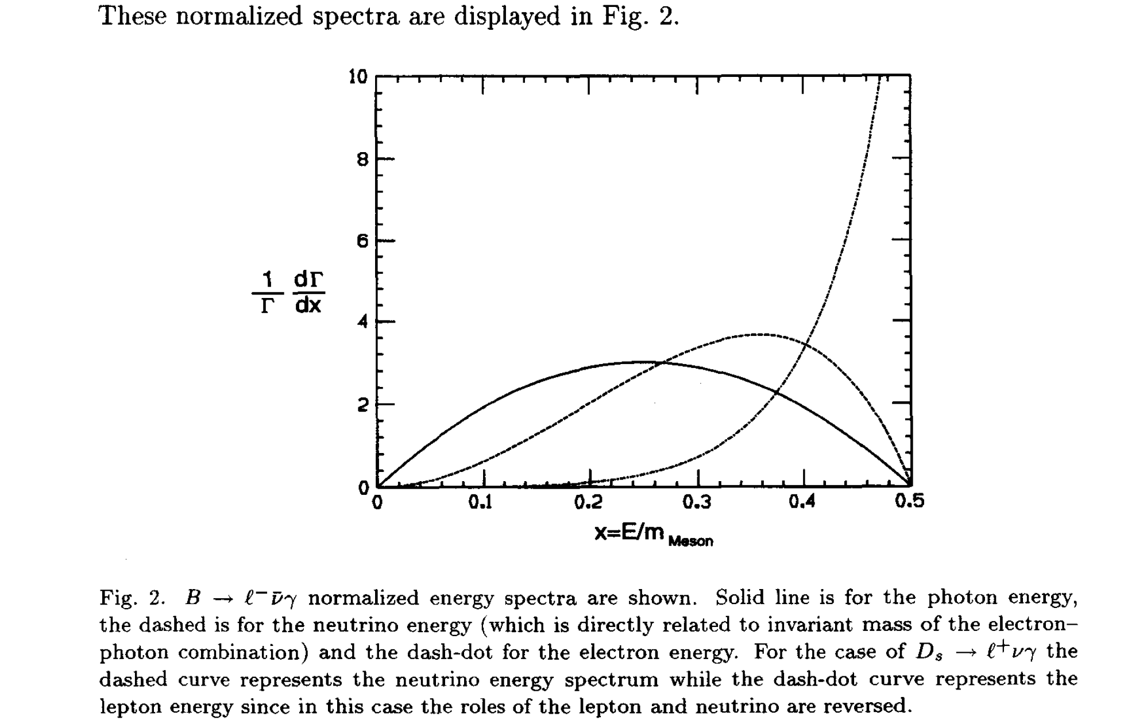
Atwood, Eilam + AS, ‘94
Toy-soluble-approx model calculation

Slide 52
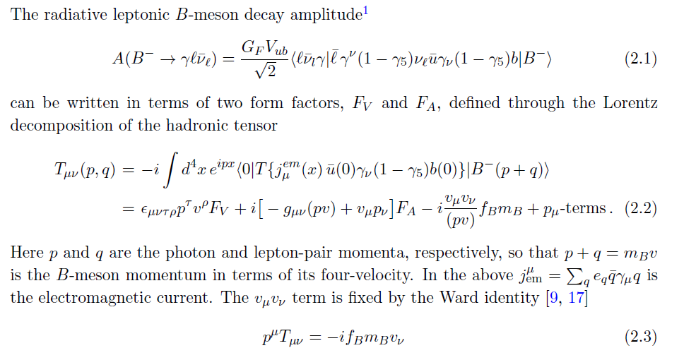
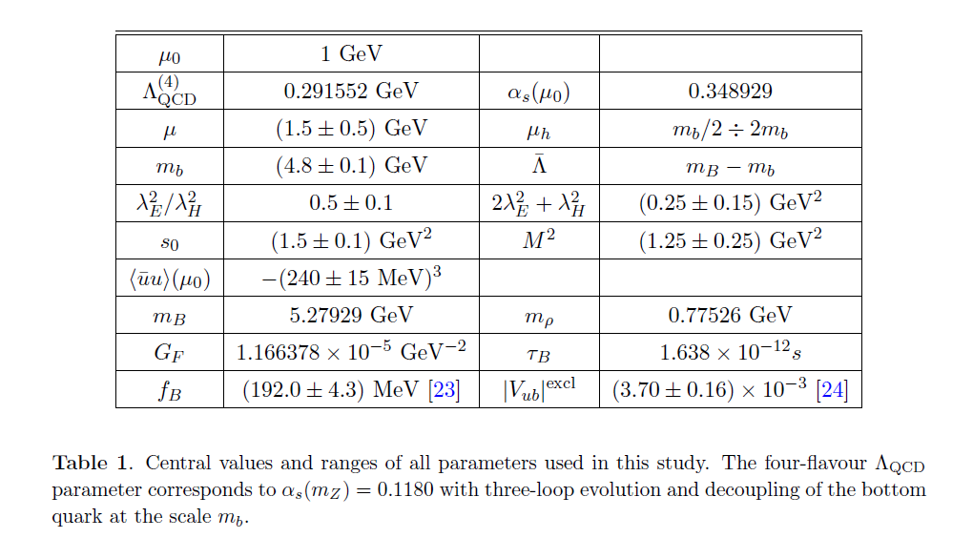

Slide 53
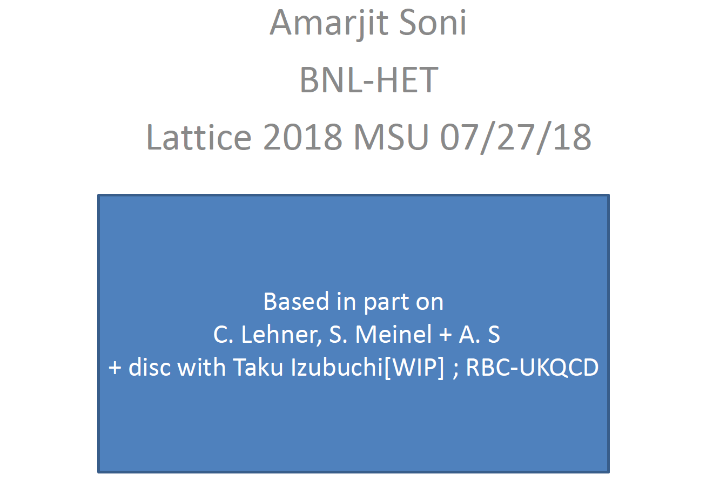

Slide 54
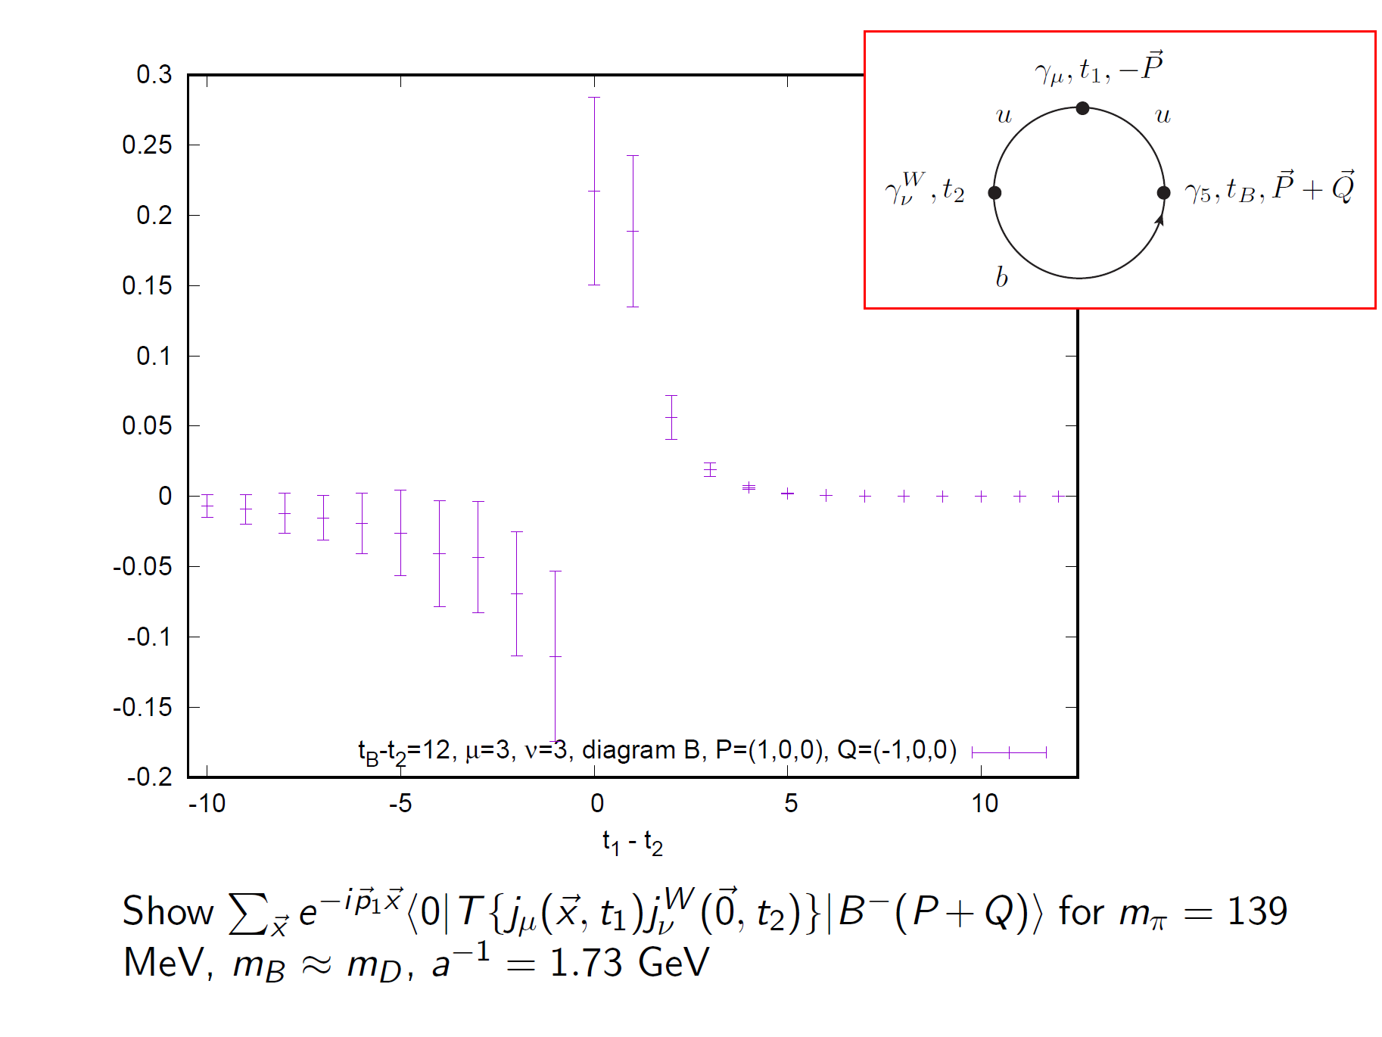

Slide 55
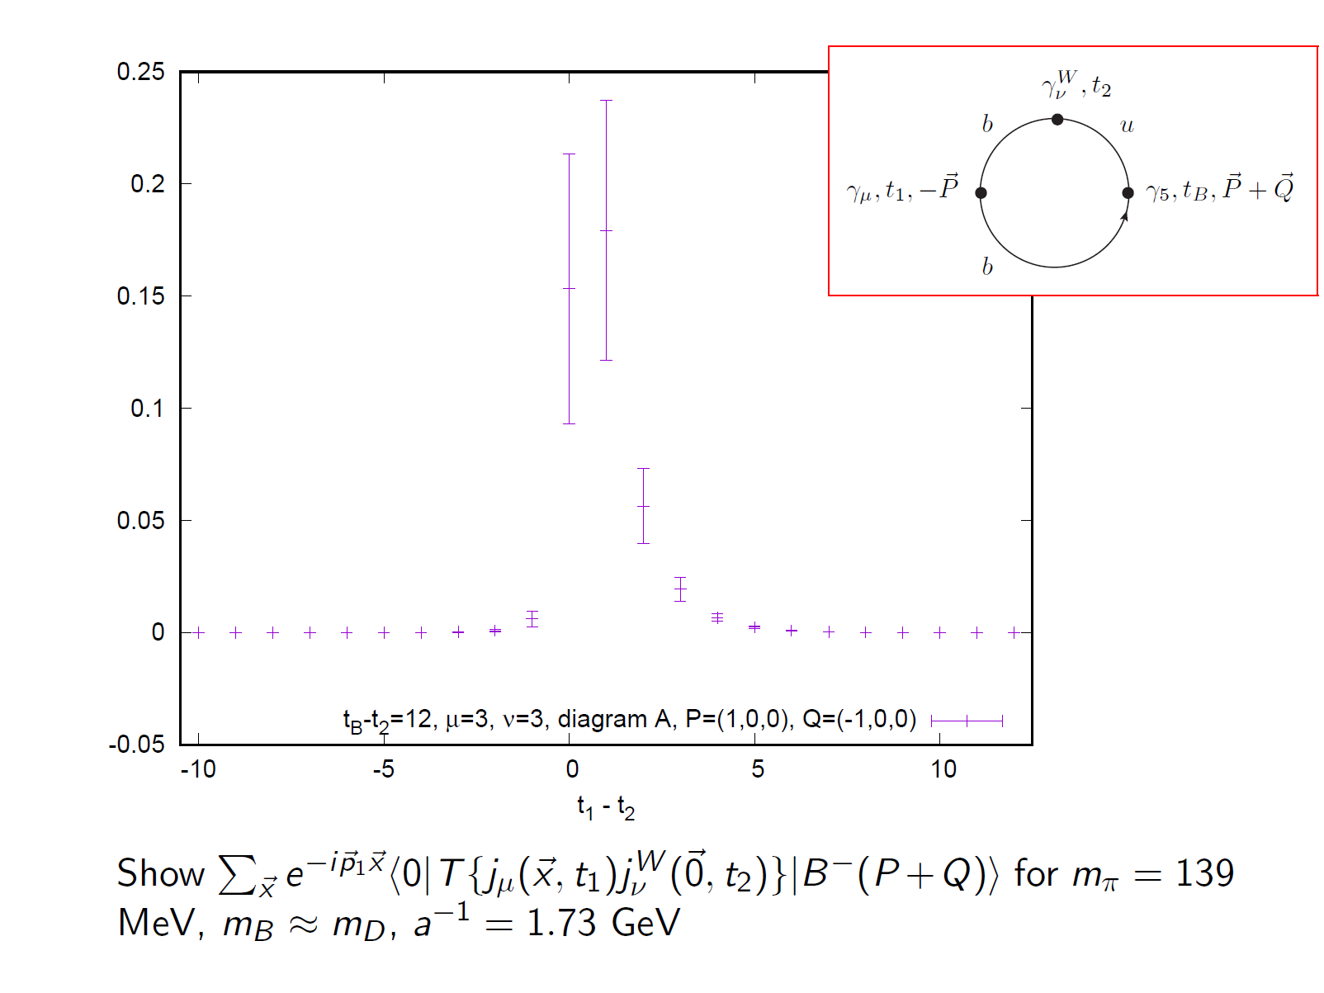

Slide 56
We hope to have results of 1st lattice calculation of l nu gamma as a function of photon energy in the near future for B⁺ and for D_{s}

Slide 57
Possible new physics opportunities in tau’s
Huge increase in fluxes of tau’s=>monitor tau closely
Rather serious several anomalies => NP esp 3rd family => also BSM-CP
Charge current: tau is the central character
A very interesting special case: tau => nu Ks pi+
Lattice can calculate rather precisely
Moreover, Babar claimed [BSM]CP
Most models for anomalies imply LFV in tau and in B-decays
Also Look for BSM-CP in tau via edm-like effects

Slide 58
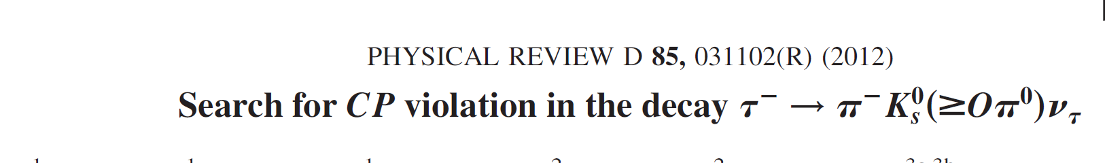
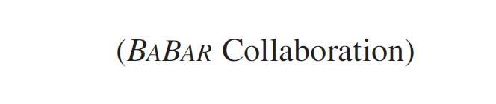
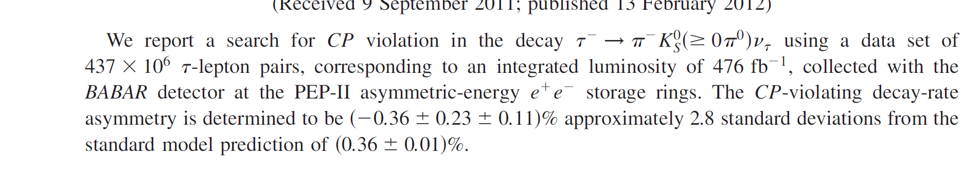

Slide 59
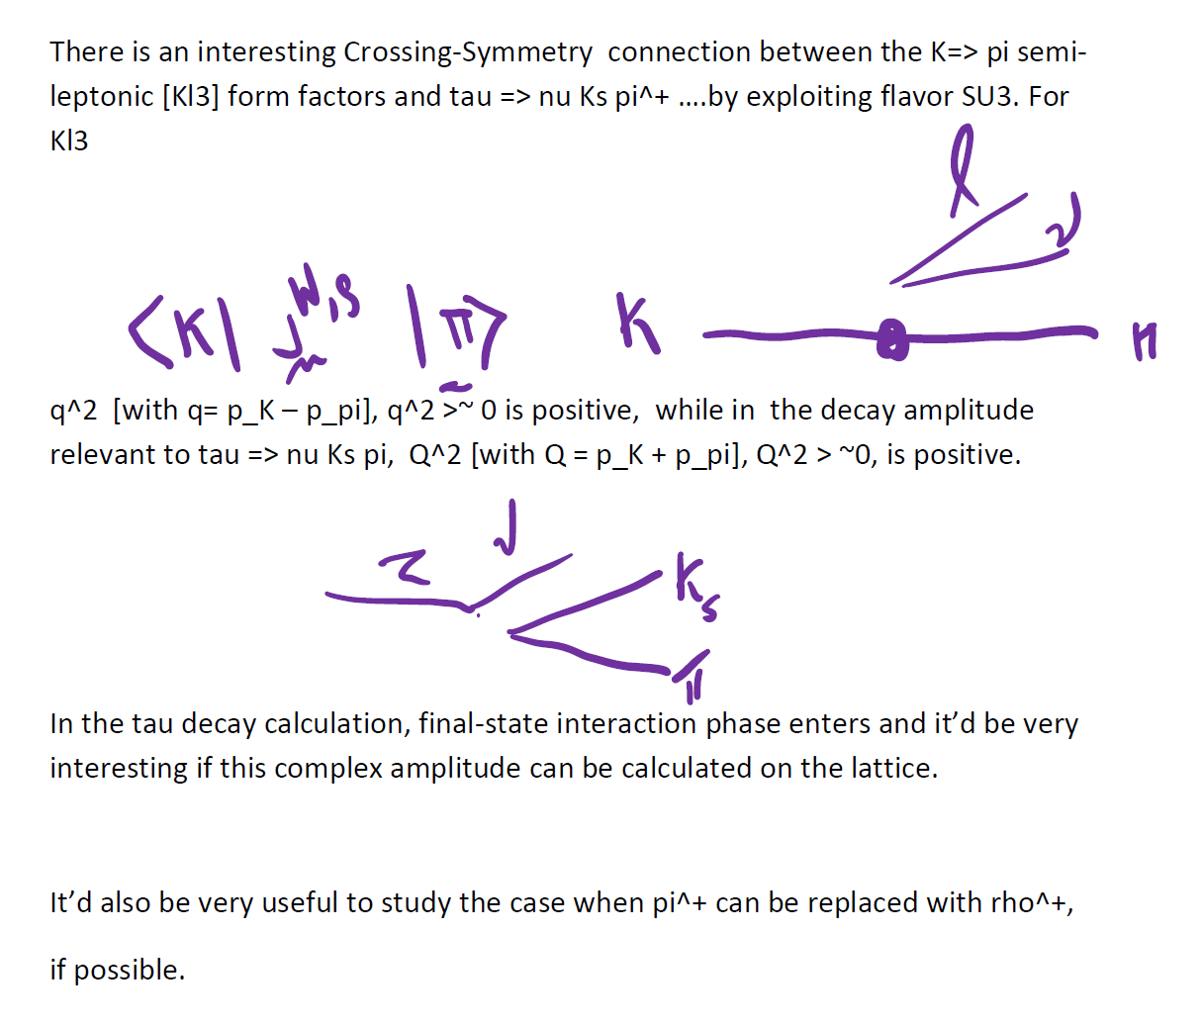

Slide 60
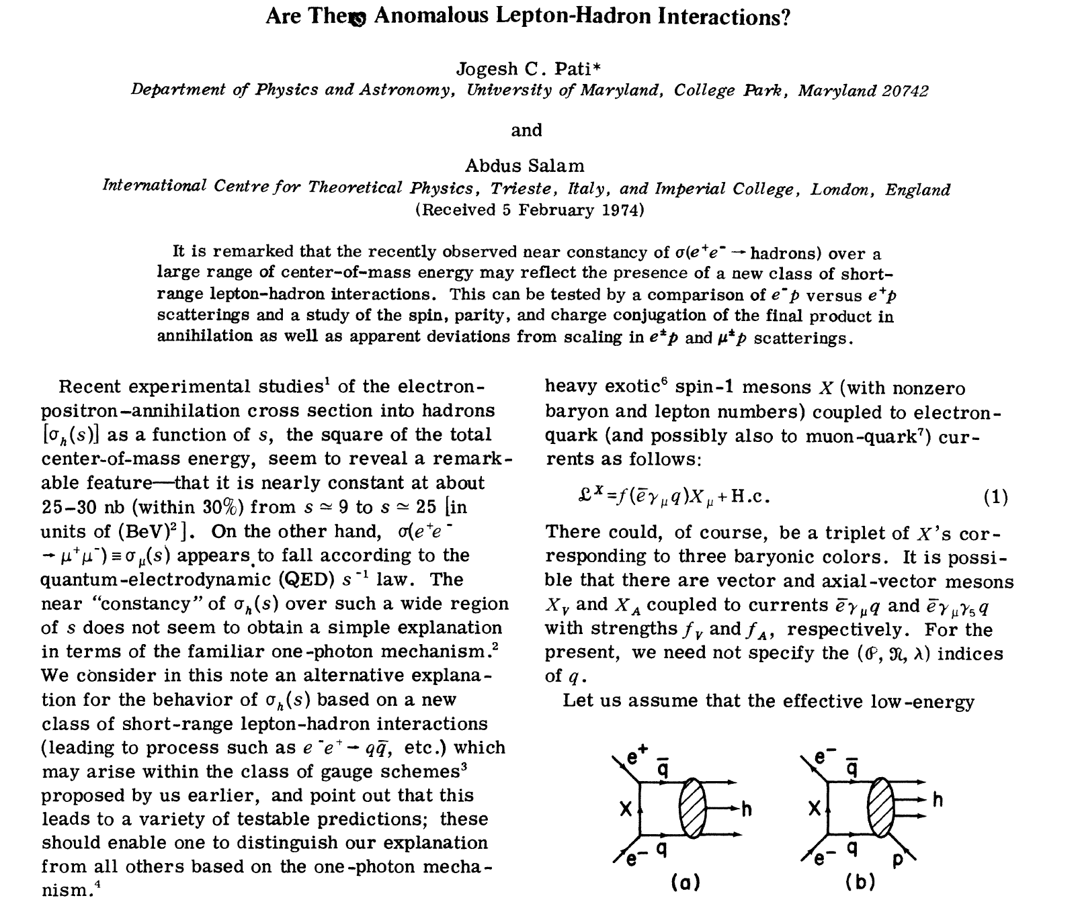
LQ Revival Circa 2018

Slide 61
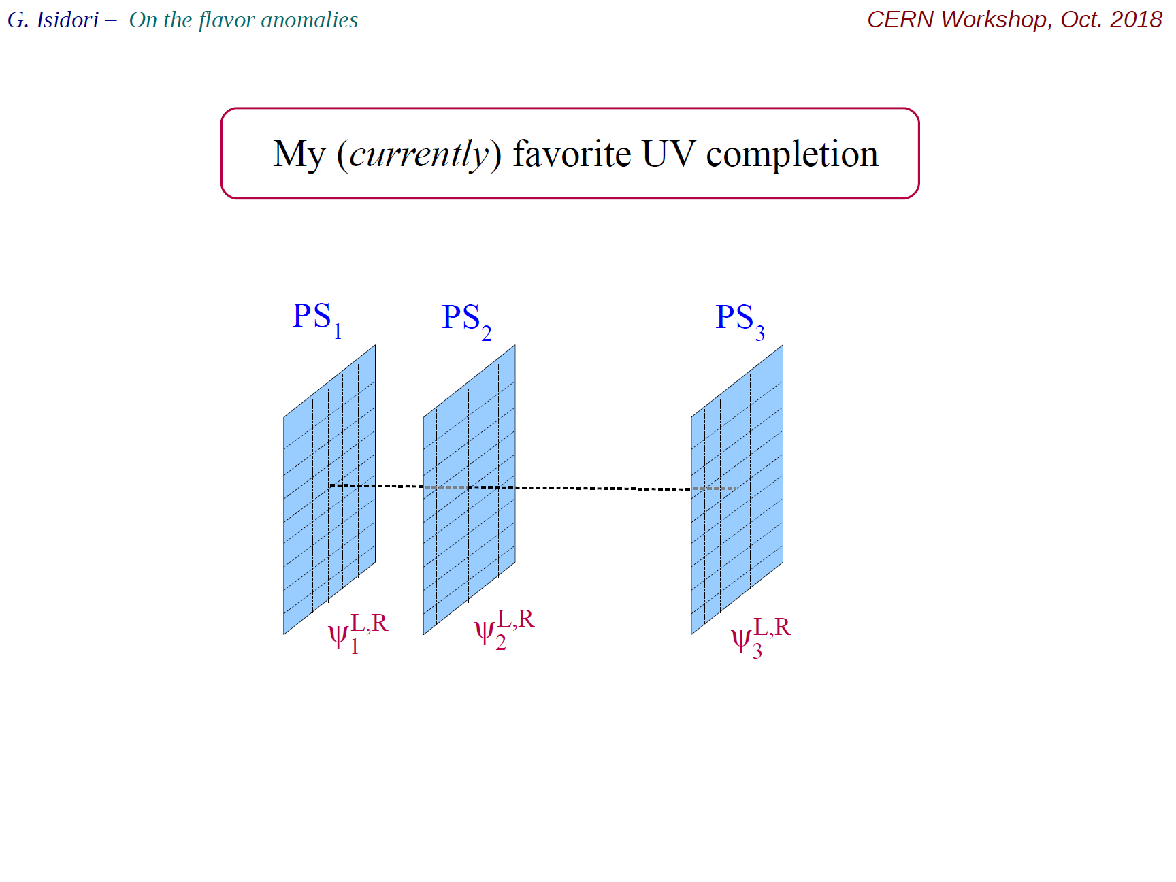


Slide 62
ASSUMING the anomaly is REAL & HERE TO STAY [BIG ASSUMPTION due to caveats mentioned]
Anomaly involves simple tree-level semi-leptonic decays
Also b => tau (3rd family)
Speculate: May be related to Higgs naturalness
Seek minimal solution: perhaps 3rd family super-partners(a lot) lighter than other 2 gens > proton decay concerns may not be relevant=> RPV [“natural” SUSY ]
RPV natural setting for LUV …can accommodate g-2 and eps’ if needs be
Collider signals tend to get a lot harder than (usual-RPC) SUSY
RPV makes leptoquarks natural
Moreover, RPV should be viewed as an umbrella i.e. under appropriate limits other models are incorporated

Slide 63
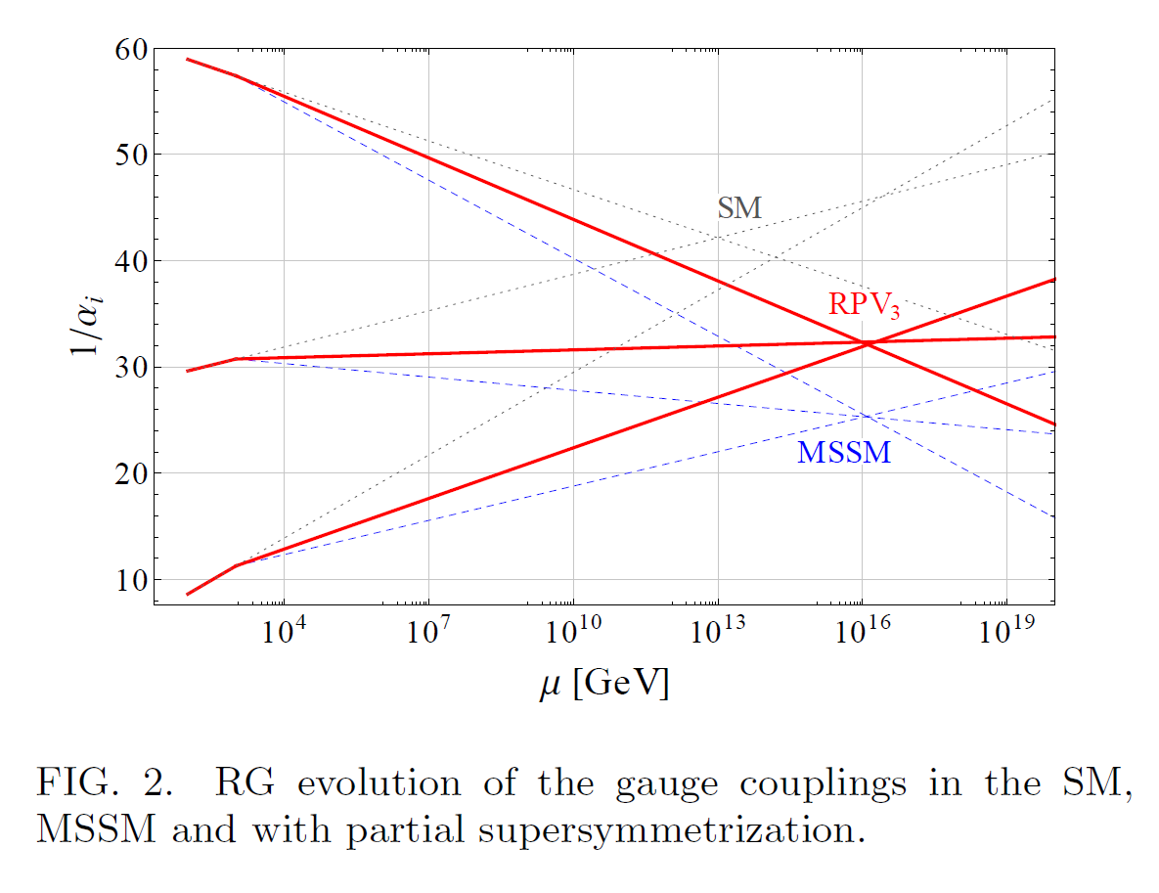

Slide 64
Possible NP in tau=> Ks pi nu

Slide 65
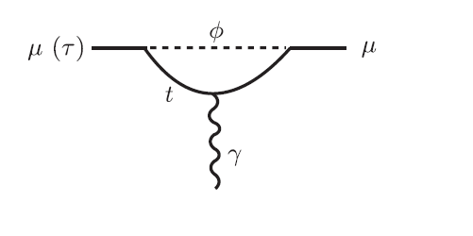

Slide 66
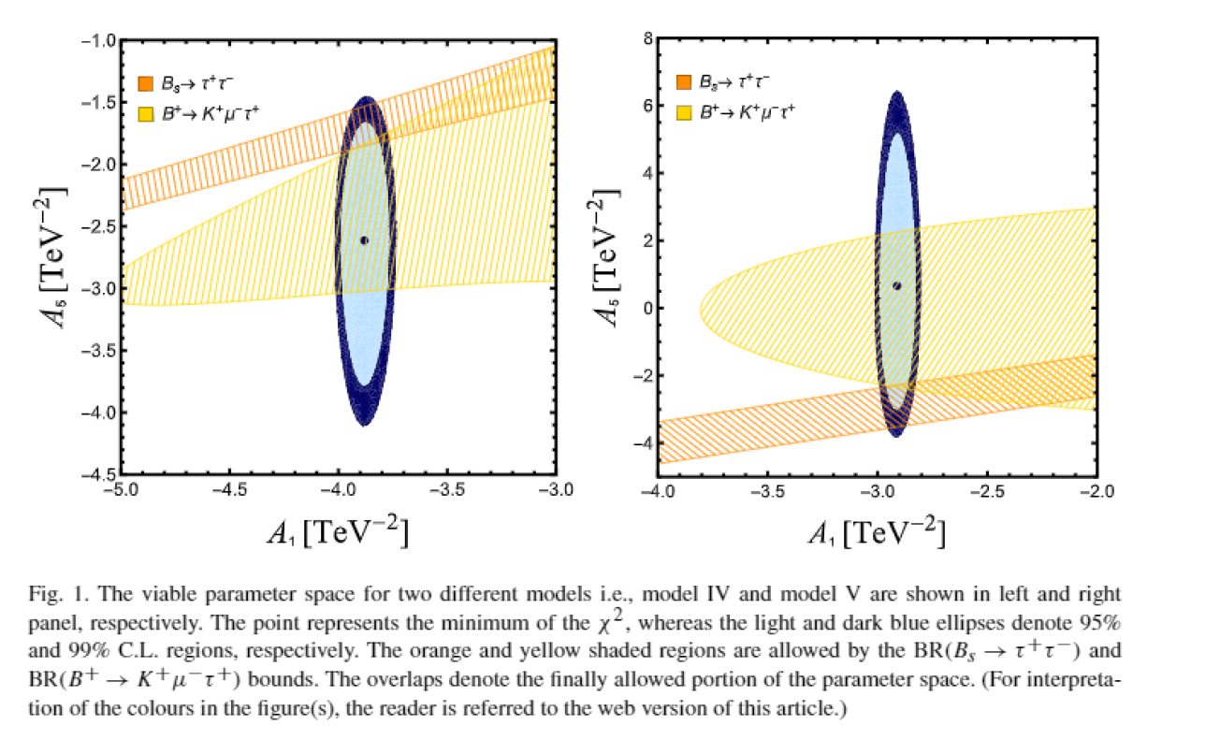
In many LQ models for anomalies, e.g. Bauer+Neubert, Mandal et al, ADS’-RPV3
B=>K mu tau and or Bs=>tau tau enhanced

Slide 67
Because of heightened interests in LQ’s
Note that tau magnetic & e dipole moments enhanced
Magetic,electric dipole moments of leptons can scale in LQ models:
d_tau ~ mt^2 m_tau
So may be many^2 orders of magnitude larger than d_e
Which is exptally bounded by < few times 10^-27 ecm

Slide 68
High hopes for IF next ~ 5 years
These likely another sightings of GODOT!

Slide 69
Summary + take home mssgs (2 pages)
Time is ripe for charm CP: Delta ACP should be not far from current bound. 2 pi0, 2Ks may have asymmetries ~1/2 to 1% …..all may well be accessible to Belle-II
3 body, 4 body modes very powerful for c and also for b…Belle-II has promising reach
So also for Fcnc leptonic channels, c, b => h ll, hhll…lattice progress scatt phases
Time dependent CP in radiative excl B decays,
e.g. gamma Ks eta(pi) excellent approx null test for SM-CP..Belle-II can improve by 10 or even more
Tau (&D*, rho) polarization (including transverse tau) in B=>D(*)[pi,rho] tau nu should also be targetted esp in view of RD(*) anomaly
For tests of LUV / CPV B => l nu gamma ……quantitative rate prediction from lattice on the horizon…. Should be an important target of Belle-II
B=>K mu tau (e); Bs=>tau tau important to pursue vigorously
Tau =Ks pi nu for NP/CP via precise rate and Dalitz studies..lattice feasible
LFV tau => mu gamma[ll, phi, hh…..] Belle-II can improve significantly
Tau mag and electric dipole moments…should be targetted by Belle-II
Moreover, (lattice) developments in ε’ and the GOLD-PLATED KL => pi0 nu nu (@Jparc) have significant consequences……

Slide 70
Take home mssgs
In the next few years due primarily to Belle-II, LHCb and because of computational advances we should be able to make significant progress in:
far better understanding of QCD dynamics pertaining to weak decays
in part. lattice can play a crucial role in quantifying SM direct CP in K, D,B, tau…
& thus on our quest for BSM-CP-odd phase
& possibly also on our quest for LFV
& May be just may be with some luck the IF will lead us, once again, to the gem of NP, and as many times in the past, guide collider physics et al

Slide 71
xtras

Slide 72
Improvements in lattice Ꜫ’ determination underway for past ~3 years
Statistics X [ > ~ 5] now aiming for
Systematics…..some already done..
EM+ isospin….
Completely diff method(s)
A) excited pipi state
B) Revisit ChPT

Slide 73
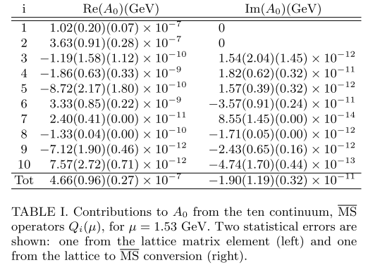

Slide 74
parenthetically
Using our lattice calculations as input [our est. ~2.1 σ] + etc
1. Buras, Gorbahn, Jaeger and Jamin, [1507.06345] ~2.8 σ
2. Kitahara, Nierste & Tremper, 1604,074002….~2.9 σ
Its great that others think significance of our result is more than we claim; would be concerned if it was the other way around
More importantly, X5 more stats underway….

Slide 75


Slide 76


Slide 77


Slide 78


Slide 80


Slide 81

Measurement reach of Asymms

Slide 82

LFV
Accidental symmetry………..

Slide 83
Contrarian/Complementary view
flavor physics is actually hanging by perhaps the weakest link i.e. a single CP-phase endowed by the 3g –SM.
[This is infact my rationale for going after eps’ for over 35 continuous years and the effort is sill continuing! ]
In many ways this is a contrarian (or complementary) point of view, in sharp contrast to the overwhelming majority following the naturalness lamp post via Higgs radiative stability.
In this context it is useful to stress
We hold these truths to be self-evident…

Slide 84

ODE to YESTERYEARS!

Slide 85

A monumental experimental achievement!

Slide 86


Slide 87


Slide 88
In many LQ models for anomalies, e.g. Bauer+Neubert, Mandal et al, ADS’-RPV3
B=>K mu tau and or Bs=>tau tau enhanced

Slide 89
II. tau => Ks pi^- nu on and off the lattice
Motivation ……
tau plays a central role in indications of LUV from semi-leptonic charge current RD(*) anomaly
If these indications of new physics become a reality, then naturalness arguments strongly suggest the new physics will entail also a new
CP-odd phase.
tau => Ks pi^+ nu is an excellent final state for experimental study and a good candidate for BSM phase or not

Slide 90
Can test for BSM also via CP-conserving observables
Select a FS where [CP conserving observables] like rate or differential distributions can be calculated precisely…
Usually use of lattice to calculates mass /rates, I find boring and stay away as they are not my primary interest…[i can look up PDG]
But a good example is tau => Ks pi^+ nu total or partial rate, or Ks pi invariant mass distribution; in the SM this can be calculated PRECISELY using lattice [and to some extent off the lattice methodology]

Slide 91
Search for NP via redundant precise measurements & precise lattice studies via the UT; lattice on-going eps’ effort ; progress in non-local, LD, Matrix elements & some new applications

Slide 92


Slide 93



Incomplete Sample of refs.

Slide 94
These anomalies in near future, <~3 yrs
Although stated significance of each of the 3 anomalies is over 3 sigma, have reservations in each case; so not yet compelling
On RD(*), RK(*) expect significant progress (including possible discoveries!) from LHCb Runs 1+2 and/or Belle-II may be with ~5 /ab coupled with
further refinements from lattice
On g-2, fermilab should have finished analysys
of over X2 compared to original BNL; also expect lattice reduction of errors by another factor of 2 to 3 soon
Outcome uncertain in so far as NP is concerned

Slide 95
Reg multi-body modes
2 body modes only allow PRA and these are severely restricted by CPT
3 body modes allow in addition, e.g. energy asymmetries….these asyms can be a lot bigger than PRA as rescattering of states onto themselves can give rise to energy asyms [unlike PRA]
4 (or more) bodies allow also TCA; these do NOT require FS phases as they are CP-odd, TN-odd observables..see Atwood, Bar-shalom, Eilam +AS, Phys Report’01

Slide 97


Slide 98



Slide 99


Slide 100


Slide 101
Hirose [BELLE]@EW MORIOND Mar. 2017
Belle deviations quite mild

Slide 103
Atwood, Eilam + AS, ‘94
Toy-soluble-approx model calculation

Slide 104
Improved strategy for DCP
Improved a bit over DA+AS, PTEP 2013, Tab I
Ds=> ρ⁰ K^{+(*)} ; K⁺ ф [NOT K+*]
D+ => ф π⁺ (ρ⁺ ) ; K^{0(*)} K⁺ [NOT K+*]
D+ => ρ⁰ π⁺ ; π⁰ π⁺ …;[ NOT ρ+ ]
D0 => K⁺ K^{-(*)} [NOT K+*] ; ф ρ⁰
D0 => ρ⁰ ρ⁰ ; ρ⁰ π⁰ ; π⁺ π⁻ ; π⁺ρ⁻ [Not ρ⁺ π⁻; ρ⁺ ρ⁻]
NOTES:
1)many FS all charged;
2) Some VV good for TCA esp. Ds=> ρ⁰ K^{+(*)} , D0 => ф ρ⁰; 2K0*
3) all π⁰ always also imply η^{(‘)} ;
4) Special Note: ρ⁰ broad width not a problem for CP tests as can always replace it with π⁺ π⁻ in a mass window so long as done C-symmetrically with the antiparticle decay as well.

Slide 106
3 g & New Physics
How can we use the non-perturbative set-up of the lattice to look for clues?
t, b, tau, nu_tau
Suitable targets b and tau
Because of its mass b is often a challenge though progress is constantly being made
tau is the BEST: lattice has no excuses
Lattice can check that every aspect of tau agrees
(or not wth SM)

Slide 107
Strategy to enhance charm-CP
For charm-CP extremely important to suppress tree and maximize interference
A) avoid W-> ud or us making charge vector state…. e.g. rho⁺⁻ or K*(+-) …..field-current ….Sakurai VMD ideas B) go for CLS ….color suppressed FS…from tree
C) go for CBS….cabibbo suppressed FS =>Singly Cabibbo Suppressed [SCS]….atomatically forced by T-P interference a la Bander, Silverman and A.S PRL 1979

Slide 108
4th rule
Zweig suppressed + CLS
Only class of modes seem possible here:
D0 => Ks Ks, K0 K0*, K0* K0*
Feynman graph

Slide 109
CP studies in b=>c [D,D*..] tau nu
Studied long ago in Atwood, Eilam, +AS, PRL(93); c also Phys. Rept’01
In addition to PRA, and energy asymmetry,
Tau polarization is extremely useful
There are 2 transverse polarization of the tau
Along the y-axis [TN-even], along Z[TN-odd]
C also T Kitahara et al ‘18;
A. Alok et al ‘17

Slide 110
More Opportunities in tau
Techniques to Improve determination of magnetic and electric dipole moments of tau
Key point : Borrow ideas determination for the top quark….i.e an “elementary fermion”

Slide 111


Slide 112

Nowadays, full-QCD, fB, \xi, Bk <~2%; Vub ~5% &
Lattice being used in many new pheno. Appls.

Slide 113


Slide 115
Possible new physics opportunities in tau’s
Ack: lattice disc with local [RBC-UKQCD] Bruno, Izubuchi, Lehner and Meyer.

Slide 116

With C. Bernard
[UCLA]
Serves as a template for the need of
Lattice calculations for more economical use of almost all experimental data
From IF

Slide 118
Strong [i.e. CP-conserving] FS interaction phases
We can calculate these phases on the lattice
for K, pi scattering see RBC-UKQCD [exploratory for K-pi; see T.Janowski et al, Lattice 2014]
and also now for pi pi
However, for an approximate result flavor SU(3) can also be used to relate them to pi pi scattering phases from Kl4 and from pi N => N pi pi following Colangelo et al…..get K pi phases upto SU(3) corrections
T.W. talk at Lattice 2018 shows pi pi I=0 phases in good agreement with Colangelo

Slide 119
LQ Revival Circa 2018

Slide 120
In charm decays the tree rules!
Tree goes as lambda ~0.22
Penguin as lamda^5 so is exceedingly small
Moreover lattice studies have demonstrated over and over again even for K =>pi pi decays,
And Delta I=1/2 enhancement,
Penguin contribution is <O(%) of tree at scales >~1.5 GeV; so for charm T >> P
=>To enhance dir CP must make tree as small as possible

Slide 121
StarEing more at charmimg penguins

Slide 123

Why B_{K} is needed?

Slide 124
Many possible decay channels
Allows you to construct many observables
So both TN-even [e.g. energy asymmetry] as well as TN-odd [Triple Correlation Asymmetries]….are possible
These studies are at large CM energy
Need to connect to s=>0 for conventional [magnetic, electric] dipole moments interpretations…….

Slide 125


Slide 126
Mixing induced CP in radiative exc. B decays [Atwood, Gronau + AS, PRL’97; Atwood, Gershon, Hazumi +AS, PRD’05]
γ in b=> s γ is predominantly LH [SM]
γ in \bar b=> \bar s γ is predominantly RH [SM]
Thus B^0 and \bar B0 cannot access common FS so they cannot MIX….=>Clean way to search NP!
In 3 body exclusive modes, γ energy can monitor QCD complications
On and off resonance FS can be combined so long as CP even and odd can be separated
Many BSM models, such as LRS, WEXD, LQ’s can cause mixing and non-vanishing asymmetries
Cleanliness of e+e- -(super)B factories gives a big edge for this class of searches!
C also Grinstein, Grossman, Ligeti, Pirjol, PRD’05; c also E. Kou et al

Slide 127



