Slide 1
eRD14 – EIC PID consortium
- An integrated program for particle identification (PID) for a future Electron-Ion Collider (EIC) detector.
M. Alfred, B. Azmoun, F. Barbosa, M. Boer, W. Brooks, T. Cao, M. Chiu, E. Cisbani, M.Contalbrigo, S. Danagoulian, A. Datta, A. Deldotto, M. Demarteau, A. Denisov, J.M. Durham, A. Durum, R. Dzhygadlo, D. Fields, Y. Furletova, C. Gleason, M. Grosse-Perdekamp, J. Harris, M. Hattawy, X. He, H. van Hecke, T. Horn, J. Huang, C. Hyde, Y. Ilieva, G. Kalicy, A. Kebede, B. Kim, E. Kistenev, M. Liu, R. Majka, J. McKisson, R. Mendez, I. Mostafanezhad, P. Nadel-Turonski, K. Peters, R. Pisani, W. Roh, P. Rossi, M. Sarsour, C. Schwarz, J. Schwiening, C.L. da Silva, N. Smirnov, J. Stevens, A. Sukhanov, X. Sun, S. Syed, R. Towell, G. Varner, R. Wagner, C. Woody, C.-P. Wong, W. Xi, J. Xie, Z.W. Zhao, B. Zihlmann, C. Zorn.
Contacts:
P. Nadel-Turonski <turonski@jlab.org>,
Y. Ilieva <jordanka@physics.sc.edu>
Generic Detector R&D for an Electron Ion Collider
Advisory Committee Meeting, BNL, January 24-25, 2019

Slide 2
Participating institutions
Abilene Christian University (ACU)
Argonne National Lab (ANL)
Brookhaven National Lab (BNL)
Catholic University of America (CUA)
City College of New York CCNY)
College of William & Mary (W&M)
Duke University (Duke)
Georgia State University (GSU)
GSI Helmholtzzentrum für Schwerionenforschung, Germany (GSI)
Howard University (HU)
Institute for High Energy Physics, Protvino, Russia
Istituto Nazionale di Fisica Nucleare, Sezione di Ferrara, Italy (INFN-Ferrara)
Istituto Nazionale di Fisica Nucleare, Sezione di Roma, Italy (INFN-Rome)
Istituto Superiore di Sanità, Italy (ISS)
Jefferson Lab (JLab)
Los Alamos National Lab (LANL)
North Carolina A&T State University (NCAT)
Old Dominion University (ODU)
Stony Brook University (SBU)
Universidad Técnica Federico Santa María, Chile (UTFSM)
University of Hawaii (UH)
University of Illinois Urbana-Champaign (UIUC)
University of New Mexico (UNM)
University of South Carolina (USC)
Yale University (Yale)

Slide 3
eRD14: an integrated program for PID at an EIC
1. A suite of detector systems covering the full angular- and momentum range required for an EIC detector
Different technologies in different parts of the detector
Focus on hadron ID with an electron ID capability
2. A cost-effective sensor and electronics solution
Development and testing of photosensors (to satisfy EIC requirements)
Development of readout electronics needed for prototyping
3. Consortium synergies (including reduction of overall R&D costs)
Close collaboration within the consortium, with coordinated goals and timelines (e.g., DIRC & LAPPD, mRICH & dRICH, etc).
Strong synergies with non-EIC experiments and R&D programs (PANDA, CLAS12, GlueX, PHENIX, commercial LAPPDs) resulting in large savings.

Slide 4
Hadron kinematics at an EIC
The maximum hadron momentum in the endcaps is close to the electron and ion beam energies, respectively.
The momentum coverage need in the central barrel depends on the desired kinematic reach, in particular in Q² – important for QCD evolution, etc.
Weak dependence on beam energies

Slide 5
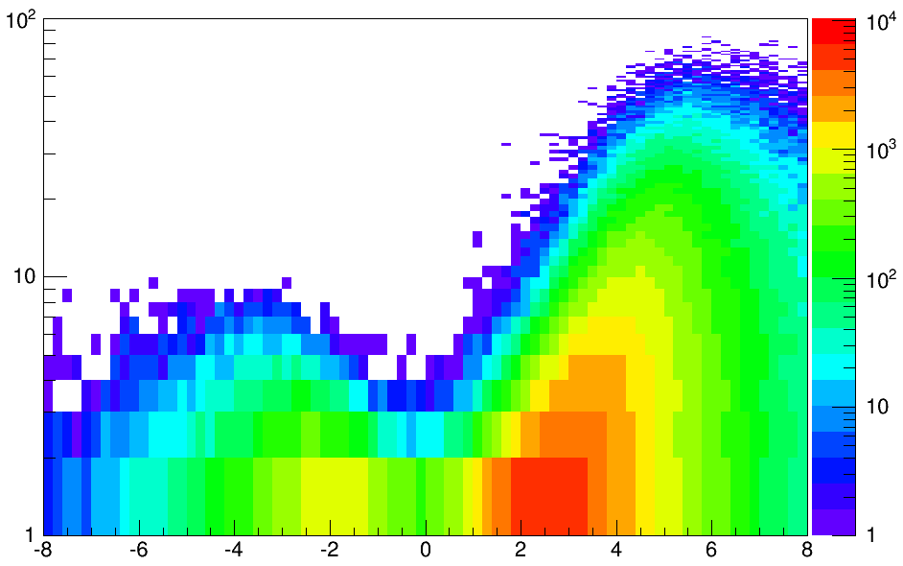
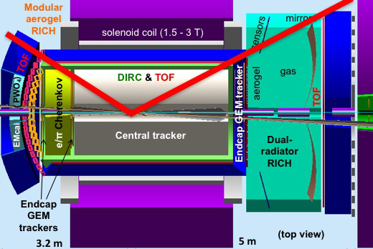
A PID solution for the EIC
e
p/A
GeV
10x100 GeV
Q² > 1 GeV²
h-endcap
h-endcap: A RICH with two radiators (gas + aerogel) is needed for
π/K separation up to ~50 GeV/c
e-endcap: A compact aerogel RICH which can be projective
π/K separation up to ~10 GeV/c
barrel: A high-performance DIRC provides a compact and cost-effective way to cover the area.
π/K separation up to ~6-7 GeV/c
TOF and/or dE/dx in a TPC: can cover lower momenta.
Photosensors and electronics: need to match the requirements of the new generation devices being developed – both for the final system and during the R&D phase
barrel
e-endcap
Dual-radiator RICH
DIRC
Aerogel RICH
rapidity

Slide 6
PID in the EIC concept detectors and integration of eRD14 systems

Slide 7
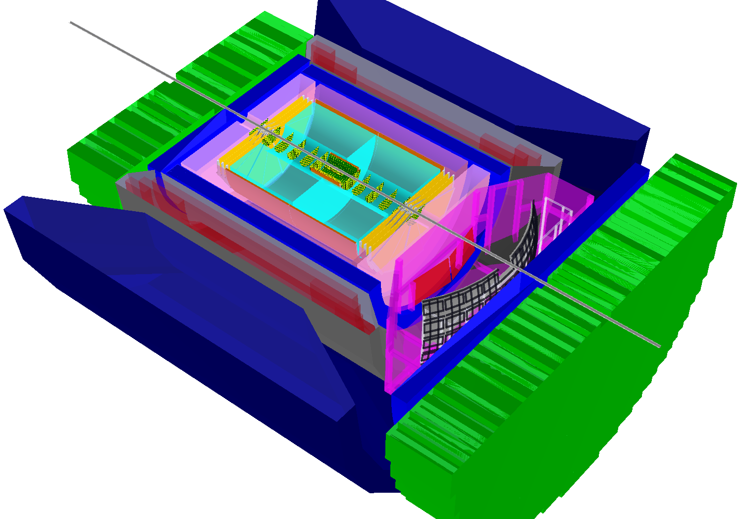
BNL BeAST EIC detector
-3.5 < η < 3.5: Tracking & e/m Calorimetry (hermetic coverage)
hadronic calorimeters
e/m calorimeters
RICH detectors
2016 changes made integration with eRD14 systems much easier!
eRD14 mRICH
electron endcap implementation ongoing
9.0m
hadrons
eRD14 dRICH implementation ongoing
eRD14 DIRC in barrel implementation to begin soon
electrons
A. Kiselev, EIC UG meeting, July 2016
silicon trackers
TPC
GEM trackers
Micromegas barrels
3T solenoid cryostat
magnet yoke

Slide 8
BNL ePHENIX EIC detector
2016 layout shown!
The DIRC, mRICH, and TOF systems already part of the current concept. An implementation in Geant4 (Fun4All) is ongoing.
In addition, either the eRD14 dRICH and eRD6 gas RICH could be used. The two options have been compared in a collaborative effort.

Slide 9
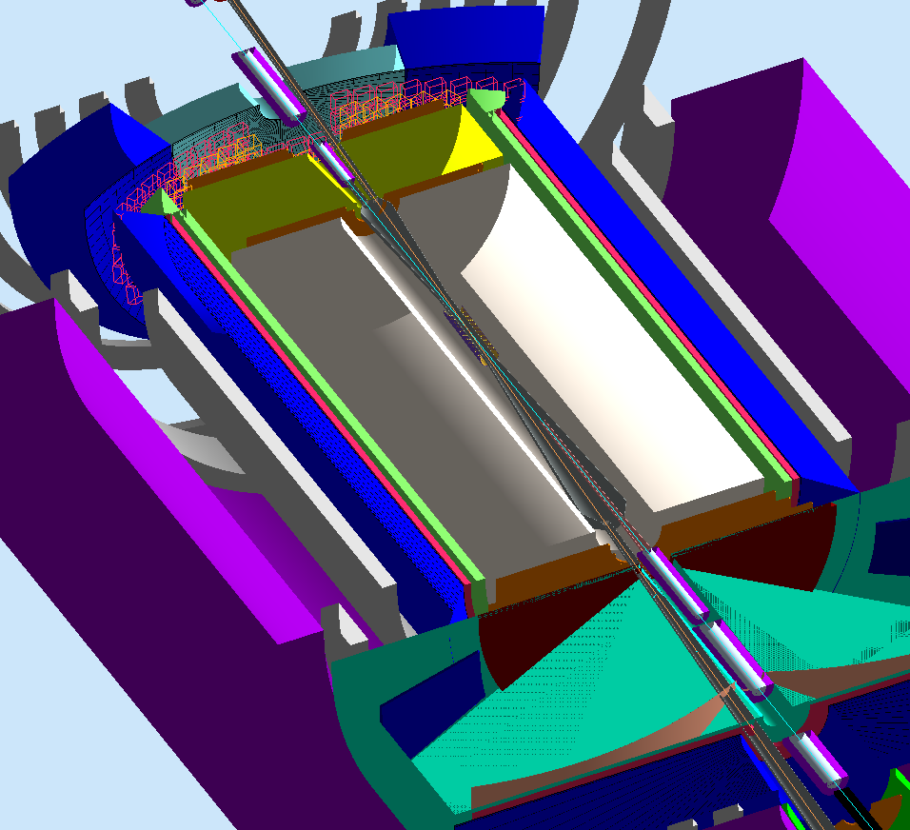
JLab EIC central detector showing PID integration
Modular aerogel RICH
EMcal
PWO₄
DIRC camera
All eRD14 systems (DIRC, mRICH, dRICH, and TOF) are part of the baseline JLab detector concept.
e/π Cherenkov?
TOF
EMcal (Sci-Fi)
DIRC & TOF
Vertex (Si pixel)
Central tracker
Solenoid coil
tracker
GEM
aerogel
Dual-radiator RICH
gas
Field shaping coils for RICH
sensors
EMcal
EMcal
mirror

Slide 10
High-resolution TOF
Goals:
Explore the possibility of achieving very high timing resolution (~10 ps)
Demonstrate 20 ps mRPC resolution in the lab.
Progress in 2nd half of 2018:
The R&D goals have been achieved.
No funding requested for FY19.

Slide 11
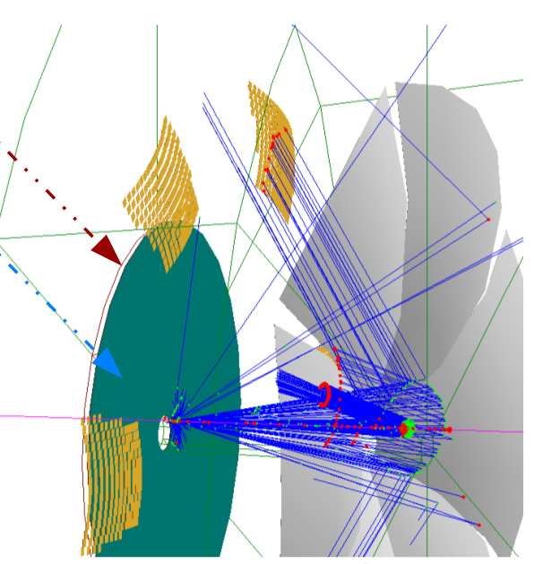
Dual-radiator RICH (dRICH)
Goal:
Provide hadron identification (π/K/p) from 3 to 50 GeV/c (3 sigma) and electron identification (e/π) up to 15 GeV/c, in the forward ion-side endcap of the EIC detector, covering polar angles up to ~25 deg.
Progress in 2nd half of 2018:
Refinements on:
Global particle ID reconstruction
Evaluation of performance in a realistic physics case
Moving towards a prototype implementation

Slide 12
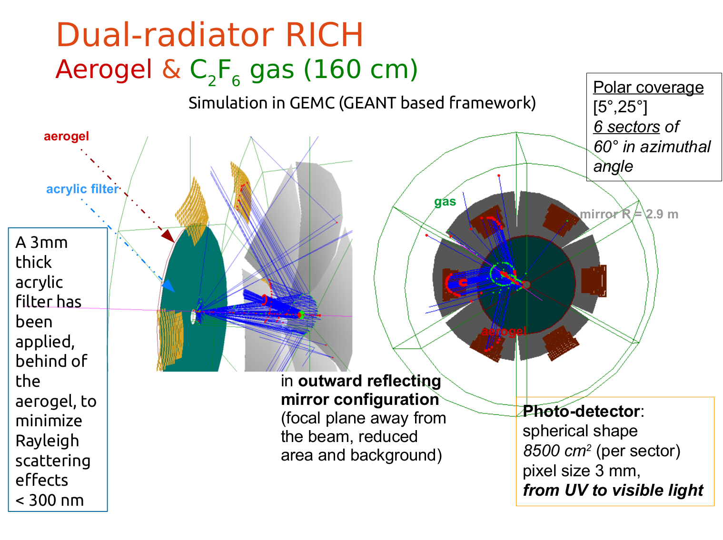
dRICH is in magnetic field (3T central field in simu)
First dual-RICH to demand excellent performance from aerogel radiator!

Slide 13
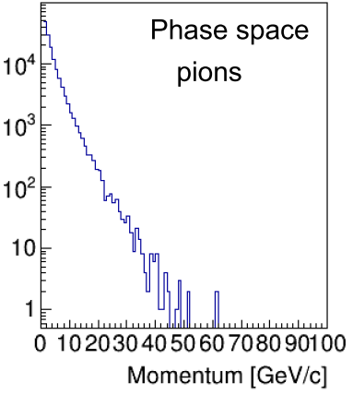
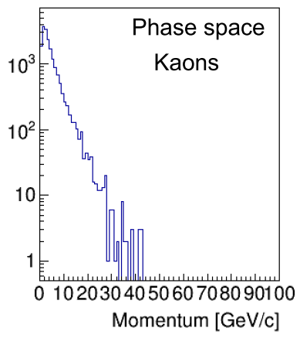
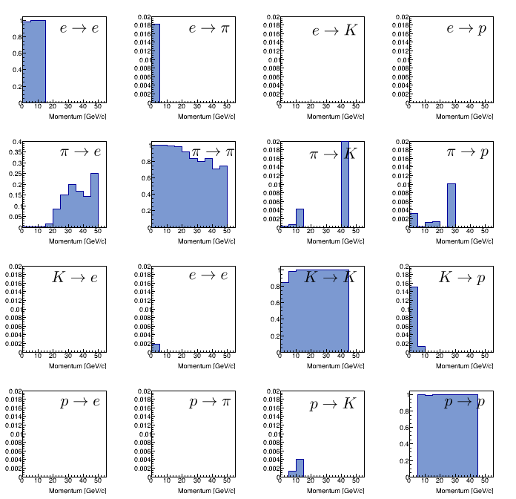
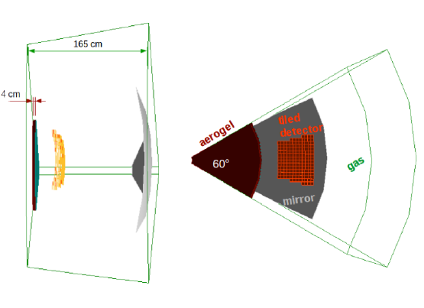
dRICH performance for a key process (Semi-Inclusive DIS)
one of the six dRICH sectors
Momentum Threshold (GeV/c)
Particle | Aerogel (1.02) | C2F6 (1.0008)
e | 0.003 | 0.013
pi | 0.694 | 3.49
K | 2.46 | 12.3
p | 4.67 | 23.5
The PID capability fulfills the design goals

Slide 14
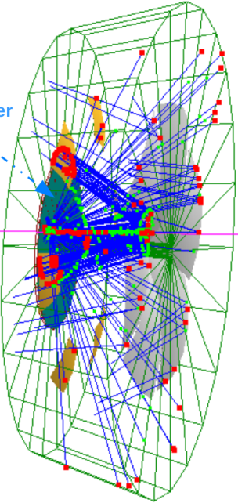
Inverse Ray Tracing: global reconstruction
Nt : tracks (+ background «dummy track»)
Nh : photon hits
Nr : radiators (aerogel and gas)
Np : potential particle types (e,pi,K,p)
PID problem: associate to each track a particle type (based on some sort of Likelihood)
Global «brute force» approach: explore all possible combinations of:
Track ∈ Particle type : Np^Nt
Photon hits ∈ (Track ⊗ Radiator + Background) : (Nt*Nr+1)^Nh
Each combination has an associated Likelihood; take the one that maximize it.
Our approach:
Determine (by IRT) the possible emission angles corresponding to each photon hit
Associate, in sequence, each photon hit to (tracks ⊗ radiator) driven by a Likelihood (L1) that depends on emission angle and a-priori (previous associations) probability; number of combinations drops to (Nt*Nr+1)*Nh
Once all hits are associated, estimate a global Likelihood (L2) for each (track ∈ particle) combination; choose the combination that maximize L2
Example: event with
2 tracks and 15 hits
Brute Force: up to ∼488 billion combinations
Our approach: 1200 combinations

Slide 15
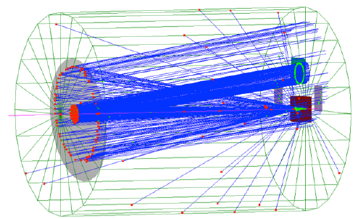
dRICH prototype
Sensors
plane
Why: evaluate critical aspects of the proposed solutions; tune relevant parameters used in MC and consolidate the estimated performances
The prototype must:
mimic the performances of the proposed dRICH components, minimizing modeling and assumptions
be cost effective (trade-off between small scale, versatility and measurable quantities)
The preliminary prototype vessel size (with spherical mirror of ∼2 m radius) driven by two main considerations:
reasonable (order of 10) photoelectrons from gas per particle; depend almost linearly on the thickness (length) of the gas and therefore of the vessel.
catch the aerogel ring (20 cm radius) in order to estimate its angular resolution; constraints the transverse size of the vessel.
We also need to minimize vessel volume, sensor area, isolate aerogel from gas …
Mirror
Aerogel
∼30 cm
∼100 cm
… going to start the detailed definition in coming months

Slide 16
FY19 outlook
Activity | T1 | T2 | T3 | T4 | Funding (USA+ITA) kUSD (1∈ ∼ 1USD)
Finalize the event based (global) IRT reconstruction (article!) |  |  |  |  | Post Doc | Mat erial | Travel
Design the small scale prototype |  |  |  |  | 30* |  | 2.5*
Implement the prototype |  |  |  |  |  | 4.2
Study the interface between gas and aerogel (and long term aerogel characterization, if able to get samples!) |  |  |  |  |  | 1.5
(m+d)RICH - electronics: consolidate design and test SiPM sensor matrix with proper cooling and thermal stability; setting up the lab laser test bench for characterization (also for irradiation campaigns); follow SiPM ongoing development toward rad hard solutions |  |  |  |  |  | 3*
(m+d)RICH - electronics: implement Hawaii (TARGETX/SiREAD) + JLab/CLAS12 readout on chosen front-end; integration/test of the JLab backend and SiREAD |  |  |  |  |  | 2*
* (m+d)RICH
Important components (electronics and sensors) of the dRICH prototype are shared with the mRICH development
CLAS12 infrastructures available in Ferrara will be used for aerogel-gas studies

Slide 17
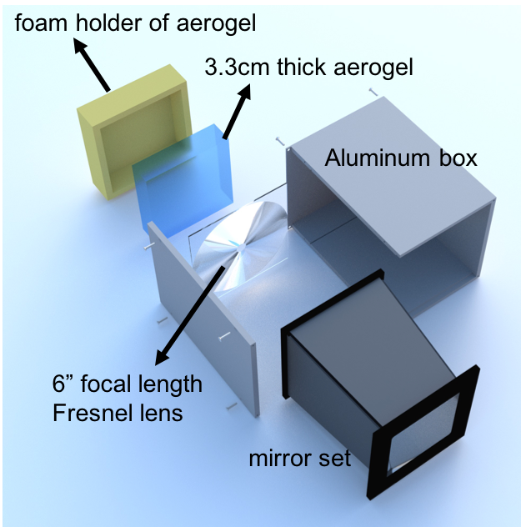
Modular aerogel RICH (mRICH)
Goals:
Compact PID device with momentum coverage up to 10 GeV/c for π/K and e/π up to 2 GeV/c.
First aerogel RICH with lens-based focusing (for performance and cost)
Progress in the 2nd half of 2018:
Completed data quality assurance analysis of the mRICH 2018 test data.
Implemented mRICH detector array in Geant4 simulation built around the sPHENIX solenoid. The results of this effort were included in an EIC detector design study which was submitted to BNL management in October 2018.
Purchased more samples for studying Fresnel lens radiation hardness.

Slide 18
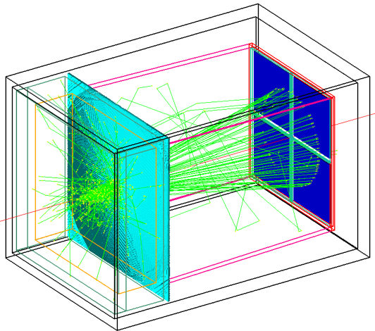
mRICH – lens-based focusing aerogel detector design
Smaller, but thinner ring improves PID performance and reduces length
Fresnel lens
Lens-Based mRICH Design |  | 9GeV/c pion beam launched at the center of xy plane in simulation Smaller and thinner ring image
Two-Layer Proximity Focusing Design (BELLE-2 ARICH) |  | EIC mRICH designed for K/pi ID up to 10 GeV/c BELLE-2 ARICH aims to separate pion and kaon up to 4 GeV/c
Aerogel
Sensor plane
9 GeV/c pion beam launched at the center of xy plane in simulation
Notes:
The modular RICH detector consists of a block of aerogel, Fresnel lens, mirror set and sensor plane.

Slide 19
mRICH – lens-based focusing aerogel detector design
Smaller, but thinner ring improves PID performance and reduces length
Lens-Based mRICH Design |  | 9 GeV/c pion beam launched at the center of xy plane in simulation Smaller and thinner ring image
Two-Layer Proximity Focusing Design (BELLE-2 ARICH) |  | EIC mRICH designed for K/pi ID up to 10 GeV/c BELLE-2 ARICH aims to separate pion and kaon up to 4 GeV/c
9 GeV/c pion beam launched at the center of xy plane in simulation
Notes:
This lens-based design generates smaller and sharper ring image compare to the state of art proximity focusing deisng.

Slide 20
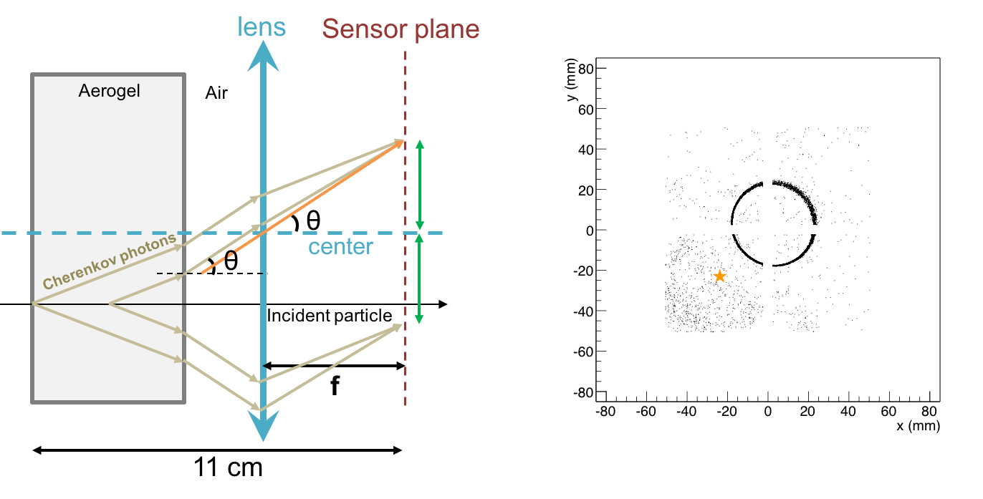
mRICH – lens-based focusing shifts image to center
Ring centering of lens-based optics reduces sensor area (main cost driver)
Lens-Based mRICH Design |  | 9 GeV/c pion beam incident at third quadrant (star) in simulation Ring image is center on the middle of the sensor plane
Two-Layer Proximity Focusing Design (BELLE-2 ARICH) |  | 9 GeV/c pion beam incident at third quadrant (star) in simulation Ring is centered at point of incidence
Notes:
Furthermore, the Cherenkove photons generated at off the optical principle can be shifted to the middle of sensor plane by the lens. These results to less required sensor plane area.

Slide 21
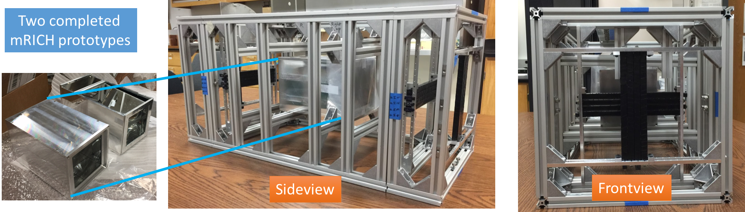
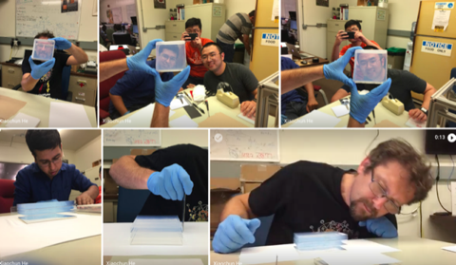
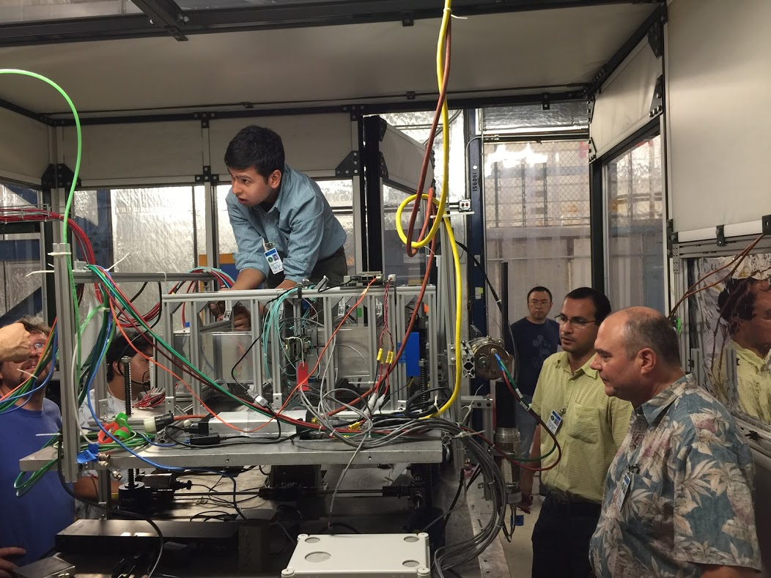
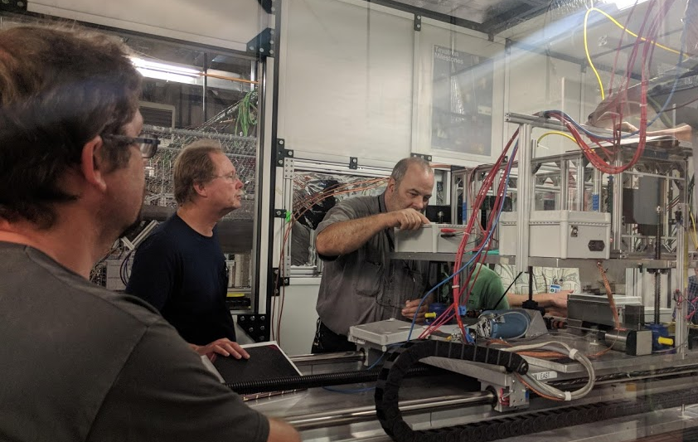
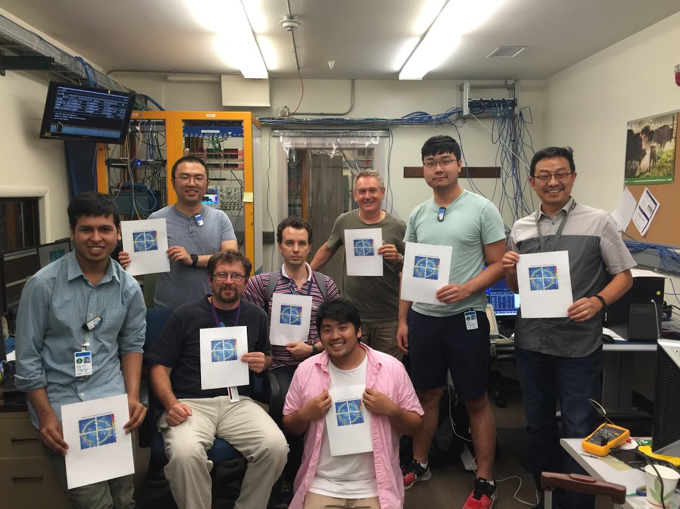
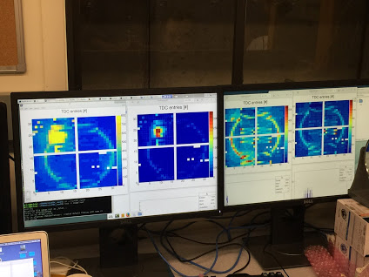
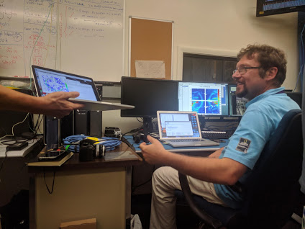
2nd mRICH Beam Test
Another very successful mRICH prototype beam test at Fermilab (6/25 to 7/6/2018)
Group photo (missing two members)
– the first confirmed ring image
Notes:
The first beam test results from last fiscal year will be published in NIM A.

Slide 22
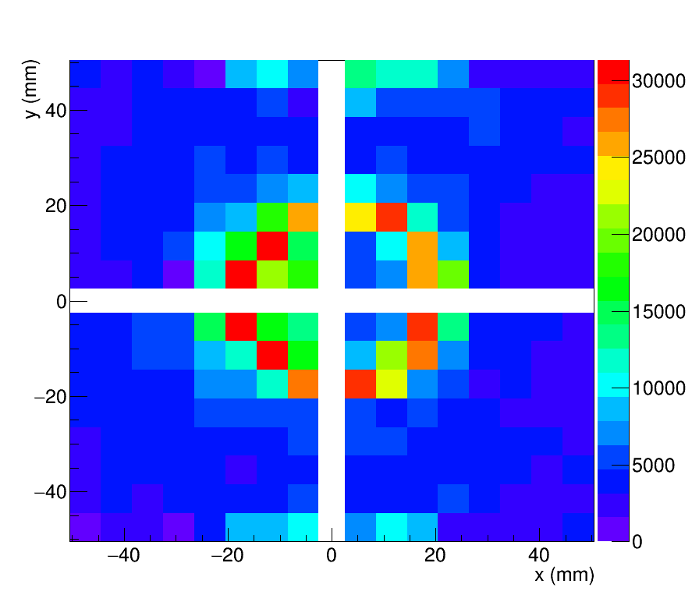
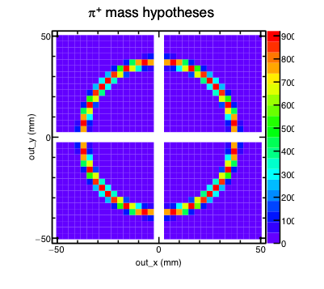
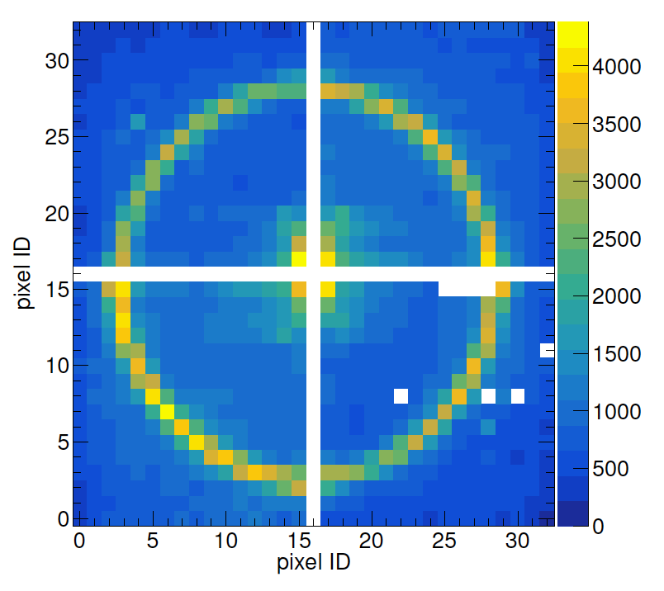
1st and 2nd Beam Test Comparison (120 GeV Proton Beam)
The 1st test beam result verified mRICH working principle and validated simulation
1st mRICH prototype was tested at Fermilab Test Beam Facility in April 2016
Images from 120 GeV
Proton beam
Simulated Images
Using GEANT4
New features: a) separation of optical and electronic components; b) longer focal length (6”); c) 3mm x 3mm photosensors.
2nd mRICH prototype was tested at Fermilab Test Beam Facility in June/July 2018

Slide 23
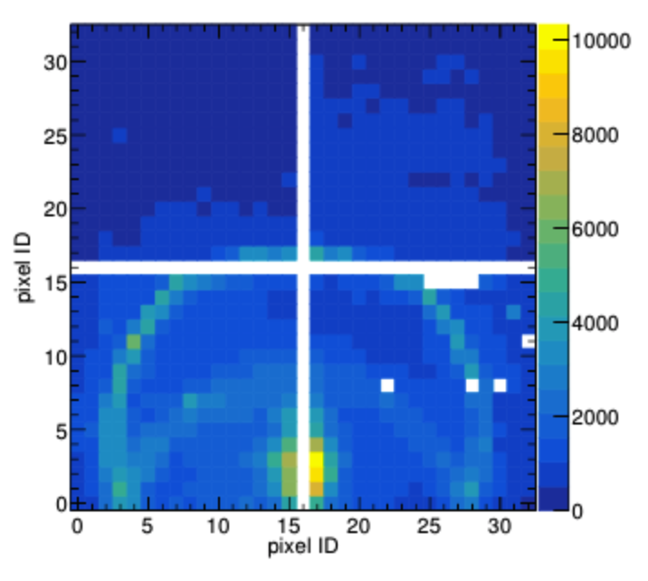
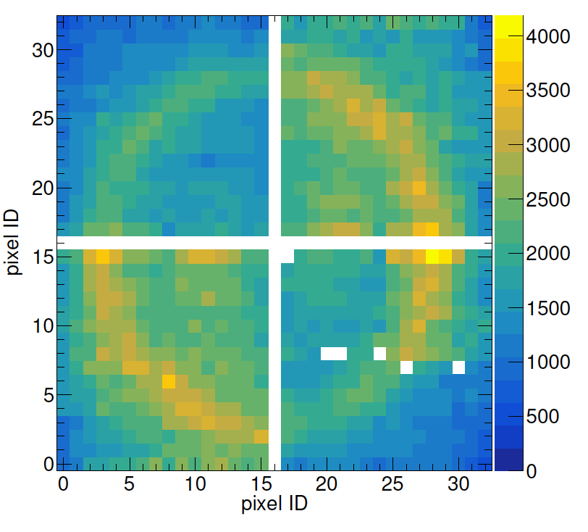
Completed Data QA Analysis for the 2nd Beam Test
Examples of cumulative ring images from the second mRICH prototype beam test
Left: ring images formed by 120-GeV primary proton beam incident on the center of mRICH. White gaps are the PMT frames.
Middle: ring images from 120-GeV primary proton beam incident at an angle of 11° toward the lower section of mRICH.
Right: images from an 8-GeV meson run. The challenge of this analysis is to determine the beam position since the beam hodoscope readout was not ready for this test.
Four Hamamatsu H13700 PMTs (3mm x 3mm pixel size; 16x16 channels) were used in these test runs. Each costs ~$5k. These sensors will NOT work in high magnetic field!!!

Slide 24
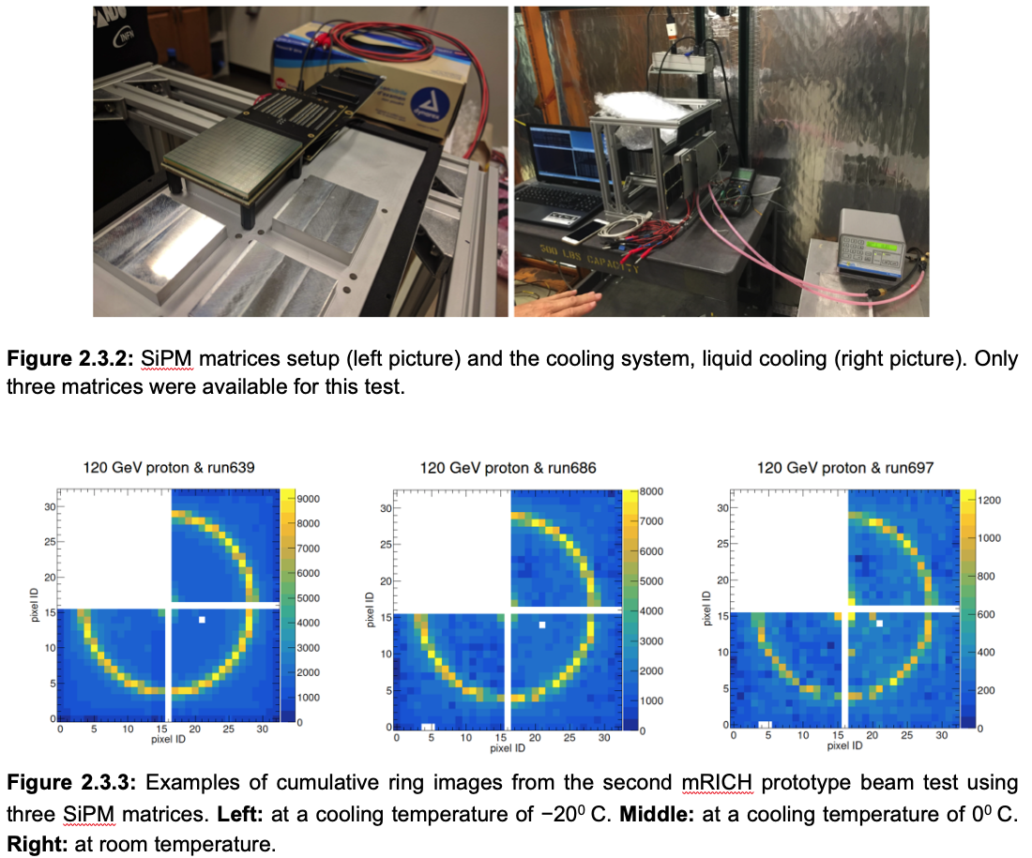
mRICH Ring Images from SiPM Sensors
SiPM matrix: 16 x 16 channels, 3mm x 3mm pixel size
To meet the requirement of operating photosensors in high magnetic field in EIC experiment, we successfully demonstrated ring imaging construction using mRICH in the 2nd beam test. There were only three Hamamatsu SiPM matrices available at the time of this test. Given the limited beam time, we only took data with the primary proton beam at 120 GeV with cooling temperature settings at
-30ºC, -20ºC, -10ºC, 0ºC and room temperature.
SiPM
Room
temp
-20ºC
0ºC
See details in the progress report

Slide 25
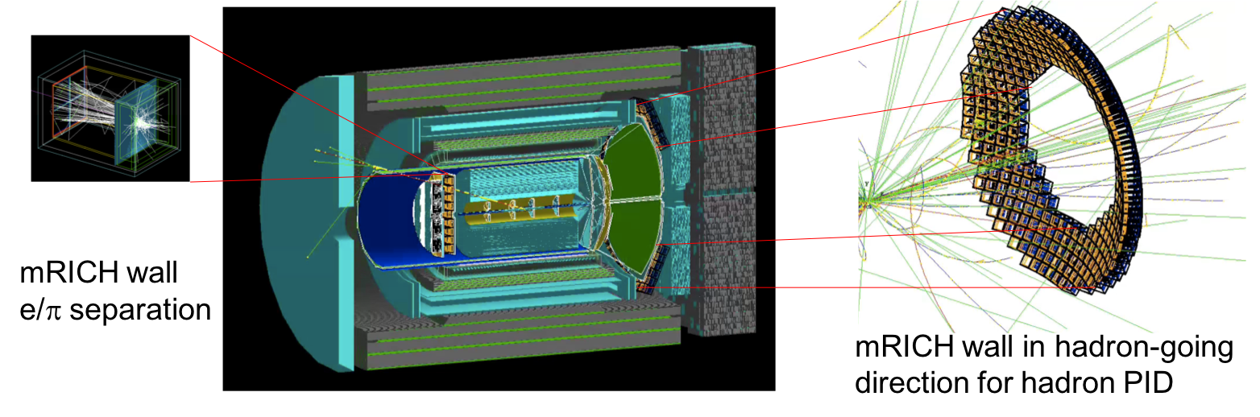
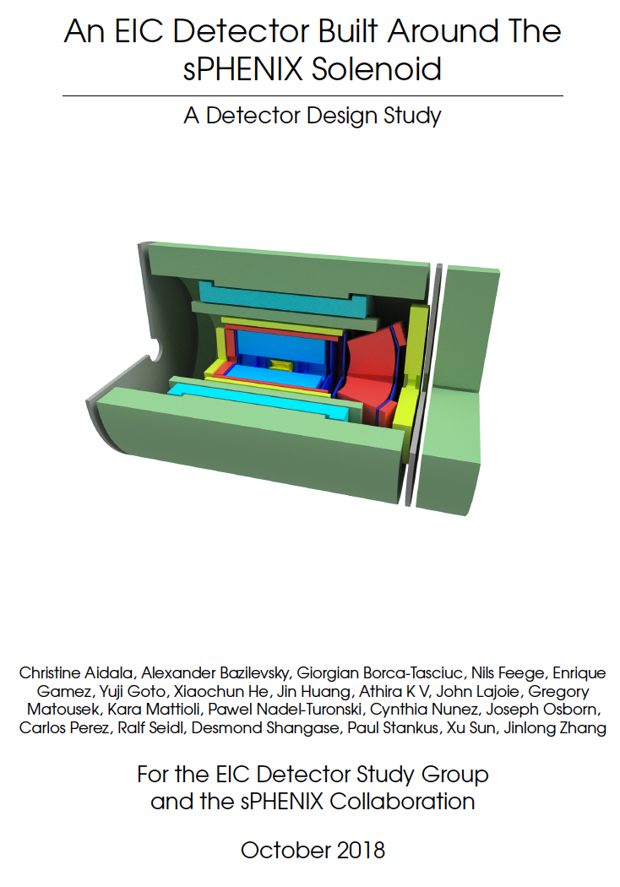
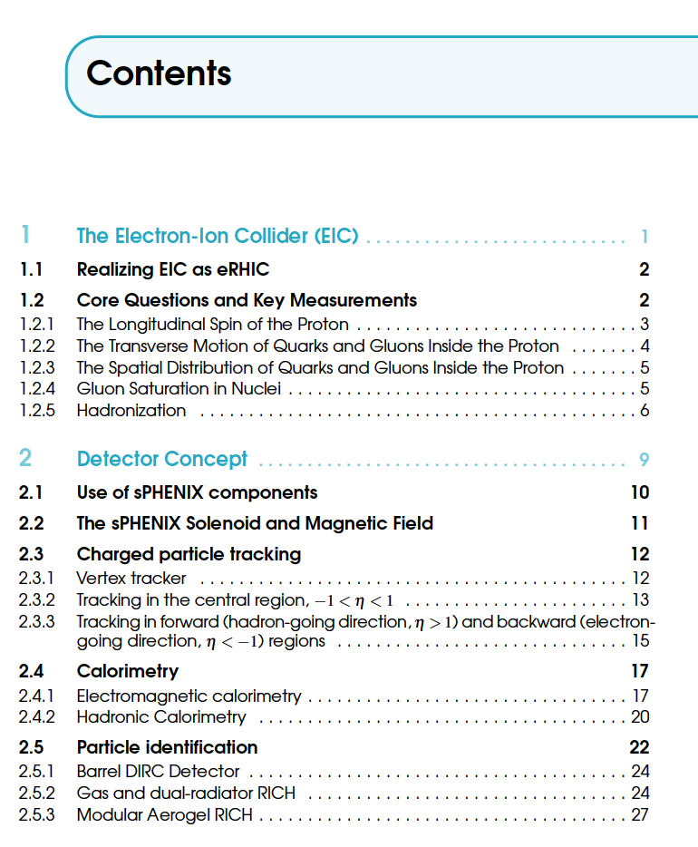
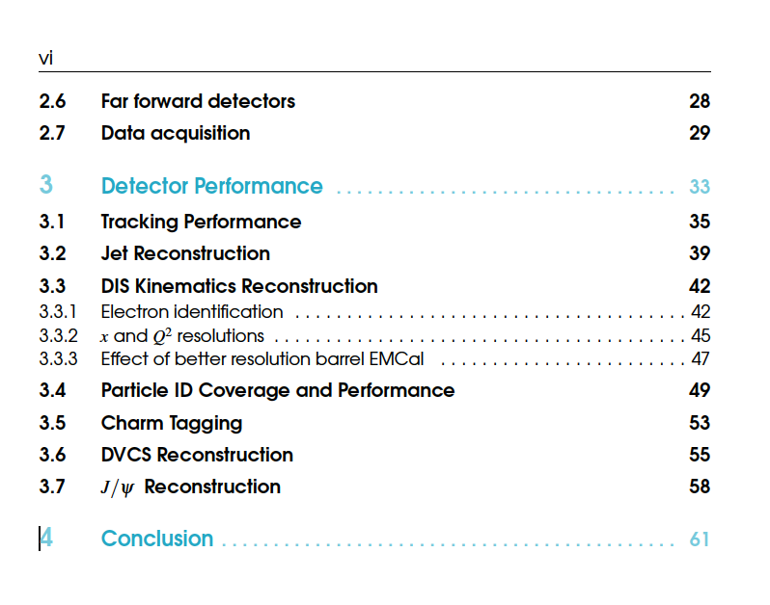
mRICH in an EIC Detector Built Around the sPHENIX Solenoid

Slide 26
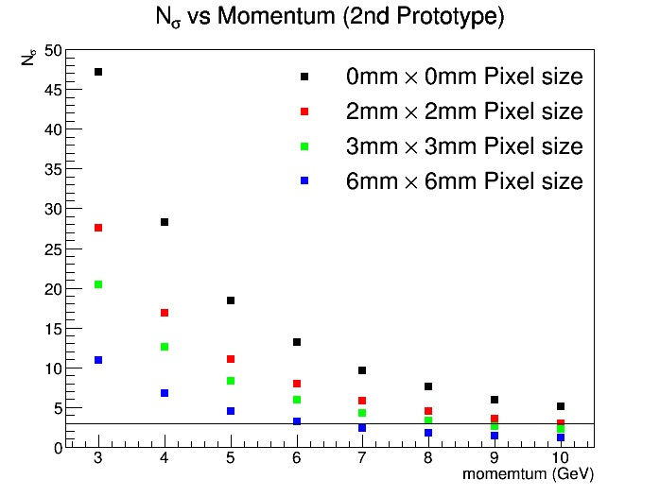
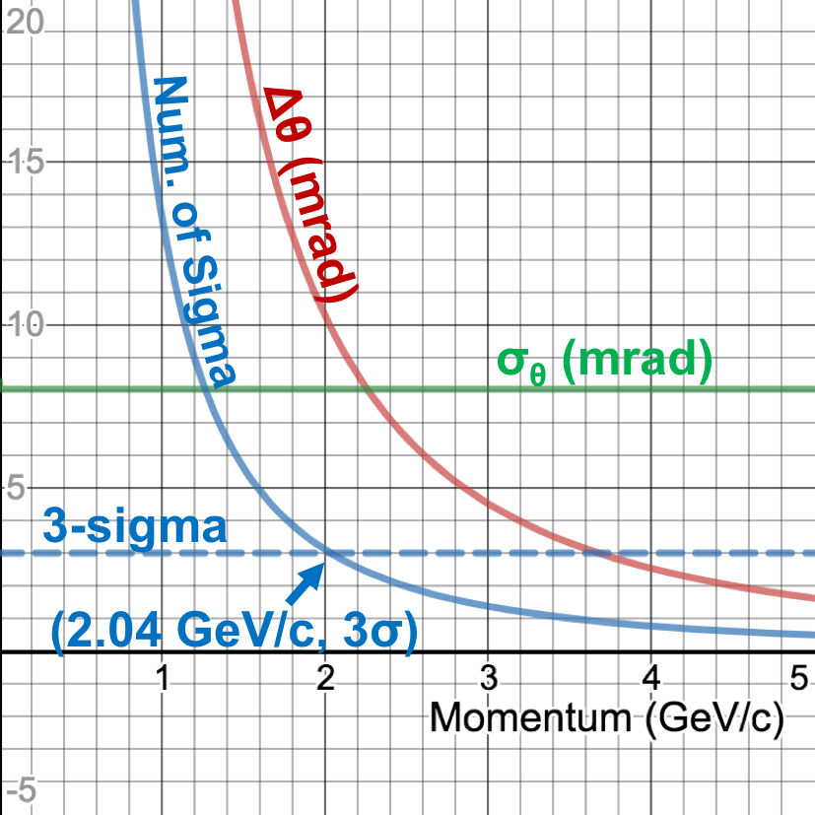
mRICH – FY19 activity (part one)
Data analysis of the 2nd mRICH beam test and publish the new results – verify the PID performance at 2, 5 and 8 GeV/c
Projected K/pi separation of mRICH 2nd prototype detector (Green dots)
2nd prototype detector can achieve 3-sigma K/pi separation up to 8 GeV/c
Projected e/pi separation of mRICH 2nd prototype detector (blue solid line)
2nd prototype detector can achieve 3-sigma e/pi separation up to 2 GeV/c
Data sets taken during the second mRICH beam test at Fermilab in June/July 2018

Slide 27
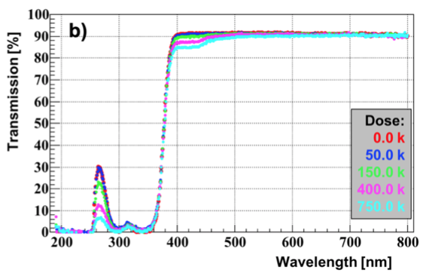
mRICH – FY19 activity (part two)
Study of the radiation hardness of Fresnel lens (i.e., address the committee concern!) in spring 2019 at BNL using ⁶⁰Co source together with DIRC team to confirm the earlier test result shown below. Have purchased more lens samples from Edmund for this test.
Simulation study of mRICH performance in the Forward sPHENIX experiment at BNL (ongoing effort).
Simulation study of mRICH performance in the electron endcap in JLEIC (ongoing effort).
Work with dRICH group to develop a plan for a join dRICH/mRICH beam test.
Tested by Greg Kalicy. 2 mm-thick acylic mRICH lens sample. A small drop of transmission was observed below 500 nm. This material seems surprisingly radiation hard even after a dose of 750 krad.

Slide 28
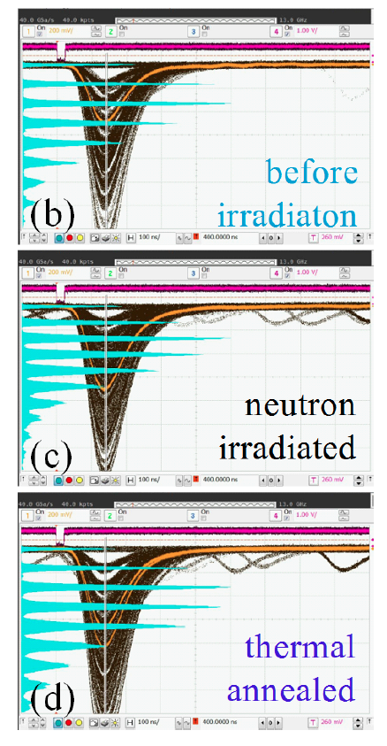
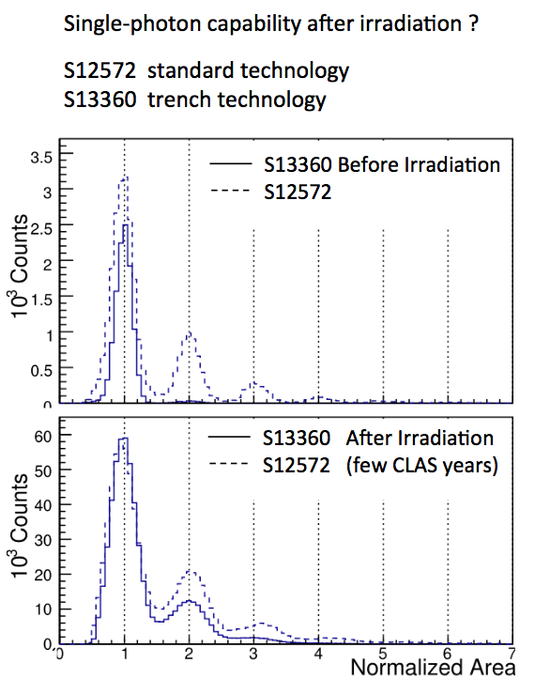
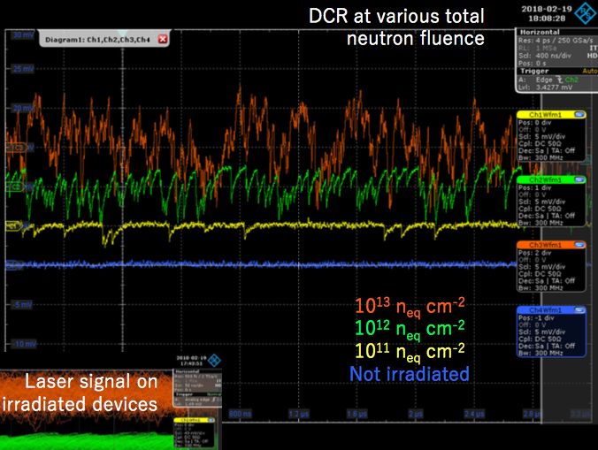
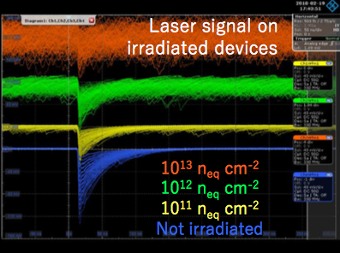
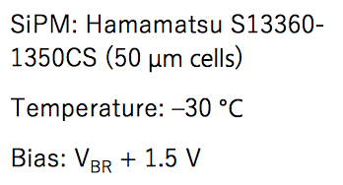
Studies of SiPM radiation toleranace
T. Tsang et al.
JINST 11 (2016) P12002
I. Balossino et al.
NIMA 876 (2017) 89
Paolo Carniti
@ RICH 2018
T= 0 C
few 10⁹ n_{eq} cm²
T= 84 K
10⁹ n_{eq} cm²
Annealing at 250 ºC
The viability of using irradiated SiPMs for single-photon detection at the EIC will be the focus of future R&D on this topic.
Notes:
Fare una immagine del PMT sulla risoluzione

Slide 29
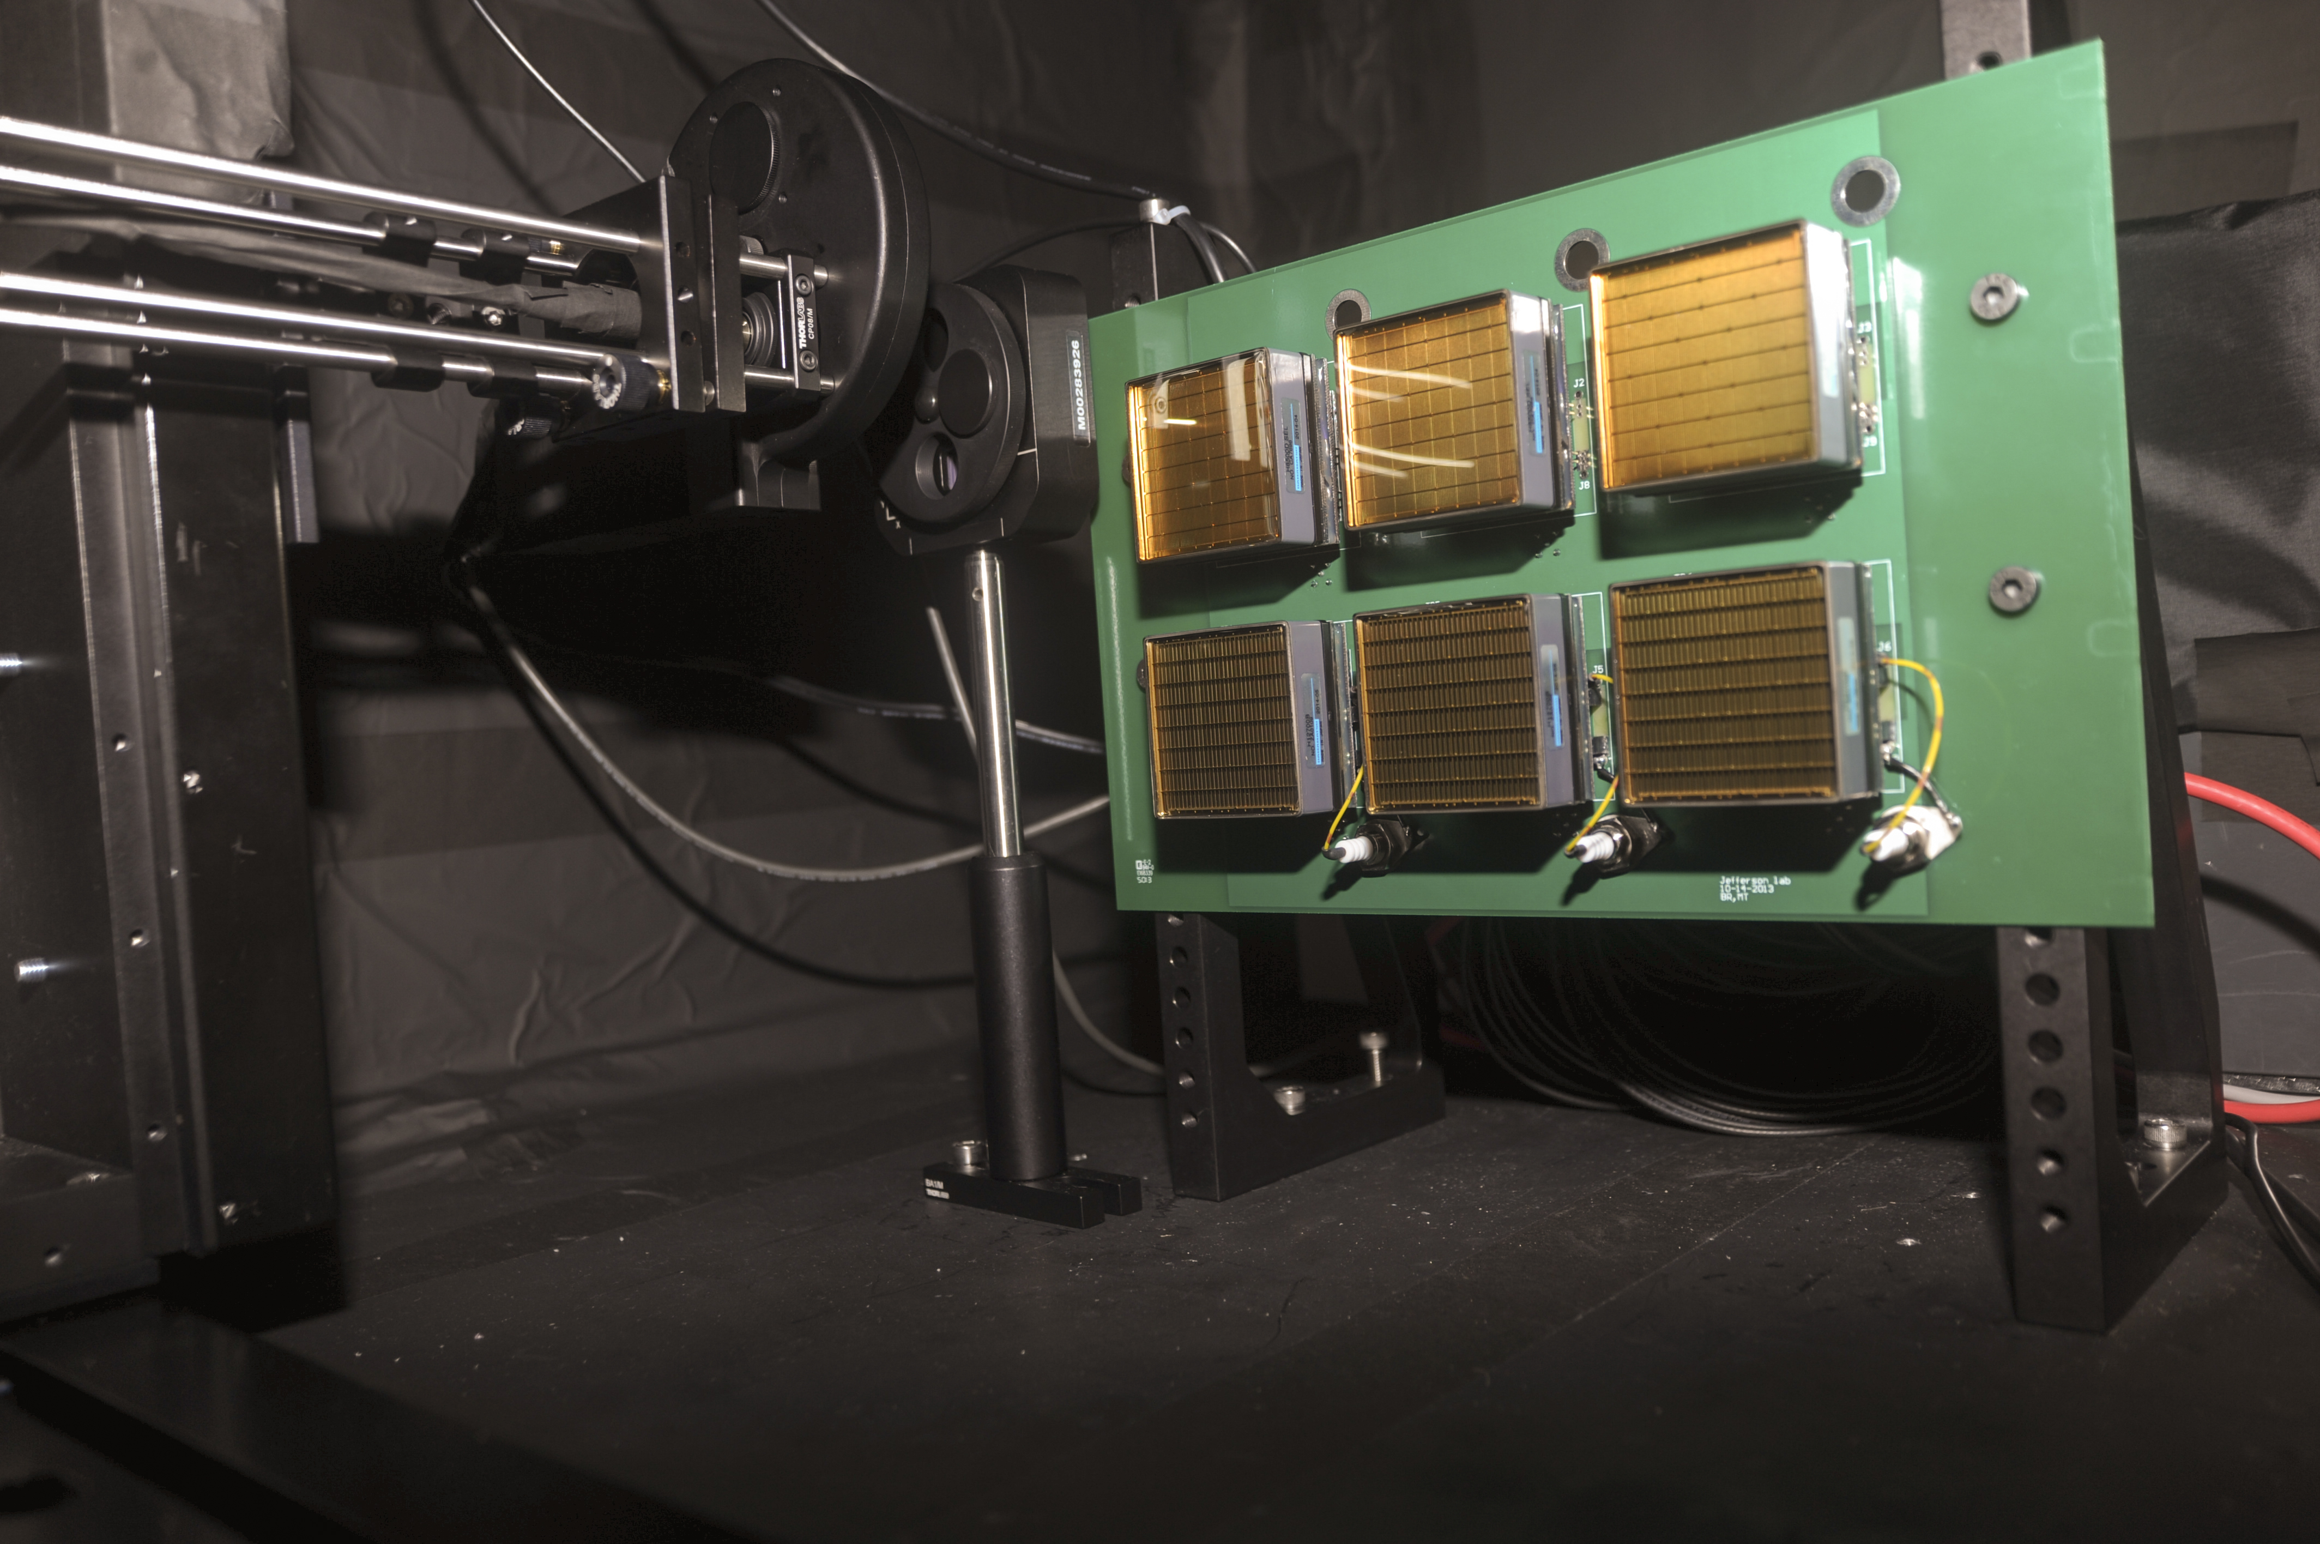
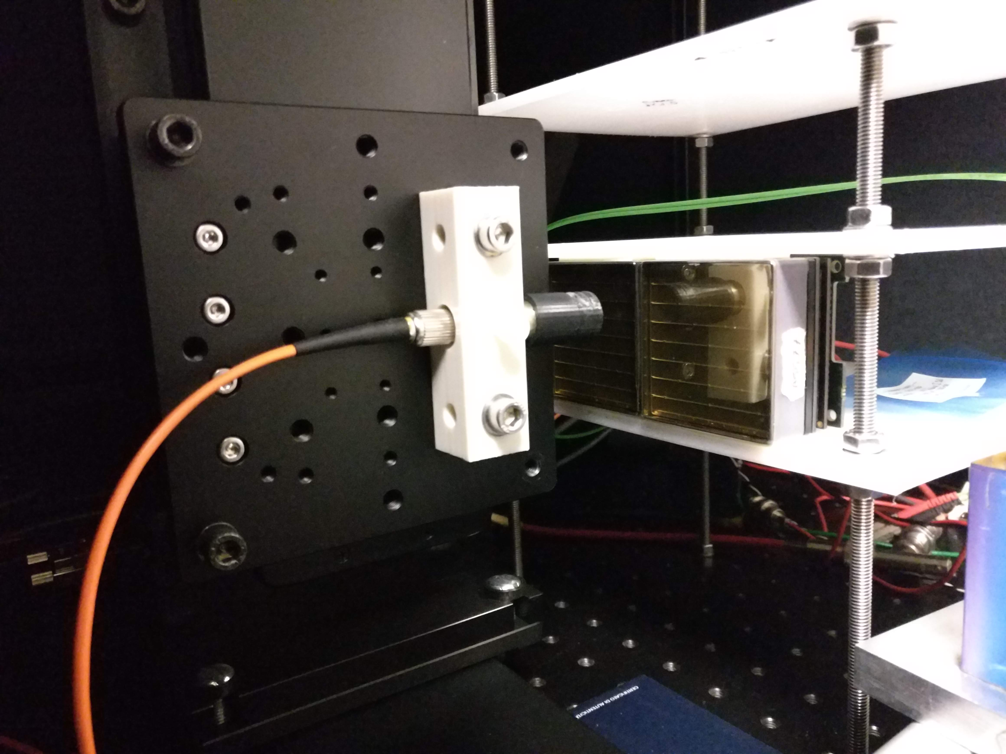
Pulsed laser test benches
Detailed characterization
Sensors: gain, efficiency, cross-talk, radiation tolerance
Electronics: gain, cross-talk, thresholds, time resolution
JLab
632 nm picosecond pulsed laser light
Light diffuser to illuminate the whole MaPMT surface
Standardized system with CLAS12 electronics
H8500 6x6 mm² pixel sensor so far
Laser head +
diffuser
MAPMT holder
Ferrara
632 nm and 407 nm picosecond pulsed laser light
Light concentrator to scan the pensor surface
Flexible layout supporting various sensors and
Front-End electronics
Laser head +
collimator
MAPMT holder
Notes:
Fare una immagine del PMT sulla risoluzione

Slide 30
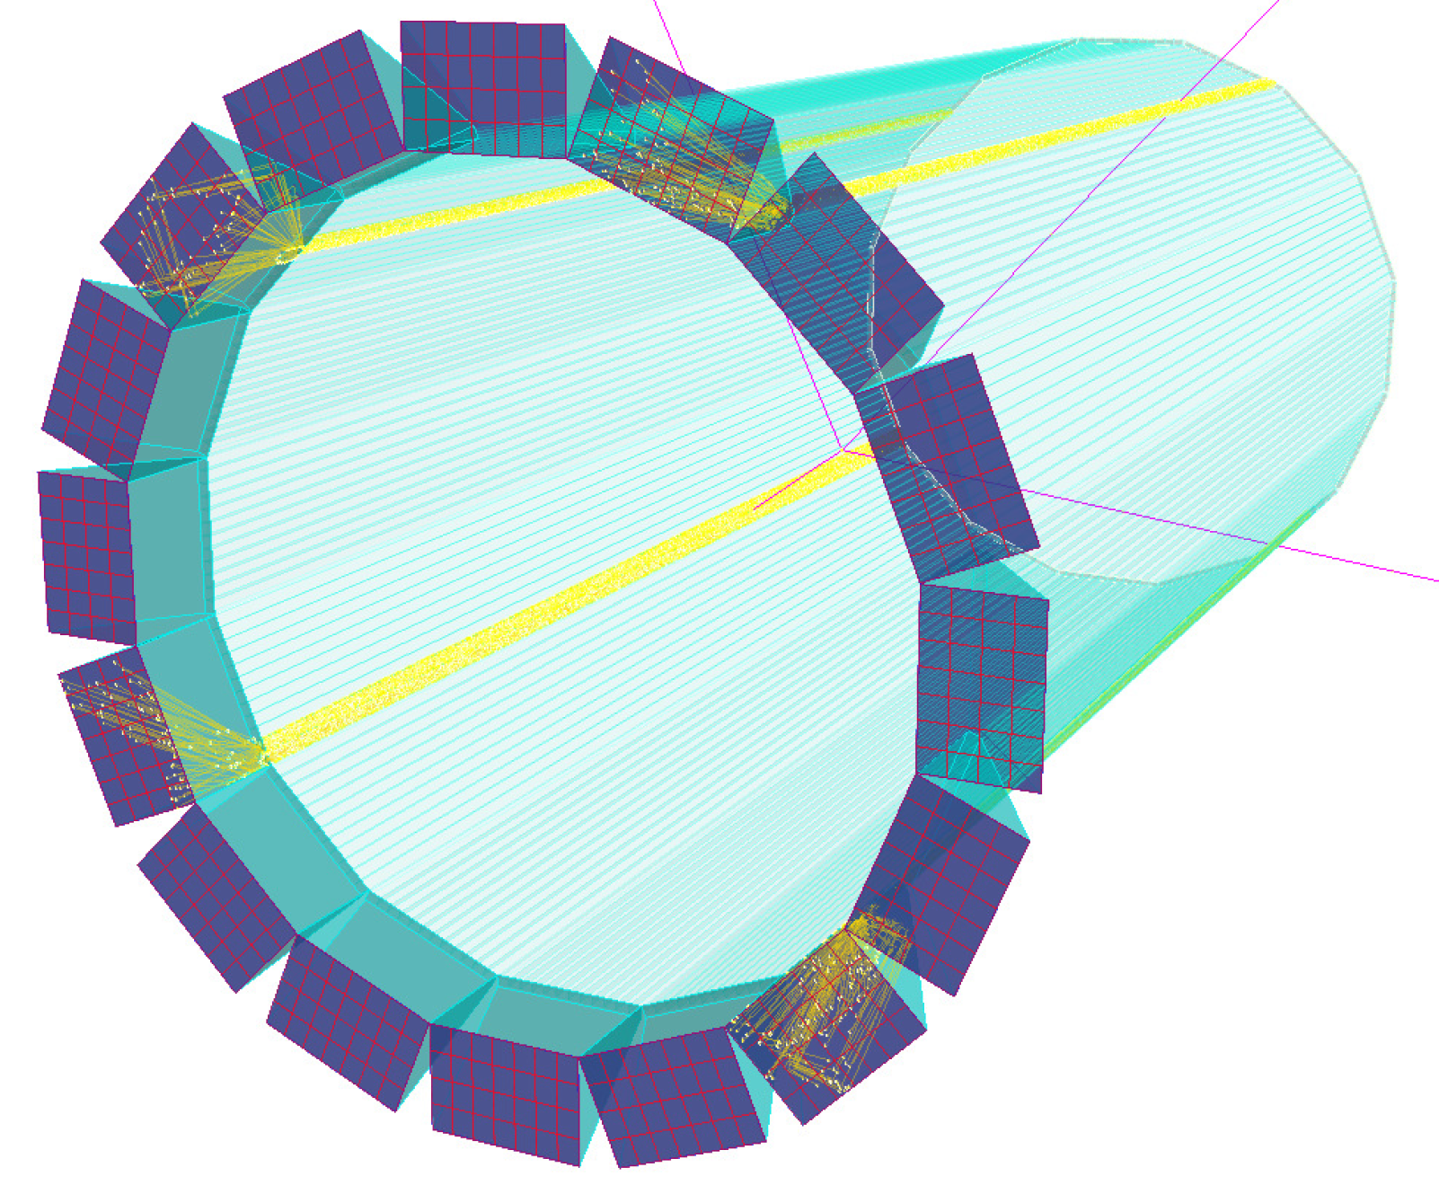
High-performance DIRC
Goals:
Very compact device with coverage up to 10 GeV/c for p/K, 6 GeV/c for π/K, and 1.8 GeV/c for e/π, pushing performance well beyond state-of-the-art
First DIRC aiming to utilize high-resolution 3D (x,y,t) reconstruction (performance and cost)
Progress in 2nd half of 2018:
Successful radiation hardness study of lens materials at BNL
Order process for two custom-made 3-layer lenses using sapphire and PbF₂ as the middle layer is close to completion
Successful beam test of the PANDA Barrel DIRC prototype performed at CERN

Slide 31
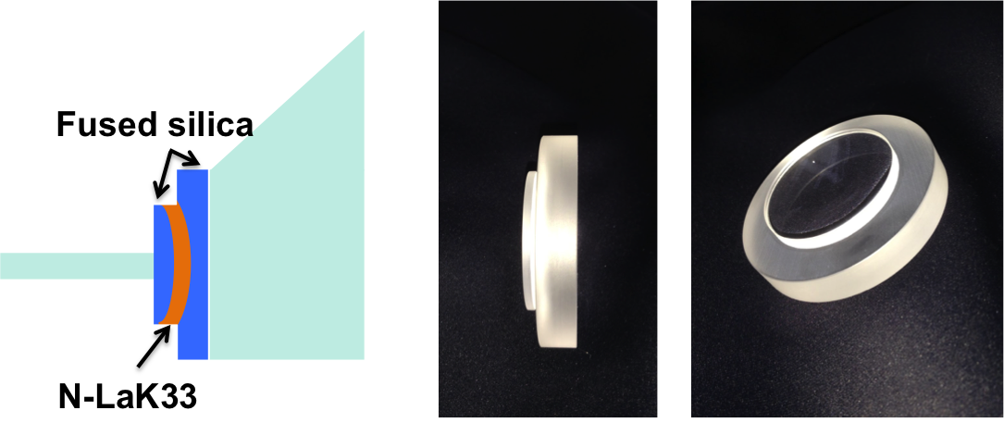
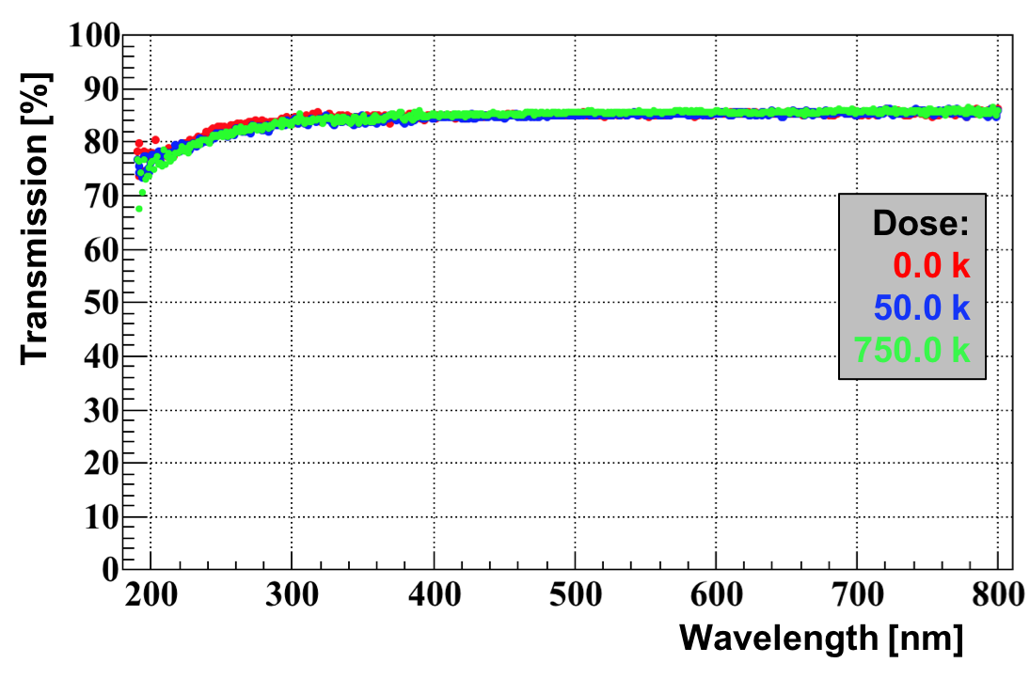
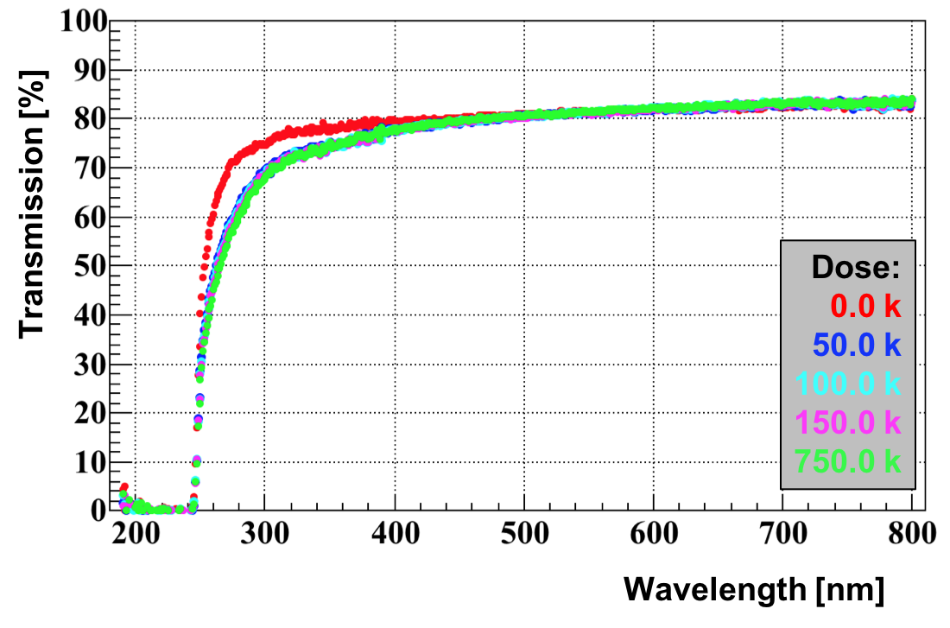
DIRC – overview
3-layer lens
Radiation hardness test in ⁶⁰Co source
Detailed radiation hardness study was performed at BNL, five materials were tested up to 750 krad.
Sapphire and PbF₂ were confirmed to be very radiation hard.
Radiation hard 3-layer lens prototypes
Both sapphire and PbF₂ present new manufacturing challenges that have to be addressed by potential vendors.
Discussions are at final stage to complete the purchase of two custom-made 3-layer spherical lenses using sapphire and PbF₂ as the middle layer.
Sapphire
Reducing sensor coverage
The successful beam test of the PANDA Barrel DIRC prototype identified the potential for a significant reduction in the number of sensors required to cover the detector plane.
PbF₂

Slide 32
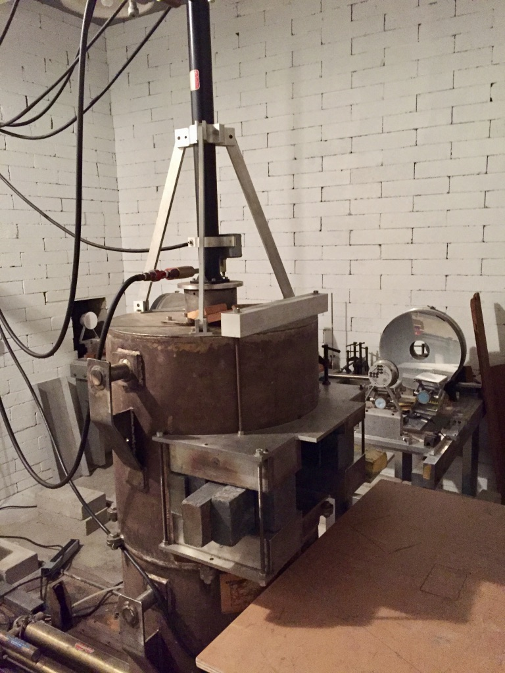
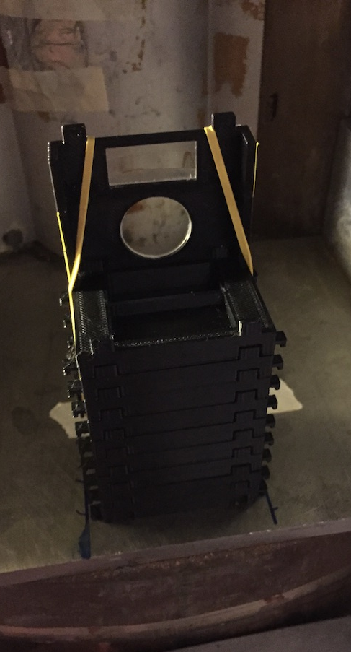
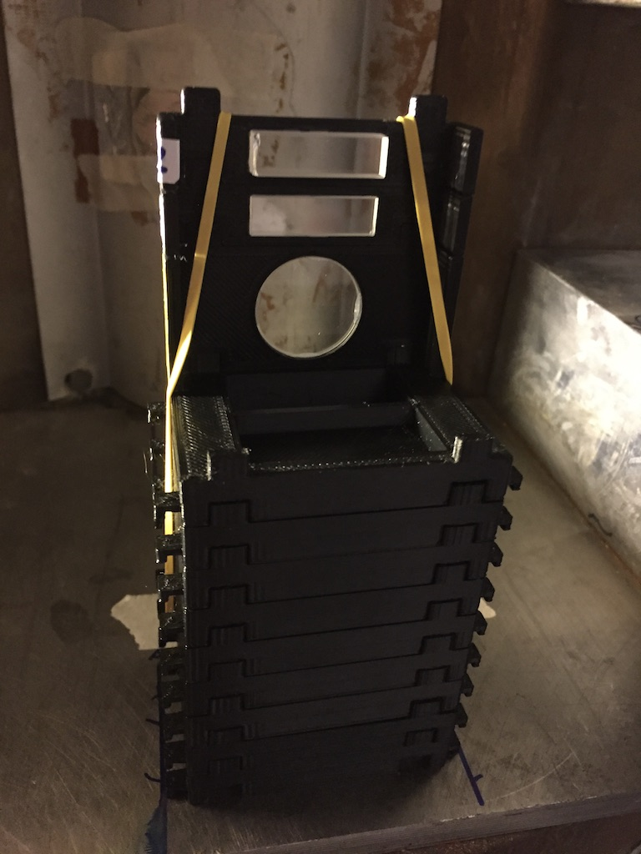
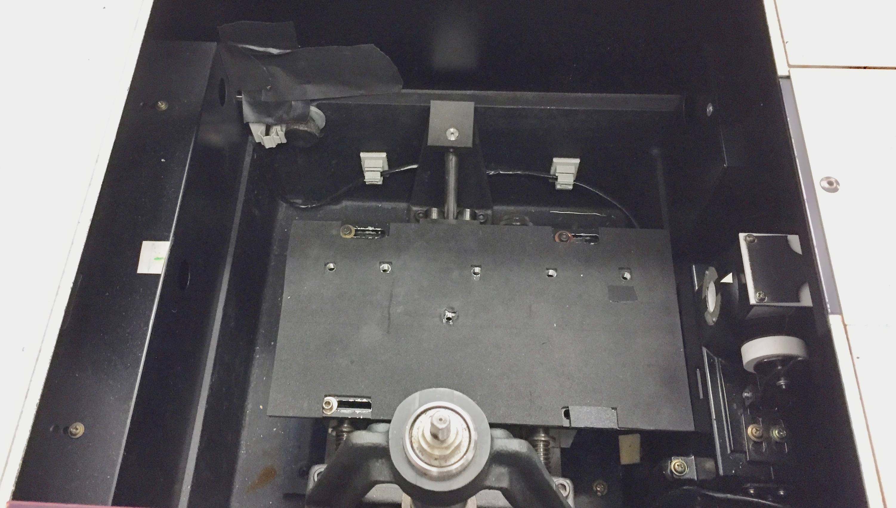
Radiation Hardness Test
Co⁶⁰ Chamber
⁶⁰Co irradiation setup at BNL
Radiation damage quantified by measuring the transmission in the 190-800 nm range in a monochromator.
Five materials studied.
Sapphire and PbF₂ confirmed to be radiation hard.
Tested samples
Monochromator

Slide 33

Radiation Hardness Test
Sapphire
⁶⁰Co irradiation results
Radiation damage quantified by measuring the transmission in the 190-800 nm range in a monochromator
Five materials studied
Radiation hardness of sapphire and PbF₂ confirmed
PbF₂
Tested samples

Slide 34


Radiation Hardness Test
S-YGH51 (NLaK33 equivalent)
⁶⁰Co irradiation results
Radiation damage quantified by measuring the transmission in the 190-800 nm range in a monochromator
Transmission loss of alternate lanthanum crown glass material (S-YGH51) confirmed
Acrylic glass samle for mRICH Fresnel lens quite radiation hard.
mRICH Fresnel lens material
Tested samples

Slide 35



2x4 MCP-PMT arrangement
Reducing sensor coverage
PANDA Barrel DIRC prototype at CERN PS in July/Aug 2018: reduced number of MCP-PMTs.
Caveat: larger sensor pixels, slower electronics than EIC DIRC → PANDA goal: 3σ π/K separation @ 3.5 GeV/c
Optics similar to EIC DIRC design: narrow bar, fused silica prism, 3-layer spherical lens
Reduced MCP-PMT coverage by 33% compared to 2017, gaps near prism sides (data analysis ongoing)
Measured key quantities: photon yield, Cherenkov angle resolution per photon and per particle, and π/K separation power – all in good agreement with simulation (used for EIC DIRC)
PID performance in 2018 close to 2017 results (photon yield lower but π/K separation still > 3σ)
Impact of reducing number of sensors promising, has to be tested in EIC simulation.
Example of hit pattern
π/p separation power at 7 GeV/c
preliminary
(equivalent to π/K @ 3.5 GeV/c)

Slide 36


FY19 outlook
Two more radiation hardness tests planned for winter/spring and summer 2019 with the goal to produce NIM publication draft by the end of FY19.
Two new prototype lenses with sapphire and PbF₂ will be build and studied on test bench to qualify their imaging properties.
The laser setup for the 3D mapping of the focal plane will be upgraded to improve measurement precision with the goal to produce NIM publication draft by the end of FY19.
Simulation studies of the reduced sensor coverage and of the impact of the very good timing precision (rms of 100ps or better) of the LAPPD sensors prototypes on the PID performance will be performed.
Administrative aspects and detailed plans of the transfer of the DIRC prototype from GSI to CUA will be finalized.

Slide 37
Photosensors and Electronics
Goals:
To evaluate commercial photosensors for EIC PID detectors and to develop alternative, cost-effective photosensors (LAPPDs).
To develop readout electronics for PID detector prototypes.
Activities:
Evaluation of photosensors in high-B fields at JLab.
Adaptation of LAPPDs to EIC requirements at ANL.
Adaptation of readout electronics (U. Hawaii and INFN-Ferrara) to detector PID prototypes.

Slide 38
Sensors in High-B Fields
Goals:
Identify the limitations of current MCP-PMTs and provide guidance for development of new photo-sensors.
Find the optimal location and orientation of sensors in the EIC detector.
Example: tilt angle with respect to the local B-field; different sensor options
Investigate suitable parameters for operations in high magnetic fields.
Progress in 2nd half of 2018:
Construction, installation, and commissioning of a timing upgrade for timing measurements (fast laser system, electronics).
Efficiency evaluation of a 10-μm Planacon MCP-PMTs as a function of field, orientation, and HV_{photocathode-MCP1}.
Ion feedback measurement as a function of HV and B-field magnitude.

Slide 39
Results from Summer 2018 Efficiency Studies
10-μm Planacon: Relative efficiency and Relative gain
Efficiency: ε = N_{1phe}/N_{ped.}
At θ=20° between the sensor and the B-field axes, the efficiency drops continuosly as B increases even though the gain shows a maximum at 0.3 T.
An increase of HV_{photocathode-MCP1} by 200 V (close to maximum allowed) recovers only about 13% of the efficiency (θ=20°).

Slide 40
Results from Summer 2018 Ion-Feedback Studies
10-μm Planacon: Ion Feedback
The accuracy of the extracted ion-feedback rate strongly depends on the noise of the signal line. The value of the threshold amplitude defining a signal, A_{thr}, critically affects the estimate of ion feedback rate.
signal no ion signal
signal no ion signal
A_{thr}
A (ADC ch.)
time interval
probed for
delayed (ion) signals
A_{thr}
noise with large amplitude
t (ns)
t (ns)
signal
ion signal
ion signal
A (ADC ch.)
A_{thr}
signal
A_{thr}=233
A_{thr}
noise with large amplitude
t (ns)
t (ns)

Slide 41
Results from Summer 2018 Ion-Feedback Studies
10-μm Planacon: Ion Feedback
Too low A_{thr} leads to an overestimate of the ion-feedback rate due to some noisy waveforms. A_{thr}=233 is the best empirically found value for Summer 2018 data.
Problem: Waveforms where A_{signal} < A _{thr} or/and A_{ions} < A _{thr} are not taken into account.
Rate is evaluated over a range of A_{thr.} Rate(A_{thr}=Pedestal) is obtained from a linear fit to the high-A_{thr} tail. This is the best estimate of the true ion rate, i.e. as would be obtained if there were no noise on the waveform, but only signal(s).

Slide 42
Results from Summer 2018 Ion-Feedback Studies
10-μm Planacon: Ion Feedback
−2.7 kV
−2.65 kV
−2.6 kV
−2.55 kV
−2.5 kV
Hv_{max} = −2.8 kV
Δ=Rate(A_{thr}=Pedestal)−Rate(A_{thr}=233). Reported above:
At all voltages the ion rate is below 2%.
Results suggest that ion-feedback is primarily driven by HV.
Ion-feedback rate dependence on B-field magnitude is relatively weak.

Slide 43
Outlook
Planned FY19 activities
Timing measurements of a 10-μm Planacon.
Some gain and efficiency measurements to understand trends observed in 2017-2018.
Work on a simulation for optimization of MCP‒PMT design parameters as time permits.

Slide 44

MCP-PMT/LAPPDTM
Goal:
Adapt LAPPDTM to the EIC requirements:
Highly pixelated LAPPDTM working at 2~3 Tesla, to be used as photosensors
for mRICH, dRICH, and DIRC detectors, as well as TOF applications.
Progress in the 2nd half of 2018:
Produced and tested 6cm MCP-PMT with Incom 10 µm pore size MCPs, the spacing is the same as current standard design
Ordered glass components (side wall and spacer), designed and prepared for another 10 µm MCP-PMT with reduced spacing
Enhanced communication with Incom, Inc on LAPPDTM, much stronger ties
Initiated MCP-PMT simulation effort to guide MCP-PMT design
Performed initial test of newly produced LAPPDTM compatible in high magnetic field
Establishing 2D single photoelectron efficiency and TTS timing scan capability

Slide 45


Fabrication of MCP-PMTs with 10 μm pore size MCPs

Slide 46


MCP-PMT performance improvement with 10 μm MCPs
- Same stack height, no spacing reduction yet
version 2: IBD design 20 μm
version 3: IBD design 10 μm
Rise time
Gain

Slide 47


MCP-PMT performance improvement with 10 μm MCPs
- Same stack height, no spacing reduction yet
Timing resolution (SPE)
version 2
version 3
$$σ_{MCP−PMT}= \sqrt{σ_{1}^{2}−σ_{Laser}^{2}−σ_{Ele.}^{2}}$$
σ_{TTS} ~ 63 ps
σ_{TTS} ~ 20 ps
System: σ₁ = 37.2 ps
Laser jitter: σ_{Laser} = 30 ps
Electronics: σ_{Ele.} = 7 ps
10 μm MCP-PMT: σ = 20 ps
Magnetic field tolerance
V3 achieved 100 ps rms timing, which is critical for future DIRC applications!
20 μm MCP-PMT | 10 μm MCP-PMT
0.7 Tesla | 1.3 Tesla

Slide 48

Enhanced communication with Incom on LAPPDTM
The advices and recommendations from the committee and feedbacks from EIC users were well explained and emphasized during ANL-Incom bi-weekly meetings.
Pixel LAPPDTM is available for the first time; negotiating for one to be delivered to ANL.
Current demonstrated pixel size: 25 mm x 25 mm
QE uniformity issue was solved here!

Slide 49





Magnetic field test on new LAPPDTM - without magnetically sensitive components
A new LAPPDTM without magnetic sensitive components was delivered at ANL for a one day test.
SBIR Phase I was fulfilled, Phase II will be submit at end of Jan. 2019.
5 HV bias connection
LAPPDTM shows better B field tolerance than the 6cm one with individual HV biases.
preliminary
preliminary
preliminary
The B field tolerance can also be further enhanced by adjusting the HVs, further study planned.

Slide 50
FY19 plans and outlook
Achieve great improvement from 0.7 T to 1.3 Tesla, and ~ 20ps timing (SPE) (Done)
2nd magnetic field testing of 20 cm LAPPD (Done)
Laser setup and approval (Done)
SBIR Phase II application (Jan. 29, 2019)
Fabrication and testing of MCP-PMT with 10 um MCPs and reduced space
Detailed testing and comparison of ANL version 2, 3, 4 MCP-PMTs in B field with fast laser setup
Establish uniformity scan capability
MCP-PMT simulation

Slide 51
Readout Electronics
Goals:
Develop an suite of readout electronics for all photosensors used by the Cherenkov detector prototypes.
Need to read out MCP-PMTs and SiPMs with 3 mm pixels
The DIRC also requires good timing (< 100 ps)
Progress in 2nd half of 2018:
Maroc-based CLAS12 front end was used for the first two mRICH beam tests, demonstrating 3 mm pixel compatibility, and is currently utilized for ongoing mRICH, dRICH, and SiPM R&D
Maroc is not an option for the DIRC due to its poor timing
A front end based on TARGETX (used in Belle II) is being developed in Hawaii to meet the requirements of all detectors, including the DIRC.
TARGETX will eventually be replaced by the new SiREAD chip
A generic DAQ system for all the consortium needs is deing developed by INFN

Slide 52




MaPMT (H13700) readout used in the mRICH beam test
Derived from CLAS12 RICH readout:
1024 channels
MAROC 64 channel parallel digitalization
FPGA generated 1 ns timestamp
DAQ protocol based on VME/VSX SSP
Custom adapter boards
- Compact distribution
Use of existing MAROC boards
Light and gas tightness
Notes:
Fare una immagine del PMT sulla risoluzione

Slide 53



SiPM readout used in the mRICH beam test
Dedicated board for readout and cooling
of a surface Mounting SiPM Matrix
SiPMs might offer a cheaper and more efficient solution, expecially in the longer term, potentially providing a device with low sensitivity to magnetic fields.
However, despite improvement in dark rate (and cost), radiation hardness remains an issue.
Challenge: cooling integrated into the sensitive readout
Custom cooling plate
Soldered to the board
Peltier cell cooling
Down to -30º in N₂
Contalbrigo M.
eRD14 PID Consortium – 01/07/19
53
Notes:
Fare una immagine del PMT sulla risoluzione

Slide 54




TARGETX-based electronics for mRICH, Rev 1.0 design
Mechanical fitting and PCB routing
4 TARGETX chips on one daughtercard
SCROD (s6 FPGA) boards already fabricated and tested
Interconnect card purely passive routing
Reuse KLM detector readout FW and SW
Can readout all 256 PMT channels
Compatible with mRICH layout (2x2 PMTs)
full 1024 channel (4x256) readout block
4x64 channel building block

Slide 55

TARGETX-based beam hodoscope readout
Used in 2018 beam test at Fermilab

Slide 56



Transition from TARGETX to SiREAD
– a common readout for all Cherenkov detectors
Specialized full waveform sampling SiPM/PMT readout System-on-Chip
initially 32 channels (prototype), but could be expanded to 64 channels
timing properties match for all Cherenkov detectors, including the DIRC (< 100 ps)
1 GSa/s, Region of Interest (RoI) readout capable
Initial testing of SiREAD complete
Results presented at IEEE NSS - Sydney
Various small ‘bugs’ found in chip that require re-submission
Next beam test in FY19:
Front-end electronics operation (ideally with SiREAD rev2),
Using SiREAD 1.0 is possible if mated with a ‘co-processing’ FPGA – Design is under way
DAQ verification,
different photosensors (including MCP-PMTs / LAPPDs )

Slide 57
eRD14 FY19 budget (including overhead)
5.9 Budget by project
5.10 Budget by institution
 | requested | approved | fraction
dRICH | 52,000 | 31,200 | 60.0%
mRICH | 77,300 | 61,840 | 80.0%
DIRC | 112,000 | 61,140 | 54.6%
high-B | 39,200 | 31,360 | 80.0%
LAPPD | 95,000 | 76,000 | 80.0%
Electronics | 86,000 | 60,200 | 70.0%
Total | 461,500 | 321,740 | 69.7%
 | requested | approved | fraction
ANL | 95,000 | 76,000 | 80.0%
CUA + GSI | 112,000 | 61,140 | 54.6%
GSU | 69,800 | 53,840 | 77.1%
INFN | 95,500 | 64,400 | 67.4%
JLab | 7,600 | 7,636 | 100.5%
U. Hawaii | 50,000 | 35,000 | 70.0%
U. SC | 31,600 | 23,724 | 75.1%
Total | 461,500 | 321,740 | 69.7%
Please note that the rollover funds from FY18 are very small. There was some confusion in this regard due to slow reporting and, in two cases, PI grants being charged by universities rather than the R&D accounts, but all these administrative issues are being addressed.

Slide 58
Thank you!
Also, please visit the eRD14 wiki
http://phynp6.phy-astr.gsu.edu/eRD14/index.php/Main_Page

Slide 59
Backup

Slide 60






Electronics – Maroc (used for FY17-18 mRICH beam tests)
CLAS12 RICH electronics
SSP Fiber-Optic DAQ
Adapter
& Asics
Boards
FPGA
Board
SiPMs
✓ Mass production technology
✓ Photon counting
✓ Excellent time resolution
✓ Compatible with magnetic field
✓ High dark rate
✓ Low radiation tolerance
Work at low temperature

Slide 61
Electronics – TARGETX
1st generation 1024 channel compact readout for the mRICH prototype (and hodoscope) based on existing TARGETX chip:
Initial sensor: 4 x H13700 MaPMTs, each with 256 channels
1 GSa/s full waveform sampling
16 us trigger buffer
16 channels
Built-in comparator generates trigger primitives
Low cost 250nm CMOS
Readout close to PMT avoids costly cabling and amplification
Technology already used in 3 projects – developed FW/SW base:
Belle II KLM upgrade, ~20k SiPM channels
Borehole Muon Detector (BMD) prototype: ~100 SiPM channels
Hawaii Muon Beamline (HMB): ~60 SiPM channels
Cherenkov Telescope Array (CTA) ~2k SiPM or PMT /telescope
Firmware development underway at Hawaii and Nalu Scientific

