Slide 1
PMG Agenda
Short Update
Path to PD-2 (planned reviews, etc..)
MVTX budget profile
Plans for iHCAL procurements before NSF MRI is approved
Constraints on sPHENIX of a bridge run in FY21/FY22
Any issues / concerns ?

Slide 2
sPHENIX MIE Overview
TPC Range | Total Budget w/ contingency | Total Baseline Cost | Actuals to Date | % Complete based on actuals | CPI | SPI
$24.2- 34.5M AY | $26.55 M AY | $20.53 M AY | $2.64 M AY | 12.8% | Pre-baseline | Pre-baseline
Scope
  Detector systems produced, tested and ready for installation: Time Projection Chamber w/ electronics, Electromagnetic Calorimeter w/ electronics, Hadronic Calorimeter w/ electronics, DAQ/Trigger, Minimum Bias Detector, Project Management
  Installation and system commissioning is not part of the scope
Schedule
  CD-0 received Sept 2016
  CD-1/3A received Aug 2018
  Early completion Oct 2021
  PD-4 (or equivalent) Dec 2022
Cost
  $24.2 – 34.5M AY
  $26.55M AY Point cost estimate including ~30% contingency

Slide 3
Recent News/Issues
LLP-2, Production order for EMCal scintillating fibers placed. 1800 km of fiber. First parts in Feb 2019. Full delivery 23 months.
First 200 preproduction tiles (out of 1600) arrived from Uniplast.
  Inspected at BNL and sent to GSU for testing.
Magnet Barrel steel sectors continue to arrive at BNL at a rate of ~ one/week.
  The 11th sector will arrive Friday Jan 18.
Lots of P-6 work by the project team. Plan to do a EVMS calculation with provisional baseline in January.
Engineering design continues on all MIE components and associated off-project support activities (e.g. A lot of engineering progress on the SC-Magnet cryo design and the Carriage/Cradle design).
  Internal Review of Carriage/Cradle tentatively scheduled for Jan 31
R&D work progressing on all sPHENIX detector components

Slide 4
sPHENIX Calendar
NP Budget Briefing Feb 14, Germantown, MD
sPHENIX in Asia meeting Mar 25-27, Taiwan
  sPHENIX has 21 collaborating institutions in Asia
Practice for Director’s Review Week of Apr 1, BNL
Director’s Review Week of Apr 8, BNL
  Covers MIE + Infrastructure and Facility + MVTX
Practice for the PD-2/3 Review Week of May 13, BNL
PD-2/3 Review (MIE only) Week of May 27, BNL

Slide 5
High Priority Issues
Finalizing the PPMP
We are revising the PPMP to include DOE recommended modification
  Modify BNL documentation on management of <$50M projects
  BNL Management input included in latest draft
EV Preparation for PD-2/3
Practice EVMS starting now. Have the process debugged by early CY2019.
We will use change control on FY19 LLP orders. We will fill out a form that is approved by the Change Control Board.
Incorporate EV calculations in monthly financial report to DOE

Slide 6
Project Management Update
sPHENIX Cobra set up is complete.
P6 is ready to support all the necessary monthly reports.
P6 Data Date has been moved to Jan 1 2019.
Change control is required to update P6 starting in January.
Monthly accruals are required starting in January.
L2 managers are working on updating their BOEs.
CAMs continue the quantitative assessment of residual risks.
CAMs are working on updating the WBS Dictionary.

Slide 7
Project Management Outlook 2-3 Months
Generate and analyze monthly EVMS reports.
Estimate duration uncertainties for Critical Path activities.
Exercise change control for the provisional project baseline updates.
Continue to place OPC (R&D) and LLP orders and monitor procurements.
Find replacements for Chief Mechanical Engineer and Electrical Engineer.
Prepare for Upcoming Reviews

Slide 8
Preparing for PD-2/3 Review, May 2019
PD-2/3 Documentation:
Prepared for PD-2/3 review in May 2019.Need near final drafts by March in preparation for practice Director’s (ALD) Review
  TDR (John H)
  PMP (EO’B)
  revised BOE and WBS Dictionary (Glenn)
  Hazard Analysis Plan (Jim)
  Updated Risk Registry and RMP (Irina)
  Cost Books, P6 reports (Cathy w/ Eric and Irina)

Slide 9
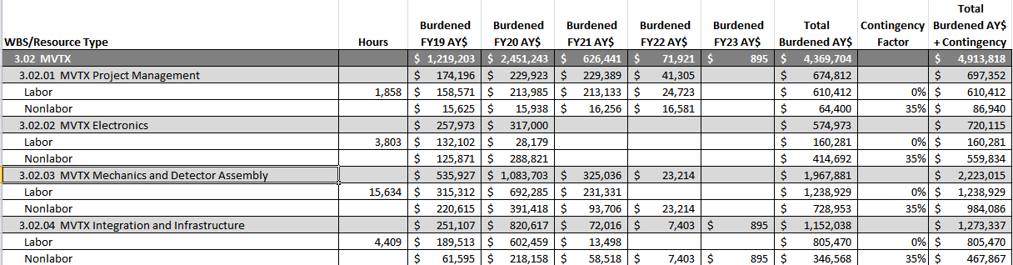
MVTX Cost Profile
Recent LANL changes to labor not yet included in this spreadsheet
Plan would be to reduce the LANL, LBNL, MIT labor lines by 35% and hold as contingency at BNL
3.02.01, 3.02.02 Labor = LANL
3.02.03 = LBNL
3.02.04 = MIT
Required by DOE to stay under $5M cap

Slide 10
IHCal Procurement of SiPMs
Order 6000 SiPM’s before Feb 4 adding to existing contract order of 100k parts.
  These parts will go obsolete soon according to Hamamatsu.
  Save ~$50k due to price break for joining in large quantity order.
Borrow $60k from Ops to be paid back by the IHCal MRI once they get funding in late CY19.
If MRI is not approved by NSF the SiPMs will be used as spares for the OHCal and EMCal.

Slide 11
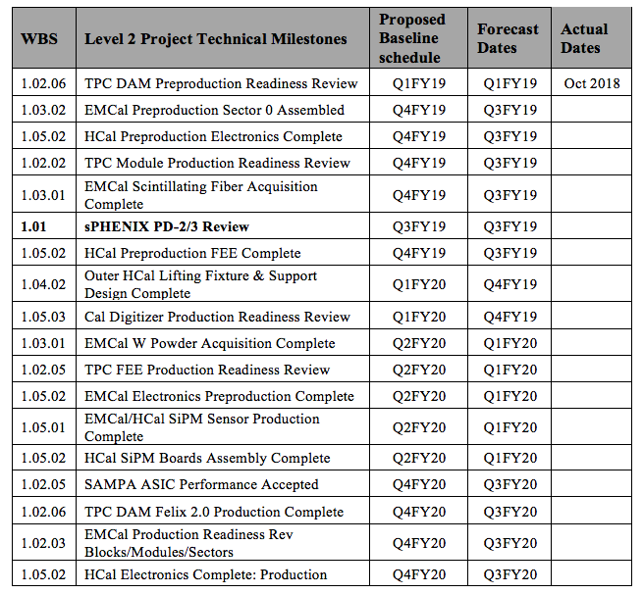
L1 and L2 Milestones

Slide 12
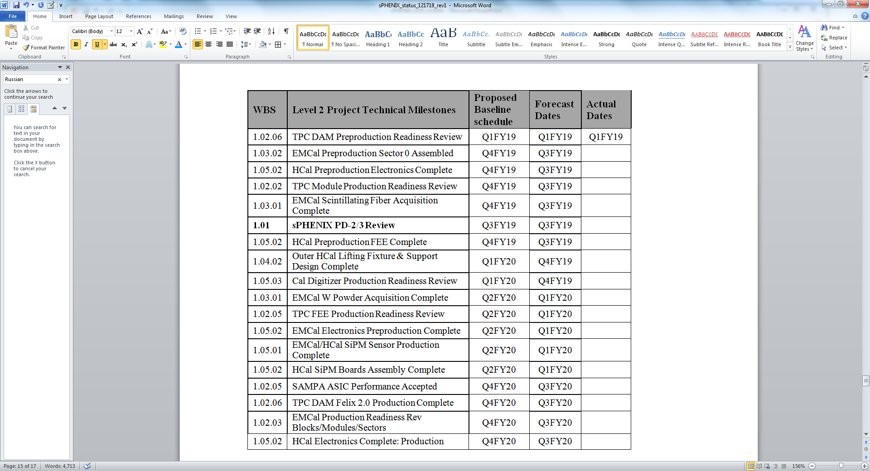
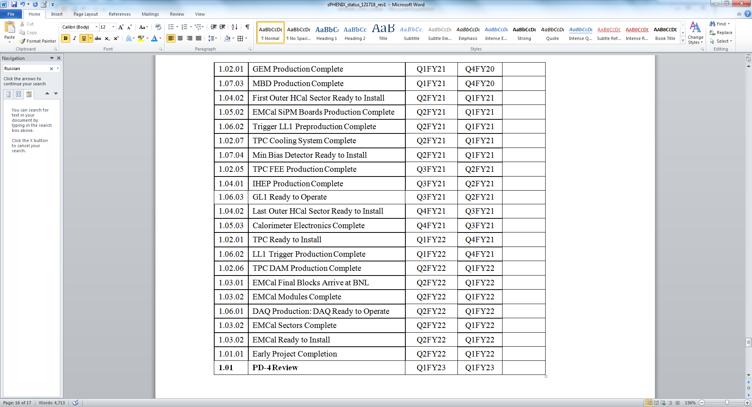
L1 and L2 Milestones

Slide 13
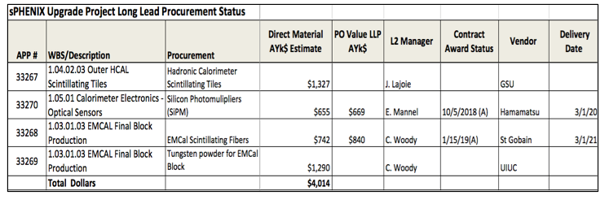
LLP Status
100k SiPMs has been placed. First parts in Feb 2019. Order complete Mar 2020
Scintillating fiber order placed. First parts in Apr 2019, Order complete Mar 2021
Working on the scintillating tile order. To be placed with Georgia State University
Tungsten powder LLP-4 order waits for additional preproduction work at UIUC. May split across FY.
  The tungsten order will wait until we have 85-90% of the FY19 funding available.

Slide 14
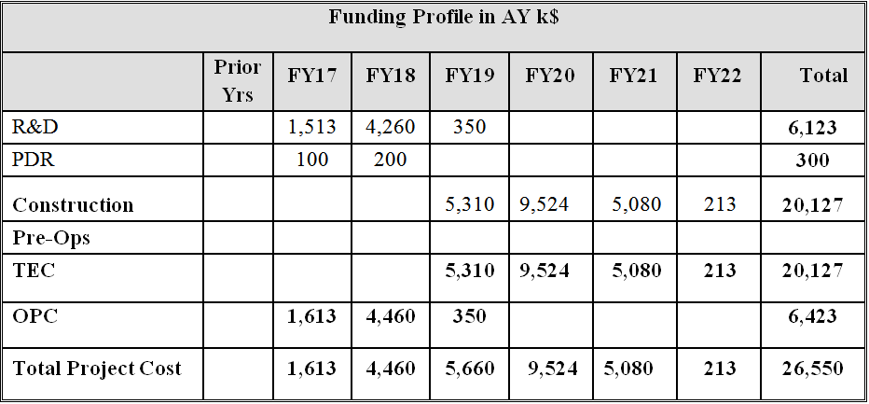
Budget at CD-1/3A
sPHENIX Budget Profile

Slide 15
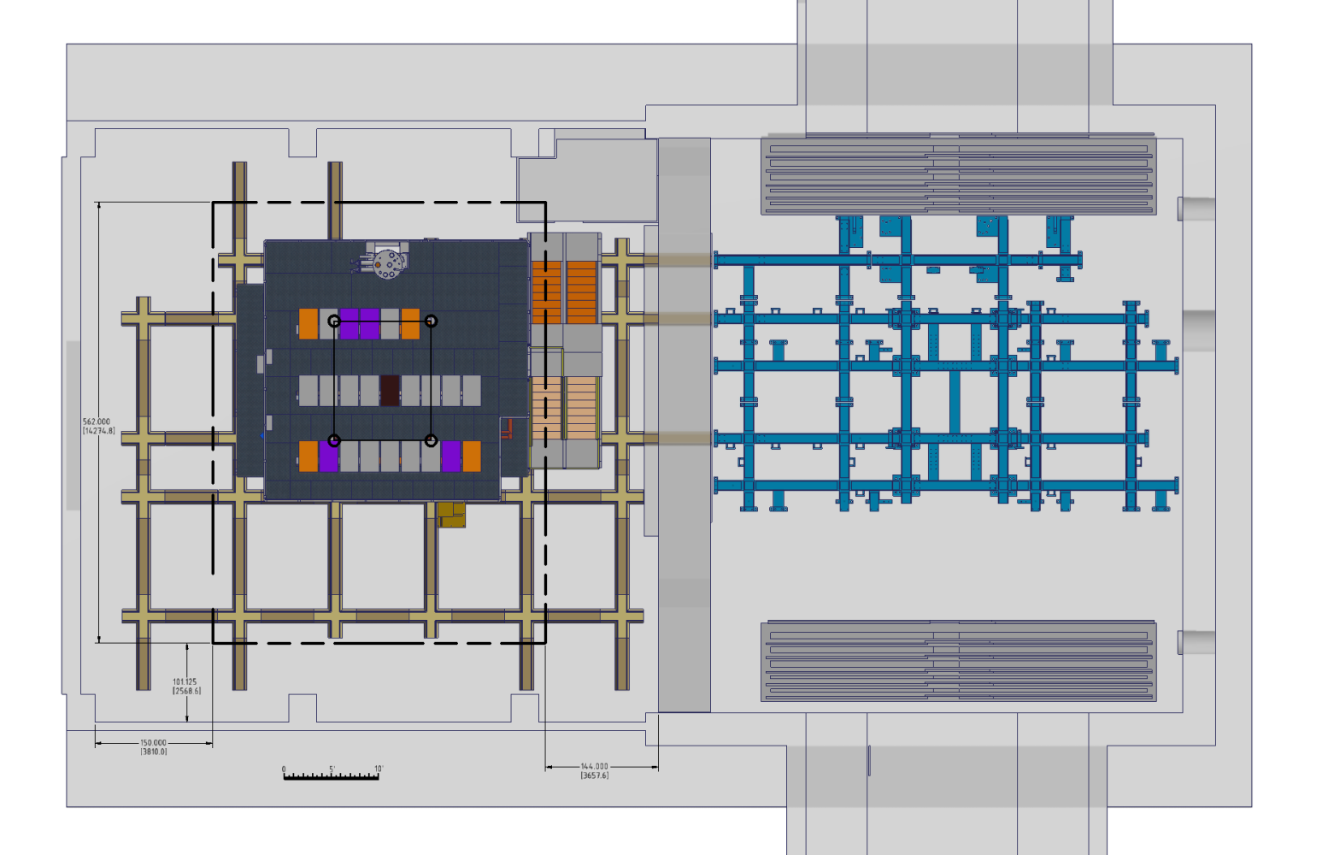
Impact of FY21-22 Run Schedule
We have been asked to assess impact of a Run in FY21-22 for STAR.
Two main questions:
Can we assemble and disassemble the shield wall in 1008 while at the same time building sPHENIX.
How does this disrupt the cryo installation schedule in 1008?
We’re addressing 1) by building and after Run-19 disassembling the shield wall as if sPHENIX was located in the 1008 Assembly Hall.
We have discussing 2) with Roberto Than and the cryo group

Slide 16
Issues/Challenges
Order with Uniplast
Preparation for PD-2/3 Review

Slide 17
Recommendations from Last Time
Keep BNL Deputy Director for Operations informed about the meeting with PPM concerning the HCAL Tiles contract – We’re not ready to meet. Waiting for GSU go ahead.
Finalize the MoU with C-AD before the NP budget briefing – Meeting this week.
Add one slide containing high level information of the milestones and achievements in future presentations. - Included
Add a table containing financial information on the LLPs, and a table for sPHENIX cost and obligations - Included
Include information on the major Infrastructure and Facility upgrade work and Si detectors in future presentations - Included

