Slide 1
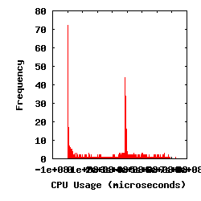
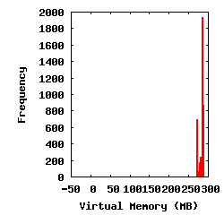
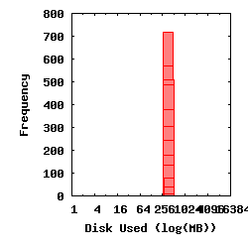
dV/dt Accelerating the Rate of Progress towards Extreme Scale Collaborative Science Miron Livny (UW), Ewa Deelman (USC/ISI), Douglas Thain (ND), Frank Wuerthwein (UCSD), Bill Allcock (ANL)
Objectives
Design a computational framework that enables computational experimentation at scale while supporting the model of “submit locally, compute globally”.
Focus on Estimating application resource needs, Finding the appropriate computing resources, Acquiring those resources, Deploying the applications and data on the resources, Managing applications and resources during run.
Impact
Accelerate time to solution for extreme scale collaboration through appropriate resource selection and management.
Enable scientists to easily launch complex applications on national computational resources and … walk away.
Develop new frameworks, algorithms, and prototypes that can be integrated into the DOE cyberinfrastructure fabric
Progress and Accomplishments
Identification of a set of applications
Initial resource requirement estimates for target workflows
Initial system architecture
Design and prototype of a monitoring/resource usage capture capability
Catalog of resource usage capture tools
Initial experimental design
Example of Analyzed Workload
SHRIMP
5080 sub-tasks
~3h on 200 nodes
Computing Storage Networking
3/18/2013

Slide 2
Thesis
Researchers band together into dynamic collaborations and employ a number of applications, software tools, data sources, and instruments
They have access to a growing variety of processing, storage and networking resources
Goal: “make it easier for scientists to conduct large-scale computational tasks that use the power of computing resources they do not own to process data they did not collect with applications they did not develop”

Slide 3
Challenges today
Estimate the application resource needs
Finding the appropriate computing resources
Acquiring those resources
Deploying the applications and data on the resources
Managing applications and resources during run
Make sure the application actually finishes successfully!

Slide 4
Approach
A planning framework that covers the entire spectrum of computing resources—processing, storage, networking, and software
The framework that encompass the five phases of collaborative computing—estimate, find, acquire, deploy, and use

Slide 5
Experimental Foundation
Real-world applications
State of the art computing capabilities—Argonne Leadership Computing Facility and Open Science Grid
Campus resources at ND, UCSD and UW
Commercial cloud services
Experimentation from the point of view of a collaboration member: “submit locally and compute globally”
Pay attention to the cost involved in acquiring the resources and the human effort involved in software and data deployment and application management

Slide 6
Application Characterization
Concurrent Workloads
Static Workloads
Dynamic Workloads
Regular Graphs
Irregular Graphs
while( more work to do) {
foreach work unit {
t = create_task();
submit_task(t);
}
t = wait_for_task();
process_result(t);
}
1
2
3
A1
A2
A3
A
B
B1
F
F
F
4
5
6
7
B2
F
F
F
C
D
E
B3
F
F
F
8
9
10
A

Slide 7
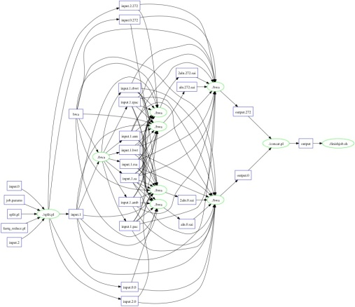
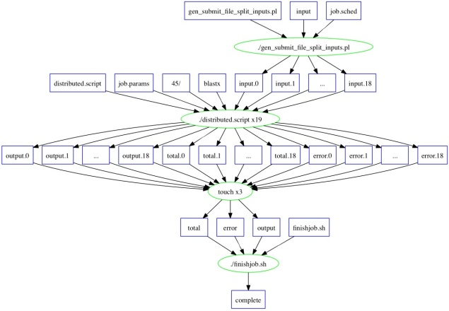
Portal Generated Workflows/ use Makeflow WMS
SHRIMP
5080 sub-tasks
~3h on 200 nodes
BLAST (Small)
17 sub-tasks
~4h on 17 nodes
BWA
825 sub-tasks
~27m on 100 nodes

Slide 8
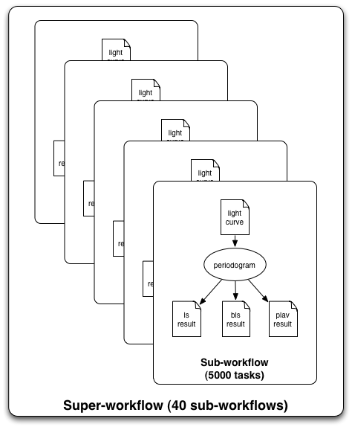
Periodograms: generate an atlas of extra-solar planets
Find extra-solar planets by
Wobbles in radial velocity of star, or
Dips in star’s intensity
210k light-curves released in July 2010
Apply 3 algorithms to each curve
3 different parameter sets
210K input, 630K output files
1 super-workflow
40 sub-workflows
~5,000 tasks per sub-workflow
210K tasks total
Planet
Star
Brightness
Light Curve
Pegasus managed workflows
Time
Notes:
I’m no domain scientist.

Slide 9
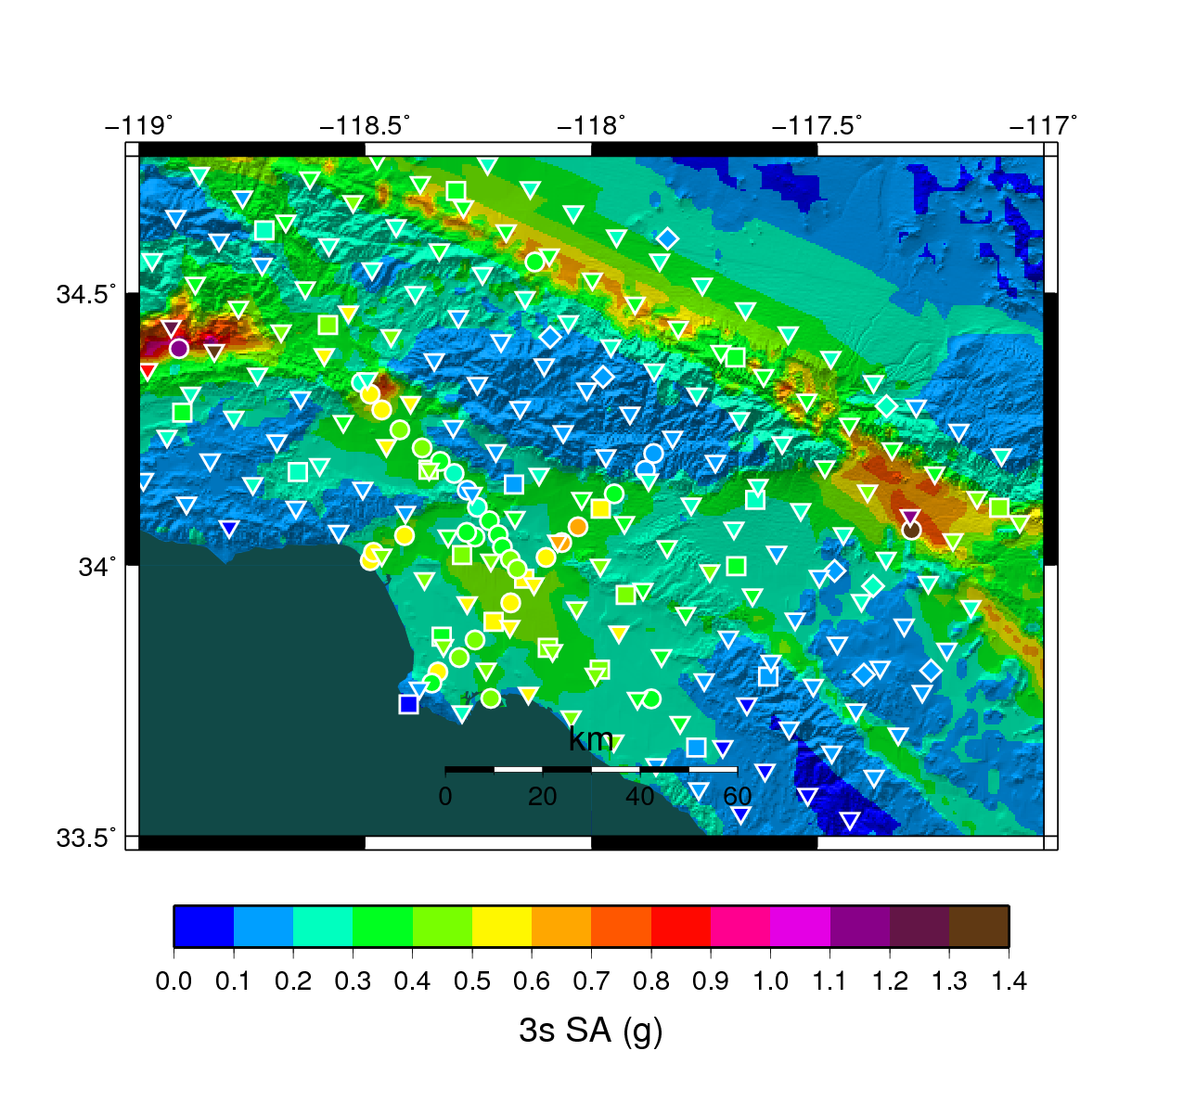
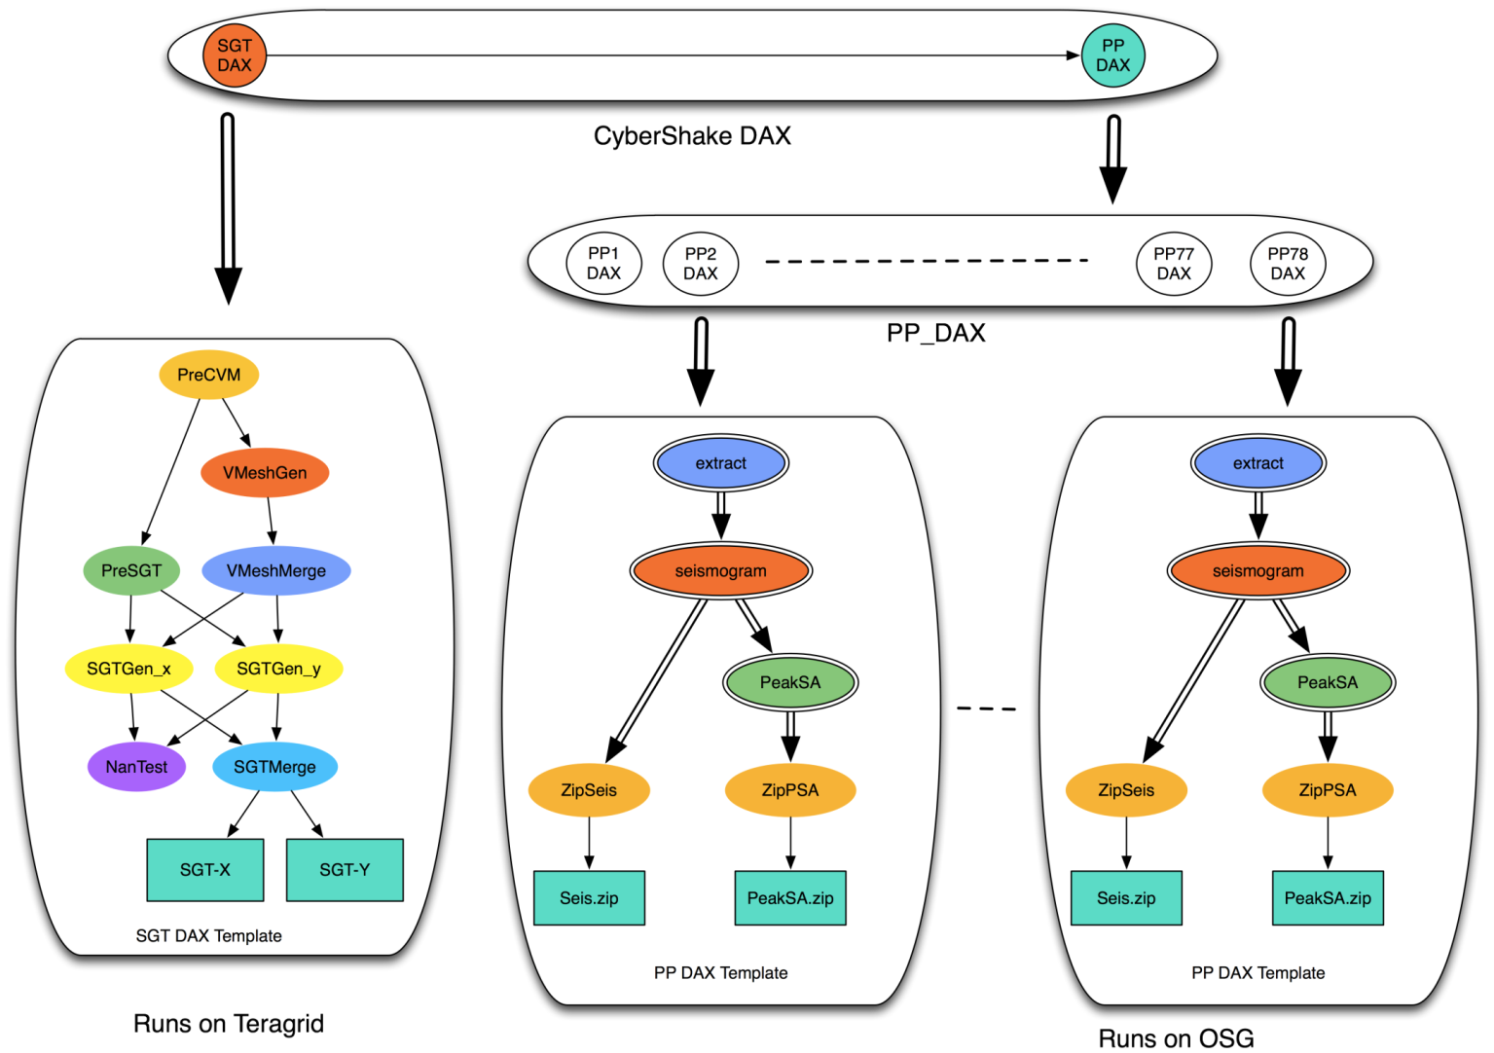
Southern California Earthquake Center
CyberShake PSHA Workflow
Description
Builders ask seismologists: “What will the peak ground motion be at my new building in the next 50 years?”
Seismologists answer this question using Probabilistic Seismic Hazard Analysis (PSHA)
239 Workflows
Each site in the input map corresponds to one workflow
Each workflow has:
820,000 tasks
MPI codes ~ 12,000 CPU hours,
Post Processing 2,000 CPU hours
Data footprint ~ 800GB
Pegasus managed workflows
Workflow Ensembles

Slide 10
Plans
Identify key, challenging applications
Develop a framework that allows to characterize the application needs, the resource availability, and plan for their use Main threads of research:
Overall planning (dynamic)
Storage and data management
Network management
CPU/Core management

Slide 11
System Entities
WF instance: the workflow that a user submits, has information about computations do be done and their data dependencies (WF system-specific)
WF structure—abstract representation of the workflow (WF system-independent)
Provisioning profile—resources needed by WF tasks
Provisioning plan– resources to be provisioned over time
Schedule– mapping of tasks to resources

Slide 12
System Components
WF Instances
Workflow System
(Makeflow, Pegasus)
Workflow Executor

Slide 13
System Components
WF Instances
Provisioning Profile
Ensemble Manager
Provisioning plan
Workflow System
(Makeflow, Pegasus)
List of resources
Resource Provisioner
Workflow Executor

Slide 14
System Components
WF Instances
WF Structure
Provisioning Profile
Ensemble Manager
Modeling
reprovision
Provisioning plan
Workflow System
(Makeflow, Pegasus)
Record
List of resources
Resource Provisioner
Workflow Executor
Monitoring
Task info

Slide 15
System Components
WF Instances
WF Structure
Provisioning Profile
Ensemble Manager
Analysis and Planning
Modeling
reprovision
Provisioning plan
Workflow System
(Makeflow, Pegasus)
Record
List of resources
Resource Provisioner
Workflow Executor
Monitoring
Task info

Slide 16
System Components
WF Instances
WF Structure
Provisioning Profile
Ensemble Manager
Analysis and Planning
Modeling
reprovision
Provisioning plan
Workflow System
(Makeflow, Pegasus)
Record
List of resources
Resource Provisioner
Workflow Executor
Monitoring
Task info

Slide 17
Task Characterization/Execution
Understand the resource needs of a task
Establish expected values and limits for task resource consumption
Launch tasks on the correct resources
Monitor task execution and resource consumption, interrupt tasks that reach limits
Possibly re-launch task on different resources

Slide 18
Modeling of tasks
exit_type / , exitcode, “signalled”, “limit”
signal -- The number of the signal that terminated the process.
limits_exceeded Comma-separated list of all the resource limits that were exceeded by the process
max_concurrent_processes--The maximum number of processes that ran concurrently.
cpu_time The total CPU time of the process (utime+stime).
wall_time
virtual_memory/resident_memory
bytes_read/bytes_written
Values that only Appear if A Working Directory is Specified
workdir_number_files_dirs-- The peak value of the number of files and directories in the working directory.
workdir_footprint---The peak value of the size of all files and directories in the working directory.

Slide 19
Data Collection and Modeling
Records From
Many Tasks
Task Record
Task Profile
workflow
RAM: 50M
Disk: 1G
CPU: 4 C
RAM: 50M
Disk: 1G
CPU: 4 C
RAM: 50M
Disk: 1G
CPU: 4 C
monitor
RAM: 50M
Disk: 1G
CPU: 4 C
P
RAM
task
min
typ
max
A
A
B
C
B
C
D
E
D
E
F
F
Schedule
Workflow Structure
Workflow Profile

Slide 20
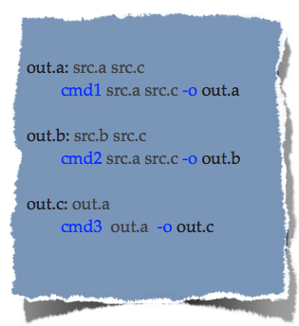
Static Workflow Monitoring
src.b src.c cmd2
makeflow
-T: condor
out.b
flow specification
resource control
flow execution

Slide 21
Static Workflow Monitoring
src.b src.c cmd2 mon limits
makeflow
-T: condor -M: limits
out.b log-rule-002 summary-002
flow specification
resource control
flow execution

Slide 22
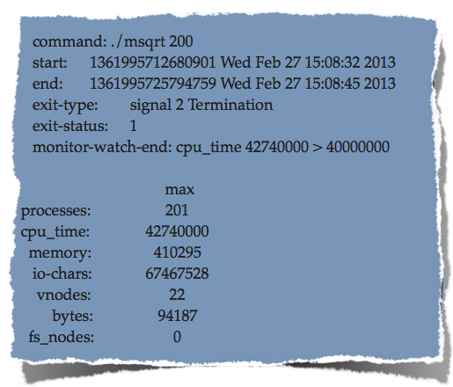
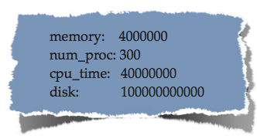
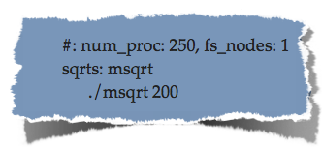
Triggering Alarms
global: limits file
local: per makeflow rule
limits specification
summary with alarm

Slide 23
Monitor
Indirect | Direct
Monitor how the world changes while the process tree is alive. | Monitor what functions, and with which arguments the process tree is calling.
Summaries | Snapshot | Events
getrusage and times | Reading /proc and measuring disk at given intervals. | Linker wrapper to libc
Available only at the end of a process. | Blind while waiting for next interval. | Fragile to modifications of the environment, no statically linked processes.

Slide 24
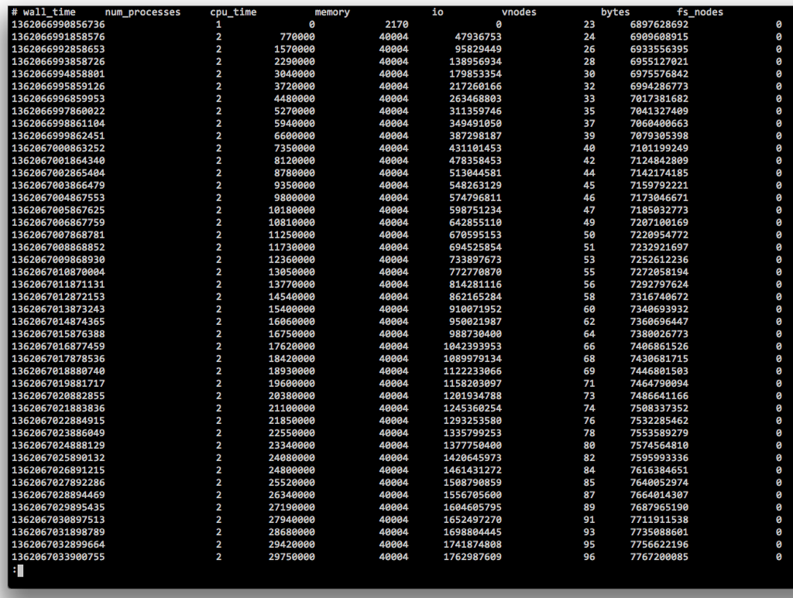
Resources Monitored Per Tree
Think of resources whose value is as invariant as possible from the load of the machine (except disk, for alarms).
CPU (user + kernel times)
Size of the tree (number of processes)
Open files
Memory (virtual memory)
Input-Output (characters read and written)
Disk (size in bytes of files, and count of virtual nodes)

Slide 25
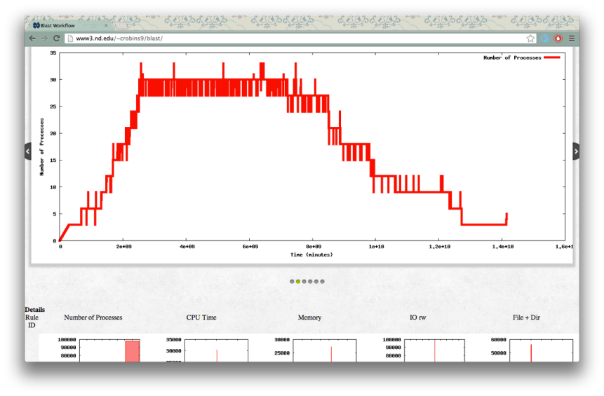
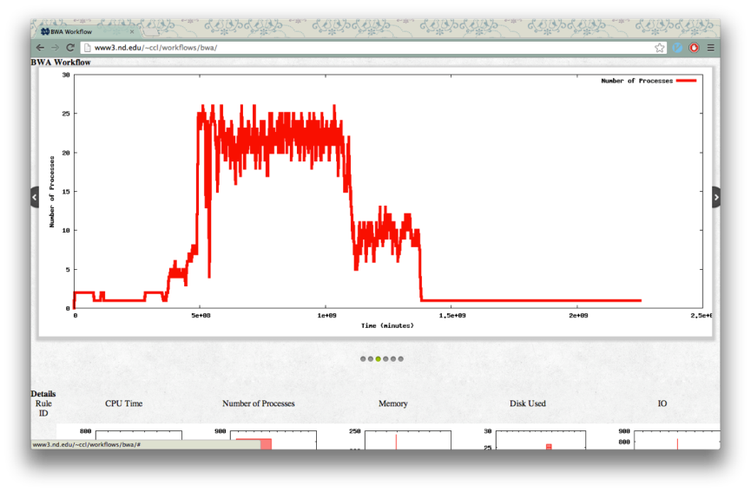
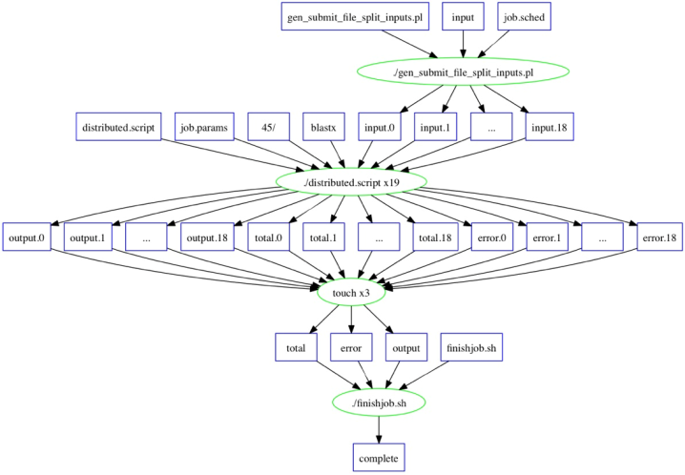
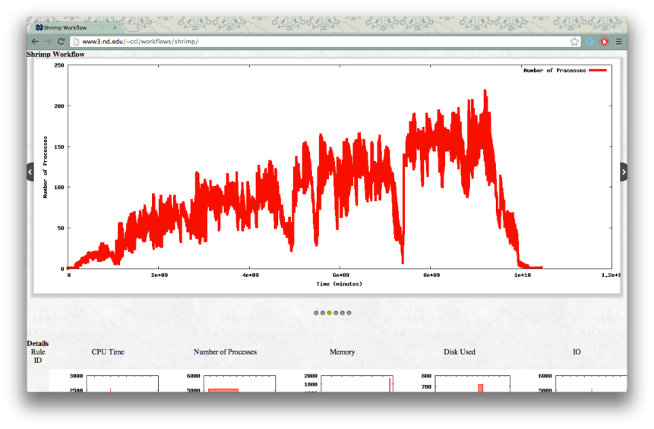
Examples
Blast: 10 workers, 3.5 hours, 70 jobs
BWA: 100 workers, 0.5 hours, 825 jobs
Shrimp: 350 workers, 2.9 hours, 5080 jobs
Visualization: Casey Robinson, Kyle Mulholland
http://www3.nd.edu/~ccl/workflows/

Slide 26
Implementation
rmonitor
(log, summary)
execv
ld_preload
read
udp
fts, statfs
librmonitor.so
(fork, wait, chdir, open)
getrusage
/proc
libc
disks
libc
summary | snapshot | events

Slide 27
Experimental design
Characterize a set of applications, run large number of instances
Design synthetic applications with a desired behavior (CPU consumption, Mem, I/O)
Run a large number of instances
Model task and application behavior
See if the model matches the input
See if the system responds appropriately
Experimental platform:
ND/Center for Research Computing, UW, USC (Year 1)
Open Science Grid (with glideinWMS) (Year 2)
Argonne Leadership Computing Facility (Year 2)
Clouds (Year 3)

Slide 28
Conclusions
dV/dt will develop a planning framework that:
Starts with an unknown application
Characterizes it and manages execution
Provisions resources/monitor execution/adapts
Experiment at scale
Avoids disaster
We will develop solutions that can be used in other projects
provide methodologies, algorithms, and prototype solutions
Initial focus on application resource characterization and monitoringWe are seeking interesting applications for characterization
https://sites.google.com/site/acceleratingexascale/

